Slide 1
HR_Employee_Attrition using Random Forest
Mahendra Thakur
Aegis School Of Data Science

Slide 2
Data Import

Slide 3
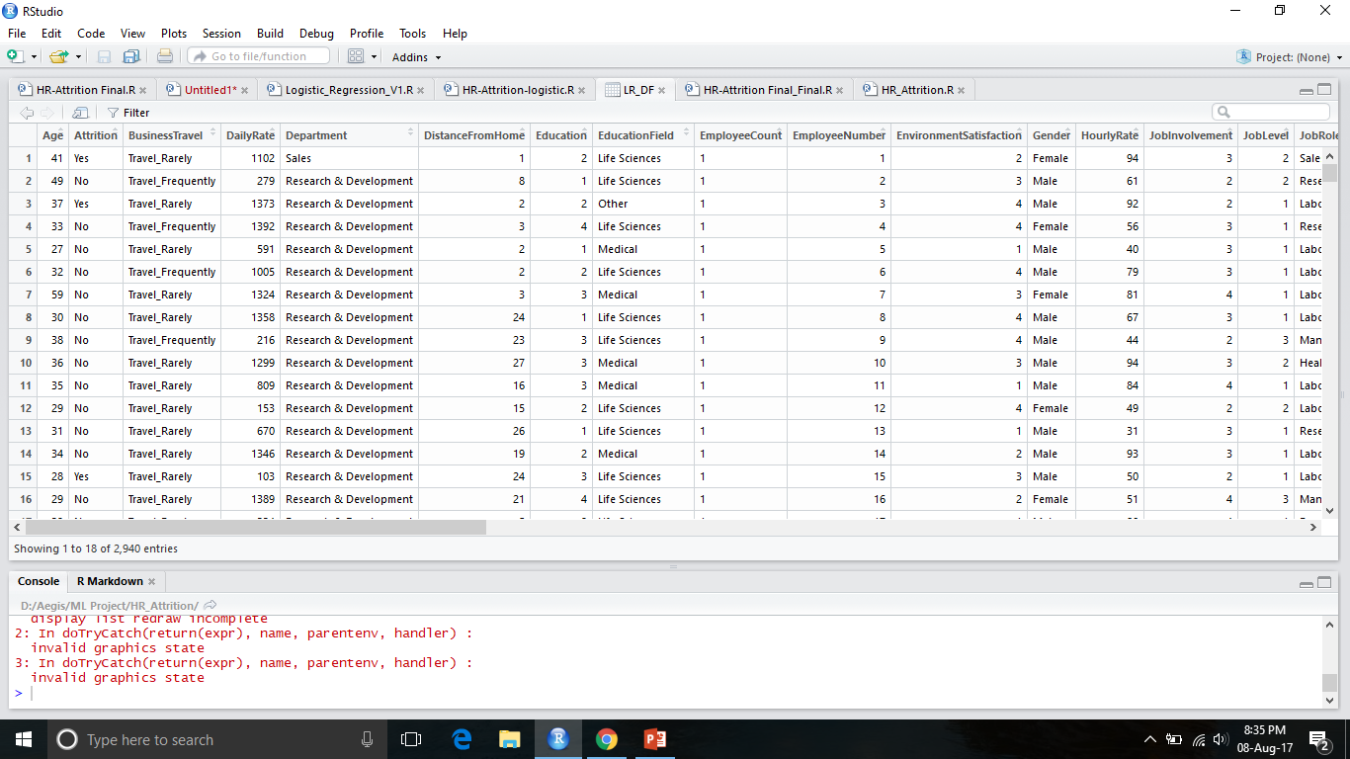

Slide 4

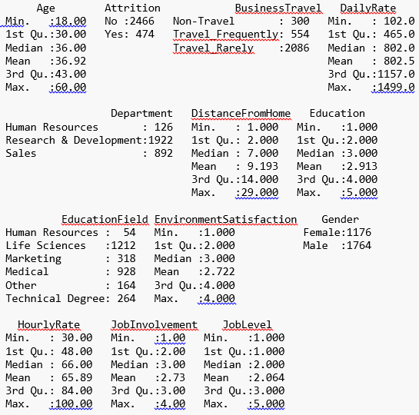
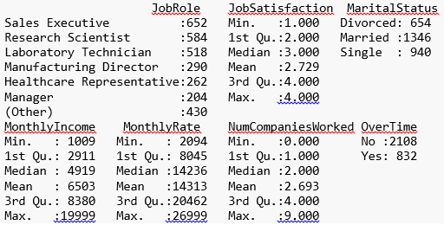
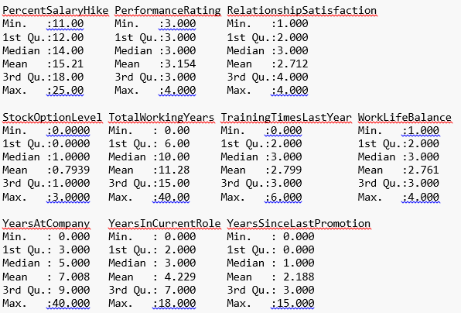
Data Summary(EDA)

Slide 6
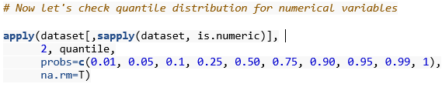
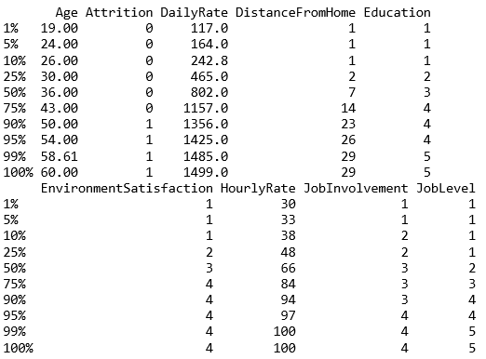
Getting Percentile Distribution
………..

Slide 7
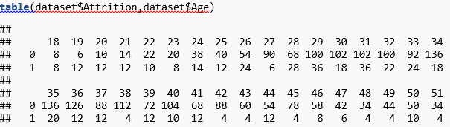
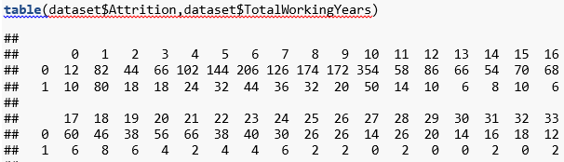
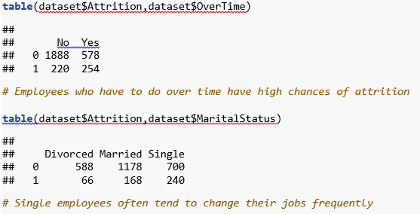

Slide 8
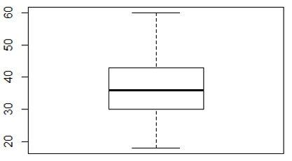
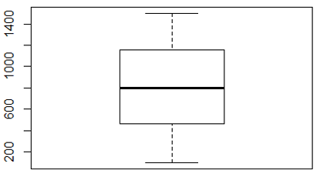
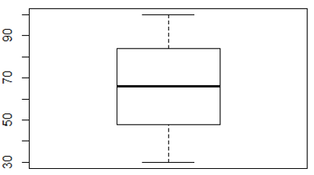
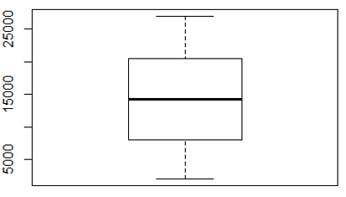

Check for missing values & outliers
boxplot(dataset$Age)
boxplot(dataset$DailyRate)
boxplot(dataset$HourlyRate)
boxplot(dataset$MonthlyRate)

Slide 9
Class Imbalance

Slide 10

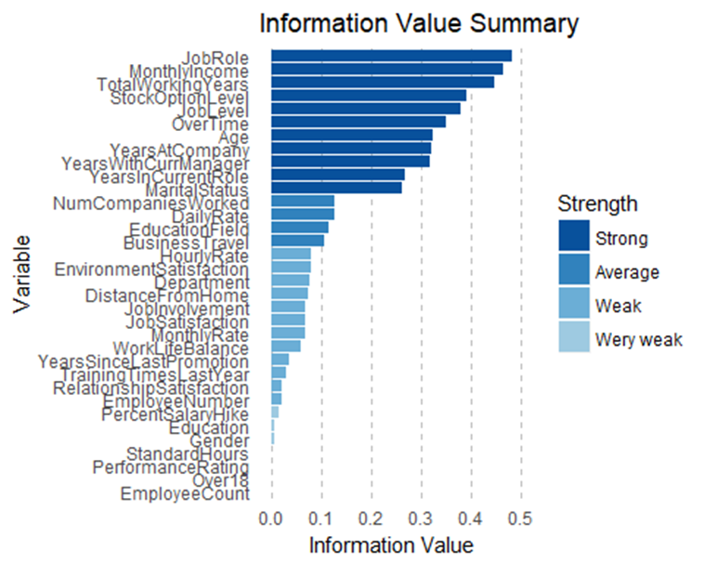
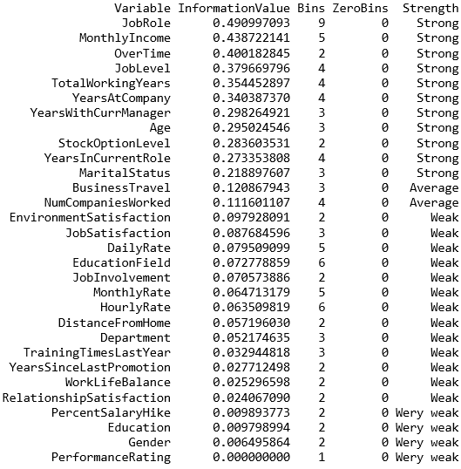

Slide 11
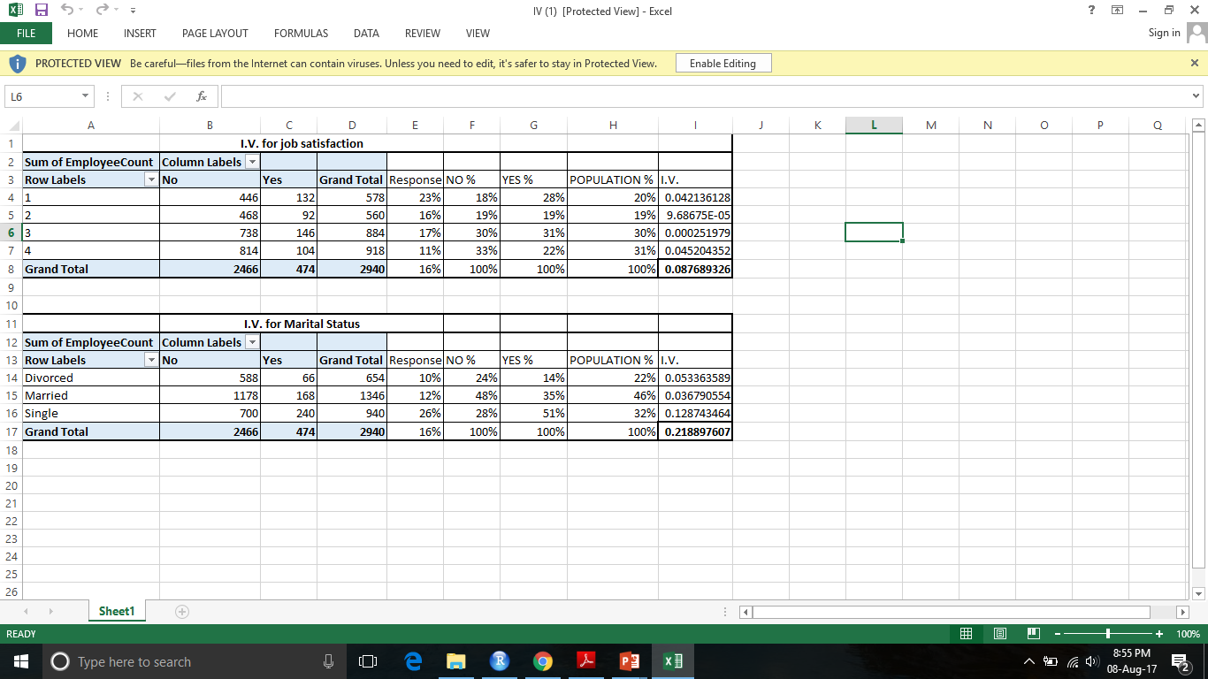
Information Value Using Excel

Slide 12
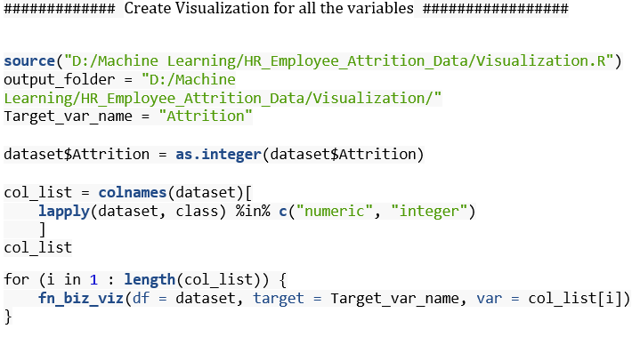

Slide 15
Sampling

Slide 16
Remove The Unused Variables Based On Iv & Variance

Slide 17
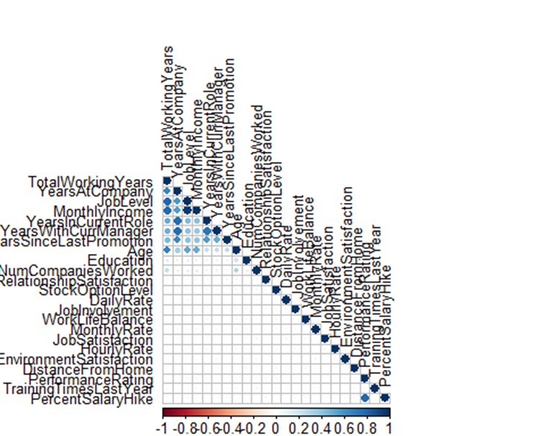
Check Correlation

Slide 18
######################### 8. Build Random Forest Model on train_set Sample #####################
############ Random Forset on Holdout data & Tunning ################
library(randomForest)
set.seed(123)
RF_model = randomForest(x = train_set[-2],
y = train_set$Attrition,
data_set = train_set,
ntree = 2000,
mtry = 6,
nodesize = 30)
RF_model
plot(RF_model, main="")
legend("topright", c("OOB", "0", "1"), text.col=1:6, lty=1:3, col=1:3)
title(main="Error Rates Random Forest train_set")
# importance(RF_model)
# varImpPlot(RF_model)
Build Random Forest Model on train_set Sample
RF_model
Call:
randomForest(x = train_set[-2], y = train_set$Attrition, ntree = 2000, mtry = 6, nodesize = 30, data_set = train_set)
Type of random forest: classification
Number of trees: 2000
No. of variables tried at each split: 6
OOB estimate of error rate: 8.45%
Confusion matrix:
No Yes class.error
No 1698 28 0.01622248
Yes 173 481 0.26452599

Slide 19
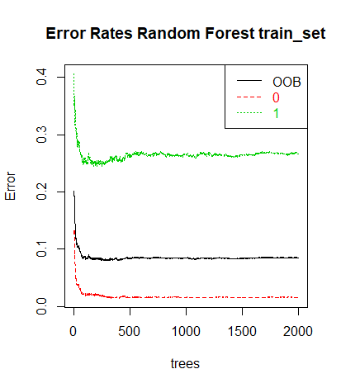
Deciding appropriate number of trees
plot(RF_model, main="")
legend("topright", c("OOB", "0", "1"), text.col=1:6, lty=1:3, col=1:3)
title(main="Error Rates Random Forest train_set")
########### Adjusted Random forest based on previous oob plot #################
set.seed(123)
RF_model = randomForest(x = train_set[-2],
y = train_set$Attrition,
data_set = train_set,
ntree = 500,
mtry = 6,
nodesize = 30)
RF_model
plot(RF_model, main = "Error Rates Random Forest train_set")

Slide 20
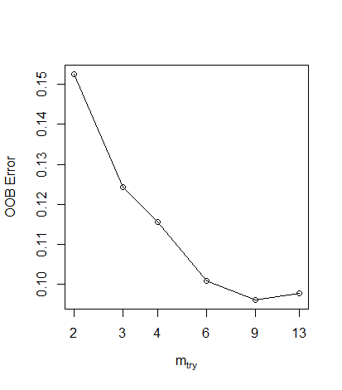
Tuning Random Forest
############################ Adjusting mtry using tuneRF ########
set.seed(321)
tuned_RF_model = tuneRF(x = train_set[-2],
y = train_set$Attrition,
data_set = train_set,
mtryStart = 2,
stepFactor = 1.5,
improve = 0.001,
ntreeTry = 500,
nodesize = 40,
doBest = T, trace = T, plot = T,importance = T)
tuned_RF_model
#tuned_RF_model$importance
#Evaluate variable importance
importance(tuned_RF_model)
varImpPlot(tuned_RF_model)
mtry = 2 OOB error = 15.25%
Searching left ...
Searching right ...
mtry = 3 OOB error = 12.44%
0.184573 0.001
mtry = 4 OOB error = 11.55%
0.07094595 0.001
mtry = 6 OOB error = 10.08%
0.1272727 0.001
mtry = 9 OOB error = 9.62%
0.04583333 0.001
mtry = 13 OOB error = 9.79%
-0.01746725 0.001

Slide 21
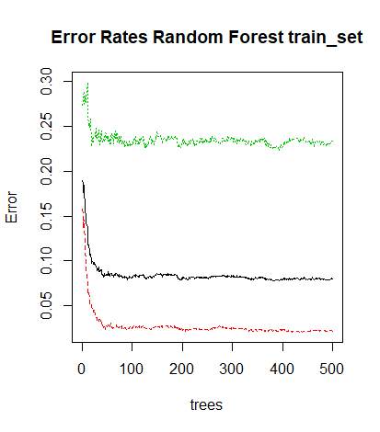
Model After tuning ntree and mtry
############# tune_RF gives the best mtry 9 ##########################
############## Adjust the model parameter ##############################
set.seed(123)
RF_model = randomForest(x = train_set[-2],
y = train_set$Attrition,
data_set = train_set,
ntree = 500,
mtry = 9,
nodesize = 30)
RF_model
plot(RF_model, main = "Error Rates Random Forest train_set")
Call:
randomForest(x = train_set[-2], y = train_set$Attrition, ntree = 500, mtry = 9, nodesize = 30, data_set = train_set)
Type of random forest: classification
Number of trees: 500
No. of variables tried at each split: 9
OOB estimate of error rate: 8.03%
Confusion matrix:
No Yes class.error
No 1688 38 0.02201622
Yes 153 501 0.23394495

Slide 22
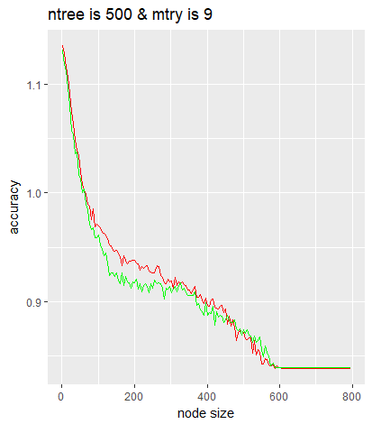
Finally tune nodesize
#################### finally tune the nodesize ################
temp_train_acc = numeric()
temp_nodesize = numeric()
temp_hold_acc = numeric()
j = 1
for (i in seq(from = 1, to = 800 , by = 5)){
set.seed(123)
RF_model = randomForest(x = train_set[-2],
y = train_set$Attrition,
data_set = train_set,
ntree = 500,
mtry = 9,
nodesize = i)
if(RF_model$confusion[1]!=2058 & RF_model$confusion[2]!=2058){
temp_train_acc[j] = (RF_model$confusion[1]+RF_model$confusion[4])/2058
temp_nodesize[j] = i
holdout_prediction = predict(RF_model, newdata = HoldOut_set, type ='class')
table = table(HoldOut_set$Attrition,holdout_prediction)
temp_hold_acc[j] = (table[1]+table[4])/882
j = j+1
}
}
nodesize_df = data.frame(x=temp_nodesize,y1=temp_train_acc,y2=temp_hold_acc)
############### use visualization for node size
library(ggplot2)
ggplot() +
geom_line(data = nodesize_df,
aes(nodesize_df$x,nodesize_df$y1),col = 'red')+
geom_line(data = nodesize_df,
aes(nodesize_df$x,nodesize_df$y2),col = 'green')+
xlab('node size')+
ylab('accuracy')+
ggtitle('ntree is 500 & mtry is 9')
################# nodesize 400 gives the best accuracy
################ so we choose the nodesize=400

Slide 23

########################### Final Random Forest Model ####################
set.seed(123)
RF_model = randomForest(x = train_set[-2],
y = train_set$Attrition,
data_set = train_set,
ntree = 500,
mtry = 9,
nodesize =400)
RF_model
plot(RF_model)
train_data$RF_Prob = predict(RF_model,newdata =train_set, type='prob')
train_data$RF_Prob =train_data$RF_Prob[,2]
Holdout_prediction_Prob = predict(RF_model,newdata = HoldOut_set, type='prob')
Holdout_prediction_class =predict(RF_model,newdata = HoldOut_set, type='class')
HoldOut_set$RF_prob =Holdout_prediction_Prob[,2]
HoldOut_set$RF_class = Holdout_prediction_class
HoldOut_data$RF_prob = HoldOut_set$RF_prob
HoldOut_data$RF_Class = Holdout_prediction_class
# Classification
Confusion_Matrix_RF=addmargins(table(actual = HoldOut_set$Attrition, Prediction = HoldOut_set$RF_class))
Confusion_Matrix_RF
Accuracy_RF=(Confusion_Matrix_RF[1]+Confusion_Matrix_RF[5])/Confusion_Matrix_RF[9]*100
Accuracy_RF
Call:
randomForest(x = train_set[-2], y = train_set$Attrition, ntree = 500, mtry = 9, nodesize = 60, data_set = train_set)
Type of random forest: classification
Number of trees: 500
No. of variables tried at each split: 9
OOB estimate of error rate: 12.61%
Confusion matrix:
No Yes class.error
No 1662 64 0.03707995
Yes 236 418 0.36085627
> Accuracy_RF
[1] 86.86275

Slide 24

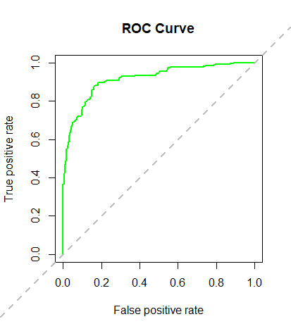
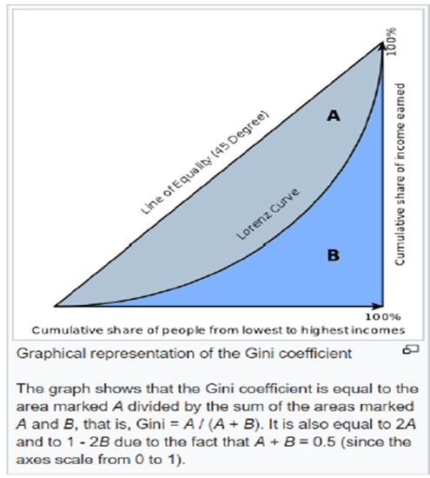
GINI Index and AUC
############ GINI Index ##############
#install.packages("ineq")
library(ineq)
gini = ineq(Holdout_prediction_Prob, type="Gini")
gini
### Calculating AUC using ROC Curve and KS for the model
#install.packages("ROCR")
library(ROCR)
pred <- prediction(Holdout_prediction_Prob[,2], HoldOut_set$Attrition)
perf <- performance(pred, "tpr", "fpr")
plot(perf, col="green", lwd=2, main="ROC Curve")
abline(a=0,b=1,lwd=2,lty=2,col="gray")
KS <- max(attr(perf, 'y.values')[[1]]-attr(perf, 'x.values')[[1]])
auc <- performance(pred,"auc");
auc <- as.numeric(auc@y.values)
KS
> gini
[1] 0.4191865

Slide 25
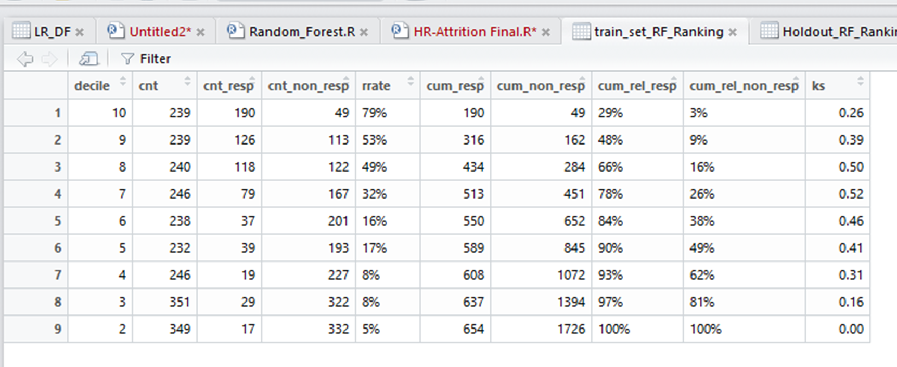
Rank Ordering train_set Table
HoldOut_set$decile = decile(Holdout_prediction_Prob[,2])
require(data.table)
require(scales)
HoldOut_set$Attrition_Numeric = ifelse(HoldOut_set$Attrition=="No",0,1)
Ranking <-function(tmp_DT){
rank = tmp_DT[, list(
cnt = length(Attrition_Numeric),
cnt_resp = sum(Attrition_Numeric),
cnt_non_resp = sum(Attrition_Numeric == 0)) ,
by=decile][order(-decile)]
rank$rrate <- round (rank$cnt_resp / rank$cnt,2);
rank$cum_resp <- cumsum(rank$cnt_resp)
rank$cum_non_resp <- cumsum(rank$cnt_non_resp)
rank$cum_rel_resp <- round(rank$cum_resp / sum(rank$cnt_resp),2);
rank$cum_rel_non_resp <- round(rank$cum_non_resp / sum(rank$cnt_non_resp),2);
rank$ks <- abs(rank$cum_rel_resp - rank$cum_rel_non_resp);
rank$rrate <- percent(rank$rrate)
rank$cum_rel_resp <- percent(rank$cum_rel_resp)
rank$cum_rel_non_resp <- percent(rank$cum_rel_non_resp)
return(rank)
}
View(rank)

Slide 26
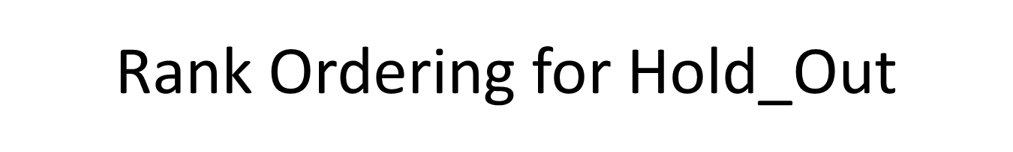
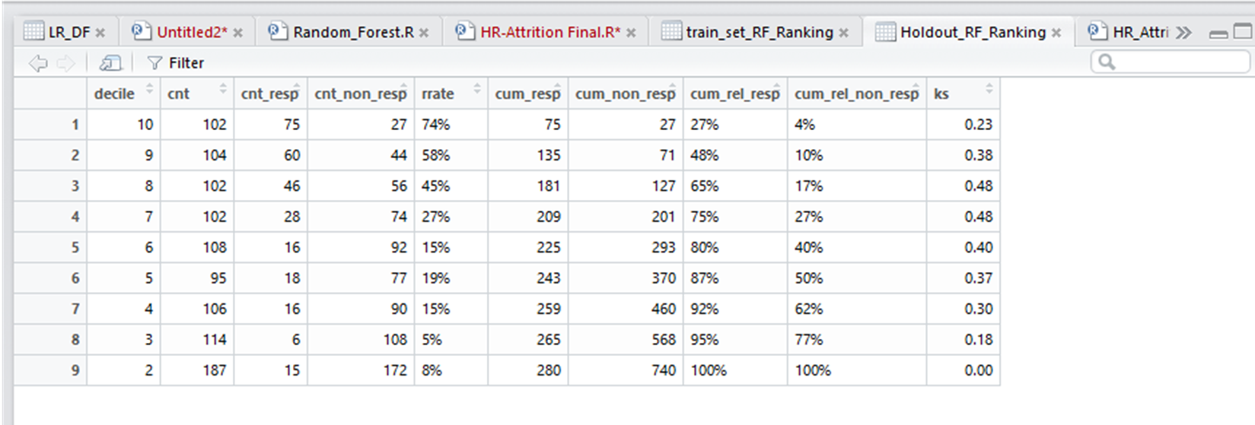
Holdout_RF_Ranking = Ranking(data.table(HoldOut_set))
train_set$Attrition_Numeric = ifelse(train_set$Attrition=="No",0,1)
train_set_Prob = predict(RF_model,newdata =train_set, type='prob')
train_set_class =predict(RF_model,newdata = train_set, type='class')
train_set$RF_prob =train_set_Prob[,2]
train_set$decile = decile(train_set_Prob[,2])
train_set$RF_class = train_set_class
train_set_RF_Ranking = Ranking(data.table((train_set)))
View(Holdout_RF_Ranking)
View(train_set_RF_Ranking)

Slide 27
Thanks

