Slide 1
HR-Attrition-logistic.R
Mahendra Thakur Mon Aug 07 21:27:15 2017
###################### 1. import the data set and packages
##################################
# install.packages("Amelia")
# install.packages("corrplot")
# install.packages("catools")
# install.packages("car")
# install.packages("caret")
LR_DF <- read.table("HR_Employee_Attrition_Data.csv",sep = ",", header = T)
View(LR_DF)
##################### 2. Perform Exploratory Data Analysis
#####################
str(LR_DF)
## 'data.frame':
2940 obs. of 35 variables:
## $ Age
## $ Attrition
: int 41 49 37 33 27 32 59 30 38 36 ...
1 1 1 ...
: Factor w/ 2 levels "No","Yes": 2 1 2 1 1 1 1
## $ BusinessTravel
: Factor w/ 3 levels "Non-
Travel","Travel_Frequently",..: 3 2 3 2 3 2 3 3 2 3 ...
## $ DailyRate : int 1102 279 1373 1392 591 1005 1324 1358
216 1299 ...
## $ Department : Factor w/ 3 levels "Human Resources",..: 3 2 2 2 2 2 2 2 2 2 ...
## $ DistanceFromHome
## $ Education
## $ EducationField
: int 1 8 2 3 2 2 3 24 23 27 ...
: int 2 1 2 4 1 2 3 1 3 3 ...
5 2 4 2 4 2 2 4 ...
: Factor w/ 6 levels "Human Resources",..: 2 2
## $ EmployeeCount
## $ EmployeeNumber
##
##
: int
: int
1 1 1 1 1 1 1 1 1 1 ...
1 2 3 4 5 6 7 8 9 10 ...
2 3 4 4 1 4 3 4 4 3 ...
$ EnvironmentSatisfaction : int
$ Gender
: Factor w/ 2 levels "Female","Male": 1 2 2 1 2
2 1 2 2 2 ...
## $ HourlyRate
## $ JobInvolvement
## $ JobLevel
## $ JobRole
: int
: int
: int
94 61 92 56 40 79 81 67 44 94 ...
3 2 2 3 3 3 4 3 2 3 ...
2 2 1 1 1 1 1 1 3 2 ...
Representative",..: 8 7 3 7 3 3 3 3 5 1 ...
: Factor w/ 9 levels "Healthcare
## $ JobSatisfaction : int
## $ MaritalStatus
4 2 3 3 2 4 1 3 3 3 ...
2 3 2 2 3 2 1 3 2 ...
: Factor w/ 3 levels "Divorced","Married",..: 3

Slide 2
## $ MonthlyIncome
: int
5993 5130 2090 2909 3468 3068 2670 2693
9526 5237 ...
## $ MonthlyRate
: int
19479 24907 2396 23159 16632 11864 9964
13335 8787 16577 ...
## $ NumCompaniesWorked
## $ Over18
...
##
: int 8 1 6 1 9 0 4 1 0 6 ...
: Factor w/ 1 level "Y": 1 1 1 1 1 1 1 1 1 1
$ OverTime
: Factor w/ 2 levels "No","Yes": 2 1 2 2 1 1 2
1 1 1 ...
## $ PercentSalaryHike
## $ PerformanceRating
##
##
##
##
##
##
##
##
##
##
: int
: int
11 23 15 11 12 13 20 22 21 13 ...
3 4 3 3 3 3 4 4 4 3 ...
1 4 2 3 4 3 1 2 2 2 ...
80 80 80 80 80 80 80 80 80 80 ...
0 1 0 0 1 0 3 1 0 2 ...
8 10 7 8 6 8 12 1 10 17 ...
0 3 3 3 3 2 3 2 2 3 ...
1 3 3 3 3 2 2 3 3 2 ...
6 10 0 8 2 7 1 1 9 7 ...
4 7 0 7 2 7 0 0 7 7 ...
0 1 0 3 2 3 0 0 1 7 ...
5 7 0 0 2 6 0 0 8 7 ...
$ RelationshipSatisfaction: int
$ StandardHours
$ StockOptionLevel
$ TotalWorkingYears
$ TrainingTimesLastYear
$ WorkLifeBalance
$ YearsAtCompany
$ YearsInCurrentRole
: int
: int
: int
: int
: int
: int
: int
$ YearsSinceLastPromotion : int
$ YearsWithCurrManager : int
summary(LR_DF)
## Age Attrition
## Min. :18.00 No :2466 Non-Travel
## 1st Qu.:30.00 Yes: 474
## Median :36.00
##
##
##
##
##
##
##
##
##
##
##
##
##
##
##
##
##
##
##
##
##
BusinessTravel
DailyRate
: 300
Min. : 102.0
Travel_Frequently: 554
1st Qu.: 465.0
Median : 802.0
Mean :36.92
Travel_Rarely
:2086
Mean
: 802.5
3rd Qu.:43.00
3rd Qu.:1157.0 Max. :1499.0
Max. :60.00
Human Resources
Department
: 126
DistanceFromHome
Education
Research & Development:1922
Min. : 1.000
Min.
:1.000
Sales
: 892
1st Qu.: 2.000
Median : 7.000
1st Qu.:2.000
Median :3.000
Mean : 9.193
Mean :2.913
3rd Qu.:14.000
3rd Qu.:4.000 Max. :5.000
Max. :29.000
EducationField EmployeeCount EmployeeNumber
Human Resources : 54 Min. :1 Min.
: 1.0
Life Sciences Marketing Medical Other
:1212
: 318
: 928
: 164
1st Qu.:1 Median :1
1st Qu.: 735.8
Median :1470.5
Mean 1
Mean
:1470.5
Technical Degree: 264
3rd Qu.:1
3rd Qu.:2205.2
Max. 1
Max. :2940.0
##
EnvironmentSatisfaction
Gender
HourlyRate
JobInvolvement
Min.
:1.000
Female:1176
Min.
: 30.00
Min.
:1.00

Slide 3
## 1st Qu.:2.000
## Median :3.000
## Mean :2.722
## 3rd Qu.:4.000
## Max. :4.000
##
##
## Min. :1.000 Sales Executive
## 1st Qu.:1.000 Research Scientist
## Median :2.000
##
##
##
##
##
##
##
##
##
##
##
##
##
##
##
##
##
##
##
##
##
##
##
##
##
##
##
##
##
##
##
##
##
##
##
##
##
##
##
Male
:1764
1st Qu.: 48.00
Median : 66.00
1st Qu.:2.00
Median :3.00
Mean : 65.89
Mean :2.73
3rd Qu.: 84.00
Max. :100.00
3rd Qu.:3.00
Max. :4.00
JobLevel
JobRole
:652
:584
:518
JobSatisfaction
Min. :1.000
Laboratory Technician
1st Qu.:2.000
Median :3.000
Mean :2.064
Manufacturing Director
:290
Mean
:2.729
3rd Qu.:3.000
Healthcare Representative:262
3rd Qu.:4.000
Max. :5.000
Manager (Other) MonthlyIncome
:204
:430
MonthlyRate
Max. :4.000
MaritalStatus Divorced: 654
Married :1346
Single : 940
Min. : 1009
Min.
: 2094
NumCompaniesWorked
1st Qu.: 2911
Median : 4919
1st Qu.: 8045
Median :14236
Min. :0.000
1st Qu.:1.000
Median :2.000
Mean : 6503
Mean
:14313
Mean
:2.693
3rd Qu.: 8380
3rd Qu.:20462
3rd Qu.:4.000
Max. :19999 Max. :26999 Max.
:9.000
Over18 Y:2940
OverTime No :2108
Yes: 832
PercentSalaryHike PerformanceRating
Min. :11.00 Min. :3.000
1st Qu.:12.00
Median :14.00
1st Qu.:3.000
Median :3.000
Mean :15.21
Mean
:3.154
3rd Qu.:18.00
3rd Qu.:3.000
Max. :25.00 Max. :4.000
RelationshipSatisfaction StandardHours StockOptionLevel TotalWorkingYears
Min. :1.000 Min. :80 Min. :0.0000 Min. : 0.00
1st Qu.:2.000
Median :3.000
1st Qu.:80 Median :80
1st Qu.:0.0000
Median :1.0000
1st Qu.: 6.00
Median :10.00
Mean :2.712
Mean 80
Mean
:0.7939
Mean
:11.28
3rd Qu.:4.000
3rd Qu.:80
3rd Qu.:1.0000
3rd Qu.:15.00
Max. :4.000 Max. :80 Max. :3.0000
Max. :40.00
TrainingTimesLastYear WorkLifeBalance YearsAtCompany
YearsInCurrentRole
Min. :0.000 Min. :1.000 Min. : 0.000
Min. : 0.000
1st Qu.:2.000
Median :3.000
1st Qu.:2.000
Median :3.000
1st Qu.: 3.000
Median : 5.000
1st Qu.: 2.000
Median : 3.000
Mean :2.799
Mean
:2.761
Mean
: 7.008
Mean
: 4.229
3rd Qu.:3.000
3rd Qu.:3.000
3rd Qu.: 9.000
Max. :40.000
3rd Qu.: 7.000
Max. :6.000 Max. :4.000
Max.
:18.000
YearsSinceLastPromotion YearsWithCurrManager
Min. : 0.000 Min.
: 0.000
##
1st Qu.: 0.000 1st Qu.: 2.000
Median : 1.000
Median : 3.000

Slide 4
## | Mean : 2.188 | Mean : 4.123
## | 3rd Qu.: 3.000 | 3rd Qu.: 7.000
## Max.
##
:15.000
Max.
:17.000
########### a. check missing value using Amelia package ###########
library(Amelia)
## Loading required package: Rcpp
## ##
## ## Amelia II: Multiple Imputation
## ## (Version 1.7.4, built: 2015-12-05)
## ## Copyright (C) 2005-2017 James Honaker, Gary King and Matthew Blackwell
## ## Refer to http://gking.harvard.edu/amelia/ for more information
## ##
missmap(LR_DF) any(is.na(LR_DF))
## [1] FALSE
#### No missing value #####
############# dataset has 35 variable now check for no of the and factor variables
############## in the dataset
dim(LR_DF)
## [1] 2940 35
table(sapply(LR_DF,class))
the numeric
##
## factor integer
## 9 26
prop.table(table(LR_DF$Attrition))
##
## No Yes
## 0.8387755 0.1612245
table(LR_DF$Attrition,LR_DF$Age)
##
## |  | 18 | 19 | 20 | 21 | 22 | 23 | 24 | 25 | 26 | 27 | 28 | 29 | 30 | 31 | 32 | 33 | 34
## | No | 8 | 6 | 10 | 14 | 22 | 20 | 38 | 40 | 54 | 90 | 68 | 100 | 102 | 102 | 100 | 92 | 136
## | Yes | 8 | 12 | 12 | 12 | 10 | 8 | 14 | 12 | 24 | 6 | 28 | 36 | 18 | 36 | 22 | 24 | 18
##
## |  | 35 | 36 | 37 | 38 | 39 | 40 | 41 | 42 | 43 | 44 | 45 | 46 | 47 | 48 | 49 | 50 | 51
## | No | 136 | 126 | 88 | 112 | 72 | 104 | 68 | 88 | 60 | 54 | 78 | 58 | 42 | 34 | 44 | 50 | 34
## | Yes | 20 | 12 | 12 | 4 | 12 | 10 | 12 | 4 | 4 | 12 | 4 | 8 | 6 | 4 | 4 | 10 | 4
##

Slide 5
## |  | 52 | 53 | 54 | 55 | 56 | 57 | 58 | 59 | 60
## | No | 30 | 34 | 36 | 38 | 22 | 8 | 18 | 20 | 10
## | Yes | 6 | 4 | 0 | 6 | 6 | 0 | 10 | 0 | 0
# Employee ranges from age 18 to 60 which is pretty common
# We can see that employees between the age group 25-35 have a high chance of attrition
table(LR_DF$Attrition,LR_DF$TotalWorkingYears)
##
## |  | 0 | 1 | 2 | 3 | 4 | 5 | 6 | 7 | 8 | 9 | 10 | 11 | 12 | 13 | 14 | 15 | 16
## | No | 12 | 82 | 44 | 66 | 102 | 144 | 206 | 126 | 174 | 172 | 354 | 58 | 86 | 66 | 54 | 70 | 68
## | Yes | 10 | 80 | 18 | 18 | 24 | 32 | 44 | 36 | 32 | 20 | 50 | 14 | 10 | 6 | 8 | 10 | 6
##
## |  | 17 | 18 | 19 | 20 | 21 | 22 | 23 | 24 | 25 | 26 | 27 | 28 | 29 | 30 | 31 | 32 | 33
## | No | 60 | 46 | 38 | 56 | 66 | 38 | 40 | 30 | 26 | 26 | 14 | 26 | 20 | 14 | 16 | 18 | 12
## | Yes | 6 | 8 | 6 | 4 | 2 | 4 | 4 | 6 | 2 | 2 | 0 | 2 | 0 | 0 | 2 | 0 | 2
##
## |  | 34 | 35 | 36 | 37 | 38 | 40
## | No | 8 | 6 | 12 | 8 | 2 | 0
## | Yes | 2 | 0 | 0 | 0 | 0 | 4
# Also,Employess who gain 1 year of experience have atleast 50% chances of attrition
# and after 15 years of experience the churn rate is very low
table(LR_DF$Attrition,LR_DF$OverTime)
##
##
##
## Yes 220
No Yes No 1888 578
254
# Employees who have to do over time have high chances of attrition
table(LR_DF$Attrition,LR_DF$MaritalStatus)
##
##
## No
## Yes
Divorced Married Single
588
66
1178
168
700
240
# Single employees often tend to change their jobs frequently
### Among 35 variables 9 factor class and 26 integer class store them in different variables for analysis
factor_ID=which(sapply(LR_DF, class) == "factor")

Slide 6
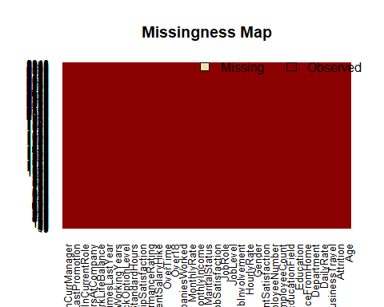
integer_ID=which(sapply(LR_DF, class) == "integer")
################# Visual representation of each variable contribution to Attrition ######
#install.packages("ggplot2")
require(ggplot2)
## Loading required package: ggplot2
# bar plots for all the factor variables
for( i in factor_ID){
name = paste(names(LR_DF[i]),'.png', sep = '')
png(filename =paste0('plots/',name), width = 800, height = 600, units = 'px')
print(ggplot( LR_DF,
aes(x=LR_DF[,i],
fill =LR_DF$Attrition))+ xlab(names(LR_DF[i]))+ ylab('Frequency')+ geom_bar(position = 'dodge')+
guides(fill = guide_legend('Attrition'))) dev.off()
print.noquote(names(LR_DF[i]))
print.noquote(summary(LR_DF[,i]))
}

Slide 7
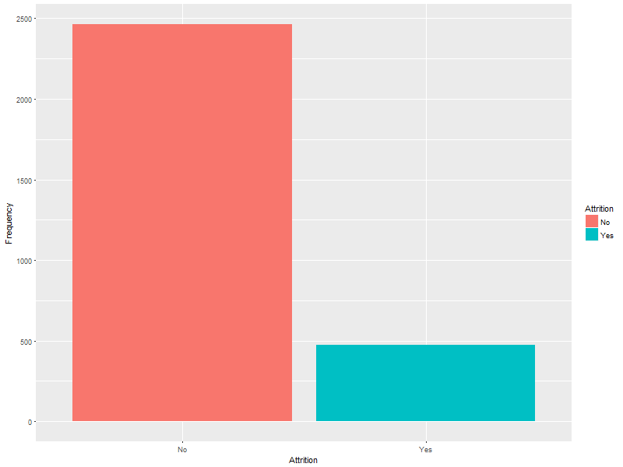
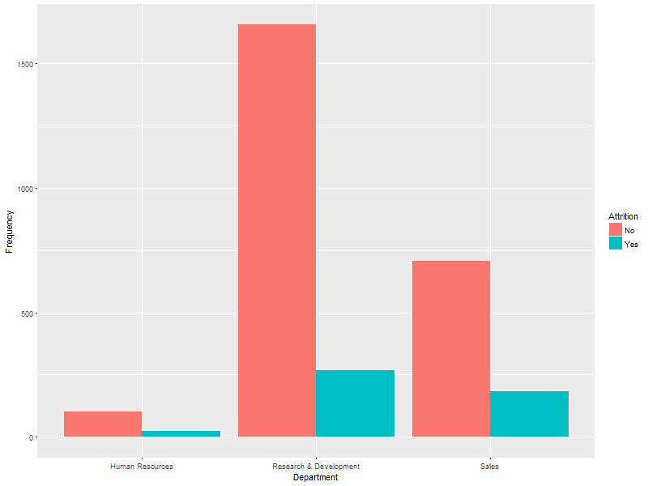
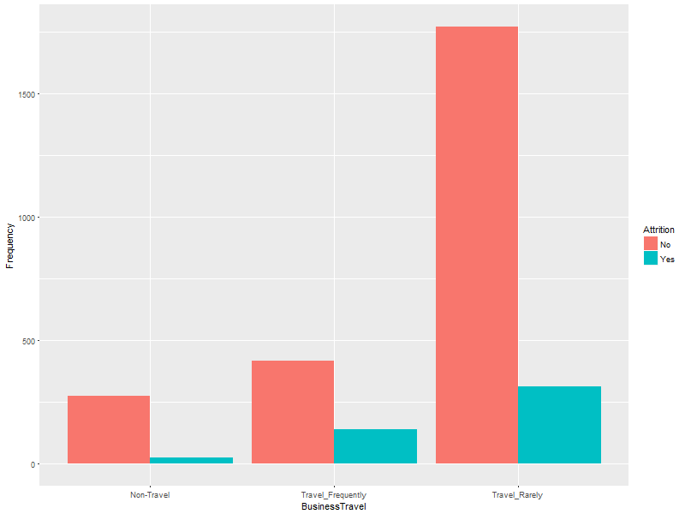
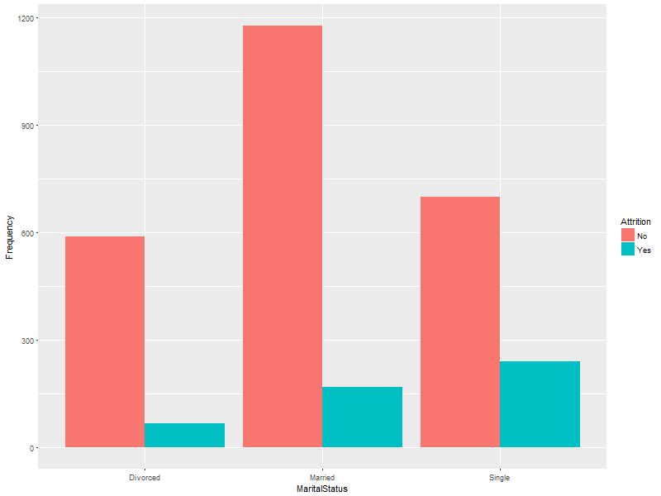

Slide 8
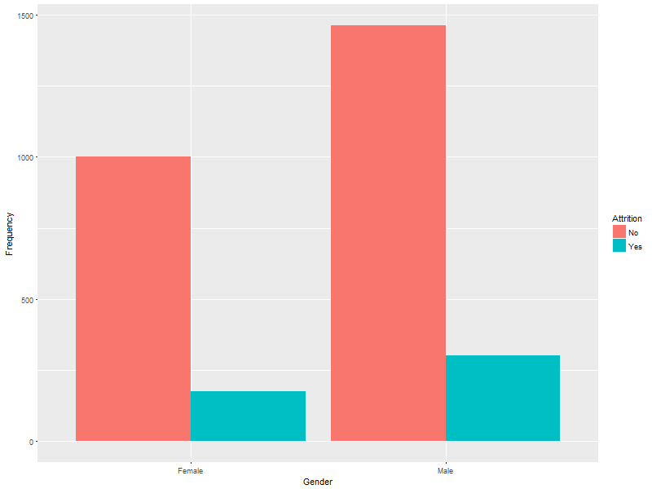
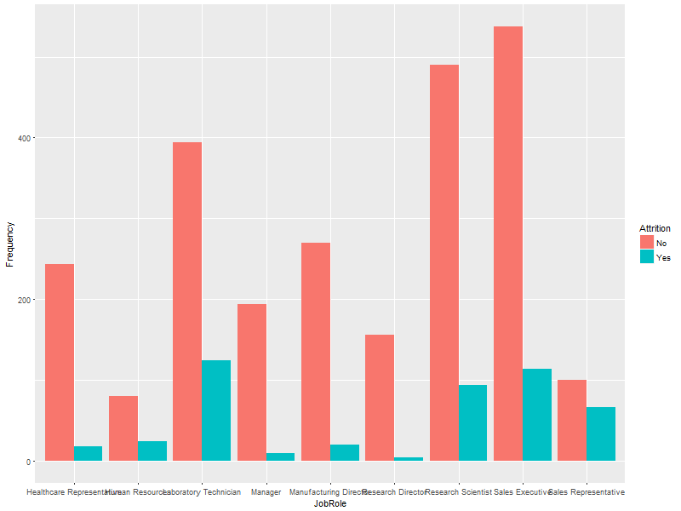
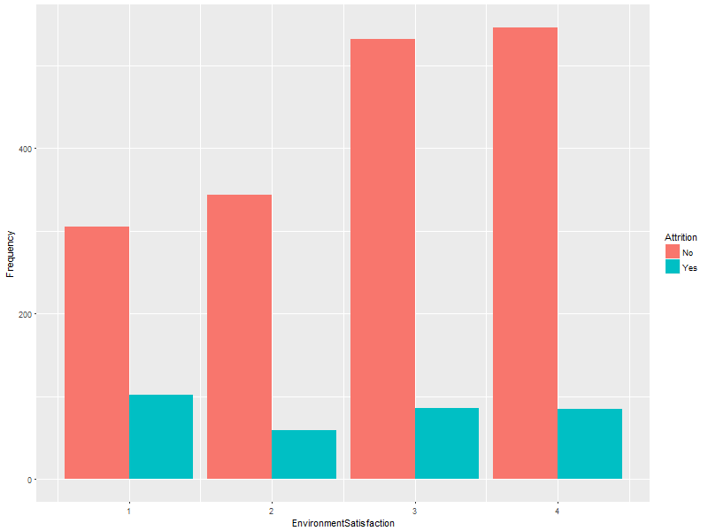

Slide 9
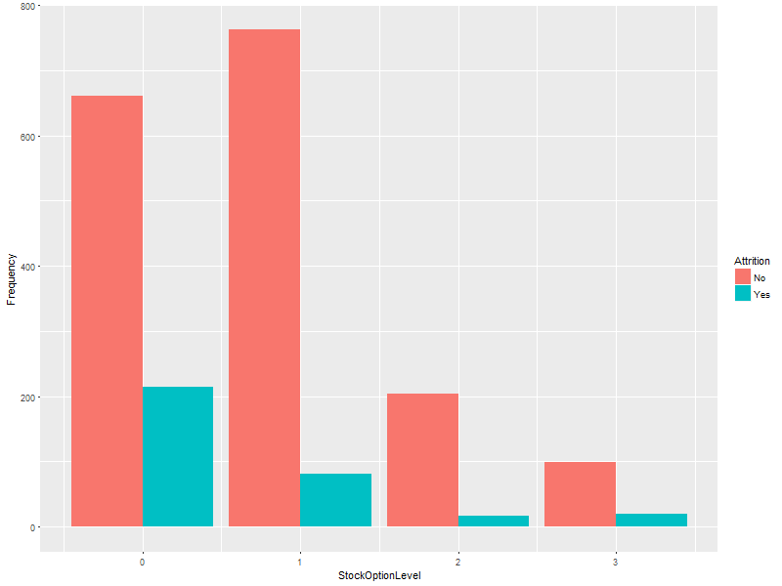
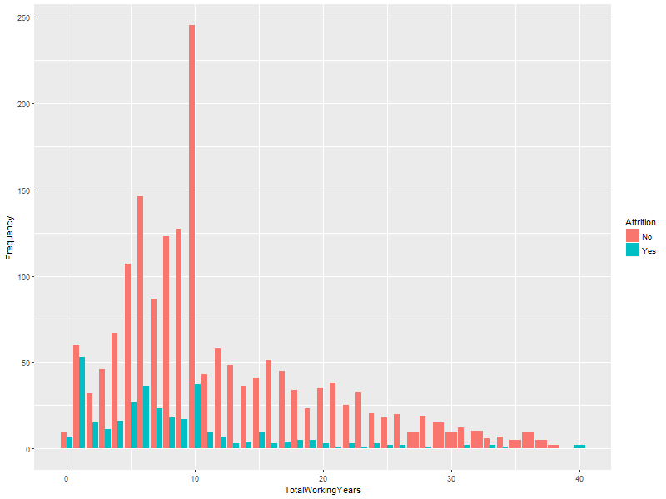
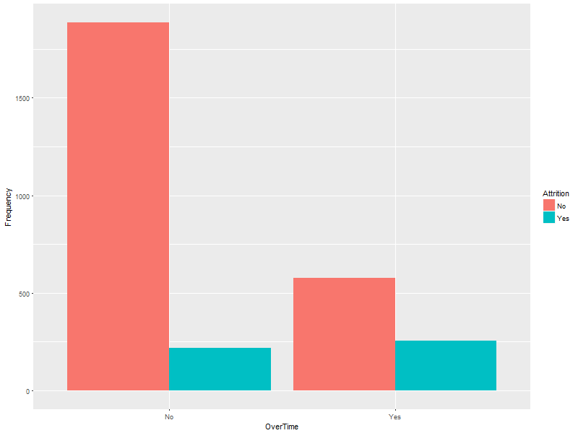

Slide 10
## [1] Attrition
## No Yes 474
## 2466
## [1] BusinessTravel
##
##
Non-Travel Travel_Frequently
Travel_Rarely
2086
300 554
## [1] Department
##
##
Human Resources Research & Development
Sales
892
126 1922
## [1] EducationField
## Human Resources
## 54
##
##
Life Sciences
1212
Marketing
318
Medical
928
Other Technical Degree
164 264
## [1] Gender
## Female
Male 1764
## 1176
## [1] JobRole
## Healthcare Representative
Human Resources
104
Manager
204
Research Director
160
Sales Executive
652
##
##
##
##
##
##
##
##
##
262
Laboratory Technician
518
Manufacturing Director
290
Research Scientist
584
Sales Representative
166
## [1] MaritalStatus
## Divorced
Married
1346
Single
940
## 654
## [1] Over18
## Y
## 2940
## [1] OverTime
## No Yes 832
## 2108
####################### Remove the unsed varibles from the dataset
###############################
############# single category variable in categorical type variables
##############

Slide 11
for(i in factor_ID){ if(length(levels(LR_DF[,i]))==1){
print.noquote(paste0(names(LR_DF[i]),' has only 1 category and its field id is ',i))
}
}
## [1] Over18 has only 1 category and its field id is 22
### Over18 has only 1 category and its field id is 22 so remove it is not contributing any
### significant information about the attrition becuse it has only one level
################ single valued variable in interger type
##########################
for( i in integer_ID){ if(max(LR_DF[,i])==min(LR_DF[,i])){
print.noquote(paste0('All the values of ',names(LR_DF[i]),' are : ',
max(LR_DF[,i]),' and its ID is : ',i ))
}
}
## [1] All the values of EmployeeCount are : 1 and its ID is : 9
## [1] All the values of StandardHours are : 80 and its ID is : 27
# All the values of EmployeeCount are : 1 and its ID is : 9
# All the values of StandardHours are : 80 and its ID is : 27
# remove the Employeecount and StandardHours becuse they have same value so SD=0 so not significant
# we also remove Employeenumber becuse no significant
### Removing 'Over18','EmployeeCount','StandardHours','Employeenumber'
LR_DF = LR_DF[,-c(9,10,22,27)]
# View(LR_DF)
dim(LR_DF)
## [1] 2940 31
## What if I want the percentile distribution for all the fields
apply(LR_DF[,sapply(LR_DF, is.numeric)], 2, quantile,
probs=c(0.01, 0.05, 0.1, 0.25, 0.50, 0.75, 0.90, 0.95, 0.99, 1),
na.rm=T)
## |  | Age | DailyRate | DistanceFromHome | Education | EnvironmentSatisfaction
## | 1% | 19.00 | 117.0 | 1 | 1 | 1
## | 5% | 24.00 | 164.0 | 1 | 1 | 1
## | 10% | 26.00 | 242.8 | 1 | 1 | 1
## | 25% | 30.00 | 465.0 | 2 | 2 | 2
## 50%
36.00
802.0
7
3
3

Slide 12
## | 75% | 43.00 1157.0 14 4 4
## | 90% | 50.00 1356.0 23 4 4
## | 95% | 54.00 1425.0 26 4 4
## | 99% | 58.61 1485.0 29 5 4
## | 100% | 60.00 1499.0 29 5 4
## |  | HourlyRate JobInvolvement JobLevel JobSatisfaction MonthlyIncome
## | 1% | 30 1 1 1 1372.26
## | 5% | 33 1 1 1 2097.00
## | 10% | 38 2 1 1 2317.60
## | 25% | 48 2 1 2 2911.00
## | 50% | 66 3 2 3 4919.00
## | 75% | 84 3 3 4 8380.00
## | 90% | 94 3 4 4 13775.60
## | 95% | 97 4 4 4 17856.00
## | 99% | 100 4 5 4 19626.61
## | 100% | 100 4 5 4 19999.00
## |  | MonthlyRate NumCompaniesWorked PercentSalaryHike PerformanceRating
## | 1% | 2324.17 0 11 3
## | 5% | 3376.00 0 11 3
## | 10% | 4603.00 0 11 3
## | 25% | 8045.00 1 12 3
## | 50% | 14235.50 2 14 3
## | 75% | 20462.00 4 18 3
## | 90% | 24001.70 7 21 4
## | 95% | 25440.00 8 22 4
## | 99% | 26705.44 9 25 4
## | 100% | 26999.00 9 25 4
## |  | RelationshipSatisfaction StockOptionLevel TotalWorkingYears
## | 1% | 1 0 1
## | 5% | 1 0 1
## | 10% | 1 0 3
## | 25% | 2 0 6
## | 50% | 3 1 10
## | 75% | 4 1 15
## | 90% | 4 2 23
## | 95% | 4 3 28
## | 99% | 4 3 35
## | 100% | 4 3 40
## |  | TrainingTimesLastYear WorkLifeBalance YearsAtCompany
## | 1% | 0 1 0
## | 5% | 1 1 1
## | 10% | 2 2 1
## | 25% | 2 2 3
## | 50% | 3 3 5
## | 75% | 3 3 9
## | 90% | 5 4 15
## | 95% | 5 4 20
## | 99% | 6 4 31
## | 100% | 6 4 40
##
YearsInCurrentRole YearsSinceLastPromotion YearsWithCurrManager

Slide 13
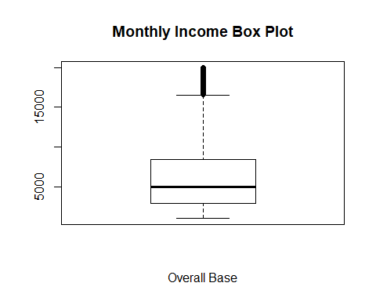
## | 1% | 0 | 0 | 0
## | 5% | 0 | 0 | 0
## | 10% | 0 | 0 | 0
## | 25% | 2 | 0 | 2
## | 50% | 3 | 1 | 3
## | 75% | 7 | 3 | 7
## | 90% | 9 | 7 | 9
## | 95% | 11 | 9 | 10
## | 99% | 15 | 14 | 14
## | 100% | 18 | 15 | 17
boxplot(LR_DF$MonthlyIncome ,
main= "Monthly Income Box Plot" , xlab = "Overall Base"
)
boxplot(LR_DF$MonthlyRate ,
main= "MonthlyRate Box Plot" , xlab = "Overall Base"
)

Slide 14
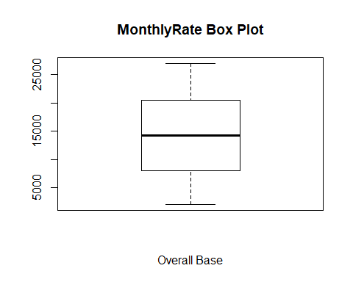
boxplot(LR_DF$YearsAtCompany ,
main= "YearsAtCompany Box Plot" , xlab = "Overall Base"
)

Slide 15
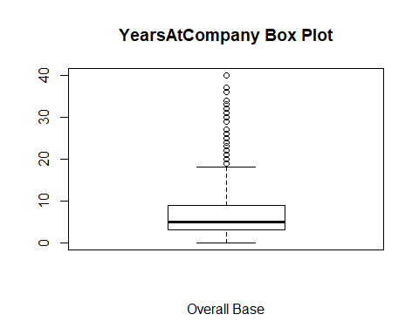
## Typically we floor and cap the variables at P1 and P99.
## Let us cap the Balance variable at P99.
# LR_DF$YearsAtCompanyCap <-
# ifelse(LR_DF$YearsAtCompany > 31, 31, LR_DF$YearsAtCompany)
#
# summary(LR_DF$YearsAtCompanyCap)
# sd(LR_DF$YearsAtCompanyCap)
#
# quantile(LR_DF$YearsAtCompanyCap,
# c(0.01, 0.05, 0.1, 0.25, 0.50, 0.75, 0.90, 0.95, 0.99, 1))
# boxplot(LR_DF$YearsAtCompanyCap ,
# main= "YearsAtCompany Box Plot" ,
# xlab = "Overall Base"
# )
train_a = subset(LR_DF, select = -c(Attrition))
# #Identifying numeric variables
numericData <- train_a[sapply(train_a, is.numeric)]
#View(numericData)
####### Calculating Correlation descrCor <- cor(numericData)
# Print correlation matrix and look at max correlation
print(descrCor)
## Age DailyRate DistanceFromHome
## Age
1.000000000
0.0106609426
-0.001686120

Slide 16
## | DailyRate | 0.010660943 1.0000000000 -0.004985337
## | DistanceFromHome | -0.001686120 -0.0049853374 1.000000000
## | Education | 0.208033731 -0.0168064332 0.021041826
## | EnvironmentSatisfaction | 0.010146428 0.0183548543 -0.016075327
## | HourlyRate | 0.024286543 0.0233814215 0.031130586
## | JobInvolvement | 0.029819959 0.0461348740 0.008783280
## | JobLevel | 0.509604228 0.0029663349 0.005302731
## | JobSatisfaction | -0.004891877 0.0305710078 -0.003668839
## | MonthlyIncome | 0.497854567 0.0077070589 -0.017014445
## | MonthlyRate | 0.028051167 -0.0321816015 0.027472864
## | NumCompaniesWorked | 0.299634758 0.0381534343 -0.029250804
## | PercentSalaryHike | 0.003633585 0.0227036775 0.040235377
## | PerformanceRating | 0.001903896 0.0004732963 0.027109618
## | RelationshipSatisfaction | 0.053534720 0.0078460310 0.006557475
## | StockOptionLevel | 0.037509712 0.0421427964 0.044871999
## | TotalWorkingYears | 0.680380536 0.0145147387 0.004628426
## | TrainingTimesLastYear | -0.019620819 0.0024525427 -0.036942234
## | WorkLifeBalance | -0.021490028 -0.0378480510 -0.026556004
## | YearsAtCompany | 0.311308770 -0.0340547676 0.009507720
## | YearsInCurrentRole | 0.212901056 0.0099320150 0.018844999
## | YearsSinceLastPromotion | 0.216513368 -0.0332289848 0.010028836
## | YearsWithCurrManager | 0.202088602 -0.0263631782 0.014406048
## |  | Education EnvironmentSatisfaction HourlyRate
## | Age | 0.208033731 0.010146428 0.024286543
## | DailyRate | -0.016806433 0.018354854 0.023381422
## | DistanceFromHome | 0.021041826 -0.016075327 0.031130586
## | Education | 1.000000000 -0.027128313 0.016774829
## | EnvironmentSatisfaction | -0.027128313 1.000000000 -0.049856956
## | HourlyRate | 0.016774829 -0.049856956 1.000000000
## | JobInvolvement | 0.042437634 -0.008277598 0.042860641
## | JobLevel | 0.101588886 0.001211699 -0.027853486
## | JobSatisfaction | -0.011296117 -0.006784353 -0.071334624
## | MonthlyIncome | 0.094960677 -0.006259088 -0.015794304
## | MonthlyRate | -0.026084197 0.037599623 -0.015296750
## | NumCompaniesWorked | 0.126316560 0.012594323 0.022156883
## | PercentSalaryHike | -0.011110941 -0.031701195 -0.009061986
## | PerformanceRating | -0.024538791 -0.029547952 -0.002171697
## | RelationshipSatisfaction | -0.009118377 0.007665384 0.001330453
## | StockOptionLevel | 0.018422220 0.003432158 0.050263399
## | TotalWorkingYears | 0.148279697 -0.002693070 -0.002333682
## | TrainingTimesLastYear | -0.025100241 -0.019359308 -0.008547685
## | WorkLifeBalance | 0.009819189 0.027627295 -0.004607234
## | YearsAtCompany | 0.069113696 0.001457549 -0.019581616
## | YearsInCurrentRole | 0.060235554 0.018007460 -0.024106220
## | YearsSinceLastPromotion | 0.054254334 0.016193606 -0.026715586
## | YearsWithCurrManager | 0.069065378 -0.004998723 -0.020123200
## |  | JobInvolvement JobLevel JobSatisfaction
## | Age | 0.029819959 0.509604228 -0.0048918771
## | DailyRate | 0.046134874 0.002966335 0.0305710078
## DistanceFromHome
0.008783280
0.005302731
-0.0036688392

Slide 17
## | Education | 0.042437634 0.101588886 -0.0112961167
## | EnvironmentSatisfaction | -0.008277598 0.001211699 -0.0067843526
## | HourlyRate | 0.042860641 -0.027853486 -0.0713346244
## | JobInvolvement | 1.000000000 -0.012629883 -0.0214759103
## | JobLevel | -0.012629883 1.000000000 -0.0019437080
## | JobSatisfaction | -0.021475910 -0.001943708 1.0000000000
## | MonthlyIncome | -0.015271491 0.950299913 -0.0071567424
## | MonthlyRate | -0.016322079 0.039562951 0.0006439169
## | NumCompaniesWorked | 0.015012413 0.142501124 -0.0556994260
## | PercentSalaryHike | -0.017204572 -0.034730492 0.0200020394
## | PerformanceRating | -0.029071333 -0.021222082 0.0022971971
## | RelationshipSatisfaction | 0.034296821 0.021641511 -0.0124535932
## | StockOptionLevel | 0.021522640 0.013983911 0.0106902261
## | TotalWorkingYears | -0.005533182 0.782207805 -0.0201850727
## | TrainingTimesLastYear | -0.015337826 -0.018190550 -0.0057793350
## | WorkLifeBalance | -0.014616593 0.037817746 -0.0194587102
## | YearsAtCompany | -0.021355427 0.534738687 -0.0038026279
## | YearsInCurrentRole | 0.008716963 0.389446733 -0.0023047852
## | YearsSinceLastPromotion | -0.024184292 0.353885347 -0.0182135678
## | YearsWithCurrManager | 0.025975808 0.375280608 -0.0276562139
## |  | MonthlyIncome MonthlyRate NumCompaniesWorked
## | Age | 0.497854567 0.0280511671 0.299634758
## | DailyRate | 0.007707059 -0.0321816015 0.038153434
## | DistanceFromHome | -0.017014445 0.0274728635 -0.029250804
## | Education | 0.094960677 -0.0260841972 0.126316560
## | EnvironmentSatisfaction | -0.006259088 0.0375996229 0.012594323
## | HourlyRate | -0.015794304 -0.0152967496 0.022156883
## | JobInvolvement | -0.015271491 -0.0163220791 0.015012413
## | JobLevel | 0.950299913 0.0395629510 0.142501124
## | JobSatisfaction | -0.007156742 0.0006439169 -0.055699426
## | MonthlyIncome | 1.000000000 0.0348136261 0.149515216
## | MonthlyRate | 0.034813626 1.0000000000 0.017521353
## | NumCompaniesWorked | 0.149515216 0.0175213534 1.000000000
## | PercentSalaryHike | -0.027268586 -0.0064293459 -0.010238309
## | PerformanceRating | -0.017120138 -0.0098114285 -0.014094873
## | RelationshipSatisfaction | 0.025873436 -0.0040853293 0.052733049
## | StockOptionLevel | 0.005407677 -0.0343228302 0.030075475
## | TotalWorkingYears | 0.772893246 0.0264424712 0.237638590
## | TrainingTimesLastYear | -0.021736277 0.0014668806 -0.066054072
## | WorkLifeBalance | 0.030683082 0.0079631575 -0.008365685
## | YearsAtCompany | 0.514284826 -0.0236551067 -0.118421340
## | YearsInCurrentRole | 0.363817667 -0.0128148744 -0.090753934
## | YearsSinceLastPromotion | 0.344977638 0.0015667995 -0.036813892
## | YearsWithCurrManager | 0.344078883 -0.0367459053 -0.110319155
## |  | PercentSalaryHike PerformanceRating
## | Age | 0.003633585 0.0019038955
## | DailyRate | 0.022703677 0.0004732963
## | DistanceFromHome | 0.040235377 0.0271096185
## | Education | -0.011110941 -0.0245387912
## EnvironmentSatisfaction
-0.031701195
-0.0295479523

Slide 18
## | HourlyRate | -0.009061986 -0.0021716974
## | JobInvolvement | -0.017204572 -0.0290713334
## | JobLevel | -0.034730492 -0.0212220821
## | JobSatisfaction | 0.020002039 0.0022971971
## | MonthlyIncome | -0.027268586 -0.0171201382
## | MonthlyRate | -0.006429346 -0.0098114285
## | NumCompaniesWorked | -0.010238309 -0.0140948728
## | PercentSalaryHike | 1.000000000 0.7735499964
## | PerformanceRating | 0.773549996 1.0000000000
## | RelationshipSatisfaction | -0.040490081 -0.0313514554
## | StockOptionLevel | 0.007527748 0.0035064716
## | TotalWorkingYears | -0.020608488 0.0067436679
## | TrainingTimesLastYear | -0.005221012 -0.0155788817
## | WorkLifeBalance | -0.003279636 0.0025723613
## | YearsAtCompany | -0.035991262 0.0034351261
## | YearsInCurrentRole | -0.001520027 0.0349862604
## | YearsSinceLastPromotion | -0.022154313 0.0178960661
## | YearsWithCurrManager | -0.011985248 0.0228271689
## |  | RelationshipSatisfaction StockOptionLevel
## | Age | 0.0535347197 0.037509712
## | DailyRate | 0.0078460310 0.042142796
## | DistanceFromHome | 0.0065574746 0.044871999
## | Education | -0.0091183767 0.018422220
## | EnvironmentSatisfaction | 0.0076653835 0.003432158
## | HourlyRate | 0.0013304528 0.050263399
## | JobInvolvement | 0.0342968206 0.021522640
## | JobLevel | 0.0216415105 0.013983911
## | JobSatisfaction | -0.0124535932 0.010690226
## | MonthlyIncome | 0.0258734361 0.005407677
## | MonthlyRate | -0.0040853293 -0.034322830
## | NumCompaniesWorked | 0.0527330486 0.030075475
## | PercentSalaryHike | -0.0404900811 0.007527748
## | PerformanceRating | -0.0313514554 0.003506472
## | RelationshipSatisfaction | 1.0000000000 -0.045952491
## | StockOptionLevel | -0.0459524907 1.000000000
## | TotalWorkingYears | 0.0240542918 0.010135969
## | TrainingTimesLastYear | 0.0024965264 0.011274070
## | WorkLifeBalance | 0.0196044057 0.004128730
## | YearsAtCompany | 0.0193667869 0.015058008
## | YearsInCurrentRole | -0.0151229149 0.050817873
## | YearsSinceLastPromotion | 0.0334925021 0.014352185
## | YearsWithCurrManager | -0.0008674968 0.024698227
## |  | TotalWorkingYears TrainingTimesLastYear
## | Age | 0.680380536 -0.019620819
## | DailyRate | 0.014514739 0.002452543
## | DistanceFromHome | 0.004628426 -0.036942234
## | Education | 0.148279697 -0.025100241
## | EnvironmentSatisfaction | -0.002693070 -0.019359308
## | HourlyRate | -0.002333682 -0.008547685
## JobInvolvement
-0.005533182
-0.015337826

Slide 19
## | JobLevel | 0.782207805 -0.018190550
## | JobSatisfaction | -0.020185073 -0.005779335
## | MonthlyIncome | 0.772893246 -0.021736277
## | MonthlyRate | 0.026442471 0.001466881
## | NumCompaniesWorked | 0.237638590 -0.066054072
## | PercentSalaryHike | -0.020608488 -0.005221012
## | PerformanceRating | 0.006743668 -0.015578882
## | RelationshipSatisfaction | 0.024054292 0.002496526
## | StockOptionLevel | 0.010135969 0.011274070
## | TotalWorkingYears | 1.000000000 -0.035661571
## | TrainingTimesLastYear | -0.035661571 1.000000000
## | WorkLifeBalance | 0.001007646 0.028072207
## | YearsAtCompany | 0.628133155 0.003568666
## | YearsInCurrentRole | 0.460364638 -0.005737504
## | YearsSinceLastPromotion | 0.404857759 -0.002066536
## | YearsWithCurrManager | 0.459188397 -0.004095526
## |  | WorkLifeBalance YearsAtCompany YearsInCurrentRole
## | Age | -0.021490028 0.311308770 0.212901056
## | DailyRate | -0.037848051 -0.034054768 0.009932015
## | DistanceFromHome | -0.026556004 0.009507720 0.018844999
## | Education | 0.009819189 0.069113696 0.060235554
## | EnvironmentSatisfaction | 0.027627295 0.001457549 0.018007460
## | HourlyRate | -0.004607234 -0.019581616 -0.024106220
## | JobInvolvement | -0.014616593 -0.021355427 0.008716963
## | JobLevel | 0.037817746 0.534738687 0.389446733
## | JobSatisfaction | -0.019458710 -0.003802628 -0.002304785
## | MonthlyIncome | 0.030683082 0.514284826 0.363817667
## | MonthlyRate | 0.007963158 -0.023655107 -0.012814874
## | NumCompaniesWorked | -0.008365685 -0.118421340 -0.090753934
## | PercentSalaryHike | -0.003279636 -0.035991262 -0.001520027
## | PerformanceRating | 0.002572361 0.003435126 0.034986260
## | RelationshipSatisfaction | 0.019604406 0.019366787 -0.015122915
## | StockOptionLevel | 0.004128730 0.015058008 0.050817873
## | TotalWorkingYears | 0.001007646 0.628133155 0.460364638
## | TrainingTimesLastYear | 0.028072207 0.003568666 -0.005737504
## | WorkLifeBalance | 1.000000000 0.012089185 0.049856498
## | YearsAtCompany | 0.012089185 1.000000000 0.758753737
## | YearsInCurrentRole | 0.049856498 0.758753737 1.000000000
## | YearsSinceLastPromotion | 0.008941249 0.618408865 0.548056248
## | YearsWithCurrManager | 0.002759440 0.769212425 0.714364762
## |  | YearsSinceLastPromotion YearsWithCurrManager
## | Age | 0.216513368 0.2020886024
## | DailyRate | -0.033228985 -0.0263631782
## | DistanceFromHome | 0.010028836 0.0144060484
## | Education | 0.054254334 0.0690653783
## | EnvironmentSatisfaction | 0.016193606 -0.0049987226
## | HourlyRate | -0.026715586 -0.0201232002
## | JobInvolvement | -0.024184292 0.0259758079
## | JobLevel | 0.353885347 0.3752806078
## JobSatisfaction
-0.018213568
-0.0276562139

Slide 20
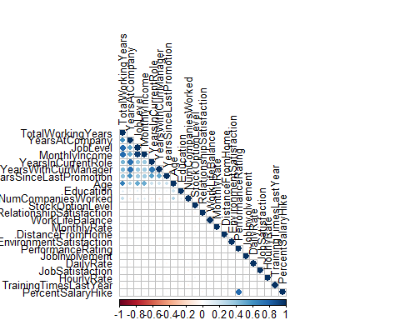
## | MonthlyIncome | 0.344977638 | 0.3440788833
## | MonthlyRate | 0.001566800 | -0.0367459053
## | NumCompaniesWorked | -0.036813892 | -0.1103191554
## | PercentSalaryHike | -0.022154313 | -0.0119852485
## | PerformanceRating | 0.017896066 | 0.0228271689
## | RelationshipSatisfaction | 0.033492502 | -0.0008674968
## | StockOptionLevel | 0.014352185 | 0.0246982266
## | TotalWorkingYears | 0.404857759 | 0.4591883971
## | TrainingTimesLastYear | -0.002066536 | -0.0040955260
## | WorkLifeBalance | 0.008941249 | 0.0027594402
## | YearsAtCompany | 0.618408865 | 0.7692124251
## | YearsInCurrentRole | 0.548056248 | 0.7143647616
## | YearsSinceLastPromotion | 1.000000000 | 0.5102236358
## | YearsWithCurrManager | 0.510223636 | 1.0000000000
# Visualize Correlation Matrix
#install.packages("corplot")
library(corrplot)
corrplot(descrCor, order = "FPC", method = "circle", type = "lower",tl.cex = 0.8, tl.col = rgb(0, 0, 0))
########## Checking Variables that are highly correlated
library(car) library(caret)
## Loading required package: lattice

Slide 21
highlyCorrelated = findCorrelation(descrCor, cutoff=0.7)
#Identifying Variable Names of Highly Correlated Variables
highlyCorCol = colnames(numericData)[highlyCorrelated]
#Print highly correlated attributes
highlyCorCol
## [1] "TotalWorkingYears" "YearsAtCompany"
## [4] "YearsInCurrentRole" "PercentSalaryHike"
"JobLevel"
# #Remove highly correlated variables and create a new dataset
# LR_DF = LR_DF[, -which(colnames(LR_DF) %in% highlyCorCol)]
# dim(LR_DF)
#install.packages("devtools")
library(devtools)
#install_github("riv","tomasgreif")
library(woe)
iv.plot.summary(iv.mult(LR_DF,
"Attrition",TRUE))
## Information Value 0.3
## Information Value 0.12
## Information Value 0.08
## Information Value 0.05
## Information Value 0.06
## Information Value 0.01
## Information Value 0.07
## Information Value 0.1
## Information Value 0.01
## Information Value 0.06
## Information Value 0.07
## Information Value 0.38
## Information Value 0.49
## Information Value 0.09
## Information Value 0.22
## Information Value 0.44
## Information Value 0.06
## Information Value 0.11
## Information Value 0.4
## Information Value 0.01
## Information Value 0
##
##
##
##
##
##
Information Information Information Information Information Information
Value Value Value Value Value Value
0.02
0.28
0.35
0.03
0.03
0.34

Slide 22
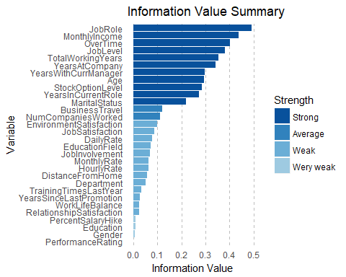
## Information Value 0.27
## Information Value 0.03
## Information Value 0.3
iv <- iv.mult(LR_DF,"Attrition",TRUE)
## Information Value 0.3
## Information Value 0.12
## Information Value 0.08
## Information Value 0.05
## Information Value 0.06
## Information Value 0.01
## Information Value 0.07
## Information Value 0.1
## Information Value 0.01
## Information Value 0.06
## Information Value 0.07
## Information Value 0.38
## Information Value 0.49
## Information Value 0.09
## Information Value 0.22
##
##
##
##
##
##
Information Information Information Information Information Information
Value Value Value Value Value Value
0.44
0.06
0.11
0.4
0.01
0

Slide 23
## ## ## ## ## ## ## ## ## | Information Value 0.02 Information Value 0.28 Information Value 0.35 Information Value 0.03 Information Value 0.03 Information Value 0.34 Information Value 0.27 Information Value 0.03 Information Value 0.3
iv
## | Variable | InformationValue | Bins | ZeroBins | Strength
## | 1 JobRole | 0.490997093 | 9 | 0 | Strong
## | 2 MonthlyIncome | 0.438722141 | 5 | 0 | Strong
## | 3 OverTime | 0.400182845 | 2 | 0 | Strong
## | 4 JobLevel | 0.379669796 | 4 | 0 | Strong
## | 5 TotalWorkingYears | 0.354452897 | 4 | 0 | Strong
## | 6 YearsAtCompany | 0.340387370 | 4 | 0 | Strong
## | 7 YearsWithCurrManager | 0.298264921 | 3 | 0 | Strong
## | 8 Age | 0.295024546 | 3 | 0 | Strong
## | 9 StockOptionLevel | 0.283603531 | 2 | 0 | Strong
## | 10 YearsInCurrentRole | 0.273353808 | 4 | 0 | Strong
## | 11 MaritalStatus | 0.218897607 | 3 | 0 | Strong
## | 12 BusinessTravel | 0.120867943 | 3 | 0 | Average
## | 13 NumCompaniesWorked | 0.111601107 | 4 | 0 | Average
## | 14 EnvironmentSatisfaction | 0.097928091 | 2 | 0 | Weak
## | 15 JobSatisfaction | 0.087684596 | 3 | 0 | Weak
## | 16 DailyRate | 0.079509099 | 5 | 0 | Weak
## | 17 EducationField | 0.072778859 | 6 | 0 | Weak
## | 18 JobInvolvement | 0.070573886 | 2 | 0 | Weak
## | 19 MonthlyRate | 0.064713179 | 5 | 0 | Weak
## | 20 HourlyRate | 0.063509819 | 6 | 0 | Weak
## | 21 DistanceFromHome | 0.057196030 | 2 | 0 | Weak
## | 22 Department | 0.052174635 | 3 | 0 | Weak
## | 23 TrainingTimesLastYear | 0.032944818 | 3 | 0 | Weak
## | 24 YearsSinceLastPromotion | 0.027712498 | 2 | 0 | Weak
## | 25 WorkLifeBalance | 0.025296598 | 2 | 0 | Weak
## | 26 RelationshipSatisfaction | 0.024067090 | 2 | 0 | Weak
## | 27 PercentSalaryHike | 0.009893773 | 2 | 0 | Wery weak
## | 28 Education | 0.009798994 | 2 | 0 | Wery weak
## | 29 Gender | 0.006495864 | 2 | 0 | Wery weak
## | 30 PerformanceRating | 0.000000000 | 1 | 0 | Wery weak
## | Pattern Detection
LR_DF$Attrition<-as.numeric(LR_DF$Attrition)
LR_DF$Attrition<-ifelse(LR_DF$Attrition==2,1,0)

Slide 24
source("C:/Users/Mahendra Thakur/Documents/Visualization/Visualization.R") output_folder = "C:/Users/Mahendra Thakur/Documents/Visualization/" Target_var_name = "Attrition"
col_list = colnames(LR_DF)[
lapply(LR_DF, class) %in% c("numeric", "integer")
]
col_list
## [1] "Age"
## [3] "DailyRate"
## [5] "Education"
## [7] "HourlyRate"
## [9] "JobLevel"
"Attrition" "DistanceFromHome" "EnvironmentSatisfaction" "JobInvolvement" "JobSatisfaction" "MonthlyRate" "PercentSalaryHike" "RelationshipSatisfaction" "TotalWorkingYears" "WorkLifeBalance" "YearsInCurrentRole" "YearsWithCurrManager"
## [11] "MonthlyIncome"
## [13] "NumCompaniesWorked"
## [15] "PerformanceRating"
## [17] "StockOptionLevel"
## [19] "TrainingTimesLastYear"
## [21] "YearsAtCompany"
## [23] "YearsSinceLastPromotion"
for (i in 1 : length(col_list)) {
fn_biz_viz(df = LR_DF, target = Target_var_name, var = col_list[i])
}
######################### Now split the dataset ############ mydata <- LR_DF
mydata$random <- runif(nrow(mydata), 0, 1) mydata.dev <- mydata[which(mydata$random <= 0.5),] mydata.val <- mydata[which(mydata$random > 0.5
& mydata$random <= 0.8 ),] mydata.hold <- mydata[which(mydata$random > 0.8),]
nrow(mydata)
## [1] 2940
nrow(mydata.dev)
## [1] 1487
nrow(mydata.val)
## [1] 925
nrow(mydata.hold)
## [1] 528
sum(mydata$Attrition) / nrow(mydata)

Slide 25
## [1] 0.1612245
sum(mydata.dev$Attrition)/ nrow(mydata.dev)
## [1] 0.1513114
sum(mydata.val$Attrition)/ nrow(mydata.val)
## [1] 0.1816216
sum(mydata.hold$Attrition)/ nrow(mydata.hold)
## [1] 0.1534091
##install.packages("aod")
##install.packages("ggplot2")
##library(aod)
##library(ggplot2)
mylogit1 <- glm( Attrition ~.,
data = mydata.dev, family = "binomial"
)
summary(mylogit1)
##
## Call:
## glm(formula = Attrition ~ ., family = "binomial", data = mydata.dev)
##
## Deviance Residuals:
## Min
1Q
-0.3810
Median
-0.1756
3Q
-0.0472
Max 3.6384
## -1.8325
##
## Coefficients:
##
## (Intercept)
## Age
## BusinessTravelTravel_Frequently
## BusinessTravelTravel_Rarely
## DailyRate
## DepartmentResearch & Development
## DepartmentSales
## DistanceFromHome
## Education
## EducationFieldLife Sciences
## EducationFieldMarketing
## EducationFieldMedical
## EducationFieldOther
## EducationFieldTechnical Degree
## EnvironmentSatisfaction
## GenderMale
Estimate Std. Error z value Pr(>|z|)
-9.171e+00
-4.895e-02 2.416e+00
1.479e+00
-1.783e-04 1.251e+01
1.315e+01
6.444e-02
-1.539e-02
-9.986e-01
-9.237e-02
-1.250e+00
-1.337e+00 1.528e-02
-5.601e-01
4.316e-01
6.148e+02
1.577e-02
4.903e-01
4.509e-01
2.437e-04
6.148e+02
6.148e+02
1.195e-02
9.710e-02
8.996e-01
9.552e-01
8.969e-01
9.599e-01
9.234e-01
9.597e-02
2.079e-01
-0.015 0.988099
-3.103 0.001915
4.929 8.28e-07
3.281 0.001036
-0.732 0.464286
0.020 0.983772
0.021 0.982935
5.395 6.86e-08
-0.159 0.874056
-1.110 0.267000
-0.097 0.922960
-1.394 0.163322
-1.393 0.163693
0.017 0.986802
-5.836 5.34e-09
2.076 0.037877
## HourlyRate
-1.145e-04
4.981e-03
-0.023 0.981661

Slide 26
## JobInvolvement
## JobLevel
## JobRoleHuman Resources
## JobRoleLaboratory Technician
## JobRoleManager
## JobRoleManufacturing Director
## JobRoleResearch Director
## JobRoleResearch Scientist
## JobRoleSales Executive
## JobRoleSales Representative
## JobSatisfaction
## MaritalStatusMarried
## MaritalStatusSingle
## MonthlyIncome
## MonthlyRate
## NumCompaniesWorked
## OverTimeYes
## PercentSalaryHike
## PerformanceRating
## RelationshipSatisfaction
## StockOptionLevel
## TotalWorkingYears
## TrainingTimesLastYear
## WorkLifeBalance
## YearsAtCompany
## YearsInCurrentRole
## YearsSinceLastPromotion
## YearsWithCurrManager
## random
##
## (Intercept)
## Age **
## BusinessTravelTravel_Frequently ***
## BusinessTravelTravel_Rarely **
## DailyRate
## DepartmentResearch & Development
## DepartmentSales
## DistanceFromHome
## Education
## EducationFieldLife Sciences
## EducationFieldMarketing
## EducationFieldMedical
## EducationFieldOther
## EducationFieldTechnical Degree
## EnvironmentSatisfaction
## GenderMale
## HourlyRate
## JobInvolvement
## JobLevel
-6.082e-01
-5.402e-01 1.374e+01
1.623e+00
9.479e-02
9.011e-01
-1.488e+00 4.091e-01
5.791e-01
1.123e+00
-4.891e-01 1.508e-01
1.311e+00
3.240e-05
-2.053e-05 2.480e-01
2.404e+00
-2.413e-02 2.186e-01
-3.585e-01
-2.968e-01
-7.238e-02
-1.878e-01
-3.991e-01 1.001e-01
-1.762e-01
2.355e-01
-1.029e-01 9.703e-01
1.339e-01
3.500e-01
6.148e+02
6.043e-01
1.307e+00
6.303e-01
1.374e+00
6.223e-01
1.708e+00
1.769e+00
9.107e-02
3.070e-01
3.969e-01
8.993e-05
1.403e-05
4.433e-02
2.243e-01
4.395e-02
4.380e-01
9.219e-02
1.900e-01
3.429e-02
8.130e-02
1.361e-01
5.008e-02
5.005e-02
4.874e-02
5.589e-02
6.713e-01
-4.542 5.59e-06
-1.543 0.122717
0.022 0.982174
2.686 0.007241
0.073 0.942182
1.430 0.152806
-1.083 0.278735
0.657 0.510948
0.339 0.734620
0.635 0.525678
-5.371 7.83e-08
0.491 0.623265
3.303 0.000956
0.360 0.718625
-1.464 0.143174
5.595 2.21e-08
10.717 < 2e-16
-0.549 0.582983
0.499 0.617709
-3.889 0.000101
-1.562 0.118246
-2.111 0.034807
-2.310 0.020872
-2.932 0.003370
1.998 0.045745
-3.521 0.000430
4.831 1.36e-06
-1.841 0.065588
1.445 0.148369
***
***
*
***
## JobRoleHuman Resources

Slide 27
## JobRoleLaboratory Technician
## JobRoleManager
## JobRoleManufacturing Director
## JobRoleResearch Director
## JobRoleResearch Scientist
## JobRoleSales Executive
## JobRoleSales Representative
## JobSatisfaction
## MaritalStatusMarried
## MaritalStatusSingle
## MonthlyIncome
## MonthlyRate
## NumCompaniesWorked
## OverTimeYes
## PercentSalaryHike
## PerformanceRating
## RelationshipSatisfaction
## StockOptionLevel
## TotalWorkingYears
## TrainingTimesLastYear
## WorkLifeBalance
## YearsAtCompany
## YearsInCurrentRole
## YearsSinceLastPromotion
## YearsWithCurrManager
## random
## ---
**
***
***
***
***
***
*
*
**
*
***
***
.
## Signif. codes: 0 '***' 0.001 '**' 0.01 '*' 0.05 '.' 0.1 ' ' 1
##
## (Dispersion parameter for binomial family taken to be 1)
##
## Null deviance: 1263.9
on 1486
on 1441
degrees of freedom degrees of freedom
## Residual deviance:
## AIC: 807.6
##
715.6
## Number of Fisher Scoring iterations: 15
##########################
library(MASS) fit=stepAIC(mylogit1,direction = "both")
## Start: AIC=807.6
## Attrition ~ Age + BusinessTravel + DailyRate + Department + DistanceFromHome +
##
##
##
##
Education + EducationField + EnvironmentSatisfaction + Gender + HourlyRate + JobInvolvement + JobLevel + JobRole + JobSatisfaction + MaritalStatus + MonthlyIncome + MonthlyRate + NumCompaniesWorked + OverTime + PercentSalaryHike + PerformanceRating +
RelationshipSatisfaction +
##
StockOptionLevel + TotalWorkingYears + TrainingTimesLastYear +

Slide 28
##
WorkLifeBalance + YearsAtCompany + YearsInCurrentRole +
YearsSinceLastPromotion +
##
##
YearsWithCurrManager + random
## |  | Df | Deviance | AIC
## | - Department | 2 | 716.33 | 804.33
## | - HourlyRate | 1 | 715.60 | 805.60
## | - Education | 1 | 715.63 | 805.63
## | - MonthlyIncome | 1 | 715.73 | 805.73
## | - PerformanceRating | 1 | 715.85 | 805.85
## | - PercentSalaryHike | 1 | 715.90 | 805.90
## | - DailyRate | 1 | 716.14 | 806.14
## | <none> |  | 715.60 | 807.60
## | - random | 1 | 717.70 | 807.70
## | - MonthlyRate | 1 | 717.76 | 807.76
## | - JobLevel | 1 | 718.02 | 808.02
## | - StockOptionLevel | 1 | 718.11 | 808.11
## | - YearsWithCurrManager | 1 | 718.97 | 808.97
## | - YearsAtCompany | 1 | 719.62 | 809.62
## | - Gender | 1 | 720.00 | 810.00
## | - TotalWorkingYears | 1 | 720.20 | 810.20
## | - TrainingTimesLastYear | 1 | 721.07 | 811.07
## | - WorkLifeBalance | 1 | 724.23 | 814.23
## | - Age | 1 | 725.69 | 815.69
## | - JobRole | 8 | 740.56 | 816.56
## | - YearsInCurrentRole | 1 | 728.13 | 818.13
## | - EducationField | 5 | 736.70 | 818.70
## | - RelationshipSatisfaction | 1 | 731.14 | 821.14
## | - MaritalStatus | 2 | 733.94 | 821.94
## | - JobInvolvement | 1 | 736.72 | 826.72
## | - YearsSinceLastPromotion | 1 | 740.03 | 830.03
## | - DistanceFromHome | 1 | 745.34 | 835.34
## | - BusinessTravel | 2 | 747.94 | 835.94
## | - JobSatisfaction | 1 | 746.08 | 836.08
## | - NumCompaniesWorked | 1 | 747.25 | 837.25
## | - EnvironmentSatisfaction | 1 | 751.93 | 841.93
## | - OverTime | 1 | 855.06 | 945.06
##
## | Step: AIC=804.33
## Attrition ~ Age + BusinessTravel + DailyRate + DistanceFromHome +
##
##
##
##
Education + EducationField + EnvironmentSatisfaction + Gender + HourlyRate + JobInvolvement + JobLevel + JobRole + JobSatisfaction + MaritalStatus + MonthlyIncome + MonthlyRate + NumCompaniesWorked + OverTime + PercentSalaryHike + PerformanceRating +
RelationshipSatisfaction +
##
##
StockOptionLevel + TotalWorkingYears + TrainingTimesLastYear + WorkLifeBalance + YearsAtCompany + YearsInCurrentRole +
YearsSinceLastPromotion +
##
YearsWithCurrManager + random
##

Slide 29
## |  | Df | Deviance | AIC
## | - HourlyRate | 1 | 716.33 | 802.33
## | - Education | 1 | 716.36 | 802.36
## | - MonthlyIncome | 1 | 716.46 | 802.46
## | - PerformanceRating | 1 | 716.56 | 802.56
## | - PercentSalaryHike | 1 | 716.60 | 802.60
## | - DailyRate | 1 | 716.85 | 802.85
## | <none> |  | 716.33 | 804.33
## | - random | 1 | 718.34 | 804.34
## | - MonthlyRate | 1 | 718.52 | 804.52
## | - JobLevel | 1 | 718.75 | 804.75
## | - StockOptionLevel | 1 | 719.05 | 805.05
## | - YearsWithCurrManager | 1 | 719.60 | 805.60
## | - YearsAtCompany | 1 | 720.47 | 806.47
## | - Gender | 1 | 720.68 | 806.68
## | - TotalWorkingYears | 1 | 720.90 | 806.90
## | + Department | 2 | 715.60 | 807.60
## | - TrainingTimesLastYear | 1 | 721.75 | 807.75
## | - WorkLifeBalance | 1 | 724.93 | 810.93
## | - Age | 1 | 726.35 | 812.35
## | - YearsInCurrentRole | 1 | 728.83 | 814.83
## | - EducationField | 5 | 737.58 | 815.58
## | - JobRole | 8 | 745.75 | 817.75
## | - RelationshipSatisfaction | 1 | 732.00 | 818.00
## | - MaritalStatus | 2 | 734.55 | 818.55
## | - JobInvolvement | 1 | 737.62 | 823.62
## | - YearsSinceLastPromotion | 1 | 740.44 | 826.44
## | - DistanceFromHome | 1 | 745.96 | 831.96
## | - BusinessTravel | 2 | 748.57 | 832.57
## | - JobSatisfaction | 1 | 747.14 | 833.14
## | - NumCompaniesWorked | 1 | 748.04 | 834.04
## | - EnvironmentSatisfaction | 1 | 752.67 | 838.67
## | - OverTime | 1 | 856.41 | 942.41
##
## | Step: AIC=802.33
## Attrition ~ Age + BusinessTravel + DailyRate + DistanceFromHome +
##
##
+
##
##
##
##
Education + EducationField + EnvironmentSatisfaction + Gender + JobInvolvement + JobLevel + JobRole + JobSatisfaction + MaritalStatus
MonthlyIncome + MonthlyRate + NumCompaniesWorked + OverTime + PercentSalaryHike + PerformanceRating + RelationshipSatisfaction + StockOptionLevel + TotalWorkingYears + TrainingTimesLastYear + WorkLifeBalance + YearsAtCompany + YearsInCurrentRole +
YearsSinceLastPromotion +
##
##
##
YearsWithCurrManager + random
## - Education
## - MonthlyIncome
Df Deviance
AIC
1 716.36 800.36
1 716.46 800.46
## - PerformanceRating
1
716.56 800.56

Slide 30
## | - PercentSalaryHike | 1 | 716.60 | 800.60
## | - DailyRate | 1 | 716.86 | 800.86
## | <none> |  | 716.33 | 802.33
## | - random | 1 | 718.34 | 802.34
## | - MonthlyRate | 1 | 718.53 | 802.53
## | - JobLevel | 1 | 718.76 | 802.76
## | - StockOptionLevel | 1 | 719.05 | 803.05
## | - YearsWithCurrManager | 1 | 719.60 | 803.60
## | + HourlyRate | 1 | 716.33 | 804.33
## | - YearsAtCompany | 1 | 720.49 | 804.49
## | - Gender | 1 | 720.70 | 804.70
## | - TotalWorkingYears | 1 | 720.92 | 804.92
## | + Department | 2 | 715.60 | 805.60
## | - TrainingTimesLastYear | 1 | 721.75 | 805.75
## | - WorkLifeBalance | 1 | 724.93 | 808.93
## | - Age | 1 | 726.46 | 810.46
## | - YearsInCurrentRole | 1 | 728.83 | 812.83
## | - EducationField | 5 | 737.61 | 813.61
## | - RelationshipSatisfaction | 1 | 732.01 | 816.01
## | - JobRole | 8 | 746.12 | 816.12
## | - MaritalStatus | 2 | 734.61 | 816.61
## | - JobInvolvement | 1 | 737.71 | 821.71
## | - YearsSinceLastPromotion | 1 | 740.77 | 824.77
## | - DistanceFromHome | 1 | 745.96 | 829.96
## | - BusinessTravel | 2 | 748.58 | 830.58
## | - JobSatisfaction | 1 | 747.35 | 831.35
## | - NumCompaniesWorked | 1 | 748.04 | 832.04
## | - EnvironmentSatisfaction | 1 | 752.67 | 836.67
## | - OverTime | 1 | 856.43 | 940.43
##
## | Step: AIC=800.36
## Attrition ~ Age + BusinessTravel + DailyRate + DistanceFromHome +
##
##
##
##
##
##
##
##
##
EducationField + EnvironmentSatisfaction + Gender + JobInvolvement + JobLevel + JobRole + JobSatisfaction + MaritalStatus + MonthlyIncome + MonthlyRate + NumCompaniesWorked + OverTime + PercentSalaryHike + PerformanceRating + RelationshipSatisfaction + StockOptionLevel + TotalWorkingYears + TrainingTimesLastYear + WorkLifeBalance + YearsAtCompany + YearsInCurrentRole + YearsSinceLastPromotion + YearsWithCurrManager + random
## - MonthlyIncome
## - PerformanceRating
## - PercentSalaryHike
## - DailyRate
## <none>
## - random
## - MonthlyRate
## - JobLevel
Df Deviance AIC
1 716.49 798.49
1 716.59 798.59
1 716.64 798.64
1 716.89 798.89
716.36 800.36
1 718.38 800.38
1 718.54 800.54
1 718.77 800.77
## - StockOptionLevel
1
719.08 801.08

Slide 31
## | - YearsWithCurrManager | 1 | 719.62 | 801.62
## | + Education | 1 | 716.33 | 802.33
## | + HourlyRate | 1 | 716.36 | 802.36
## | - YearsAtCompany | 1 | 720.50 | 802.50
## | - Gender | 1 | 720.79 | 802.79
## | - TotalWorkingYears | 1 | 720.96 | 802.96
## | + Department | 2 | 715.63 | 803.63
## | - TrainingTimesLastYear | 1 | 721.83 | 803.83
## | - WorkLifeBalance | 1 | 724.93 | 806.93
## | - Age | 1 | 726.96 | 808.96
## | - YearsInCurrentRole | 1 | 728.88 | 810.88
## | - EducationField | 5 | 737.66 | 811.66
## | - RelationshipSatisfaction | 1 | 732.15 | 814.15
## | - JobRole | 8 | 746.23 | 814.23
## | - MaritalStatus | 2 | 734.62 | 814.62
## | - JobInvolvement | 1 | 737.78 | 819.78
## | - YearsSinceLastPromotion | 1 | 740.79 | 822.79
## | - DistanceFromHome | 1 | 745.96 | 827.96
## | - BusinessTravel | 2 | 748.59 | 828.59
## | - JobSatisfaction | 1 | 747.36 | 829.36
## | - NumCompaniesWorked | 1 | 748.04 | 830.04
## | - EnvironmentSatisfaction | 1 | 752.68 | 834.68
## | - OverTime | 1 | 856.43 | 938.43
##
## | Step: AIC=798.49
## Attrition ~ Age + BusinessTravel + DailyRate + DistanceFromHome +
##
##
##
+
##
##
##
##
##
##
EducationField + EnvironmentSatisfaction + Gender + JobInvolvement + JobLevel + JobRole + JobSatisfaction + MaritalStatus + MonthlyRate + NumCompaniesWorked + OverTime + PercentSalaryHike + PerformanceRating
RelationshipSatisfaction + StockOptionLevel + TotalWorkingYears + TrainingTimesLastYear + WorkLifeBalance + YearsAtCompany + YearsInCurrentRole + YearsSinceLastPromotion + YearsWithCurrManager + random
## - PerformanceRating
## - PercentSalaryHike
## - DailyRate
## <none>
## - random
## - MonthlyRate
## - StockOptionLevel
## - JobLevel
## - YearsWithCurrManager
## + MonthlyIncome
## + Education
## + HourlyRate
## - YearsAtCompany
Df Deviance AIC
1 716.69 796.69
1 716.75 796.75
1 717.04 797.04
716.49 798.49
1 718.51 798.51
1 718.74 798.74
1 719.23 799.23
1 719.58 799.58
1 719.82 799.82
1 716.36 800.36
1 716.46 800.46
1 716.49 800.49
1 720.63 800.63
## - Gender
1
720.95 800.95

Slide 32
## | - TotalWorkingYears | 1 | 721.01 | 801.01
## | + Department | 2 | 715.75 | 801.75
## | - TrainingTimesLastYear | 1 | 722.05 | 802.05
## | - WorkLifeBalance | 1 | 725.07 | 805.07
## | - Age | 1 | 727.03 | 807.03
## | - YearsInCurrentRole | 1 | 728.95 | 808.95
## | - EducationField | 5 | 738.05 | 810.05
## | - RelationshipSatisfaction | 1 | 732.56 | 812.56
## | - JobRole | 8 | 746.56 | 812.56
## | - MaritalStatus | 2 | 734.71 | 812.71
## | - JobInvolvement | 1 | 737.94 | 817.94
## | - YearsSinceLastPromotion | 1 | 741.57 | 821.57
## | - DistanceFromHome | 1 | 746.23 | 826.23
## | - BusinessTravel | 2 | 748.68 | 826.68
## | - JobSatisfaction | 1 | 747.65 | 827.65
## | - NumCompaniesWorked | 1 | 748.41 | 828.41
## | - EnvironmentSatisfaction | 1 | 752.84 | 832.84
## | - OverTime | 1 | 857.77 | 937.77
##
## | Step: AIC=796.69
## Attrition ~ Age + BusinessTravel + DailyRate + DistanceFromHome +
##
##
##
EducationField + EnvironmentSatisfaction + Gender + JobInvolvement + JobLevel + JobRole + JobSatisfaction + MaritalStatus + MonthlyRate + NumCompaniesWorked + OverTime + PercentSalaryHike +
RelationshipSatisfaction +
##
##
StockOptionLevel + TotalWorkingYears + TrainingTimesLastYear + WorkLifeBalance + YearsAtCompany + YearsInCurrentRole +
YearsSinceLastPromotion +
##
##
##
YearsWithCurrManager + random
## - PercentSalaryHike
## - DailyRate
## <none>
## - random
## - MonthlyRate
## - StockOptionLevel
## - JobLevel
## - YearsWithCurrManager
## + PerformanceRating
## + MonthlyIncome
## + Education
## + HourlyRate
## - YearsAtCompany
## - TotalWorkingYears
## - Gender
## + Department
## - TrainingTimesLastYear
## - WorkLifeBalance
Df Deviance
AIC
1 716.75 794.75
1 717.22 795.22
716.69 796.69
1 718.79 796.79
1 719.06 797.06
1 719.61 797.61
1 719.80 797.80
1 720.03 798.03
1 716.49 798.49
1 716.59 798.59
1 716.66 798.66
1 716.69 798.69
1 720.86 798.86
1 721.14 799.14
1 721.16 799.16
2 715.98 799.98
1 722.28 800.28
1 725.32 803.32
## - Age
1
727.40 805.40

Slide 33
## | - YearsInCurrentRole | 1 | 729.16 | 807.16
## | - EducationField | 5 | 738.20 | 808.20
## | - RelationshipSatisfaction | 1 | 732.74 | 810.74
## | - MaritalStatus | 2 | 734.76 | 810.76
## | - JobRole | 8 | 747.17 | 811.17
## | - JobInvolvement | 1 | 738.16 | 816.16
## | - YearsSinceLastPromotion | 1 | 741.71 | 819.71
## | - DistanceFromHome | 1 | 746.24 | 824.24
## | - BusinessTravel | 2 | 749.26 | 825.26
## | - JobSatisfaction | 1 | 747.85 | 825.85
## | - NumCompaniesWorked | 1 | 748.43 | 826.43
## | - EnvironmentSatisfaction | 1 | 753.01 | 831.01
## | - OverTime | 1 | 859.58 | 937.58
##
## | Step: AIC=794.75
## Attrition ~ Age + BusinessTravel + DailyRate + DistanceFromHome +
##
##
##
##
##
EducationField + EnvironmentSatisfaction + Gender + JobInvolvement + JobLevel + JobRole + JobSatisfaction + MaritalStatus + MonthlyRate + NumCompaniesWorked + OverTime + RelationshipSatisfaction + StockOptionLevel + TotalWorkingYears + TrainingTimesLastYear + WorkLifeBalance + YearsAtCompany + YearsInCurrentRole +
YearsSinceLastPromotion +
##
##
##
YearsWithCurrManager + random
## - DailyRate
## <none>
Df Deviance
AIC
1 717.29 793.29
716.75 794.75
## | - | random | 1 | 718.82 | 794.82
## | - | MonthlyRate | 1 | 719.08 | 795.08
## | - | StockOptionLevel | 1 | 719.69 | 795.69
## | - | JobLevel | 1 | 719.85 | 795.85
## | - | YearsWithCurrManager | 1 | 720.16 | 796.16
## | + | MonthlyIncome | 1 | 716.65 | 796.65
## | + | PercentSalaryHike | 1 | 716.69 | 796.69
## | + | Education | 1 | 716.72 | 796.72
## | + | PerformanceRating | 1 | 716.75 | 796.75
## | + | HourlyRate | 1 | 716.75 | 796.75
## | - | YearsAtCompany | 1 | 720.98 | 796.98
## | - | TotalWorkingYears | 1 | 721.19 | 797.19
## | - | Gender | 1 | 721.27 | 797.27
## | + | Department | 2 | 716.05 | 798.05
## | - | TrainingTimesLastYear | 1 | 722.32 | 798.32
## | - | WorkLifeBalance | 1 | 725.33 | 801.33
## | - | Age | 1 | 727.57 | 803.57
## | - | YearsInCurrentRole | 1 | 729.20 | 805.20
## | - | EducationField | 5 | 738.35 | 806.35
## | - | MaritalStatus | 2 | 734.79 | 808.79
## | - | RelationshipSatisfaction | 1 | 732.83 | 808.83
## | - | JobRole | 8 | 747.18 | 809.18
## - JobInvolvement
1
738.24 814.24

Slide 34
## | - YearsSinceLastPromotion | 1 | 741.80 | 817.80
## | - DistanceFromHome | 1 | 746.25 | 822.25
## | - BusinessTravel | 2 | 749.50 | 823.50
## | - JobSatisfaction | 1 | 747.89 | 823.89
## | - NumCompaniesWorked | 1 | 748.69 | 824.69
## | - EnvironmentSatisfaction | 1 | 753.01 | 829.01
## | - OverTime | 1 | 859.62 | 935.62
##
## | Step: AIC=793.29
## Attrition ~ Age + BusinessTravel + DistanceFromHome + EducationField +
##
##
##
##
##
EnvironmentSatisfaction + Gender + JobInvolvement + JobLevel + JobRole + JobSatisfaction + MaritalStatus + MonthlyRate + NumCompaniesWorked + OverTime + RelationshipSatisfaction + StockOptionLevel + TotalWorkingYears + TrainingTimesLastYear + WorkLifeBalance + YearsAtCompany + YearsInCurrentRole +
YearsSinceLastPromotion +
##
##
##
YearsWithCurrManager + random
## <none>
Df Deviance
AIC
717.29 793.29
## | - | random | 1 | 719.43 | 793.43
## | - | MonthlyRate | 1 | 719.55 | 793.55
## | - | StockOptionLevel | 1 | 720.16 | 794.16
## | - | JobLevel | 1 | 720.43 | 794.43
## | - | YearsWithCurrManager | 1 | 720.75 | 794.75
## | + | DailyRate | 1 | 716.75 | 794.75
## | + | MonthlyIncome | 1 | 717.16 | 795.16
## | + | PercentSalaryHike | 1 | 717.22 | 795.22
## | + | Education | 1 | 717.25 | 795.25
## | + | PerformanceRating | 1 | 717.28 | 795.28
## | + | HourlyRate | 1 | 717.29 | 795.29
## | - | YearsAtCompany | 1 | 721.64 | 795.64
## | - | Gender | 1 | 721.70 | 795.70
## | - | TotalWorkingYears | 1 | 721.92 | 795.92
## | + | Department | 2 | 716.59 | 796.59
## | - | TrainingTimesLastYear | 1 | 722.93 | 796.93
## | - | WorkLifeBalance | 1 | 725.61 | 799.61
## | - | Age | 1 | 728.25 | 802.25
## | - | YearsInCurrentRole | 1 | 730.32 | 804.32
## | - | EducationField | 5 | 739.41 | 805.41
## | - | JobRole | 8 | 747.43 | 807.43
## | - | RelationshipSatisfaction | 1 | 733.57 | 807.57
## | - | MaritalStatus | 2 | 735.87 | 807.87
## | - | JobInvolvement | 1 | 739.47 | 813.47
## | - | YearsSinceLastPromotion | 1 | 743.38 | 817.38
## | - | DistanceFromHome | 1 | 747.32 | 821.32
## | - | BusinessTravel | 2 | 750.63 | 822.63
## | - | NumCompaniesWorked | 1 | 749.06 | 823.06
## - JobSatisfaction
1
749.10 823.10

Slide 35
## - EnvironmentSatisfaction
## - OverTime
1 753.75 827.75
1 859.68 933.68
summary(fit)
##
## Call:
## glm(formula = Attrition ~ Age + BusinessTravel + DistanceFromHome +
##
##
##
##
##
EducationField + EnvironmentSatisfaction + Gender + JobInvolvement + JobLevel + JobRole + JobSatisfaction + MaritalStatus + MonthlyRate + NumCompaniesWorked + OverTime + RelationshipSatisfaction + StockOptionLevel + TotalWorkingYears + TrainingTimesLastYear + WorkLifeBalance + YearsAtCompany + YearsInCurrentRole +
YearsSinceLastPromotion +
##
##
YearsWithCurrManager + random, family = "binomial", data = mydata.dev)
## Deviance Residuals:
## Min
1Q
-0.3811
Median
-0.1791
3Q
-0.0477
Max 3.6265
## -1.8298
##
## Coefficients:
##
## (Intercept)
## Age
## BusinessTravelTravel_Frequently
## BusinessTravelTravel_Rarely
## DistanceFromHome
## EducationFieldLife Sciences
## EducationFieldMarketing
## EducationFieldMedical
## EducationFieldOther
## EducationFieldTechnical Degree
## EnvironmentSatisfaction
## GenderMale
## JobInvolvement
## JobLevel
## JobRoleHuman Resources
## JobRoleLaboratory Technician
## JobRoleManager
## JobRoleManufacturing Director
## JobRoleResearch Director
## JobRoleResearch Scientist
## JobRoleSales Executive
## JobRoleSales Representative
## JobSatisfaction
## MaritalStatusMarried
## MaritalStatusSingle
## MonthlyRate
## NumCompaniesWorked
Estimate Std. Error z value Pr(>|z|)
3.453e+00
-4.990e-02 2.435e+00
1.486e+00
6.435e-02
-8.998e-01 5.748e-02
-1.162e+00
-1.248e+00 1.099e-01
-5.595e-01 4.296e-01
-6.212e-01
-4.576e-01 1.281e+00
1.641e+00
3.492e-01
9.336e-01
-1.342e+00 4.171e-01
1.232e+00
1.721e+00
-4.935e-01 1.409e-01
1.296e+00
-2.078e-05 2.477e-01
1.462e+00
1.545e-02
4.886e-01
4.489e-01
1.187e-02
8.540e-01
9.105e-01
8.534e-01
9.210e-01
8.820e-01
9.566e-02
2.068e-01
1.335e-01
2.611e-01
8.031e-01
5.995e-01
1.001e+00
6.266e-01
1.344e+00
6.187e-01
5.660e-01
6.743e-01
8.994e-02
3.058e-01
3.935e-01
1.386e-05
4.409e-02
2.362 0.018200 *
-3.231 0.001235 **
4.983 6.26e-07 ***
3.310 0.000933 ***
5.420 5.97e-08 ***
-1.054 0.292043
0.063 0.949666
-1.361 0.173365
-1.355 0.175483
0.125 0.900852
-5.848 4.97e-09 ***
2.077 0.037789 *
-4.653 3.26e-06 ***
-1.752 0.079708 .
1.595 0.110709
2.738 0.006181 **
0.349 0.727301
1.490 0.136243
-0.998 0.318212
0.674 0.500201
2.176 0.029551 *
2.552 0.010700 *
-5.487 4.09e-08 ***
0.461 0.644833
3.293 0.000991 ***
-1.499 0.133897
5.619 1.93e-08 ***
## OverTimeYes
2.414e+00
2.230e-01
10.828
< 2e-16 ***

Slide 36
## | RelationshipSatisfaction | -3.645e-01 | 9.156e-02 | -3.981 | 6.85e-05 | ***
## | StockOptionLevel | -3.124e-01 | 1.870e-01 | -1.670 | 0.094847 | .
## | TotalWorkingYears | -7.248e-02 | 3.419e-02 | -2.120 | 0.034040 | *
## | TrainingTimesLastYear | -1.906e-01 | 8.123e-02 | -2.346 | 0.018953 | *
## | WorkLifeBalance | -3.890e-01 | 1.350e-01 | -2.881 | 0.003962 | **
## | YearsAtCompany | 1.027e-01 | 4.947e-02 | 2.076 | 0.037898 | *
## | YearsInCurrentRole | -1.785e-01 | 4.970e-02 | -3.592 | 0.000328 | ***
## | YearsSinceLastPromotion | 2.372e-01 | 4.726e-02 | 5.018 | 5.23e-07 | ***
## | YearsWithCurrManager | -1.041e-01 | 5.572e-02 | -1.868 | 0.061769 | .
## | random | 9.765e-01 | 6.679e-01 | 1.462 | 0.143724
## | ---
## Signif. codes: 0 '***' 0.001 '**' 0.01 '*' 0.05 '.' 0.1 ' ' 1
##
## (Dispersion parameter for binomial family taken to be 1)
##
## Null deviance: 1263.88
on 1486
on 1449
degrees of freedom degrees of freedom
## Residual deviance:
## AIC: 793.29
##
717.29
## Number of Fisher Scoring iterations: 7
############################ After stepAIC ###########
mylogit<-glm(formula = Attrition ~ Age + BusinessTravel + DailyRate + DistanceFromHome + EnvironmentSatisfaction +
HourlyRate + JobInvolvement + JobLevel + JobRole + JobSatisfaction +
MaritalStatus + NumCompaniesWorked + OverTime + RelationshipSatisfaction +
TotalWorkingYears + TrainingTimesLastYear + WorkLifeBalance +
YearsAtCompany + YearsInCurrentRole + YearsSinceLastPromotion + YearsWithCurrManager, family = "binomial", data = mydata.dev)
summary(mylogit)
##
## Call:
## glm(formula = Attrition ~ Age + BusinessTravel + DailyRate +
##
##
+
##
##
##
##
##
DistanceFromHome + EnvironmentSatisfaction + HourlyRate + JobInvolvement + JobLevel + JobRole + JobSatisfaction + MaritalStatus
NumCompaniesWorked + OverTime + RelationshipSatisfaction + TotalWorkingYears + TrainingTimesLastYear + WorkLifeBalance + YearsAtCompany + YearsInCurrentRole + YearsSinceLastPromotion + YearsWithCurrManager, family = "binomial", data = mydata.dev)
## Deviance Residuals:
## Min
1Q
-0.4095
Median
-0.2032
3Q
-0.0562
Max 3.7874
## -1.7583
##
## Coefficients:

Slide 37
##
## (Intercept)
## Age
## BusinessTravelTravel_Frequently
## BusinessTravelTravel_Rarely
## DailyRate
## DistanceFromHome
## EnvironmentSatisfaction
## HourlyRate
## JobInvolvement
## JobLevel
## JobRoleHuman Resources
## JobRoleLaboratory Technician
## JobRoleManager
## JobRoleManufacturing Director
## JobRoleResearch Director
## JobRoleResearch Scientist
## JobRoleSales Executive
## JobRoleSales Representative
## JobSatisfaction
## MaritalStatusMarried
## MaritalStatusSingle
## NumCompaniesWorked
## OverTimeYes
## RelationshipSatisfaction
## TotalWorkingYears
## TrainingTimesLastYear
## WorkLifeBalance
## YearsAtCompany
## YearsInCurrentRole
## YearsSinceLastPromotion
## YearsWithCurrManager
## ---
Estimate Std. Error z value Pr(>|z|)
2.489187
-0.049247
2.233490
1.330966
-0.000217
0.059443
-0.536379
-0.001651
-0.608447
-0.347926
1.812203
1.765433
0.244052
0.909058
-1.556237
0.677307
1.696305
2.281791
-0.497573
0.350719
1.653606
0.226709
2.291028
-0.300961
-0.067446
-0.215182
-0.421167
0.098450
-0.153524
0.212664
-0.111885
1.174921
0.014966
0.464392
0.429474
0.000233
0.011444
0.091050
0.004780
0.130385
0.252220
0.699202
0.595378
0.985465
0.621277
1.347535
0.609428
0.541165
0.656455
0.087397
0.286003
0.286391
0.041672
0.212529
0.086993
0.032820
0.079114
0.131972
0.047775
0.048405
0.045999
0.053800
2.119 0.034124 *
-3.291 0.001000 **
4.809 1.51e-06 ***
3.099 0.001941 **
-0.931 0.351684
5.194 2.05e-07 ***
-5.891 3.84e-09 ***
-0.345 0.729884
-4.667 3.06e-06 ***
-1.379 0.167754
2.592 0.009547 **
2.965 0.003025 **
0.248 0.804404
1.463 0.143410
-1.155 0.248141
1.111 0.266405
3.135 0.001721 **
3.476 0.000509 ***
-5.693 1.25e-08 ***
1.226 0.220095
5.774 7.74e-09 ***
5.440 5.32e-08 ***
10.780 < 2e-16 ***
-3.460 0.000541 ***
-2.055 0.039876 *
-2.720 0.006530 **
-3.191 0.001416 **
2.061 0.039331 *
-3.172 0.001516 **
4.623 3.78e-06 ***
-2.080 0.037560 *
## Signif. codes: 0 '***' 0.001 '**' 0.01 '*' 0.05 '.' 0.1 ' ' 1
##
## (Dispersion parameter for binomial family taken to be 1)
##
## Null deviance: 1263.88
on 1486
on 1456
degrees of freedom degrees of freedom
## Residual deviance:
## AIC: 812.94
##
750.94
## Number of Fisher Scoring iterations: 7
############## remove the variable IV<.1
##install.packages("car") library(car) vif(mylogit)

Slide 38
## |  | GVIF | Df | GVIF^(1/(2*Df))
## | Age | 1.779249 | 1 | 1.333885
## | BusinessTravel | 1.222270 | 2 | 1.051458
## | DailyRate | 1.088682 | 1 | 1.043399
## | DistanceFromHome | 1.134597 | 1 | 1.065175
## | EnvironmentSatisfaction | 1.130351 | 1 | 1.063180
## | HourlyRate | 1.067205 | 1 | 1.033056
## | JobInvolvement | 1.086280 | 1 | 1.042248
## | JobLevel | 4.797930 | 1 | 2.190418
## | JobRole | 5.268689 | 8 | 1.109447
## | JobSatisfaction | 1.130408 | 1 | 1.063206
## | MaritalStatus | 1.181372 | 2 | 1.042550
## | NumCompaniesWorked | 1.447891 | 1 | 1.203284
## | OverTime | 1.282266 | 1 | 1.132372
## | RelationshipSatisfaction | 1.070906 | 1 | 1.034846
## | TotalWorkingYears | 4.377302 | 1 | 2.092200
## | TrainingTimesLastYear | 1.079964 | 1 | 1.039213
## | WorkLifeBalance | 1.061489 | 1 | 1.030286
## | YearsAtCompany | 7.090654 | 1 | 2.662828
## | YearsInCurrentRole | 2.508526 | 1 | 1.583833
## | YearsSinceLastPromotion | 2.432349 | 1 | 1.559599
## | YearsWithCurrManager | 3.192718 | 1 | 1.786818
mylogit<-glm(formula = Attrition ~ Age + BusinessTravel + DailyRate + DistanceFromHome + EducationField + EnvironmentSatisfaction + HourlyRate + JobInvolvement + JobRole + JobSatisfaction + MaritalStatus + NumCompaniesWorked + OverTime +
RelationshipSatisfaction +
TotalWorkingYears + TrainingTimesLastYear + WorkLifeBalance
+ YearsInCurrentRole + YearsSinceLastPromotion + YearsWithCurrManager, family = "binomial", data = mydata.dev)
summary(mylogit)
##
## Call:
## glm(formula = Attrition ~ Age + BusinessTravel + DailyRate +
##
##
##
DistanceFromHome + EducationField + EnvironmentSatisfaction + HourlyRate + JobInvolvement + JobRole + JobSatisfaction + MaritalStatus + NumCompaniesWorked + OverTime +
RelationshipSatisfaction +
##
##
##
##
TotalWorkingYears + TrainingTimesLastYear + WorkLifeBalance + YearsInCurrentRole + YearsSinceLastPromotion + YearsWithCurrManager, family = "binomial", data = mydata.dev)
## Deviance Residuals:
## Min
1Q
-0.4029
Median
-0.1991
3Q
-0.0566
Max 4.0407
## -1.9783
##
## Coefficients:

Slide 39
## |  | Estimate | Std. Error | z value | Pr(>|z|)
## | (Intercept) | 2.8026289 | 1.3480065 | 2.079 | 0.037609 | *
## | Age | -0.0525399 | 0.0152692 | -3.441 | 0.000580 | ***
## | BusinessTravelTravel_Frequently | 2.2951666 | 0.4718608 | 4.864 | 1.15e-06 | ***
## | BusinessTravelTravel_Rarely | 1.3803215 | 0.4346683 | 3.176 | 0.001495 | **
## | DailyRate | -0.0001713 | 0.0002386 | -0.718 | 0.472708
## | DistanceFromHome | 0.0597449 | 0.0115611 | 5.168 | 2.37e-07 | ***
## | EducationFieldLife Sciences | -0.8899066 | 0.8456864 | -1.052 | 0.292667
## | EducationFieldMarketing | 0.0350310 | 0.9023041 | 0.039 | 0.969031
## | EducationFieldMedical | -1.1257002 | 0.8488282 | -1.326 | 0.184780
## | EducationFieldOther | -1.1453143 | 0.9156909 | -1.251 | 0.211020
## | EducationFieldTechnical Degree | 0.1394256 | 0.8762099 | 0.159 | 0.873572
## | EnvironmentSatisfaction | -0.5642044 | 0.0936304 | -6.026 | 1.68e-09 | ***
## | HourlyRate | -0.0005175 | 0.0048458 | -0.107 | 0.914945
## | JobInvolvement | -0.6275592 | 0.1314758 | -4.773 | 1.81e-06 | ***
## | JobRoleHuman Resources | 1.7718755 | 0.7743800 | 2.288 | 0.022130 | *
## | JobRoleLaboratory Technician | 2.1422240 | 0.5537390 | 3.869 | 0.000109 | ***
## | JobRoleManager | 0.0760963 | 0.9302670 | 0.082 | 0.934805
## | JobRoleManufacturing Director | 0.8308353 | 0.6244798 | 1.330 | 0.183372
## | JobRoleResearch Director | -1.1911316 | 1.1922264 | -0.999 | 0.317755
## | JobRoleResearch Scientist | 0.9809768 | 0.5627415 | 1.743 | 0.081297 | .
## | JobRoleSales Executive | 1.2832444 | 0.5646682 | 2.273 | 0.023052 | *
## | JobRoleSales Representative | 2.2301084 | 0.6300384 | 3.540 | 0.000401 | ***
## | JobSatisfaction | -0.4820225 | 0.0878109 | -5.489 | 4.03e-08 | ***
## | MaritalStatusMarried | 0.3267841 | 0.2856283 | 1.144 | 0.252587
## | MaritalStatusSingle | 1.6944936 | 0.2877137 | 5.890 | 3.87e-09 | ***
## | NumCompaniesWorked | 0.2314302 | 0.0424263 | 5.455 | 4.90e-08 | ***
## | OverTimeYes | 2.3212330 | 0.2162219 | 10.735 | < 2e-16 | ***
## | RelationshipSatisfaction | -0.3223804 | 0.0885910 | -3.639 | 0.000274 | ***
## | TotalWorkingYears | -0.0619193 | 0.0274554 | -2.255 | 0.024116 | *
## | TrainingTimesLastYear | -0.2044132 | 0.0799026 | -2.558 | 0.010519 | *
## | WorkLifeBalance | -0.4396066 | 0.1329944 | -3.305 | 0.000948 | ***
## | YearsInCurrentRole | -0.1303105 | 0.0459871 | -2.834 | 0.004602 | **
## | YearsSinceLastPromotion | 0.2478104 | 0.0446896 | 5.545 | 2.94e-08 | ***
## | YearsWithCurrManager | -0.0452532 | 0.0476367 | -0.950 | 0.342130
## | ---
## Signif. codes: 0 '***' 0.001 '**' 0.01 '*' 0.05 '.' 0.1 ' ' 1
##
## (Dispersion parameter for binomial family taken to be 1)
##
## Null deviance: 1263.9
on 1486
on 1453
degrees of freedom degrees of freedom
## Residual deviance:
## AIC: 803
##
735.0
## Number of Fisher Scoring iterations: 7
library(car) vif(mylogit)

Slide 40
## |  | GVIF | Df | GVIF^(1/(2*Df))
## | Age | 1.818794 | 1 | 1.348627
## | BusinessTravel | 1.232813 | 2 | 1.053718
## | DailyRate | 1.101806 | 1 | 1.049670
## | DistanceFromHome | 1.143229 | 1 | 1.069219
## | EducationField | 3.350404 | 5 | 1.128521
## | EnvironmentSatisfaction | 1.160220 | 1 | 1.077135
## | HourlyRate | 1.064533 | 1 | 1.031762
## | JobInvolvement | 1.078829 | 1 | 1.038667
## | JobRole | 4.894796 | 8 | 1.104354
## | JobSatisfaction | 1.118689 | 1 | 1.057681
## | MaritalStatus | 1.200497 | 2 | 1.046743
## | NumCompaniesWorked | 1.419848 | 1 | 1.191574
## | OverTime | 1.293078 | 1 | 1.137136
## | RelationshipSatisfaction | 1.087548 | 1 | 1.042856
## | TotalWorkingYears | 2.955158 | 1 | 1.719057
## | TrainingTimesLastYear | 1.085663 | 1 | 1.041951
## | WorkLifeBalance | 1.085409 | 1 | 1.041830
## | YearsInCurrentRole | 2.228689 | 1 | 1.492880
## | YearsSinceLastPromotion | 2.247081 | 1 | 1.499027
## | YearsWithCurrManager | 2.477438 | 1 | 1.573988
################
## Rank Ordering Test
## Calculating the probabilities and create deciles mydata.dev$prob <- predict(mylogit, mydata.dev, type="response") mydata.dev$deciles <- decile(mydata.dev$prob)
##install.packages("data.table")
##install.packages("scales") library(data.table) library(scales)
tmp_DT = data.table(mydata.dev) rank <- tmp_DT[, list(
cnt = length(Attrition), cnt_resp = sum(Attrition),
cnt_non_resp = sum(Attrition == 0)) ,
by=deciles][order(-deciles)]
rank$rrate <- round (rank$cnt_resp / rank$cnt,3); rank$cum_resp <- cumsum(rank$cnt_resp) rank$cum_non_resp <- cumsum(rank$cnt_non_resp)
rank$cum_rel_resp <- round(rank$cum_resp / sum(rank$cnt_resp),3); rank$cum_rel_non_resp <- round(rank$cum_non_resp / sum(rank$cnt_non_resp),3);
rank$ks <- percent(abs(rank$cum_rel_resp - rank$cum_rel_non_resp)); rank$rrate <- percent(rank$rrate)
rank$cum_rel_resp <- percent(rank$cum_rel_resp)
rank$cum_rel_non_resp <- percent(rank$cum_rel_non_resp)

Slide 41
View(rank)
#***FUNCTION TO CALCULATE CONCORDANCE AND DISCORDANCE***#
concordance=function(y, yhat)
{
Con_Dis_Data = cbind(y, yhat)
ones = Con_Dis_Data[Con_Dis_Data[,1] == 1,] zeros = Con_Dis_Data[Con_Dis_Data[,1] == 0,] conc=matrix(0, dim(zeros)[1], dim(ones)[1]) disc=matrix(0, dim(zeros)[1], dim(ones)[1]) ties=matrix(0, dim(zeros)[1], dim(ones)[1]) for (j in 1:dim(zeros)[1])
{
for (i in 1:dim(ones)[1])
{
if (ones[i,2]>zeros[j,2])
{conc[j,i]=1}
else if (ones[i,2]<zeros[j,2])
{disc[j,i]=1}
else if (ones[i,2]==zeros[j,2])
{ties[j,i]=1}
}
}
Pairs=dim(zeros)[1]*dim(ones)[1] PercentConcordance=(sum(conc)/Pairs)*100 PercentDiscordance=(sum(disc)/Pairs)*100 PercentTied=(sum(ties)/Pairs)*100
return(list("Percent Concordance"=PercentConcordance,"Percent Discordance"=PercentDiscordance,"Percent Tied"=PercentTied,"Pairs"=Pairs))
}
#***FUNCTION TO CALCULATE CONCORDANCE AND DISCORDANCE ENDS***#
concordance_output = concordance(mydata.dev$Attrition, mydata.dev$prob) concordance_output
## $`Percent Concordance`
## [1] 90.31273
##
## $`Percent Discordance`
## [1] 9.687269
##
## $`Percent Tied`
## [1] 0
##
## $Pairs
## [1] 283950

Slide 42
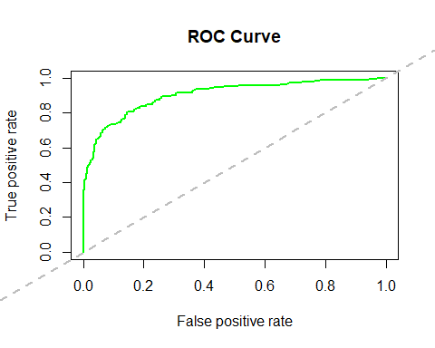
############ GINI Index ##############
#install.packages("ineq")
library(ineq)
gini = ineq(mydata.dev$prob, type="Gini") gini
## [1] 0.6970837
####################### Calculating AUC using ROC Curve and KS for the model
#install.packages("ROCR")
library(ROCR)
## Loading required package: gplots
##
## Attaching package: 'gplots'
## The following object is masked from 'package:stats':
##
## lowess
pred <- prediction(mydata.dev$prob, mydata.dev$Attrition) perf <- performance(pred, "tpr", "fpr")
plot(perf, col="green", lwd=2, main="ROC Curve")
abline(a=0,b=1,lwd=2,lty=2,col="gray")
KS <- max(attr(perf, 'y.values')[[1]]-attr(perf, 'x.values')[[1]])
auc <- performance(pred,"auc");

Slide 43
auc <- as.numeric(auc@y.values) KS
## [1] 0.6602289
auc
## [1] 0.9031273
################################# Validation of Model ####################
mylogit_val<-glm(formula = Attrition ~ Age + BusinessTravel + DailyRate + DistanceFromHome + EducationField + EnvironmentSatisfaction + HourlyRate + JobInvolvement + JobRole + JobSatisfaction + MaritalStatus + NumCompaniesWorked + OverTime +
RelationshipSatisfaction +
TotalWorkingYears + TrainingTimesLastYear + WorkLifeBalance
+ YearsInCurrentRole + YearsSinceLastPromotion + YearsWithCurrManager, family = "binomial", data = mydata.val)
summary(mylogit_val)
##
## Call:
## glm(formula = Attrition ~ Age + BusinessTravel + DailyRate +
##
##
##
DistanceFromHome + EducationField + EnvironmentSatisfaction + HourlyRate + JobInvolvement + JobRole + JobSatisfaction + MaritalStatus + NumCompaniesWorked + OverTime +
RelationshipSatisfaction +
##
##
##
##
TotalWorkingYears + TrainingTimesLastYear + WorkLifeBalance + YearsInCurrentRole + YearsSinceLastPromotion + YearsWithCurrManager, family = "binomial", data = mydata.val)
## Deviance Residuals:
## Min
1Q
-0.5631
Median
-0.2947
3Q
-0.1091
Max 3.4310
## -1.7073
##
## Coefficients:
##
## (Intercept)
## Age
## BusinessTravelTravel_Frequently
## BusinessTravelTravel_Rarely
## DailyRate
## DistanceFromHome
## EducationFieldLife Sciences
## EducationFieldMarketing
## EducationFieldMedical
## EducationFieldOther
## EducationFieldTechnical Degree
Estimate Std. Error z value Pr(>|z|)
1.7800175
-0.0429202
2.1469705
1.0127589
-0.0004258
0.0398932
-0.6681893
-1.0175762
-0.6716035
-0.8873554
-0.0796305
1.4175607
0.0161814
0.5173036
0.4814015
0.0002685
0.0129703
0.8361199
0.8920574
0.8348153
0.9270129
0.8654985
1.256 0.209228
-2.652 0.007991 **
4.150 3.32e-05 ***
2.104 0.035398 *
-1.586 0.112775
3.076 0.002100 **
-0.799 0.424201
-1.141 0.253992
-0.804 0.421112
-0.957 0.338456
-0.092 0.926694
## EnvironmentSatisfaction
-0.3765530
0.0949055
-3.968 7.26e-05 ***

Slide 44
## | HourlyRate | 0.0085370 | 0.0051910 | 1.645 | 0.100055
## | JobInvolvement | -0.6779247 | 0.1465299 | -4.627 | 3.72e-06 | ***
## | JobRoleHuman Resources | 1.3076342 | 0.6959378 | 1.879 | 0.060251 | .
## | JobRoleLaboratory Technician | 1.1972007 | 0.4854121 | 2.466 | 0.013649 | *
## | JobRoleManager | 0.2023290 | 0.6780061 | 0.298 | 0.765384
## | JobRoleManufacturing Director | -0.4510729 | 0.6204024 | -0.727 | 0.467186
## | JobRoleResearch Director | -0.8268305 | 1.1180834 | -0.740 | 0.459599
## | JobRoleResearch Scientist | 0.0063396 | 0.4996056 | 0.013 | 0.989876
## | JobRoleSales Executive | 0.9801374 | 0.4843731 | 2.024 | 0.043020 | *
## | JobRoleSales Representative | 1.5890190 | 0.5545879 | 2.865 | 0.004167 | **
## | JobSatisfaction | -0.3496697 | 0.0987598 | -3.541 | 0.000399 | ***
## | MaritalStatusMarried | 0.6597260 | 0.3103866 | 2.125 | 0.033545 | *
## | MaritalStatusSingle | 1.1519099 | 0.3265233 | 3.528 | 0.000419 | ***
## | NumCompaniesWorked | 0.1663526 | 0.0444759 | 3.740 | 0.000184 | ***
## | OverTimeYes | 1.9180420 | 0.2288099 | 8.383 | < 2e-16 | ***
## | RelationshipSatisfaction | -0.1243861 | 0.0970410 | -1.282 | 0.199917
## | TotalWorkingYears | -0.0106441 | 0.0279908 | -0.380 | 0.703743
## | TrainingTimesLastYear | -0.1452112 | 0.0831452 | -1.746 | 0.080728 | .
## | WorkLifeBalance | -0.2269257 | 0.1533728 | -1.480 | 0.138988
## | YearsInCurrentRole | -0.0849973 | 0.0511445 | -1.662 | 0.096532 | .
## | YearsSinceLastPromotion | 0.1413248 | 0.0478796 | 2.952 | 0.003161 | **
## | YearsWithCurrManager | -0.0897029 | 0.0500185 | -1.793 | 0.072910 | .
## | ---
## Signif. codes: 0 '***' 0.001 '**' 0.01 '*' 0.05 '.' 0.1 ' ' 1
##
## (Dispersion parameter for binomial family taken to be 1)
##
## Null deviance: 876.61 on 924 degrees of freedom
## Residual deviance: 617.13
## AIC: 685.13
##
on 891 degrees of freedom
## Number of Fisher Scoring iterations: 6
################
## Rank Ordering Test
## Calculating the probabilities and create deciles
mydata.val$prob <- predict(mylogit_val, mydata.val, type="response") mydata.val$deciles <- decile(mydata.val$prob)
##install.packages("data.table")
##install.packages("scales") library(data.table) library(scales)
tmp_DT = data.table(mydata.val) rank.val <- tmp_DT[, list(
cnt = length(Attrition),
cnt_resp = sum(Attrition),
cnt_non_resp = sum(Attrition == 0)) ,

Slide 45
by=deciles][order(-deciles)]
rank.val$rrate <- round (rank.val$cnt_resp / rank.val$cnt,3); rank.val$cum_resp <- cumsum(rank.val$cnt_resp) rank.val$cum_non_resp <- cumsum(rank.val$cnt_non_resp)
rank.val$cum_rel_resp <- round(rank.val$cum_resp / sum(rank.val$cnt_resp),3); rank.val$cum_rel_non_resp <- round(rank.val$cum_non_resp /
sum(rank.val$cnt_non_resp),3);
rank.val$ks <- percent(abs(rank.val$cum_rel_resp - rank.val$cum_rel_non_resp));
rank.val$rrate <- percent(rank.val$rrate)
rank.val$cum_rel_resp <- percent(rank.val$cum_rel_resp) rank.val$cum_rel_non_resp <- percent(rank.val$cum_rel_non_resp)
View(rank.val)
concordance_output.val = concordance(mydata.val$Attrition, mydata.val$prob) concordance_output.val
## $`Percent Concordance`
## [1] 84.74948
##
## $`Percent Discordance`
## [1] 15.25052
##
## $`Percent Tied`
## [1] 0
##
## $Pairs
## [1] 127176
############ GINI Index ##############
#install.packages("ineq")
library(ineq)
gini.val = ineq(mydata.val$prob, type="Gini") gini.val
## [1] 0.5859106
####################### Calculating AUC using ROC Curve and KS for the model
#install.packages("ROCR")
library(ROCR)
pred <- prediction(mydata.val$prob, mydata.val$Attrition) perf <- performance(pred, "tpr", "fpr")
plot(perf, col="green", lwd=2, main="ROC Curve")
abline(a=0,b=1,lwd=2,lty=2,col="gray")

Slide 46
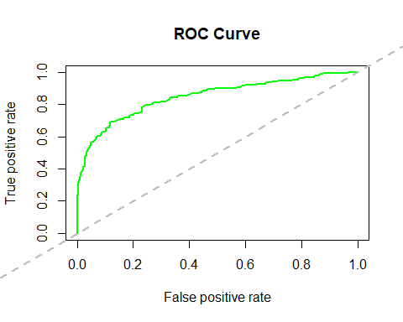
KS <- max(attr(perf, 'y.values')[[1]]-attr(perf, 'x.values')[[1]]) auc <- performance(pred,"auc");
auc <- as.numeric(auc@y.values) KS
## [1] 0.5729068
auc
## [1] 0.8474948
# df<-data.frame(mylogit$coefficients,mylogit_val$coefficients)
# summary(mylogit)
################## 11. Finally test the Rank Ordering on Hold-Out Sample
##########
## Scoring syntax
mydata.hold$prob <- predict(mylogit, mydata.hold, type="response") mydata.hold$deciles <- decile(mydata.hold$prob)
tmp_DT = data.table(mydata.hold) h_rank <- tmp_DT[, list(
cnt = length(Attrition),
cnt_resp = sum(Attrition), cnt_non_resp = sum(Attrition == 0)) , by=deciles][order(-deciles)]
h_rank$rrate <- round (h_rank$cnt_resp / h_rank$cnt,2);

Slide 47
h_rank$cum_resp <- cumsum(h_rank$cnt_resp) h_rank$cum_non_resp <- cumsum(h_rank$cnt_non_resp)
h_rank$cum_rel_resp <- round(h_rank$cum_resp / sum(h_rank$cnt_resp),2); h_rank$cum_rel_non_resp <- round(h_rank$cum_non_resp / sum(h_rank$cnt_non_resp),2);
h_rank$ks <- abs(h_rank$cum_rel_resp - h_rank$cum_rel_non_resp);
library(scales)
h_rank$rrate <- percent(h_rank$rrate) h_rank$cum_rel_resp <- percent(h_rank$cum_rel_resp)
h_rank$cum_rel_non_resp <- percent(h_rank$cum_rel_non_resp)
View(h_rank)

Slide 48
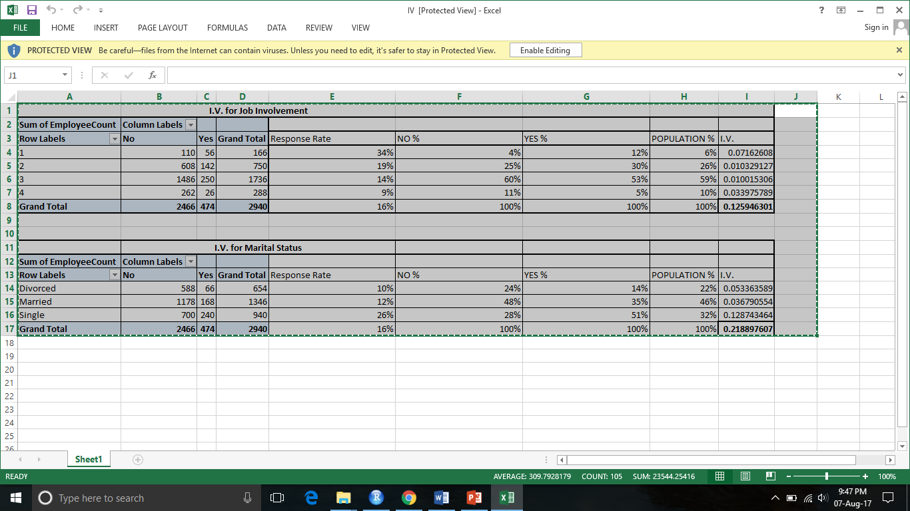
Compute IV for “JobInvolvement”, “MaritalStatus” in Excel

