Slide 1

Ansible
It is Simple Configuration Automation Tool

Slide 2
What is Configuration Installing packages on target machines
Nginx
Apache
Httpd
Database

Slide 3
How does Ansible works
Inventory file
In this file we mention host machine information, like target machine IP, user & private key to connect target machine.
Playbook
Playbook is list of tasks which we want to perform on host machine.

Slide 4
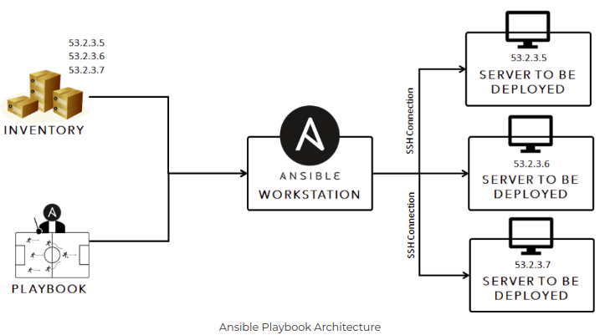
Let’s see architecture of Ansible

