Slide 1

B.Tech
BCSE497J – Project-I
PUMS: Lesion-Level Joint Conformal Risk Control with Lesion-Equalized Prediction Sets
A Post-hoc Framework that Guarantees Lesion-Level, Not Just Pixel-Level, Miss Rates in Medical Image Segmentation
Team members:
• Vansh Bhatiya (23BCE0631)
• Mahendra Sajjan Choudhary (23BCE0701)
Faculty guide :
Dr. Shashank Mouli Satapathy

Slide 2
Approval Mail From Guide
Fall Semester Project Review 3, Project ID <<enter Project ID>> – approval requested from the guide by mail before 21-10-2026:
Meeting with Guide Frequently: Satisfied / Not Satisfied
PowerPoint Presentation: Approved / Not Approved
Project Demonstration: Approved / Not Approved
Final Project Report: Satisfied / Not Satisfied
Project Outcome: Ongoing (research-paper draft in preparation)
Turnitin Plagiarism Percentage: ____ % (insert from the Turnitin report)
Turnitin AI Score: ____ (must be below 25%)
Approval status: to be confirmed by the faculty guide through the required email process. All items above are for the guide to mark.

Slide 3
Aim
To build a post-hoc, model-agnostic layer on top of PUMS that guarantees, with finite-sample rigour, that the average pixel miss rate, the lesion miss rate and the small-lesion miss rate of a medical segmentation model all stay below a chosen level α, without retraining the model and without inflating the prediction sets.
Why lesions, not pixels: big lesions carry most of the pixels, so a pixel guarantee can hold while small lesions are routinely missed. Clinically, the missed small lesion is often the error that matters.
Central idea:
  Posterior p̂ → score family → three risks (pixel, lesion, small lesion)
  → joint threshold λ̂ = max of per-risk CRC thresholds → guaranteed prediction set

Slide 4
Abstract
Conformal risk control (CRC) guarantees that a segmentation model's average pixel false-negative rate stays below α. Large lesions carry that guarantee and small lesions are not protected: on Kvasir-SEG, images with several lesions miss lesions at up to 1.56× the target rate.
This project defines lesion-miss and small-lesion-miss risks on ground-truth connected components and controls them jointly with pixel FNR. The joint guarantee costs at most 0.7% in set size, whereas Learn-Then-Test needs 10–46% larger sets and morphological prediction sets 1–43% larger sets. It also proposes lesion-equalized prediction sets, a new nested family.
A pre-registered evaluation (FracAtlas, Kvasir-SEG, six baselines, 3 seeds × 1000 splits, plus a simulation) found every guarantee valid. Lesion-equalized sets cut set size by up to 47% in simulation but only tied joint thresholding on real data, where the CPU backbone is weak. A research prototype, not a medical device.

Slide 5

Literature Review (1/2)
Paper | Objective | Methodology | Pros / Cons | Findings
Angelopoulos et al., ICLR 2024 Conformal Risk Control | Control the expected value of any monotone loss | Choose λ̂ on a calibration set so that (n·R̂ + 1)/(n + 1) ≤ α | + exact at finite n, model-agnostic – marginal only; needs exchangeability | Engine of this project; demonstrated on pixel FNR
Angelopoulos et al., 2021 Learn-Then-Test (arXiv 2110.01052) | Risk control for several risks with high probability | Multiple testing over a λ grid (fixed sequence, Hoeffding–Bentkus p-values) | + stronger high-probability guarantee – conservative, larger sets | Baseline: needs 10–46% larger sets in our tests
Tan et al., 2025 Conformal Lesion Segmentation (arXiv 2510.17897) | Guarantee for 3-D lesion segmentation | Calibrates voxel FNR per volume | + high-probability per volume – loss counts voxels; small lesions not treated | Called lesion-level but a missed small lesion costs only its voxel share
Luo & Zhou, 2025 CRA / CCRA / CCRA-S (arXiv 2504.07611) | Conditional pixel-FNR control | Per-stratum thresholds; strata = total predicted mass per image | + expectation per stratum – strata are images, not lesions | Baseline: −2% to +16% set size vs joint thresholding

Slide 6
Literature Review (2/2)
Paper | Objective | Methodology | Pros / Cons | Findings
Mossina & Friedrich, MICCAI 2025 Morphological prediction sets | Sets that contain the ground-truth mask | Dilate the predicted mask by a calibrated radius | + simple, high-probability – one risk; containment loss | Baseline: 1–43% larger sets at the same guarantee
ReCIRC, arXiv 2609.38112 (2026) | Per-image budget for pixel FNR | Rectified conformal risk control | + approximate conditional validity – pixel loss only | Orthogonal; can be combined with our family
Per-organ recall, arXiv 2608.18193 (2026) | Recall control per organ under shift | RCPS with Bonferroni over organs | + organ-wise guarantee – organs are not lesions | No component-level loss
FDR for instance segmentation, arXiv 2504.04482 | Control pixel FDR or FNR | CRC on one loss at a time | + expectation guarantee – one risk at a time | Not simultaneous, not lesion-level
Andéol et al., COPA 2023 Object detection with CRC | Confident object detection | Box-wise or pixel recall, one at a time | + nearest object-level loss – detection, not segmentation sets | Closest idea; not for segmentation

Slide 7
Research Gap
Pixel-level guarantees: CRC, CLS, CCRA-S, ReCIRC and per-organ recall state their risk on pixels or voxels, so large lesions dominate the average.
Measured gap: at the pixel-CRC threshold, images with ≥ 2 lesions miss lesions at 1.56× the target rate (Kvasir-SEG, α = 0.10).
Multi-risk tools (Learn-Then-Test) exist but give conservative, larger sets. Nobody controls ground-truth-lesion risk jointly with pixel FNR.
Set family: no work designs the prediction-set family for a lesion loss. Thresholding is forced down by the faintest lesion.
Claim (literature search of 14 Oct 2026) | Status | Why
1. Risk defined on ground-truth lesions, incl. small lesions | New, supported | No published segmentation risk control defines its loss on ground-truth components
2. Joint control of pixel, lesion and small-lesion risk | New, simple | A corollary of CRC (max of thresholds): a new formulation with a measured gap, not a deep theorem
3. Lesion-equalized prediction sets | New, not yet supported on real data | Wins in simulation (up to −47%), ties on both real datasets

Slide 8


Objectives
Define lesion-miss and small-lesion-miss risks on ground-truth components and prove they are CRC-valid under any nested set family.
Control them jointly with pixel FNR using a union (max) threshold, with no Bonferroni split.
Design lesion-equalized sets: a nested family that keeps the guarantee exact but needs smaller sets.
Measure the pixel-to-lesion gap and compare against six baselines under a pre-registered protocol.
Integrate the method into the PUMS API and dashboard with full provenance.
Identified SDGs: 3, 9, 4
Technology readiness: TRL 3 → 4
Outcomes:
Conference paper (LNCS / MICCAI format): draft complete, target MICCAI UNSURE workshop, not yet submitted.
Open reproducible code, pre-registration and live demo.

Slide 9
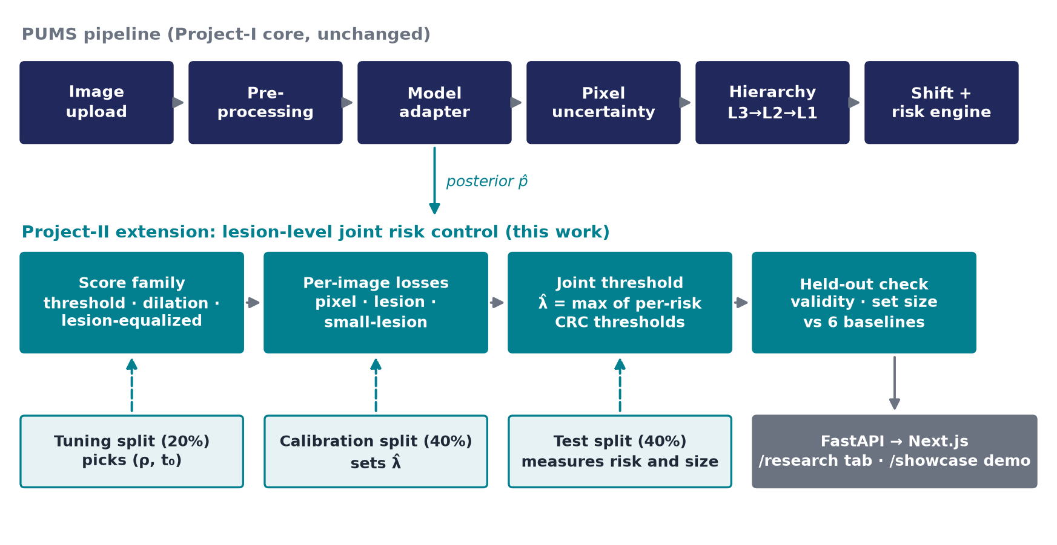
Framework / Architecture / Block Diagram
Top row: the Project-I PUMS pipeline, unchanged.
Teal row: the new layer. It consumes only the posterior p̂, so any segmenter can be swapped in.
Three disjoint splits: tune picks the score family, calibrate sets λ̂, test measures the result. This keeps the guarantee exact.
Output: results JSON → FastAPI → dashboard.

Slide 10
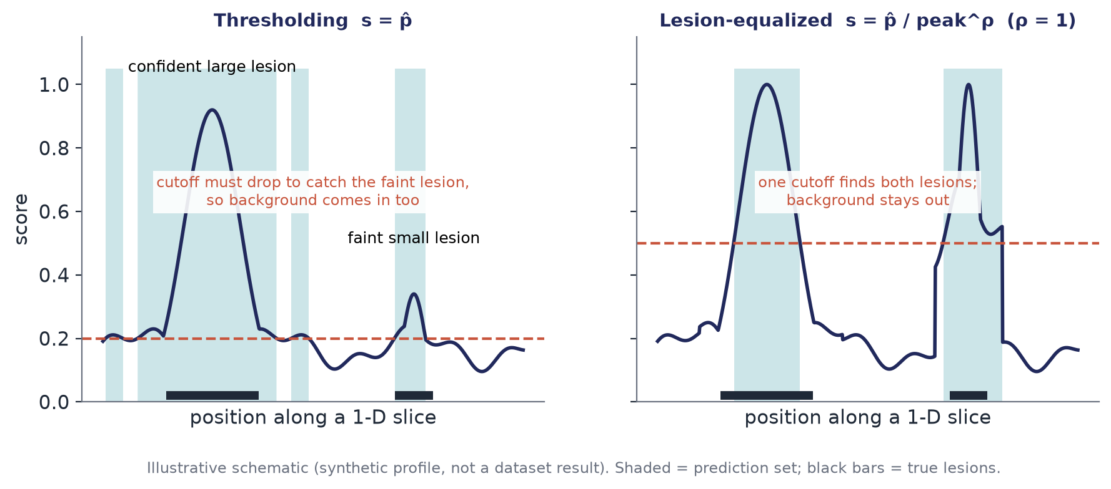
Proposed Method: Lesion-Equalized Sets
Three losses: pixel FNR, lesion miss (a lesion is found if ≥ 50% of it is inside the set), small-lesion miss (lesions below the 33rd size percentile).
Joint threshold: λ̂ = max over risks of each CRC threshold, so every risk is ≤ α in expectation at once.
Lesion-equalized score: inside each candidate component of {p̂ ≥ t₀}, s = p̂ / peak^ρ; ρ = 0 is plain thresholding.

Slide 11
Functional Requirements
Load images (PNG, JPEG, TIFF, DICOM) and the public datasets FracAtlas (COCO polygons) and Kvasir-SEG.
Produce out-of-fold posteriors by 5-fold cross-fitting, with a sha256 manifest.
Compute pixel, lesion-miss and small-lesion-miss losses per image (connected components, τ = 50%).
Select thresholds by CRC: union, max-form, Learn-Then-Test, morphological and CCRA-S strata.
Choose the score family (ρ, t₀) on a disjoint tuning split.
Report validity (mean test risk ≤ α) and set size for every method, with pre-registered verdicts.
Serve results at GET /api/research/mgcrc and show them in the Lesion-level CRC tab and /showcase demo.
Keep every Project-I function: uncertainty heat-map, calibration, shift warning, risk signal, provenance tags.

Slide 12
Modules
Module | File | Role
Families | backend/app/calibration/families.py | Threshold, dilation and lesion-equalized score transforms
Losses | backend/app/calibration/losses.py | Per-image grid counts for the three risks (one sort per image)
Selection rules | backend/app/calibration/joint.py | CRC, union, max-form, LTT, strata, family selection, evaluation
App method | backend/app/calibration/lesion_crc.py | lesion_aware_crc and morphological_conformal in the method registry
Data | backend/app/datasets/loaders.py | FracAtlas COCO-polygon loader (new)
Backbones | backend/scripts/experiments/train_backbone*.py | 5-fold cross-fitting: CPU random forest, U-Net, 3-D Task08 pipeline
Experiments | mgcrc.py, simulation.py, posthoc_multi.py | E1–E8, then aggregate.py for verdicts and paper_macros.py for paper numbers
API + UI | api/routes/research.py; frontend/app/research, /showcase | Results endpoint, Lesion-level CRC tab, live demo
Tests: 123 backend + 29 frontend, including loss monotonicity, a brute-force check of Lemma 2, a Monte-Carlo validity check and an API contract test. CI runs pytest, typecheck, lint and node tests.

Slide 13
Experiments and Results: Setup
Pre-registered before any result; two dated amendments (backbone change; simulation added, debug runs disclosed).
Backbone: random forest on a multiscale filter bank, 5-fold cross-fitting, so every posterior is out-of-fold.
Repetitions: 3 seeds × 1000 random splits (tune 20% / calibrate 40% / test 40%).
Baselines: pixel CRC, joint thresholding (reference), max-form, Learn-Then-Test, morphological, CCRA-S.
Metric: set-to-truth ratio Σ|S| / Σ|Y| at a threshold covering all three risks; validity = mean test risk ≤ α.
 | FracAtlas | Kvasir-SEG
Modality | X-ray | Colonoscopy
Images | 719 | 1000
≥ 2 lesions | 159 | 48
Small lesion | 234 | 312
Backbone Dice (out-of-fold) | 0.057 | 0.413
FracAtlas results describe a near-failing segmenter (Dice 0.057). Kvasir-SEG has few multi-lesion images and serves as a near single-lesion control.

Slide 14
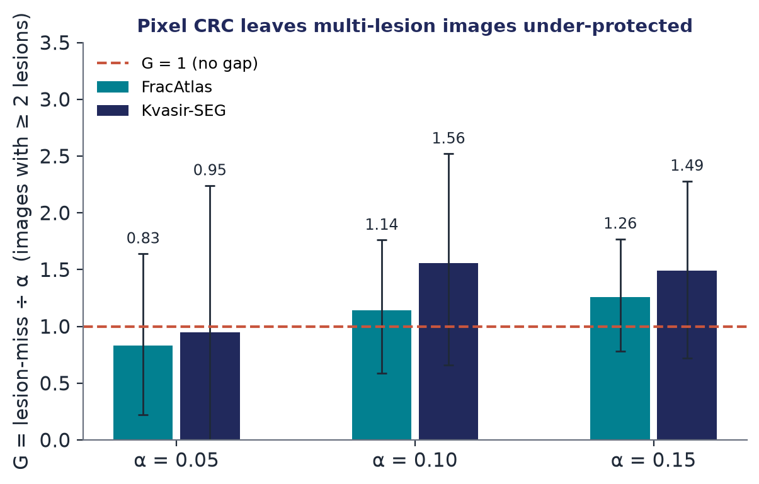
Experiments and Results: Validity and the Gap
Validity: every method met every guarantee it claims on held-out data, at every α, on both datasets.
H1 (gap), Kvasir-SEG: multi-lesion images miss lesions at 1.56α (α = 0.10). Verdict PROCEED.
FracAtlas: 1.14α, but the interval is wide (about 95 multi-lesion images per calibration split). Verdict INCONCLUSIVE.
Bars: G = lesion-miss ÷ α at the pixel-CRC threshold; error bars are 95% split intervals.

Slide 15
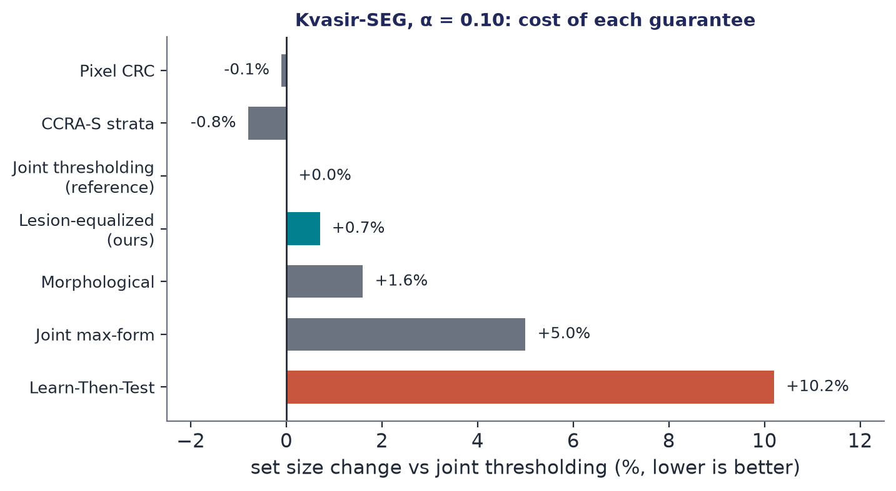
Experiments and Results: Cost of the Guarantee
Joint lesion control costs ≤ 0.7% set size over pixel-only CRC.
Learn-Then-Test needs +10–46%, morphological sets +1–43%, CCRA-S −2% to +16%. LTT's high-probability guarantee is stronger, so it is not like-for-like.
H2 FAILED: lesion-equalized sets tied joint thresholding (+0.3% to +3.6%). With the weak CPU backbone the pixel constraint binds, so there is nothing to save.

Slide 16
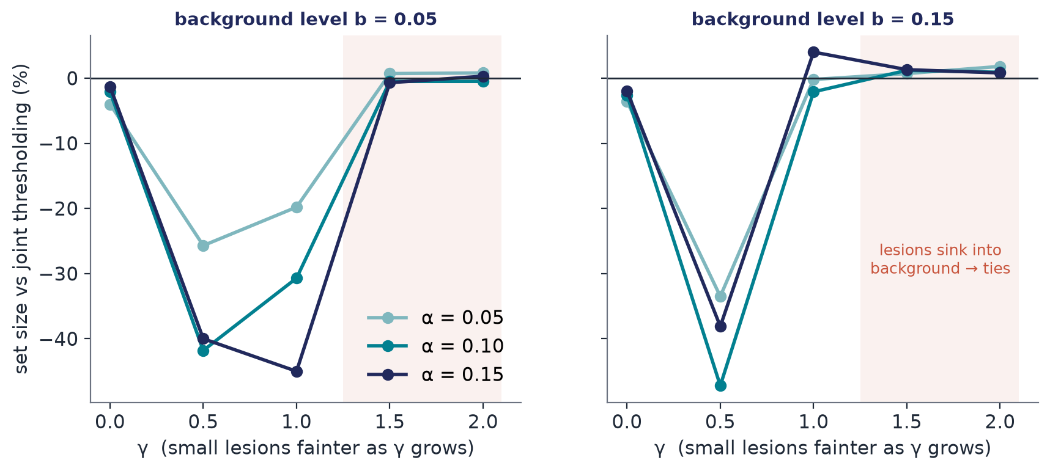
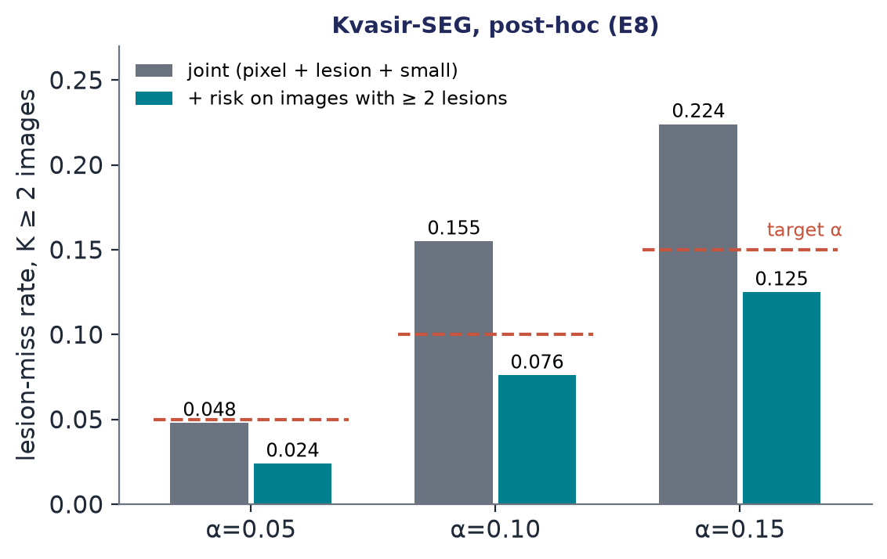
Experiments and Results: Simulation and Multi-lesion
Simulation (E7): up to −47% set size when small lesions are moderately faint (γ = 0.5–1); about 0 when they sink into background (γ ≥ 1.5). The pre-registered rule FAILED, but the mechanism is confirmed in its regime.
Post-hoc E8 (not pre-registered): adding a risk on images with ≥ 2 lesions roughly halves their miss rate on Kvasir (0.155 → 0.076 at α = 0.10) for 16–28% larger sets.

Slide 17
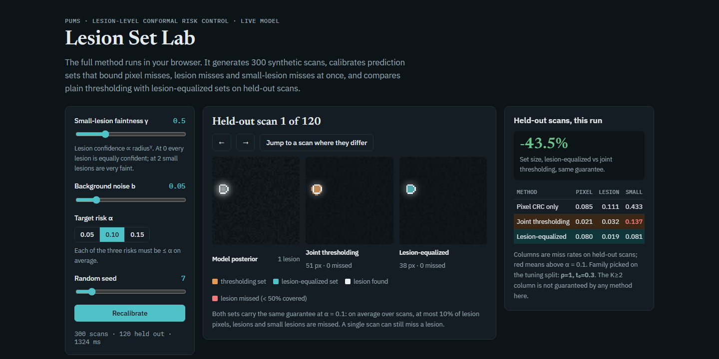
Project Demonstration
Lesion Set Lab (/showcase): the full method runs in the browser on 300 synthetic scans: calibrates three risks, then compares thresholding with lesion-equalized sets on held-out scans.
Live steps: move the faintness slider γ, press Recalibrate, then jump to a scan where the two methods differ.
Dashboard: /research → Lesion-level CRC tab: α selector, set-size chart, risk and gap tables, verdict badges.
Screenshot: Lesion Set Lab at γ = 0.5, α = 0.10 (−43.5% set size on this run).
Run it: open docs/showcase/lesion-set-lab.html, or run the frontend and go to /showcase.

Slide 18
Conclusion and Future Work
Conclusion
Pixel guarantees really do hide missed lesions: up to 1.56α in multi-lesion images.
Joint lesion-level control is cheap (≤ 0.7%) and beats Learn-Then-Test and morphological sets on set size. Every guarantee held.
Lesion-equalized sets: −47% in simulation, a tie on real data. This is stated openly.
Research prototype; no clinical claims.
Future Work
GPU U-Net / nnU-Net backbone and 3-D MSD Task08 multi-tumour data (both pipelines implemented, not yet run): the decisive test of H2.
Make the conditional multi-lesion risk a first-class option.
Weighted conformal to restore validity under the shift PUMS already detects.
Submit the paper (MICCAI UNSURE workshop).

Slide 19
Outcome Achieved
Patent: not filed.
International conference proceedings: paper draft complete (LNCS / MICCAI format); target MICCAI UNSURE workshop; not yet submitted.
Journal publication: none yet.
Start-up information: none.
Others: pre-registration, open reproducible code (one-command reproduce, CI), 123 + 29 tests, live demo.
Outcome achieved proof to be uploaded on or before 27 Oct 2026 in the given link https://forms.gle/B9B71VPy5b9bZ9dJ8

Slide 20
References
[1] A. N. Angelopoulos, S. Bates, A. Fisch, L. Lei and T. Schuster, “Conformal Risk Control,” in Proc. ICLR, 2024.
[2] A. N. Angelopoulos, S. Bates, E. J. Candès, M. I. Jordan and L. Lei, “Learn then Test: Calibrating Predictive Algorithms to Achieve Risk Control,” arXiv:2110.01052, 2021.
[3] S. Bates, A. Angelopoulos, L. Lei, J. Malik and M. Jordan, “Distribution-Free, Risk-Controlling Prediction Sets,” J. ACM, vol. 68, no. 6, 2021.
[4] B. Tan, Z. Wang et al., “Conformal Lesion Segmentation for 3D Medical Images,” arXiv:2510.17897, 2025.
[5] R. Luo and Z. Zhou, “Conditional Conformal Risk Adaptation,” arXiv:2504.07611, 2025.
[6] L. Mossina and C. Friedrich, “Conformal Prediction for Image Segmentation Using Morphological Prediction Sets,” in Proc. MICCAI, 2025.
[7] ReCIRC: Rectified Conformal Risk Control, arXiv:2609.38112, 2026. Per-organ recall risk control, arXiv:2608.18193, 2026. FDR in medical instance segmentation via CRC, arXiv:2504.04482, 2025.
[8] L. Andéol, T. Fel, F. de Grancey and L. Mossina, “Confident Object Detection via Conformal Prediction and Conformal Risk Control,” in Proc. COPA (PMLR 204), 2023.
[9] I. Abedeen et al., “FracAtlas: A Dataset for Fracture Classification, Localization and Segmentation of Musculoskeletal Radiographs,” Scientific Data, vol. 10, p. 521, 2023.
[10] D. Jha et al., “Kvasir-SEG: A Segmented Polyp Dataset,” in Proc. MMM, 2020.
[11] M. Antonelli et al., “The Medical Segmentation Decathlon,” Nature Communications, vol. 13, art. 4128, 2022.

