Slide 1

UberStudent

Slide 2

What is Uberstudent ?
UberStudent is a free and open-source computer operating system similar to other OS like Windows, Linux, Ubuntu, etc.
UberStudent is a Linux distribution for learning, doing, and teaching academic success
Uberstudent software is easy to use and its has full featured learning platform
Beside learning it comes with dozens of
amazing Linux games

Slide 3
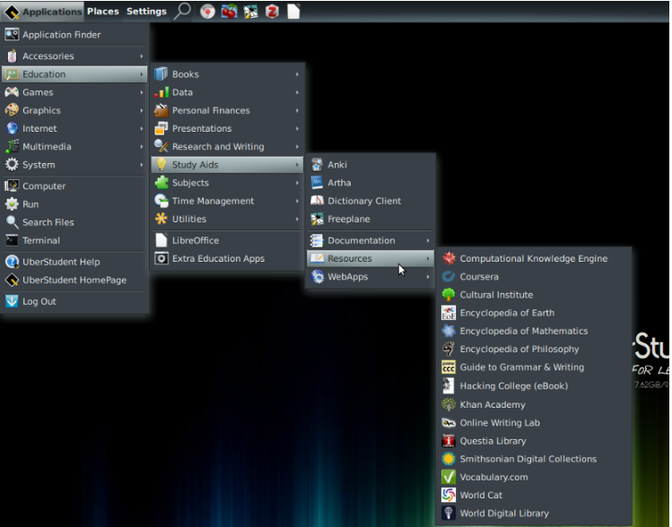
Education utilities
Academic writing and grammar
tutorials
Academic digital collections
resources
Several major academic
encyclopedia
WebApps (not Wikipedia)
WolframAlpha WebApps
Scientific calculator
An IDE
Google Sky WebApp
Universal unit conversion utility
GPA calculator
LibreOffice Present

Slide 4
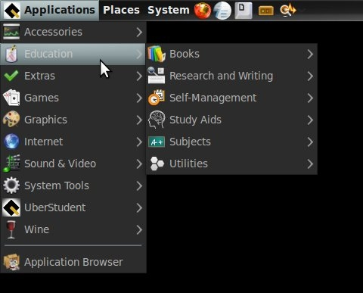
Intent behind making it open source
Its main aim was to increase the adoption of free and open source computing platforms within higher education and secondary school
UberStudent is for students those who wish to learn to excel at the tasks and habits of top students and researchers,

Slide 5
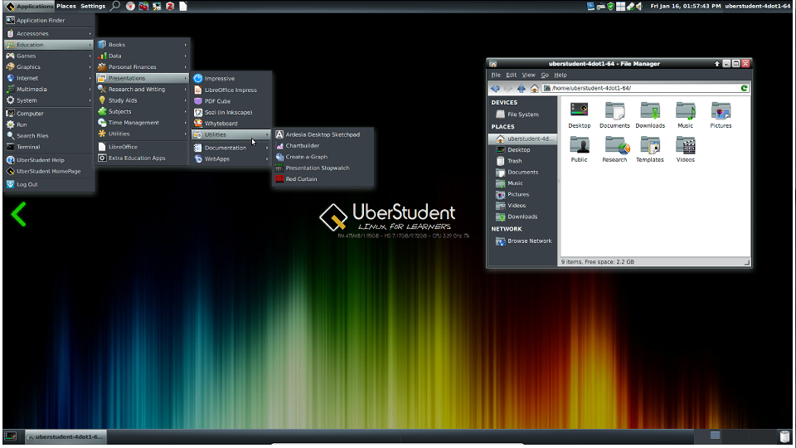
UberStudent's founder and lead developer is Stephen Ewen, a U.S.-based educator First Version 1.0 was released on 15 July 2010, was named as Cicero. 1.0

Slide 6
IMPACT UberStudent 1.0 Cicero, ranked the most popular Linux distribution for education After v4.1 release, it ranked as the fifth-most popular Linux distribution in the world

Slide 7


Licensing

Slide 8


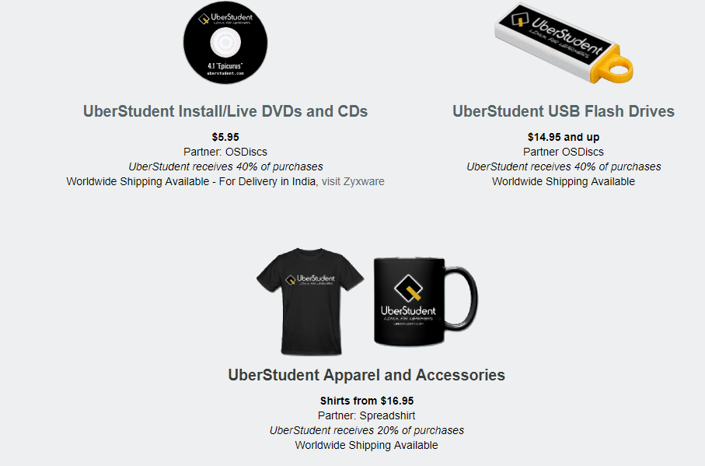
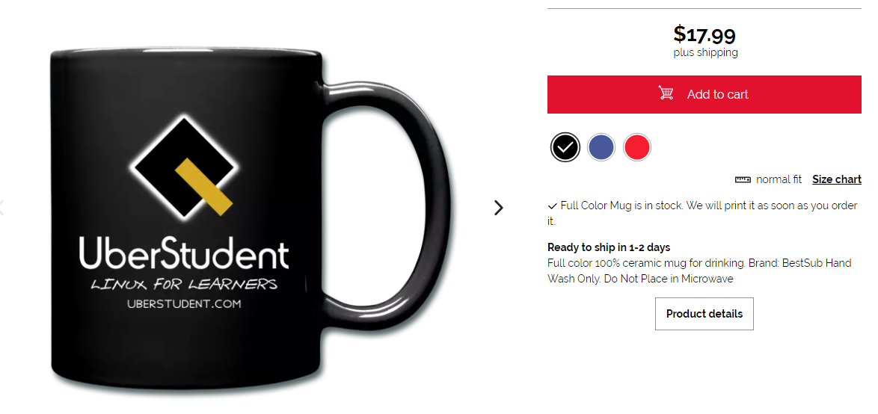
Monterizing Model

Slide 9
Thank You

