Slide 1
UDACITY · AI AGENTS WITH LANGGRAPH
HealthBot
✦ LangGraph State Workflow
✦ Tavily Real-Time Search
AI-Powered Patient Education System
✦ Adaptive Difficulty Levels
A LangGraph-based multi-node workflow that delivers
personalised health education, adaptive quizzes, and
intelligent topic suggestions — powered by OpenAI & Tavily.
✦ Multi-Question Quiz Engine
✦ Auto-Grading with Citations
✦ Related Topic Suggestions
Built on Python 3.12 · LangChain 0.2 · LangGraph 0.2 · OpenAI GPT-3.5

Slide 2
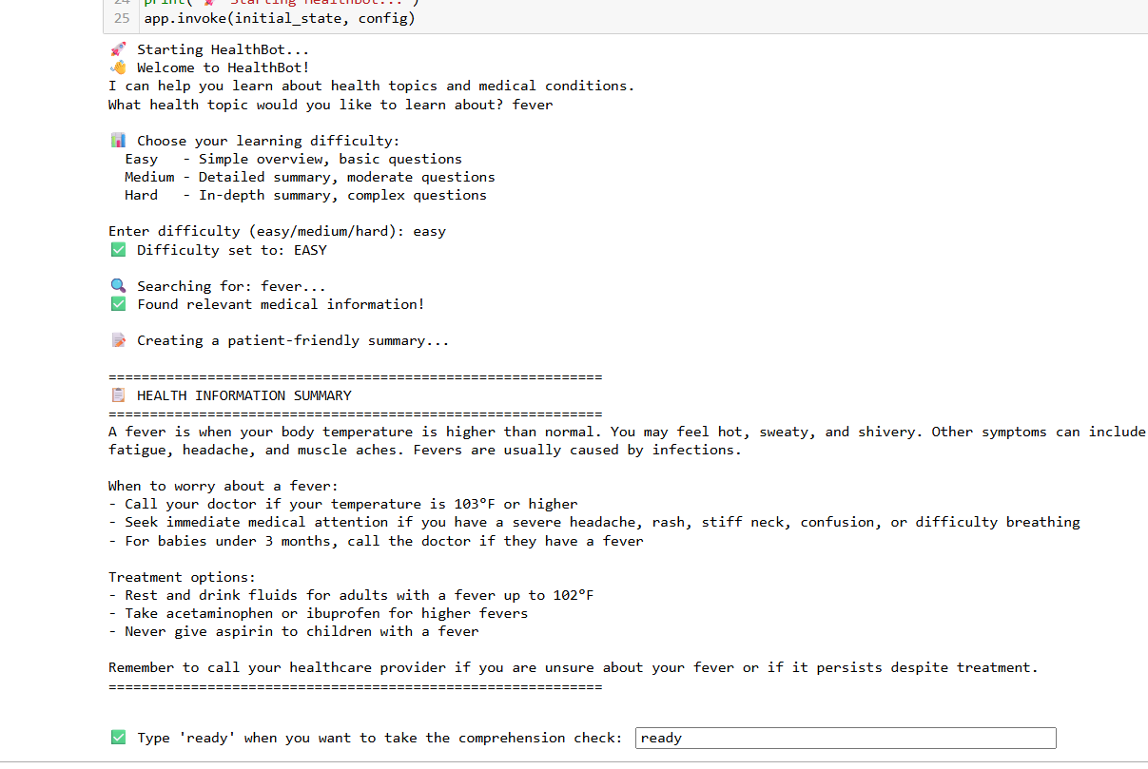
01
Workflow Nodes 1 – 4
Topic Selection, Difficulty Setting & Health Summary
KEY ACTIONS
User enters topic (Fever) → selects Easy difficulty → HealthBot searches Tavily for medical data → LLM generates a concise, patient-friendly summary.

Slide 3
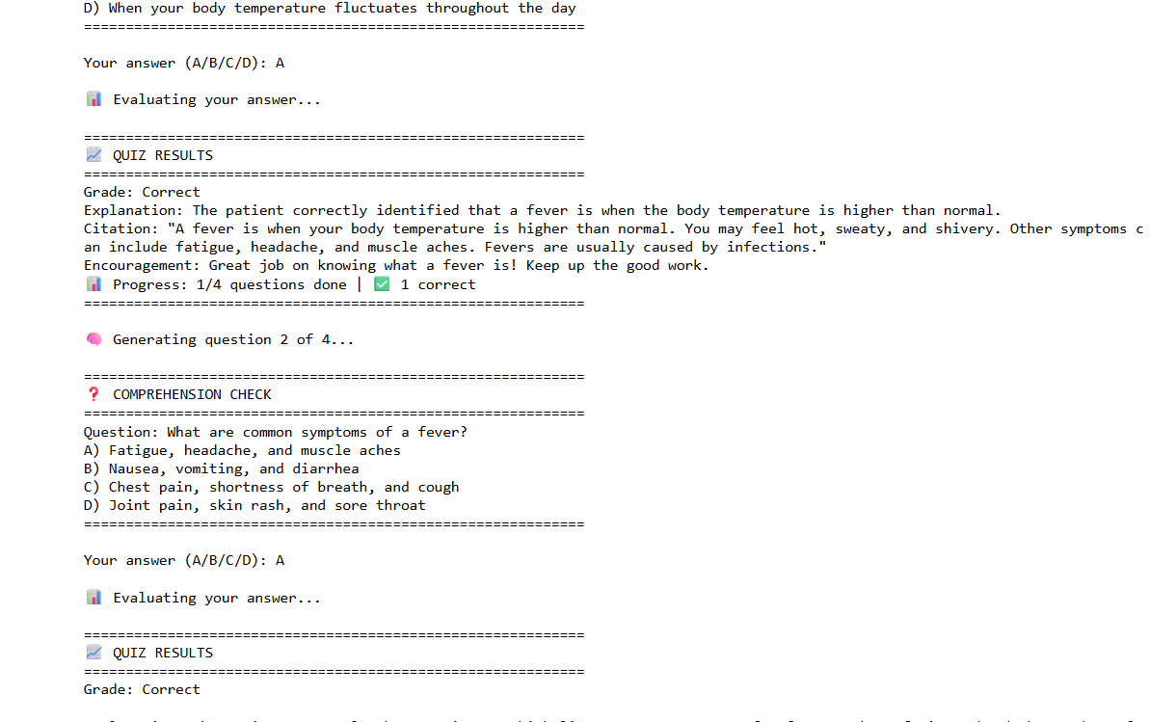
02
Workflow Nodes 5 – 9
Comprehension Quiz with Step-by-Step Grading
KEY ACTIONS
Patient confirms readiness → chooses number of questions (4) → each question targets a different topic aspect → LLM grades each answer with explanation and citation from the summary.

Slide 4
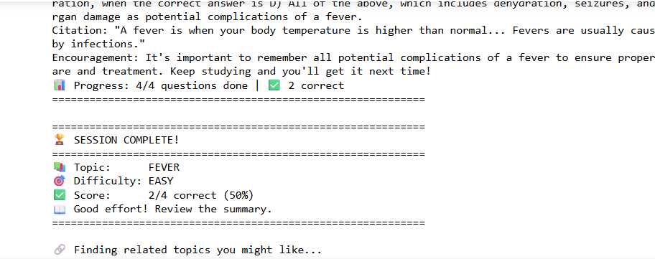
03
Workflow Node 10 – 11
Session Complete — Final Score & Performance Summary
KEY ACTIONS
After all questions are answered, the workflow displays the final score (2/4 correct, 50%), topic, difficulty level, and a personalised performance message before suggesting related topics.

Slide 5
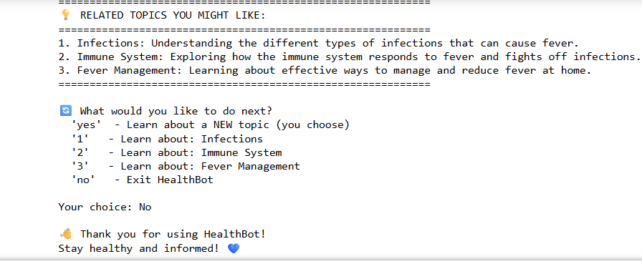
04
Workflow Node 12 — Stand-Out Feature
Related Topic Suggestions & Session Navigation
KEY ACTIONS
LLM generates 3 contextually related health topics. Patient can jump directly to a suggestion (1/2/3), choose a new topic (yes), or exit cleanly (no). State resets fully between sessions for privacy.

Slide 6
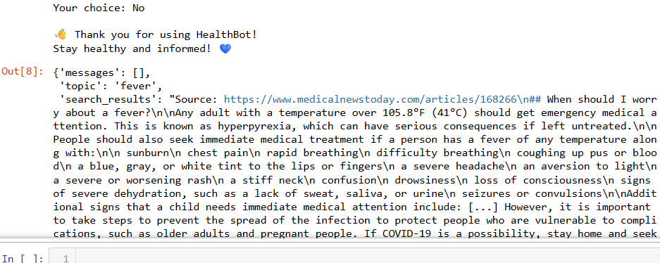
05
Technical Validation
LangGraph State Output — Full Workflow Execution Trace
KEY ACTIONS
Complete LangGraph state dictionary returned after session end. Confirms all state fields (topic, search_results, summary, quiz_questions, grade, etc.) are correctly populated and passed between nodes throughout the workflow.

Slide 7
LANGGRAPH WORKFLOW — NODE MAP
Complete 13-Node Workflow Architecture
1. Ask Topic
2. Difficulty
3. Tavily Search
4. Summarize
5. Present
6. Wait Ready
7. # Questions
8. Gen Quiz
9. Show Quiz
10. Get Answer
11. Grade
12. Show Grade
13. Suggest
⚙ Adaptive Difficulty
🔁 Multi-Question Loop
🏆 Final Score Card
💡 Related Suggestions
Easy / Medium / Hard level
adjusts summary & quiz depth
1–5 questions with loop-back
conditional edge in graph
Tracks correct answers;
displays % at session end
LLM suggests 3 next topics;
one-click topic switching
All 3 Udacity stand-out suggestions implemented · 13 LangGraph nodes · Full state management

