Slide 1
Comparative Study of DeepLabV3, U-Net and SegFormer for Semantic Segmentation in FoodSeg103
Mahendran Jinachandran
MSc Artificial Intelligence and Machine Learning
University of Limerick
August 2025

Slide 2
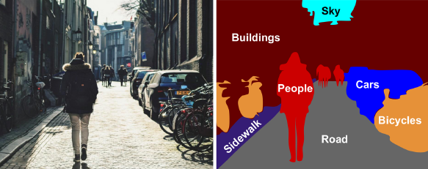
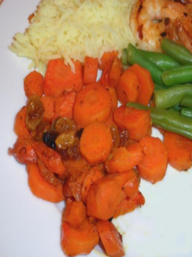
Introduction
What is semantic segmentation?
Importance of food segmentation in health and nutrition
Challenges: Overlapping food items, diverse appearances, class imbalance
Rise of deep learning in computer vision, especially semantic segmentation.

Slide 3
Research Questions
RQ1: Comparative Study of DeepLabV3, U-Net and SegFormer for Semantic Segmentation in FoodSeg103.
RQ2: Which of the following loss functions performs better – Cross Entropy, Focal, and Dice Loss separately or combinations thereof
RQ3: Does WarmupPolyLR improve training stability compared to standard decay schedules?

Slide 4

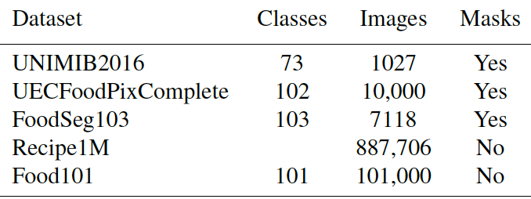
Background & Literature Review
Search Strategy - Searched using keywords like "Semantic Segmentation", "CNN for segmentation”. Used platforms like Google Scholar, ResearchGate, IEEE Xplore, Springer and Arxiv.
Started from basics of Machine Learning (ML) to semantic segmentation
Summarized 10+ relevant papers.
Identified gaps such as lack of domain-specific testing on FoodSeg103

Slide 5
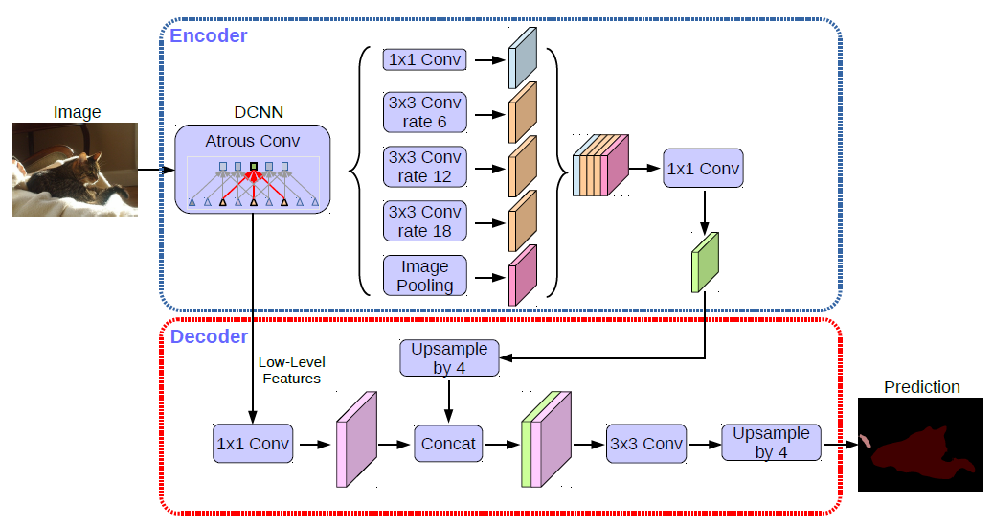
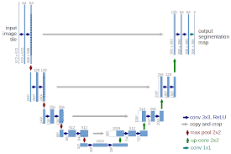
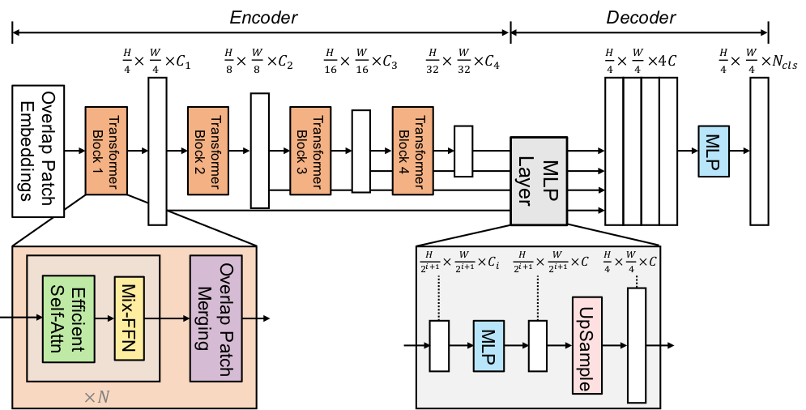
Background & Literature Review
DeepLabV3:
Atrous Spatial Pyramid Pooling (ASPP)
Capture different scales of objects
Final 1x1 convolution
U-Net:
Encoder and Decoder
Skip connections
SegFormer:
MiT (Mix Vision Transformer) Encoder
No fixed positional encoding, uses hierarchical
Multi Layer Perceptron Decoder
Each model has different architecture. Classic CNN vs Modern CNN vs Transformer
Dataset: FoodSeg103 with 104 food classes (103 + background).

Slide 6
Strategies Used
Losses used: CrossEntropy, Focal, Dice (individually and combination).
Learning Rate: WarmupPolyLR used for smooth training.
Freezing and unfreezing the encoder during training.

Slide 7
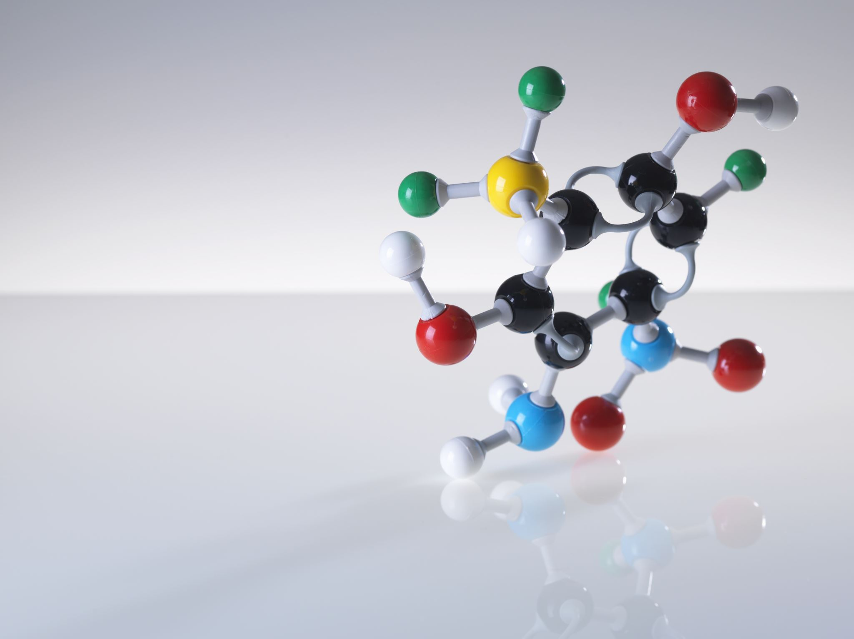
Empirical Studies
Scope of Experiments:
10 different experiments conducted
Explored loss functions (Cross Entropy, Focal, Dice, and combinations)
Tested learning rate schedules (WarmupPolyLR, standard decay)
Fine-tuning strategies (freezing/unfreezing encoder)
Generalization tested on Cityscapes dataset
Key Evaluation Metrics:
Pixel Accuracy (PA)
Mean Intersection over Union (mIoU)
Visual analysis of segmentation quality

Slide 8
Accuracy and mIoU Scores Across 10 Experiments
Experiment | DeepLab Accuracy | U-Net Accuracy | SegFormer Accuracy | DeepLab mIoU | U-Net mIoU | SegFormer mIoU
1 | 7.84 | 75.29 | 77.74 | 26.83 | 16.32 | 28.82
2 | 77.99 | 75.00 | 78.80 | 27.37 | 16.73 | 32.00
3 | 78.14 | 74.67 | 77.91 | 32.37 | 21.46 | 37.18
4 | - | - | 79.08 | - | - | 36.57
5 | - | - | 78.55 | - | - | 38.22
6 | - | - | 78.86 | - | - | 6.80
7 | 78.47 | 75.00 | 79.87 | 33.36 | 19.90 | 40.76
8 | 77.73 | 75.21 | 79.18 | 35.51 | 22.71 | 41.14
9 | 77.47 | 74.89 | 78.70 | 34.48 | 23.73 | 40.39
10 | - | 75.59 | - | - | 23.68 | -
Mean | 75.09 | 77.94 | 78.74 | 20.65 | 31.65 | 36.88
Median | 75.00 | 77.91 | 78.80 | 21.46 | 32.86 | 37.18
Std Dev | 0.30 | 0.35 | 0.65 | 3.12 | 3.69 | 4.13
SegFormer consistently outperformed other models with best mIoU of 41.14% with SegFormer in Exp 8 using Focal + Dice + Freezing / Unfreezing.
DeepLabV3 had strong accuracy but weaker mIoU than SegFormer. U-Net consistently had lower performance.
Pearson's Correlation: 0.89
Spearman's Correlation: 0.83
Mann-Whitney U Test: 0.016 (DeepLabV3 vs SegFormer)
t-test: p = 0.154 (DeepLabV3 vs SegFormer)

Slide 9
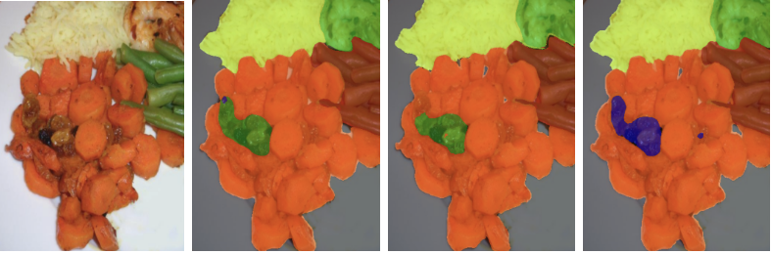
Sample Predictions from Models
Results of the best experiment (Exp 8) output
Original Image, DeepLabV3, U-Net and SegFormer predictions on FoodSeg103

Slide 10
Generalization on Cityscapes
Best configuration (Exp 8) evaluated on Cityscapes dataset.
SegFormer achieved 91.35% accuracy and 50.84 mIoU.
Performed better than DeepLabV3 and U-Net.
Proved SegFormer’s strength beyond food domain.

Slide 11
Discussion and Conclusion
SegFormer best suited for food segmentation tasks.
Advanced loss functions and WarmupPolyLR helped improve training.
Transformer-based models generalize well across domains.
Statistical tests validated the reliability of the results.

Slide 12
References
Sinha, Grant et al. (2023). “Transferring Knowledge for Food Image Segmentation using Transformers and Convolutions”. In: arXiv preprint arXiv:2306.09203. url: https://arxiv.org/abs/2306.09203 (cit. on pp. 1, 32, 33, 36, 53, 76).
Geron, AurÅLelien (2023). Hands-On Machine Learning with Scikit-Learn, Keras, and TensorFlow: Concepts, Tools, and Techniques to Build Intelligent Systems. 3rd. O’Reilly Media. isbn: 9781098125974 (cit. on pp. 8–10, 17, 19, 22).
Chen, Liang Chieh et al. (2018). “DeepLab: Semantic image segmentation with deep convolutional nets, atrous convolution, and fully connected CRFs”. In: IEEE transactions on pattern analysis and machine intelligence 40.4, pp. 834–848. url: https://arxiv.org/abs/1606.00915 (cit. on p. 24).
Xie, Enze et al. (2021). “SegFormer: Simple and efficient design for semantic segmentation with transformers”. In: Advances in Neural Information Processing Systems 34, pp. 12077–12090. url: https://arxiv.org/abs/2105.15203 (cit. on pp. 2–4, 24, 28, 42, 80).
(Full list on the dissertation)

Slide 13

Thank you!!
Q/A?

