Slide 1
VisTR
End-to-End Video Instance Segmentation with Transformers
Authors: Yuqing Wang , Zhaoliang Xu , Xinlong Wang, Chunhua Shen, Baoshan Cheng, Hao Shen, Huaxia Xia Meituan
Presented by: Sourav Karmakar, Mahendra Nandi

Slide 2
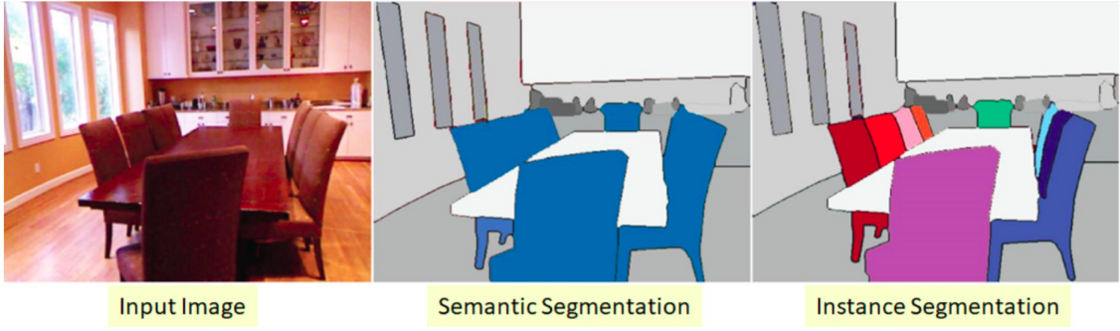
Segmentation
Two types:
Semantic Segmentation
Instance Segmentation

Slide 3


Input <<< Video clip consisting multiple image frames
Sequence of mask for each instance in order >>> Output
Input
Output
Video Clip
VisTR
Mask for each instance

Slide 4
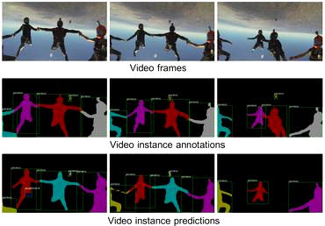
What is our target ?

Slide 5
Video Instance Segmentation
3 internal steps
Requires simultaneously classifying,segmenting and tracking
Instance segmentation is to learn the pixel-level similarity
And instance tracking is to learn the similarity between instances.
Thus, it will be brilliant to solve these two sub-tasks in a single framework and benefit each other
State-of-the-art methods typically develop sophisticated pipelines to tackle it.

Slide 6
Other VIS tasks and models
MaskTrack R-CNN extends the Mask R-CNN with a tracking branch and external memory that saves the features of instances across multiple frames.
Maskprop builds on the Hybrid Task Cascade Network and re-uses the predicted masks to crop the extracted features, then propagates them temporally to improve the segmentation and tracking.
STEm-Seg proposes to model video clips as 3D spacetime volumes and then separates object instances by clustering learned embeddings.
The above approaches either rely on complex heuristic rules to associate the instances or require multiple steps to generate and optimize the masks iteratively.
In contrast, they aimed to build a simple and end-to-end trainable VIS framework.

Slide 7
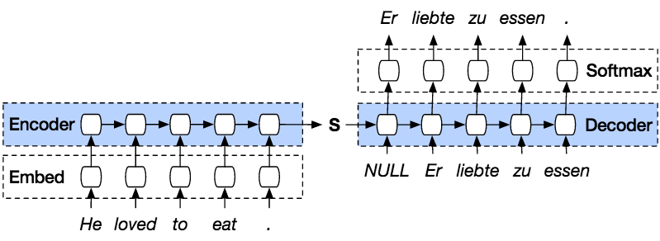
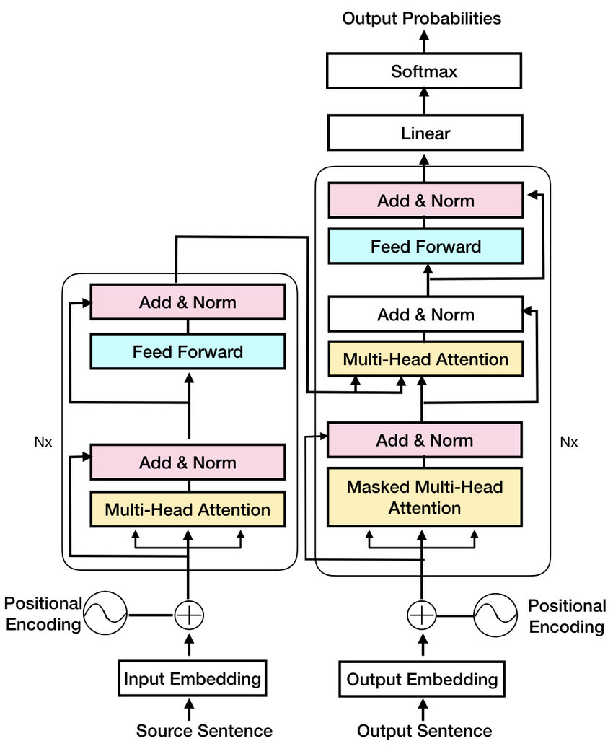
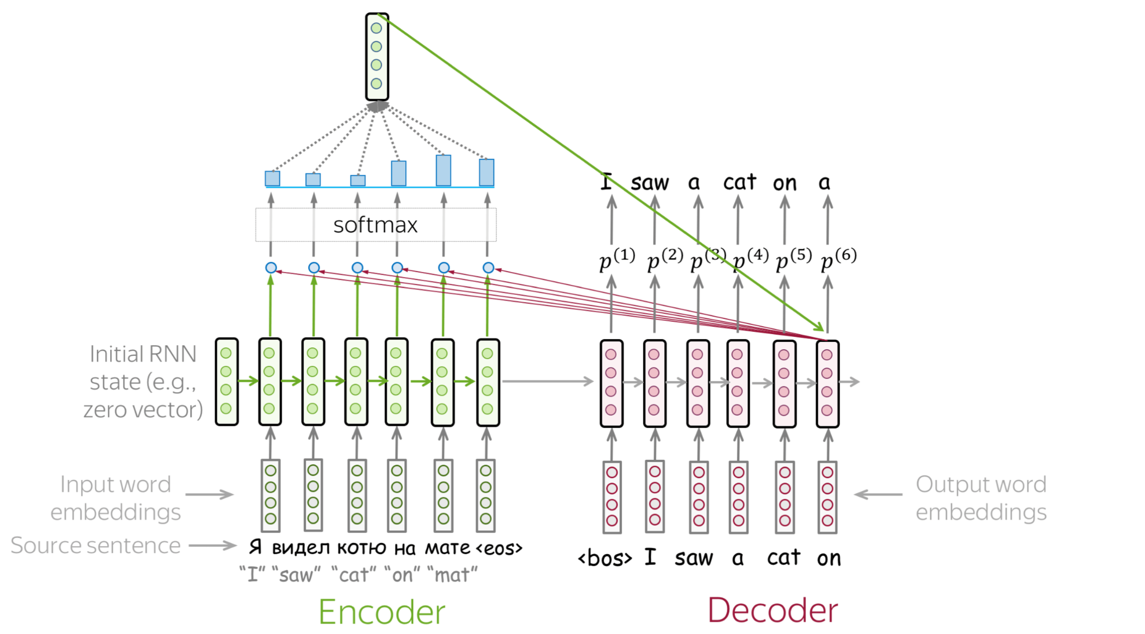
Transformer .. [ A little history ]
RNN based transformer with encoder decoder
Simple RNN based seq2seq model or encoder decoder architecture
Seq2seq model with attention layer

Slide 8
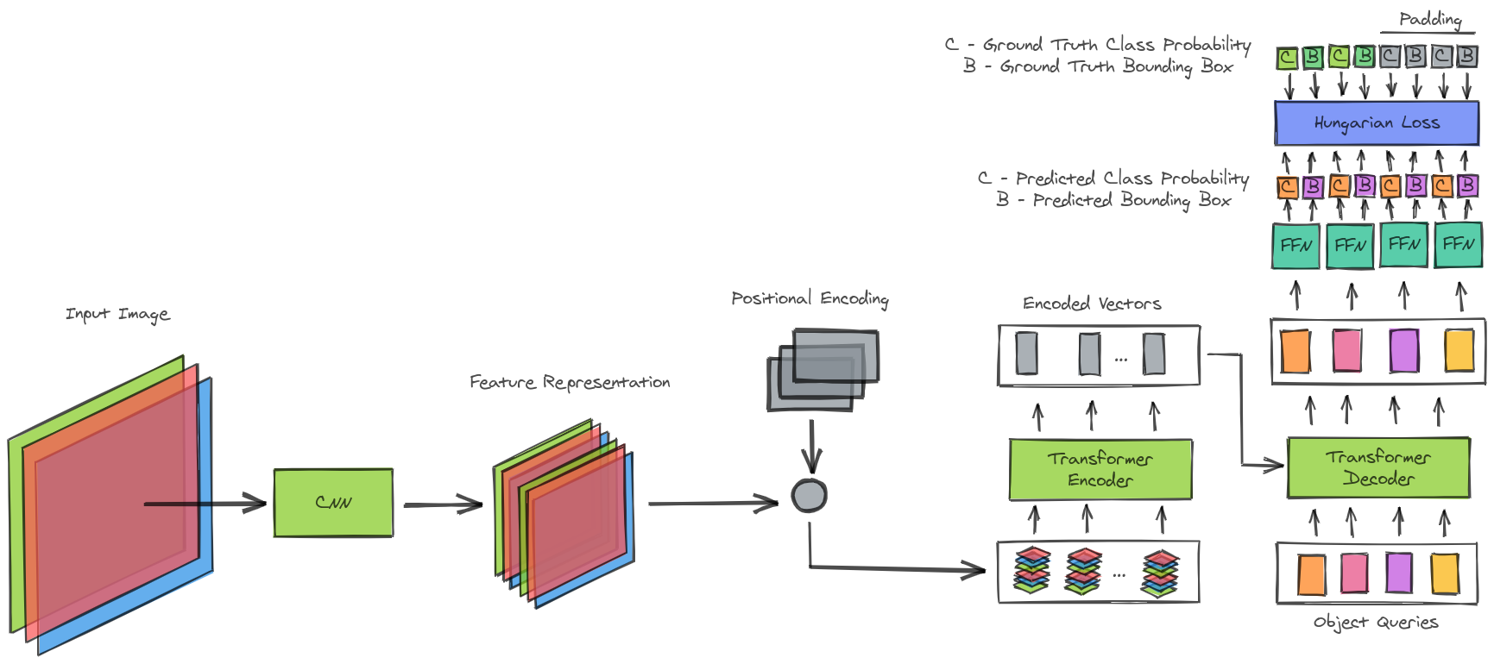
DETR (1st application of transformer in CV)

Slide 9
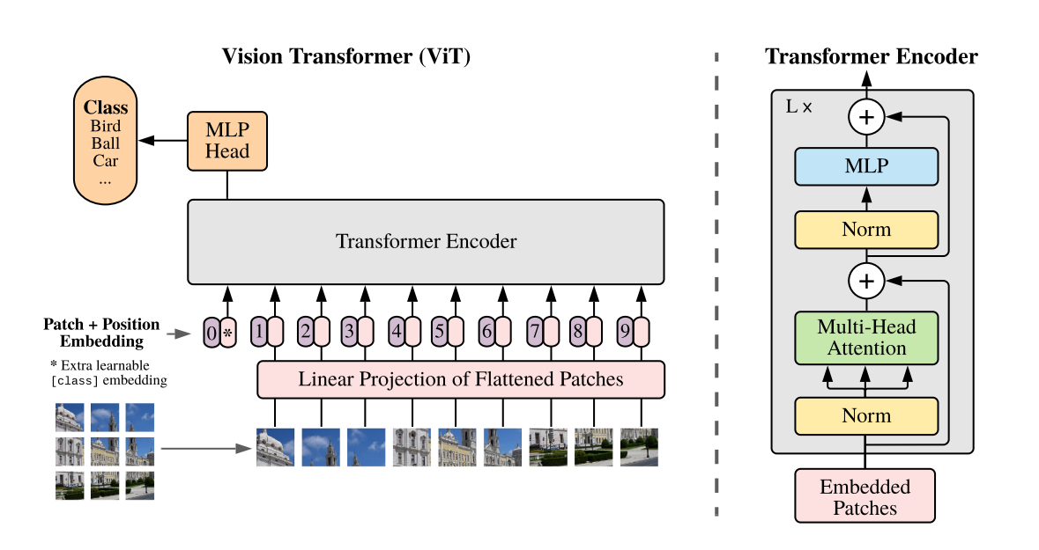
ViT ( Vision Transformer )
[ another application of transformer ]
ViT introduces the Transformer to image recognition
It models an image as a sequence of patches,
which attains excellent results compared to
stateof-the-art convolutional networks

Slide 10
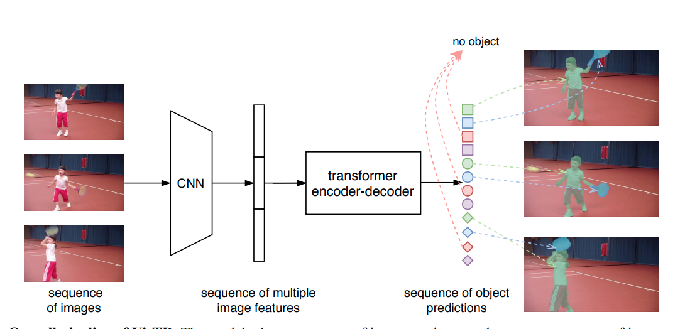
How does VisTR work ?

Slide 11
The two main challenges
1) How to maintain the order of outputs
2) How to obtain the mask sequence for each instance out of the Transformer network
Instance sequence matching strategy
Instance sequence segmentation module.

Slide 12
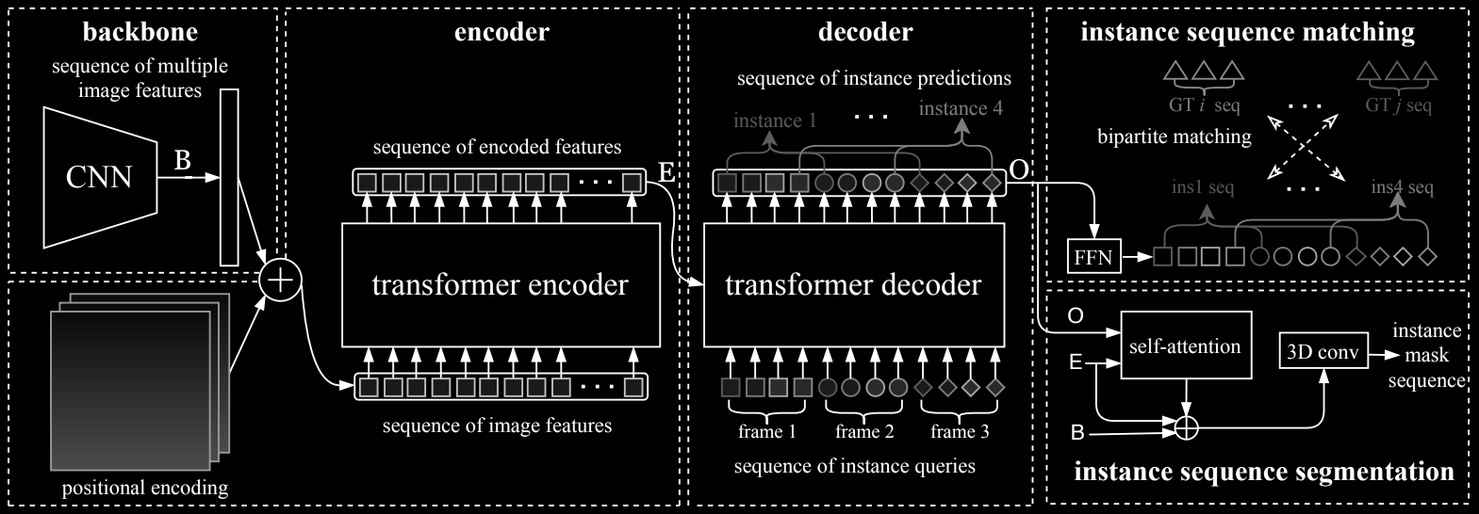
VisTR Architecture
It contains four main components:
A CNN backbone to extract compact feature representations of multiple frames
An encoder-decoder Transformer to model the similarity of pixel-level and instance-level features
An instance sequence matching module for supervising the model
And an instance sequence segmentation module

Slide 13
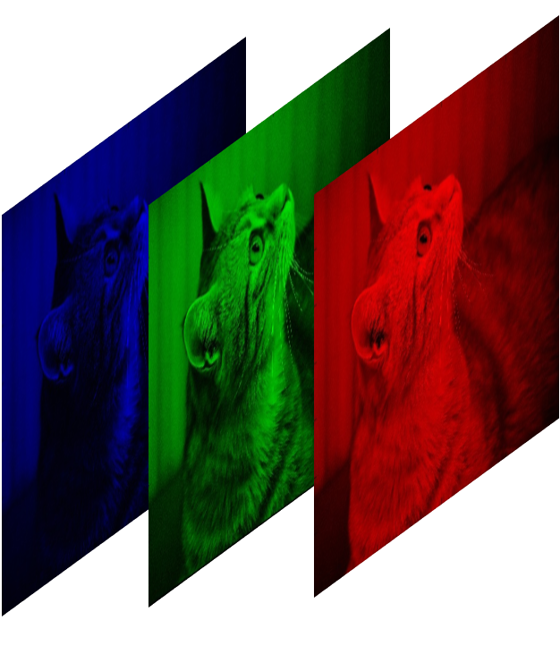
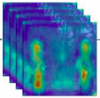
CNN backbone
Video Clip
Feature maps for each frame
}
CNN
T * 3 * H。* W。
T * C * H* W

Slide 14
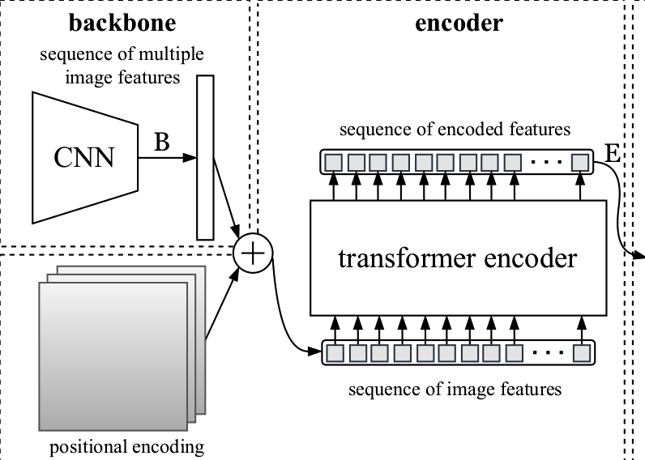
Transformer encoder
1*1 convolution applied to the feature map
Dimension reduces from T x C x H x W to
T x d x H x W
Flattening temporal and spatial dimensions with initial temporal order
Resulting 2D feature map of size d x (T*H*W)
Each encoder layer has a multi-head self-attention module and a fully connected feed forward network which is brain of the network.

Slide 15
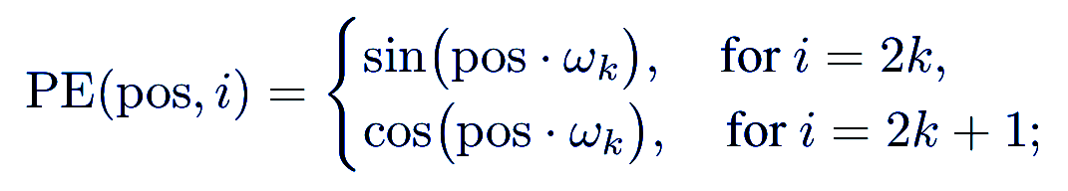
Transformer architecture is permutation invariant
Segmentation task requires positional information
Temporal and Spatial Encoding
Solution to this is we supplement the features with fixed positional encodings information that contains the three dimensional(temporal,horizontal and vertical) positional information.
Here we adapt positional encoding for our 3D case.
For the coordinates of each dimension we independently use d/3 sine and cosine functions with different frequencies:
where w_{k}=1/10000^{2k/(d/3)} and pos is the position in the corresponding dimension.
The positional encodings of the three dimensions should be concatenated to form the final d channel positional encoding.
These encodings are added to the input of each attention layer.

Slide 16
Why Transformers?
Video frames contain richer information than single images [ motion patterns and temporal consistency of instances ] offering useful cues for instance segmentation, and classification.
At the same time, the better learned instance features can help tracking of instances
Transformers are capable of modeling long-range dependencies, and thus can be naturally applied to video for learning temporal information across multiple frames.
The core mechanism of Transformers, self-attention, is designed to learn and update the features based on all pairwise similarities between them. The above characteristics of Transformers make them great candidates for the VIS task.

Slide 17
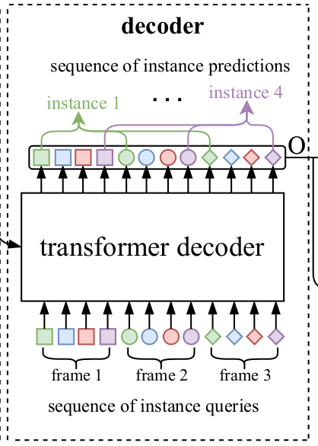
Decoder
Decodes the top pixel features that can represent the instances of each frame, which is called instance level feature.
There are fixed number of input embeddings to query the instance features from pixel features, termed as instance queries.
Suppose that model decodes n instances each frame, then for T frames the instance query number is N= n.T
The instance queries are learned by the model and have the same dimension with the pixel features.
Taking the output of encoder E and N instance queries Q as input, the transformer decoder outputs N instance features, denoted by O.
The overall predictions follow the input frame order, the order of instance predictions for different images is the same.
Thus tracking of instances in different frames could be realized by linking the items of the corresponding indices directly.

Slide 18
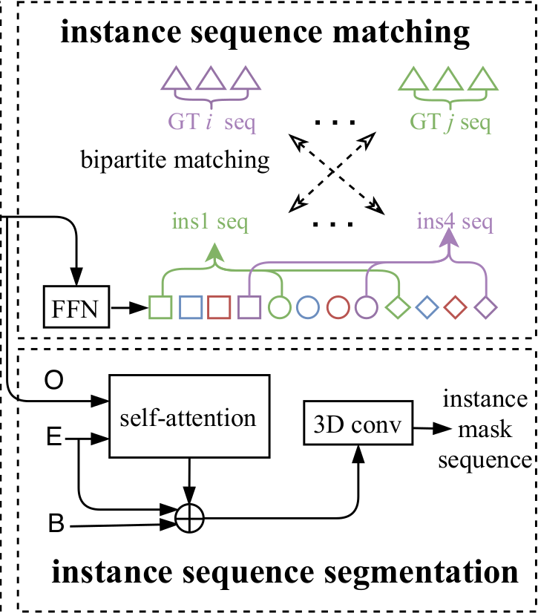
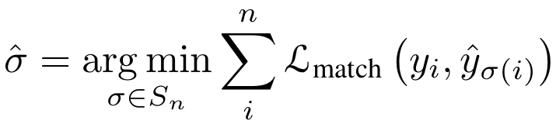
Instance Sequence Matching
The number of instance sequence is same as decode instances each frame i.e., n.
Assuming n is larger than the number of instances in the video clip, we consider the ground truth also a set of size n padded with 0.
In order to find a bipartite graph matching between the two sets we search for a permutation of n elements with lowest cost:
This optimal assignment could be computed efficiently by the Hungarian algorithm.
To obtain the box predictions, authors applied a 3-layer feed forward(FFN) network with ReLu activation function and a linear projection layer to the object predictions O of Transformer decoder.
Authors also add a “background” class to represent that no object is detected and the linear layer predicts the class label using a softmax function.

Slide 19
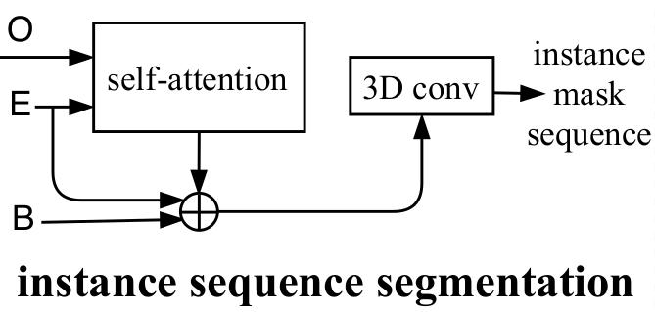
Instance Sequence Segmentation
This module aims to predict the mask sequence for each instance
The mask features are obtained by computing the similarity map between the object predictions O and the Transformer encoded features E.
To simplify the calculation, we only compute with the features of its corresponding frame for each object prediction.
For each frame, the object predictions O and the corresponding encoded feature maps E are fed into the self-attention module to obtain the initial attention maps.
Then the attention map will be fused with initial backbone features B and he tanformed encoded features E of the corresponding frames, following similar practice with the DETR.
The last layer of the fusion is a deformable convolution layer.

Slide 20
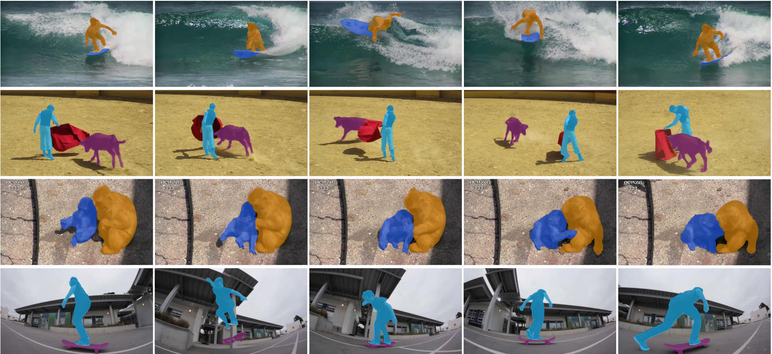
Some Results

Slide 21
Ablation study
Length | AP | AP50 | AP75 | AR1 | AR10
18 | 29.7 | 50.4 | 31.1 | 29.5 | 34.4
24 | 30.5 | 47.8 | 33.0 | 29.5 | 34.4
30 | 31.7 | 53.2 | 32.8 | 31.3 | 36.0
36 | 33.3 | 53.4 | 35.1 | 33.1 | 38.5
 | AP | AP50 | AP75 | AR1 | AR10
w/o | 28.4 | 50.1 | 29.5 | 29.6 | 33.3
w | 33.3 | 53.4 | 35.1 | 33.1 | 38.5
Position encoding: Position encoding brings about 5% AP gains to VisTR
Video sequence length:
The performance improves as the sequence length increases.
 | AP | AP50 | AP75 | AR1 | AR10
w/o | 33.3 | 53.4 | 35.1 | 33.1 | 38.5
w | 34.4 | 55.7 | 36.5 | 33.5 | 38.9
Instance sequence segmentation module: The module with 3D convolutions brings 1.1% AP gains.

Slide 22
Thank You

