Slide 1
DATA VISUALISATION
PROJECT ON
BOOK REVIEW DATASET
BY: ASIF IKBAL & MAHENDRA NANDI

Slide 2

Visualizing Book Review Dataset
The dataset consists 13 columns. Our primary goal is to visualize all the dependencies among them and finding out the key factors for a good review of the books. A good review in the sense that it may have a higher average rating, higher number of reviews.

Slide 3
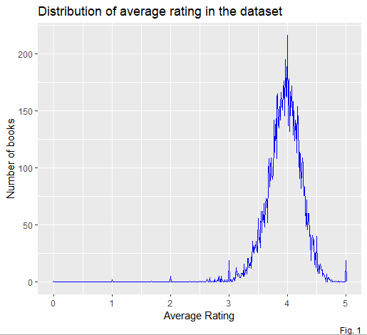
Dependencies:
(1) Distribution of average rating
•
From the distribution of the average rating in Fig. 1 it is clear that almost all the books
have been rated in the range 3.5-
4.5 . Out of almost 11000 books 22 books is rated as ‘’5’’.

Slide 4

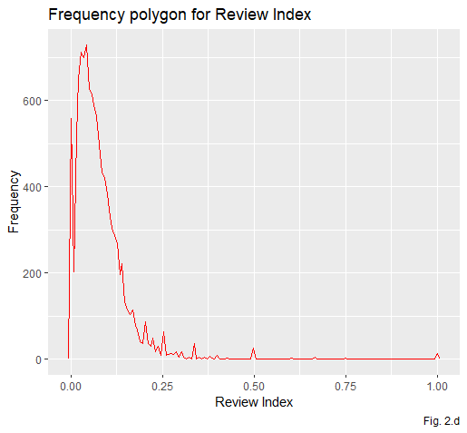
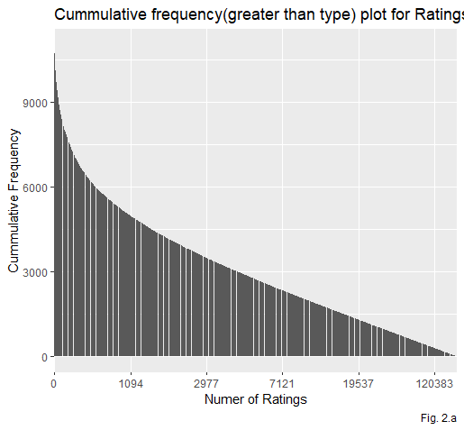
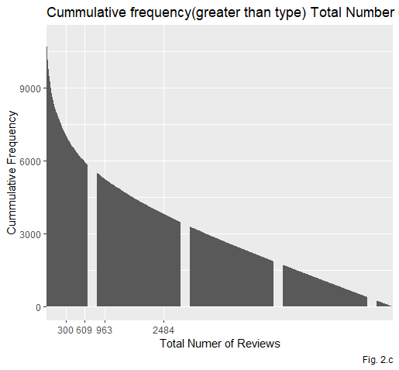
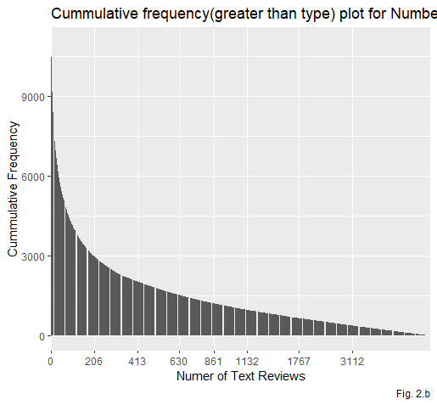
(2)Dependencies between different review parameters and average ratings
We can see that maximum books got reviews less than 20000 . Fig. 2.a,2.b,2.c and 2.d shows the distribution.

Slide 5
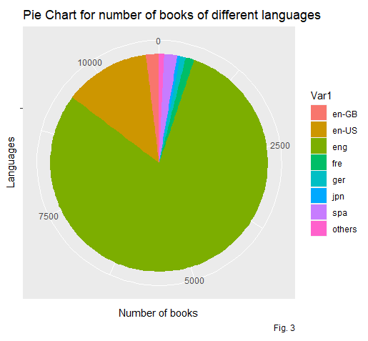
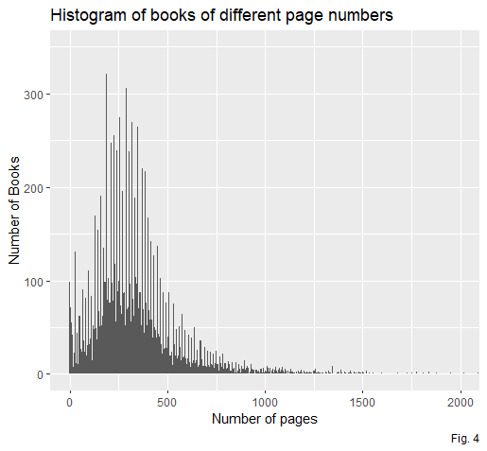
(3.) Number of books in different
.(4) Number of books in different
page ranges
Pages of maximum books(around 60%) are in
the range of 200-400
la.nguages
Here maximum books are written in “eng” language . 80% book is written in “eng” 13% in “en-US” and the remaining 7% is in other language.

Slide 6
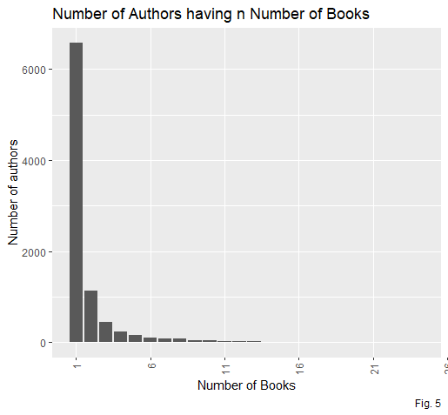
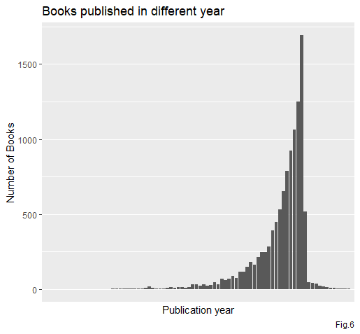
.• (6) Books published in a different
(5) Number of authors having exact number of books
There are more than 6000 authors who wrote only one book . And 1000 authors wrote two books . The number of authors who wrote more than 5 books is very low.
.
years
It is seen that in every year no of published books is increased largely . But after 2016 it suddenly goes down.
.

Slide 7
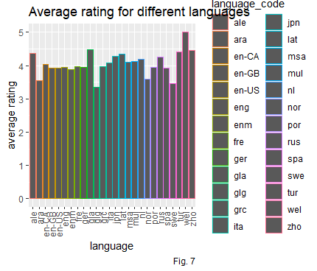
.
.
• ..
(7)Dependency between Average
rating and different languages
Though the number of books written in “eng”
is much greater than other languages ,
• a.verage rating of books written in 'eng' is ~3.9
. Whereas very few books are written
in “wel” but the average rating is 5 .

Slide 8
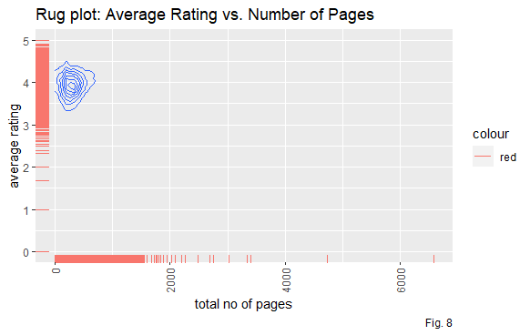
..
.
• .
(8) Relation between Average
Rating and Number of pages
We can find here that rating is almost varies as the num of pages of the book . Book with no of pages 2600-2700 is of high rated . Though there are few books in this range , It actually ensures that if a book is interesting to the readers, total number pages of book does not matter.

Slide 9

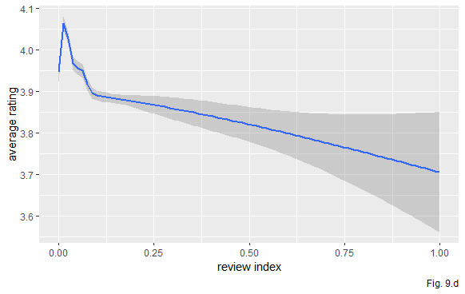
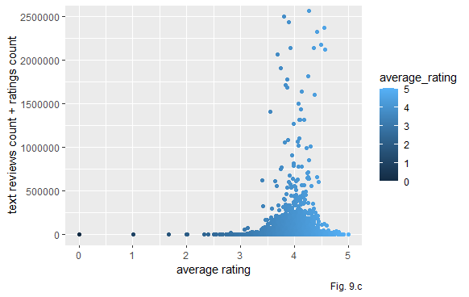
 | .(9)Dependencies of |  | As we earlier saw that there are very few books with very high number of reviews . The books with very high reviews also fall under the rating range 3.5-4.5 . So, we can say maximum people, who gives a review ,
 |  | the various review parameters with | responds to a book with an average rating of 3.5-4.5 ,unless they get a good satisfaction with the book or become totally hopeless .Which is intuitively acceptable.

Slide 10
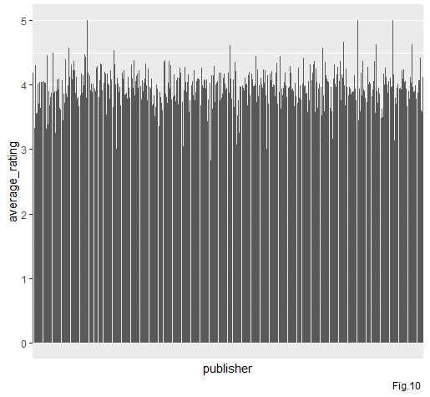
(10) How average rating is differed for different publishers
There are 2290 publishers published the books . Out of 2290 publishers 47 publishers got average rating greater than 4.5 , 2190 got in the range [3.5,4.5] , and the remaining 134 publishers got rating less than 3.5.
10

Slide 11
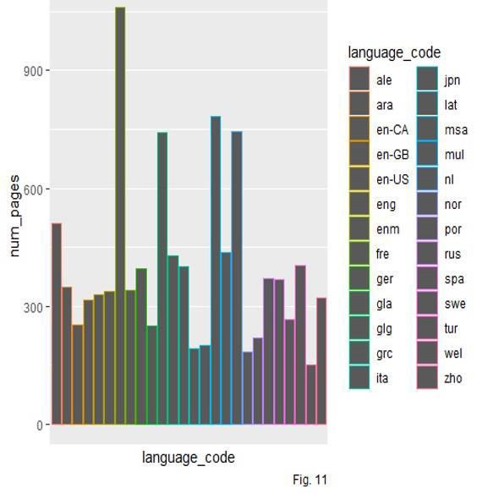
(11) Average number of pages for different languages
Among the languages, the most used language is ‘eng ’ . And we can see that books with “eng” language have 300 pages in average . Whereas books written in “enm” has maximum no of average
pages (around 1100 ) . But it is also a point to note that books of most average-
rated language “wel” are of total average pages 150 ( which is minimum among the used languages )

Slide 12
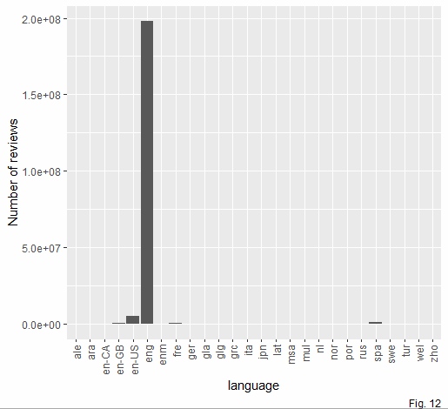
(12) Number of reviews for different languages
As the most used language to write a book is “eng”, it has highest total reviews . But also it has a
highest number of reviews which is far more from others . So we can
conclude that most of the people who read books of ‘eng’ language used to give reviews after reading it .

Slide 13

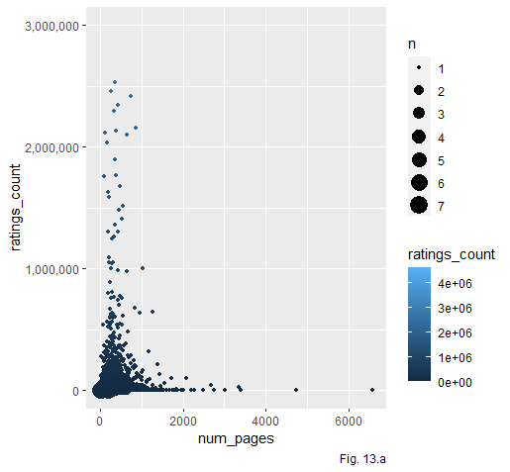
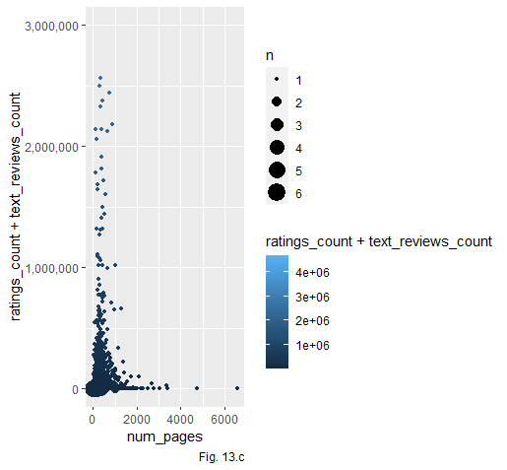
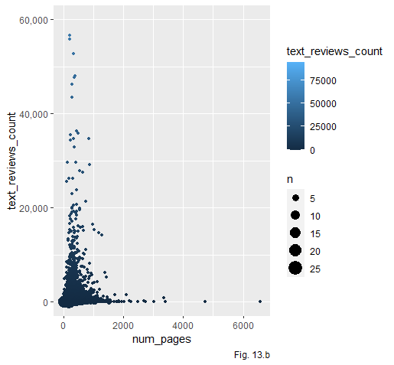
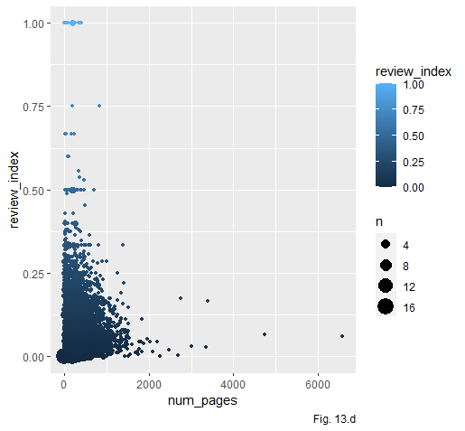
 |  | (13) Dependency between Number of pages and Review parameters
 | Books are reviewed most for the books having pages less than 1000. Number of reviews for books having more number of pages are very low.

Slide 14

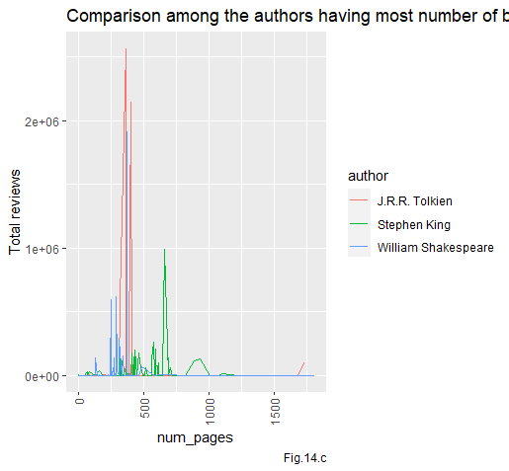
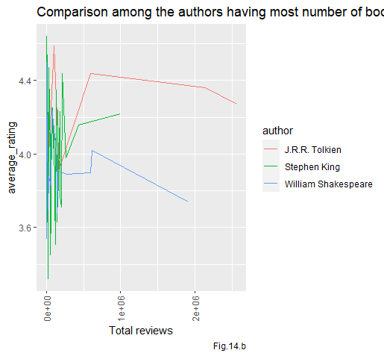
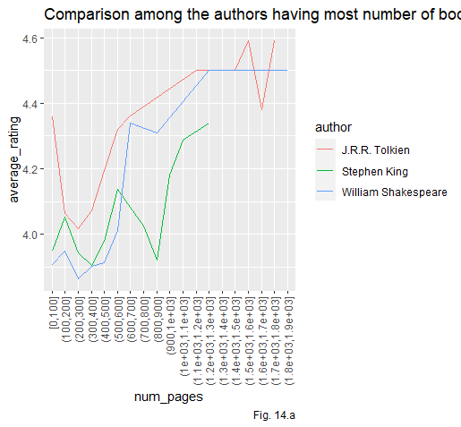
(14) Comparison between top three
authors having most number of books
Initially averae rating decreases fore more number of pages ,but later on it increases for all 3 author.
For low number of reviews all the authors has a mixed average rating. But when total number of reviews increases, average rating decreased for J.R.R. Tolkein and William Shakespeare but increases for Stephan King.
All three author has more reviews in pages between 250 to 750.

Slide 15
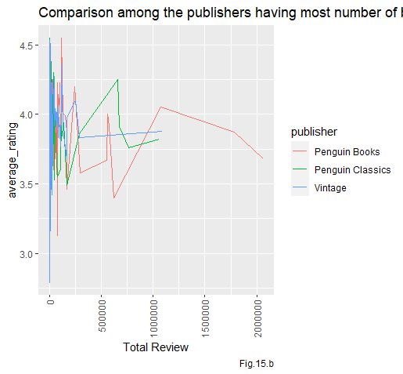
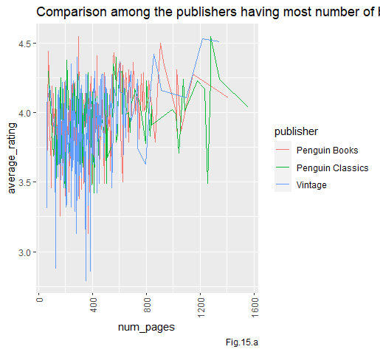
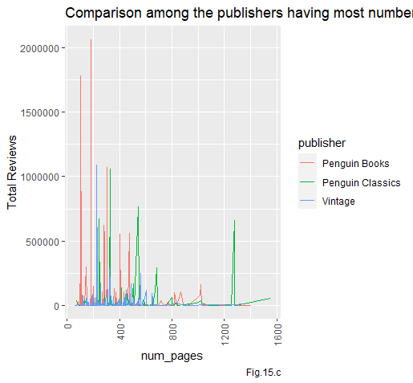



(15) Comparison between top three publishers
For higher number of reviews, average ratings
are below 4 for these publishers
Average rating has not such pattern for
different number of pages
For hiher number of paes , total reviews
decreases for all publishers

Slide 16

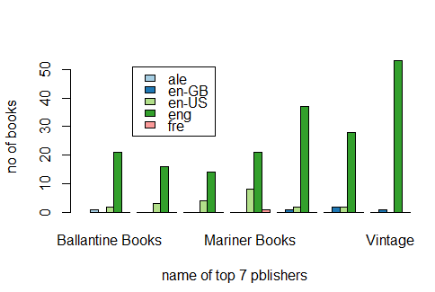
(16) Books published by top publishers in different languages

Slide 17
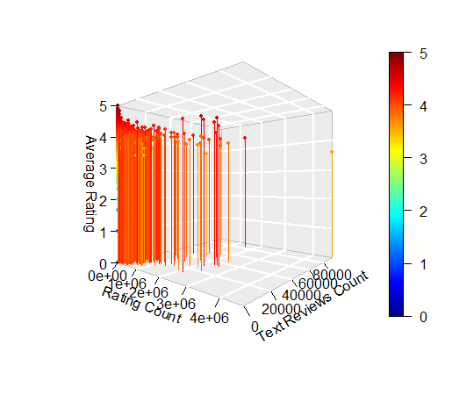
Average Rating for
different Rating count
and Text reviews count
Average ratings are mostly between 4 and 4.5
Less number of points for large values of Ratings count and text review count

Slide 18

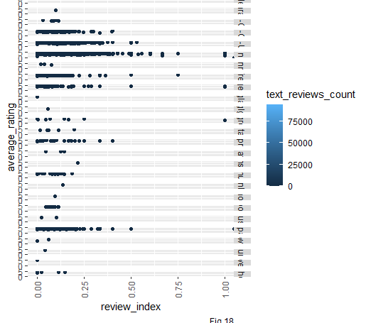
Dependencies of review index and average rating for different languages and text review count
Review index mostly lie between 0-0.25 for most of the languages. For few, it goes above 0.5.

Slide 19
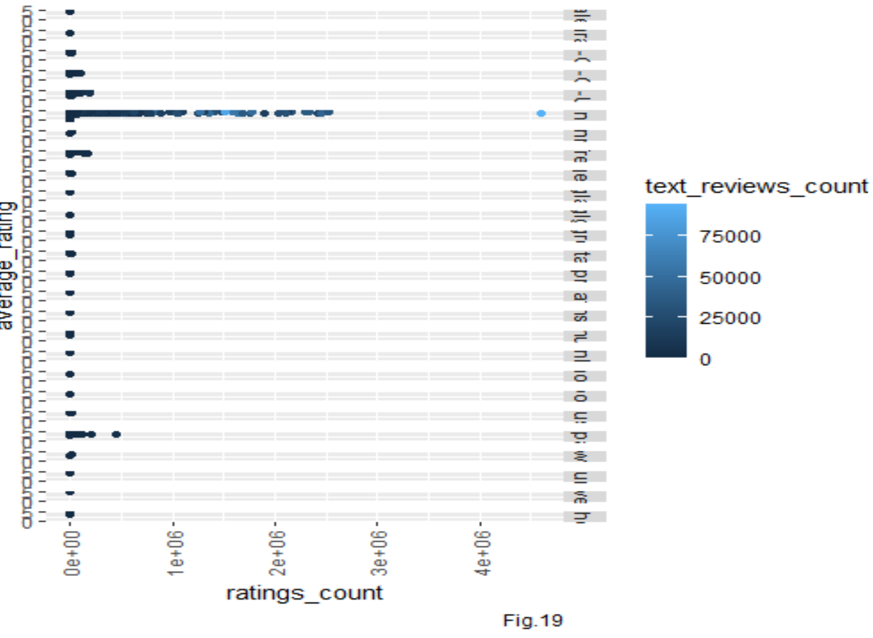
Dependencies of ratings count and average rating for different languages and text review count

Slide 20
Conclusion
Number of reviews are mostly for the books written in english. Probably because of the reader of the language are more than others.Also most books in the dataset are written in this language.
Good average ratings are for the books having page ranges 250-750
Review index ( ratio between text reviews and ratings count) are mostly below 0.25. So only a quarter of the reviewer gives a text review.
For higher review index, average rating
decreases.
20

Slide 21
Appendix-1
R codes
#Visualizing different factors for having a good review of books
#
#
###
library(ggplot2)
library(dplyr)
#Read data from file
books<-read.csv("C:\\Users\\kabir\\OneDrive\\Desktop\\pds_visualization\\books.csv") books<-na.omit(books)
#datatype conversion
books$language_code<-as.factor(books$language_code)
books$average_rating<-as.numeric(books$average_rating) books$num_pages<-as.integer(books$num_pages)

Slide 22
books$ratings_count<-as.integer(books$ratings_count)
books$text_reviews_count<-as.integer(books$text_reviews_count)
#Adding derived column
books<-cbind(books,review_index=books$text_reviews_count/books$ratings_count)
books<-na.omit(books)
#(1) average rating vs. number of books of that rating
ggplot(books, aes(average_rating)) + geom_freqpoly(binwidth=0.01,color = "blue")+
labs( x = "Average Rating", y = "Number of books",title ="Distribution of average rating in the dataset",caption = "Fig. 1" )
#(2) Number of reviews
#(a) ratings_count distribution
ratingcount.df<-data.frame(table(books$ratings_count))
names(ratingcount.df)<-c("ratings_count","cum_freq") ratingcount.df$cum_freq<-rev(cumsum(rev(ratingcount.df$cum_freq))) ggplot(ratingcount.df, aes(x=ratings_count, y=cum_freq)) + geom_col()+
labs(x="Numer of Ratings",y="Cummulative Frequency",title="Cummulative frequency(greater than type) plot for Ratings count",caption="Fig. 2.a")+
scale_x_discrete(breaks = levels(ratingcount.df$ratings_count)[c(T,rep(F,999))])

Slide 23
#(b) text reviews distribution
treviewcount.df<-data.frame(table(books$text_reviews_count)) names(treviewcount.df)<-c("text_reviews_count","cum_freq")
treviewcount.df$cum_freq<-rev(cumsum(rev(treviewcount.df$cum_freq)))
ggplot(treviewcount.df, aes(x=text_reviews_count, y=cum_freq)) + geom_col()+
labs(x="Numer of Text Reviews",y="Cummulative Frequency",title="Cummulative frequency(greater than type) plot for Number of Text Reviews",caption = "Fig. 2.b")+
scale_x_discrete(breaks = levels(ratingcount.df$ratings_count)[c(T,rep(F,205))])
#(c) total reviews distribution
reviews.df<-data.frame(table(books$ratings_count+books$text_reviews_count)) names(reviews.df)<-c("reviews_count","cum_freq")
reviews.df$cum_freq<-rev(cumsum(rev(reviews.df$cum_freq)))
ggplot(reviews.df, aes(x=reviews_count, y=cum_freq)) + geom_col()+
labs(x="Total Numer of Reviews",y="Cummulative Frequency",title="Cummulative frequency(greater than type) Total Number of Reviews",caption = "Fig. 2.c")+
scale_x_discrete(breaks = levels(ratingcount.df$ratings_count)[c(T,rep(F,299))])
#(d) review index distribution
ggplot(books,aes(review_index))+

Slide 24
geom_freqpoly(binwidth=0.007,colour="red")+
labs(x="Review Index",y="Frequency",title="Frequency polygon for Review Index",caption = "Fig. 2.d")
#(3) Number of books for different languages
lang<-data.frame(table(books$language_code)) lang<-lang[order(lang$Freq,decreasing=T),]
levels(lang$Var1)<-c(levels(lang$Var1),"others")
lang<-rbind(lang %>% top_n(7,lang$Freq),c("others",sum(lang$Freq[8:31],na.rm=T))) ggplot(lang, aes(x="", y=as.integer(Freq), fill=Var1))+
geom_bar(width = 1, stat = "identity")+ coord_polar("y", start=0)+
labs(x="Languages",y="Number of books",title="Pie Chart for number of books of different languages",caption = "Fig. 3")
#(4) Number of books of different pages
ggplot(books,aes(num_pages))+ geom_histogram(binwidth = 5)+
labs(x="Number of pages",y="Number of Books",title="Histogram of books of different page numbers",caption = "Fig. 4")+
coord_cartesian(xlim = c(0,2000),ylim = c(0,350))

Slide 25
#(5) number of authers having exactly certain number of books barplot
# creates a dataframe with number of authors having n number of books
author<-data.frame(table(table(unlist(strsplit(books$authors,split = "/"))))) names(author)<-c("no_of_books","no_of_authors")
ggplot(author, aes(no_of_books, no_of_authors)) + geom_col() +
theme(axis.text.x = element_text(angle = 90, vjust = 0.5, hjust=1))+ scale_x_discrete(breaks=levels(author$no_of_books)[c(T,rep(F,4))])+
labs(x="Number of Books",y="Number of authors",title="Number of Authors having n Number of Books",caption = "Fig. 5")+
coord_cartesian(xlim = c(0,25))+ scale_fill_brewer(palette = "Blues")
#(6) Book published in different years
pubdate<-substr(books$publication_date, nchar(books$publication_date)-4+1, nchar(books$publication_date))
pubdate<-as.integer(pubdate) pubdate<-pubdate[pubdate>=1900]
pubdate<-data.frame(table(pubdate)) ggplot(data=pubdate, aes(x=pubdate, y=Freq)) + geom_bar(stat = 'identity') +

Slide 26
theme(axis.text.x = element_text(angle = 90, vjust = 0.5, hjust=1))+
scale_x_discrete(breaks=levels(pubdate)[T,rep(F,9)])+ scale_fill_brewer(palette = "Blues")+
labs(x="Publication year",y="Number of Books",title = "Books published in different year",caption = "Fig.6")
# (7) Language vs average rating
avg.lang<-aggregate(average_rating~language_code, data=books, FUN = mean)
ggplot(avg.lang, aes(language_code, average_rating)) + geom_col(aes(colour=language_code))+
theme(axis.text.x = element_text(angle = 90, vjust = 0.5, hjust=1))+ labs(title="Average rating for different languages",caption="Fig. 7")
#(8) number of pages vs average ratings

Slide 27
ggplot(books,aes(num_pages,average_rating))+
geom_rug(aes(colour="red"))+
theme(axis.text.x = element_text(angle = 90, vjust = 0.5, hjust=1))+
labs(title = "Rug plot: Average Rating vs. Number of Pages",caption = "Fig. 8")
#(9) Reviews vs average rating
#(a) rating count vs average rating ggplot(books,aes(average_rating,ratings_count))+
geom_jitter(aes(colour=average_rating))+
labs(caption="Fig. 9.a")+ coord_cartesian(ylim = c(0,2500000))
#(b) text reviews vs average rating
ggplot(books,aes(average_rating,text_reviews_count))+ geom_jitter(aes(colour=average_rating))+ labs(caption="Fig. 9.b")+
coord_cartesian(ylim = c(0,50000))

Slide 28
#(c) Total reviews vs average rating
ggplot(books,aes(average_rating,ratings_count+text_reviews_count))+ geom_jitter(aes(colour=average_rating))+
labs(caption="Fig. 9.c")+
coord_cartesian(ylim = c(0,2500000))
#(d) review_index vs average rating
ggplot(books,aes(review_index,average_rating))+ geom_smooth(aes(colour=review_index))+
labs(caption="Fig. 9.d")
#(10) average ratings for different publishers
avg.pub<-aggregate(average_rating~publisher, data=books, FUN = mean) ggplot(avg.pub, aes(publisher,average_rating)) +
geom_col()+
scale_x_discrete(breaks=NULL)+ labs(caption = "Fig.10 ")

Slide 29
#(11) pages per book for different languages
pagesperbook<-aggregate(num_pages~language_code,data=books, FUN=mean) ggplot(pagesperbook,aes(language_code,num_pages))+
geom_col(aes(colour=language_code))+
theme(axis.text.x = element_text(angle = 90, vjust = 0.5, hjust=1))+ scale_x_discrete(breaks=NULL)+
labs(caption="Fig. 11")
#(12) total reviews for different languages
reviews.lang<-aggregate(ratings_count+text_reviews_count~language_code,data=books, FUN=sum)
names(reviews.lang)<-c("language","reviews")
ggplot(reviews.lang,aes(x=language,y=as.integer(reviews)))+ geom_bar(stat = "identity")+
theme(axis.text.x = element_text(angle = 90, vjust = 0.5, hjust=1))+ labs(y="Number of reviews",caption = "Fig. 12")

Slide 30
#(13) number of pages vs reviews
#(a) pages vs rating count
ggplot(books,aes(num_pages,ratings_count))+ geom_count(aes(colour=ratings_count))+ scale_y_continuous( labels = scales::comma)+ coord_cartesian(ylim = c(0,3000000))+ labs(caption="Fig. 13.a")
#(b) pages vs text reviews count
ggplot(books,aes(num_pages,text_reviews_count))+
geom_count(aes(colour=text_reviews_count))+ scale_y_continuous( labels = scales::comma)+ coord_cartesian(ylim = c(0,60000))+ labs(caption="Fig. 13.b")
#(c) total reviews vs number of pages
ggplot(books,aes(num_pages,ratings_count+text_reviews_count))+ geom_count(aes(colour=ratings_count+text_reviews_count))+
scale_y_continuous( labels = scales::comma)+
coord_cartesian(ylim = c(0,3000000))+

Slide 31
labs(caption="Fig. 13.c")
#(d) review_index vs number of pages
ggplot(books,aes(num_pages,review_index))+ geom_count(aes(colour=review_index))+ scale_y_continuous( labels = scales::comma)+
labs(caption="Fig. 13.d")
#(14) 3 authors having most number of books
book.author<-data.frame(table(unlist(strsplit(books$authors,split = "/")))) book.author<-book.author%>% slice_max(Freq,n=3)
book.author.df<-books[grep(as.character(book.author$Var1[1]),books$authors),]
book.author.df$num_pages<-cut_width(book.author.df$num_pages,100,boundary=0) book.author.df<-aggregate(average_rating~num_pages,data = book.author.df,mean)
author<-rep(book.author$Var1[1],nrow(book.author.df))
book.author.df1<-cbind(book.author.df,author)

Slide 32
book.author.df<-books[grep(as.character(book.author$Var1[2]),books$authors),]
book.author.df$num_pages<-cut_width(book.author.df$num_pages,100,boundary=0) book.author.df<-aggregate(average_rating~num_pages,data = book.author.df,mean) author<-rep(book.author$Var1[2],nrow(book.author.df))
book.author.df2<-cbind(book.author.df,author)
book.author.df<-books[grep(as.character(book.author$Var1[3]),books$authors),]
book.author.df$num_pages<-cut_width(book.author.df$num_pages,100,boundary=0) book.author.df<-aggregate(average_rating~num_pages,data = book.author.df,mean) author<-rep(book.author$Var1[3],nrow(book.author.df))
book.author.df3<-cbind(book.author.df,author)
book.author.df<-rbind(rbind(book.author.df1,book.author.df2),book.author.df3)
#(a) number of pages vs average ratings ggplot(book.author.df,aes(num_pages,average_rating))+ geom_line(aes(group = author,colour=author))+
theme(axis.text.x = element_text(angle = 90, vjust = 0.5, hjust=1))+

Slide 33
labs(title = "Comparison among the authors having most number of books",caption = "Fig.
14.a")
#(b) total reviews vs average rating for top 3 author
# book.author.review<- books[c(grep(as.character(book.author$Var1[1]),books$authors),grep(as.character(book.autho r$Var1[2]),books$authors),grep(as.character(book.author$Var1[3]),books$authors)),]
book.author.review.df1<-books[grep(as.character(book.author$Var1[1]),books$authors),] book.author.review.df2<-books[grep(as.character(book.author$Var1[2]),books$authors),]
book.author.review.df3<-books[grep(as.character(book.author$Var1[3]),books$authors),] author1<-rep(book.author$Var1[1],nrow(book.author.review.df1))
author2<-rep(book.author$Var1[2],nrow(book.author.review.df2)) author3<-rep(book.author$Var1[3],nrow(book.author.review.df3))
book.1<-cbind(book.author.review.df1,author=author1)
book.2<-cbind(book.author.review.df2,author=author2) book.3<-cbind(book.author.review.df3,author=author3)
book.author.review<-rbind(rbind(book.1,book.2),book.3)

Slide 34
ggplot(book.author.review,aes(ratings_count+text_reviews_count,average_rating))+
geom_line(aes(group = author,colour=author))+
theme(axis.text.x = element_text(angle = 90, vjust = 0.5, hjust=1))+
labs(x="Total reviews",caption = "Fig.14.b",title ="Comparison among the authors having most number of books" )
#(c) total reviews vs number of pages ggplot(book.author.review,aes(num_pages,ratings_count+text_reviews_count))+
geom_line(aes(group = author,colour=author))+
theme(axis.text.x = element_text(angle = 90, vjust = 0.5, hjust=1))+
labs(y="Total reviews",caption = "Fig.14.c",title ="Comparison among the authors having most number of books" )
#(15) For top 3 publishers
publishers.top<-data.frame(table(books$publisher))
publishers.top<-publishers.top %>% slice_max(Freq,n=3) pub.top<-as.character(publishers.top$Var1)
publishers.top.df1<-books[books$publisher==pub.top[1] | books$publisher==pub.top[2] | books$publisher==pub.top[3] ,]
# (a) number of pages vs average ratings
ggplot(publishers.top.df1,aes(num_pages,average_rating))+

Slide 35
geom_line(aes(group = publisher,colour=publisher))+
theme(axis.text.x = element_text(angle = 90, vjust = 0.5, hjust=1))+
labs(caption = "Fig.15.a",title ="Comparison among the publishers having most number of books" )
# (b) total reviews vs average ratings
ggplot(publishers.top.df1,aes(ratings_count+text_reviews_count,average_rating))+ geom_line(aes(group = publisher,colour=publisher))+
theme(axis.text.x = element_text(angle = 90, vjust = 0.5, hjust=1))+
labs(x="Total Review",caption = "Fig.15.b",title ="Comparison among the publishers having most number of books" )
#(c) number of pages vs total number of reviews
ggplot(publishers.top.df1,aes(num_pages,ratings_count+text_reviews_count))+ geom_line(aes(group = publisher,colour=publisher))+
theme(axis.text.x = element_text(angle = 90, vjust = 0.5, hjust=1))+
labs(y="Total Reviews",caption = "Fig.15.c",title ="Comparison among the publishers having most number of books" )
#(16)
pub<-data.frame(table(books$publisher)) pub<-pub[order(pub$Freq,decreasing=T),]
pub7 <-pub %>% top_n(7,pub$Freq)

Slide 36
top7publisher <-as.vector(pub7$Var1)
lang.pub <-table(books[books$publisher==top7publisher,c(7,12)])
barplot(lang.pub,1, beside = T,legend.text= rownames(lang.pub),col =blues9,args.legend = list(x=ncol(lang.pub)+350,y=50))
library(RColorBrewer) barplot(lang.pub,beside=T,xlim=
c(0,ncol(lang.pub)+300),col=brewer.pal(nrow(lang.pub),"Paired"),ylab="no of books",xlab=
"name of top 7 pblishers",legend.text= T,args.legend= list(x=ncol(lang.pub)+370))
#(17)
library(plot3D)
rating_count<-books$ratings_count text_reviews_count<-books$text_reviews_count average_rating<-books$average_rating
scatter3D(rating_count,text_reviews_count,average_rating,xlab="Rating Count",ylab="Text Reviews Count",zlab="Average Rating",pch = 19, bty = "g", type = "h", phi = 0,ticktype = "detailed",cex=0.5)
#(18)
ggplot(books,aes(review_index,average_rating,colour=text_reviews_count))+
geom_jitter()+
facet_grid(vars(language_code))+

Slide 37
theme(axis.text.x = element_text(angle = 90, vjust = 0.5, hjust=1))+
labs(caption = "Fig.18" )+ scale_y_continuous(n.breaks = 2)
#(19)
ggplot(books,aes(ratings_count,average_rating,colour=text_reviews_count))+ geom_point()+
facet_grid(vars(language_code))+
theme(axis.text.x = element_text(angle = 90, vjust = 0.5, hjust=1))+ labs(caption = "Fig.19" )+
scale_y_continuous(n.breaks = 2)
##############################################################################
###########################################
##############################################################################
############################################

Slide 38
Appendix-2
Different type of plots
one variable continuous : Fig. 1, Fig. 2.a, Fig. 2.b , Fig 2.c, Fig 2.d , Fig. 4
One variable discrete (categorical data) : Fig. 3 , Fig 5, Fig. 6
Two variables (both continuous) : Fig. 8, Fig. 9.d
Two variables (one discrete and one continuous) : Fig. 7, Fig. 9.a,Fig. 9.b, Fig. 9.c,Fig 10,Fig. 13.d
Two variables (both discrete) : Fig. 11, Fig. 12,Fig. 13.a,Fig. 13.b,Fig. 13.c,Page-16
Three variable : Fig. 14.a,Fig. 14.b, Fig. 14.c,Fig. 14.d,Fig.15.a,Fig. 15.b,Fig., 15.c,Page-17
Four Variable : Page-18,Page-19

