Slide 1
CollabNet TeamForge Git Integration
History Protection
How one can rewrite history in Git
Why one would rewrite history
How TeamForge Git Integration can protect against history re-write
How to enable history protection in Teamforge Git
How to use History Protection reporting and restore history
Dharmesh Sheta
CollabNet Engineering Office
Potsdam, Germany

Slide 2
1. How one can rewrite history in Git

Slide 3

Code Base History Re-Write
Change log
Change log after History Re-Write
No traces about deleted changes (commits & metadata associated, files, directories)
Periodic ‘Garbage Collector’ will remove references soon and thereon no references will be available on ‘blessed repository’
Blessed Git Repo
Commit #4
Files Deleted
File A Delete
Commit #5
More files added
File X added
Commit #3
Files modified
File A modified
Commit #1
Initially files added
File A added
Commit #2
More files added
File B Added
Commit #1
Initially files added
File A added
git clone
git push –f origin master
Local Git Repo
Commit #4
Files Deleted
File A Delete
Commit #4
Files Deleted
Commit #5
More files added
File X added
Developer
Commit #3
Files modified
File A modified
Developer
Commit #1
Initially files added
File A added
Removes some files either
by purpose or accidentally
Commit #3
Files modified
Local git commit(s)
Commit #2
More files added
File B Added
Commit #2
More files added
Commit #1
Initially files added
File A added
Commit #1
Initially files added
File A added

Slide 4
Formal definition of History Rewrite
“We define History Rewrite as non-fast forward updates of remote refs and its associated objects. This happens whenever a branch in the remote repository gets deleted, previously pushed commits get amended/tree filtered and forcefully re-pushed, or a remote branch/tag is pointed to an entire different commit history.”

Slide 5
2. Why one would rewrite history

Slide 6
Use cases for rewriting history
Legitimate use cases
Developers
Deleting accidently committed file(s)/ change(s)
Change appearance of commits
squashing multiple commits into unified single commit
change order of commits
- Build / Release managers / Developers
Removing Copyrights/ Intellectual Property(IP) related resources from code base
Removing large file(s)
Removing feature branch(es) created temporarily and already merged
Not (so) Legitimate use cases
Developers / Build /Release Managers
Remove somebody else’s changes without leaving any trace
Pretending someone else’s change as own (forgery)
Accidentally removing branches

Slide 7
TeamForge Git Integration ‘History Protection’
Prevents
By enforcing Role Based Access Control for Git repositories
Project admin can decide upon who can push to ‘blessed repository’ and who is allowed to use ‘push -f’ in first place
Manages
Project admin can turn on ‘History Protection’ per Git repository basis – or - all Git repositories hosted by TeamForge
Reports
Every ‘History re-write’ event is reported by Email to site-admin
Every incident will be stored and available in Gerrit WebUI
With info about when, what, who has re-written history
Resurrects
Provides a possibility to restore history as it was before conveniently from Gerrit WebUI or using Git client

Slide 8
3. How TeamForge Git Integration can protect against history re-write

Slide 9
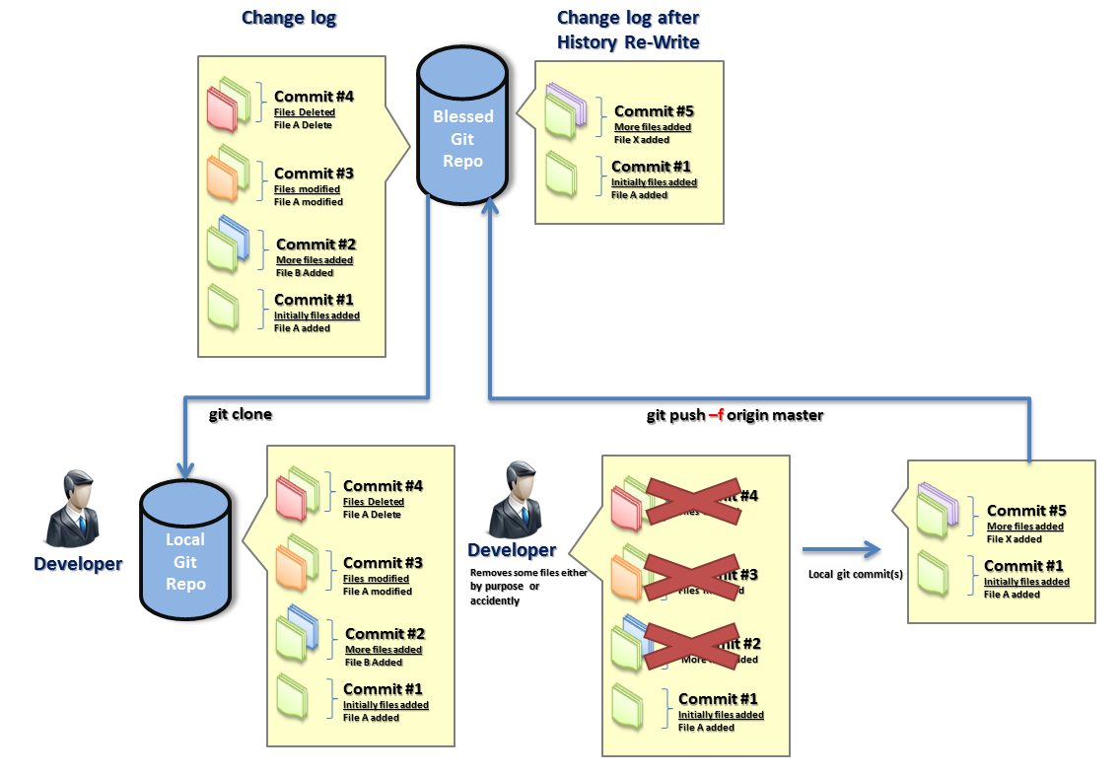

How does it work
Signals event into TeamForge Git
Sends an e-mail to Gerrit Administrators
Copies history (a snapshot) under refs/rewrite -or- refs/deleted on blessed repository
Reports into Gerrit WebUI for audit and restoration purpose

Slide 10
4. How to enable history protection in TeamForge Git

Slide 11

Enable ‘History Protection’ Site Wide
Option allows to protect all Git repository hosted by TeamForge 6.2 site
TeamForge site -admin with file system access to machine where TeamForg Git Integration server is hosted, in file /opt/collabnet/gerrit/etc/gerrit.config can set forceHistoryProtection = true
For TeamForge 7.0 onwards set property GERRIT_FORCE_HISTORY_PROTECTION=true in file
/opt/collabnet/teamforge/runtime/conf/runtime-options.conf

Slide 12
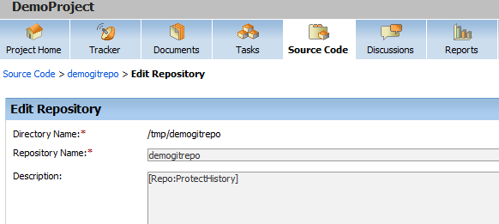

Enable ‘History Protection’ per Git repository
Alternatively this option allows you to protect history of particular Git repository hosted by TeamForge in specific TeamForge Project
Go to TeamForge project ->source code
1
2
Make sure that your description field contains exact string “[Repo:ProtectHistory]” , and then press ‘save’
Once this option is set, history protection is enabled. However at any of point, switch off by removing “[Repo:ProtectHistory]” from description if needed

Slide 13
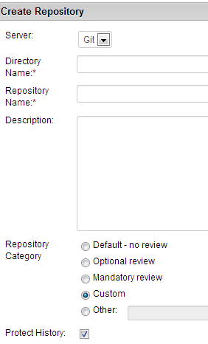
Enable ‘History Protection’ per Git repository in TeamForge 7.0
Alternatively this option allows you to protect history of particular Git repository hosted by TeamForge in specific TeamForge 7.0 Project
Go to TeamForge project ->source code->select Protect History
1
Once this option is selected, history protection is enabled. However at any of point, it can be switch off by unchecking this option

Slide 14
5. How to use History Protection reporting and restore history

Slide 15
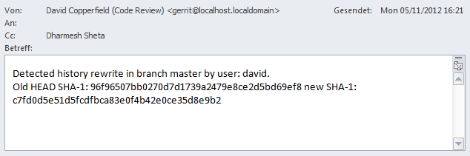
History Protection Report
Whenever history gets ‘re-written’, an email gets sent out to ‘Gerrit Administrators’ containing details about old HEAD of branch and new HEAD after ‘re-write’

Slide 16
History Protection Report
History ‘re-write’ event is also logged in /opt/collabnet/gerrit/logs/gerrit.audit.log
Following events related to ‘History re-writes’ get logged in and can be used for audit purpose
History re-write
Backup branch deletion
Resurrection from backup branch

Slide 17
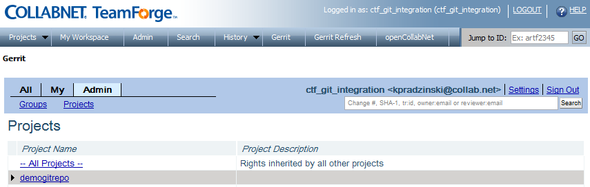
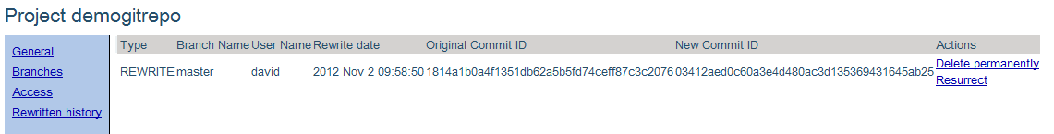
History Protection Report
Whenever history gets ‘re-written’, this event will logged in Gerrit Web UI and can be used for audit and restoration (resurrection)
1
Login as ‘Gerrit Administrator’ in TeamForge
2
3
Click ‘Admin’ tab
Click on ‘Projects’
4
5
Select and click on project (Git Repo in TeamForge)
Select ‘Rewritten history’
6
Either
REWRITE or DELETE
User who re-wrote history
Time when history got re-written
SHA-1 referring
Change just before history rewrite
SHA-1 referring
Change just after history rewrite
Further actions
(Follow next slide for details)

Slide 18
History Protection Report
Delete permanently will remove entry completely
Resurrect will allow you to restore history as it was just before ‘history re-write’ into a separate branch
Alternatively users can also use their standard Git client o find about about rewritten/deleted branches by running git fetch && git ls-remote

Slide 19
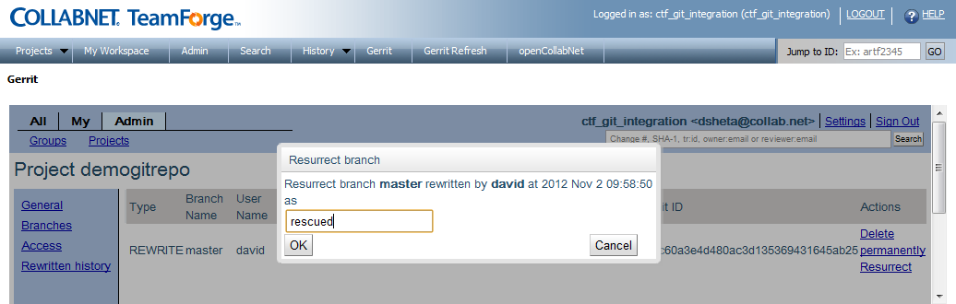
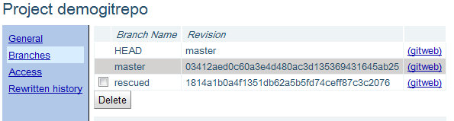
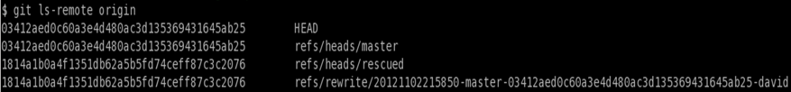
Restore (resurrect) History Using Gerrit WebUI
TeamForge Git Integration allows you to restore history as it was just before ‘re-write’, into a separate branch right from Gerrit WebUI
1
Login as Gerrit Administrator
2
Goto Gerrit and select Git repository
Click on ‘Re-written history’
3
5
4
Chosen Resurrect , then box will pop-up as shown
Give a name for branch in which history will be resurrected and press ‘OK’ button
Click on ‘Branches’ to resurrect branch
6
7
Resurrected branch is now available for all user having atleast read access(view only) for this Git repository in TeamForge
Resurrected branch visible to all users who have atleast ‘view-only’ access to Git repository in TeamForge
Following command on git client side will show restored branch

Slide 20

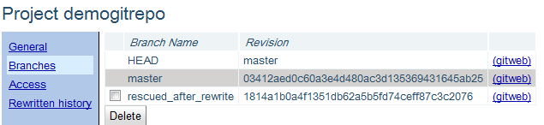
Restore (resurrect) History Using Git Command Line
Alternatively users having permissions to create a new branch can restore history by using their git client
Run this command on git command line
1
Copy HEAD SHA1 of branch created after history ’re-write’
2
Fetch SHA1 of rewritten history from server
3
Use copied SHA1 to create new local branch in Git
4
Push this local branch to remote ‘blessed reposiotry’
5
Resurrected branch via command line is now available for all user having atleast read access(view only) for this Git repository

Slide 21
More details on both options can be found on hcn and our README

