Slide 1
Web Scraping

Slide 2
Topics
1.Web Scraping
2.Why Scraping
3.DOM -Document Object Model
4.Scraping Environment
Requests
Bs4

Slide 3

Document Object Model

Slide 4
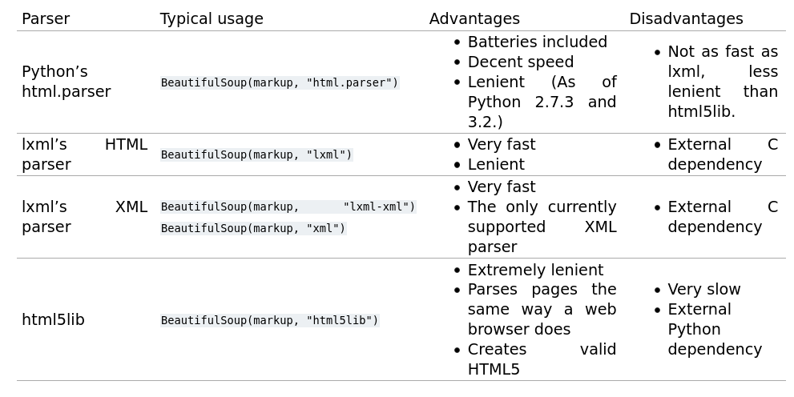
Parser

