Slide 1
CHILD SEXUAL ABUSE

Slide 2
INTRODUCTION :
What’s your favorite way to feel safe and cozy?
(e.g., blanket, family, a pet)Everyone has the right to feel safe.
What Does “My Body Belongs to Me” Mean?
. My body is mine.I have the right to feel safe and comfortable.
. No one should touch me in a way that makes me feel bad.

Slide 3

PRIVATE PARTS :
.These parts are special and belong only to you .
.No one has the right to look or touch your private parts

Slide 4
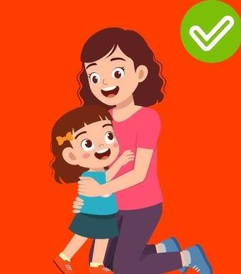
SAFE TOUCH
. A Safe touch is a kind and caring touch that makes you feel happy,loved and comfortable.
.It never hurts you or makes you feel scared or confused.
.Examples of Safe Touch: A hug from your parents or grandparents when you’re feeling sad .
. A pat on the back from your teacher for doing good workHolding hands with a friend while walking.
.A high-five when you win a game.
.A doctor’s check-up when your parents are with youYour mom or dad helping you take a bath or get dressed

Slide 5
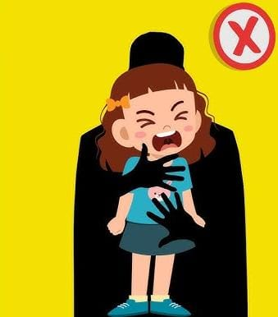
UNSAFE TOUCH
Unsafe touch means something that can hurt you or make you feel scared, uncomfortable, or not okay.
"Example: Someone trying to touch your private parts.
.A stranger asking you to go somewhere with them.
.A friend or adult asking you to keep a bad secret (like a secret touch)

Slide 6
CONCLUSION
So today we understood what does "my body belongs to me "mean , what are private parts and no one should touch them or ask to see them. Also we got know about safe touch and unsafe touch

Slide 7
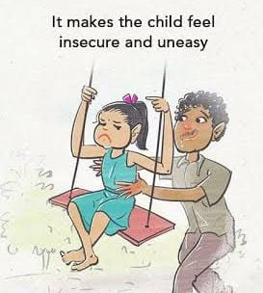
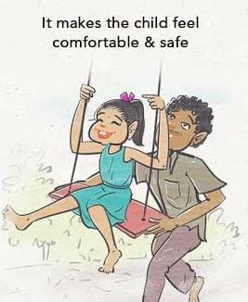
NOW IT’S TIME FOR SOME IMPORTANT QUESTIONS :
Q. What does it mean when we say, “My body belongs to me”?
Q. How do you know if a touch is safe?
Q. Can you describe what are unsafe touch?

