Slide 1
Child Rights Fundamental Rights of Every Child
Presented by: Group E
Anushka Ghose (Group Leader)
Samranggi Biswas
Supriti Das
Samreen Humaira
Tanu Bhutra

Slide 2
Table Of Contents
S. NO. | TITLE
1. | Introduction to Child Rights
2. | Key Child Rights
3. | Right to Education
4. | Right to Protection
5. | Right to Participation
6. | Child Health and Nutrition
7. | Challenges Faced by Children
8. | Role of Organizations like CRY
9. | Acknowledgements

Slide 3


Introduction to Child Rights
What are Child Rights?
Child rights are the basic human rights given to all children below the age of 18. CRY defines child rights as essential entitlements that ensure children have a safe, healthy, and nurturing environment.
Why Are They Important?
They ensure children grow up in a safe, healthy, and nurturing environment.
Recognized by the United Nations Convention on the Rights of the Child (UNCRC), which India ratified in 1992.
Upholding these rights ensures long-term and sustainable change, breaking the cycle of poverty and exploitation.
CRY believes every child must have the opportunity to realize their full potential—not as a matter of charity, but as a matter of right.

Slide 4
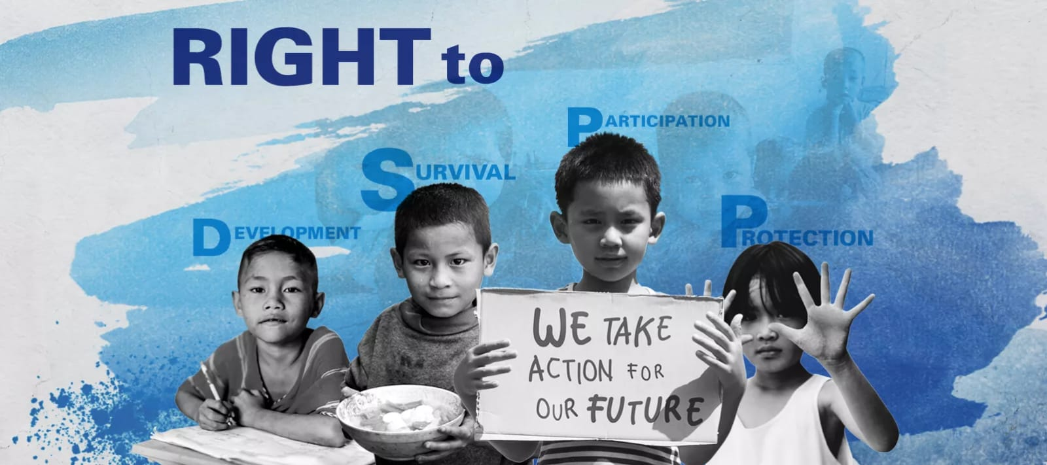
Key Child Rights According to CRY’s Policy
Right to Survival: Every child has the right to live with proper food, clean water, healthcare, and shelter. CRY ensures that children are not denied these basic needs.
Right to Development: Children must get quality education, emotional care, and the chance to play and learn. CRY helps children grow into confident and skilled individuals.
Right to Protection: Children should be safe from abuse, exploitation, and harmful situations like child labour or early marriage. CRY works to protect children in every community.
Right to Participation: Every child has the right to express their views and be heard in matters affecting them. CRY creates safe spaces where children can freely share their thoughts.

Slide 5

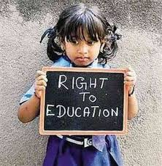

Right to Education
Every Child deserves: Free & quality education that fosters personal growth, development, & breaks the cycle of poverty.
Empowering through Education: Enables children to make informed decisions, exercise their rights, & reach their full potential.
Government Initiatives: Right to Education (RTE) Act ensures access to education for all children.
CRY's Work: Improving school access, prioritizing girl child education, & promoting inclusive learning environments.

Slide 6
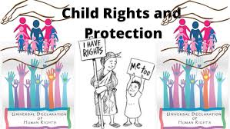
Right to Protection
Protecting Children: Abuse, neglect, violence, & exploitation can have lasting impacts on their lives.
Prevention through Education: Educating children & adults about child rights to prevent issues like child labour, trafficking, & child marriage.
Support and Care: Providing essential services for victims of abuse, ensuring their physical, emotional, & psychological well-being.
Policy and Advocacy: Implementing & enforcing laws & policies that safeguard children's rights & protect them from harm.

Slide 7
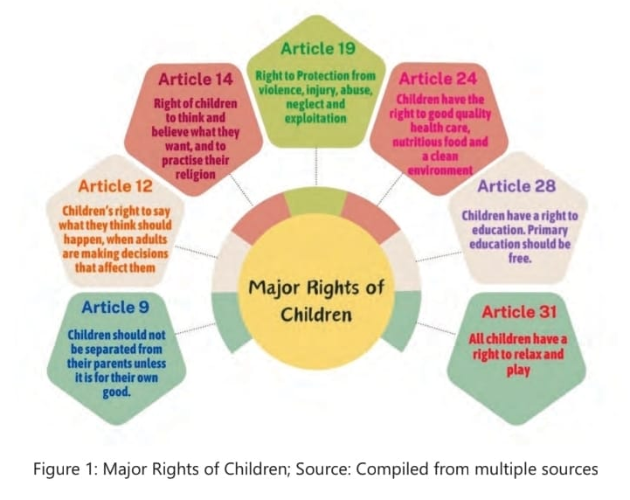
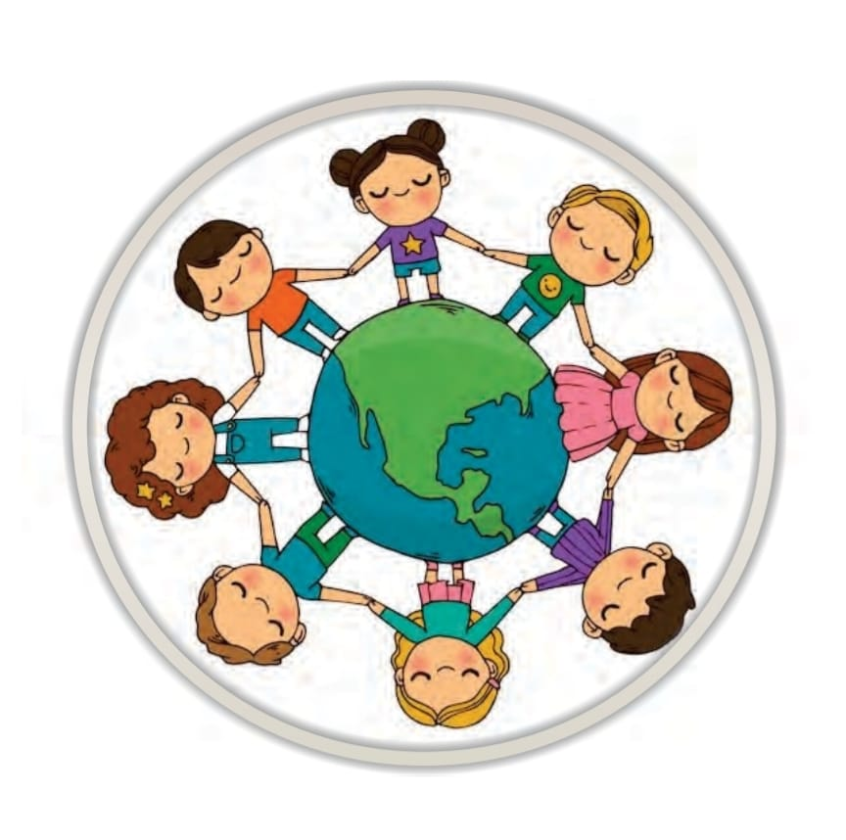
Right to Participation
Every child has the right to express their views freely in matters affecting them (UNCRC Article 12).
Participation strengthens children’s confidence, decision-making skills, and sense of belonging.
It can happen in families, schools, communities, and even policy-making spaces.
Barriers include age-based discrimination, adultism, lack of safe spaces, and social norms that silence children.
CRY empowers children through clubs, peer groups, campaigns, and youth leadership programs.

Slide 8
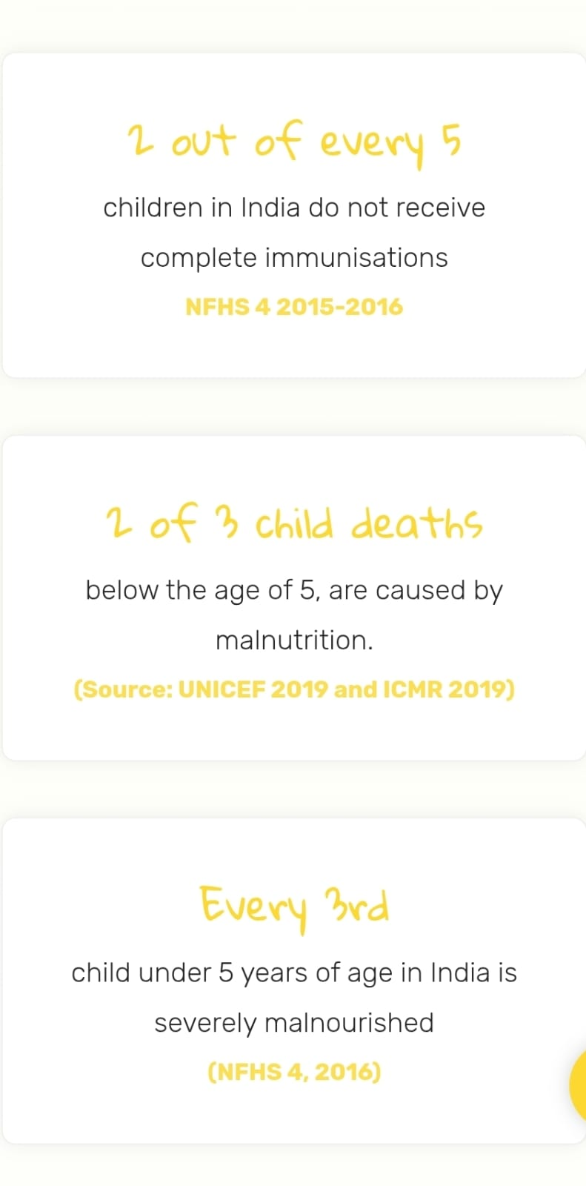
Child Health and Nutrition
Every child has the right to good health and nutrition for survival, development, and lifelong well-being.
Malnutrition and anaemia are major issues in India, affecting children's growth, learning, and immunity.
Challenges include poverty, poor sanitation, early marriage, lack of awareness, and gender discrimination.
Government schemes like ICDS, Mid-Day Meals, and Poshan Abhiyaan aim to address these issues.
CRY supports health rights by connecting families to services and raising awareness in underserved areas.
Government schemes: ICDS, Mid-Day Meals, Poshan Abhiyaan.
Awareness on hygiene and nutrition.
CRY connects families to health services, conducts community monitoring.

Slide 9
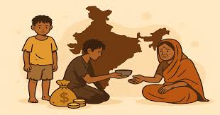

Challenges Faced by Children
Children across India face many challenges that prevent them from enjoying their basic rights. These issues often affect their education, health, and safety.
Poverty: Many families cannot afford school fees, healthcare, or nutritious food. Children are often forced to drop out of school to work and support their families. Poor living conditions also increase the risk of disease and malnutrition.
Exploitation: Children face exploitation in the form of child labour, child marriage, trafficking, and abuse. Lack of awareness, weak enforcement of laws, and social norms contribute to this problem. Many children are unaware of their rights or too afraid to speak up.
These challenges make it harder for children to grow up safe, healthy, and educated. Solving them requires action from individuals, communities, NGOs, and the government.

Slide 10
Role of Organizations like CRY
CRY (Child Rights and You) is a leading Indian NGO that works to ensure every child enjoys their basic rights — like education, protection, health, and a safe environment.
What CRY does:
Helps children go to school and stay in school.
Protects children from child labour, child marriage, and abuse.
Supports families and communities to become more aware and involved in protecting child rights.
Works to improve child health and nutrition in underserved areas.
Collaborates with government systems by supporting programs, training local officials, and sharing data to improve child-related policies and services.
Impact so far:
Reached over 3 million children across India.
Helped increase school enrollment and reduce child marriage and child labour.
Created safer, more supportive environments for children at the community level.

Slide 11
Acknowledgements
Supriti Das: Responsible for the Overall Presentation Preparation.
Anushka Ghose: Researcher (Slides 5,6) and Presenter (Slides 5,6).
Tanu Bhutra: Researcher (Slides 3,4) and Presenter (Slides 1,3,4).
Samreen Humaira: Researcher (Slides 7,8) and Presenter (Slides 7,8).
Samranggi Biswas: Researcher (Slides 9,10) and Presenter (Slides 9,10).
We sincerely thank CRY for the opportunity to contribute to this meaningful initiative. It was an enriching experience.

