Slide 1
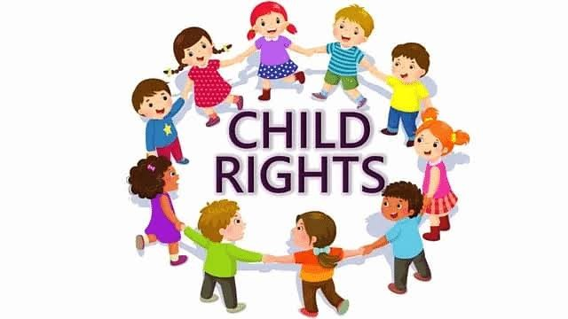
Who is a Child? What are Child Rights?
A child is defined as any person under the age of 18. Child rights are specialized human rights that recognize the unique needs of children. They include: - Right to survival - Right to protection - Right to development - Right to participation

Slide 2
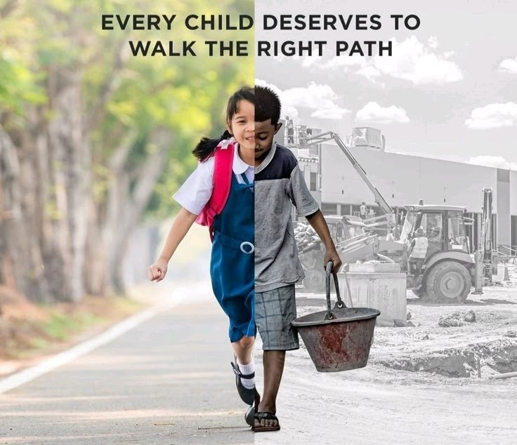
Child Marriage
Child marriage refers to any formal or informal marriage involving a person below the age of 18. Consequences: - Denial of education - Health risks due to early pregnancy - Increased domestic violence - Violation of human rights

Slide 3
Children’s Right to Participation
This right ensures children have the freedom to express their views in matters affecting them. Key Aspects: - Freedom of expression - Right to be heard - Inclusion in decision-making - Access to information

Slide 4
Right to Education
The Right to Education Act (RTE), 2009 in India mandates: - Free and compulsory education for children aged 6-14 - No child shall be held back, expelled, or required to pass a board exam until the completion of elementary education.

Slide 5
Right to Education
Key Provisions: - 25% reservation for disadvantaged groups in private schools - Quality norms for schools - Prohibition of physical punishment and mental harassment - Banning of capitation fees and screening procedures

Slide 6
ICDS - Early Childhood Care
Integrated Child Development Services (ICDS) is a government program providing: - Supplementary nutrition - Immunization - Health check-ups - Referral services

Slide 7
ICDS - Early Childhood Care
Objectives: - Improve nutritional and health status of children under 6 - Lay the foundation for proper psychological, physical, and social development - Reduce incidence of mortality, morbidity, and school dropout

Slide 8
Child Labour
Child labour refers to the exploitation of children through any form of work that deprives them of their childhood. Causes: - Poverty - Lack of education - Social norms - Inadequate laws

Slide 9
Child Labour
Laws & Interventions: - Child Labour (Prohibition and Regulation) Act, 1986 - National Child Labour Project (NCLP) - Right to Education Act - Role of NGOs and public awareness campaigns

Slide 10
Juvenile Justice System
The Juvenile Justice (Care and Protection of Children) Act, 2015 aims to: - Provide care, protection, and rehabilitation for children in conflict with the law or in need of care. - Set up Juvenile Justice Boards and Child Welfare Committees.

Slide 11
Juvenile Justice System
Key Provisions: - Children under 18 cannot be tried as adults (exceptions for heinous crimes aged 16-18) - Emphasis on reform and reintegration - Prohibition of capital punishment or life imprisonment for juveniles

