Slide 1
Child Safeguarding Policy Creating a Safe Environment for Every Child
Presented by: Group E
Anushka Ghose (Group Leader)
Samranggi Biswas
Supriti Das
Samreen Humaira
Tanu Bhutra

Slide 2
Table Of Contents
S. NO. | TITLE
1. | Introduction to Child Safeguarding Policy
2. | Objectives of the Child Safeguarding Policy
3. | Key Principles of Child Safeguarding Policy
4. | Behavioural Code for staffs, associates and visitors
5. | Roles and Responsibilities
6. | Reporting and Responding to Concerns
7. | Conclusion and Commitment
8. | Acknowledgements

Slide 3
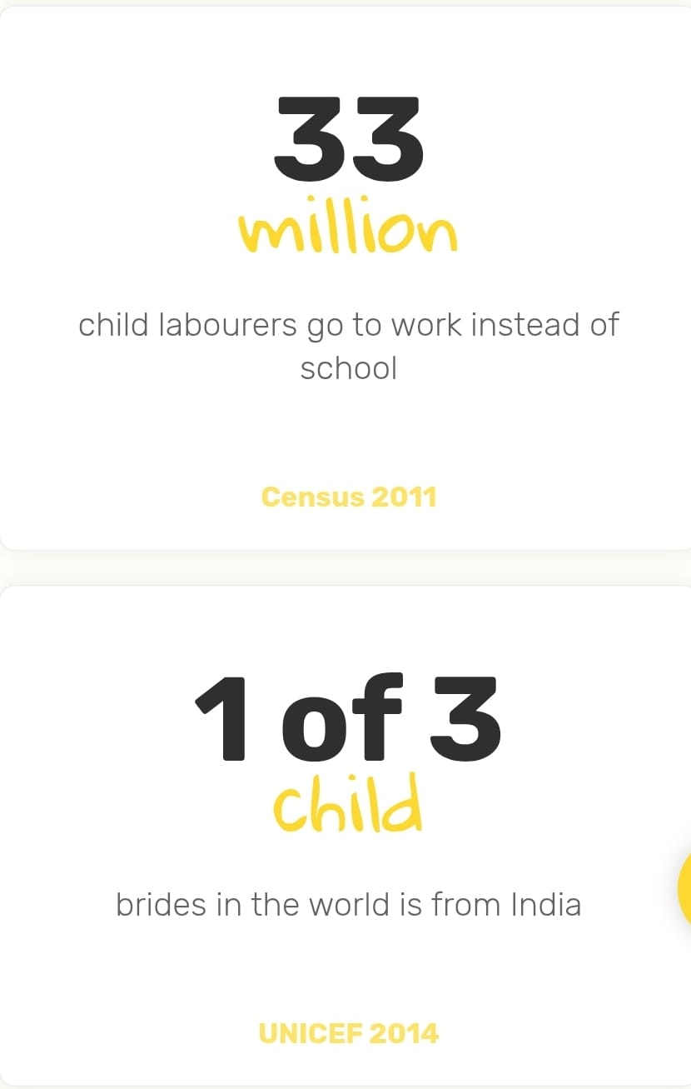

Introduction to Child Safeguarding Policy
A Child Safeguarding Policy protects children from abuse, neglect, exploitation, and violence.
Provides guidelines, roles, and responsibilities for staff, interns, volunteers, and partners.
CRY's policy is based on the UNCRC, Indian Constitution, and upholds Zero Tolerance for any form of child abuse.
Applies to all individuals interacting with children in any CRY-supported space.

Slide 4



Objectives of the Child Safeguarding Policy
Reinforce CRY’s commitment to protecting children from all harm.
Ensure the dignity, welfare, and safety of children in all programs.
Provide a clear Code of Conduct for all representatives.
Establish confidential and safe reporting systems.
Empower everyone to prevent, recognize, and respond to child abuse.

Slide 5


Key Principles of Child Safeguarding Policy
Treat all children equally: Respect every child and listen to them, no matter their background.
Act in the child’s best interest: Always make decisions that are best for the child’s safety and well-being.
Let children share their views: Give children a chance to express themselves freely in classrooms and in decisions about their lives.
Zero tolerance for child abuse: Any kind of abuse is completely unacceptable.

Slide 6
Behavioural Code for staffs, associates and visitors
Do's | Don'ts
Respect the privacy & dignity of every child. | Do not abuse, hit, or harm any child in any way.
Make proactive efforts for ensuring safety of children | Do not engage in behaviour that is sexually inappropriate, offensive, or provocative.
Always seek informed consent from children & their guardians before taking interviews, photos, or videos. | Do not disclose the identity and /or personal information of children.

Slide 7

Roles and Responsibilities
1. Directors / Functional Heads / Program Heads:
Ensure that representatives are aware of CRY’s commitment to preventing child abuse and exploitation.
2. HR Function:
Ensure that all representatives read, sign, and abide by CRY’s Child Safeguarding Policy and Code of Conduct.
Monitor policy breaches and take appropriate disciplinary action if required, as per CRY’s procedures.

Slide 8
3. Management:
Develop and implement CRY’s Standard Operating Procedures (SOPs) in line with local laws.
Appoint a Designated Authority (DA) as a focal point to oversee implementation and monitoring of CRY’s child protection systems.
Ensure that CRY’s reporting and response mechanisms are functional and effective.
4. Staff & Associates:
Be fully aware of and comply with CRY’s child safeguarding procedures.
Ensure informed consent is obtained before collecting children’s images, and respect children’s dignity and privacy in alignment with CRY’s values.
Participate in training and empower themselves regarding CRY’s child protection mechanisms.
5. General Representatives:
Report any suspected or known abuse within 24 hours using proper documentation as per CRY’s guidelines.
Cooperate in CRY’s investigations and ensure confidentiality is maintained.
Do not share personal information about children unless legally required, in line with CRY’s data protection standards.

Slide 9


Reporting and Responding to Concerns
Reporting Responsibilities:
All CRY staff and associates must report any suspicion of child abuse within 24 hours.
Reports go to the Designated Authority (DA), HR Director, or CEO.
Reports must be documented clearly: time, place, people involved, and what happened.
Confidentiality is critical – information is shared only on a need-to-know basis.
Responding to Reports:
CRY will act within 48 hours to support and protect the child.
Investigations will be confidential, impartial, and thorough.
Violations may lead to disciplinary action or legal steps as per policy and law.

Slide 10
Conclusion and Commitment
CRY’s Commitment:
CRY believes that child safeguarding is everyone’s responsibility – staff, volunteers, interns, visitors, and partners.
All representatives must read, sign, and follow CRY’s Child Safeguarding Policy and Code of Conduct.
Safeguarding is a shared responsibility, it includes:
Being aware of and committed to preventing child abuse, exploitation, and neglect.
Following CRY’s SOPs, protection mechanisms, and legal obligations at all times.
Promoting a safe and respectful environment where children can speak freely and are treated with dignity.
Identifying and managing risks proactively in all child-accessed spaces.
Upholding the highest standards of behaviour toward children both professionally and personally.
Key Message:
Safeguarding is not optional — it is an organizational value, a legal obligation, and a collective duty.

Slide 11
Acknowledgements
Supriti Das: Responsible for the Overall Presentation Preparation.
Anushka Ghose: Researcher (Slides 5, 6, 7) and Presenter (Slides 5, 6).
Samreen Humaira: Researcher (Slides 3, 4) and Presenter (Slides 1, 3, 4).
Tanu Bhutra: Reviewer and Editor (Slide 7, 8) and Presenter (Slide 7, 8).
Samranggi Biswas: Researcher (Slides 9, 10) and Presenter (Slides 9, 10).
Special thanks to CRY for providing us the opportunity to work on this project.

