Slide 1

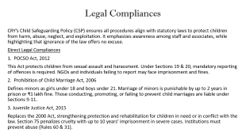
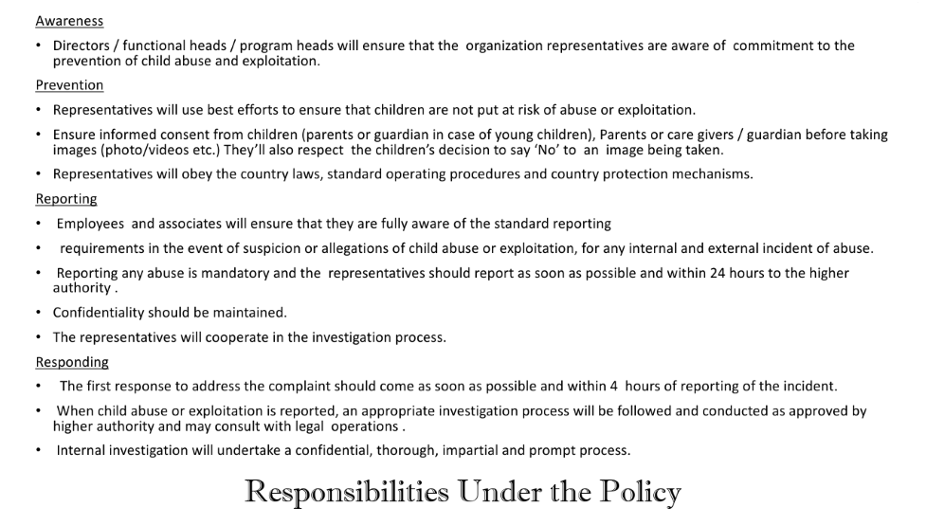
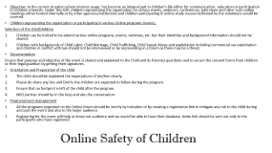
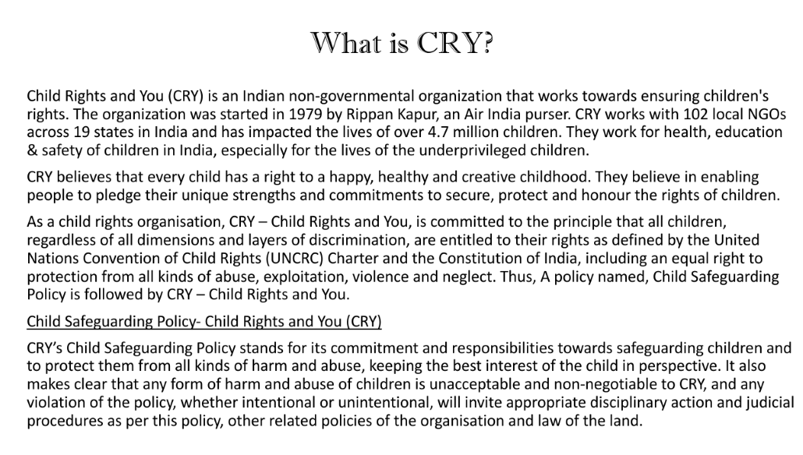
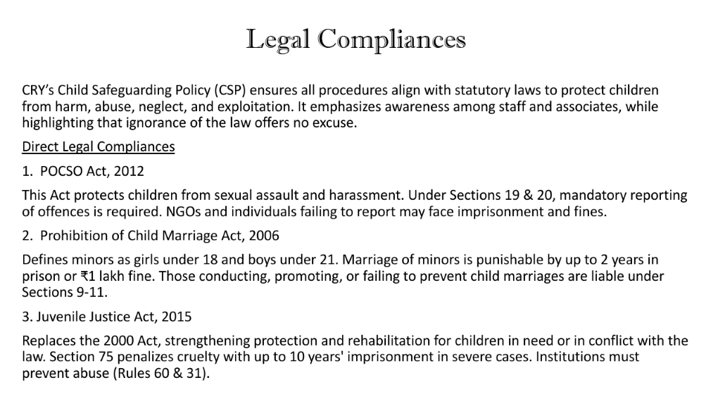
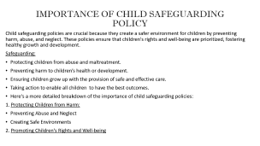
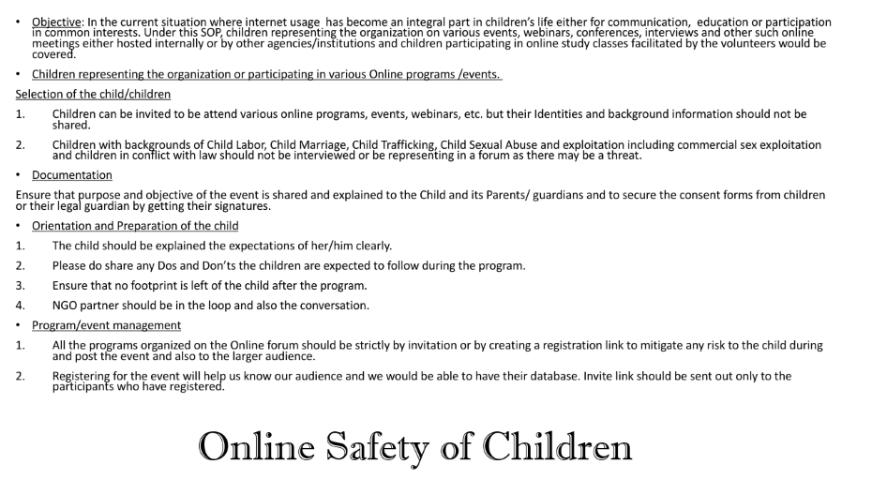
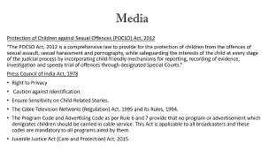
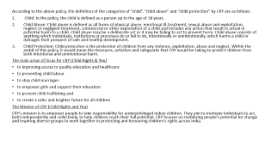
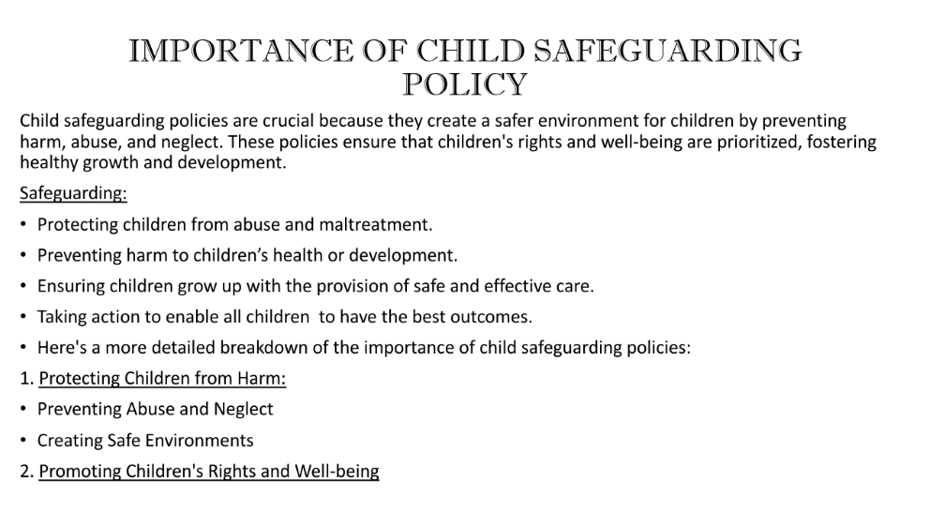
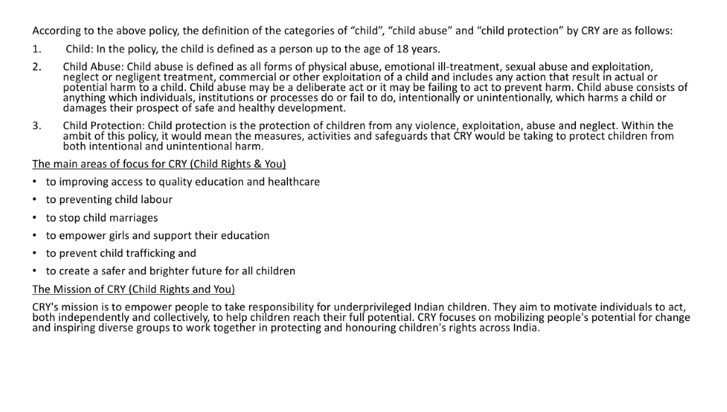
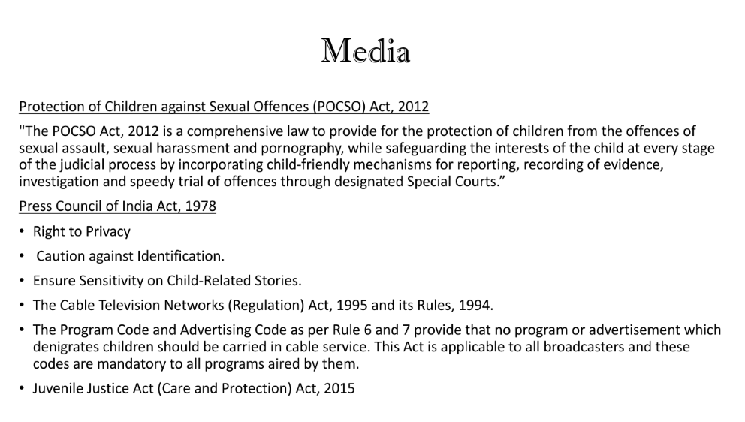
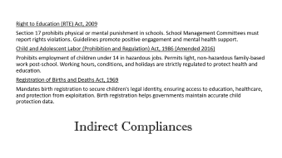
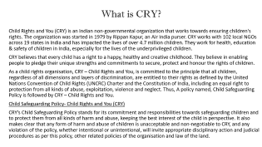
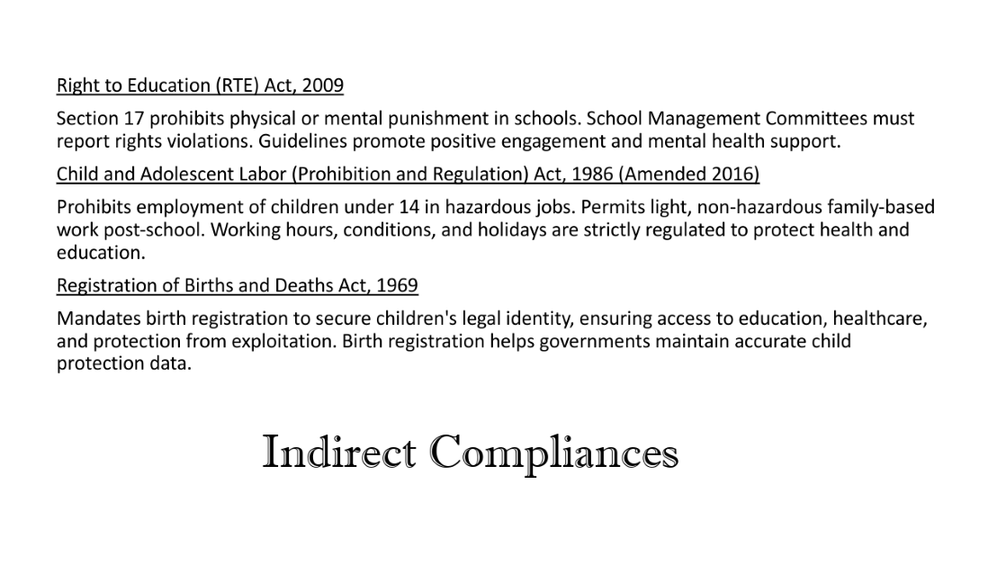
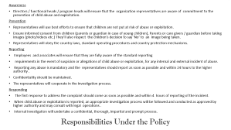
CHILD SAFEGUARDING POLICY

Slide 2
What is CRY?
Child Rights and You (CRY) is an Indian non-governmental organization that works towards ensuring children's rights. The organization was started in 1979 by Rippan Kapur, an Air India purser. CRY works with 102 local NGOs across 19 states in India and has impacted the lives of over 4.7 million children. They work for health, education & safety of children in India, especially for the lives of the underprivileged children.
CRY believes that every child has a right to a happy, healthy and creative childhood. They believe in enabling people to pledge their unique strengths and commitments to secure, protect and honour the rights of children.
As a child rights organisation, CRY – Child Rights and You, is committed to the principle that all children, regardless of all dimensions and layers of discrimination, are entitled to their rights as defined by the United Nations Convention of Child Rights (UNCRC) Charter and the Constitution of India, including an equal right to protection from all kinds of abuse, exploitation, violence and neglect. Thus, A policy named, Child Safeguarding Policy is followed by CRY – Child Rights and You.
Child Safeguarding Policy- Child Rights and You (CRY)
CRY’s Child Safeguarding Policy stands for its commitment and responsibilities towards safeguarding children and to protect them from all kinds of harm and abuse, keeping the best interest of the child in perspective. It also makes clear that any form of harm and abuse of children is unacceptable and non-negotiable to CRY, and any violation of the policy, whether intentional or unintentional, will invite appropriate disciplinary action and judicial procedures as per this policy, other related policies of the organisation and law of the land.

Slide 3
c
According to the above policy, the definition of the categories of “child”, “child abuse” and “child protection” by CRY are as follows:
Child: In the policy, the child is defined as a person up to the age of 18 years.
Child Abuse: Child abuse is defined as all forms of physical abuse, emotional ill-treatment, sexual abuse and exploitation, neglect or negligent treatment, commercial or other exploitation of a child and includes any action that result in actual or potential harm to a child. Child abuse may be a deliberate act or it may be failing to act to prevent harm. Child abuse consists of anything which individuals, institutions or processes do or fail to do, intentionally or unintentionally, which harms a child or damages their prospect of safe and healthy development.
Child Protection: Child protection is the protection of children from any violence, exploitation, abuse and neglect. Within the ambit of this policy, it would mean the measures, activities and safeguards that CRY would be taking to protect children from both intentional and unintentional harm.
The main areas of focus for CRY (Child Rights & You)
to improving access to quality education and healthcare
to preventing child labour
to stop child marriages
to empower girls and support their education
to prevent child trafficking and
to create a safer and brighter future for all children
The Mission of CRY (Child Rights and You)
CRY's mission is to empower people to take responsibility for underprivileged Indian children. They aim to motivate individuals to act, both independently and collectively, to help children reach their full potential. CRY focuses on mobilizing people's potential for change and inspiring diverse groups to work together in protecting and honouring children's rights across India.

Slide 4
Legal Compliances
CRY’s Child Safeguarding Policy (CSP) ensures all procedures align with statutory laws to protect children from harm, abuse, neglect, and exploitation. It emphasizes awareness among staff and associates, while highlighting that ignorance of the law offers no excuse.
Direct Legal Compliances
1. POCSO Act, 2012
This Act protects children from sexual assault and harassment. Under Sections 19 & 20, mandatory reporting of offences is required. NGOs and individuals failing to report may face imprisonment and fines.
2. Prohibition of Child Marriage Act, 2006
Defines minors as girls under 18 and boys under 21. Marriage of minors is punishable by up to 2 years in prison or ₹1 lakh fine. Those conducting, promoting, or failing to prevent child marriages are liable under Sections 9-11.
3. Juvenile Justice Act, 2015
Replaces the 2000 Act, strengthening protection and rehabilitation for children in need or in conflict with the law. Section 75 penalizes cruelty with up to 10 years' imprisonment in severe cases. Institutions must prevent abuse (Rules 60 & 31).

Slide 5
Indirect Compliances
Right to Education (RTE) Act, 2009
Section 17 prohibits physical or mental punishment in schools. School Management Committees must report rights violations. Guidelines promote positive engagement and mental health support.
Child and Adolescent Labor (Prohibition and Regulation) Act, 1986 (Amended 2016)
Prohibits employment of children under 14 in hazardous jobs. Permits light, non-hazardous family-based work post-school. Working hours, conditions, and holidays are strictly regulated to protect health and education.
Registration of Births and Deaths Act, 1969
Mandates birth registration to secure children's legal identity, ensuring access to education, healthcare, and protection from exploitation. Birth registration helps governments maintain accurate child protection data.

Slide 6
IMPORTANCE OF CHILD SAFEGUARDING POLICY
Child safeguarding policies are crucial because they create a safer environment for children by preventing harm, abuse, and neglect. These policies ensure that children's rights and well-being are prioritized, fostering healthy growth and development.
Safeguarding:
Protecting children from abuse and maltreatment.
Preventing harm to children’s health or development.
Ensuring children grow up with the provision of safe and effective care.
Taking action to enable all children to have the best outcomes.
Here's a more detailed breakdown of the importance of child safeguarding policies:
1. Protecting Children from Harm:
Preventing Abuse and Neglect
Creating Safe Environments
2. Promoting Children's Rights and Well-being

Slide 7
s
Awareness
Directors / functional heads / program heads will ensure that the organization representatives are aware of commitment to the prevention of child abuse and exploitation.
Prevention
Representatives will use best efforts to ensure that children are not put at risk of abuse or exploitation.
Ensure informed consent from children (parents or guardian in case of young children), Parents or care givers / guardian before taking images (photo/videos etc.) They’ll also respect the children’s decision to say ‘No’ to an image being taken.
Representatives will obey the country laws, standard operating procedures and country protection mechanisms.
Reporting
Employees and associates will ensure that they are fully aware of the standard reporting
requirements in the event of suspicion or allegations of child abuse or exploitation, for any internal and external incident of abuse.
Reporting any abuse is mandatory and the representatives should report as soon as possible and within 24 hours to the higher authority .
Confidentiality should be maintained.
The representatives will cooperate in the investigation process.
Responding
The first response to address the complaint should come as soon as possible and within 4 hours of reporting of the incident.
When child abuse or exploitation is reported, an appropriate investigation process will be followed and conducted as approved by higher authority and may consult with legal operations .
Internal investigation will undertake a confidential, thorough, impartial and prompt process.
Responsibilities Under the Policy

Slide 8
Media
Protection of Children against Sexual Offences (POCSO) Act, 2012
"The POCSO Act, 2012 is a comprehensive law to provide for the protection of children from the offences of sexual assault, sexual harassment and pornography, while safeguarding the interests of the child at every stage of the judicial process by incorporating child-friendly mechanisms for reporting, recording of evidence, investigation and speedy trial of offences through designated Special Courts.”
Press Council of India Act, 1978
Right to Privacy
Caution against Identification.
Ensure Sensitivity on Child‐Related Stories.
The Cable Television Networks (Regulation) Act, 1995 and its Rules, 1994.
The Program Code and Advertising Code as per Rule 6 and 7 provide that no program or advertisement which denigrates children should be carried in cable service. This Act is applicable to all broadcasters and these codes are mandatory to all programs aired by them.
Juvenile Justice Act (Care and Protection) Act, 2015

Slide 9
Online Safety of Children
Objective: In the current situation where internet usage has become an integral part in children’s life either for communication, education or participation in common interests. Under this SOP, children representing the organization on various events, webinars, conferences, interviews and other such online meetings either hosted internally or by other agencies/institutions and children participating in online study classes facilitated by the volunteers would be covered.
Children representing the organization or participating in various Online programs /events.
Selection of the child/children
Children can be invited to be attend various online programs, events, webinars, etc. but their Identities and background information should not be shared.
Children with backgrounds of Child Labor, Child Marriage, Child Trafficking, Child Sexual Abuse and exploitation including commercial sex exploitation and children in conflict with law should not be interviewed or be representing in a forum as there may be a threat.
Documentation
Ensure that purpose and objective of the event is shared and explained to the Child and its Parents/ guardians and to secure the consent forms from children or their legal guardian by getting their signatures.
Orientation and Preparation of the child
The child should be explained the expectations of her/him clearly.
Please do share any Dos and Don’ts the children are expected to follow during the program.
Ensure that no footprint is left of the child after the program.
NGO partner should be in the loop and also the conversation.
Program/event management
All the programs organized on the Online forum should be strictly by invitation or by creating a registration link to mitigate any risk to the child during and post the event and also to the larger audience.
Registering for the event will help us know our audience and we would be able to have their database. Invite link should be sent out only to the participants who have registered.

