Slide 1
TRUSTING ADULTS AND ASKING FOR HELP :
SESSION – 3

Slide 2
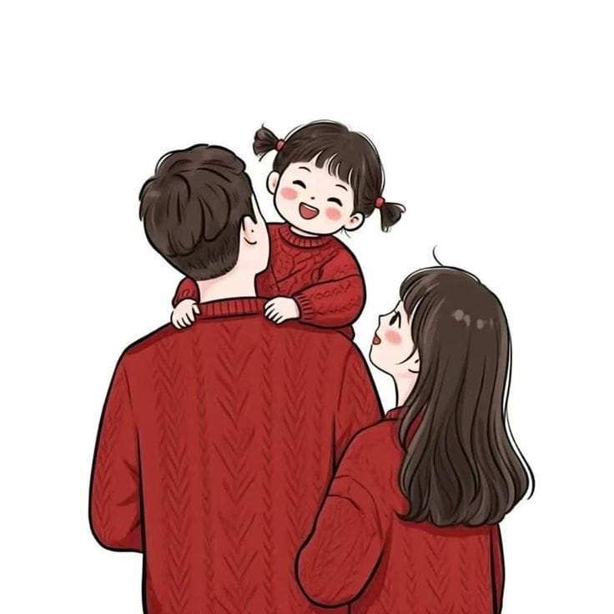
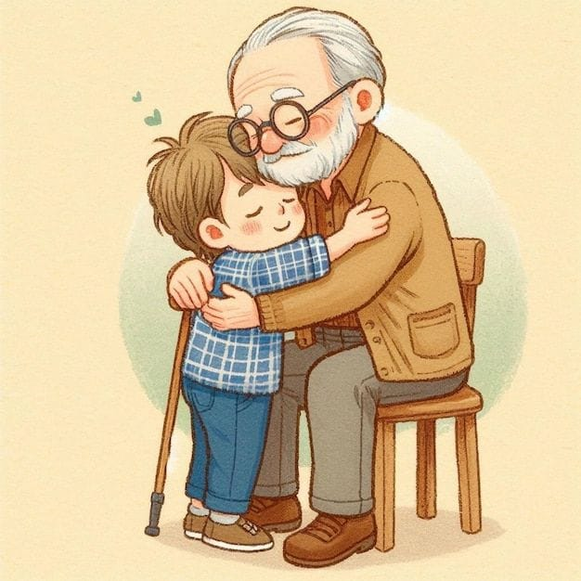
Who is a Trusted Adult ?
Trusting Adults and asking for help sometimes, you may feel scared, confused, or sad. That’s when you need to talk to a trusted adult — someone who cares about you and will help you feel safe.
A trusted adult can be your :
Parents
Teachers
Grandparents
School counsellor
Any grown-up who listens to you, helps you, and keeps you safe.

Slide 3
WHEN YOU SHOULD ASK FOR HELP ?
. If someone hurts you or makes you feel uncomfortable.
. If someone tells you to keep a secret that makes you feel worried or scared.
. If you see someone being bullied or in trouble.
What Can You Say ?
. I don’t feel safe.
. I need help.
. Can I talk to you about something?”
Remember: Talking to a trusted adult is never wrong even if someone tells you not to.
. You are never alone.
. You can always ask for help.

Slide 4


PRACTISE SAYING NO :
Sometimes, someone might ask you to do something that feels wrong, weird, or makes you uncomfortable.
It’s okay to say NO — even to a grown-up!

Slide 5


WHEN TO SAY NO ?
If someone wants to touch you in a way you don’t like.
If someone asks you to keep a bad secret.
If someone shows you something that feels wrong or scary.
If someone tells you not to tell your parents or teacher.
How to Say “NO” ?
You can say it in a strong, clear voice:“NO! Stop it!”“I don’t like that!”“
Please leave me alone!”“
I will tell a grown-up!”
You can also run away and tell a trusted adult right away.
Remember: Your body is yours, and you have the right to say NO.
Even if it’s someone you know — if it feels wrong, say NO and tell a trusted adult.

Slide 6
NOW IT’S TIME FOR SOME QUESTION :
Who are your trusted adults?
How can you tell a trusted adult if you feel unsafe?
If someone wants to touch you in a way you don’t like what will you say?
How to Say “NO”If someone asks you to keep a bad secret.

