Slide 1

Cyber Safety And Well being
2nd Master Class – Activity list

Slide 2
ACTIVITY 1- Digital Superhero
Description :
A fun, imaginative, and hands-on activity where students create a superhero who protects the internet and promotes cyber safety and well-being. Each student gets to invent a character who battles online threats like cyberbullying, fake news, screen addiction, and more. Interns draw their superhero, give them a name, superpowers, a mission, and even a backstory. They then present their heroes to the class and display them in a “Cyber Hero Gallery.” The activity encourages storytelling, creativity, and empathy — while reinforcing important lessons about responsible online behavior.
Learning Outcomes:
By the end of this activity, intern will understand key digital risks such as cyberbullying, misinformation, and screen over use. Demonstrate creative thinking and empathy in designing a hero to combat those risks. Recognize traits of a responsible digital citizen and how to model positive online behaviour. Practice communication and presentation skills in a fun, peer-supported environment.

Slide 3
Guideline
Introduce the concept of a Digital Superhero who protects the online world.
Ask students to think about online dangers and how a superhero might fight them.
Provide drawing materials or allow students to use a drawing app.
Ask students to:
Draw their superhero.
Name their superhero.
Complete a superhero profile with:
Origin story
Powers
Mission
Weakness (optional)
Have students present their superhero to the class or in small groups.
Create a display space titled “Cyber Hero Gallery” and post all superhero drawings and profiles.
Allow students to view and appreciate each other’s work.
Optional: Let students vote for fun categories like “Most Creative Power” or “Best Mission.”
Optional: In pairs, students create a short comic strip where their superheroes team up to defeat an online villain.
End with a short reflection or group discussion on what they learned about being safe and kind online.

Slide 4
ACTIVITY 2 - Inside Out of the Internet
Description:
a lively, movement-based activity where students respond to common online experiences by moving to one of five emoji zones that represent different emotions. This engaging format helps interns reflect on how digital interactions impact their feelings, encourages open discussion about screen time and online behavior, and promotes positive coping strategies for cyber stress.
The activity transforms everyday online scenarios into emotional learning moments, using emojis as tools for expression, empathy, and communication.
Learning outcomes
Identify and express emotional responses to online situations.
Develop emotional awareness about screen time and digital interactions.
Learn and share healthy coping strategies for digital stress or negative experiences.
Build empathy and peer connection through shared reflection.

Slide 5
Guideline
Set up 5 large emoji posters in different corners or areas of the room: 😊 (Happy), 😐 (Neutral), 😞 (Sad), 😡 (Angry), 😱 (Scared/Shocked)
Gather the students in the center of the room.
Read aloud one Scenario Card at a time (e.g., “You received 100 likes on your photo,” or “Someone left a mean comment on your post”).
After each scenario, ask students to move to the emoji zone that best matches how they would feel in that situation.
Once everyone has chosen a zone, allow brief sharing from each zone — a few students can explain why they chose that feeling.
Repeat with 8–10 different scenarios, changing the pace with optional music or a bell between rounds.
After the last scenario, hand out “Digital Rescue Tool” cards — each with a coping strategy (e.g., “Take a break from the screen,” “Talk to a friend,” “Block and report”).
Ask each intern to pick a card they feel could help them handle a tough online moment, and invite volunteers to share how or when they might use it.
Optional: Hand out Cyber Wellness badges or stickers as recognition for thoughtful participation.
Optional: As a final reflection, students can write or draw a quick note on a sticky note about one thing they’ll do to stay mentally healthy online and post it on a "Well-being Wall.“

Slide 6
South Zone May , June - Highlights
Fundraising Triumph: A dynamic force of 53 volunteers and interns raised ₹2.2 lakhs, powering our mission forward.
Young Changemakers in the Making – Our vibrant collaboration with DPS North through Children For Children brought child rights conversations to classrooms, nurturing awareness and empathy early on.

Slide 7
South Zone
May , June
Highlights
Fundraising Triumph: A dynamic force of 53 volunteers and interns raised ₹2.2 lakhs, powering our mission forward.
Young Changemakers in the Making – Our vibrant collaboration with DPS North through Children For Children brought child rights conversations to classrooms, nurturing awareness and empathy early on.

Slide 8
1
2
Looking ahead
Summer Spark: Rolling out engaging summer camps across 5 PAGs in Bangalore to strengthen volunteer participation and deepen our work with children.

Slide 9
1
2
Growing Our Footprint: New PAGs coming up in 2 additional Bangalore locations and seeking the green light for expansion into Chennai and Hyderabad. Why it matters? – More schools, more volunteers, greater impact – especially in our growing hubs of Chennai and Hyderabad.

Slide 10
Looking ahead
Summer Spark: Rolling out engaging summer camps across 5 PAGs in Bangalore to strengthen volunteer participation and deepen our work with children.
Growing Our Footprint: New PAGs coming up in 2 additional Bangalore locations and seeking the green light for expansion into Chennai and Hyderabad. Why it matters? – More schools, more volunteers, greater impact – especially in our growing hubs of Chennai and Hyderabad.

Slide 11
A Grateful Salute
Every smile you sparked, every hour you gave – it mattered. Thank you for being the change.

Slide 12

Every smile you sparked, every hour you gave – it mattered. Thank you for being the change

Slide 13
Child Rights and You
Vol cycle- Rec, Orient, Engage, Track

Slide 14
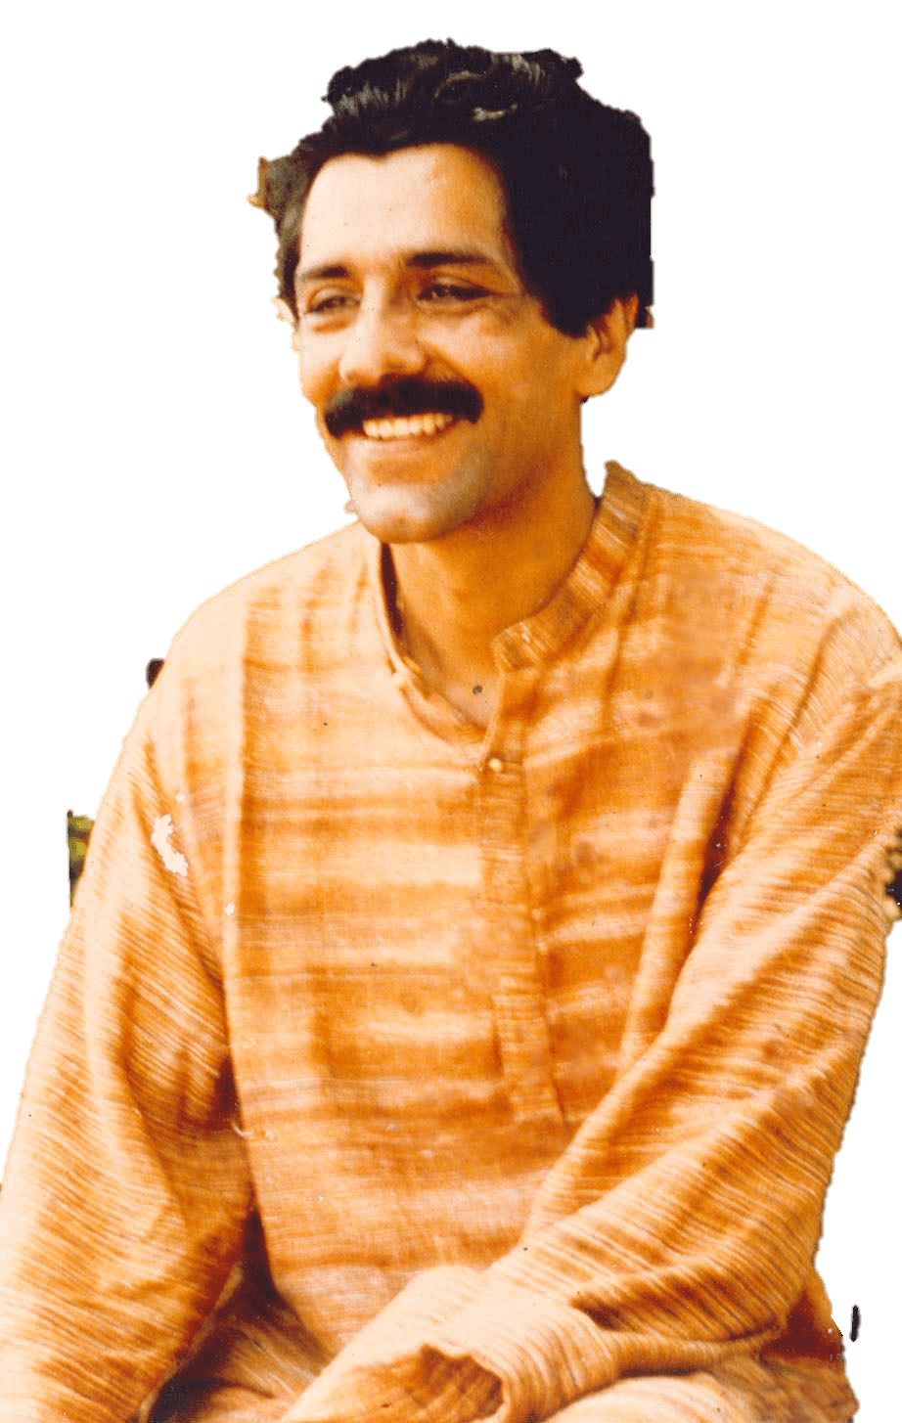
ABOUT CRY

Slide 15
ABOUT CRY
What began in 1979 as a small dream—with just ₹50 and a group of six friends led by Indian Airlines purser Rippan Kapur—has grown into one of India’s most impactful child rights movements. Today, CRY partners with 144 grassroots organizations across 20 states and has transformed the lives of over 4.7 million children.

Slide 16
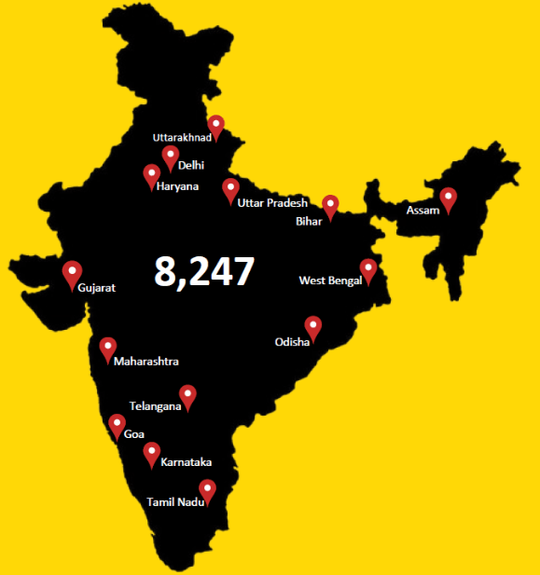
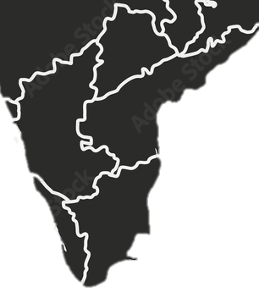
All-India Volunteer Presence
United by purpose, our volunteers drive change across every state, every community.
10,000 +

Slide 17
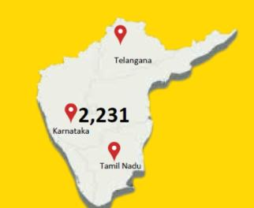
Southern Region Presence -
Empowering communities across Bangalore, Hyderabad, Chennai, and beyond.
10,000 +

Slide 18
01
Volunteer Demographics
Volunteer profile and Gender
01
Volunteer Demographics
02
Why individuals volunteer with CRY
03
Volunteer recruitment

Slide 19
01
Volunteer Demographics
Volunteer profile and Gender
01
Volunteer Demographics
02
Why individuals volunteer with CRY
03
Volunteer recruitment

Slide 20
01
Volunteer Demographics
01
Volunteer Demographics
Working Professionals 43%
College Students 31%
School students 16%
Others 10%
Gender demographics
Male 40%
Female 60%

Slide 21

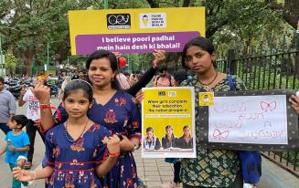
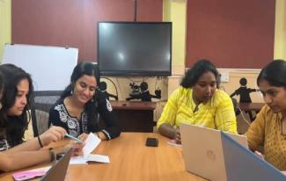
01
Volunteer Demographics
02
Why individuals volunteer with CRY
CRY offers a wide range of volunteering opportunities tailored to people from diverse backgrounds and locations. In Bangalore, volunteers actively participate in school-based interventions, working closely with children and educators. In Hyderabad, they contribute through hands-on involvement in children’s homes. While opportunities in Chennai are being shaped based on local needs, remote volunteers from cities like Vizag, Vijayawada, and Cochin—as well as other tier-2 cities—play a vital role by lending their skills in areas such as design, data analysis, translation, documentation, fundraising, and research. Whether working on-site or remotely, every volunteer has a meaningful way to make an impact.
Working Professionals 43%
College Students 31%
School students 16%
Others 10%
Gender demographics
Male 40%
Female 60%
with children and educators. In Hyderabad, they
Because it’s more than just volunteering—it’s about being part of a movement that creates real change. Volunteers join CRY not just to give back, but to grow, learn, and become change-makers in their communities

Slide 22
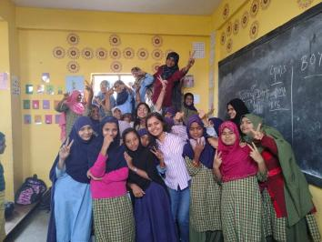
01
Volunteer Demographics
02
Why individuals volunteer with CRY
CRY offers a wide range of volunteering opportunities tailored to people from diverse backgrounds and locations. In Bangalore, volunteers actively participate in school-based interventions, working closely with children and educators. In Hyderabad, they contribute through hands-on involvement in children’s homes. While opportunities in Chennai are being shaped based on local needs, remote volunteers from cities like Vizag, Vijayawada, and Cochin—as well as other tier-2 cities—play a vital role by lending their skills in areas such as design, data analysis, translation, documentation, fundraising, and research. Whether working on-site or remotely, every volunteer has a meaningful way to make an impact.
Working Professionals 43%
College Students 31%
School students 16%
Others 10%
Gender demographics
Male 40%
Female 60%
with children and educators. In Hyderabad, they
Driven by curiosity and the desire to create change, school students step in with youthful energy. Volunteering not only fuels their passion—it also shapes their future, building skills and experiences that stay with them for life.

Slide 23
01
Volunteer Demographics
02
Why individuals volunteer with CRY
Working Professionals 43%
College Students 31%
School students 16%
Others 10%
Gender demographics
Male 40%
Female 60%
CRY believes in valuing its volunteers meaningfully. From regular thank-yous and personalized feedback to inclusion in staff events and project consultations, every effort is acknowledged. Volunteers are recognized at key levels—including mentions by leadership like Trustees and the CEO. Select critical roles may receive honoraria, while annual celebrations, certifications, and a growing repository of volunteer stories ensure their contributions are celebrated and shared widely.
Fueled by energy and enthusiasm, college students dive into volunteering not just to lead, but to learn. They take on impactful roles, build leadership skills, and shape profiles that prepare them for the future—with purpose at the core.

Slide 24
01
Volunteer Demographics
02
Why individuals volunteer with CRY
Working Professionals 43%
College Students 31%
School students 16%
Others 10%
Gender demographics
Male 40%
Female 60%
To keep volunteers motivated and committed, CRY ensures they are given trusted, impactful roles with real responsibility. Volunteers work alongside leadership, contribute to high-impact initiatives, and are encouraged to take ownership of their tasks. They’re involved in planning how work is executed within clear guidelines and are part of setting measurable goals—with regular feedback to help them grow and see the difference they’re making.
Young professionals bring purpose and precision to the table—they volunteer for a cause they believe in, apply strategic thinking, and often become powerful connectors who help drive new opportunities and partnerships.
Seasoned professionals lend their expertise not for profit, but for purpose—championing pro bono projects, mentoring passionate teams, helping raise vital funds, and shaping new CRY spaces where change can truly grow

Slide 25
03
Volunteer recruitment
01
Volunteer Demographics
02
Why individuals volunteer with CRY
Website Presence: Highlight the cause, showcase volunteer testimonials, success stories, and outline perks of volunteering.
Social Media Campaigns: Use creative, engaging posts to communicate the unique CRY volunteering experience. Go beyond generic messaging—focus on the need, role clarity, community impact, and volunteer benefits. Promote key programs like YCC, Sprint, and Micro Volunteering.
Strategic Outreach: Align recruitment with current trends, such as targeting micro-volunteers—college students and young professionals seeking flexible engagement.
Efficient Onboarding Process:
Respond promptly to inquiries
Conduct two orientations per month (based on staff capacity)
Include Q&A sessions
Ensure a smooth, seamless registration and joining experience
Adapt timelines based on the volunteering program type
Working Professionals 43%
College Students 31%
School students 16%
Others 10%
Gender demographics
Male 40%
Female 60%
Because it’s more than just volunteering—it’s about being part of a movement that creates real change. Volunteers join CRY not just to give back, but to grow, learn, and become change-makers in their communities
Website presence
Social media campaign
Strategic outreach
Efficient Onboardprocess

Slide 26
Engagement, explanation, expectation clarity
&
How to sustain them
123
Support them by:
a) Giving them the space and confidence to share ideas
b) Equipping them with skills and perspectives
c) Active handholding and mentoring as required
d) Giving access to information and resources

Slide 27
123
Supervise through:
a) Periodic meetings with volunteers
b) Field visits
c) Programme evaluations

Slide 28
123
.Develop by:
a) Productive feedback
b) Facilitating healthy interactions
c) Forming peer learning groups
d) Delegating responsibilities and kindling volunteer ownership
e) Organising CBs/ workshops/ exposures
.Develop by:
a) Productive feedback
b) Facilitating healthy interactions
c) Forming peer learning groups
d) Delegating responsibilities and kindling volunteer ownership
e) Organising CBs/ workshops/ exposures

Slide 29
( Picture)
To make volunteering more effective and rewarding, CRY assigns tasks based on each volunteer’s strengths, skills, and convenience. Volunteers are grouped by their expertise—such as design, data analysis, or translation—and matched with CRY mentors for guidance and collaboration. We also prioritize location-based placements to save time and resources; for example, a volunteer from Marathahalli would be assigned to a nearby school rather than one across the city in Yeswanthpur. This thoughtful approach helps volunteers stay engaged while maximizing their impact.

Slide 30
One of the most effective ways to keep volunteers engaged and committed is by building a sense of community among them. At CRY, we’ve seen this in action—like during the WCDW program, which started with just three volunteers. Their consistent participation, willingness to share their experiences, and open feedback inspired others to join in. By the end, the group had grown to 14. When volunteers support and motivate each other, it creates a ripple effect that strengthens the entire program.
( picture)

Slide 31
