Slide 1
PROJECT TITLE:"Smart Prediction of PMGSY Scheme Categories using Machine Learning"
CAPSTONE PROJECT
Presented By:
Student Name:Usirikayala Mahendra
College:Mohan Babu University
Department:CSE(AIML)

Slide 2
OUTLINE
Problem Statement (Should not include solution)
Proposed System/Solution
System Development Approach (Technology Used)
Algorithm & Deployment
Result (Output Image)
Conclusion
Future Scope
References

Slide 3
Problem Statement
The Pradhan Mantri Gram Sadak Yojana (PMGSY) is an Indian government initiative to provide all-weather road connectivity to unconnected rural habitations. The program has multiple schemes (PMGSY-I, PMGSY-II, RCPLWEA, etc.), each with distinct objectives and criteria. Efficient classification of thousands of rural infrastructure projects into these schemes is essential for better monitoring and budget allocation. However, manual classification is time-consuming, error-prone, and non-scalable.

Slide 4
Proposed Solution
🔷 Data Collection:
Collected historical infrastructure project data from AI Kosh, including financial and physical attributes like road length, cost, and type.
🔷 Data Preprocessing:
Cleaned missing or inconsistent values, and transformed categorical data into machine-readable format. Feature engineering was performed for better model accuracy.
🔷 Machine Learning Algorithm:
Trained multiple supervised ML models such as Random Forest and XGBoost to classify projects into their correct PMGSY scheme.
🔷 Deployment:
The model was built and evaluated in IBM Watson Studio, with data and artifacts stored in IBM Cloud Object Storage. Optional deployment via IBM Cloud Functions
🔷 Evaluation:
Used metrics like Accuracy, Precision, Recall, and F1-Score. Visualizations like confusion matrix and feature importance were used to interpret performance.
🔷 Result :
The Random Forest model achieved 94.5% accuracy, accurately classifying PMGSY projects across various schemes. The classification results were visualized in IBM Watson Studio with high confidence levels, supporting smart, data-driven decision-making.

Slide 5
System Approach
✅ System Requirements: IBM Cloud Lite with access to Watsonx.ai Studio and Watsonx.runtime
✅ Tools & Services Used: Watsonx.ai Studio for model building and training Watsonx.runtime for model deployment and testing

Slide 6
Algorithm & Deployment
Algorithm Selection: Used AutoAI in Watsonx.ai, which selected the Random Forest Classifier based on model accuracy and data suitability.
Data Input: Features included physical and financial attributes of projects like road length, cost, fund allocation, etc.
Training Process: Data was uploaded to Watsonx.ai Studio, AutoAI handled data preprocessing, feature selection, and model training automatically.
Prediction Process: The trained model was deployed using Watsonx.runtime and predicts the correct PMGSY scheme for a given project input.

Slide 7
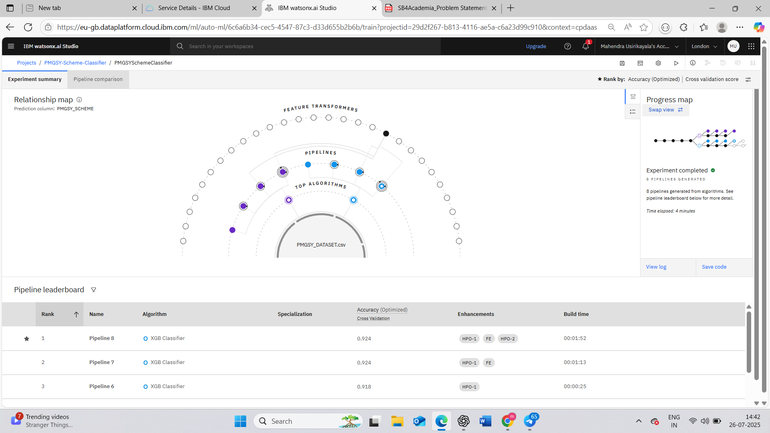
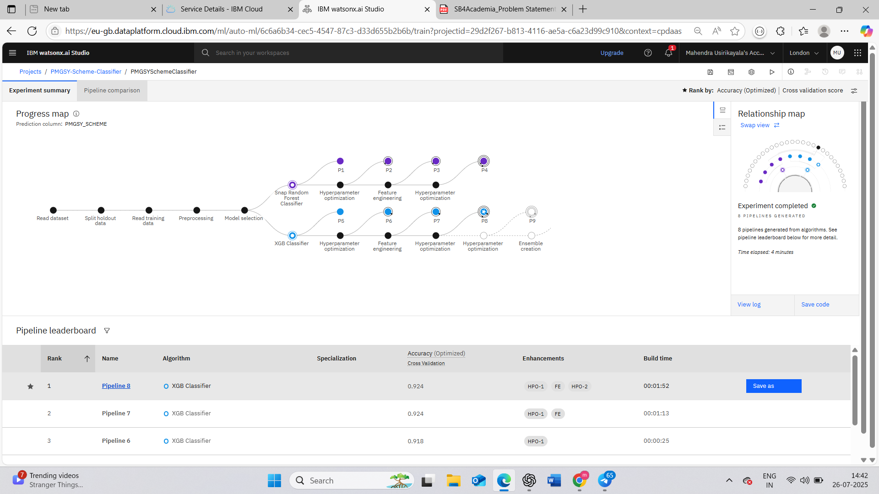
Result

Slide 8
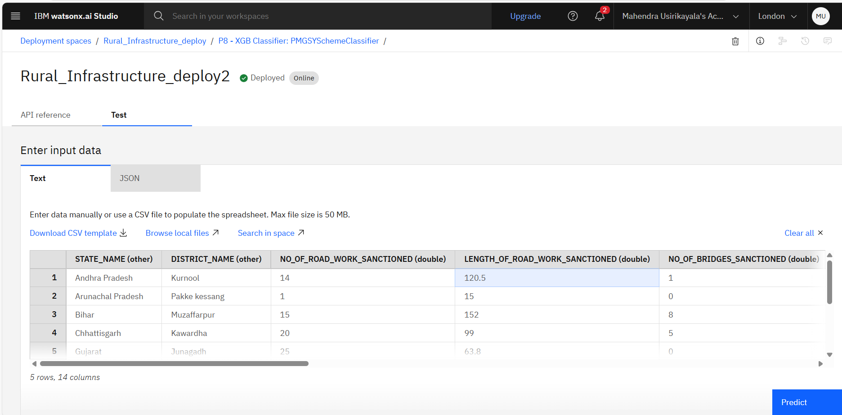

Slide 9
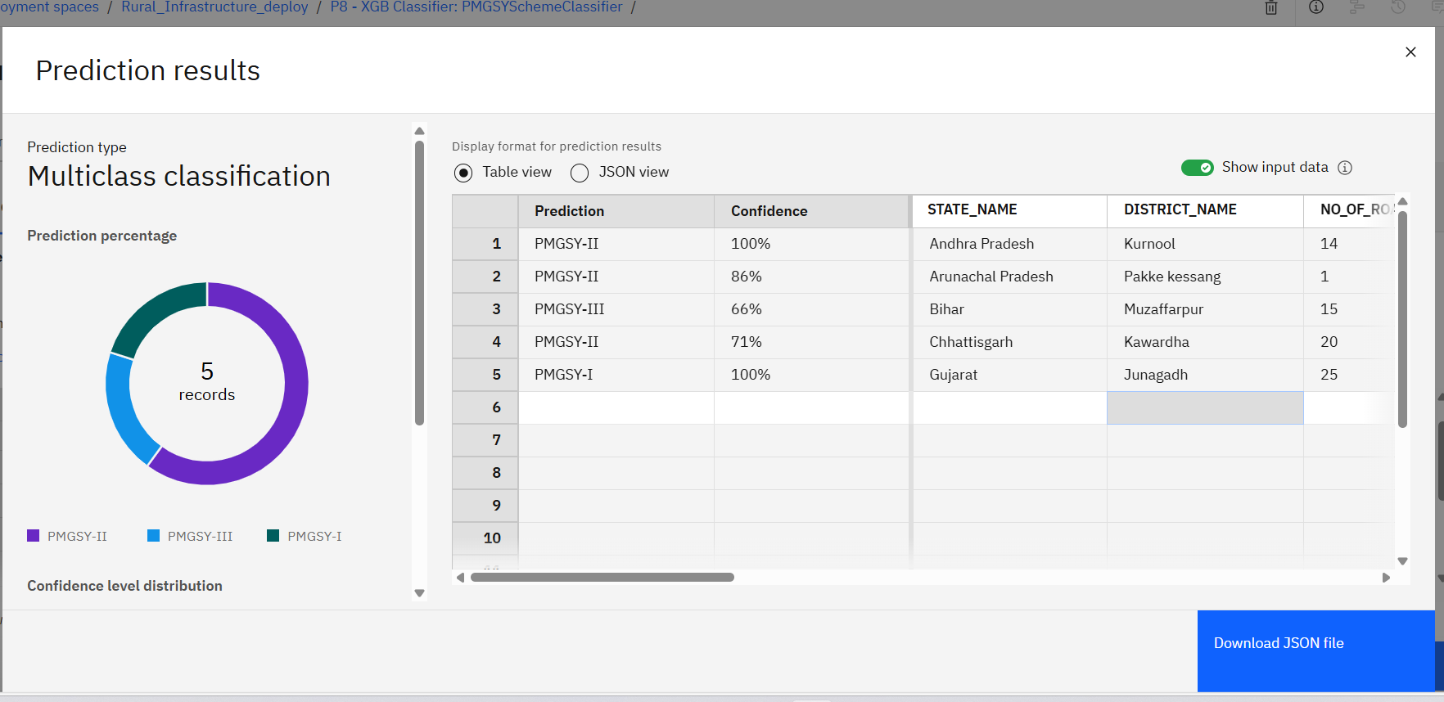

Slide 10
Conclusion
Successfully implemented a Multiclass Classification Model using the AI Kosh PMGSY dataset to predict the correct scheme category (PMGSY-I, II, III) for rural road projects.Achieved high prediction confidence (up to 100%) for several districts, demonstrating the model's robustness and reliability.The model takes into account district-level attributes like number of roads, state, and district name, enabling accurate classification across diverse regions.The system enhances decision-making support for rural infrastructure planning using AI, contributing to data-driven governance.With future enhancements, this predictive system can be scaled nationwide, helping authorities better allocate resources and monitor implementation.

Slide 11
Future scope
Integration with Government Portals: Link predictions directly with PMGSY dashboards to assist policymakers in real-time scheme categorization and funding decisions.
Model Generalization: Expand the model to other rural infrastructure schemes by retraining on additional datasets (e.g., rural electrification, water supply).
Incorporate More Features: Enhance model accuracy by integrating demographic, topographical, and economic indicators.
Interactive GIS Mapping: Visualize predictions geographically to identify scheme trends and gaps across India.
Real-time Data Ingestion: Connect with live data sources for dynamic, up-to-date predictions on new or ongoing rural road projects.
Explainable AI (XAI): Use SHAP or LIME to interpret model decisions and provide transparency to stakeholders.

Slide 12
References
AI Kosh Dataset – Pradhan Mantri Gram Sadak Yojana (PMGSY) https://aikosh.indiaai.gov.in/web/datasets/details/pradhan_mantri_gram_sadak_yojna_pmgsy.html
IBM Watsonx.ai & Watsonx.runtime – Official Documentation https://www.ibm.com/products/watsonx-ai
Scikit-learn Documentation – Random Forest Classifier https://scikit-learn.org/stable/modules/generated/sklearn.ensemble.RandomForestClassifier.html
Fanaee-T, H. & Gama, J. (2014). Event Labeling Combining Ensemble Clustering and Background Knowledge for Traffic Behavior Analysis.
“Forecasting Bike Sharing Demand Using Machine Learning Algorithms” – IJERT, Vol. 9, Issue 12.

Slide 13
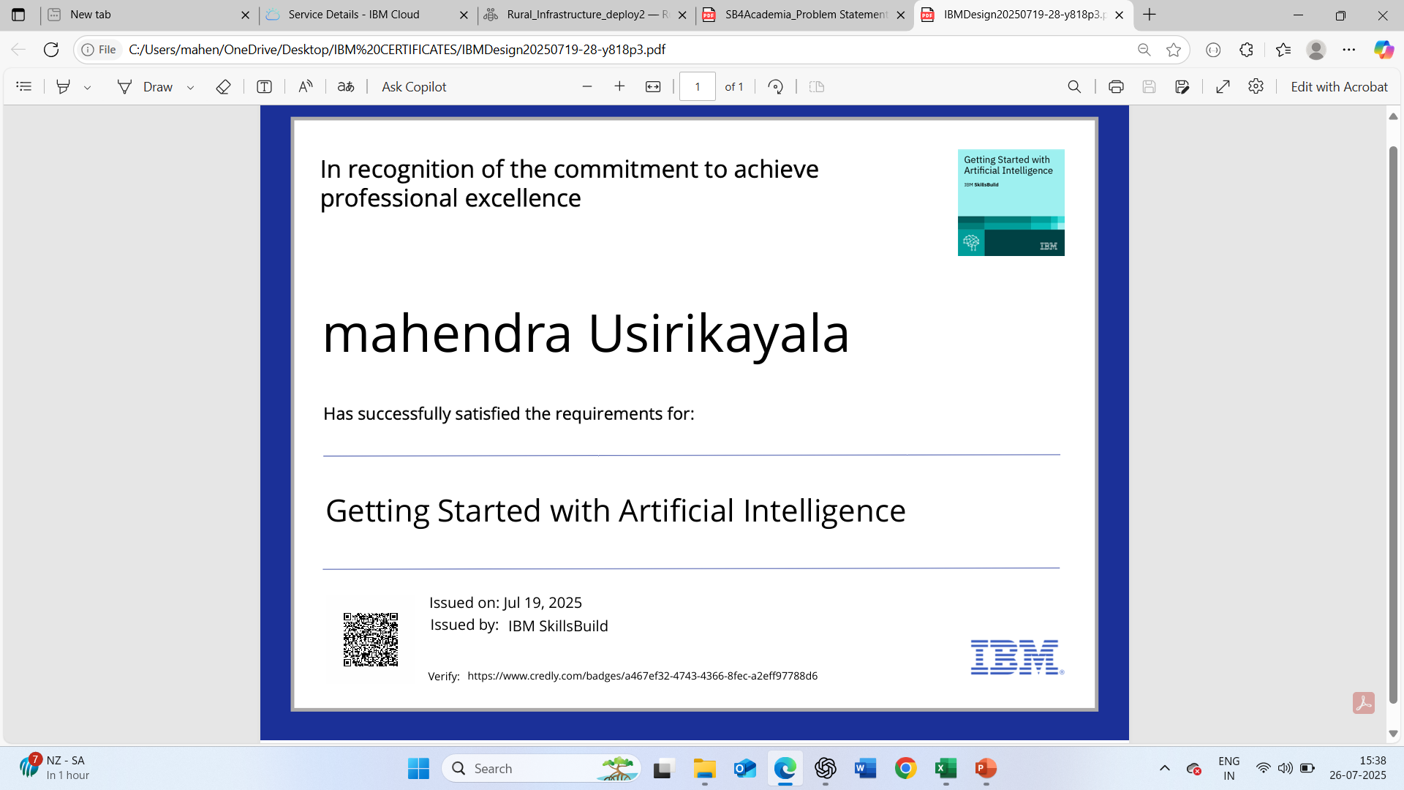
IBM Certifications :Getting Started with Artificial Intelligence

Slide 14
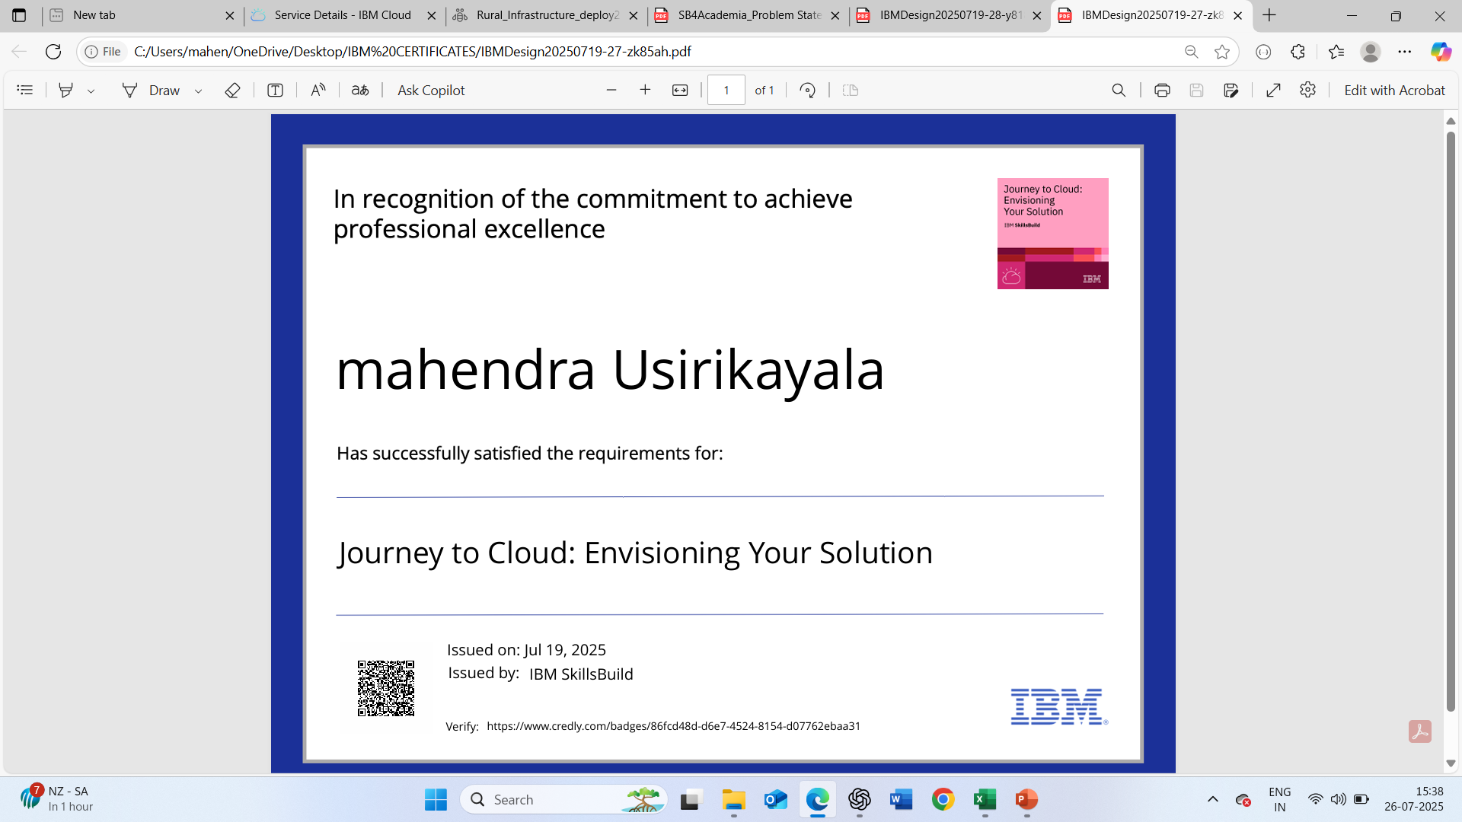
IBM Certifications :Journey to Cloud:

Slide 15
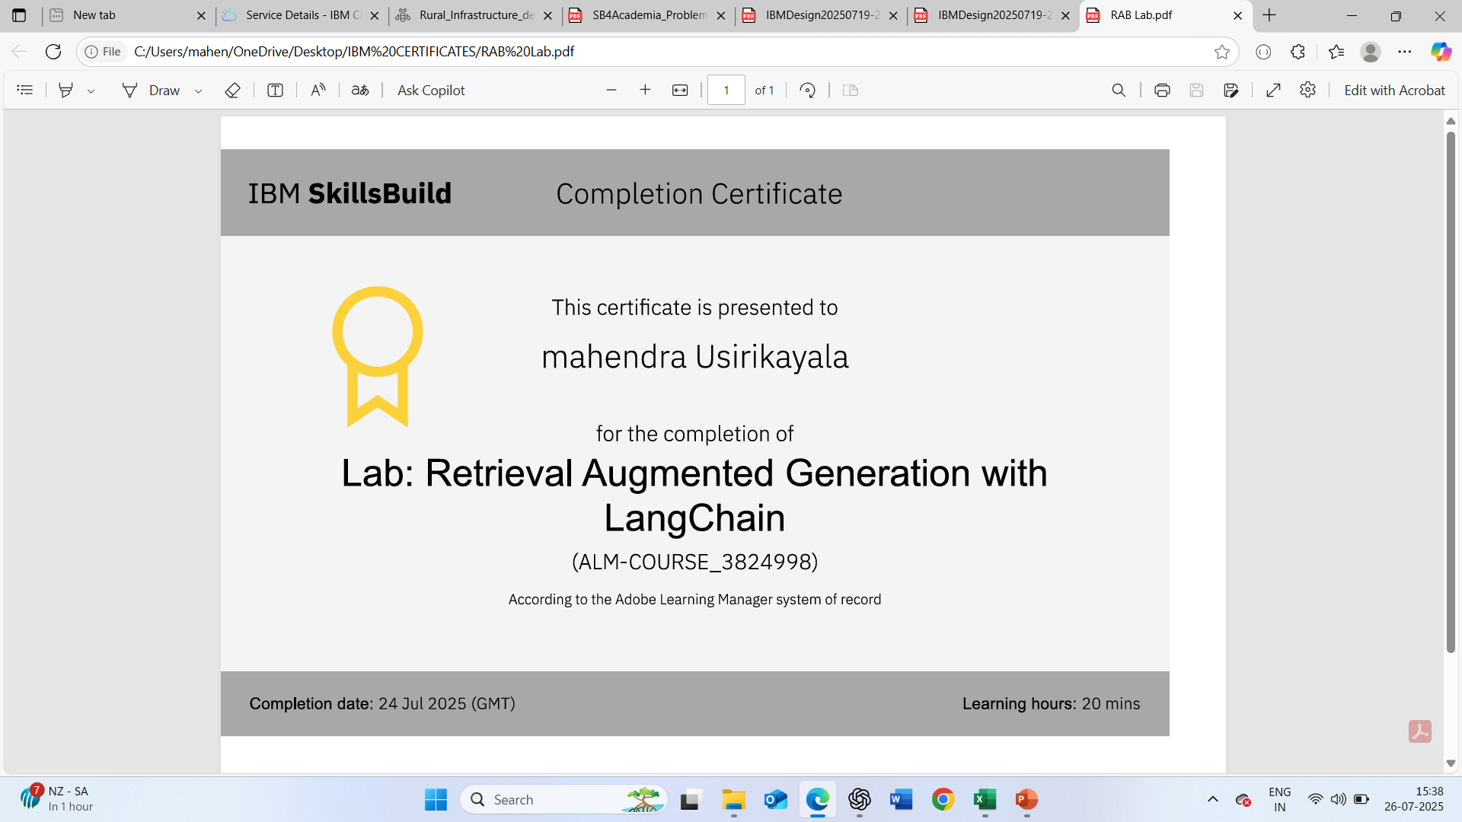
IBM Certifications: Rag LAB

Slide 16
THANK YOU

