Slide 1
DDoS Detection Using SVM

Slide 2
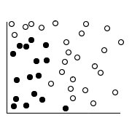
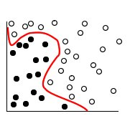
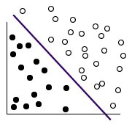
Support Vector Machine Algorithm (SVM):
is a supervised machine learning algorithm
Mapping data and categorize it when the data are not otherwise linearly separable
Use a mathematical function called kernel to define the data by a hyperplane
Notes:
it is a supervised machine learning algorithm that can be used for both classification and regression tasks

Slide 3
Logic:
Collect the network metrics as training data
Train the machine learning algorithm with training data
In live traffic, the controller will collects the network metrics and classify with machine learning algorithm
machine learning algorithm classify as Normal traffic or Attack traffic

Slide 4
Network Metrics :
Collect the training data :
SFE(Speed of Flow Entry)
SSIP(Speed of Source IP)
RFIP(Ratio of Flow Pair)
SDFB(Standard deviation of flow bytes)
SDFP(Standard deviation of flow packets)

Slide 5
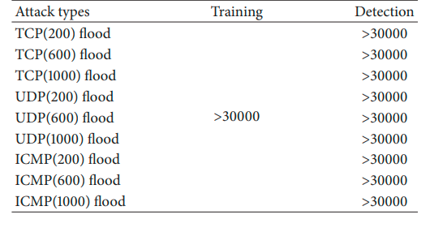
Network Metrics :
This floods are used as training and for detection of attack samples.
The numbers in brackets are the size of the packets .
The sampling period is 3 second
Collect the flow table every 60 periods. .
then process and normalize the data of each period.
Notes:
The numbers in brackets are the size of the packets at the time of attack, They are same as the size of the packets of training data.
the sampling period T (interval) is 3 second.
- we collect the flow table data of 60 periods

Slide 6
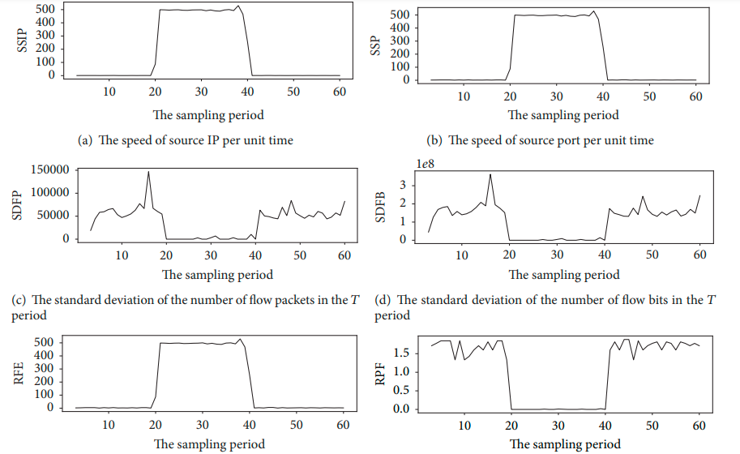
Network Metrics :
Notes:
we get the normal samples and DDoS attack flow samples of the six-tuple characteristic values matrix

Slide 7
Demo

Slide 8
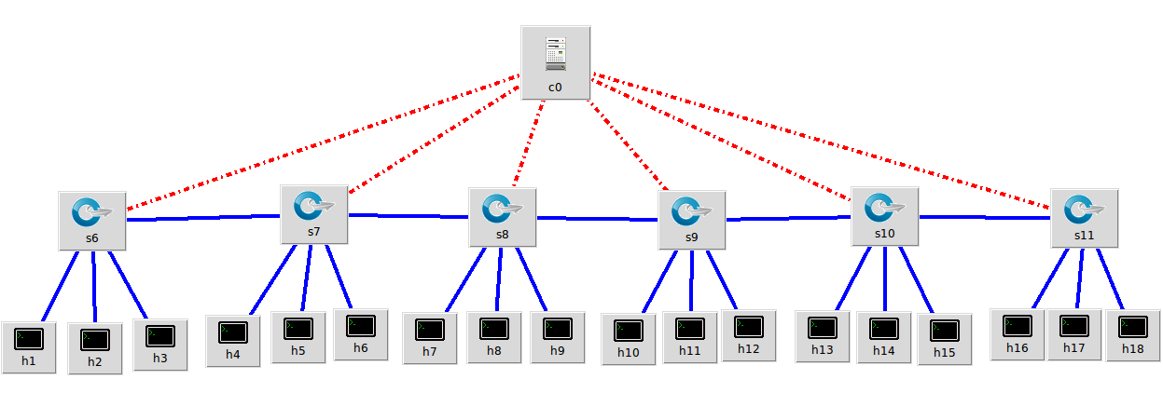
Topology
Controller
Switch
Host

Slide 9
Thank you

