Slide 1
LEBNET TECH FELLOWS · AI FOR LEBANON · SUMMER 2026
Beirut ReRoute
→ Lebanon ReConnect
An AI-designed, simulated, and regionally-envisioned public transport system for Lebanon — from one underserved Beirut neighborhood to a reconnected national and regional network.
Maher Bekdash
maherbekdash05@gmail.com
Notes:
Hi, I'm Maher Bekdash, and this is my LebNet Tech Fellows final project: Beirut ReRoute, which grew into Lebanon ReConnect. In one sentence, this project designs, and proves in simulation, an AI-driven path from Beirut's fragmented public transport to a regionally-reconnected Lebanon. Over the next few minutes I'll walk through why this problem matters, how my thinking on it evolved three separate times, exactly how the AI methodology works, what the real results actually are, and what I learned building it.

Slide 2
ROADMAP
What this presentation covers
01
The problem
02
Evolution of thought
Why Lebanon's transport system needed this project
How the project's scope changed three times, and why
03
Methodology
04
Real results
Two layers: an AI-designed simulated pilot, and a national vision
Coverage, simulation, and centrality numbers — all from real code runs
05
Contributions & limits
06
Action plan & reflection
What's genuinely novel, and what we're not claiming
Where this goes next, and what the process taught me
2
Notes:
Here's the shape of the talk. First, the problem — why Lebanon's transport system needed this project. Second, and I want to spend real time here, the evolution of thought: this project did not arrive at its final form on day one, and I think the path it took is as instructive as the destination. Third, the methodology, split into two layers. Fourth, the real results, all pulled from actual code runs, not estimates. Fifth, what's genuinely novel here and, just as important, what I'm not claiming. And finally, the action plan and my honest reflection on the process.

Slide 3
PROBLEM DEFINITION
Lebanon runs on private cars — because nothing else works well enough
650,000
5%
92.2%
#1
vehicles enter the Greater
Beirut Area every day
of Lebanon's GDP lost
to congestion (World Bank)
walk-accessibility today —
sounds high, but ~235k people
are still outside it
Lebanon has the highest
transport CO₂/capita in the Levant
Meanwhile: Beirut's transport is a patchwork. Informal vans fill the gaps roads leave, and the new 2024 OCFTC/ACTC formal bus network (11 lines) runs in the same mixed traffic as everyone else — no dedicated lanes, no signal priority, and no feeder network connecting underserved neighborhoods to it.
This project's question: what would it take — concretely, provably — to fix that, and how far could the ambition scale, from one neighborhood to the whole region?
3
Notes:
Let's start with why this matters. The World Bank estimates 650,000 vehicles enter the Greater Beirut Area every single day, and congestion costs Lebanon roughly 5 percent of its GDP. Lebanon has the highest transport-related CO2 emissions per capita in the Levant. And even though walk-accessibility to some kind of stop today measures at 92.2 percent, that remaining 7.8 percent is around 235,000 real people with no practical way to reach public transport. The deeper issue is that Beirut's transport is a patchwork: informal vans fill gaps organically, and the new 2024 OCFTC formal bus network — eleven lines — runs in the exact same mixed traffic as every private car, with no dedicated lanes, no signal priority, and critically, no feeder network connecting underserved neighborhoods to it. So the real question this project asks is: what would it actually take to fix that, concretely and provably, and how far could that ambition scale — from one neighborhood, all the way up to the whole region?

Slide 4
AIM
Design — and prove in simulation — an AI-driven path from Beirut's
fragmented transit to a regionally-reconnected Lebanon.
Not a diagnosis. Not a wish list. An AI method that actually designs a route network, a simulation that actually tests it against today's system, and real, sourced regional data quantifying what reconnection could mean for Beirut's role in the region.
4
Notes:
So here's the aim, stated as precisely as I can state it. Design, and prove in simulation, an AI-driven path from Beirut's fragmented transit to a regionally-reconnected Lebanon. I want to be specific about what that means in practice. This is not a diagnosis — I'm not just producing another report that says 'Beirut has a transit problem.' It's not a wish list either. It's an AI method that actually designs a route network using real optimization, a simulation that actually tests that network against the status quo using real road data, and real, sourced regional data quantifying what reconnecting Lebanon regionally could concretely mean for Beirut's role in the wider region.

Slide 5
EVOLUTION OF THOUGHT — PART 1
It started as: “fix Beirut's buses”
1
Original passion
Beirut's transport specifically: routes, hotspots, gaps, congestion data, and modern tech (IEEE 802.11p / V2X) on Beiruti roads.
2
Four candidate ideas
I generated four scoped AI/ML directions before committing: transit-desert detection, congestion+V2X corridor simulation, an AI trip planner, and a mobility-equity dashboard.
3
Chose: congestion + V2X simulation
Predict hotspots with ML, then simulate a V2X-style adaptive signal controller on one corridor.
4
Scope reality check
RL-based signal control plus a full ML prediction pipeline is genuinely ambitious solo work in 3 weeks — flagged honestly before building anything.
5
Descoped
Single corridor, an existing RL library instead of a custom controller, one prediction model instead of two — kept the idea, cut the risk.
5
Notes:
Now, the evolution of thought — part one. This started as simply wanting to fix Beirut's buses: I cared specifically about routes, congestion hotspots, coverage gaps, and modern technology like IEEE 802.11p, or V2X, on Beiruti roads. Before committing to a direction, I generated four scoped candidate ideas: a transit-desert detector, a congestion-plus-V2X corridor simulation, an AI trip planner for the informal bus network, and a mobility-equity dashboard. I chose the congestion-plus-V2X direction: predict congestion hotspots with machine learning, then simulate a V2X-style adaptive traffic signal controller on one corridor. But before writing a line of code, I did a scope reality check — reinforcement-learning-based signal control, layered on top of a full separate ML prediction pipeline, is genuinely ambitious for solo work in three weeks. So I descoped deliberately: one corridor instead of the whole network, an existing reinforcement-learning library instead of a custom controller I'd have to build and debug from scratch, and one prediction model instead of two. The idea stayed the same; the risk went down.

Slide 6
EVOLUTION OF THOUGHT — PART 2
“Congestion prediction isn't the point — a working system is”
1
The pushback
“I don't just want to predict congestion — I want to propose a system that solves the shortcomings. Congestion is a subtopic, used as a black box.”
2
Restructure
The AI headline became network *design*: a coverage-optimization algorithm (MCLP) that actually proposes a feeder route network — not a diagnostic.
3
Congestion model demoted
Travel-time prediction became a supporting utility feeding the design and simulation — never the star.
4
Simulation added
A rule-based transit-signal-priority simulation (representing what V2X/802.11p enables) validates the proposed network against status quo.
5
Result
This became Layer B: Beirut ReRoute — an AI-designed, simulated feeder-and-trunk network.
6
Notes:
Evolution of thought, part two. At this point I got direct pushback on the framing, and it was the right pushback: 'I don't just want to predict congestion — I want to propose a system that solves the current shortcomings. Congestion prediction is a subtopic, used as a black box.' That single sentence restructured the entire project. The AI headline stopped being congestion prediction and became network design itself: a coverage-optimization algorithm — specifically, a Maximal Covering Location Problem, or MCLP — that actually proposes a feeder route network, rather than just diagnosing where the problems are. The travel-time and congestion model got demoted to a supporting utility that feeds realistic estimates into the design and simulation steps — never the star of the show. And a simulation got added: a rule-based transit-signal-priority simulation, representing what real V2X and 802.11p communication would enable, that validates the proposed network against today's system. This is where Layer B was born — what I now call Beirut ReRoute.

Slide 7
EVOLUTION OF THOUGHT — PART 3
“I want to envision all of Lebanon, not just Beirut”
1
The bigger ask
Ports, rail, trams, metro, international lines — Beirut as a regional hub connecting to Damascus, Amman, Cyprus, Turkey — “regardless of budget.”
2
Reality check
Simulating ports, ships, and rail nationwide isn't buildable solo in days — but the ambition was legitimate and, as research showed, well-timed.
3
Grounded, not invented
Real 2025-2026 developments: the Jounieh–Cyprus ferry, the Turkey-Syria-Jordan-Saudi Hejaz Railway revival, Lebanon's own Arab Mashreq Railway agreement.
4
The reconciliation
Split into two honestly-scoped layers instead of one overreaching one — see next section.
5
Then: the pivot to code
Discovered Layer B was already substantially implemented in real, tested code — pivoted straight into extending it for Layer A.
7
Notes:
Evolution of thought, part three, and this is the big one. The ask expanded again: 'I want to envision all of Lebanon, not just Beirut' — ports, rail, trams, metro, international lines, Beirut as a regional hub connecting to Damascus, Amman, Cyprus, and Turkey, regardless of budget. My honest reality check: physically simulating ports, ships, and a national rail network is not buildable solo in a matter of days. But the ambition itself was completely legitimate, and when I actually researched it, it turned out to be extremely well-timed rather than speculative. There is a real, dated Jounieh-to-Cyprus ferry launching in 2026. There is a real Turkey-Syria-Jordan-Saudi Arabia agreement reviving the historic Hejaz Railway, signed across 2025 and 2026. And Lebanon is already a signatory to the Arab Mashreq International Railway agreement. So instead of building one project that tried to do everything and risked finishing none of it, I reconciled the ambition into two honestly-scoped layers — which I'll show you next. And around this same point, I discovered that Layer B, the Beirut pilot, was already substantially implemented in real, tested code — so the work pivoted directly into extending that codebase for the new national layer.

Slide 8
SYSTEM ARCHITECTURE
Two layers, reconciled by scope — not by ambition
LAYER A — Lebanon ReConnect
LAYER B — Beirut ReRoute
National / regional vision
AI-designed, simulated pilot
A lightweight network graph of Lebanon's ports, historic and
currently-revived rail, and the 2026 regional ferry — evaluated
with graph centrality, not physical simulation.
Answers: how much more central could Beirut become,
regionally, if reconnected?
Scope: days, not weeks. Topological, not engineering-grade.
A coverage-optimization algorithm (MCLP) designs a real feeder
network for underserved Beirut neighborhoods, connecting them
to the 2024 OCFTC trunk lines.
A signal-priority simulation (SimPy) tests the proposed system
against today's, on real OSM roads and real geocoded stops.
Scope: one region, fully executable, fully tested.
Connected by a phased action plan: Layer B is Phase 1 of Layer A's vision.
8
Notes:
Here's how the two layers fit together. Layer A, Lebanon ReConnect, is the national and regional vision: a lightweight network graph of Lebanon's ports, its historic and currently-being-revived rail lines, and the 2026 regional ferry, evaluated using graph centrality analysis rather than physical simulation. It answers one specific question: how much more central could Beirut become, regionally, if these dormant and planned links were restored? This layer is scoped to days, not weeks, and it's explicitly topological rather than engineering-grade. Layer B, Beirut ReRoute, is the AI-designed, simulated pilot: the coverage-optimization algorithm designs a real feeder network for underserved Beirut neighborhoods, connecting them to the 2024 OCFTC trunk lines, and a signal-priority simulation tests that proposed system against today's, on real OSM roads and real geocoded stops. This layer is scoped to one region, but it's fully executable and fully tested. And critically, the two are connected by a phased action plan — Layer B is explicitly Phase 1 of Layer A's larger vision, not a separate, disconnected project.

Slide 9
METHODOLOGY · LAYER B
Beirut ReRoute: four stages, real data at every step
①
Data acquisition
Real OSM road/walk networks, WorldPop population density, the crowdsourced Lebanese Bus Routes dataset, and OCFTC/ACTC's 9 formal lines — hand-transcribed from transitapp.com and geocoded via Nominatim (191 stops, 157 resolved).
②
Accessibility scoring
An H3 hex grid scores every cell's walk-time to the nearest stop today — the status-quo baseline: 92.2% population-weighted coverage.
③
AI network design (MCLP)
A Maximal Covering Location Problem, solved with PuLP/OR-Tools, chooses feeder stops that maximize newly-covered underserved population per trunk line — the actual 'AI designs a network' step.
④
Signal-priority simulation
A SimPy discrete-event simulation runs status-quo vs. proposed (feeder network + rule-based transit signal priority, representing V2X/802.11p) on real roads with real traffic signals.
9
Notes:
Let's get into how Layer B actually works, technically, in four stages. Stage one is data acquisition: real OpenStreetMap road and walk networks, WorldPop population density data, the crowdsourced Lebanese Bus Routes dataset for informal vans, and OCFTC's nine formal lines, which I hand-transcribed from transitapp-dot-com and geocoded through OpenStreetMap's Nominatim service — 191 stops total, 157 successfully resolved. Stage two is accessibility scoring: an H3 hexagonal grid scores every cell's walk-time to its nearest stop today, which gives the status-quo baseline of 92.2 percent population-weighted coverage. Stage three is the actual AI network design: a Maximal Covering Location Problem, solved with PuLP and OR-Tools, chooses feeder stops that maximize newly-covered underserved population for each trunk line — this is the real 'AI designs a network' step, not a diagnostic. Stage four is the signal-priority simulation: a SimPy discrete-event simulation runs status-quo versus proposed — meaning the feeder network plus rule-based transit signal priority representing V2X and 802.11p — on real roads with real traffic signal locations.

Slide 10
METHODOLOGY · LAYER A
Lebanon ReConnect: a graph, not a simulation — on purpose
①
18 sourced nodes
5 coastal hub cities, 3 inland hubs/junctions, 2 border crossings, 5 regional cities, 3 ferry destinations — every one tied to a real historic route, a signed agreement, or a dated 2026 launch.
②
18 sourced edges, 2 states
Status-quo (today's formal buses + informal links, 7 edges) vs. proposed (+ historic-dormant rail, the Arab Mashreq Railway, the Hejaz Railway revival, the Jounieh ferry — 18 edges).
③
Betweenness & closeness centrality
NetworkX computes both, weighted by great-circle distance, on each graph — quantifying Beirut's structural role rather than just asserting it.
④
Compare, don't assume
Every number is a real before/after delta from the actual computed graphs — including a negative, counter-intuitive result kept and explained, not hidden (see Results).
10
Notes:
Now Layer A's methodology, and I want to be clear about why this is a graph rather than a simulation. It starts with 18 sourced nodes: five coastal hub cities, three inland hubs and rail junctions, two border crossings, five regional cities, and three ferry destinations — every single one tied to a real historic route, a real signed agreement, or a real dated 2026 launch, not an invented placeholder. Then 18 sourced edges across two states: a status-quo graph with just today's formal buses and informal links, seven edges, versus a proposed graph that adds historic-dormant rail, the Arab Mashreq Railway, the Hejaz Railway revival corridor, and the Jounieh ferry — eighteen edges total. On both graphs, I compute betweenness and closeness centrality using NetworkX, weighted by great-circle distance, which quantifies Beirut's structural role instead of just asserting it in prose. And every number that comes out is a real before-and-after delta from the actual computed graphs — including one negative, counter-intuitive result that I kept and explained rather than dropping, which I'll show you in the results section.

Slide 11
TECHNICAL BUILDING
The stack
GeoPandas / Shapely
OSMnx
H3
Geospatial data wrangling
Real road & walk networks
Uber's hex-grid spatial index
PuLP / OR-Tools
NetworkX
SimPy
MCLP optimization solvers
Graph algorithms & centrality
Discrete-event traffic simulation
Folium
Matplotlib
Nominatim / OSM
Interactive Leaflet maps
Static charts & diagrams
Real-world geocoding
Python 3.14 · pytest (16/16 passing) · one-command reproducible pipeline (run_pipeline.py)
11
Notes:
For the technically curious, here's the full stack. GeoPandas and Shapely handle geospatial data wrangling. OSMnx pulls real road and walk networks. H3, Uber's hexagonal spatial index, builds the accessibility grid. PuLP and OR-Tools solve the MCLP optimization. NetworkX runs the graph algorithms and centrality analysis for Layer A. SimPy powers the discrete-event traffic simulation. Folium builds the interactive Leaflet maps. Matplotlib produces the static charts and diagrams you're seeing in this deck. And Nominatim handles real-world geocoding throughout. All of it runs on Python 3.14, backed by a sixteen-out-of-sixteen passing test suite, and the entire pipeline reproduces from a single command.

Slide 12
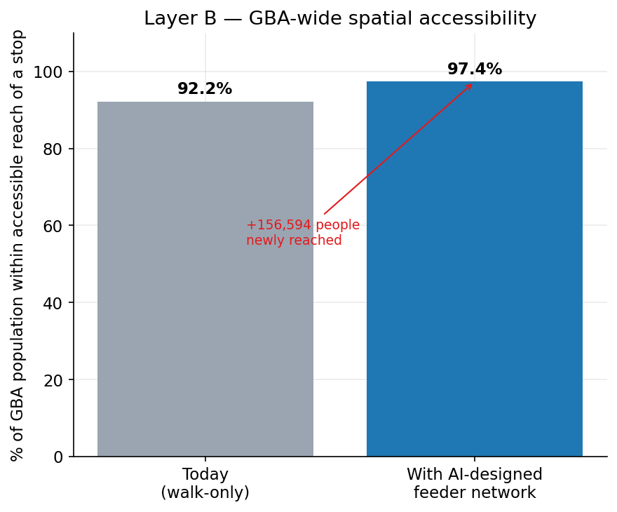
RESULTS · LAYER B
GBA-wide accessibility, before and after
92.2% → 97.4%
of GBA population within reach of a stop
The AI-designed feeder network reaches 156,594 additional people beyond the walk-only baseline — a real, computed number from the MCLP output, not an estimate.
12
Notes:
Let's look at real results, starting with Layer B's citywide accessibility. Today, 92.2 percent of the Greater Beirut Area's population is within walking reach of some kind of stop. With the AI-designed feeder network added, that rises to 97.4 percent. Concretely, that's 156,594 additional people reached — and I want to emphasize that number is computed directly from the MCLP optimizer's real output, not an estimate or a round number I picked for the slide.

Slide 13
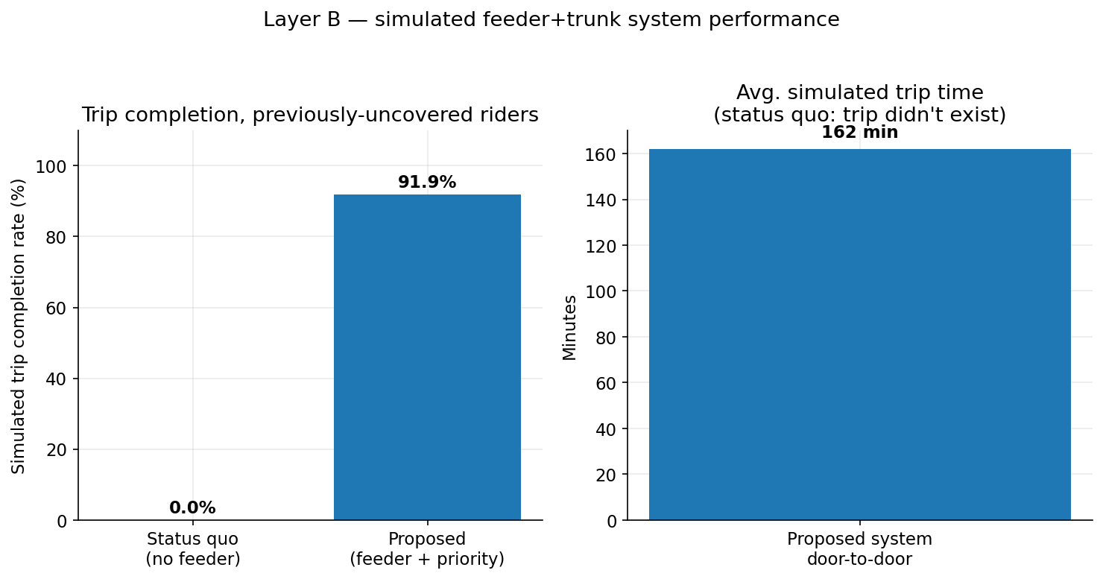
RESULTS · LAYER B
Does the proposed system actually work? (simulated)
0% → 91.9%
simulated trip completion, previously-uncovered riders
Distinct from the accessibility number: this is trip completion inside the SimPy simulation, among riders who had literally no route before. Average simulated door-to-door time: ~162 minutes (pulled up by one genuinely long ~4.4hr intercity corridor, ML1 — a real long-haul trunk, not a bug).
13
Notes:
This next number answers a different, narrower question: does the proposed system actually work when you simulate real riders moving through it? Among people who were previously completely uncovered — literally no route existed for them — simulated trip completion goes from 0 percent to 91.9 percent once they have the feeder-plus-trunk system available. The average simulated door-to-door trip time comes out to about 162 minutes, and that number is pulled upward by one genuinely long intercity corridor — line ML1, at roughly four and a half hours trunk time alone. That's a real long-haul corridor, not a simulation bug, and I want to be upfront about that rather than quietly averaging it away.

Slide 14
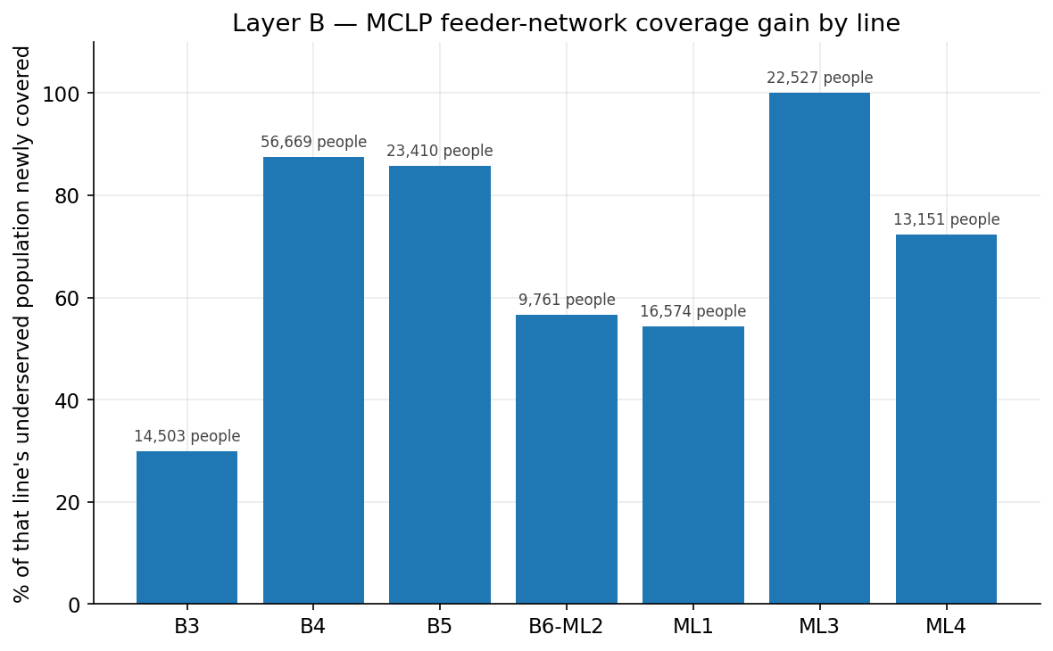
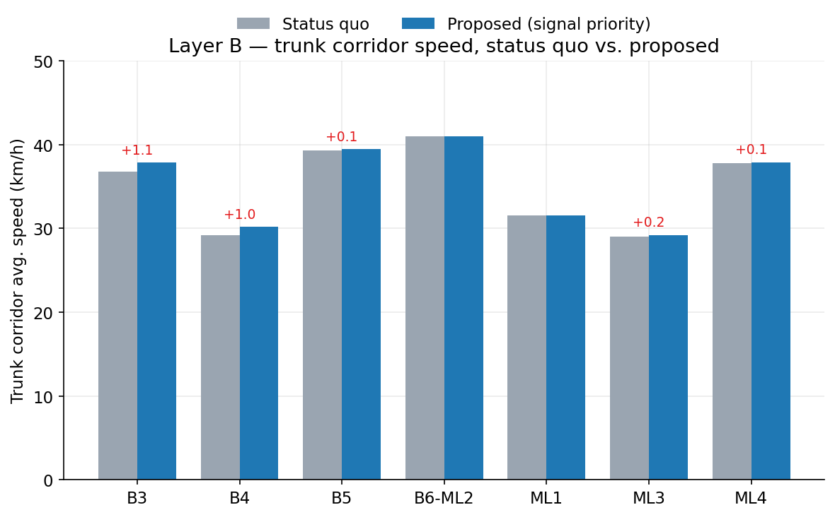
RESULTS · LAYER B
Per-line results: coverage gain and trunk speed
22 feeder stops across 7 lines · 68.4% (156,594 / 228,965) of underserved population newly covered · signal priority gives small, real speed gains where corridors actually have OSM-tagged traffic signals to act on (B3, B4 most; B6-ML2 and ML1 unchanged because their corridors have none — an honest null result, not a bug).
14
Notes:
Breaking this down per line: across the 7 lines that received a feeder network, 22 feeder stops were placed, covering 68.4 percent — 156,594 out of 228,965 people — of each line's underserved population. On trunk speed, signal priority produces small but real gains specifically where a corridor actually has OpenStreetMap-tagged traffic signals for it to act on — lines B3 and B4 see the clearest gains. Lines B6-ML2 and ML1 show no change at all, because their corridors contain zero real traffic-signal nodes — signal priority literally has nothing to intervene on there. I'm calling that out explicitly as an honest null result, not a bug I'm hiding.

Slide 15
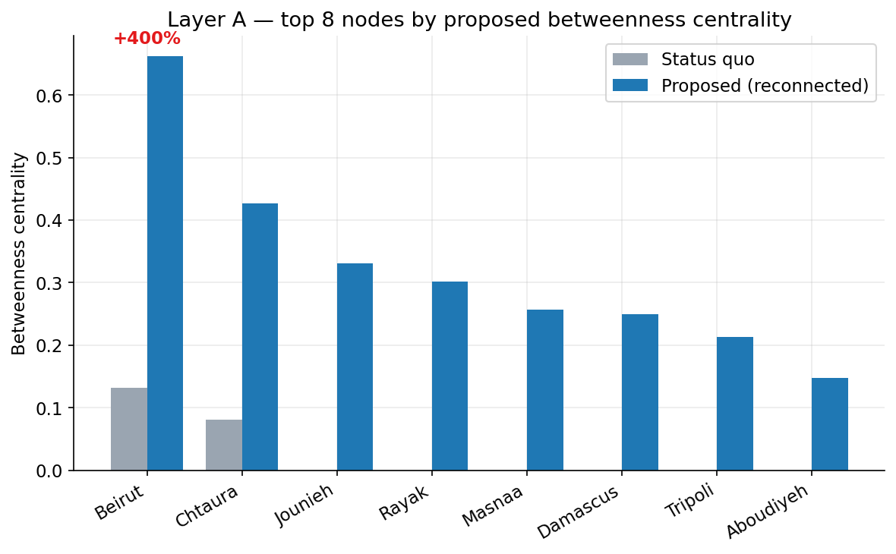
RESULTS · LAYER A
Reconnecting Lebanon would make Beirut a regional bridge
+400%
Beirut's betweenness centrality, status quo → proposed
Betweenness centrality measures how often a node sits on the shortest path between two others — a structural 'bridge' score. Restoring the historic rail, the Hejaz Railway revival corridor, and the 2026 ferry doesn't just add links to Beirut — it makes Beirut the node everything else routes through.
15
Notes:
Now Layer A. This is the headline regional number: if Lebanon's dormant and planned links were restored, Beirut's betweenness centrality in the regional network increases by 400 percent, from about 0.132 to about 0.662. Betweenness centrality measures how often a node sits on the shortest path between two other nodes — it's a structural 'bridge' score. So this isn't just saying Beirut gets more connections. It's saying Beirut becomes the node that everything else in the region increasingly has to route through.

Slide 16
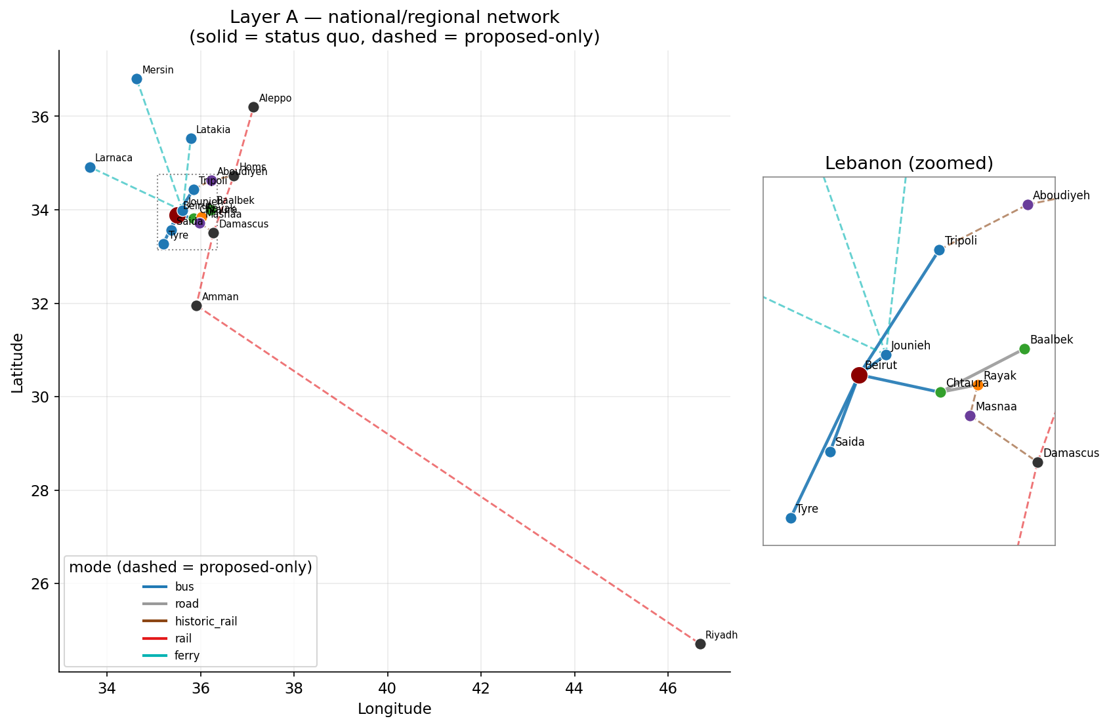
RESULTS · LAYER A
The network — and a result I kept instead of hiding
0.0082 → 0.0046 (−44%)
Beirut's closeness centrality — it FALLS
Not a bug. Closeness measures average distance to every reachable node. The proposed network makes genuinely distant places reachable for the first time — Riyadh, Mersin, Larnaca, hundreds to ~1,500km away. Average distance rises faster than reach does.
Reconnecting Lebanon is a bridging/gateway role, not a 'closer to everything' one — a real, worth-reporting finding I chose to explain rather than quietly drop.
16
Notes:
And here's a result I want to spend real time on, because I think how you handle a result like this says a lot about the rigor of a project. Beirut's closeness centrality — a different metric, measuring average distance to every reachable node — actually falls, by about 44 percent, from roughly 0.0082 to 0.0046. That is not a bug. Closeness measures average distance to everywhere reachable, and the proposed network makes genuinely distant places reachable for the very first time — Riyadh, Mersin, Larnaca, some of them over 1,500 kilometers away. Adding far-but-newly-reachable places increases the average distance faster than it increases how many places you can reach. The honest takeaway is that reconnecting Lebanon gives it a bridging or gateway role in the region, not a 'closer to everything' role — and I chose to report that finding and explain it, rather than quietly drop the metric that didn't confirm my thesis.

Slide 17
CONTRIBUTIONS
What's actually novel here
Design, not diagnosis
Two honestly-different scales
An optimization algorithm that proposes an actual route network (MCLP), not a model that just flags problems.
A lightweight graph-abstraction method for national vision, reconciled with a fully-simulated method for a real pilot — instead of overreaching on one.
Grounded in live regional history
Full reproducibility
The Hejaz Railway revival and the Jounieh ferry are 2025-2026 real developments — this project is timed with them, not speculative.
One command (`run_pipeline.py`) rebuilds every number and every figure in this deck from source data. 16/16 tests passing.
Real bugs, documented
Honest about limits
Five real data bugs found and fixed during actual runs (directed-graph connectivity, a wrong-direction Dijkstra trick, a simulation window sizing bug...) — logged, not erased.
Every result states its own caveats in the same breath — see next slide.
17
Notes:
So what's actually novel here, pulling it together? First, this is design, not diagnosis — an optimization algorithm that proposes an actual route network, not a model that just flags where problems are. Second, two honestly-different scales: a lightweight graph method for national vision, reconciled with a fully-simulated method for a real pilot, instead of one project overreaching on everything. Third, this is grounded in live regional history — the Hejaz Railway revival and the Jounieh ferry are real 2025-2026 developments, so this project is timed with the region, not speculating about it. Fourth, full reproducibility: one command rebuilds every number and every figure in this entire presentation from source data, backed by a fully passing test suite. Fifth, real bugs, documented rather than erased — five separate real data bugs were found and fixed during actual pipeline runs, and I kept a written record of each one. And sixth, honesty about limits, which gets its own slide next.

Slide 18
HONESTY ABOUT LIMITS
What we are — and aren't — claiming
Layer B
Layer A
• OD demand is representative hub-based flow, not a full four-step travel demand model.
• Layer A's edge weight is great-circle distance — a topological abstraction, not a costed or routing-grade network.
• Feeder route geometry is heuristic stop-chaining, not full vehicle routing.
• Layer A's node coordinates were pre-seeded (network-blocked sandbox) with known-accurate values for well-documented places — flagged for live re-verification.
• The congestion multiplier on OSM free-flow speeds is a documented, unvalidated placeholder.
• 3 of Layer B's real trunk lines (ML1, ML4, B6-ML2) have unconfirmed regular-operation status per the project's own earlier QA — carried through honestly, not smoothed over.
18
Notes:
I want to be explicit about what I'm not claiming. On Layer B: the origin-destination demand is representative hub-based flow, not a full four-step travel demand model; feeder route geometry is heuristic stop-chaining, not full vehicle routing; and the congestion multiplier applied to free-flow speeds is a documented, unvalidated placeholder pending a better public source. On Layer A: edge weight is great-circle distance, meaning this is a topological abstraction, not a costed or routing-grade network; the node coordinates were pre-seeded rather than pulled live, because my development sandbox had no route to the geocoding service, and I've flagged that explicitly for live re-verification; and three of Layer B's real trunk lines — ML1, ML4, and B6-ML2 — have unconfirmed regular-operation status per the project's own earlier quality-check work, which I've carried through honestly rather than smoothing over.

Slide 19
WHERE THIS GOES NEXT
A phased roadmap, tied to real initiatives already underway
Phase 1
Phase 2
Phase 3
Phase 4
This project's Beirut pilot
Replicate the method
Domestic rail revival
Regional integration
Feeder network + signal priority, one region, proven in simulation.
→
Run the same AI network-design approach around Tripoli, Saida, Tyre, Jounieh.
→
Beirut–Bekaa–Damascus and Tripoli–Homs, tied to OCFTC/ACTC and the Ministry of Public Works.
→
Plug into the Arab Mashreq Railway and the Hejaz Railway revival already being negotiated.
End state: public transport, not the private car, is the default way to move through Lebanon.
19
Notes:
Where does this go next? I've laid out a four-phase roadmap, deliberately tied to real initiatives already underway rather than invented ones. Phase one is this project's Beirut pilot — the feeder network plus signal priority, proven in simulation. Phase two replicates the same AI network-design method around the other coastal hub cities: Tripoli, Saida, Tyre, and Jounieh. Phase three is domestic rail revival — Beirut to the Bekaa to Damascus, and Tripoli to Homs — tied directly to OCFTC, ACTC, and the Ministry of Public Works and Transport. And phase four is regional integration: plugging into the Arab Mashreq Railway and the Hejaz Railway revival that are already being negotiated by real governments right now. The end state across all four phases: public transport, not the private car, becomes the default way to move through Lebanon.

Slide 20
REFLECTION
Rewarding and challenging, in equal measure
Rewarding
Challenging
• Seeing real numbers come out of real code — 92.2%→97.4%, +400% centrality — not estimates.
• The discipline of descoping three separate times without losing the original ambition, just relocating it into a vision layer that could stay honest about its own scope.
• Finding that the region's own history (the Hejaz Railway, Arab Mashreq Railway) was already pointing the same direction the project wanted to go.
• Balancing genuine national ambition against a solo, 3-week (then 7-day) timeline — without either abandoning the vision or letting it swallow the deliverable.
• A sandboxed dev environment with no route to live geocoding — solved by pre-seeding known-accurate data and documenting exactly why that's low-risk here.
• Reporting a counter-intuitive result (falling closeness centrality) honestly instead of quietly dropping the metric that didn't confirm the thesis.
20
Notes:
A few honest reflections on the process itself. What was rewarding: watching real numbers come out of real code — 92.2 to 97.4 percent, a 400 percent centrality increase — rather than estimates I made up for a slide. The discipline of descoping three separate times without ever actually losing the original ambition, just relocating it into a vision layer that could stay honest about its own scope. And discovering that the region's own history was already pointing the same direction I wanted to take the project. What was challenging: constantly balancing genuine national-scale ambition against a solo, originally three-week, and later seven-day timeline, without either abandoning the vision or letting it swallow the whole deliverable. Working around a sandboxed development environment with no live route to a geocoding service, which I solved by pre-seeding known-accurate data and documenting precisely why that's low-risk for these particular, well-known places. And reporting a counter-intuitive result — that falling closeness centrality number — honestly, instead of quietly dropping the one metric that didn't confirm the thesis I was hoping for.

Slide 21
BETWEEN NOW AND SUBMISSION
What's left
1
Live re-verification
Re-run the pipeline on a machine with normal internet access; spot-check the pre-seeded geocoding against live Nominatim.
2
2-4 page final report
Synthesize this deck's content into the required written report — most of the material already exists.
3
3-minute video
Walk through the plan, the two-layer execution, and the results shown here.
4
GitHub
Push the repository so the code is open-sourced as required.
21
Notes:
Between now and final submission, here's what's left. Live re-verification: re-running the pipeline on a machine with normal internet access, and spot-checking the pre-seeded geocoding against live Nominatim results. Writing the required two-to-four page final report, which is largely a synthesis of material that already exists across this deck and the project's documentation. Recording the three-minute video walking through the plan, the two-layer execution, and these results. And pushing the repository to GitHub so the code is properly open-sourced as required.

Slide 22
Lebanon ReConnect
From one Beirut neighborhood to a reconnected region.
Thank you.
Maher Bekdash · maherbekdash05@gmail.com · LebNet Tech Fellows 2026
Notes:
To close: Lebanon ReConnect, from one underserved Beirut neighborhood all the way to a reconnected region. Thank you for listening — I'm Maher Bekdash, this was built for the LebNet Tech Fellows program, and I'm happy to go deeper into any part of the methodology or results.

