Slide 1






Optimizing Endotracheal Suctioning Classification: Leveraging Prompt Engineering in Machine Learning for Feature Selection
May 28-31, 2024
Nakatsu and Kitakyushu, Kyushu, Japan
6th ABC Nursecare Challenge
Mahera R Islam (University of Dhaka); Anik Mahmud Ferdous (University of Dhaka); Shahera Hossain (University of East London,
UK); Md Atiqur Rahman Ahad (University of East London, UK); Fady Alnajjar (United Arab Emirates University)

Slide 2
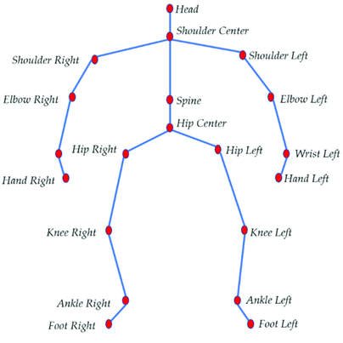
Flowchart
Joint angles, distances, velocity, acceleration, etc.
Evaluate each model and select the one with the highest F1 score.
Data processing and feature extraction
ML Models
Correct data imbalance
Raw Data (Skeletal Joints)
Select the best model
Final results
LLMs
Generate feature suggestions
through prompt engineering
GPT 3.5 and Claude 2.0
Classical models (Random Forest, XGBoost, etc), and Deep Learning (LSTM)
Use SMOTE

Slide 3
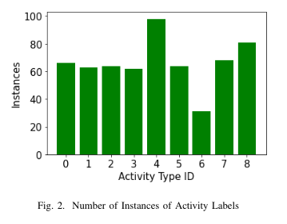
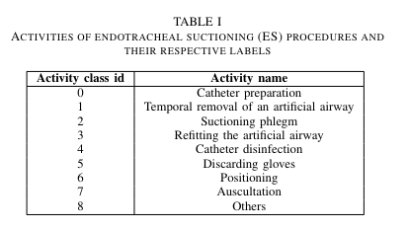
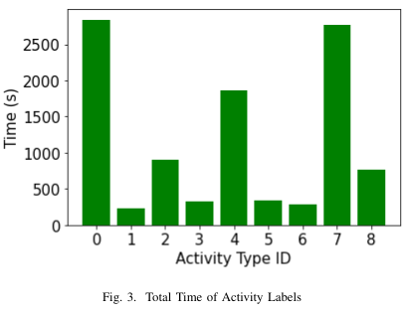
Exploring the data…

Slide 4


Prompting Strategy
Introduce
1/ Introduce the objective of the problem, I
A short summary of what we are trying to accomplish and what to find.
Provide
2/ Provide the context, C(x_i).
Skeletal key point data and its corresponding annotated labels.
Break
3/ Break the problem into subproblems and iteratively prompt the LLMs to answer step by step, T
Chain of thought prompting
Ask
4/ Ask the final question, Q.
“Which features calculated from each time frame can distinguish the activity labels from each other?”
Entire prompt:
Feature extracted:

Slide 5
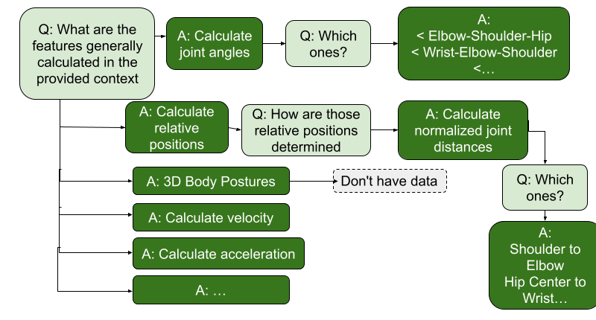
Chain of Thought ⛓️‍💥🧠
➡️ Break a problem in small solvable steps and prompt. Iterate if needed. Easier for LLMs to solve.
A brief example

Slide 6
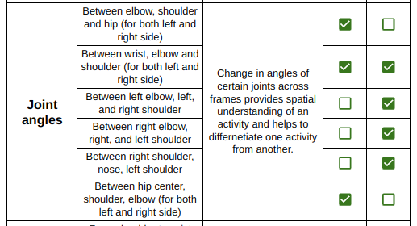
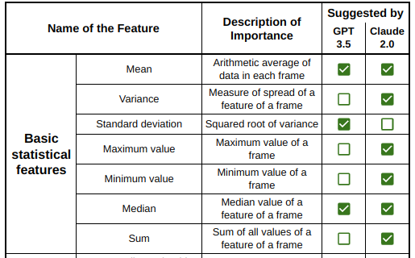
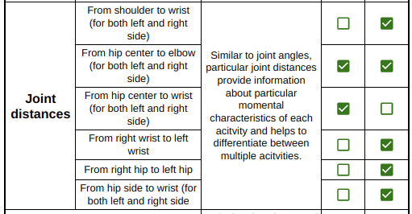
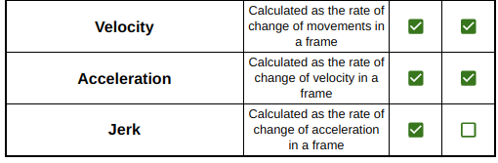
Features obtained

Slide 7
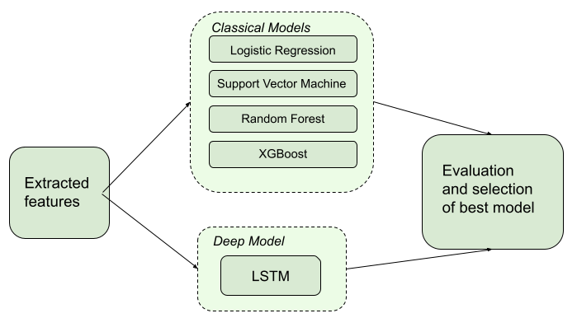
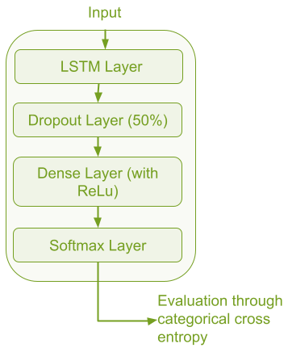
Models
Classical models were hyperparametized using RandomSearch.
LSTM accuracy: 65.12% (cumulative) Window size: 3 seconds

Slide 8
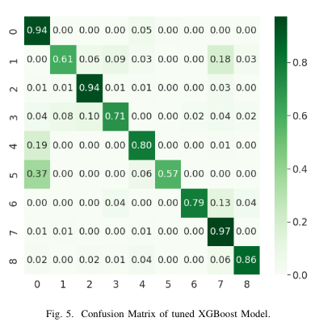
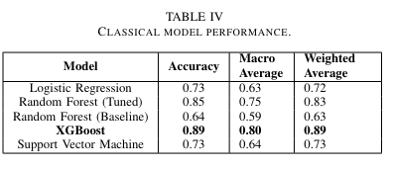

Slide 9
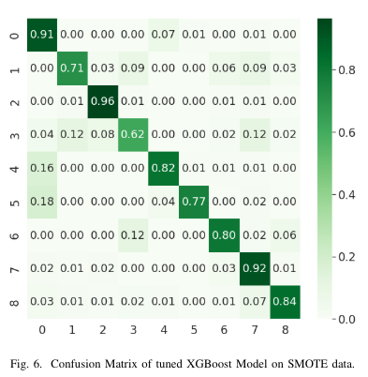
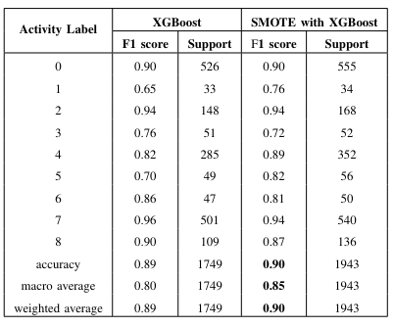
Correcting Data Imbalance
Use SMOTE to synthetically generate sampled data.

Slide 10
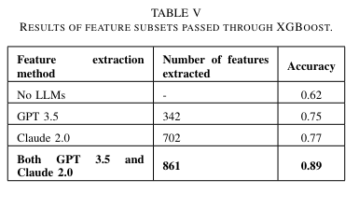
Evaluation of Feature Subsets of LLMs
Even though Claude 2.0 suggested twice the number of features, it’s accuracy was only marginally higher
Best results when both subsets were used

Slide 11
Thank You!
Q/A
Mahera R Islam (University of Dhaka); Anik Mahmud Ferdous (University of Dhaka); Shahera Hossain (University of Asia Pacific,
Bangladesh); Md Atiqur Rahman Ahad (University of East London, UK); Fady Alnajjar (United Arab Emirates University)

