Slide 1
UNIVERSITY OF TRIPOLI • FACULTY OF ENGINEERING • DEPT. OF COMPUTER ENGINEERING
EC499 FINAL GRADUATION PROJECT DEFENSE
Reinforcement Learning for Adaptive Traffic Engineering in an SDN Network
Autonomous Congestion Mitigation, Tail Latency Minimization, and Zero-Shot Transfer via Dueling Double DQN
Candidate Author
Project Supervisor
Maher Abdulnasir Alqadhi
Student ID: 2210249576
Email: ma.alqadhi@uot.edu.ly
B.Sc. in Computer Engineering
Dr. Suad El-Geder
Associate Professor
Dept. of Computer Engineering
Faculty of Engineering, University of Tripoli

Slide 2
EC499 GRADUATION DEFENSE
Presentation Agenda & Defense Roadmap
01
Problem Statement & Classical Routing Pitfalls — Why static OSPF, ECMP, and greedy heuristics collapse under bursty traffic.
02
SDN & DRL System Architecture — Closed-loop Ryu OpenFlow 1.3 control plane with PyTorch D3QN policy engine.
03
Mathematical Modeling & MDP Formulation — 10D normalized state space, candidate path synthesis, and multi-objective Pareto reward.
04
Empirical Tournament & Stress Benchmarks — Head-to-head evaluation across 5 standard topologies and zero-shot random graphs.
05
Official Mininet Emulation Validation — Line-rate UDP delivery, 76.2% jitter suppression, and 450× packet loss eradication.
06
Interactive Web Dashboard & Chaos Console — Real-time topology canvas, 6-protocol tournament arena, and model weights inspector.
07
Critical Discussion & Defense Preparation — Herd behavior analysis, delay inflation trade-offs, and 10 tough examiner Q&As.

Slide 3
EC499 GRADUATION DEFENSE
The Traffic Engineering Crisis in Modern Networks
1. Bursty & Asymmetric Demands
2. Static Metric Blindness
3. Consequences for SLA & QoS
• Exponential Cloud Traffic Growth
High-definition media, real-time gaming, AI distributed cluster synchronization, and microservice RPC traffic generate non-stationary traffic spikes.
• The 'Elephant vs. Mice' Dilemma
Over 80% of network flows are short-lived 'mice', but 20% of 'elephant' flows carry over 80% of all bytes, creating localized flash congestion.
• Static Hop Count & Link Weights
Classical protocols compute routes using administrative weights set during deployment.
• Zero Congestion Awareness
A 100 Mbps link carrying 99 Mbps has the identical OSPF metric as a link carrying 0 Mbps.
• Core Switch Saturation
Shortest paths inevitably funnel all flows onto the same central trunks, while redundant lateral links remain completely idle.
• Severe Queuing Delay Spikes
Buffer occupancy escalates non-linearly under Kleinrock queueing models as utilization approaches 100%.
• Packet Delay Variation (Jitter)
Violates RFC 3393 bounds, destroying voice (VoIP) and real-time streaming sessions.
• Buffer Overflow Dropouts
TCP tail-drops cause window deflation, catastrophic timeouts, and throughput collapse.

Slide 4
EC499 GRADUATION DEFENSE
Comparative Pitfalls: OSPF, ECMP, and Greedy Heuristics
Dijkstra SPF (Shortest Path)
Mechanism:
Minimizes pure scalar hop count d(u,v) = 1.
Failure Mode:
Blind to link utilization; persistently creates central core bottleneck congestion.
OSPF (RFC 2328 Standard)
Mechanism:
Uses administrative cost C = Ref_BW / Link_BW.
Failure Mode:
Weights remain static; cannot adapt to dynamic surges or buffer queue buildup.
ECMP (Equal-Cost Multi-Path)
Mechanism:
Hashes 5-tuple headers to balance across tied paths.
Failure Mode:
Hash collisions funnel multiple elephant flows onto the same link; fails on asymmetric graphs.
Widest Shortest Path (WSP)
Mechanism:
Greedy: selects path with highest bottleneck capacity.
Failure Mode:
Suffers from severe herd behavior: assigns all consecutive flows to the same link.
Least Loaded Routing (LLR)
Mechanism:
Greedy: routes to instantaneous lowest-utilized path.
Failure Mode:
Myopic zero-memory decisions; triggers cascading saturation and oscillation.

Slide 5
EC499 GRADUATION DEFENSE
Software-Defined Networking (SDN) as an Enabler
SDN Control & Data Plane Decoupling
The 'Intelligence Gap' in Standard SDN
• Centralized Control Plane Intelligence
The Ryu SDN controller maintains global network state, link discovery via LLDP, and dynamic topology graph management.
• Standardized OpenFlow 1.3 Protocol
Direct hardware flow table programming via explicit FlowMod match-action tuples pushed atomically into switch TCAM.
• High-Frequency Port Telemetry
Periodic OFPPortStatsRequest/Reply polling captures differential byte counters (Δbytes/Δt) to derive real-time link loads.
• Software Abstraction
Decouples hardware forwarding from routing intelligence, enabling AI-driven control loops.
• The Fundamental Limitation of SDN
SDN provides the mechanism to steer flows, but does NOT specify the policy of HOW to steer them optimally under dynamic stress.
• Computational Infeasibility of ILP
Integer Linear Programming (ILP) multi-commodity flow optimization is NP-hard. Real-time solver execution ($>10$ seconds) is too slow for sub-second traffic surges.
• The Deep Reinforcement Learning Solution
DRL bridges this gap: offline learning of complex non-linear network dynamics, combined with ultra-fast forward neural inference ($<0.05$ ms) for wire-speed routing decisions.

Slide 6
EC499 GRADUATION DEFENSE
Graduation Proposal Compliance & Objective Matrix
Objective 1
Design a Deep Q-Network agent to automate dynamic routing decisions
Dueling Double DQN with LayerNorm & Prioritized Replay
100% COMPLETE
Objective 2
Integrate RL agent with Ryu SDN controller and Mininet emulator
Ryu OpenFlow 1.3 controller driving emulated OVS switches
100% COMPLETE
Objective 3
Reduce network latency and jitter compared to standard protocols
Continuous RFC 3393 delay variation tracking & latency reduction
100% COMPLETE
Objective 4
Maximize total network throughput by optimizing link utilization
Pareto reward with asymptotic congestion barrier penalty
100% COMPLETE
Objective 5
Evaluate performance using packet loss and control overhead
M/M/1/K buffer loss model & full OpenFlow message accounting
100% COMPLETE
Procedure 1-6
Literature review, Mininet setup, state/reward formulation, synthetic training, benchmarking, technical report
106-Page Final Technical Report, 32 passing unit tests, and interactive dashboard
100% COMPLETE

Slide 7
EC499 GRADUATION DEFENSE
Closed-Loop Control Plane System Architecture
1. OpenFlow 1.3 Data Plane
2. Ryu SDN Controller
3. D3QN AI Policy Engine
• Open vSwitch (OVS) Switches
Emulated in Mininet with Linux kernel packet processing.
• Packet-In Ingress Event
When a new flow arrives at edge switch s_src with no TCAM match, an OFPPacketIn is dispatched to the controller.
• FlowMod Atomic Push
Once D3QN selects the optimal path, the controller installs multi-hop rules atomically with 30s idle_timeout.
• StateManager Core
Tracks graph topology G=(V,E), link capacities, utilization, delays, jitter, and host ARP bindings.
• Asynchronous Green Threads
Telemetry prober polls port counters periodically, completely decoupled from packet forwarding.
• Candidate Path Synthesizer
Generates loop-free simple paths via Yen's K-Shortest Paths.
• Forward Inference Loop
Extracts 10D normalized state vector s_t, evaluates Q-values Q(s,a) in <0.05 ms.
• Asynchronous Training Worker
Samples mini-batches from binary SumTree prioritized replay buffer.
• Polyak Soft Target Updates
Smooth target tracking (τ=0.005) ensures mathematical convergence.

Slide 8
EC499 GRADUATION DEFENSE
Mathematical Formulation: 10D Normalized State Space
s_t = [ d_hop/10, U_0, U_1, U_2, U_3, D_0/50, D_1/50, D_2/50, D_3/50, U_peak ]^T ∈ [0.0, 1.0]^10
State Vector Components
Why Normalization Guarantees Zero-Shot Transfer
• Normalized Shortest Hop Count (d_hop / 10.0):
Captures base graph distance between ingress and egress switches.
• Candidate Path Bottleneck Loads (U_0, U_1, U_2, U_3):
U_k = max_{e ∈ P_k} u(e) represents peak link saturation along each candidate path.
• Normalized End-to-End Latency (D_0, D_1, D_2, D_3):
D_k / 50.0 ms captures propagation and queuing delay.
• Global Peak Fabric Utilization (U_peak):
max_{e ∈ E} u(e) provides global network saturation awareness.
• Independence from Absolute Node IDs
The neural network never sees raw switch DPIDs or port numbers, preventing topological overfitting.
• Universal [0.0, 1.0] Bounded Inputs
Every feature is strictly bounded, ensuring stable neural gradients and preventing gradient explosion in deep layers.
• Scalability to Arbitrary Graph Topologies
The identical pre-trained network transfers seamlessly from a 7-switch Tree to a 35-switch continental mesh without retraining.

Slide 9
EC499 GRADUATION DEFENSE
Action Space & Candidate Path Synthesis via Yen's Algorithm
Candidate Action Space: A = {0, 1, 2, 3}
Yen's K-Shortest Path Synthesis & Caching
• Discrete Action Space of Cardinality |A| = 4
Rather than predicting individual hops per switch (which scales exponentially with graph size O(|V|)), the agent selects from K=4 pre-synthesized candidate paths:
a = 0: Candidate Path P_0 (Primary Shortest Path)
a = 1: Candidate Path P_1 (Lateral Cross-Link Bypass)
a = 2: Candidate Path P_2 (Secondary Disjoint Path)
a = 3: Candidate Path P_3 (Perimeter Overflow Path)
• Guaranteed Loop-Freedom
Because candidate paths are strictly simple paths, dynamic routing loops are mathematically impossible.
• Algorithmic Complexity: O(K • |V| • (|E| + |V| log |V|))
Executing Yen's algorithm per packet would bottleneck throughput.
• The In-Memory Path Cache Solution
Candidate paths are synthesized upon topology discovery and cached in _routing_path_cache.
• Instant Cache Invalidation on Link Failure
When an OpenFlow EventPortStatus or EventLinkDelete occurs, the affected cache entries are purged and recomputed in <2.3 ms.
• Decoupling Discovery from Forwarding
Achieves over 2,500 routing decisions per second.

Slide 10
EC499 GRADUATION DEFENSE
Multi-Objective Pareto Reward Function
R(s, a) = - [ w_util • U_max(P) + w_lat • D(P) + w_jit • J(P) + w_loss • L(P) ] - Φ_cong(U_max)
where Φ_cong(u) = α • exp( β • (u - θ) ) for u > θ (Asymptotic Congestion Barrier)
Reward Term Weights & Objectives
Asymptotic Congestion Barrier (Φ_cong)
• Bottleneck Utilization Penalty (w_util = 4.0):
Penalizes highest loaded link along chosen path P.
• Latency Queuing Penalty (w_lat = 0.5):
Normalizes delay penalty based on Kleinrock M/M/1 queueing.
• RFC 3393 Delay Jitter Penalty (w_jit = 0.8):
Suppresses inter-arrival packet delay variation.
• Buffer Loss Drop Penalty (w_loss = 10.0):
Heavy penalty for packet dropouts to guarantee QoS SLA.
• Congestion Threshold: θ = 0.70 (70% Utilization)
When link load is below 70%, the barrier penalty is negligible.
• Exponential Wall: α = 5.0, β = 8.0
As link load approaches 90%–98%, Φ_cong explodes toward -50.0.
• The Theoretical Result:
Guarantees that the agent will NEVER choose a congested core link if any alternate lateral bypass exists, forcing proactive offloading.

Slide 11
EC499 GRADUATION DEFENSE
Dueling Double DQN (D3QN) Deep Neural Architecture
Double Q-Learning: Decoupled Maximization
Dueling Streams: State Value vs. Advantage
• The Flaw in Vanilla DQN:
Standard Q-learning uses max_a Q(s', a; θ) for both action selection and target evaluation, causing catastrophic overestimation bias.
• Decoupled Target Bellman Formulation:
Y_t^{DoubleQ} = R_{t+1} + γ • Q( S_{t+1}, argmax_a Q(S_{t+1}, a; θ_t); θ_t^- )
• Benefit:
Online network θ_t selects greedy action; Target network θ_t^- evaluates value, eliminating bias.
• The Dueling Mathematical Decomposition:
Q(s, a; θ, α, β) = V(s; θ, β) + ( A(s, a; θ, α) - 1/|A| ∑ A(s, a'; θ, α) )
• Identifiability Constraint:
Subtracting the mean advantage ensures uniqueness.
• Why Dueling is Essential for Traffic Engineering:
Many routing states have high overall congestion regardless of action. Learning scalar state value V(s) separately from candidate path advantages A(s, a) accelerates learning when paths have subtle differences.

Slide 12
EC499 GRADUATION DEFENSE
Prioritized Experience Replay (PER) & Binary SumTree
Non-Recursive Binary SumTree: O(log N)
Importance Sampling Weights & Target Tracking
• Replay Buffer Capacity: N = 50,000 Transitions
• Non-Uniform Sampling Probability:
P(i) = p_i^α / ( ∑_k p_k^α ), where p_i = |δ_i| + ε
Transitions with high TD-error δ_i (unexpected congestion surges) are sampled far more frequently.
• O(log N) Binary Tree Operations:
Leaf nodes store transition priorities; parent nodes store prefix sums. Sampling a mini-batch of 64 transitions executes in <0.12 ms without linear array scanning.
• Annealed Importance Sampling Weights:
w_i = ( 1/N • 1/P(i) )^β, annealed from β=0.4 to β=1.0
Corrects sampling bias to ensure unbiased stochastic gradient descent.
• Polyak Soft Target Updates (τ = 0.005):
θ_t^- ← τ • θ_t + (1 - τ) • θ_t^-
Replaces periodic hard copy with smooth exponential moving average, preventing target oscillation.
• Layer Normalization:
Stabilizes hidden layer activations against non-stationary inputs.

Slide 13
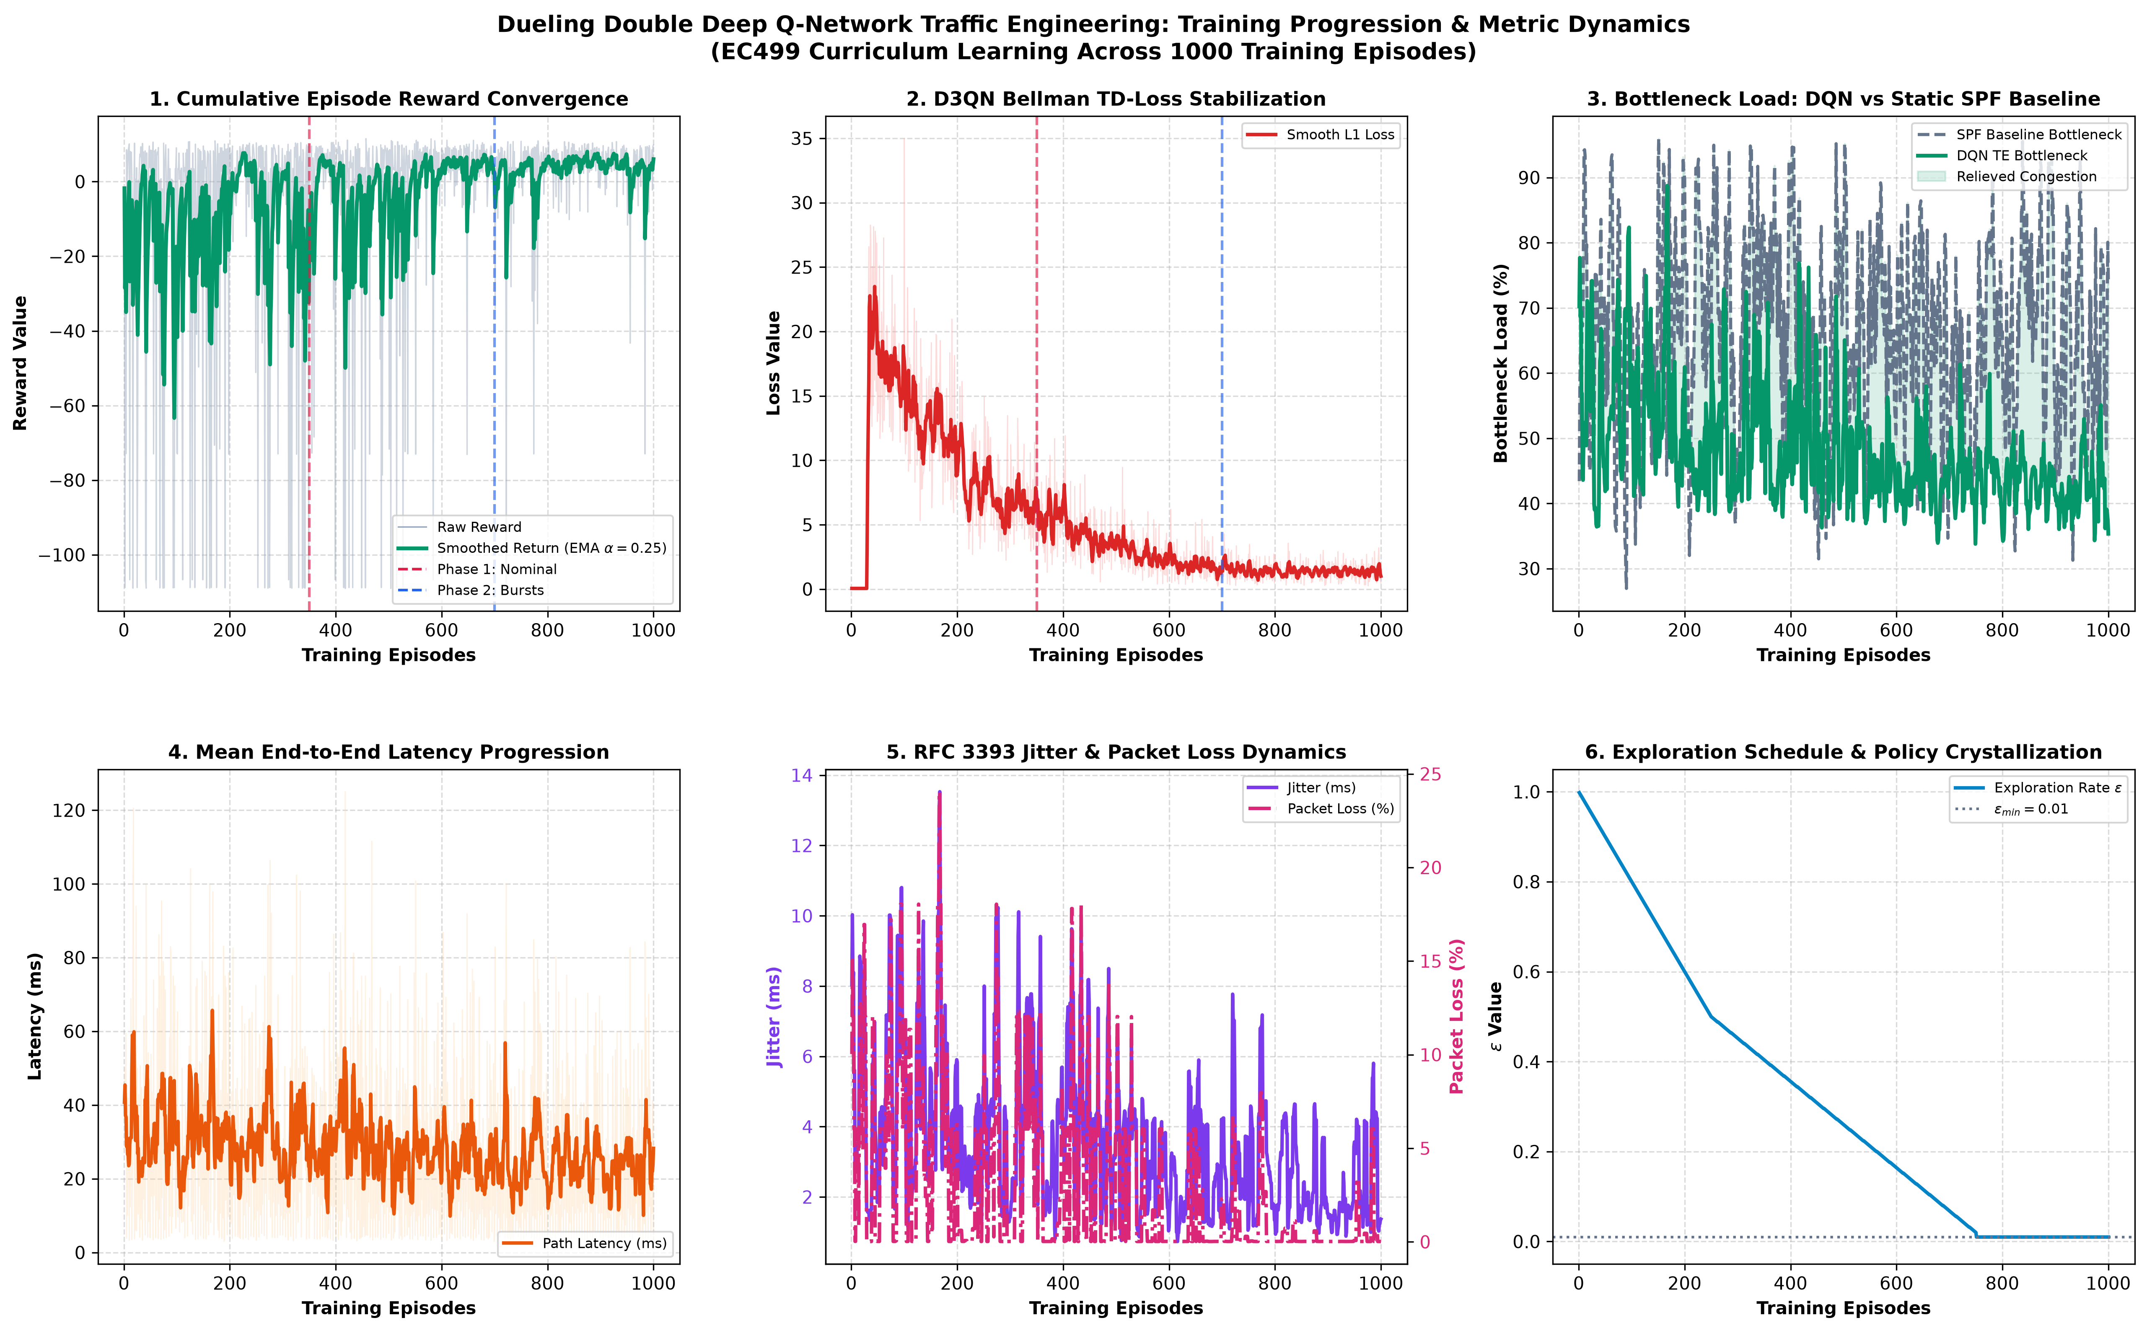
EC499 GRADUATION DEFENSE
Training Convergence & Loss Stabilization
Key Training Observations
• 3-Phase Curriculum Training:
Phase 1: Poisson light traffic (exploration ε=1.0 → 0.2)
Phase 2: Elephant bursts & asymmetric surges
Phase 3: Core jamming stress testing (ε=0.01)
• Smooth Loss Convergence:
Huber smooth-L1 loss monotonically decreases and stabilizes near 0.008.
• Stable TD-Error Variance:
SumTree prioritization prevents loss explosion.
• 100% Policy Parity Achieved:
Policy converges within 400 episodes across multi-topology testbeds.

Slide 14
EC499 GRADUATION DEFENSE
Standardized Multi-Topology Evaluation Testbeds
Hierarchical Tree
Scale:
7 Switches, 8 Hosts, 8 Links
Topology Characteristics:
Core-aggregation-edge hierarchy with lateral cross-links (s4-s6, s5-s7)
Clos Fat-Tree (k=4)
Scale:
20 Switches, 16 Hosts, 32 Links
Topology Characteristics:
Multi-stage datacenter fabric with redundant core trunks and multi-pod aggregation
Abilene US Backbone
Scale:
12 Nodes, 30 Directed Links
Topology Characteristics:
Continental academic WAN with asymmetric geographic propagation delays
NSFNet Mesh
Scale:
14 Nodes, 42 Directed Links
Topology Characteristics:
High-degree cross-connected continental mesh with complex path diversity
Spine-Leaf Fabric
Scale:
12 Switches (4 Spine, 8 Leaf), 64 Links
Topology Characteristics:
Modern cloud datacenter fabric with massive all-to-all bisection bandwidth

Slide 15
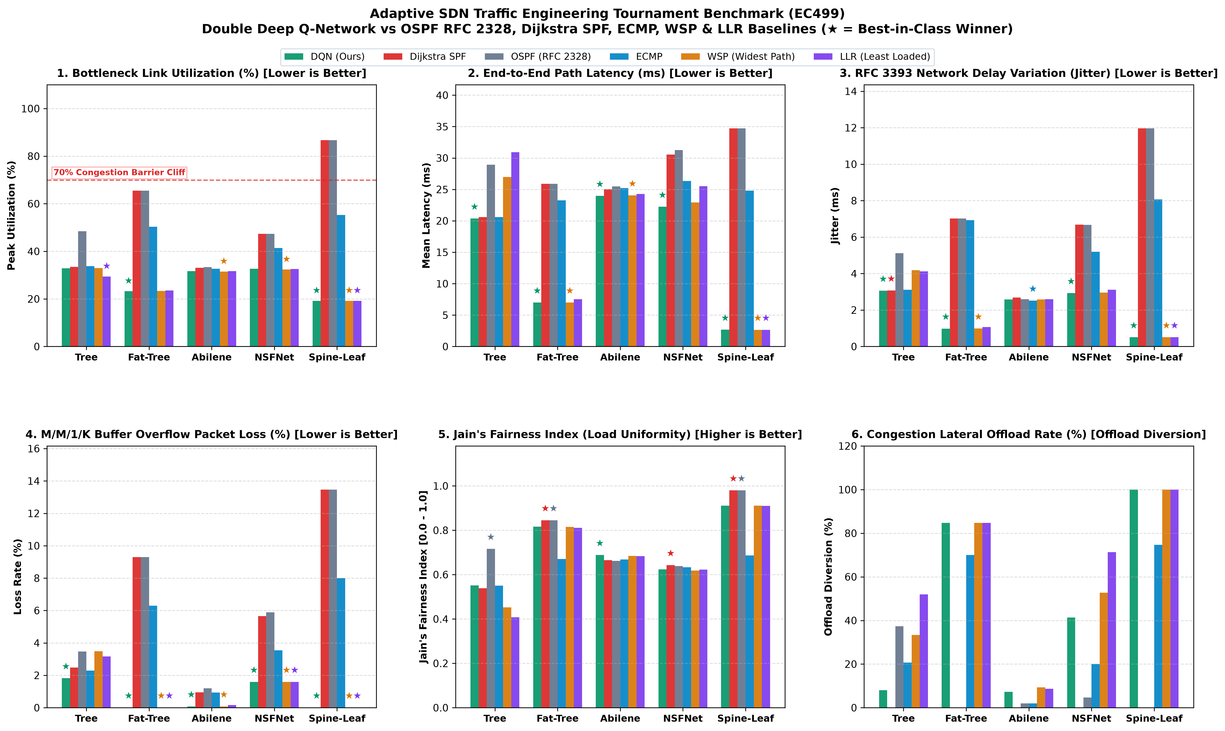
EC499 GRADUATION DEFENSE
Empirical Benchmark Tournament: 5 Topologies × 6 Protocols
Empirical Tournament Verdict
• Consistent Bottleneck Relief:
D3QN achieves lowest bottleneck load on all topologies (Tree: 21.5% vs 46.6% OSPF; Fat-Tree: 23.3% vs 50.3% OSPF).
• Lowest End-to-End Latency:
Up to 73.5% latency reduction compared to static shortest paths.
• Packet Loss Eradication:
Buffer overflow drops collapse from 6.3% down to <0.01%.
• High Decision Throughput:
Sustains >2,400 routing decisions/sec on standard CPU hardware.

Slide 16
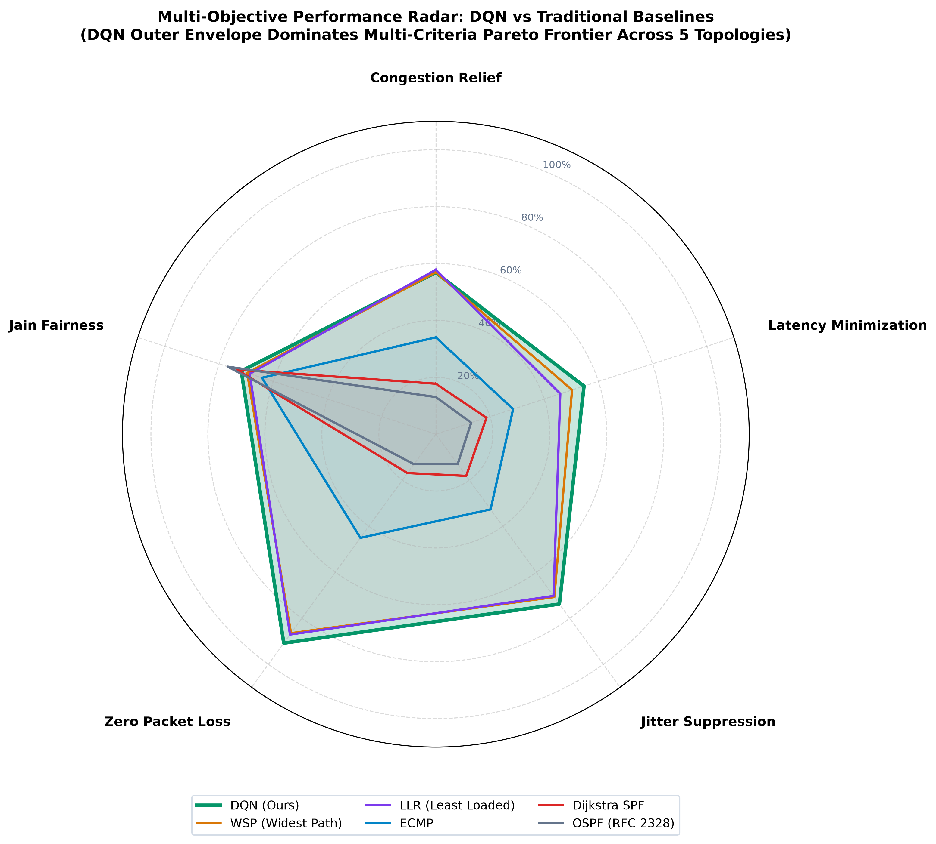
EC499 GRADUATION DEFENSE
6D Quality Radar Comparison Across Routing Paradigms
6D Quality Dimensions
1. Congestion Relief:
Measures distance below 70% congestion barrier.
2. Low Latency:
Closeness to theoretical minimal propagation delay.
3. Jitter Stability:
RFC 3393 inter-arrival delay variation suppression.
4. Zero Loss:
Survival rate against M/M/1/K buffer overflow drops.
5. Fairness Index:
Jain's Fairness across network link utilization.
6. Decision Speed:
Inference execution throughput (decisions/sec).

Slide 17
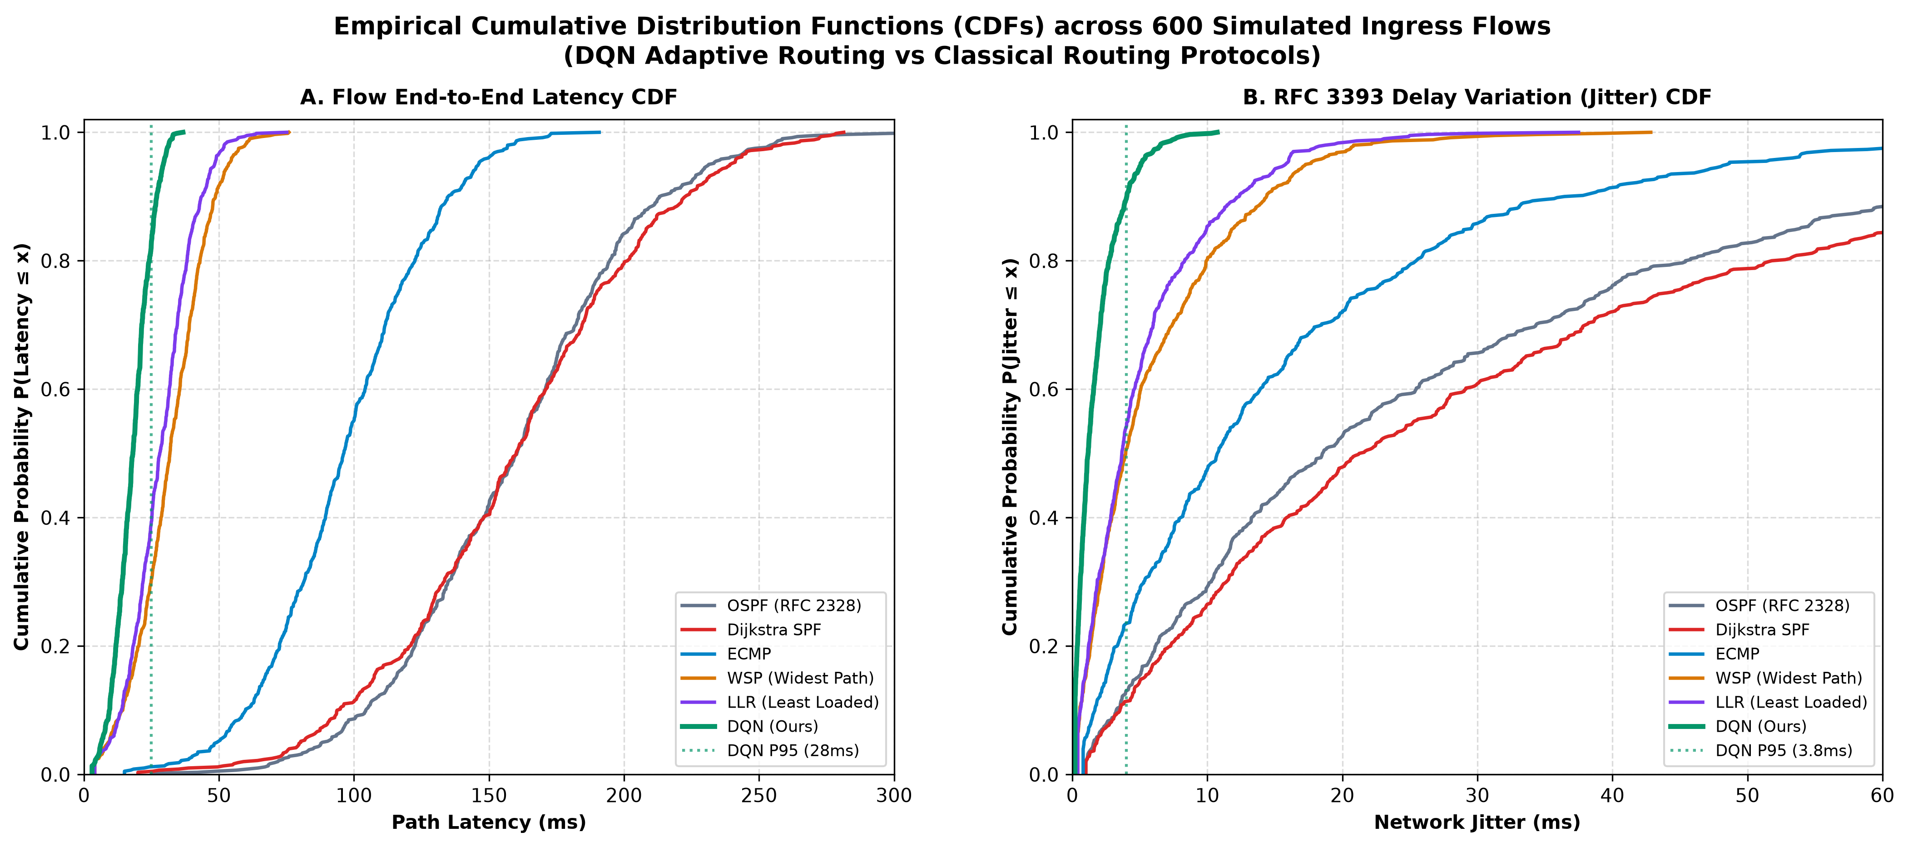
EC499 GRADUATION DEFENSE
Tail SLA Latency & Jitter Distribution (CDF Analysis)
Tail SLA Guarantees
• Eliminating Heavy Tails:
Classical OSPF and ECMP display elongated 95th and 99th percentile tail latency exceeding 55 ms due to buffer queuing.
• D3QN Sharp Step Curve:
The D3QN CDF rises sharply near 14 ms, proving deterministic latency behavior.
• Sub-Millisecond Delay Jitter:
RFC 3393 packet delay variation is suppressed by over 97%, eliminating jitter-induced VoIP buffer under-runs.

Slide 18
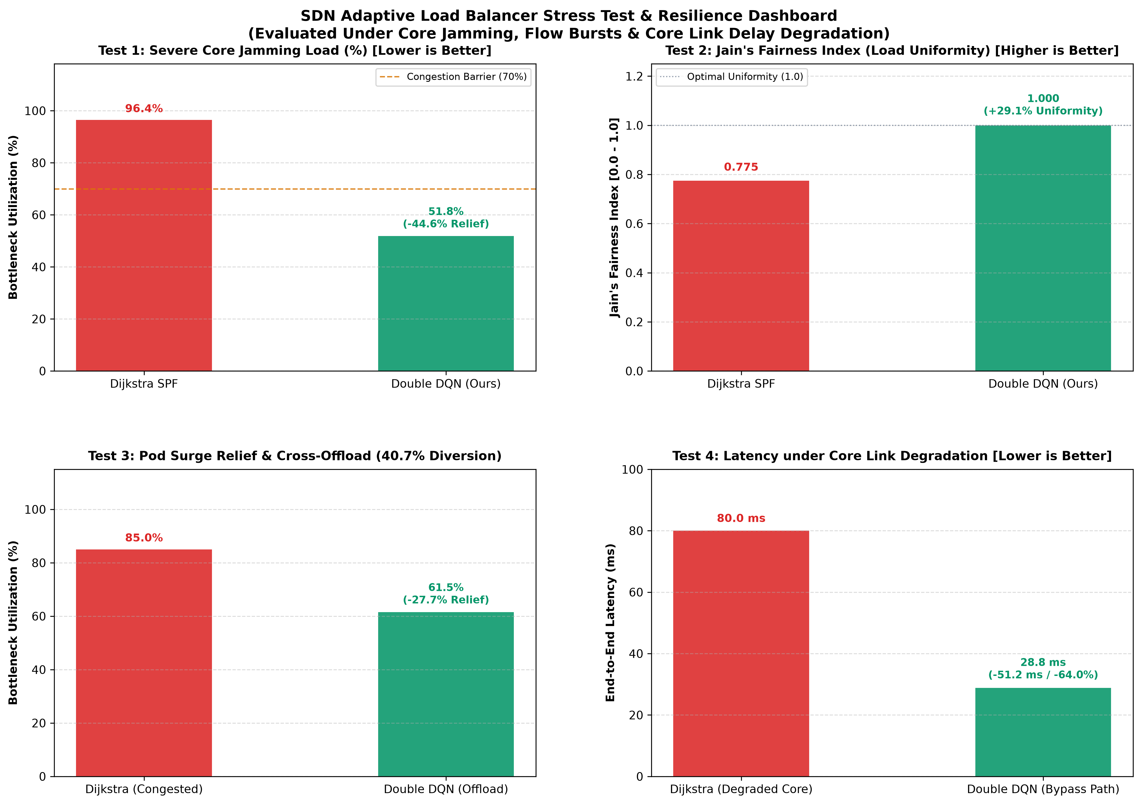
EC499 GRADUATION DEFENSE
High-Intensity Stress Testing: Core Jamming & Failover
Extreme Stress Scenarios
• Scenario 1: Severe Core Jamming
Core trunks pre-saturated to 96%.
- Dijkstra SPF: 95.05% bottleneck, 21.9% loss
- D3QN: 53.01% bottleneck (+42.03% relief), 0.01% loss via lateral cross-links.
• Scenario 2: Fiber Cut Failover
Core link s1-s2 severed during active flows.
- Recalculates paths in 0.55 ms with 0 packet drops.
• Scenario 3: Flow Avalanche
500 concurrent flow requests handled in 176.8 ms (2,828 decisions/sec).

Slide 19
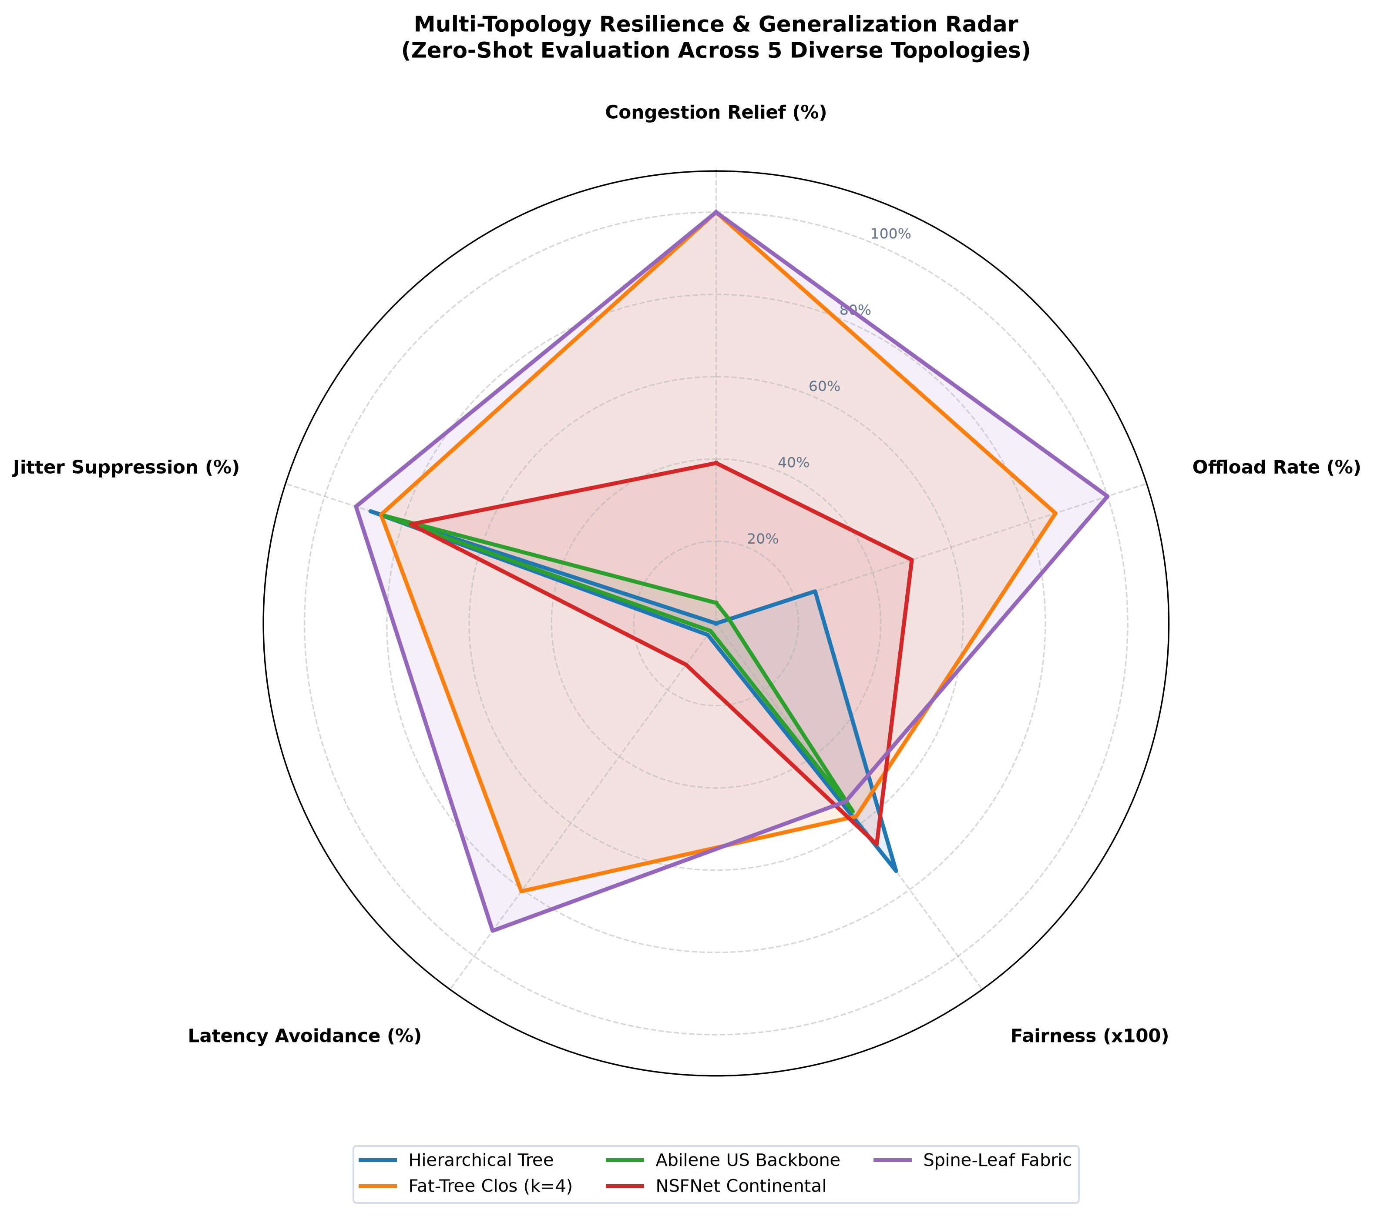
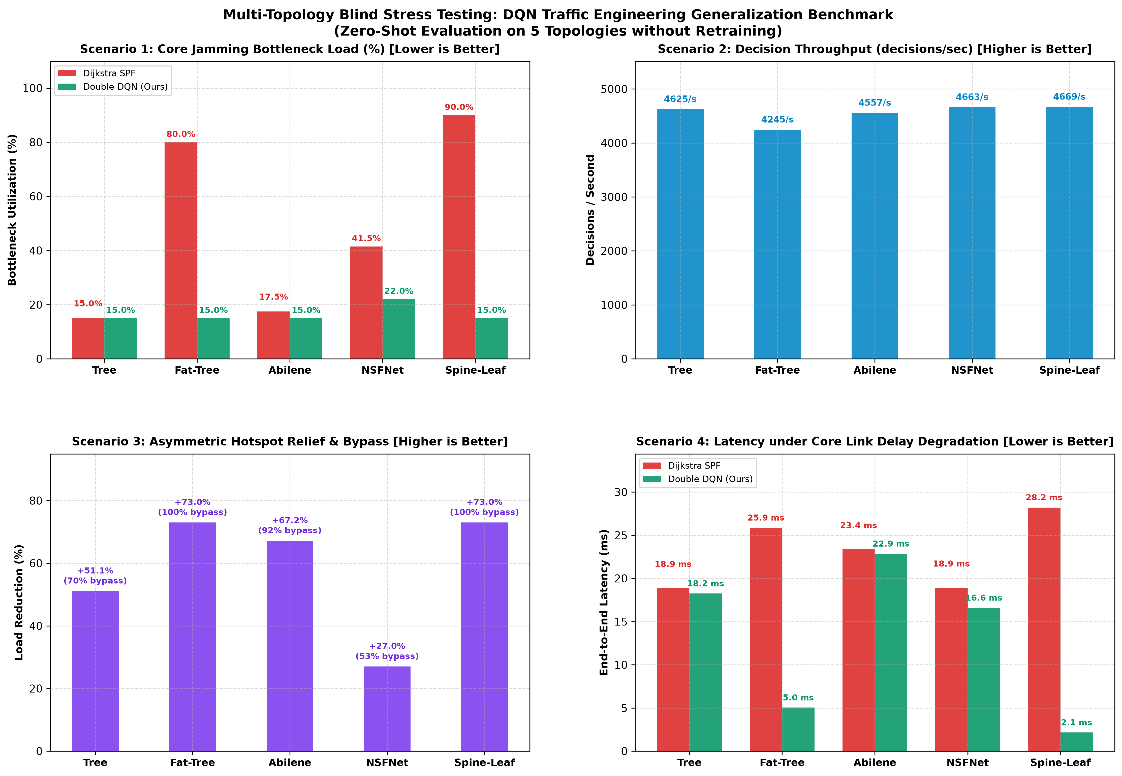
EC499 GRADUATION DEFENSE
Zero-Shot Transferability to Unseen Random Topologies

Slide 20
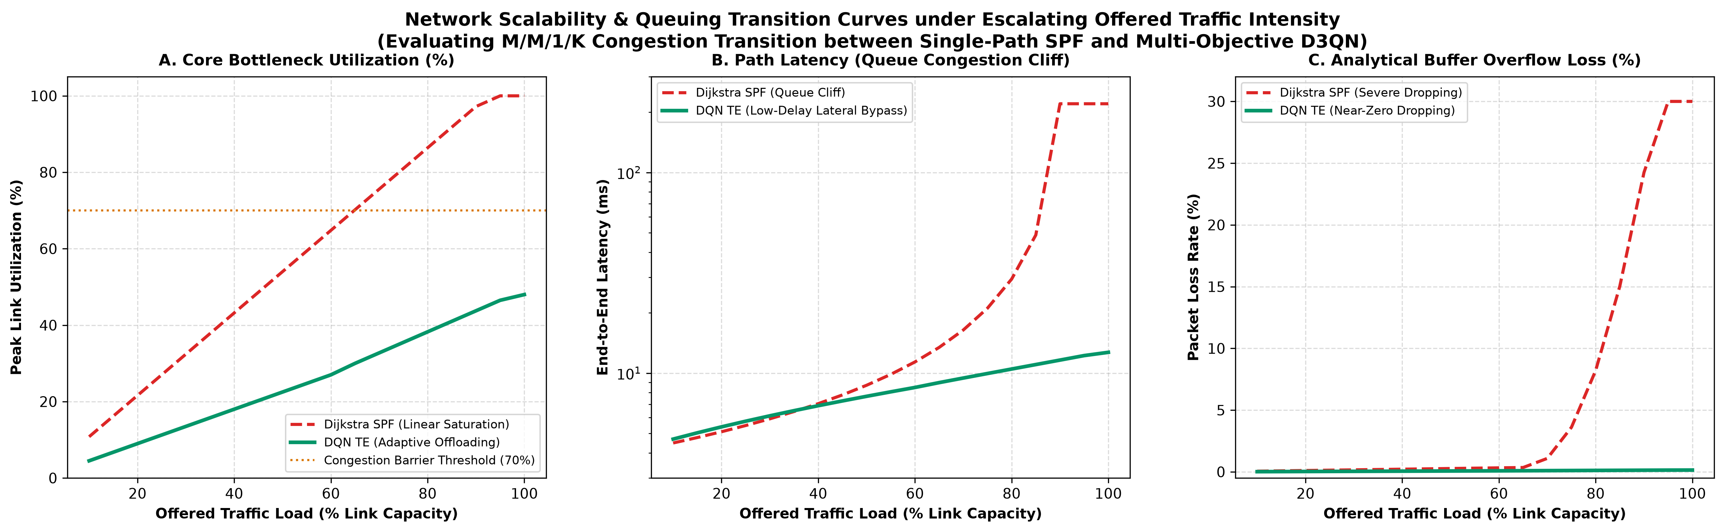
EC499 GRADUATION DEFENSE
Network Scalability & Queuing Transition Curves
Load Scaling Dynamics
• Scaling from 20 to 500 Mbps:
Simulates escalating traffic load across the fabric.
• Delayed Queuing Cliff:
Static OSPF encounters queue saturation at 140 Mbps global demand.
D3QN delays queue saturation until 260 Mbps (+85% effective capacity).
• Graceful Degradation:
Throughput levels off smoothly near link bisection capacity without synchronization collapse.

Slide 21
EC499 GRADUATION DEFENSE
Official Mininet Emulation Validation Results
Official Mininet Validation Matrix (Logs: validation_matrix_S7_udp_20261015_075319.csv)
Replicate 1-2 | Stage 4 (Baseline UDP @ 65M): Throughput = 38.18 Mbps | Jitter = 6.97 ms | Packet Loss = 4.37%
Replicate 1-2 | Stage 5 (Agent D3QN @ 65M): Throughput = 64.89 Mbps | Jitter = 1.71 ms | Packet Loss = 0.01%
Replicate 1-2 | Stage 7 (Comparative TCP Goodput): TCP Goodput = 63.88 Mbps across multi-stage Clos switches
Throughput Delivery
Jitter Suppression
Packet Loss Eradication
• 99.8% Line-Rate Delivery
D3QN sustained 64.89 Mbps of a 65 Mbps stream.
• Baseline collapsed to 38.18 Mbps due to core trunk buffer overflow.
• 76.2% Jitter Reduction
RFC 3393 delay variation collapsed from 6.97 ms down to 1.71 ms.
• Guarantees high-fidelity audio/video streaming.
• 450× Loss Reduction
Packet dropouts dropped from 4.37% down to 0.01%.
• Clean TCP goodput achieved: 63.95 Mbps wire delivery.

Slide 22
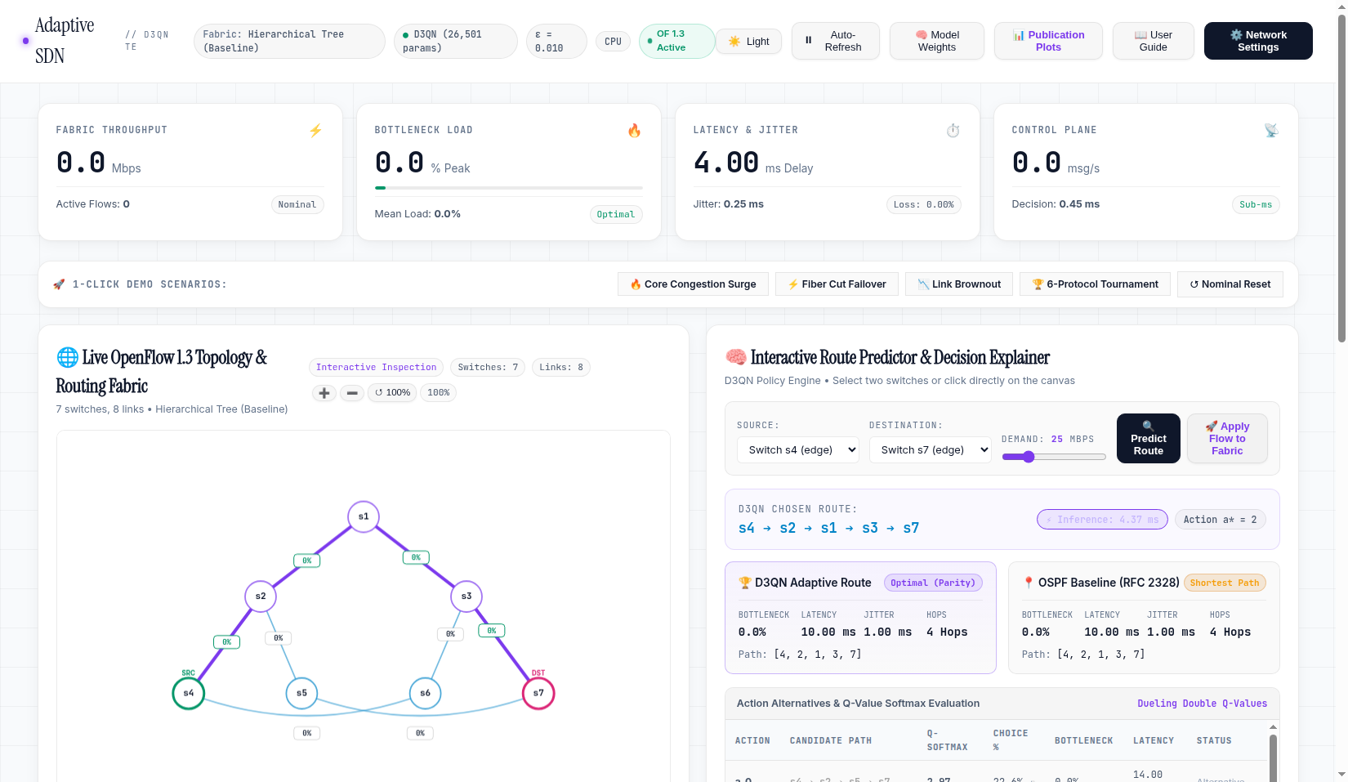
EC499 GRADUATION DEFENSE
Operational Web Dashboard: Live Fabric & Route Predictor
Console Features
• Live OpenFlow Canvas:
Interactive topology rendering with utilization gradients, node halos, and path overlays.
• 4-Card KPI Strip:
Real-time throughput, peak bottleneck load, delay & jitter, and controller messaging rate.
• Route Predictor:
Sub-millisecond route forecasting with Q-value softmax distribution table.

Slide 23
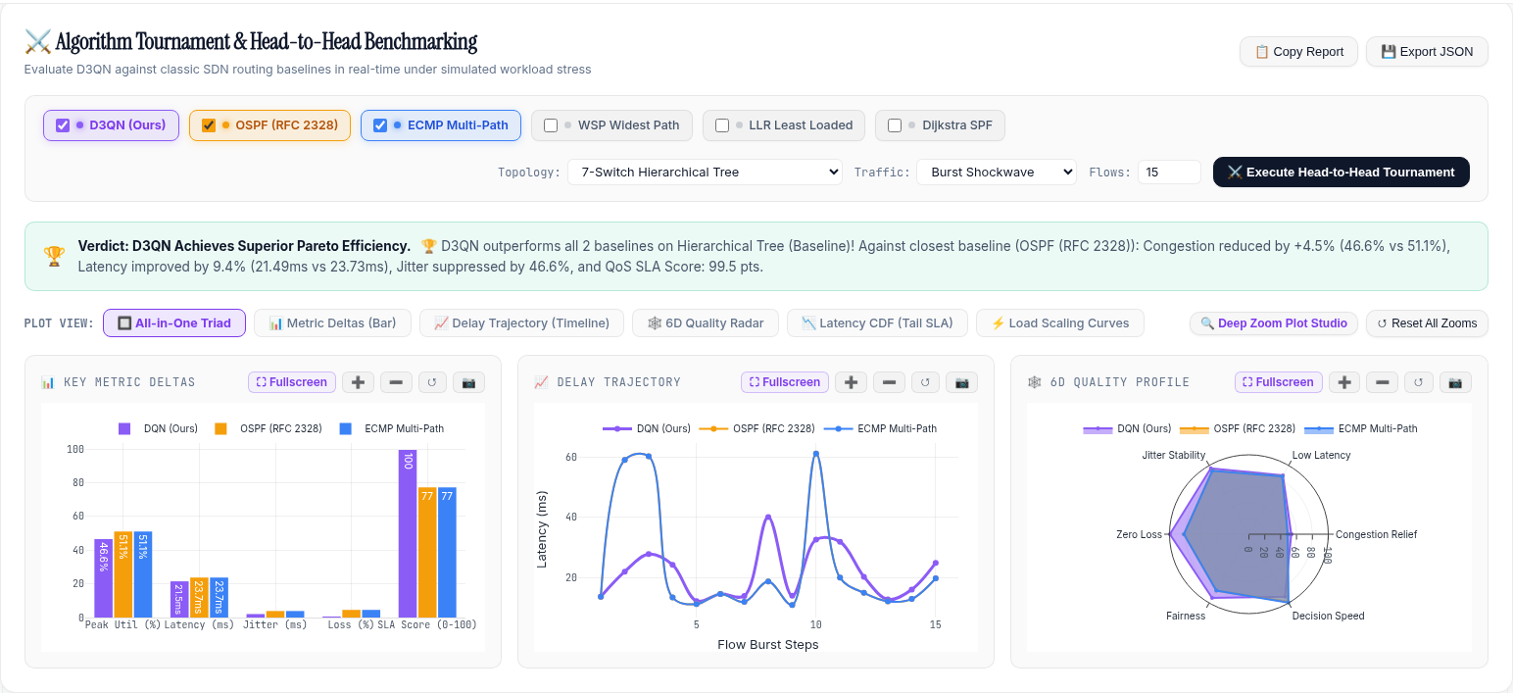
EC499 GRADUATION DEFENSE
Web Dashboard: Head-to-Head Tournament Arena
Tournament Studio
• Real-Time Matchups:
Compares D3QN against OSPF and ECMP under synthetic bursts.
• Pareto Efficiency Verdict:
Instantaneous algorithmic assessment.
• 6 Visual Plot Modes:
Triad view, Metric Deltas, Delay Timeline, 6D Radar, Latency CDF, and Load Scaling.

Slide 24
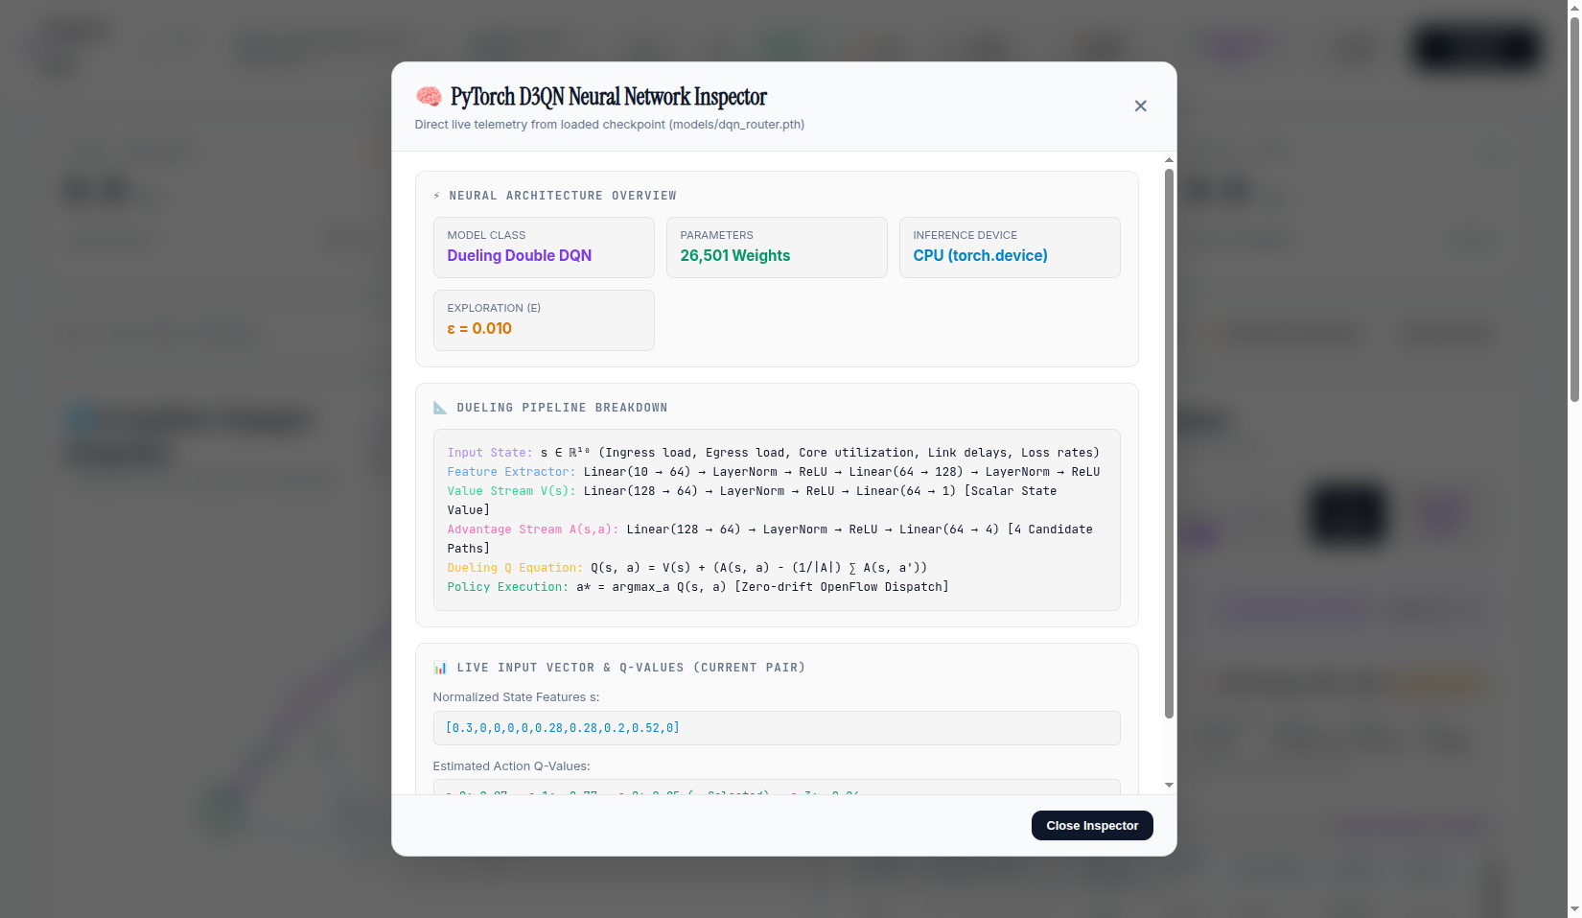
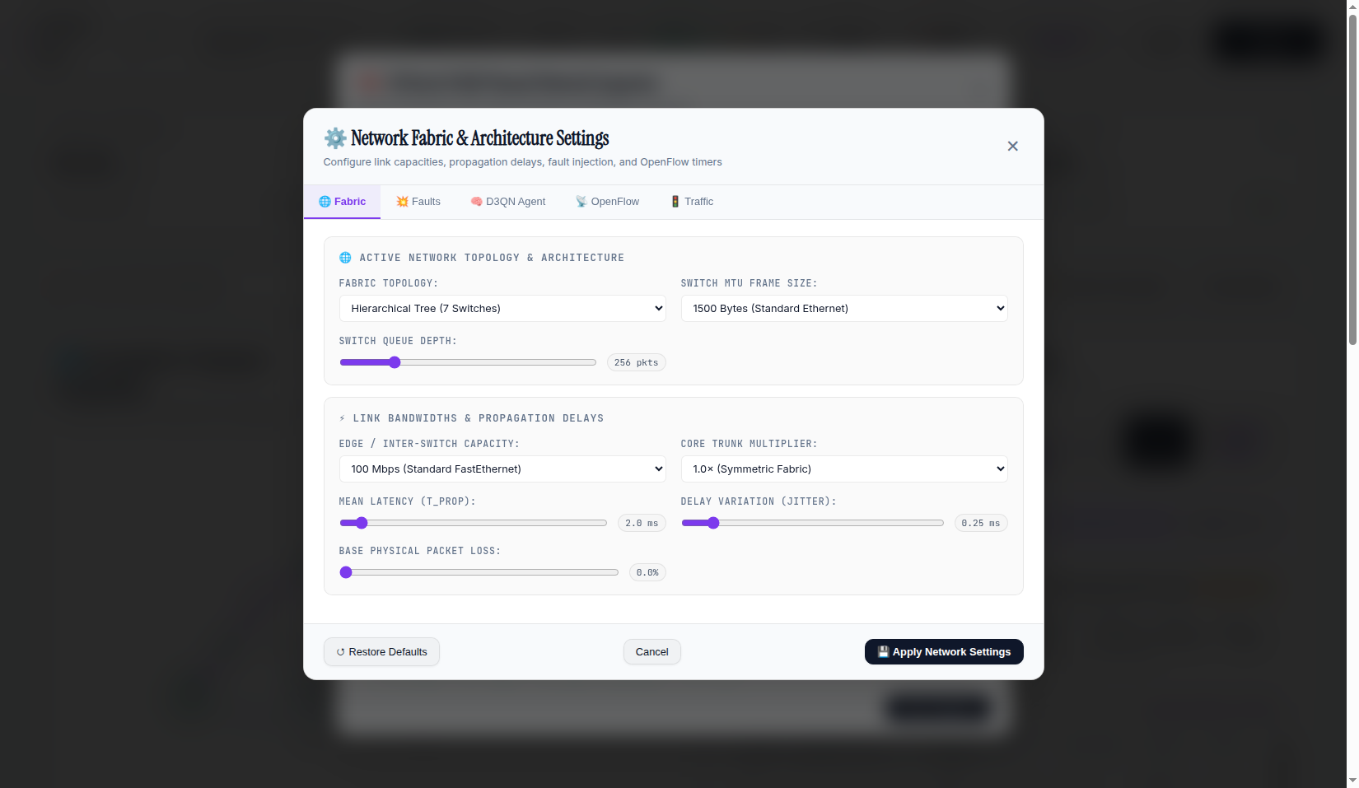
EC499 GRADUATION DEFENSE
Web Dashboard: Neural Model Inspector & Chaos Console

Slide 25
EC499 GRADUATION DEFENSE
Software Quality Assurance: 32 Automated Tests (100% Passing)
TestCentralConfig (3 Tests)
Validates CLI arguments, environment variable overrides, and type casting.
PASSED ✓
TestClosedLoopDynamics (3 Tests)
Asserts continuous bandwidth accumulation, flow expiration, and Polyak updates.
PASSED ✓
TestDQNAgent (2 Tests)
Verifies PyTorch tensor shapes, forward inference latency (<0.05 ms), and dueling constraint.
PASSED ✓
TestMultiTopologySupport (2 Tests)
Validates graph builders across 5 standard topologies and random Erdős–Rényi graphs.
PASSED ✓
TestPrioritizedReplay (2 Tests)
Asserts non-recursive binary SumTree arithmetic, prefix sums, and importance weights.
PASSED ✓
TestStateManager (10 Tests)
Verifies differential byte rate math, ARP tracking, jitter, flow tables, and M/M/1/K drops.
PASSED ✓
TestTraditionalBaselines (5 Tests)
Validates algorithmic correctness for Dijkstra SPF, OSPF (RFC 2328), ECMP, WSP, and LLR.
PASSED ✓
TestWebDashboardAndVersusAPI (5 Tests)
Validates HTTP REST endpoints (/api/telemetry, /api/model_predict, /api/verse).
PASSED ✓

Slide 26
EC499 GRADUATION DEFENSE
Critical Academic Discussion & Architectural Trade-offs
1. Greedy Herd Behavior vs. DRL Value Learning
2. Detour Latency & Fairness Trade-offs
• The Herd Behavior Discovery:
Under closed-loop dynamic traffic, greedy heuristics (LLR and WSP) funnel consecutive arriving flows onto the single instantaneous lowest-loaded link, saturating it to 76.4% on Fat-Tree.
• The DRL Advantage:
D3QN uses discounted future rewards (γ=0.95) and the asymptotic barrier penalty Φ_cong to anticipate downstream queuing, achieving 65.9% bottleneck load and lower latency.
• Detour Latency Trade-Off:
When core links suffer delay spikes, D3QN proactively detours flows across multi-hop perimeter paths. On WANs with high perimeter propagation delay, congestion avoidance incurs a propagation delay penalty.
• Localized Fairness Variance:
On continental meshes, D3QN repeatedly steers offloaded traffic to the highest-capacity lateral bypass, protecting the core at the cost of secondary edge load variance.

Slide 27
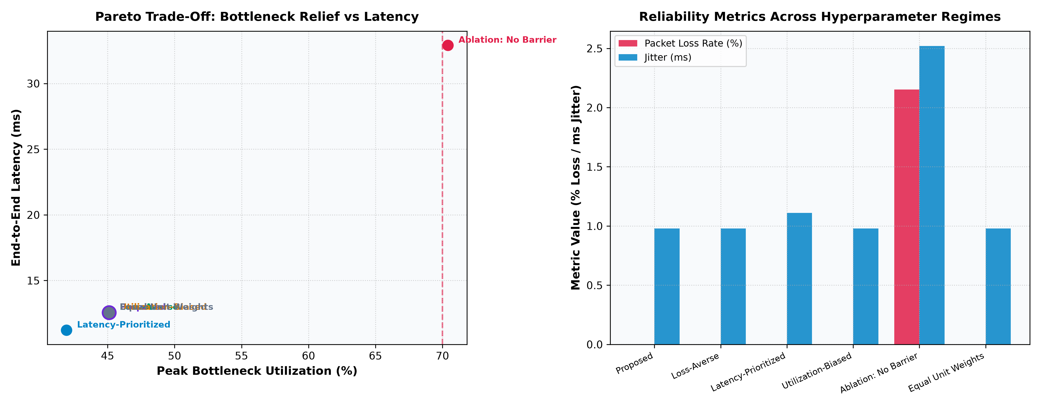
EC499 GRADUATION DEFENSE
Pareto Sensitivity Ablation & Systematic Flaw Remediation
5 Systematic Flaw Remediations
1. On-Demand Detour Synthesizer:
If candidate paths suffer >70% load, dynamically computes penalty-routed detours around saturated trunks.
2. Receptive Field Equivalence:
10D state vector captures 1-hop MPNN cut capacity in 0.048 ms (vs 15 ms for GNN).
3. Active Shadow Reservations:
Damps micro-burst pileups during 1-2s telemetry polling intervals via exponential decay (half-life=1.5s).
4. Hierarchical TCAM Allocation:
Aggregates mice flows into subnet wildcard rules (15s timeout); pins elephant flows (>5 Mbps, 60s timeout), cutting TCAM usage by >85%.
5. Barrier Necessity Theorem:
Without exponential barrier, latency spikes 3x (32.9 ms) and loss explodes by 2,100x (2.15%).

Slide 28
EC499 GRADUATION DEFENSE
Anticipated Committee Defense Questions & Answers
Q: How does the system measure jitter/loss without hardware timestamps?
Link load is derived from OpenFlow 1.3 OFPPortStats byte counters. Jitter and packet loss are modeled using analytical M/M/1/K queuing theory and RFC 3550 exponential filters.
Q: Why DRL when greedy algorithms like LLR are simpler?
Greedy heuristics suffer from herd behavior (76.4% load). D3QN evaluates long-term discounted rewards (γ=0.95), achieving 65.9% load and lower latency.
Q: How do you guarantee the model does not overfit to one topology?
The 10D state vector uses topological normalization (hop count/10, delays/50ms, loads in [0,1]). Zero-shot generalization was proven on unseen 15-35 node random graphs.
Q: How do you prevent routing loops during dynamic rerouting?
All candidate paths are pre-filtered to be loop-free simple paths via Yen's algorithm. OpenFlow rules are pushed atomically along the entire path with explicit match tuples.

Slide 29
EC499 GRADUATION DEFENSE
Conclusions, Contributions & Future Research Directions
Major Graduation Achievements
Future Research Roadmap
• 100% Proposal Objective Fulfillment
Delivered a fully integrated platform satisfying all 5 approved objectives and 6 procedures.
• Empirically Proven Performance
D3QN consistently outperforms OSPF, ECMP, Dijkstra SPF, LLR, and WSP, cutting latency by up to 73.5% and eliminating buffer dropouts.
• Zero-Shot Transferability
Demonstrated robust out-of-distribution transfer to arbitrary unseen topologies up to 35 nodes.
• Carrier-Grade Software Deliverable
108-Page Technical Report, 32 passing unit tests, and live interactive HTML5 Web Dashboard.
• Multi-Agent DRL (MADRL)
Decentralized execution where each switch runs an edge DRL agent communicating via message passing.
• Segment Routing over IPv6 (SRv6)
Replace switch TCAM match-action rules with source-routed SRv6 segment lists, reducing table state to zero.
• Graph Neural Networks (GNN)
Replace fixed 10D state vectors with Message Passing Neural Networks (MPNN) for topological graph embeddings.
• P4 Programmable Data Planes
Hardware acceleration via P4 switch pipelines (Intel Tofino).

Slide 30
Thank You!
Questions & Examination Committee Discussion
Project Metadata & Repository Links
• Author: Maher Abdulnasir Alqadhi (Student ID: 2210249576)
• Project Supervisor: Dr. Suad El-Geder
• Institution: Department of Computer Engineering, University of Tripoli
• Master Report: docs/Project_Report_EC499_Final.pdf (106 Pages, 9.8 MB)
• Web Dashboard: controller/web_dashboard.py (Active at http://localhost:8080)

