Slide 1
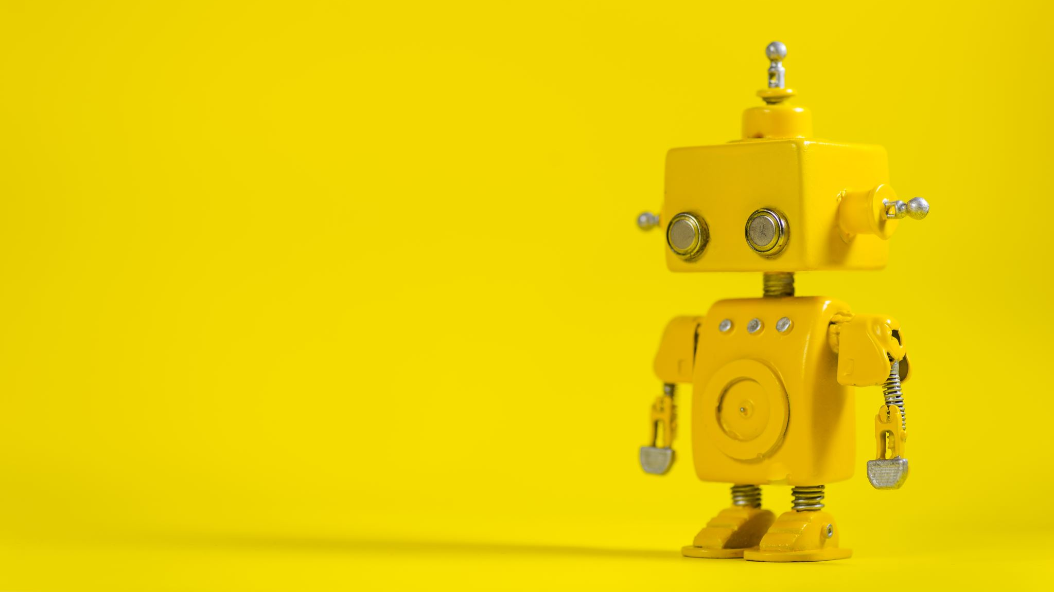
Robotics
Anthony

