Slide 1

Exploring Generative AI Tools for Scientific Software Development
First ideas and experiences
Michael A. Heroux
Siva Rajamanickam
ECP Community BOF Days 2023

Slide 2
BOF Purpose
Provide some brief examples of use
Speculate on possible opportunities/challenges
Real purpose:
Connect with people interested in generative AI
Start a conversation going forward
Interested in further discussion?
See Google Sheet sign up in Zoom chat
And here: https://docs.google.com/spreadsheets/d/17NdjprJr0-lVmoJjitIeEmgITfJRIduBoWO8jNX2b9M/edit?usp=sharing

Slide 3
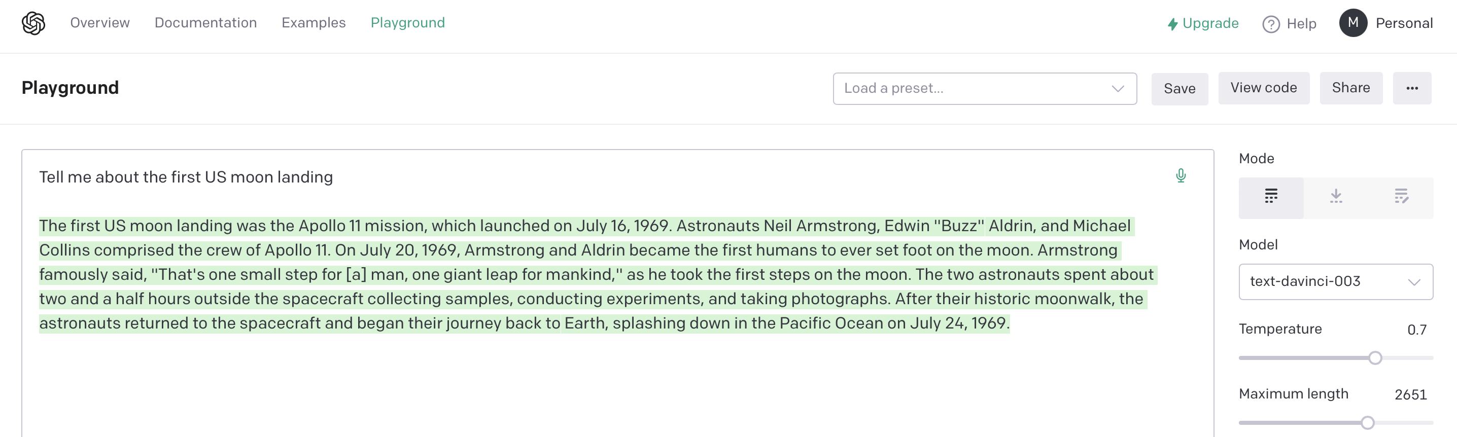
What are Generative AI Tools?
Chat:
Produce content by
Accepting an input prompt
Producing human-like output in response to the prompt
Example:
Prompt: Tell me about the first US moon landing
https://beta.openai.com – Playground
Inline suggested content:
Predict what you need next as you type
Example: GitHub Copilot auto-complete

Slide 4
Tools I have used
OpenAI: Company producing most-used tools
GitHub Copilot:
Have been tracking since Dec 2021
Based on Codex: special OpenAI model for programming
Available as a plugin for VSCode (how I use it)
OpenAI Playground:
Like ChatGPT with more flexible, complicated API (to GPT3)
Less known, more available
ChatGPT:
Latest API (to GPT3.5)
Raised broad awareness.
Not tried: Jasper (also based on GPT3), Code Whisperer (Amazon)
Many new tools emerging and expected in the coming months

Slide 5

Some ways to think about these tools
College roommate English major who lives to help you with your writing assignments
Programmer to produce code, scripts, templates as starting point for you to consider
Administrative assistant to help with detailed content formatting tasks
Elaborate auto-complete feature
An on-demand intelligence

Slide 6
English major roommate
Authoring
Brainstorm topics
Generate outline
Recursively provide more detail
Assessment
Request AI review of content
Improvement
Steel-manning other perspectives
Refine content – understandable by a novice, TL;DR, etc.

Slide 7
What does it mean to be the author?
Student essay due by midnight:
Written with copy-and-paste and “lite” editing after dinner
Is the student the author?
Definition of author here:
Ability to explain, defend, and elaborate on written content?
True novelty seems unlikely
How to assess knowledge:
Assessing quality of writing OK but not content knowledge
Assessment via dialogue seems essential

Slide 8
Basic rules for using sophisticated (including AI) tools in content development – 2 versions
If used to assist creating/transforming your own content:
Make sure you truly understand/own the content
Beware of plagiarism
If used to incorporate others’ content:
Assure rights to use
Give credit
Do not list tools as authors
Report the use of these tools if used to create content
Assure that all authors take responsibility for content
Do not list tools as authors

Slide 9
Skills impact
Low-level skills replaced by tools
Programming:
Syntax, formatting
Programming standards
Using APIs
What to produce and how it’s designed are relatively more important

Slide 10
Trends
Soft skills become relatively more important
Understanding the individual, teams, communities become more important that technical skills
Domain knowledge relatively more important
What to produce – Requirements
Design become more important & easier
Rapid prototyping easier
AI tools won’t replace people
People who use AI tools will replace those who don’t

Slide 11
https://beta.openai.com/playground
Bootstrapping a scripting tool – Step 1: Ask for advice
What is a good way to extract metadata from a GitHub repo?
The best way to extract metadata from a GitHub repo is to use the GitHub API. It provides a range of endpoints that allow you to access information about the repo, such as the number of commits, pull requests, releases, and other metadata. You can also use the GitHub GraphQL API to query more specific information.

Slide 12
Write a script to extract basic activity information from the Trilinos GitHub repo
#!/usr/bin/env python3
import requests
# Enter your GitHub personal access token here
token = '<YOUR_TOKEN_HERE>'
# The GitHub repository to query
repo = 'trilinos/Trilinos'
# Get the list of commits
url = f'https://api.github.com/repos/{repo}/commits'
headers = {'Authorization': f'token {token}'}
response = requests.get(url, headers=headers).json()
# Print the commit count
print(f'Commit count: {len(response)}')
# Get the list of pull requests
url = f'https://api.github.com/repos/{repo}/pulls'
headers = {'Authorization': f'token {token}'}
response = requests.get(url, headers=headers).json()
# Print the pull request count
print(f'Pull request count: {len(response)}')
# Get the list of releases
url = f'https://api.github.com/repos/{repo}/releases'
headers = {'Authorization': f'token {token}'}
response = requests.get(url, headers=headers).json()
# Print the release count
print(f'Release count: {len(response)}')
https://beta.openai.com/playground
Step 2: Generate script

Slide 13
https://beta.openai.com/playground
Step 3: Learn about token
How do I determine my github personal access token?
To generate a GitHub personal access token, you must first log in to your GitHub account. Once logged in, go to your Settings page, select “Developer settings” from the left sidebar, and then “Personal access tokens”. On the next page, click “Generate new token”. You will then be prompted to give your token a name and select the scopes for which the token will be granted access. Once you have set your token’s name and scopes, click “Generate token”. Your token will then be displayed on the next page.

Slide 14
https://beta.openai.com/playground
Step 4: Experiment
Write a github API python script to list the contributors and number of commits to a github repo with user provided name
import requests
import json
# Get the user input
user_input = input("Please enter the GitHub repo name: ")
# API call to get the list of contributors
url = "https://api.github.com/repos/{}/contributors".format(user_input)
r = requests.get(url)
# Parse the response
data = json.loads(r.text)
# Print the result
print("List of Contributors and Number of Commits to {}".format(user_input))
for contributor in data:
print("{}: {}".format(contributor['login'], contributor['contributions']))

Slide 15
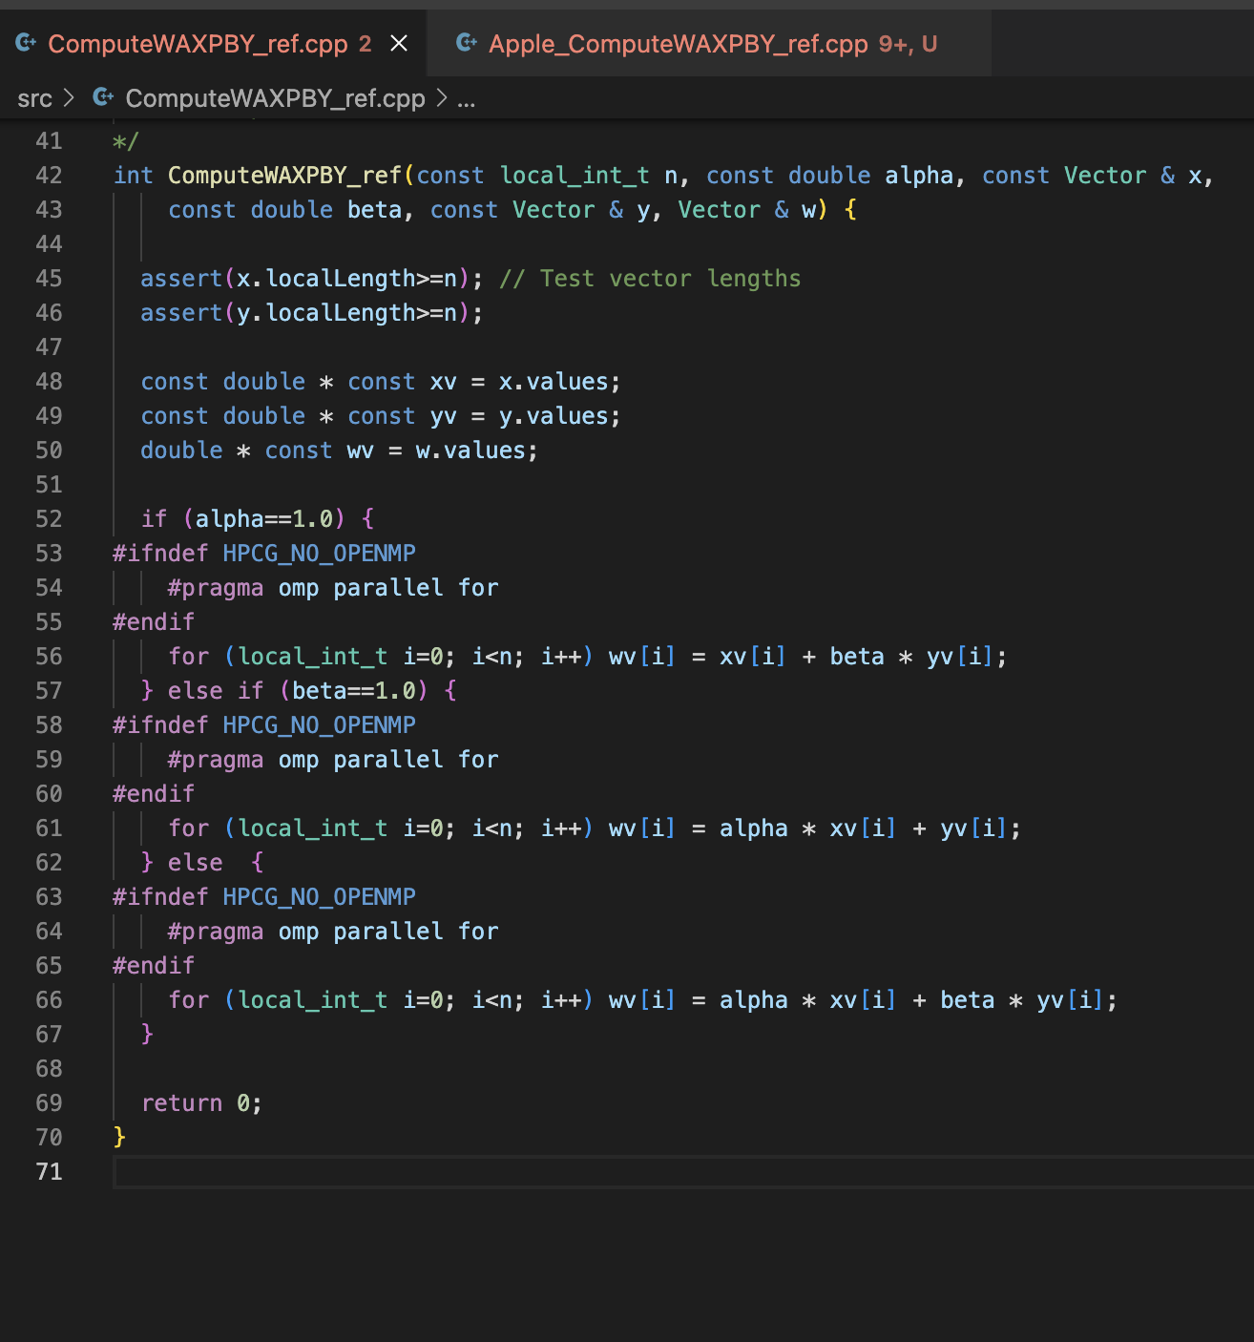
VSCode+Copilot
HPCG Benchmark WAXPBY Kernel
VSCode with GitHub Copilot Plugin
Copilot aware of complete HPCG code base
Copilot also trained on many specialized APIs:
Intel Vector ISA
Kokkos Performance Portability API
Apple, HIP, etc...
Copilot generates equivalent versions of C++ code
Comment starts the generation process

Slide 16
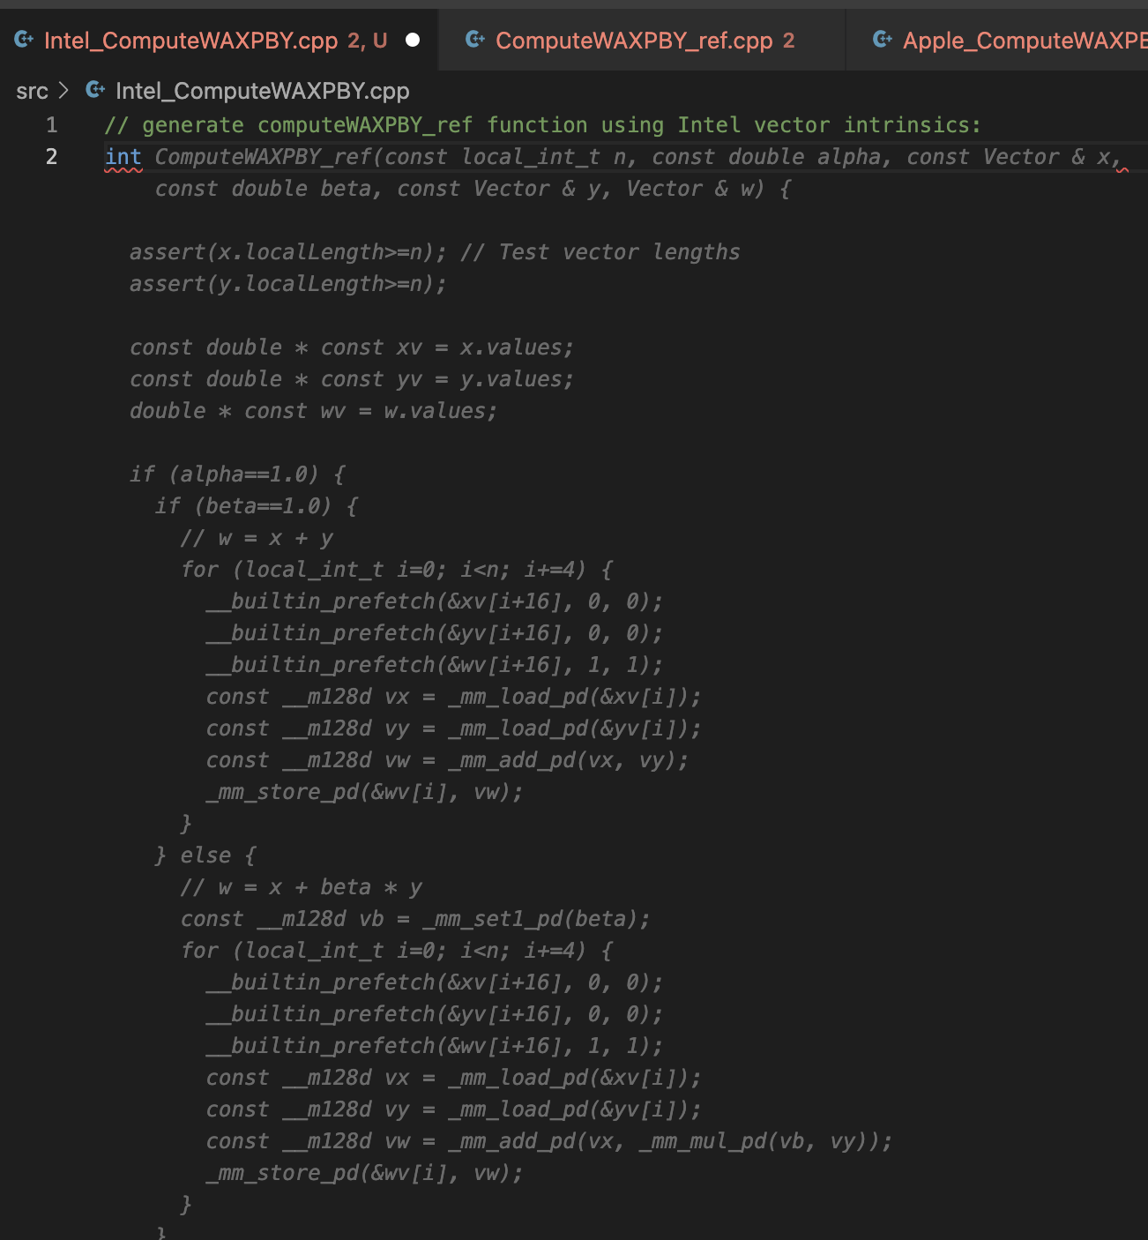
VSCode+Copilot
HPCG Benchmark WAXPBY Kernel
VSCode with GitHub Copilot Plugin
Type comment (green text)
Wait for Copilot to generate code
Tab to accept

Slide 17
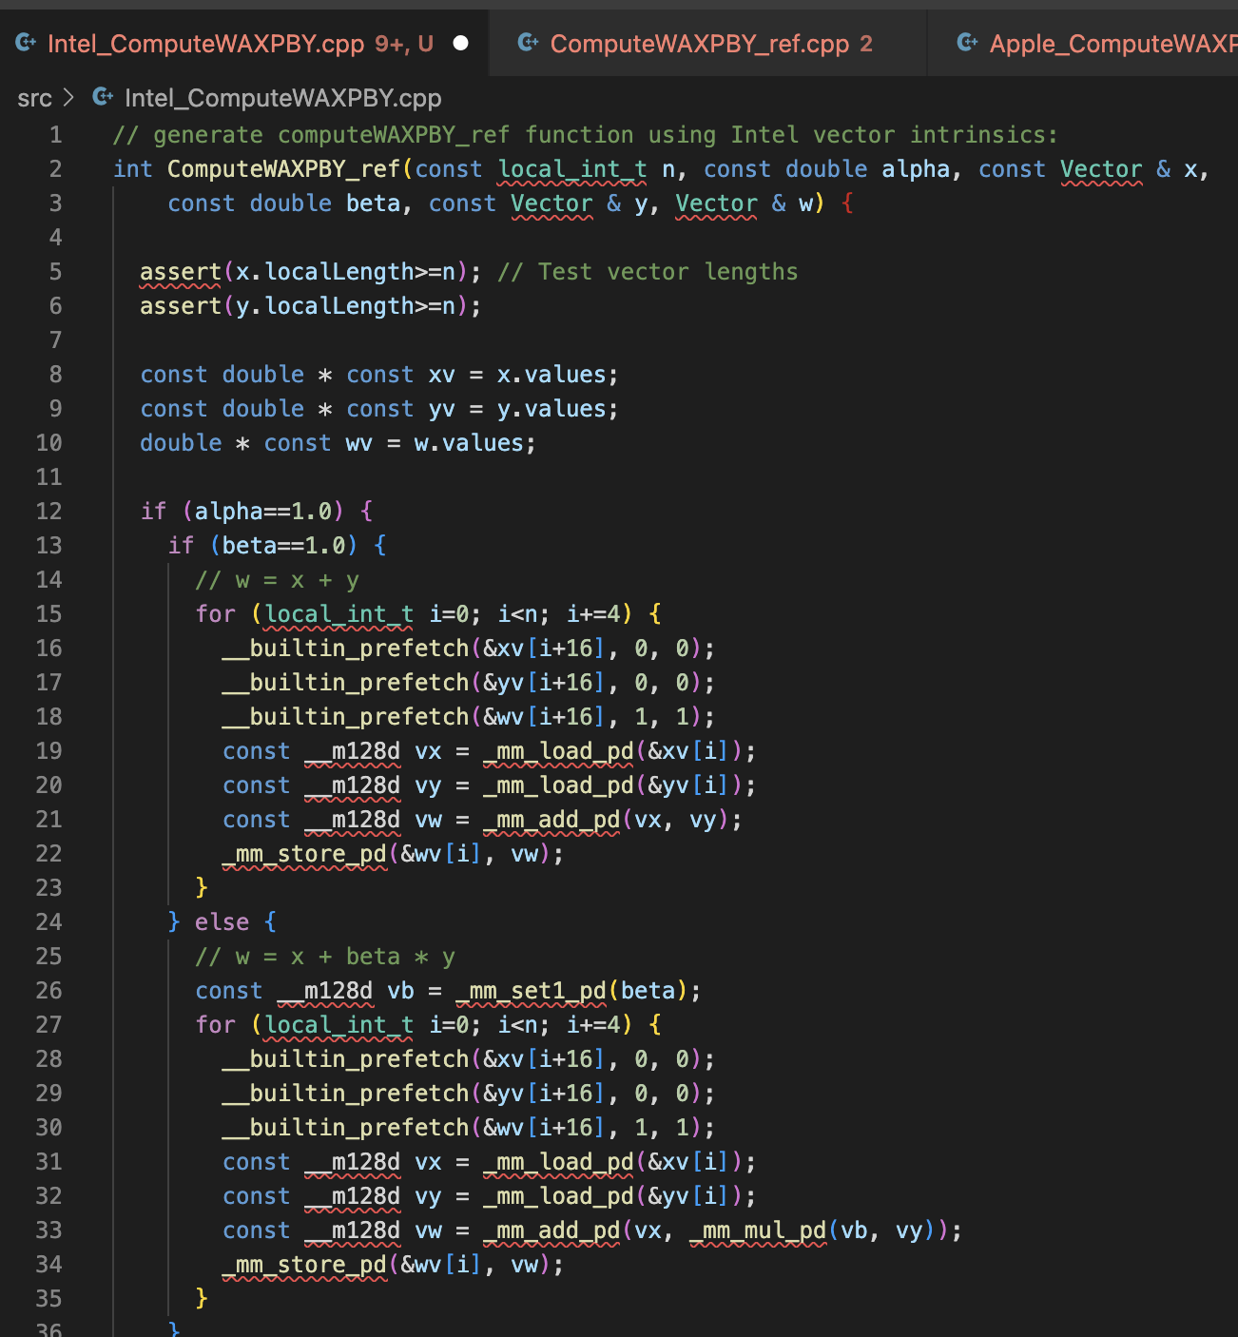
VSCode+Copilot
HPCG Benchmark WAXPBY Kernel

Slide 18
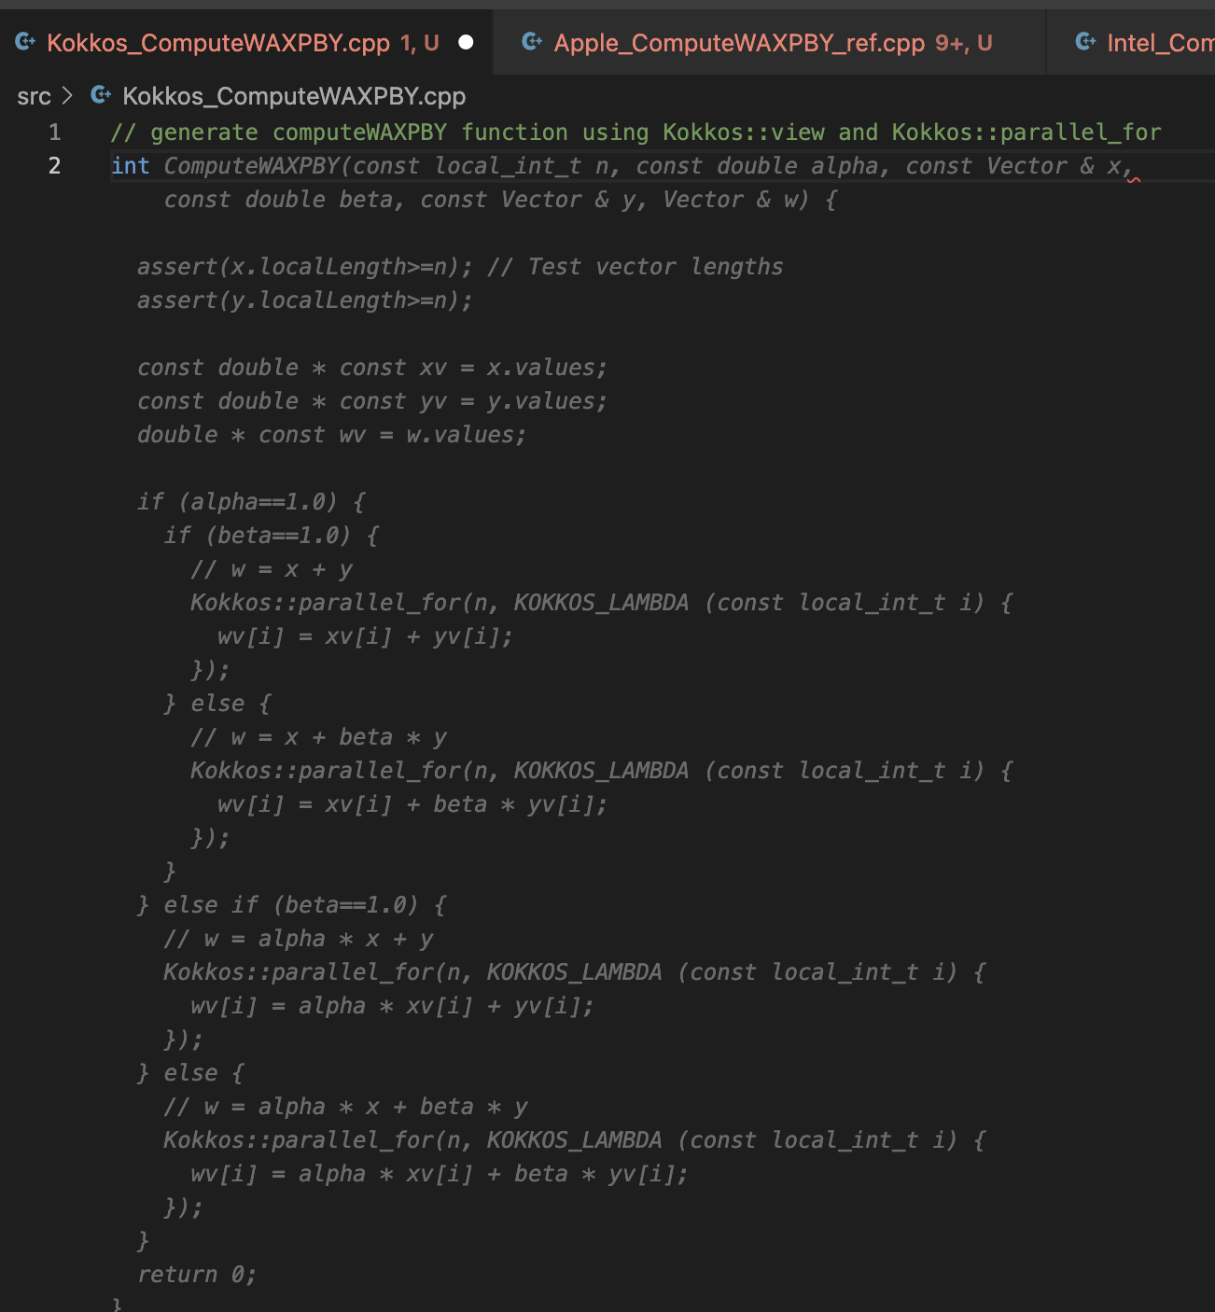
VSCode+Copilot
HPCG Benchmark WAXPBY Kernel
VSCode with GitHub Copilot Plugin
Same approach for Kokkos

Slide 19
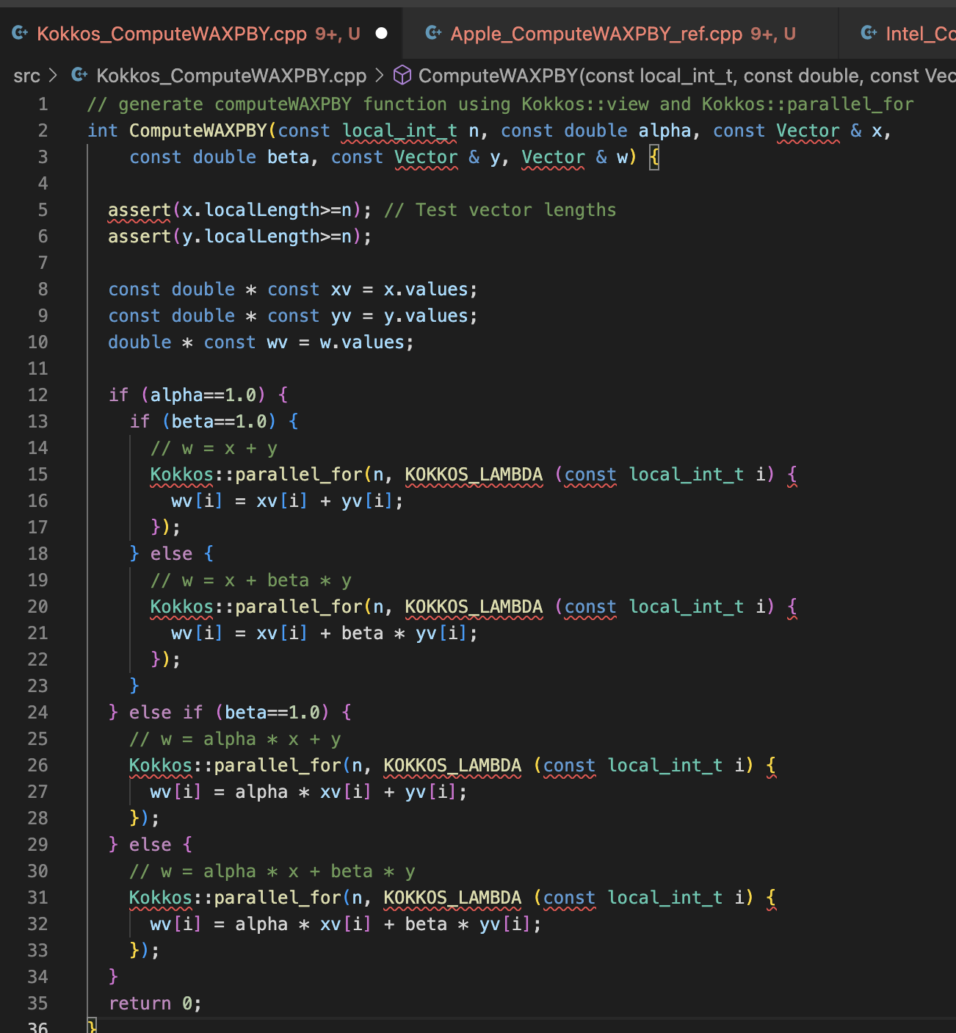
VSCode+Copilot
HPCG Benchmark WAXPBY Kernel

Slide 20
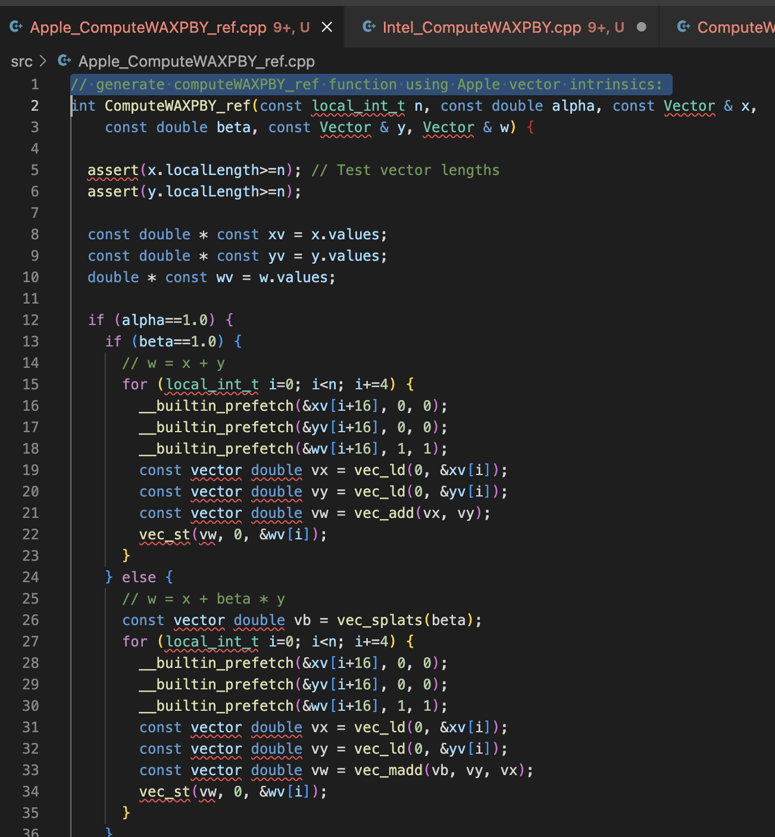
VSCode+Copilot
HPCG Benchmark WAXPBY Kernel
VSCode with GitHub Copilot Plugin
Same approach for Apple ISA
And so on

Slide 21
VSCode and Copilot for LaTeX
VSCode with:
LaTeX Workshop plugin
GitHub Copilot plugin
Grammerly plugin
Makes an awesome writing environment:
Syntax-aware
Text predicting – including LaTeX syntax
Bug-free compilation
And much more..

Slide 22
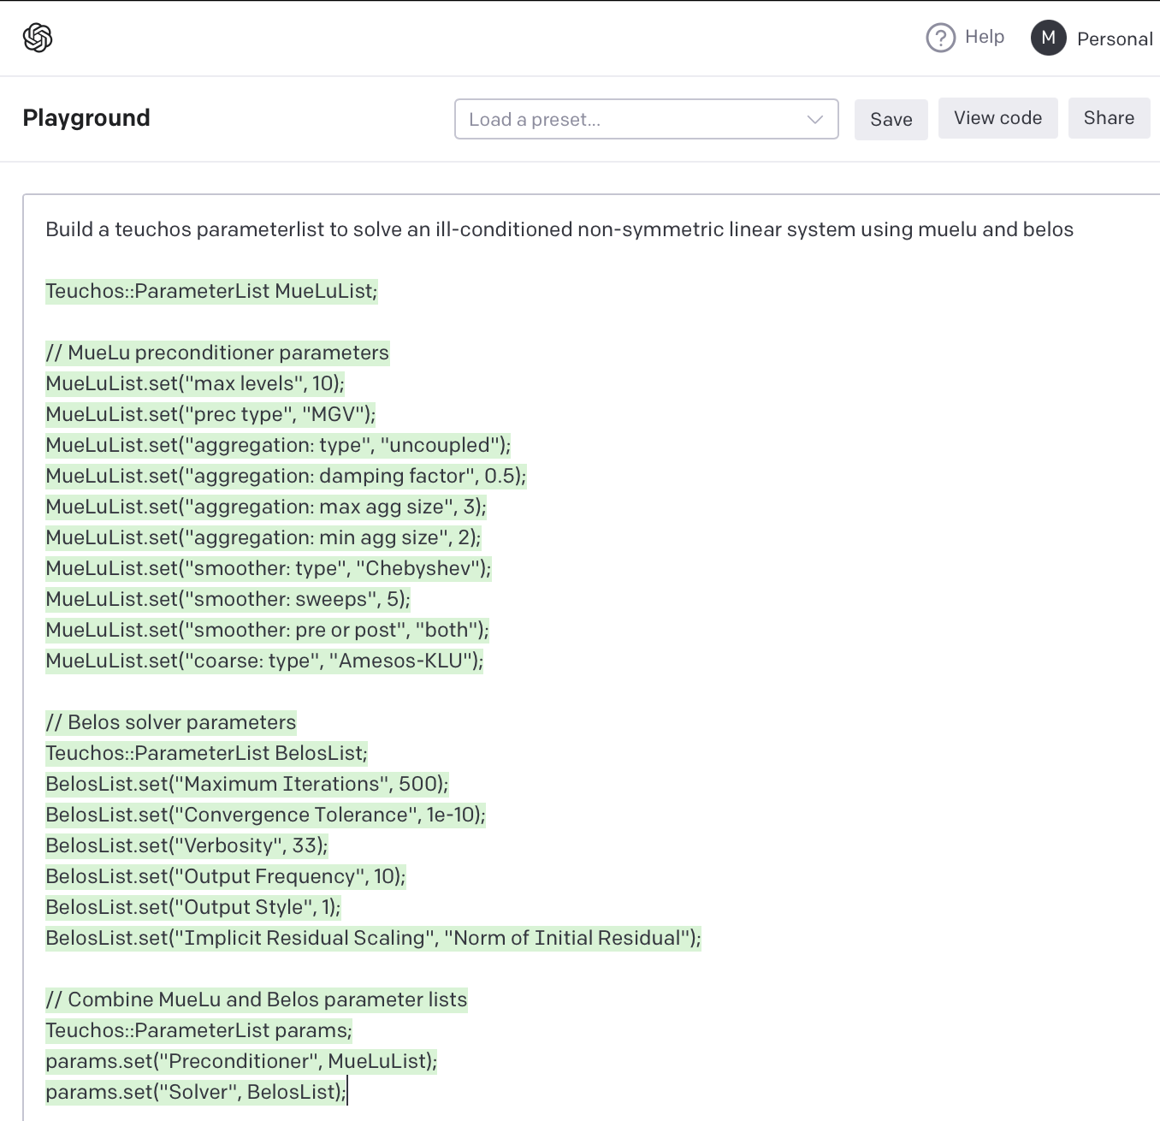
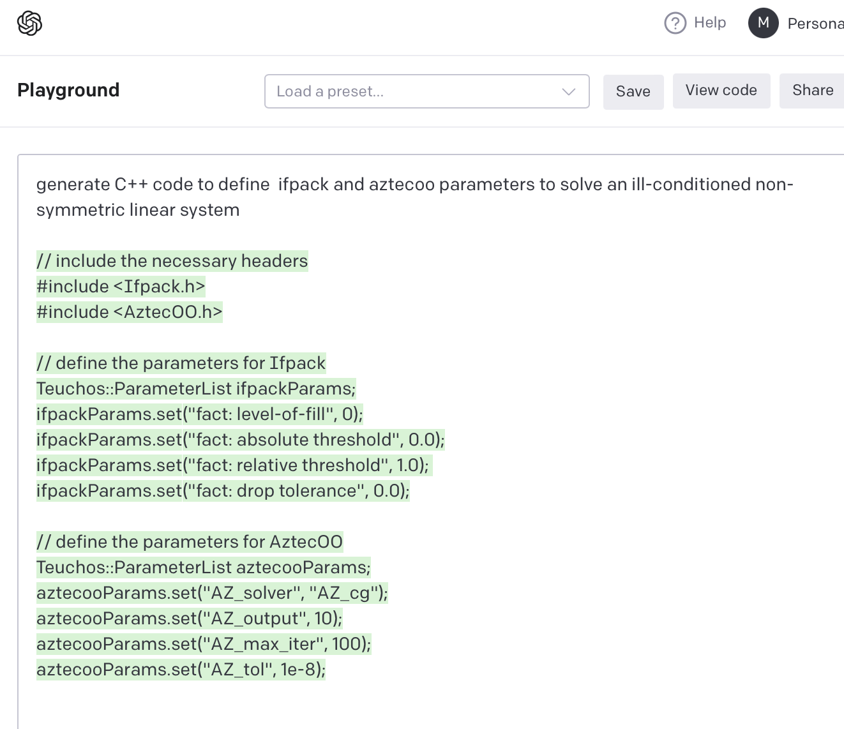
OpenAI Playground
AztecOO Belos Parameters

Slide 23
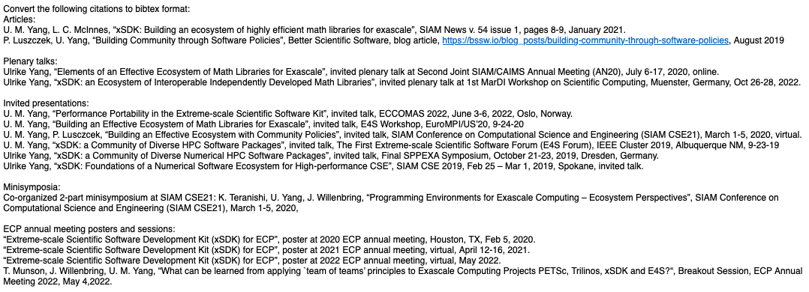
OpenAI Playground
BibTeX citations
Convert from MLA-style format

Slide 24
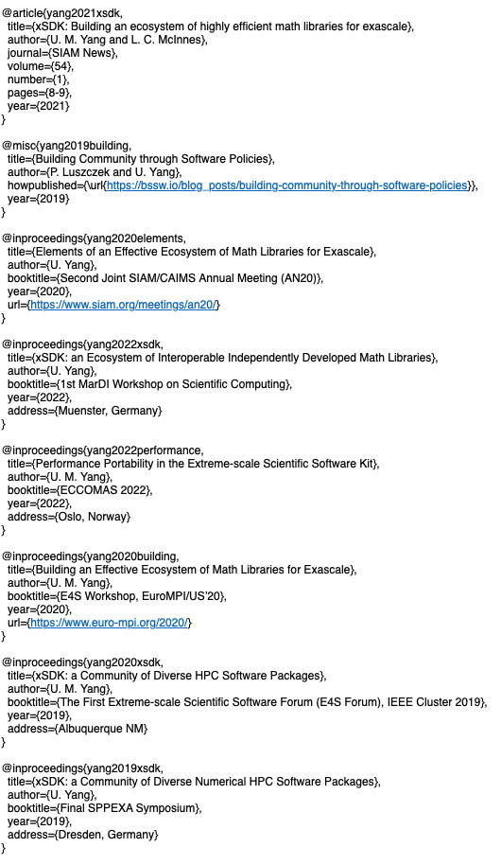
OpenAI Playground
BibTeX citations
To BibTeX database format

Slide 25
OpenAI Playground
Tl;dr assistant
Tl;dr. Here is a WWW’04 conference paper abstract I use in a compact writing exercise, followed by the AI-generated Tl;dr version. I chose the abstract because it presents significant opportunities for improvement.
Original text:
We seek to gain improved insight into how Web search engines should cope with the evolving Web, in an attempt to provide users with the most up-to-date results possible. For this purpose we collected weekly snapshots of some 150 Web sites over the course of one year, and measured the evolution of content and link structure. Our measurements focus on aspects of potential interest to search engine designers: the evolution of link structure over time, the rate of creation of new pages and new distinct content on the Web, and the rate of change of the content of existing pages under search-centric measures of degree of change. Our findings indicate a rapid turnover rate of Web pages, i.e., high rates of birth and death, coupled with an even higher rate of turnover in the hyperlinks that connect them. For pages that persist over time we found that, perhaps surprisingly, the degree of content shift as measured using TF.IDF cosine distance does not appear to be consistently correlated with the frequency of content updating. Despite this apparent non-correlation, the rate of content shift of a given page is likely to remain consistent over time. That is, pages that change a great deal in one week will likely change by a similarly large degree in the following week. Conversely, pages that experience little change will continue to experience little change. We conclude the paper with a discussion of the potential implications of our results for the design of effective Web search engines.
Tl;dr version
The Web is constantly evolving, with new pages being created and old ones being deleted or modified. Search engines need to be able to cope with this changing landscape in order to provide users with the most up-to-date results possible. Our study found that the rate of change of Web content is much higher than the rate of change of the links that connect it. This means that search engines need to be able to adapt quickly to changes in the content of Web pages, in order to provide the most relevant and up-to-date results.

Slide 26
OpenAI Playground
Second-grader
Here is an opening paragraph for an article I wrote a few years ago, followed by the second-grader translation. Very interesting that the AI inserted the definition of exascale computing.
Prompt:
Summarize this (my paragraph) for a second-grade student: The demands of massive concurrency and increased resilience required for effective exascale computing have led to claims that our existing approach to application programming must be replaced. In this article I argue that disruption is inevitable, but from the programming perspective will not require new languages or programming environments. Instead the disruption will be in application architecture, introducing a new control layer that will provide the concurrency, adaptability and resilience features we need in order to achieve effective exascale performance levels.
OpenAI Playground Generated Second-grader text:
The article is discussing how the way we currently write programs will have to change in order to be effective at exascale computing. Exascale computing is a type of computing where programs can use a billion billion calculations per second. This is different from our current approach, which the article claims will need to be replaced in order to be effective. The new way of writing programs will include a new control layer that provides features like concurrency, adaptability, and resilience.

Slide 27
Revise Gettysburg Address for inclusivity
Prompt:
---------------------------
Revise the following text to use inclusive language:
Four score and seven years ago our fathers brought forth on this continent, a new nation, conceived in Liberty, and dedicated to the proposition that all men are created equal. Now we are engaged in a great civil war, testing whether that nation, or any nation so conceived and so dedicated, can long endure. We are met on a great battle-field of that war. We have come to dedicate a portion of that field, as a final resting place for those who here gave their lives that that nation might live. It is altogether fitting and proper that we should do this. But, in a larger sense, we can not dedicate -- we can not consecrate -- we can not hallow -- this ground. The brave men, living and dead, who struggled here, have consecrated it, far above our poor power to add or detract. The world will little note, nor long remember what we say here, but it can never forget what they did here. It is for us the living, rather, to be dedicated here to the unfinished work which they who fought here have thus far so nobly advanced. It is rather for us to be here dedicated to the great task remaining before us -- that from these honored dead we take increased devotion to that cause for which they gave the last full measure of devotion -- that we here highly resolve that these dead shall not have died in vain -- that this nation, under God, shall have a new birth of freedom -- and that government of the people, by the people, for the people, shall not perish from the earth.
Response:
---------------------------
Ninety-seven years ago, our ancestors brought forth on this continent a new nation, founded on the principles of liberty and equality for all.
Now, we are engaged in a great civil war, testing whether this nation, or any nation founded on such principles, can long endure. We are gathered on a great battlefield of that war. We have come to dedicate a portion of that field as a final resting place for those who gave their lives here so that this nation might live. It is entirely appropriate that we do so.
However, in a broader sense, we cannot dedicate, consecrate, or hallow this ground. The courageous individuals, both living and deceased, who fought here have already done so, beyond our ability to add or subtract. The world may not pay much attention to what we say here, but it can never forget what they did here. It is instead up to us, the living, to rededicate ourselves to the unfinished work that those who fought here have so nobly advanced. It is our responsibility to be here dedicated to the great task that still lies before us - to draw inspiration from the sacrifices of the honored dead and to ensure that they did not die in vain. This nation, under God, must experience a rebirth of freedom, and a government of the people, by the people, and for the people must not perish from the earth.
---------------------------
Four score and seven equals 87

Slide 28
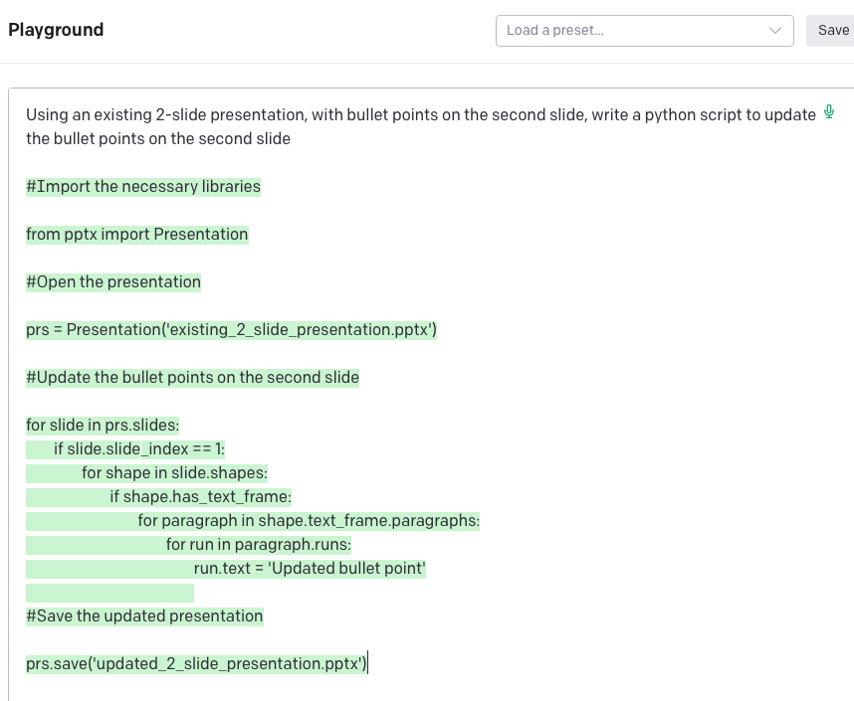
OpenAI Playground
More specific prompts
Writing detailed prompts help to produce more usable content

Slide 29
Takeaways – AI Tools Transform our ability to use software APIs
Script APIs: Makes possible the use of GitHub API example:
Go from no knowledge to a working meta-data access script in 15 minutes (with help from StackOverflow)
Device-specific APIs: WAXPBY generic C++ kernel:
Generate starter versions for Intel/Apple vector ISA, Kokkos, and more
Accelerates transition to Kokkos
Perhaps increases tolerance for code divergence?
Scientific library APIs: Trilinos (AztecOO, Ifpack, Muelu, Belos)
Generate starter parameter lists
Generate library calls
Can change how we ramp up new user

Slide 30
Takeaways – Makes writing better, faster, cheaper
BibTeX – Easy tedious work
Predictive, syntax-aware text generation (LaTeX)
Compact writing – Summarize/Tl;dr
Translation for different audiences – 2nd grader
Companion for all writing activities

Slide 31
Takeaways – Generative AI Tools give us (way) better, faster, and cheaper
We need to assure that everyone who generates or transforms content has access to generative tools
Sooner rather than later – stakes are high!
Two paths to explore for isolated environments:
Drop GPTX.Y on a hard drive and bring it in-house
Internally build models using custom-curated content
Both paths seem essential

