Slide 1
Technical Writing & Presenting 2.0
CSCI 373
Mike Heroux

Slide 2
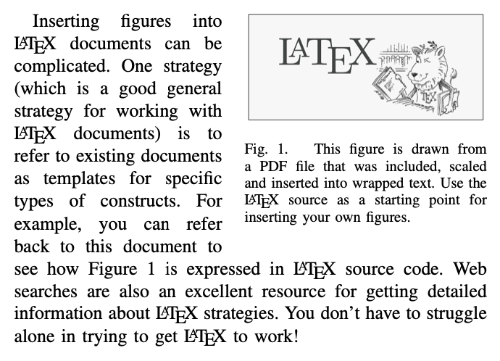
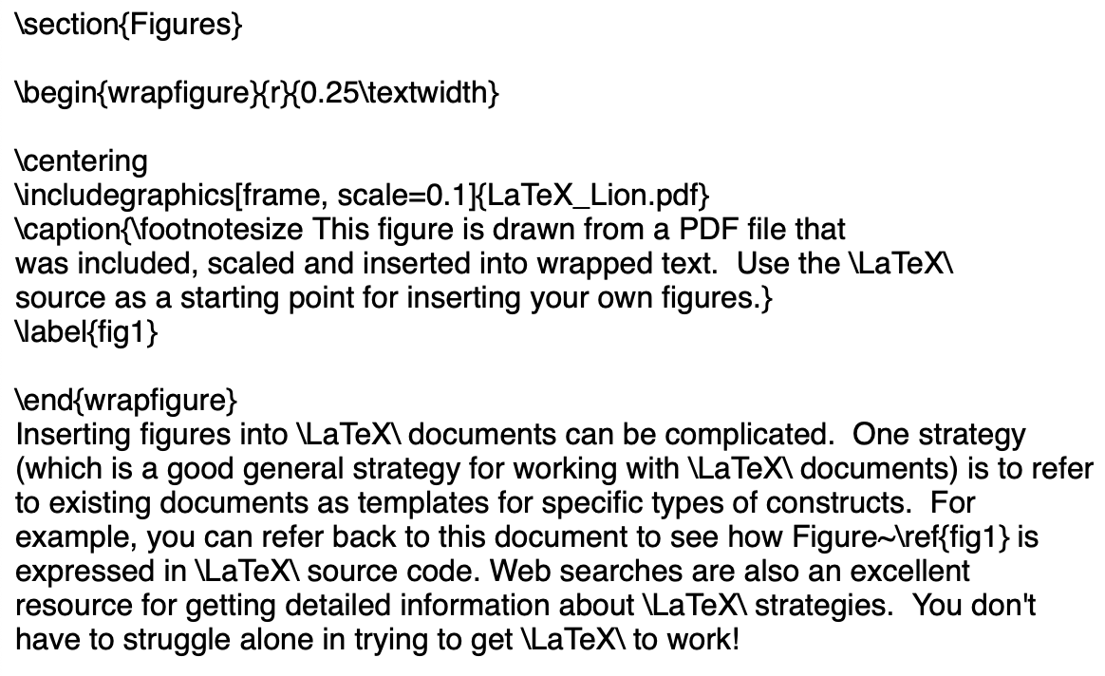
Labels
\label{label_name} and \ref{label_name}

Slide 3
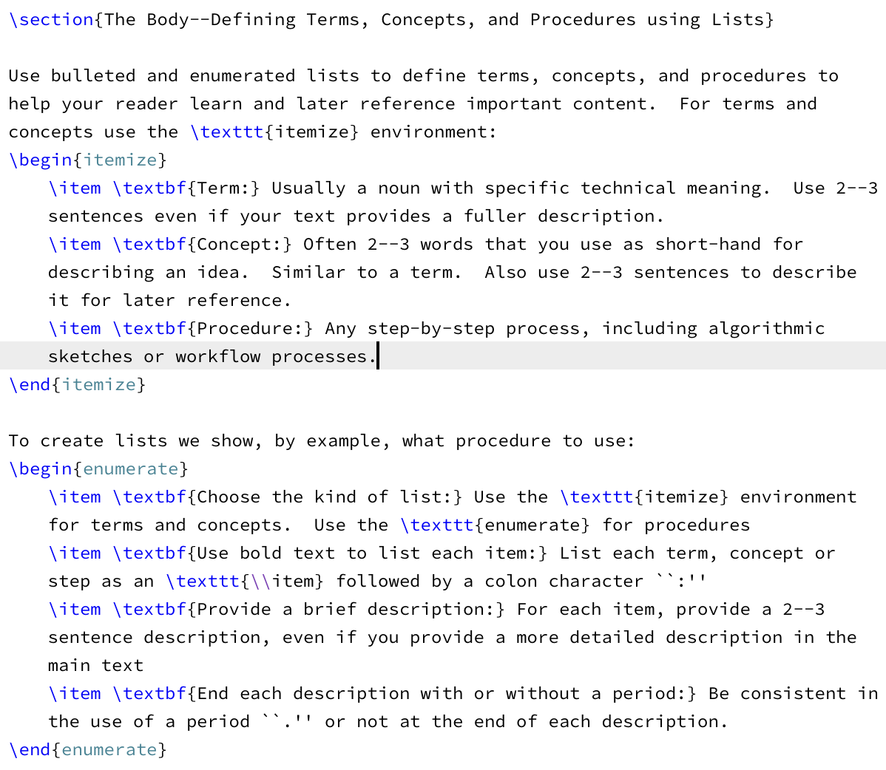
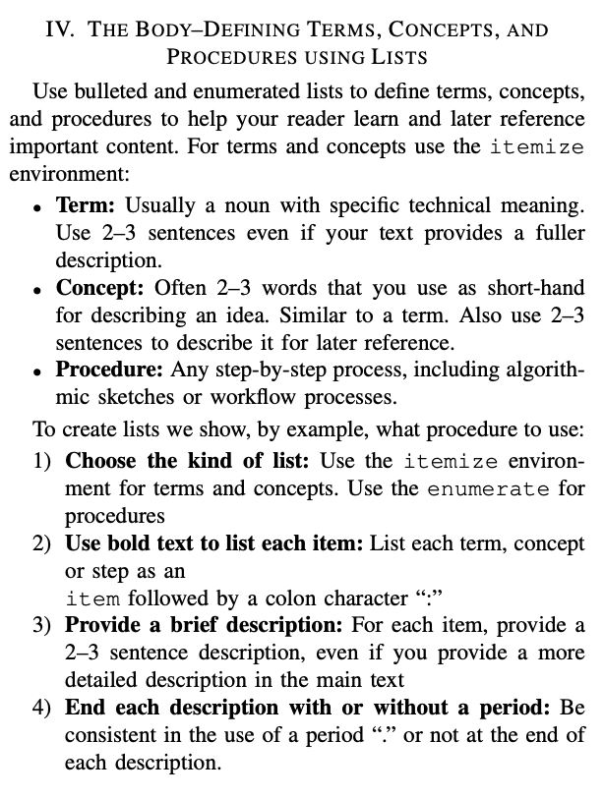
Terms, Concepts, Procedures
Use lists

Slide 4
Spacing using ~
Use ~:
In Smith and Jones~\cite{2014SmithJones}, we see that …
In Section~\ref{intro}, …
In Figure~\ref{fig1}, …

Slide 5
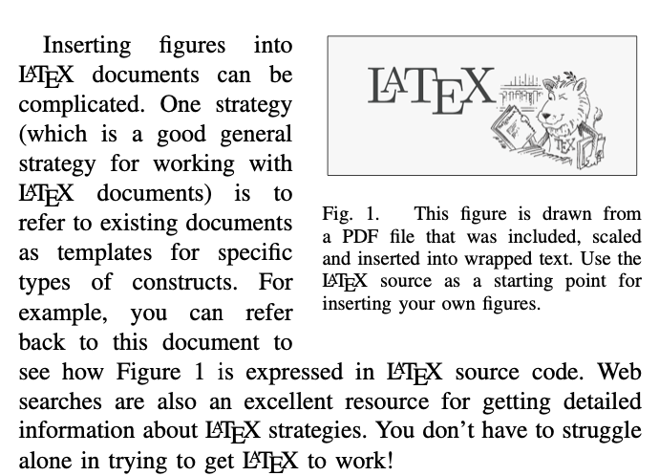
Figures
Figures:
Graphs:
Clearly label units, legend, title
Captions:
Explain the figure in summary
2-3 sentences that tell the story of the figure

Slide 6
Wide figures
Spreading a figure across two columns
Use figure*
To spread a figure across two columns:
Use the figure* environment. So instead of
\begin{figure}[ht]
\centering
...
\end{figure}
you should use
\begin{figure*}[ht]
\centering
...
\end{figure*}
This also works for tables (i.e. table*).

Slide 7
Writing Rules
Rule #7:
Use pictures, charts and graphs,
But keep in mind #4 (Simplicity).
Rule #8: Use examples to explain complex ideas.
Rule #9: Use:
Headings (Chapter, Section, etc.).
Bulleted Lists.
Numbered lists.
to provide structure, clarity and conciseness to your document.
Rule #10: Provide guidance :
Table of Contents.
List of Figures, list of Tables.
Index and Glossary.
Abstract.
Note: LaTeX provides these!

Slide 8
Slide Guidelines
Let us read the data.
Use diagrams, charts, figures.
Intersection: minimal.
Prepare for disaster.
If slides are big notecards, don’t have slides.
What
you
say
What is
on your slides

Slide 9
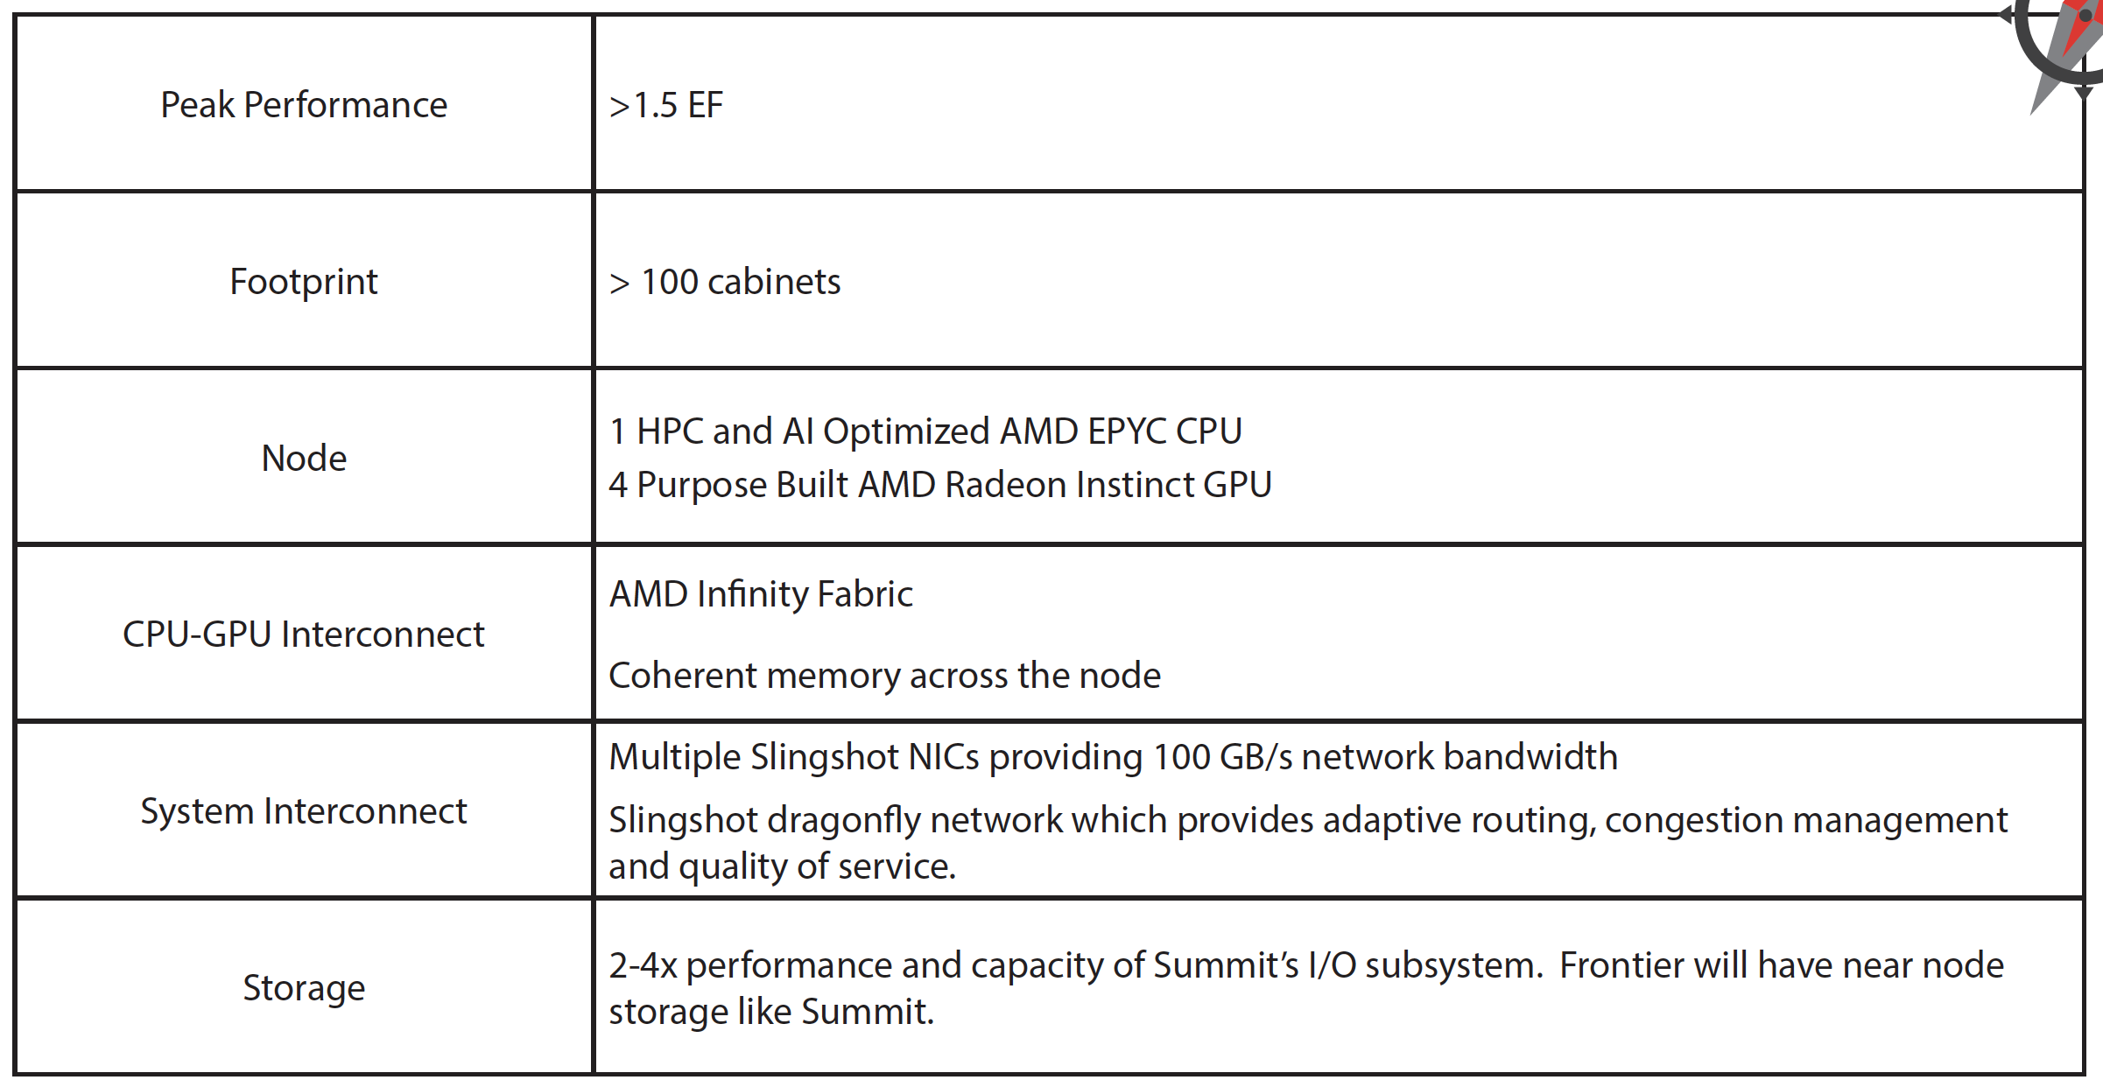
Put Details on Slides
DOE Oak Ridge Exascale System Frontier Specs.

Slide 10
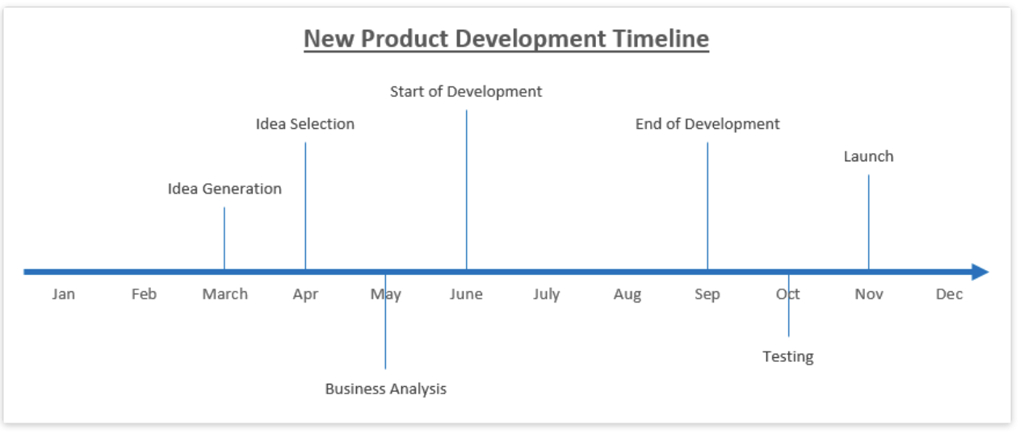
Create Timelines
http://www.excel-board.com/how-to-create-timeline-chart-in-excel-quickly-and-easily/

Slide 11
PowerPoint Defaults
The default format for PowerPoint is:
Outline Format.
Brief statements.
Slide is a big notecard for the speaker.
This is BAD:
Credible argument:
Problems with space shuttle O-rings were known.
Poor PowerPoint hid the issue.
NASA Challenger exploded in 1986.
The best default for a new PowerPoint slide?

