Slide 1
Technical Research, Writing & Presenting 2.0
CSCI 373
Mike Heroux

Slide 2
Need help?
Use our AI tools:
Have a deep conversation with ChatGPT
Ask Gemini to generate one (or many!) research reports for you
Don’t like what you got the first time?
Ask again, and again, and again.
Not sure how to ask?
Ask how to ask!

Slide 3
If you find one good resource
Look at its bibliography, notes, resources
Go to the library site, find the article and click on the link that finds article that cite that article
Find the authors’ websites and look for other papers they have published
And iterate with anything new you find
Soon, you will have a good collection of related resources

Slide 4
Signs you are becoming an expert
You have read, viewed, and listened to many resources: Dozens, not 10, 15
When you find a new resource, it covers ideas you have already encountered and builds upon your existing understanding
When you read, view, or listen to a resource:
A new, novel idea comes to mind
A new or more elaborate mental model emerges

Slide 5
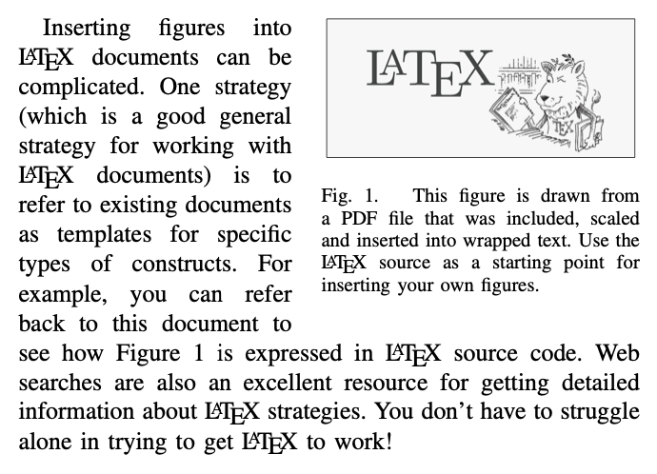
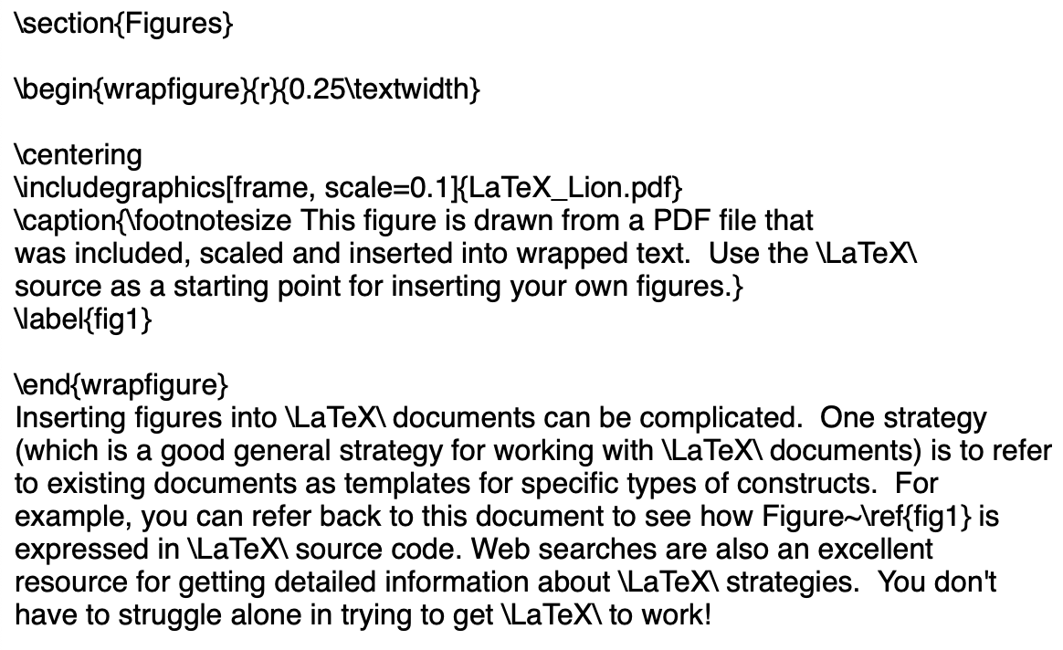
Labels
\label{label_name} and \ref{label_name}

Slide 6
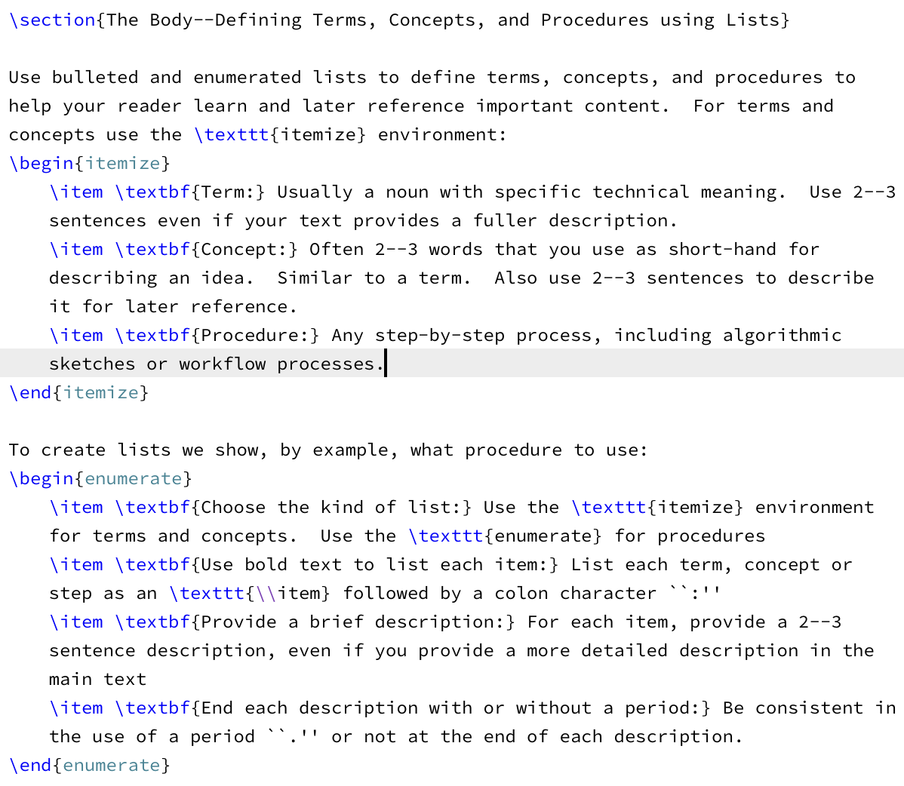
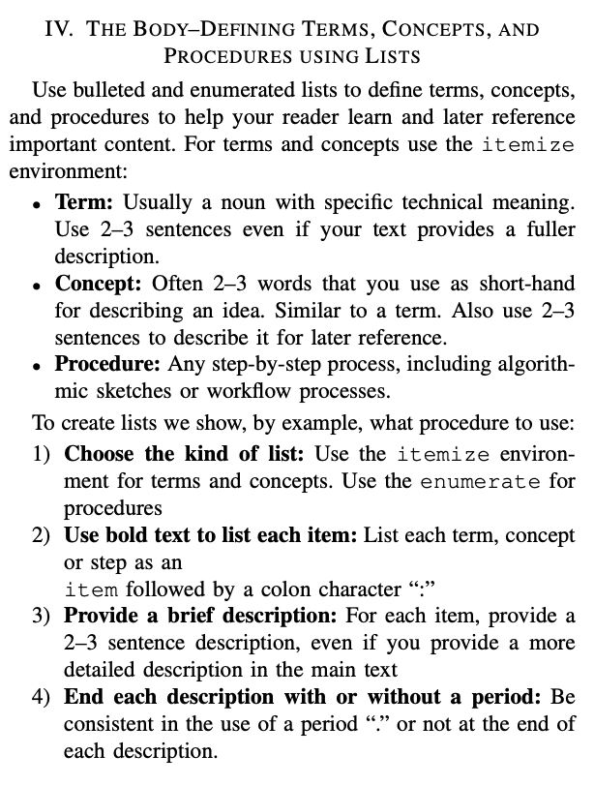
Terms, Concepts, Procedures
Use lists

Slide 7
Spacing using ~
Use ~:
In Smith and Jones~\cite{2014SmithJones}, we see that …
In Section~\ref{intro}, …
In Figure~\ref{fig1}, …

Slide 8
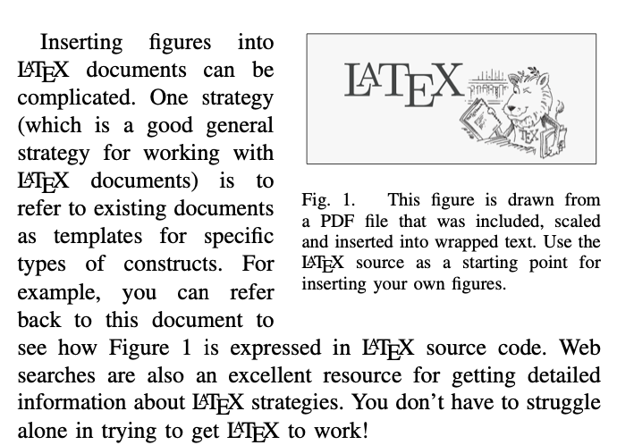
Figures
Figures:
Graphs:
Clearly label units, legend, title
Captions:
Explain the figure in summary
2-3 sentences that tell the story of the figure
Tips for Writing Strong Stand-Alone Captions
Start with context: What is being shown and why?
Describe the method or metric: How was the data obtained or calculated?
Interpret the result: What should the reader take away?
Reference if needed: Optionally tie to the main text for deeper details.
See this webpage:
https://maherou.github.io/Teaching/files/CS373/CaptionsThatWork/

Slide 9
Wide figures
Spreading a figure across two columns
Use figure*
To spread a figure across two columns:
Use the figure* environment. So instead of
\begin{figure}[ht]
\centering
...
\end{figure}
you should use
\begin{figure*}[ht]
\centering
...
\end{figure*}
This also works for tables (i.e. table*).

Slide 10
Writing Rules
Rule #7:
Use pictures, charts and graphs,
But keep in mind #4 (Simplicity).
Rule #8: Use examples to explain complex ideas.
Rule #9: Use:
Headings (Chapter, Section, etc.).
Bulleted Lists.
Numbered lists.
to provide structure, clarity and conciseness to your document.
Rule #10: Provide guidance :
Table of Contents.
List of Figures, list of Tables.
Index and Glossary.
Abstract.
Note: LaTeX provides these!

Slide 11
Slide Guidelines
Let us read the data.
Use diagrams, charts, figures.
Intersection: minimal.
Prepare for disaster.
If slides are big notecards, don’t have slides.
What
you
say
What is
on your slides

Slide 12
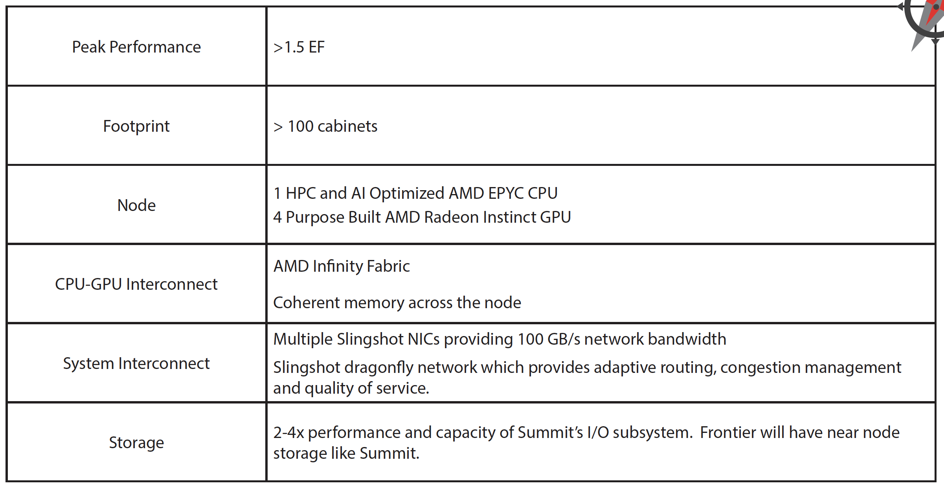
Put Details on Slides
DOE Oak Ridge Exascale System Frontier Specs.

Slide 13
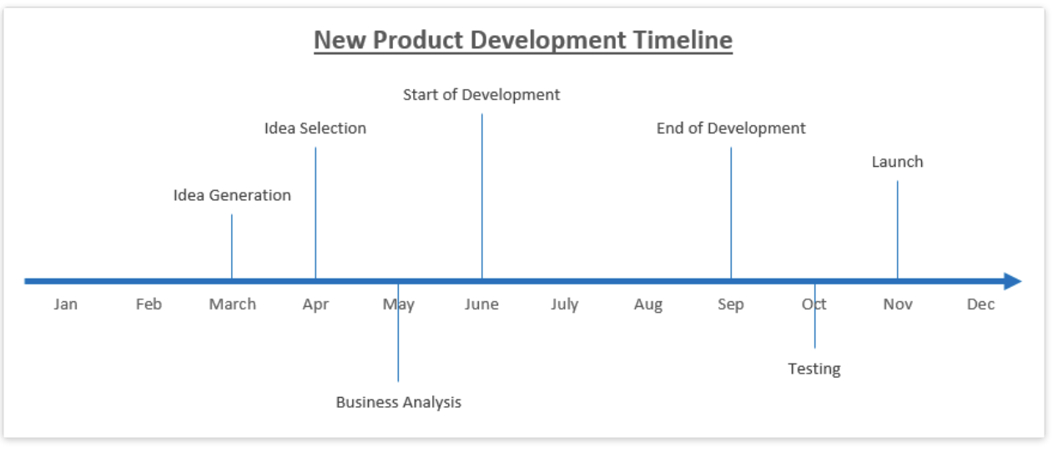
Create Timelines
http://www.excel-board.com/how-to-create-timeline-chart-in-excel-quickly-and-easily/

Slide 14
PowerPoint Defaults
The default format for PowerPoint is:
Outline Format.
Brief statements.
Slide is a big notecard for the speaker.
This is BAD:
Credible argument:
Problems with space shuttle O-rings were known.
Poor PowerPoint hid the issue.
NASA Challenger exploded in 1986.
The best default for a new PowerPoint slide?

