Slide 1
Technical Writing & Presenting 2.0
CSCI 373
Mike Heroux

Slide 2
Labels and Citations
Labels:
\label{label_name} and \ref{label_name}
Use ~:
In Smith and Jones~\cite{2014SmithJones}, we see that …
In Section~\ref{intro}, …
In Figure~\ref{fig1}, …

Slide 3
Figures
Figures:
Clearly labeled: Units, legend, title.
Captions: Should explain the figure in summary.
Spreading a figure across two columns.
To spread a figure across two columns:
Use the figure* environment. So instead of
\begin{figure}[ht]
\centering
...
\end{figure}
you should use
\begin{figure*}[ht]
\centering
...
\end{figure*}
This also works for tables (i.e. table*).

Slide 4
Writing Rules
Rule #6:
Use pictures, charts and graphs,
But keep in mind #4 (Simplicity).
Rule #7: Use examples to explain complex ideas.
Rule #9: Use:
Headings (Chapter, Section, etc.).
Bulleted Lists.
Numbered lists.
to provide structure, clarity and conciseness to your document.
Rule #10: Provide guidance :
Table of Contents.
List of Figures, list of Tables.
Index and Glossary.
Abstract.
Note: LaTeX provides these!

Slide 5
Slide Guidelines
Let us read the data.
Use diagrams, charts, figures.
Intersection: minimal.
Prepare for disaster.
If slides are big notecards, don’t have slides.
What
you
say
What is
on your slides

Slide 6
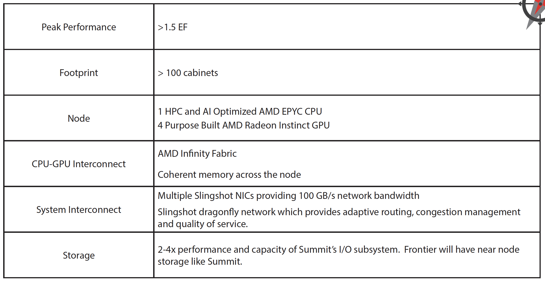
Put Details on Slides
DOE Oak Ridge Exascale System Frontier Specs.

Slide 7
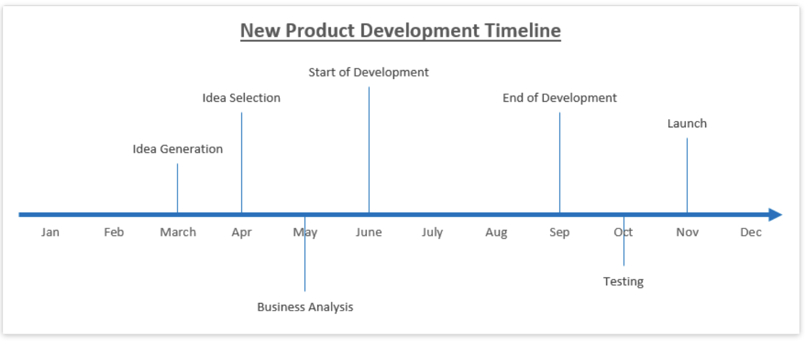
Create Timelines
http://www.excel-board.com/how-to-create-timeline-chart-in-excel-quickly-and-easily/

Slide 8
PowerPoint Defaults
The default format for PowerPoint is:
Outline Format.
Brief statements.
Slide is a big notecard for the speaker.
This is BAD:
Credible argument:
Problems with space shuttle O-rings were known.
Poor PowerPoint hid the issue.
NASA Challenger exploded in 1986.
The best default for a new PowerPoint slide?

