Slide 1
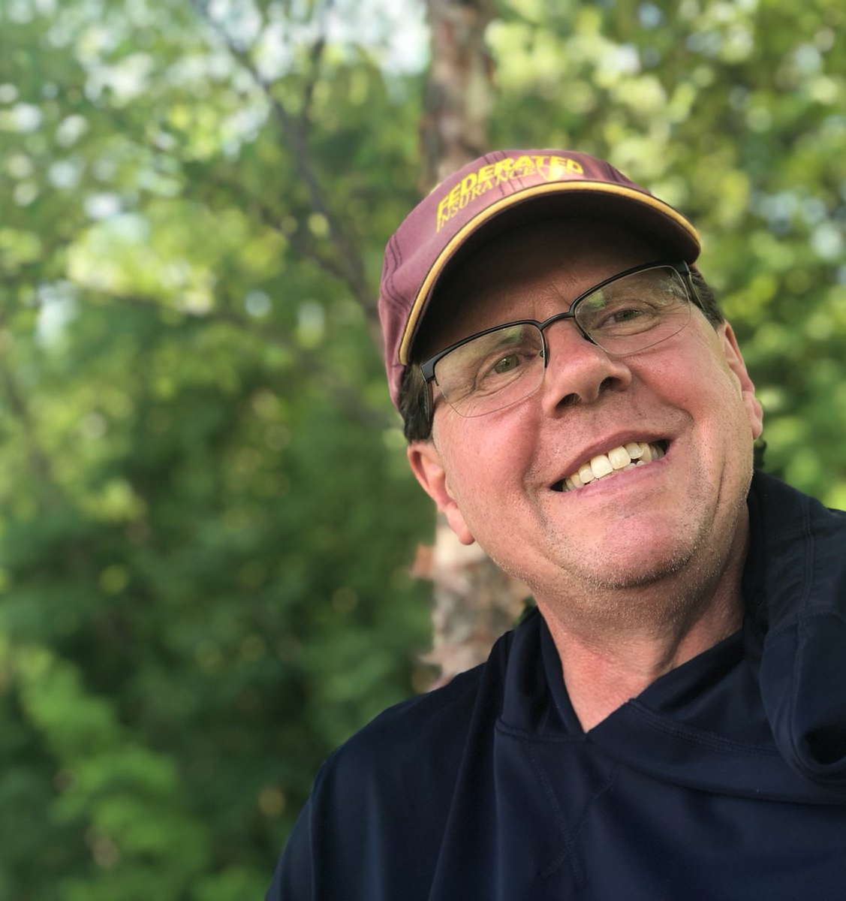

Hi, I am Mike Heroux
I enjoy all aspects of creating and using software for scientific research
I especially enjoying exploring the human aspects of creating and using software for scientific discovery
I like to learn about new tools, processes, and strategies that make scientific software developers and teams more effective, efficient, and happier

