Slide 1
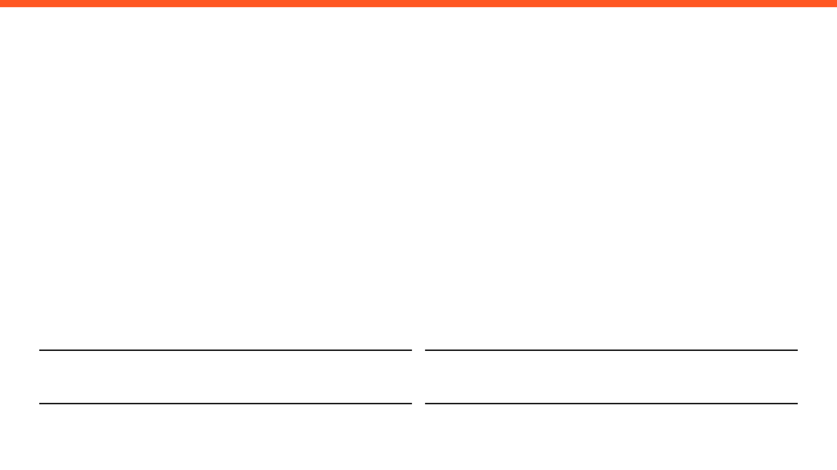
WEEKLY PROGRESS REPORT
Mechatronic System Design (MEC483) – Course Project
PROJECT / PHASE
DATE RANGE
Smart Pick and Place Robot
19/5/2026 – 02/6/2026
TEAM MEMBERS
Maher Abo Abed (1087993) , Sabeeha Zainab Hasham (1089042), Basel Feras Ghunaim (1088912), Ahmad Nasser Alshehhi (1090882)

Slide 2
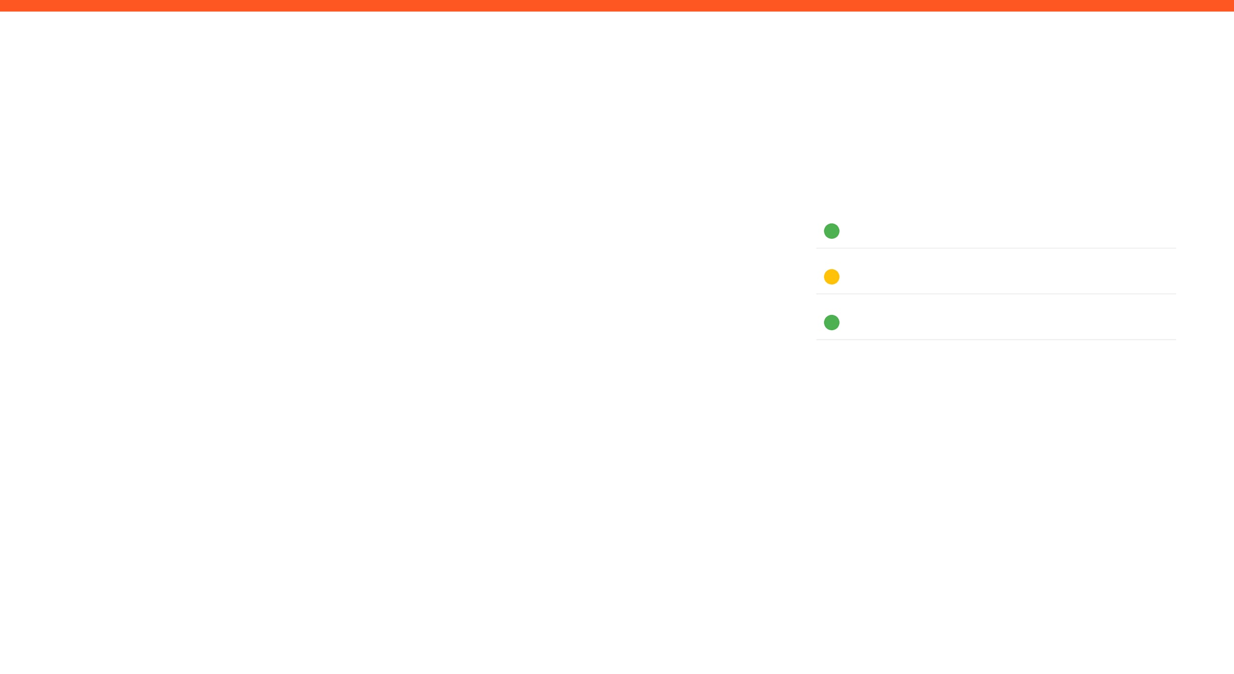
HOW ARE WE DOING THIS WEEK?
TOP WINS
KEY BLOCKERS / RISKS
PROJECT HEALTH
Multi system integration
Wireless communication
Manual control established
Computer vision through wifi bridge
Eid break
Scope
Under Execution
Schedule
Potential Delays
Fabrication & Prototyping
Under Execution
OPEN ISSUES
2 Active

Slide 3

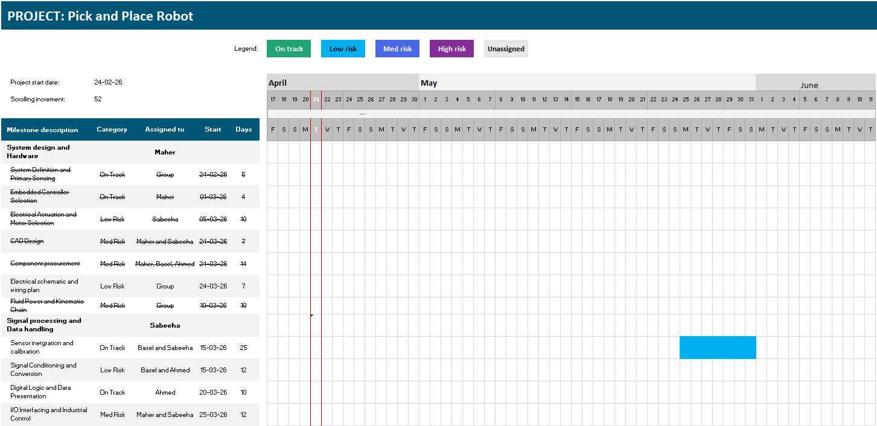
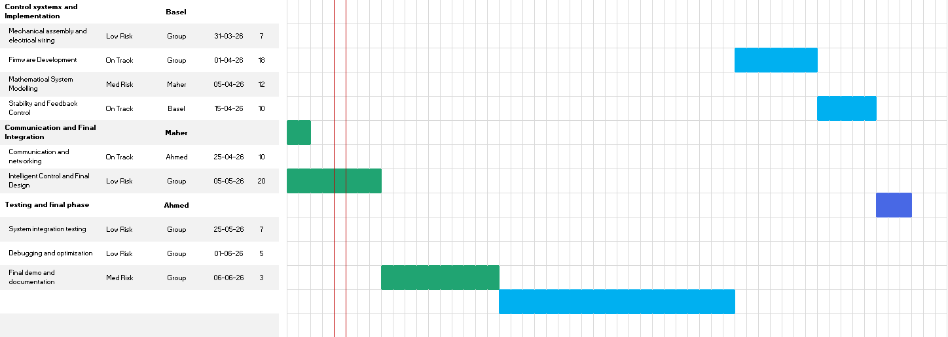
Project Schedule (Gantt)
Agile Gantt chart1.xlsx​

Slide 4
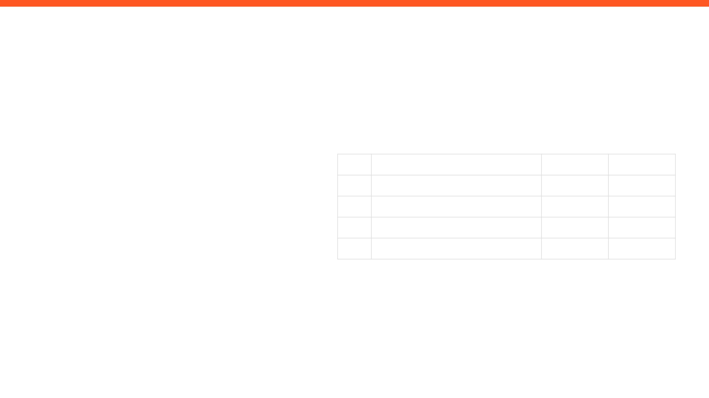
ISSUES, RISKS, AND ACTION ITEMS
TOP ISSUES (BLOCKING PROGRESS)
ACTION ITEMS (NEXT 7 DAYS)
ID
ACTION ITEM DESCRIPTION
MEMBER
WEEK DUE
A1
TBD
Sabeeha
Week 11
A2
TBD
Maher
Week 11
MITIGATIONS / DECISIONS NEEDED
A3
TBD
Basel
Week 11
A4
TBD
Ahmad
Week 11

Slide 5

GROUP UPDATE
WEEKLY PROGRESS & NEXT STEPS
MEMBER 1
MEMBER 2
Maher Abo Abed
Sabeeha Zainab Hasham
MEMBER 3
MEMBER 4
Basel Feras Ghunaim
Ahmad Nasser Alshehhi

Slide 6
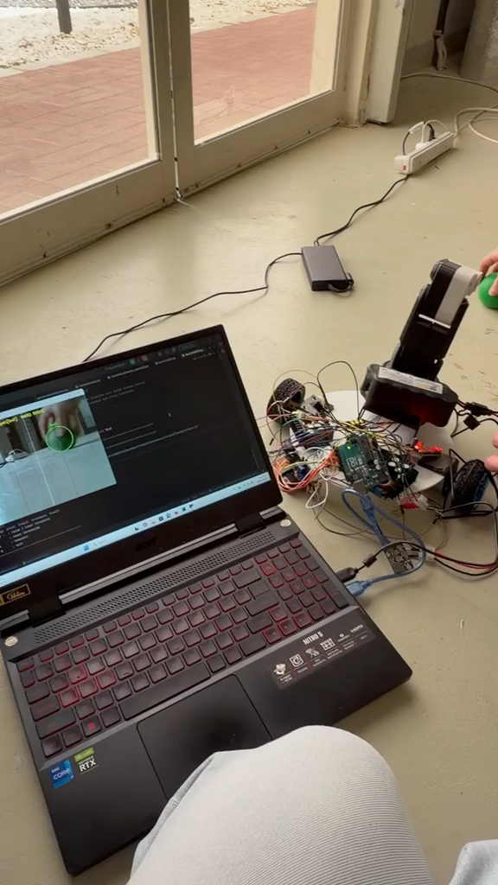
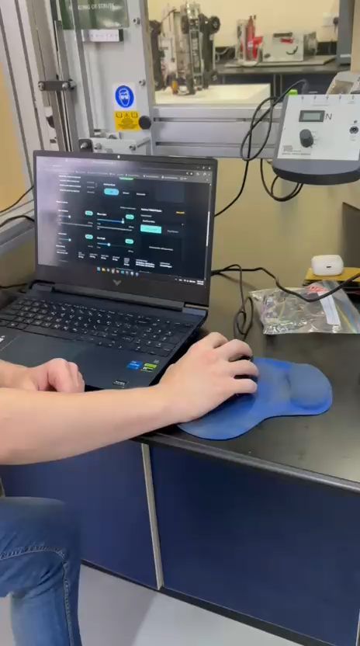

Slide 7
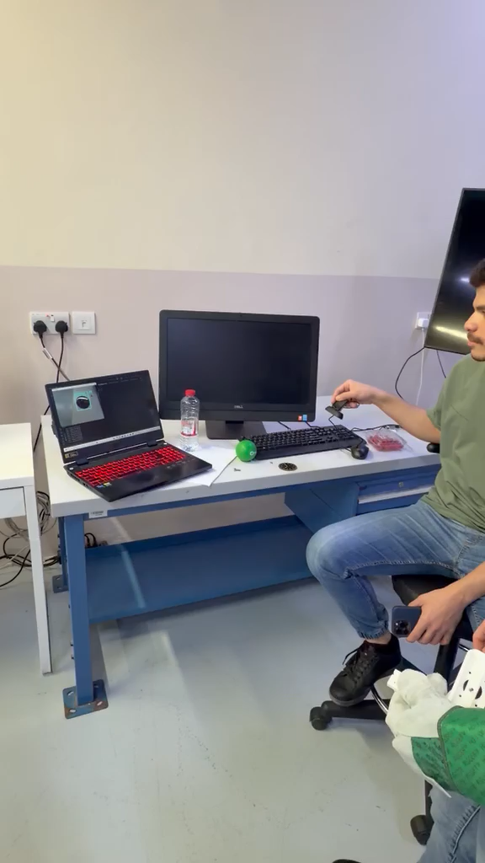
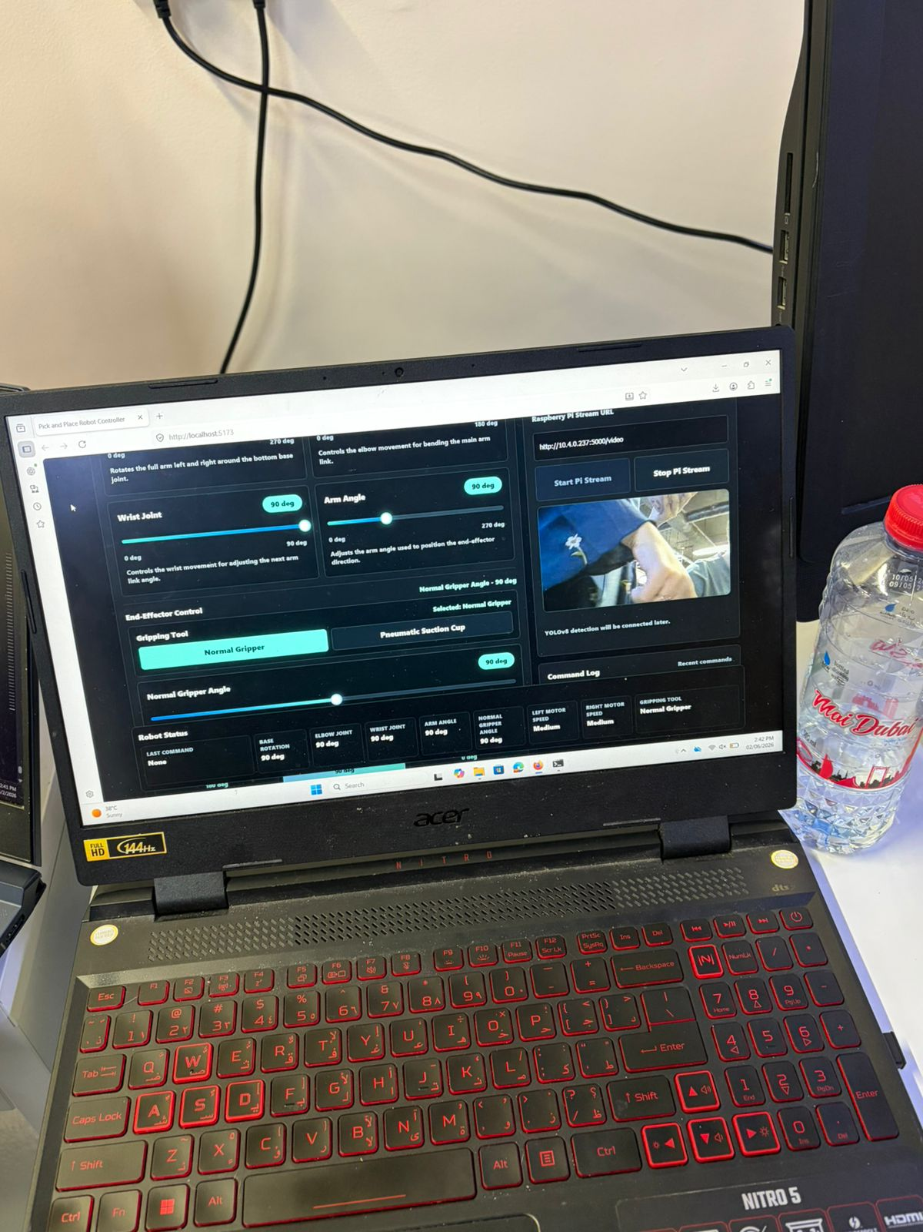

Slide 8
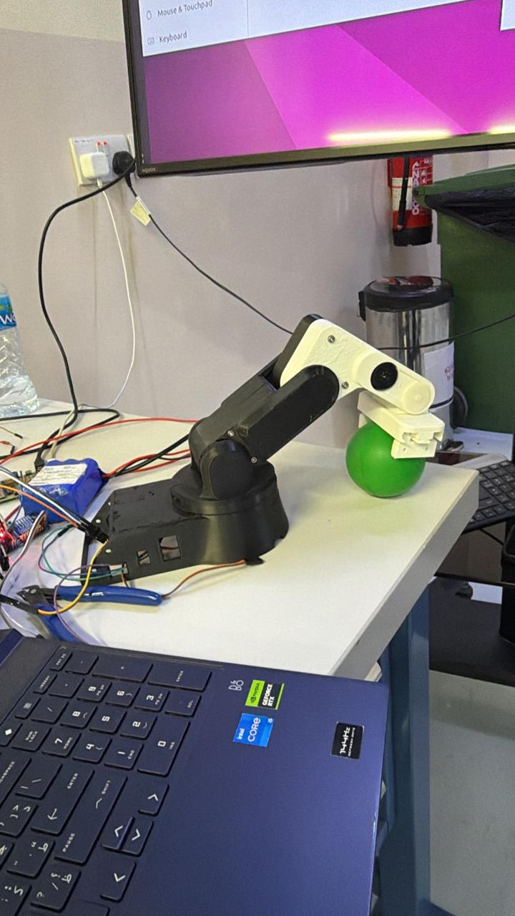
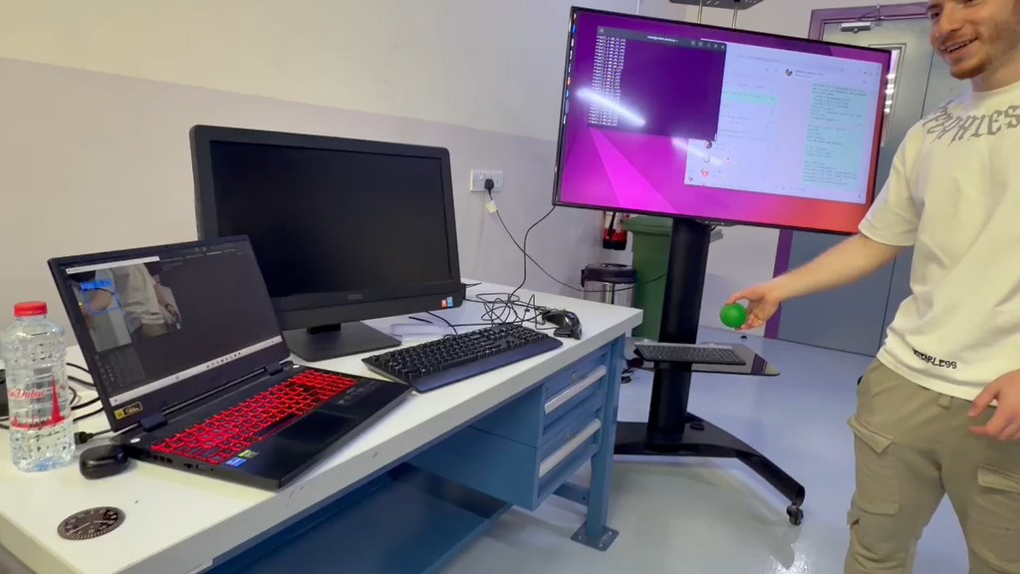

Slide 9
WRAP-UP: WHAT WE NEED FROM THE INSTRUCTOR / STAKEHOLDERS
DECISIONS REQUESTED
ACTION ITEMS FOLLOW-UP
QUESTIONS / FEEDBACK
APPENDIX
https://maherrrrr99.github.io/maherrrrr99/
https://sabeehahasham.github.io/
https://basel-ghunaim.github.io/
https://ahmed1090822.github.io/Ahmed109.github.io/

