Slide 1
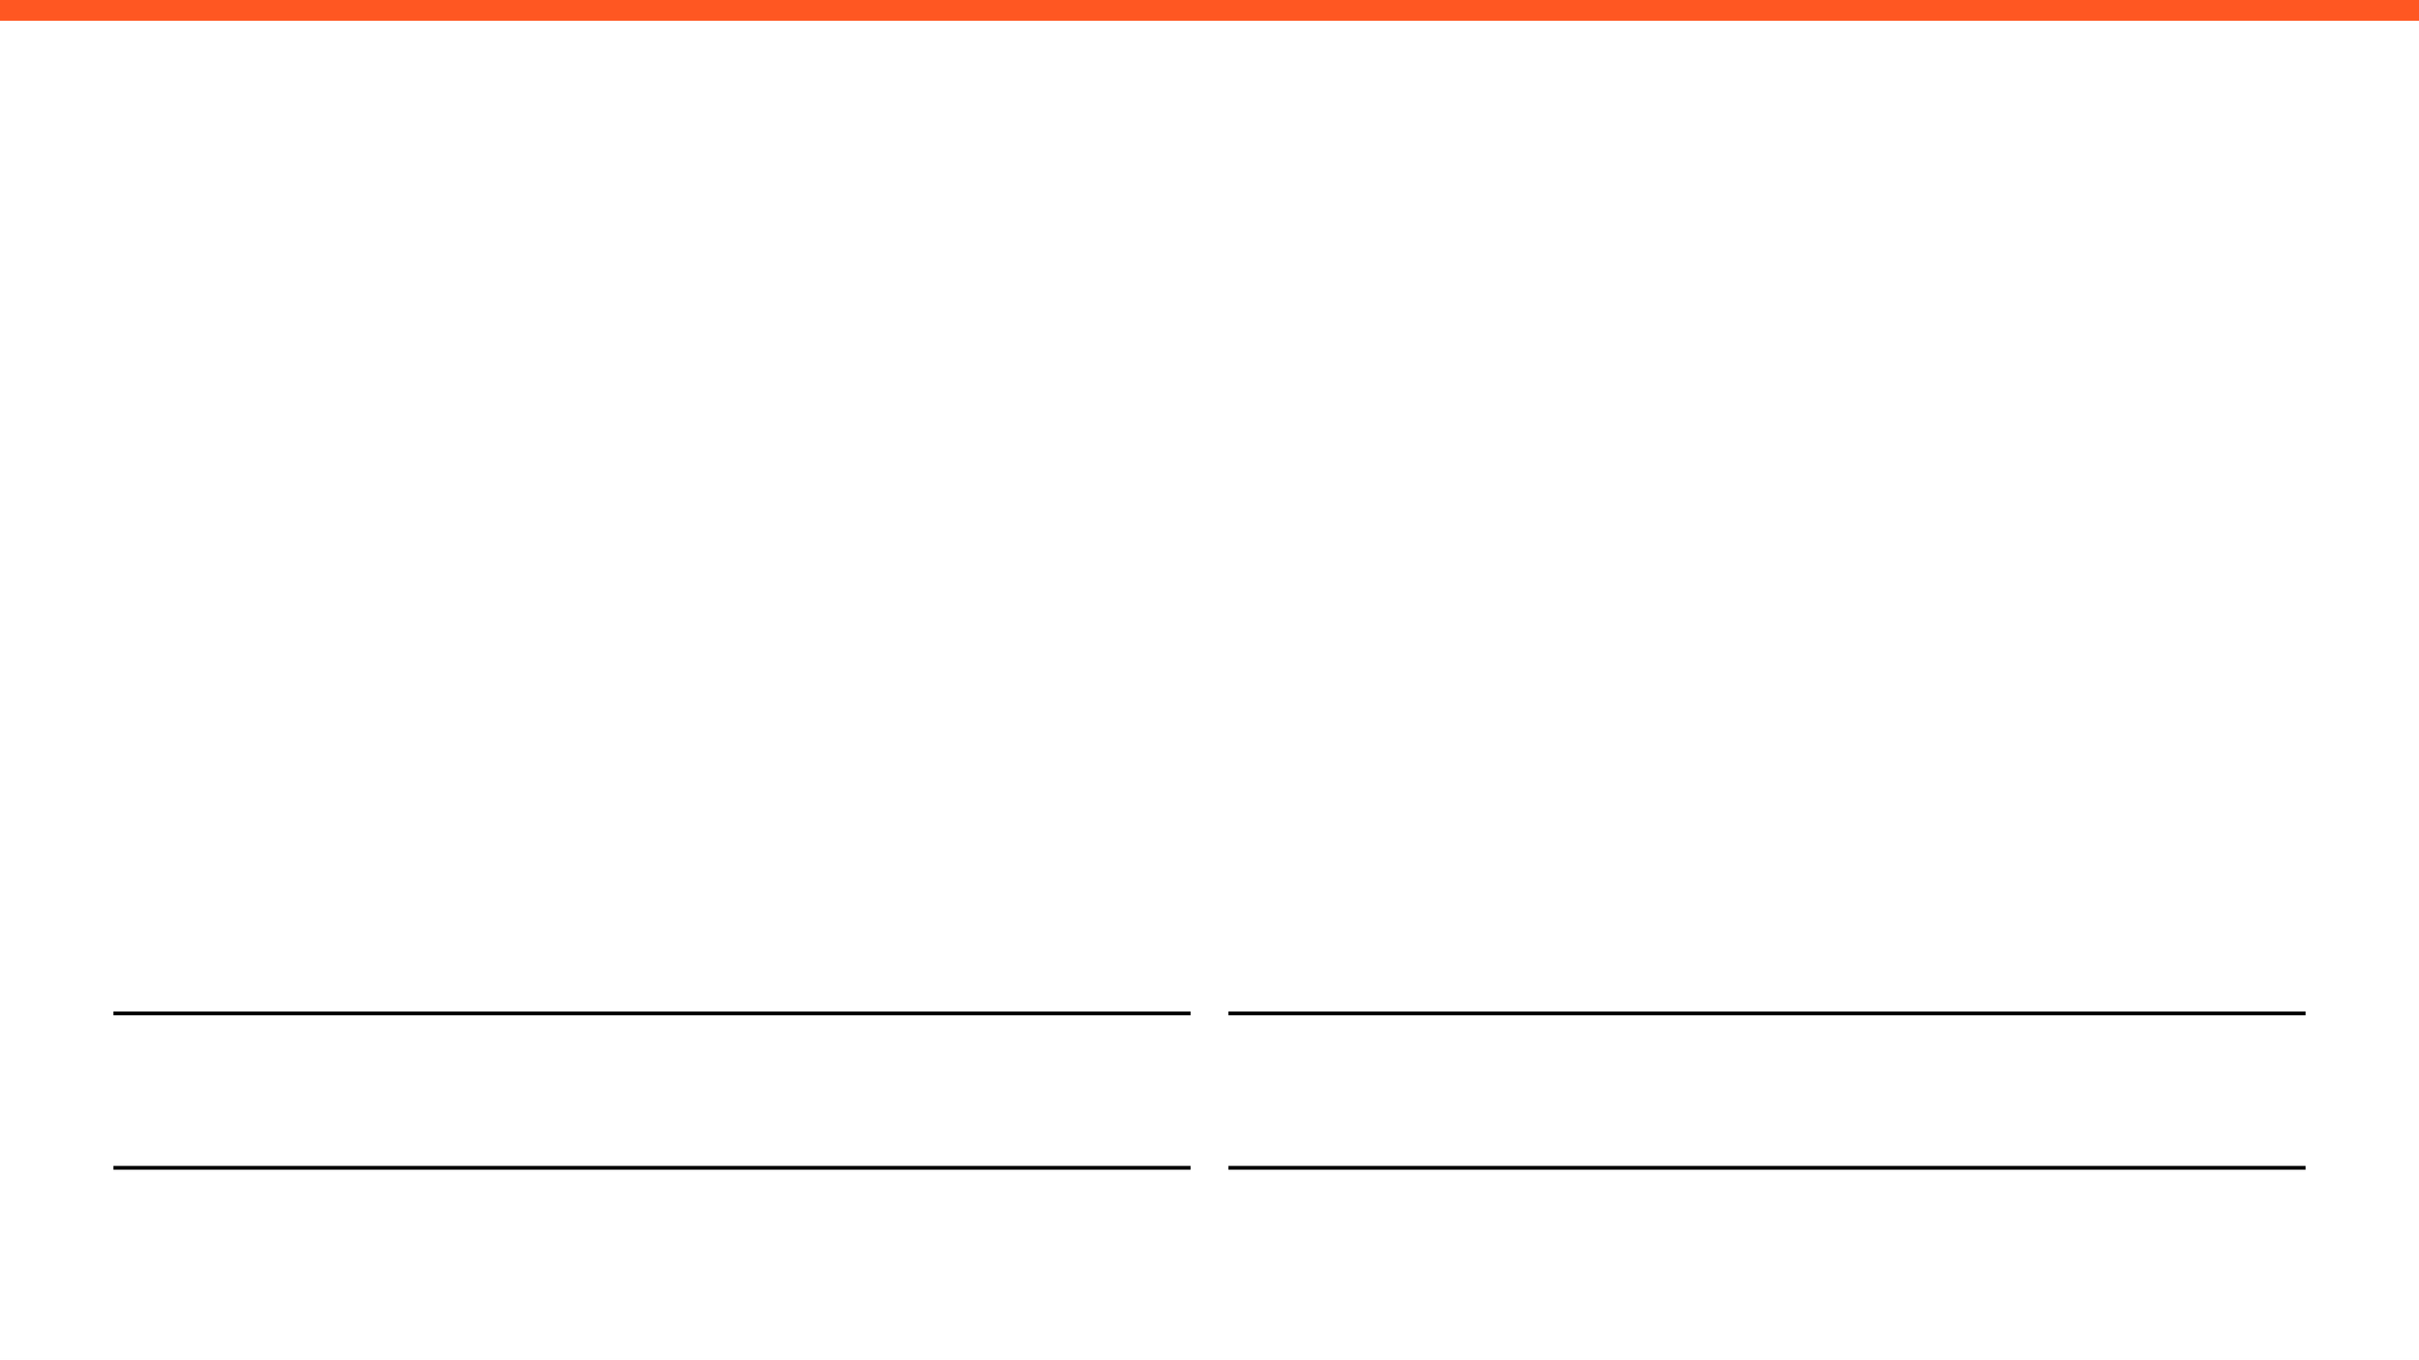
WEEKLY PROGRESS REPORT
Mechatronic System Design (MEC483) – Course Project
PROJECT / PHASE
DATE RANGE
Smart Pick and Place Robot
31/4/2026 – 7/4/2026
TEAM MEMBERS
Maher Abo Abed (1087993) , Sabeeha Zainab Hasham (1089042), Basel Feras Ghunaim (1088912), Ahmad Nasser Alshehhi (1090882)

Slide 2

HOW ARE WE DOING THIS WEEK?
TOP WINS
KEY BLOCKERS / RISKS
PROJECT HEALTH
Design: Finalized the CAD model, used OpenSCAD to parametrically design spur gears, conducted an unknown torque analysis in SolidWorks to verify motor selection, and started the printing process.
Began the procurement process.
Begin and are exploring the use open-source frameworks. Started with Rviz and Moveit2 to conduct FK and IK, by creating a URDF model and importing it to Ubuntu and ROS 2.
Collected, cleaned and labeled egg image data, then trained a YOLOv8 model and tested it in real time using OpenCV to detect eggs.
Blocker : Limited university access, making gathering as a group extremely difficult.
Risk: The components are pricey, so every step has to be studied carefully before executing.
Blocker: Uncertainty around the future of the semester is creating hesitation and doubt.
Blocker: The run time of training datasets is massive, sometimes can take up to a day depending on the number of images used to train
Scope
Under Execution
Schedule
Potential Delays
Fabrication & Prototyping
Under Execution
OPEN ISSUES
3 Active

Slide 3

Project Schedule (Gantt)
Agile Gantt chart1.xlsx​

Slide 4
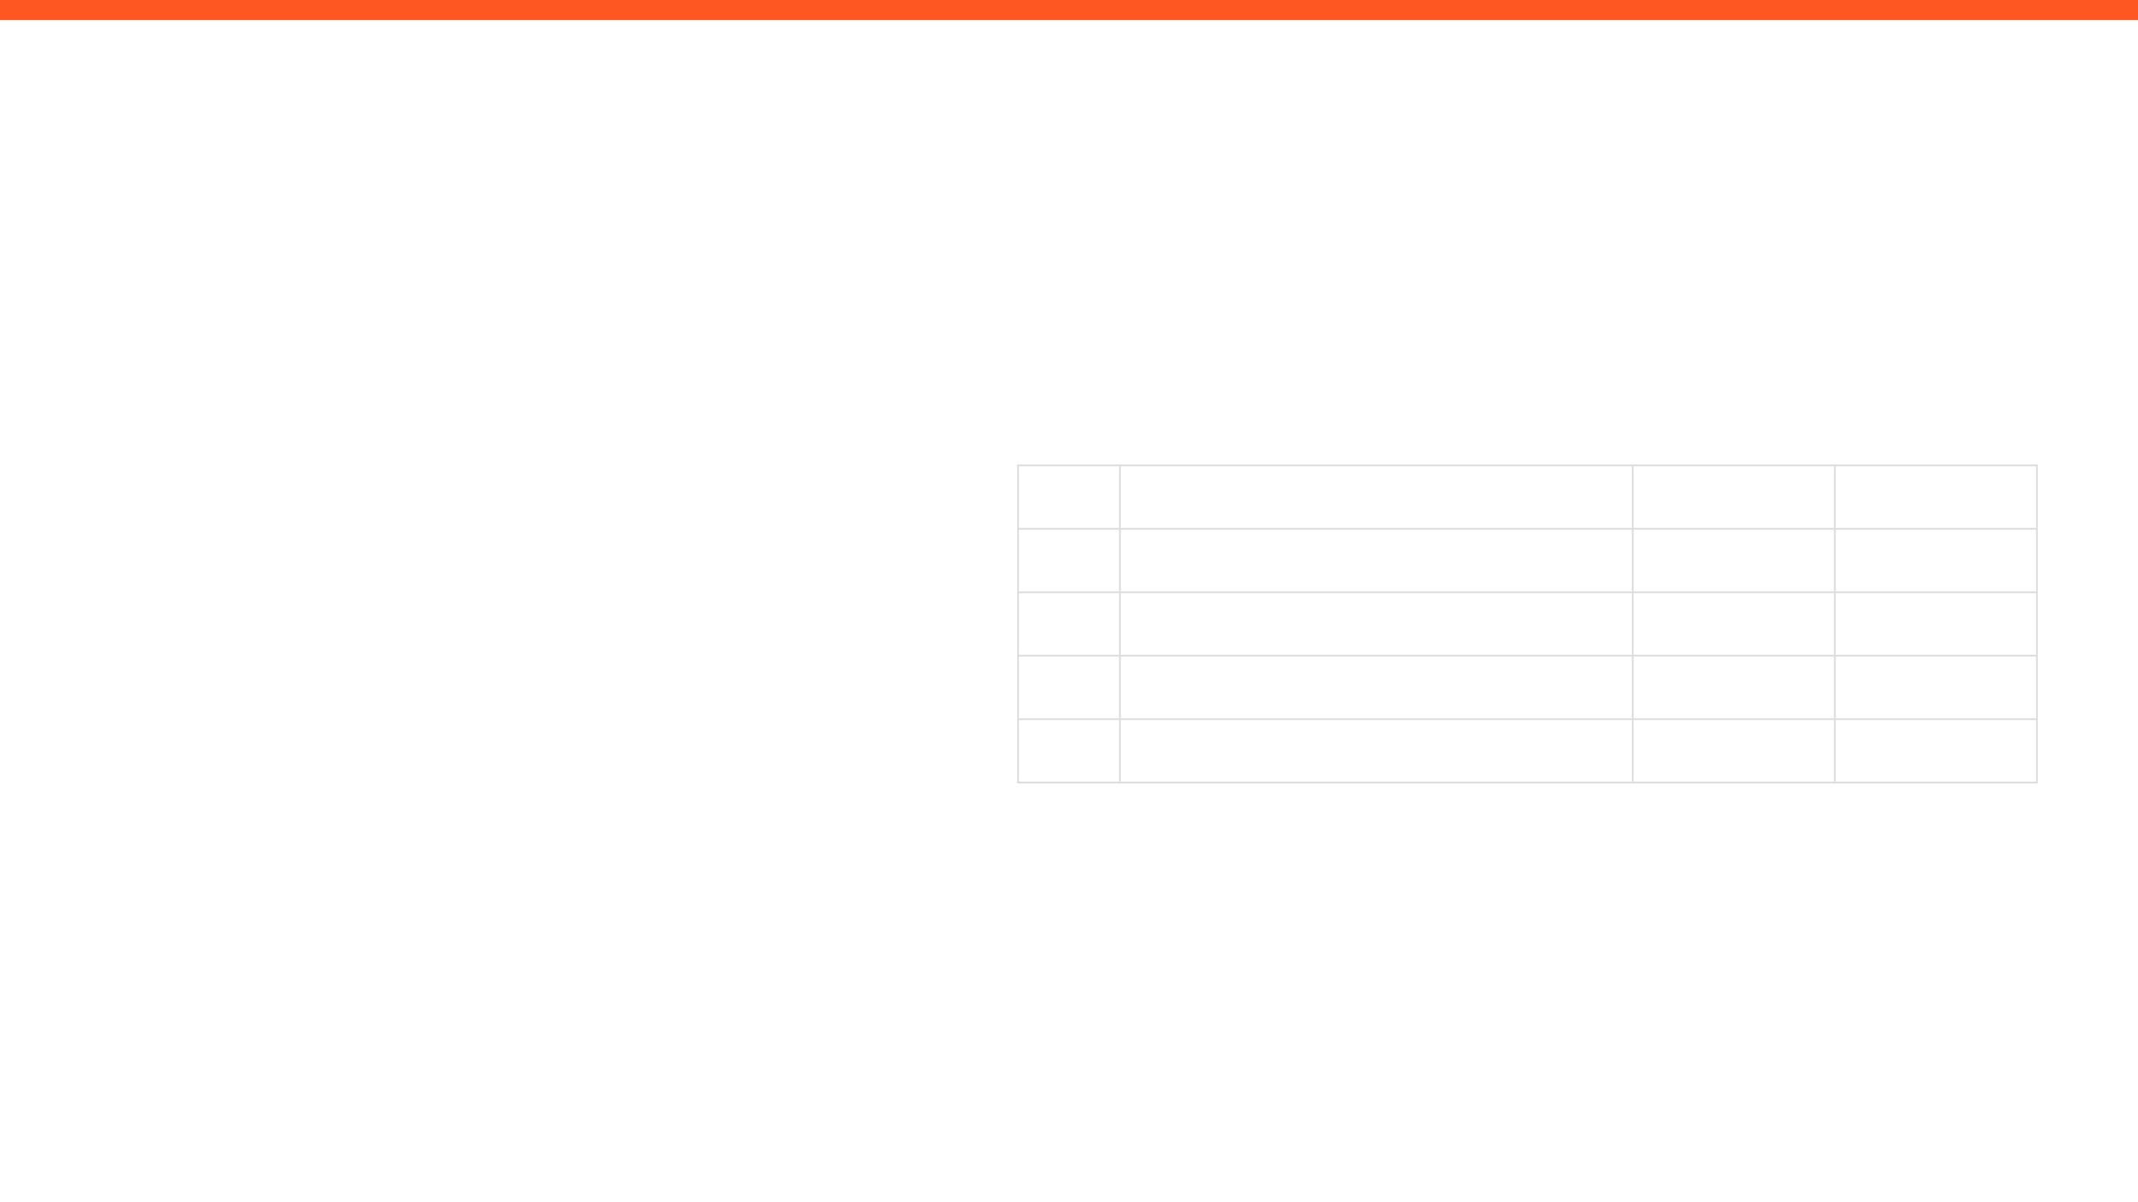
ISSUES, RISKS, AND ACTION ITEMS
TOP ISSUES (BLOCKING PROGRESS)
ACTION ITEMS (NEXT 7 DAYS)
Due to current circumstances, teammates cannot meet in person to discuss project planning, this has resulted in Microsoft Teams meetings occurring 1-2 times a week. This can be limiting as only one teammate has access to the objects that need to be picked up by the arm.
No access to university is slowing down work efforts, and overall progress.
ID
ACTION ITEM DESCRIPTION
MEMBER
WEEK DUE
A1
Investigate how to mitigate issues experienced using vision detection
Sabeeha
Week 6
A2
Finish the FK and IK kinematics
Maher
Week 6
MITIGATIONS / DECISIONS NEEDED
A3
Finalize gripper design + Pneumatic Integration
Basel
Week 6
A4
Finalize gripper design + Pneumatic Integration
Ahmad
Week 6
Conduct virtual meetings often.
Constant communication and updates.
Each member should take their own initiatives.
Aim to make any sort of progress, regardless of how small or big.

Slide 5

INDIVIDUAL UPDATES
WEEKLY PROGRESS & NEXT STEPS
MEMBER 1
MEMBER 2
Maher Abo Abed
Sabeeha Zainab Hasham
MEMBER 3
MEMBER 4
Basel Feras Ghunaim
Ahmad Nasser Alshehhi

Slide 6
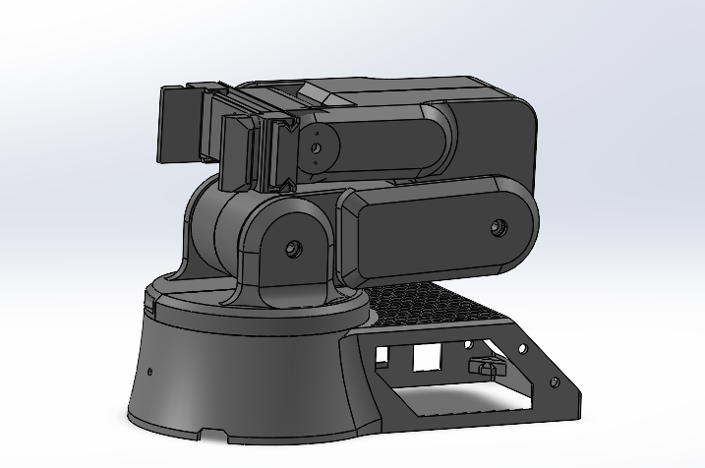
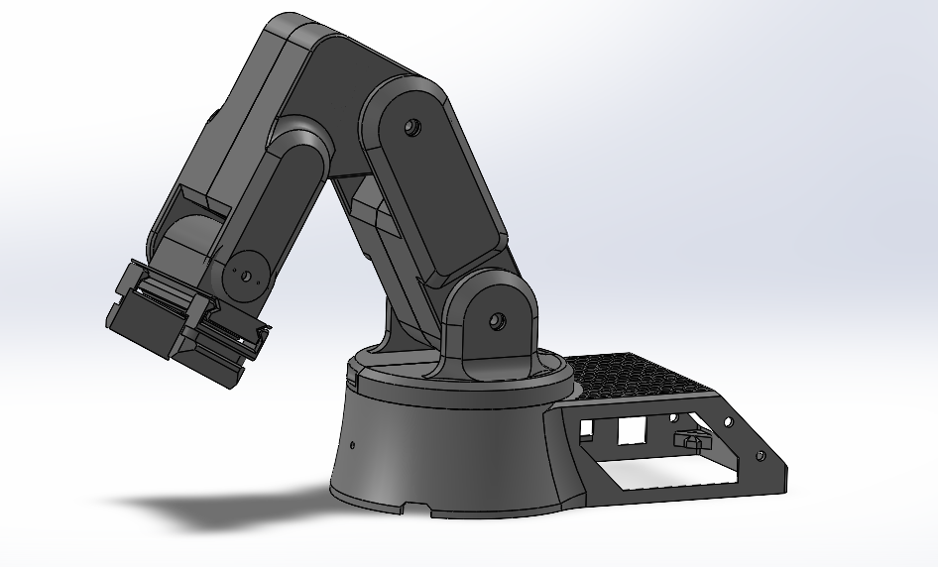
MEMBER 1: Maher Abo Abed
ACCOMPLISHED (SINCE LAST REPORT)
EVIDENCE
Finalized the CAD model.
Parametrically designed spur gears using OpenSCAD.
Conducted unknown torque analysis using SolidWorks to verify motor selection.
Prepared STL files.
Acquired few components.
Preparing to use ROS 2 open-source frameworks.
Created a URDF code
Imported the code to Rviz and Moveit2, to conduct FK and IK.
IN PROGRESS
Conducting the FK and IK
Printing
Further procurement
NEXT WEEK PLAN
Mechanical assembly
Finish the FK and IK
Control the motors, by linking them to the classifier model.

Slide 7
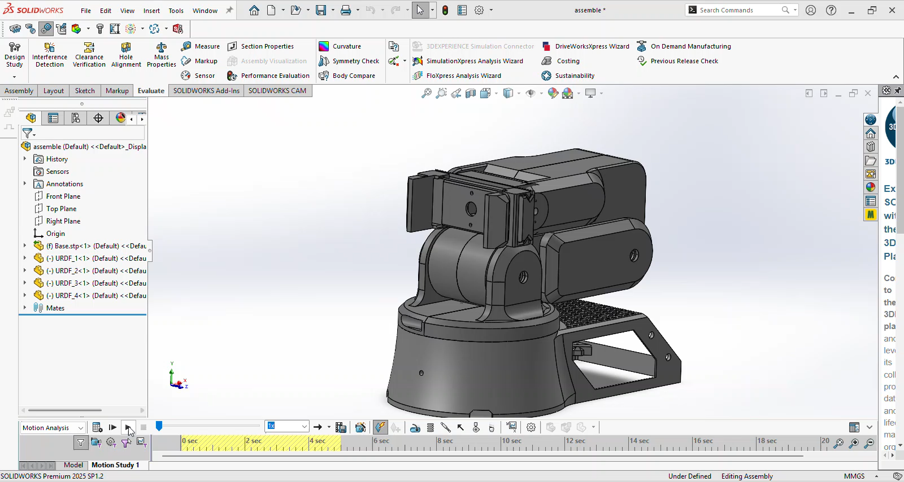
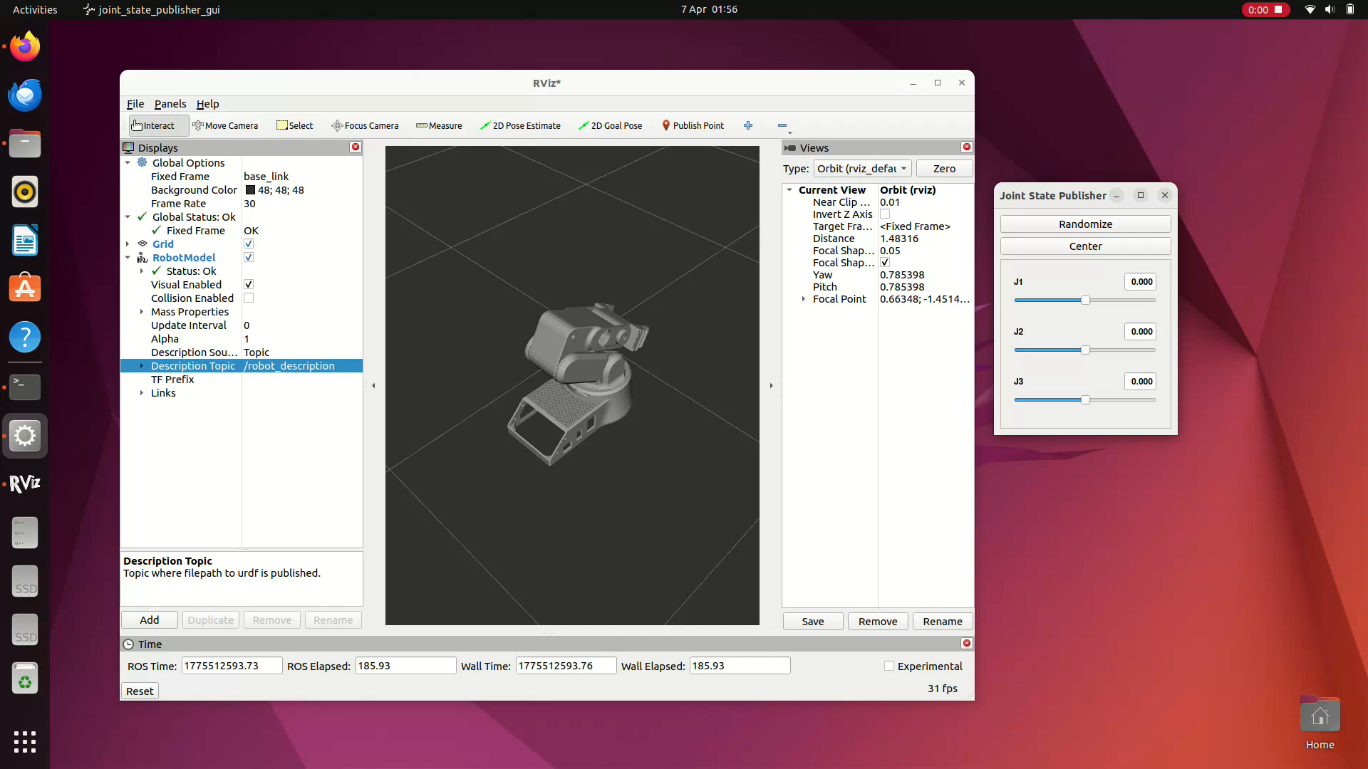
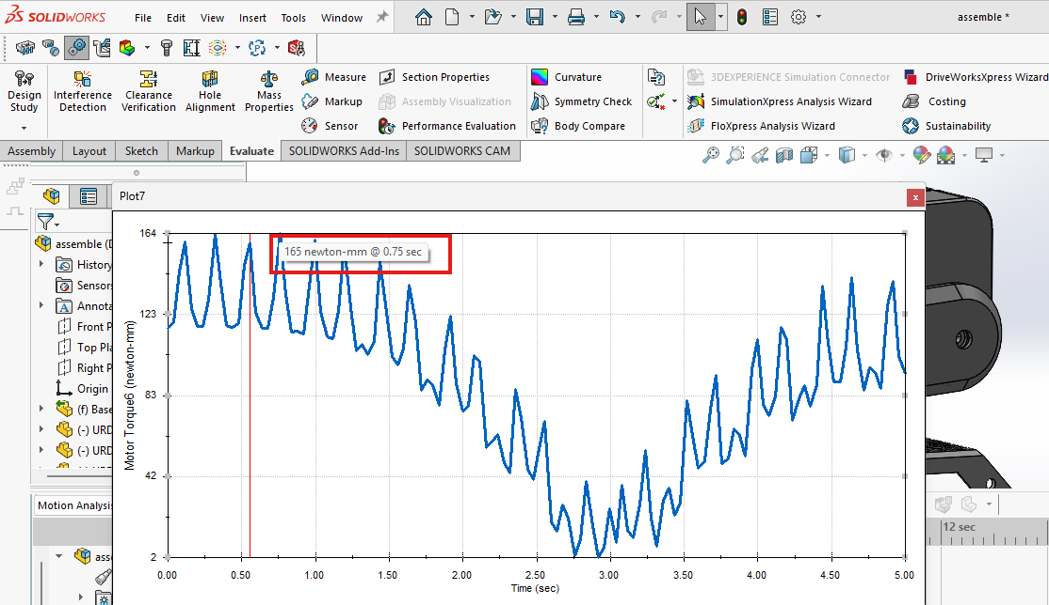
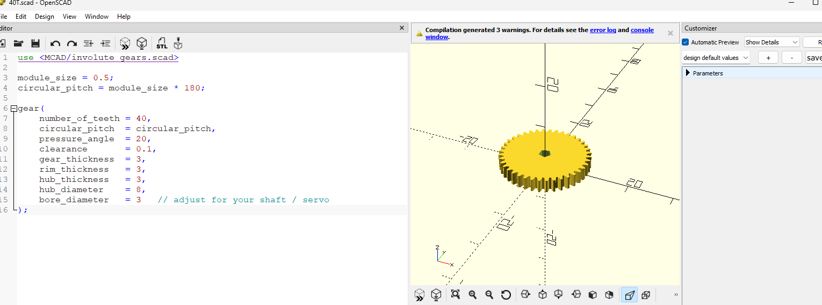

Slide 8
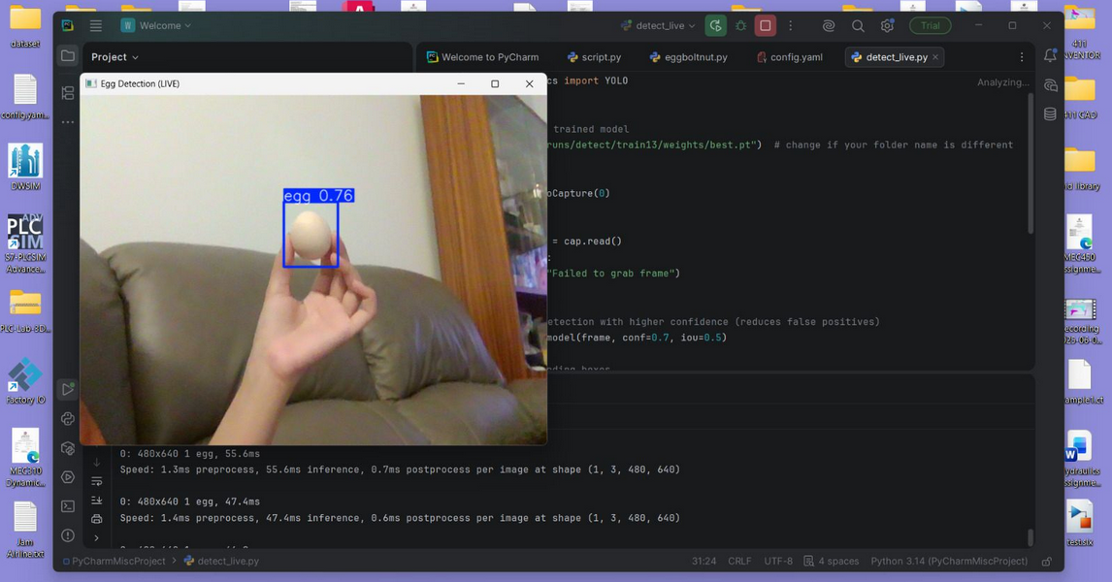
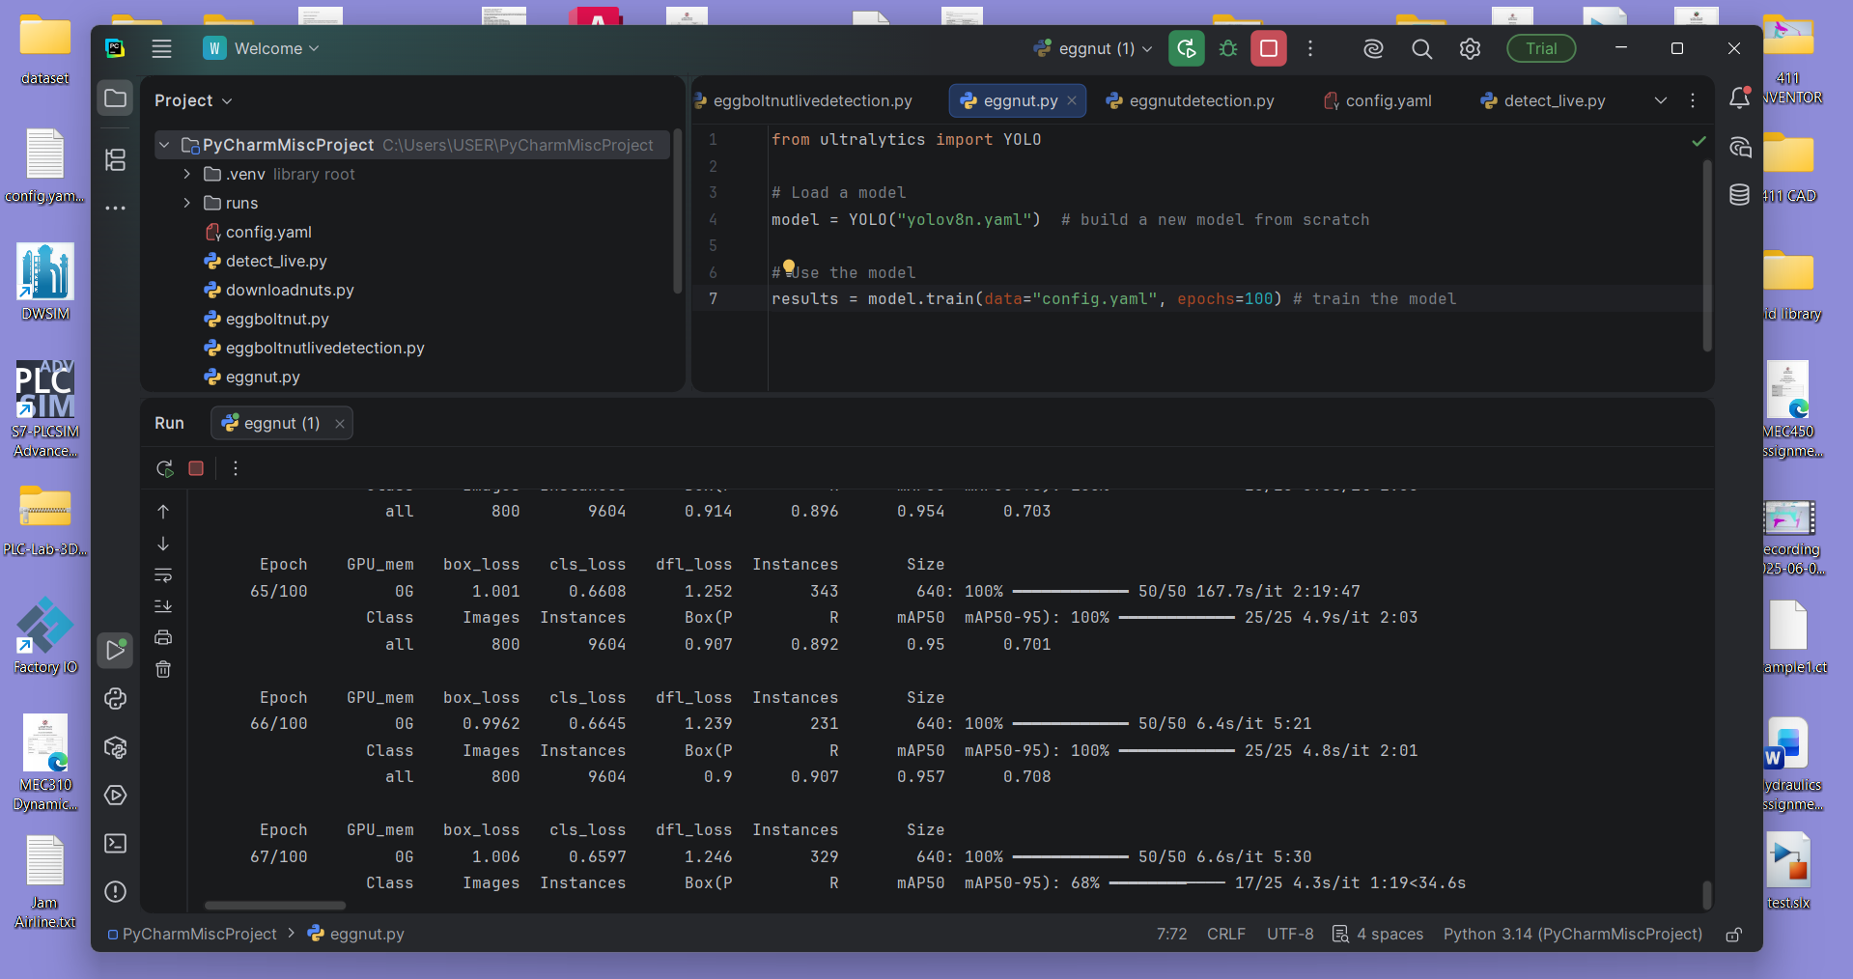
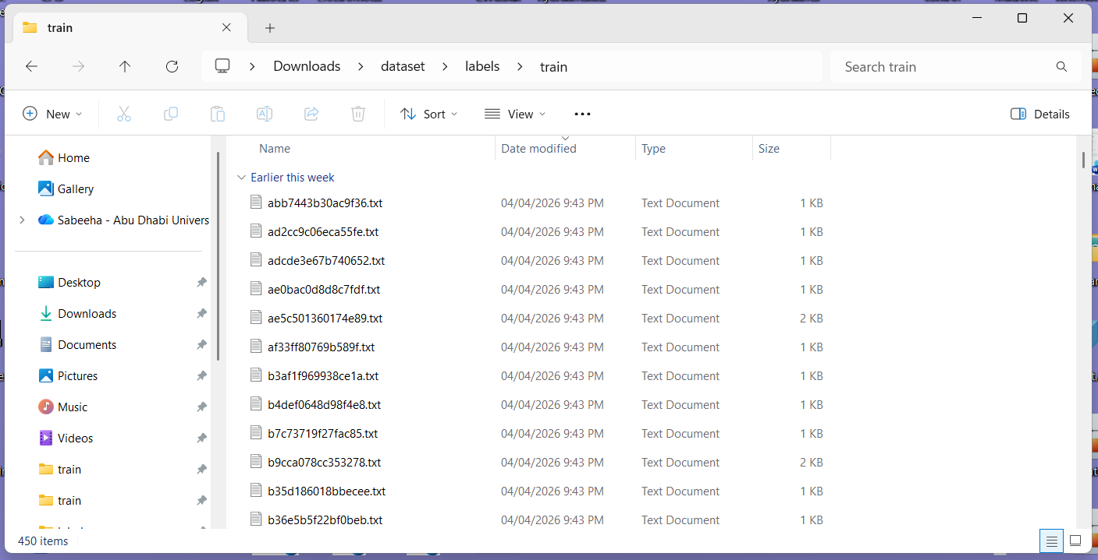
MEMBER 2: Sabeeha Hasham
EVIDENCE (SHOW, DON'T TELL)
ACCOMPLISHED (SINCE LAST REPORT)
•
Found a series of datasets for the egg, nut and bolt, downloaded, filtered the dataset to only to use appropriate images (from 800 images to 450), then annotated the dataset for the egg – this meant the corresponding annotations were downloaded in the YOLO format label file from cvat.
Installed PyCharm to train the Yolov8 model using the ultralytics library and tested it – used 450 images to train for the egg, dataset was clean and split into image files and their corresponding label txt files.
Training for 100 epochs showed higher accuracy using the live feed using openCV.
•
•
•
IN PROGRESS
To use the datasets for the other objects that I have and merge it with the egg one so it can identify multiple objects that we are using – test and ensure the accuracy is high.
•
NEXT WEEK PLAN
Object detection refining – ensure it works for the other objects that we have using the data sets collected
•
HELP NEEDED / QUESTIONS

Slide 9
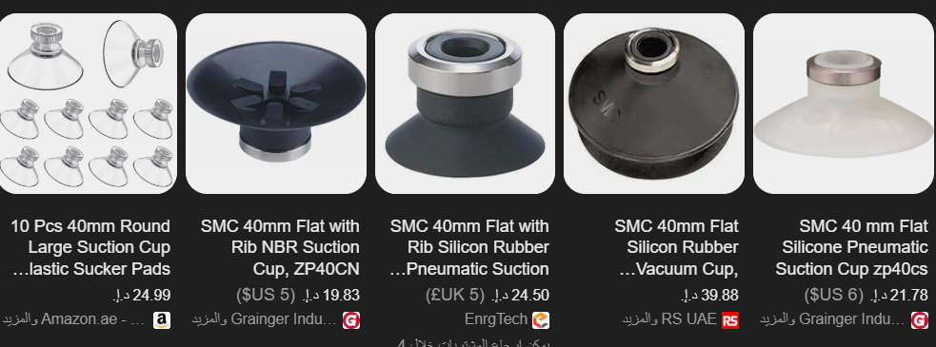
MEMBER 3: Basel Feras Ghunaim
ACCOMPLISHED (SINCE LAST REPORT)
IN PROGRESS
Completed evaluation of motion control strategies (AccelStepper vs custom step generation).
Finalized decision to use stepper motor step-counting with homing as the primary positioning method.
Conducted detailed analysis of encoder integration options (single encoder, dual encoder, and comparison with motor step tracking).
Refined hybrid end-effector concept (mechanical gripper + suction cup) and validated feasibility for all target objects.
Investigated vacuum pump specifications and confirmed suitability of electric vacuum pump over compressed air systems.
Implementing initial stepper motor control logic and testing basic motion behavior.
Evaluating potential positioning errors due to gear backlash and belt elasticity.
Optimizing suction cup placement and integration within the gripper design.
Reviewing control sequence timing for coordinated pick-and-place operations.
•
•
•
•
•
•
•
•
•
NEXT WEEK PLAN
•
•
•
•
•
•
•

Slide 10
MEMBER 4: Ahmed Alshehhi
ACCOMPLISHED (SINCE LAST REPORT)
IN PROGRESS
Reviewed research papers and technical resources on robotic gripper design.
• Selecting the most suitable gripper design based on object shape, weight, and fragility • Studying methods to control gripping force to ensure safe handling of delicate objects (e.g., egg)
•
•
Analyzed different gripper types (mechanical, soft grippers, and vacuum-based systems).
NEXT WEEK PLAN
HELP NEEDED / QUESTIONS
Finalize the gripper design and add it to the CAD model
•
•
Begin testing basic gripping concepts using a simple prototype
•

Slide 11
WRAP-UP: WHAT WE NEED FROM THE INSTRUCTOR / STAKEHOLDERS
DECISIONS REQUESTED
ACTION ITEMS FOLLOW-UP
Gripper design
Pneumatic integration
Exploring other required features such as a mobile robot and how this can be integrated
Gripper design
Pneumatic integration
Exploring other required features such as a mobile robot and how this can be integrated
Building on the computer vision model.
QUESTIONS / FEEDBACK
Could you guide us on inserts and threading's for 3D parts. Is it necessary, if so, what is the best approach?
APPENDIX
https://maherrrrr99.github.io/maherrrrr99/
https://sabeehahasham.github.io/
https://basel-ghunaim.github.io/
https://ahmed1090822.github.io/Ahmed109.github.io/

