Slide 1
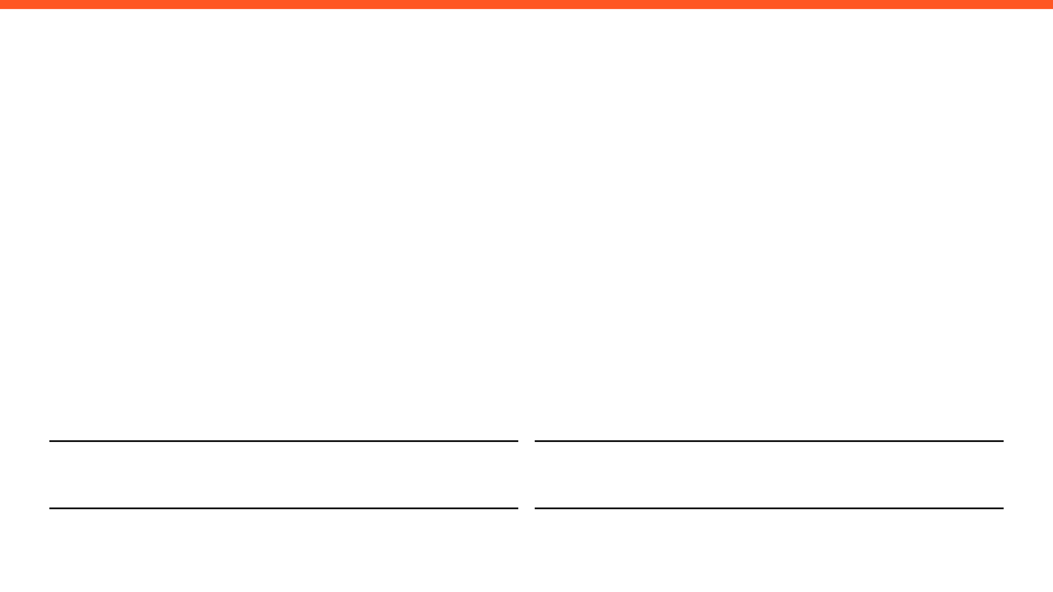
WEEKLY PROGRESS REPORT
Mechatronic System Design (MEC483) – Course Project
PROJECT / PHASE
DATE RANGE
Smart Pick and Place Robot
7/4/2026 – 14/4/2026
TEAM MEMBERS
Maher Abo Abed (1087993) , Sabeeha Zainab Hasham (1089042), Basel Feras Ghunaim (1088912), Ahmad Nasser Alshehhi (1090882)

Slide 2
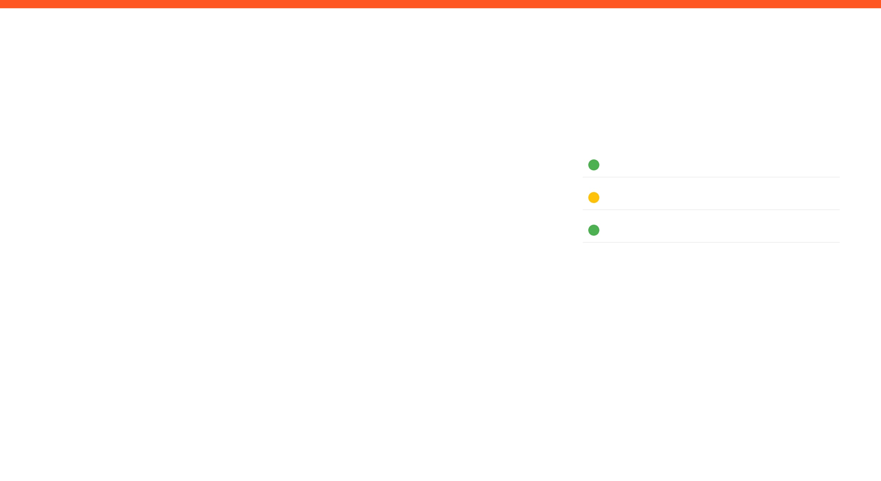
HOW ARE WE DOING THIS WEEK?
TOP WINS
KEY BLOCKERS / RISKS
PROJECT HEALTH
Completed the gripper design (electrical + pneumatic)
Completed forward kinematics
Attempted three different approaches for inverse kinematics
Established control of the motors through an interactive UI, considering it a method amongst alternatives of manual override
Finalised the vision detection system – has fairly decent accuracy but can be used for initial testing until it is refined more
Blocker :Completed 3D Parts were misplaced in the university, printing must be restarted .
Blocker: Printing issues with the spur gears, alternative fabrication method needs to be considered (laser cutting)
Blocker: The run time of training datasets is massive, sometimes can take up to a day depending on the number of images used to train
Scope
Under Execution
Schedule
Potential Delays
Fabrication & Prototyping
Under Execution
OPEN ISSUES
3 Active

Slide 3

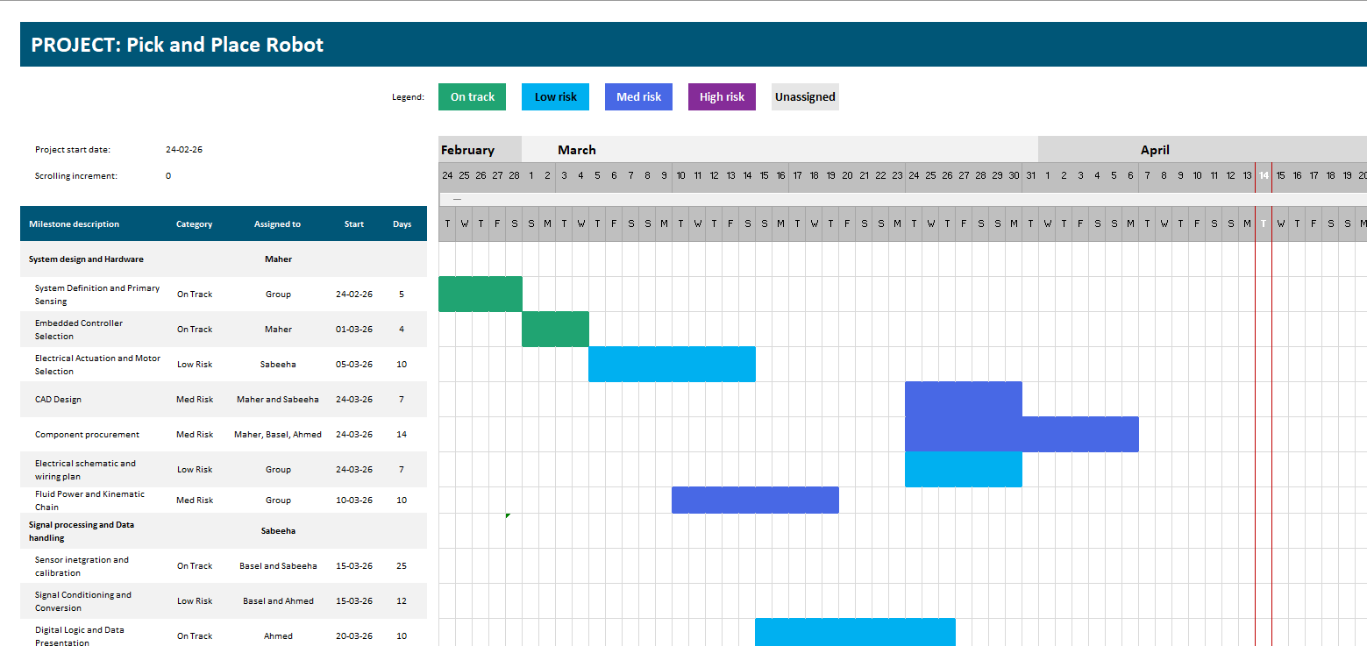
Project Schedule (Gantt)
Agile Gantt chart1.xlsx​

Slide 4
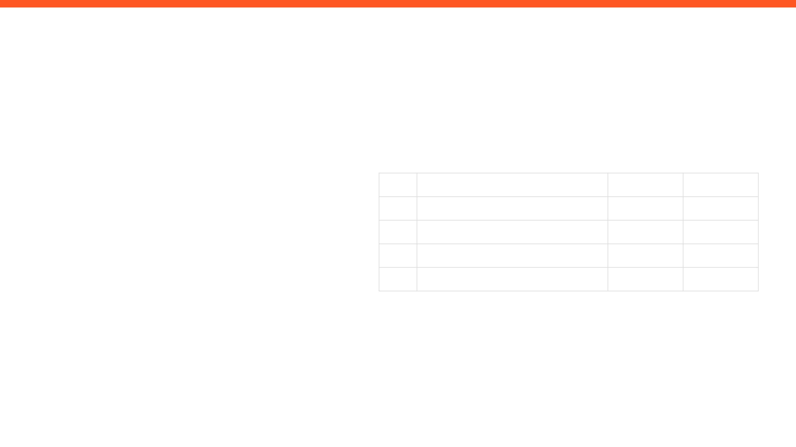
ISSUES, RISKS, AND ACTION ITEMS
TOP ISSUES (BLOCKING PROGRESS)
ACTION ITEMS (NEXT 7 DAYS)
Fabrication delays
No access to university is slowing down work efforts, and overall progress.
ID
ACTION ITEM DESCRIPTION
MEMBER
WEEK DUE
A1
Finalize and deploy the computer vision model
Sabeeha
Week 7
A2
Finish the IK kinematics
Maher
Week 7
MITIGATIONS / DECISIONS NEEDED
A3
Procure, assemble, and experiment on gripper.
Basel
Week 7
A4
Finalize a manual override system
Ahmad
Week 7
Conduct virtual meetings often.
Constant communication and updates.
Each member should take their own initiatives.
Aim to make any sort of progress, regardless of how small or big.

Slide 5

INDIVIDUAL UPDATES
WEEKLY PROGRESS & NEXT STEPS
MEMBER 1
MEMBER 2
Maher Abo Abed
Sabeeha Zainab Hasham
MEMBER 3
MEMBER 4
Basel Feras Ghunaim
Ahmad Nasser Alshehhi

Slide 6
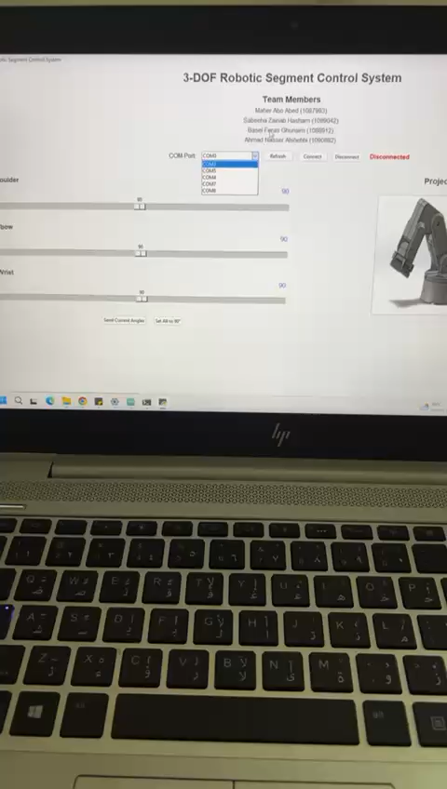
MEMBER 1: Maher Abo Abed
ACCOMPLISHED (SINCE LAST REPORT)
EVIDENCE
Position based control of the motor
Software developed to control angular position of motors using interactive GUI through a python code
Attempted three approaches for inverse kinematics
IKFast an analytical IK solver in ROS – Converts URDF to DAE, extracts kinematic chains, solves symbolic equations and gives a .cpp file – solver validation and IK were inconsistent – issue with modeling and kinematic chain
Moveit2 – FK kinematics works fine – however IK Solver is 6 DOF, our system is 4 DOF is over constrained
Manual ai-aided calculations using matlab
IN PROGRESS
Inverse kinematic and assembly
NEXT WEEK PLAN
Mechanical assembly
Finish the IK
Control the motors, by linking them to the classifier model.
What is the best inverse kinematic approach, or what are possible solutions to my problems?
HELP NEEDED / QUESTIONS

Slide 7
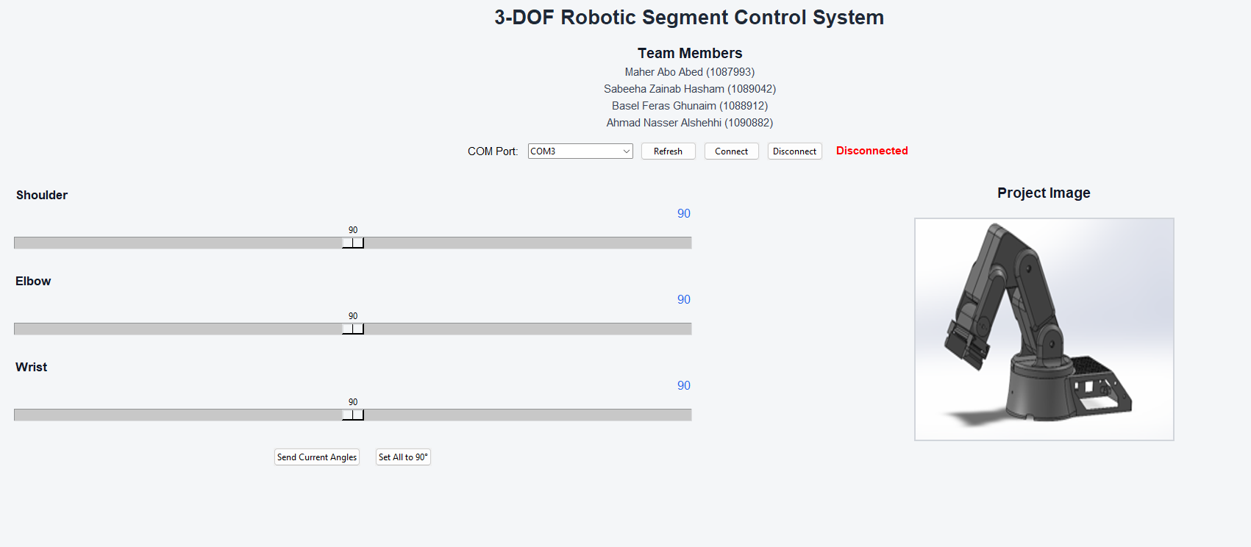
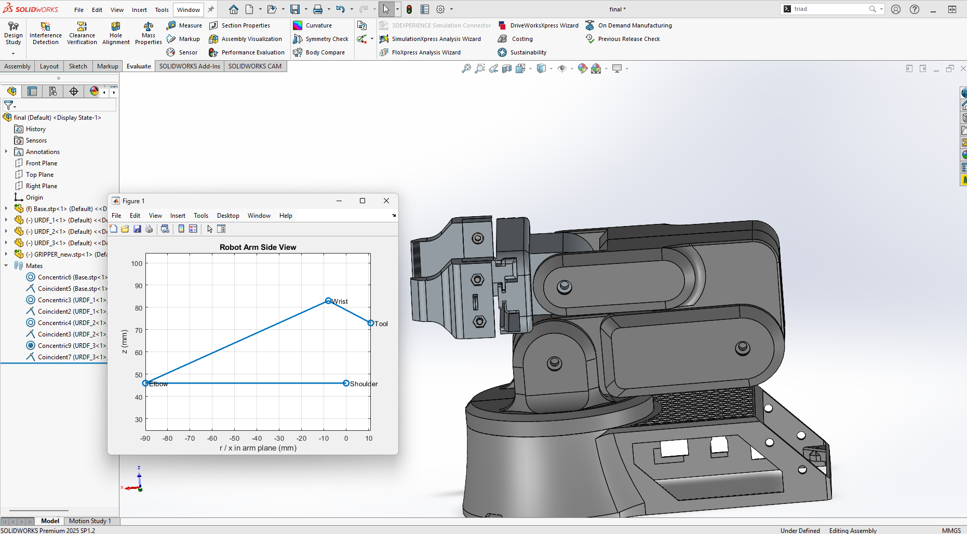
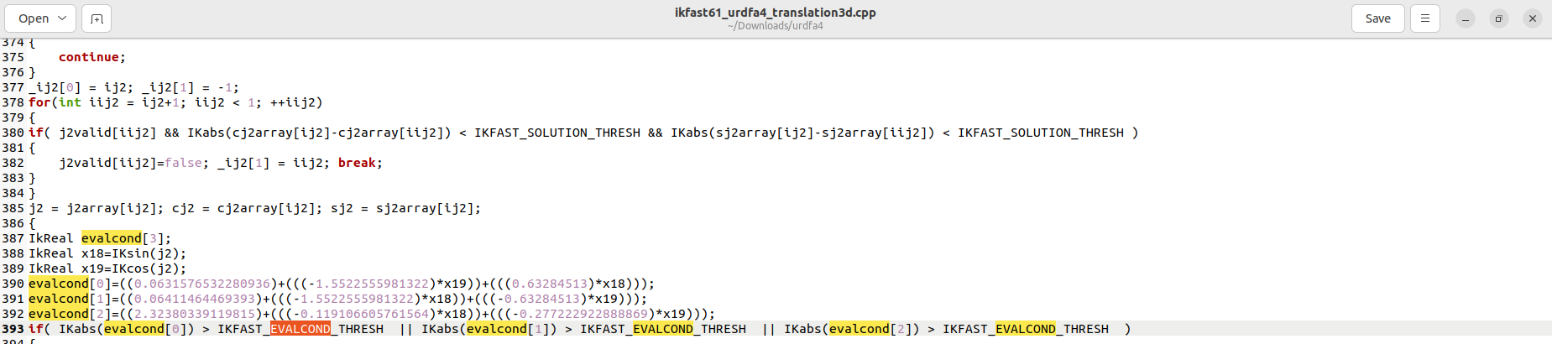

Slide 8
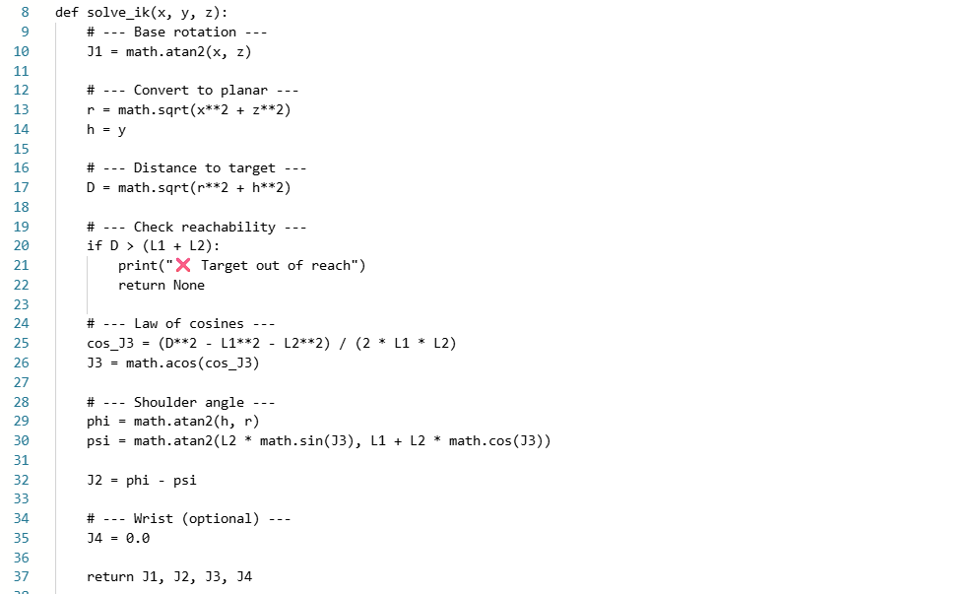

Slide 9
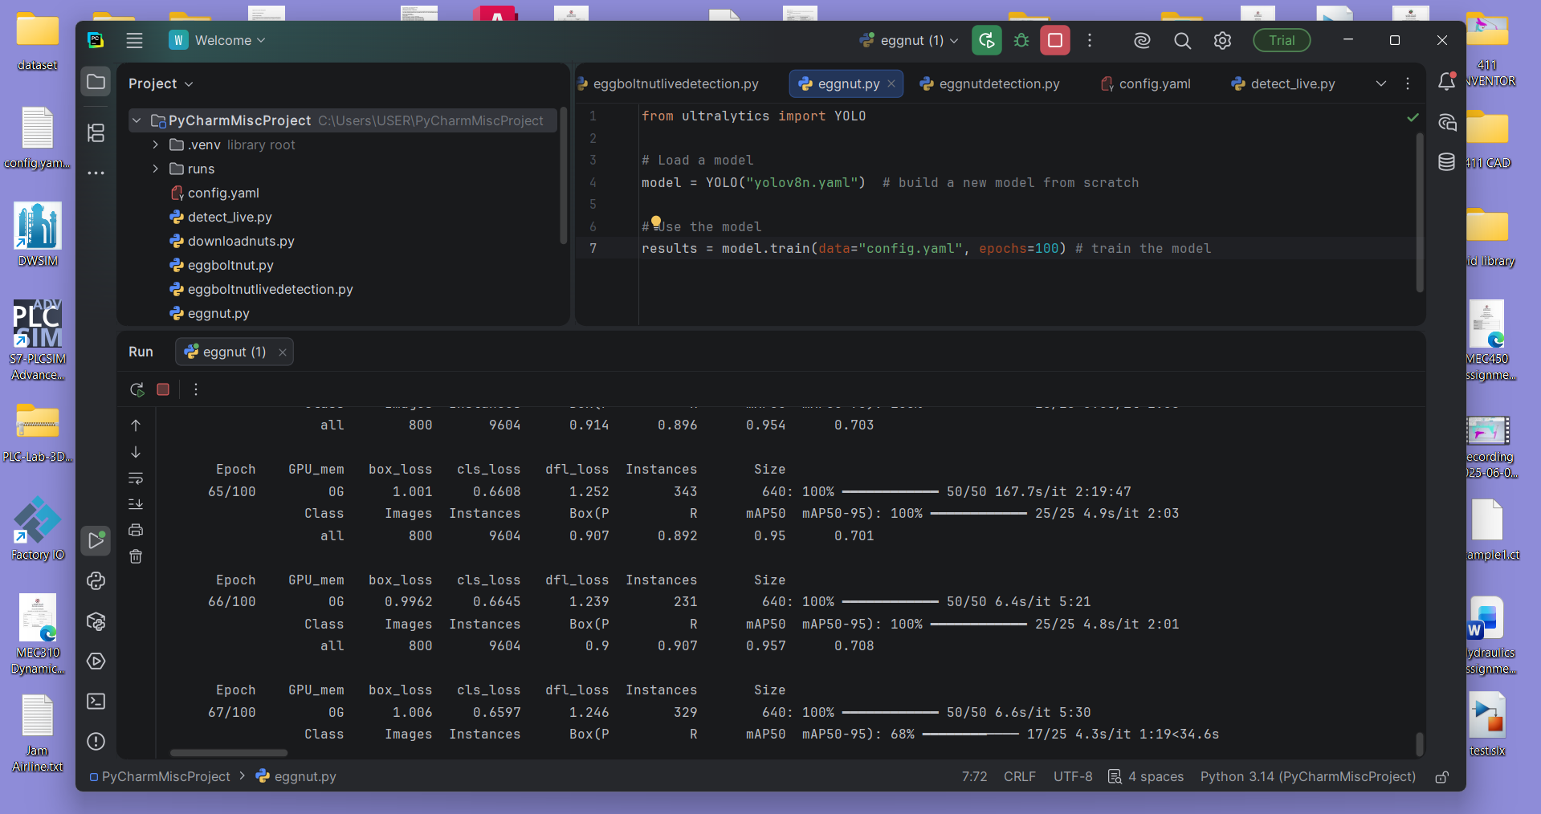
MEMBER 2: Sabeeha Hasham
EVIDENCE (SHOW, DON'T TELL)
ACCOMPLISHED (SINCE LAST REPORT)
•
Made the dataset for the compass, and for half of the bolt identification (the rest was an online dataset) and annotated the objects - this meant the corresponding annotations were downloaded in the YOLO format label file from cvat.
Used PyCharm to train the Yolov8 model using the ultralytics library and tested it – used 400 images to train for the egg, nut, bolt and compass, the dataset was clean and split into image files and their corresponding label txt files – took 100 images for the dataset for the compass
Training for 100 epochs showed higher accuracy using the live feed using openCV for all of the objects – Connected the iVCam from my iPhone to my laptop to have my phone camera displayed as opposed to using the laptop camera – see if this increases accuracy.
Not holding up the objects to the camera also increase the sensitivity for detection a lot as it reduces visual noise- determined through experimentation
•
•
•
•
IN PROGRESS
Refine the current model – make the compass detection more accurate, ensure it does not get confused with the bolt, figure out a way to integrate everything so it can be used in the final system
NEXT WEEK PLAN
•
Final object detection refining – ensure it works for the other objects that we have using the data sets collected – implement it
HELP NEEDED / QUESTIONS

Slide 10
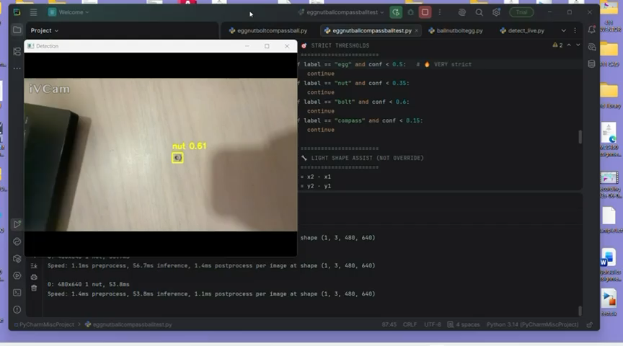

Slide 11
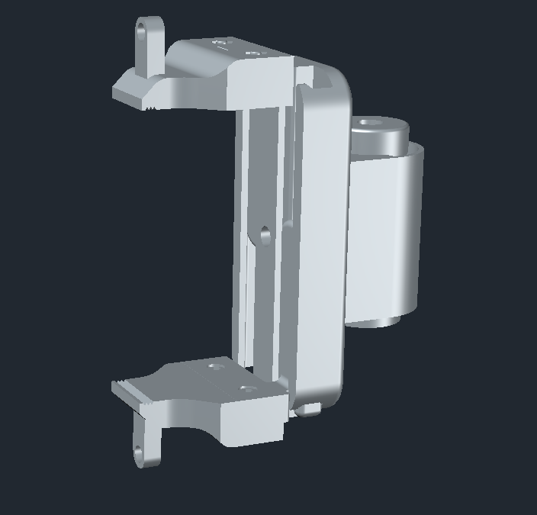
MEMBER 3: Basel Feras Ghunaim
ACCOMPLISHED (SINCE LAST REPORT)
IN PROGRESS
Completed the gripper mechanical design using a rack and pinion mechanism
Finalized the V-shaped gripping area for improved handling of small objects
Completed full CAD design of the gripper, including suction integration
Designed and aligned the suction mounting system with the gripper tip
Selected and finalized components:
Vacuum pump
M5 joint silicone suction cup
4 mm brass barbed connector
Sent all parts for 3D printing
Fabrication phase: 3D printing of gripper components
Preparing for assembly of mechanical and suction systems
Reviewing design for any last adjustments before testing
NEXT WEEK PLAN
Receive and assemble printed parts
Integrate:
Gripper mechanism
Suction system (pump + tube + suction cup)
Perform initial functional testing:
Gripper opening/closing
Suction performance
Identify and fix any mechanical or alignment issues
Begin basic control integration

Slide 12
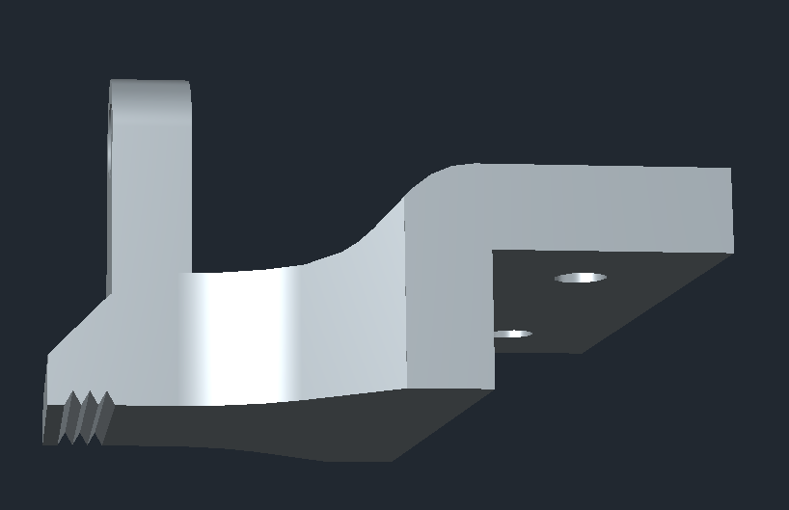
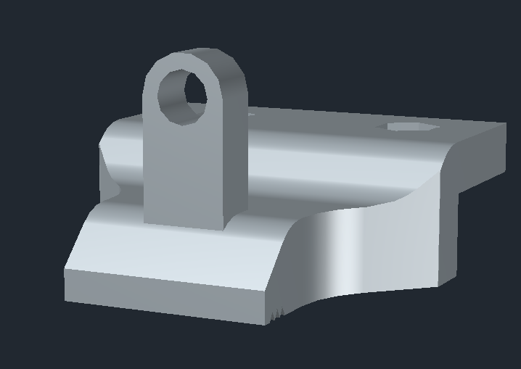
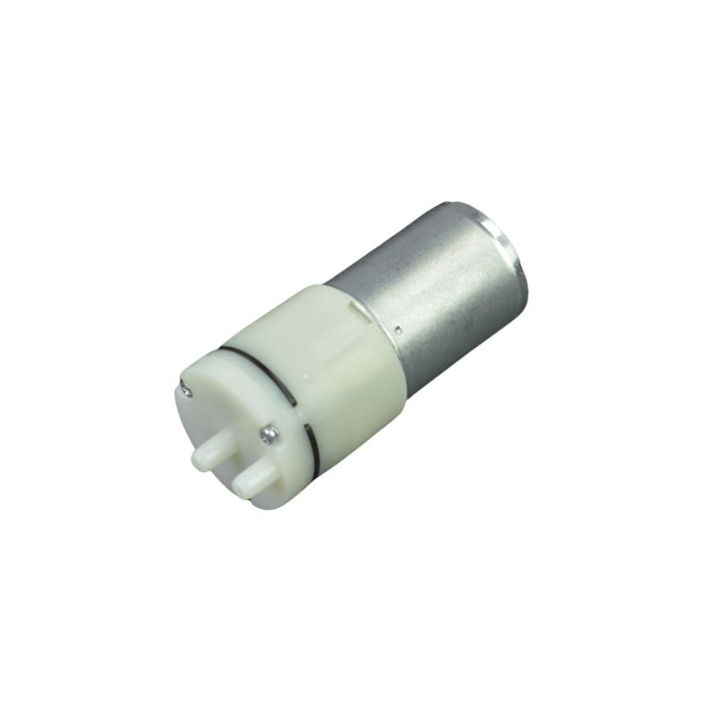
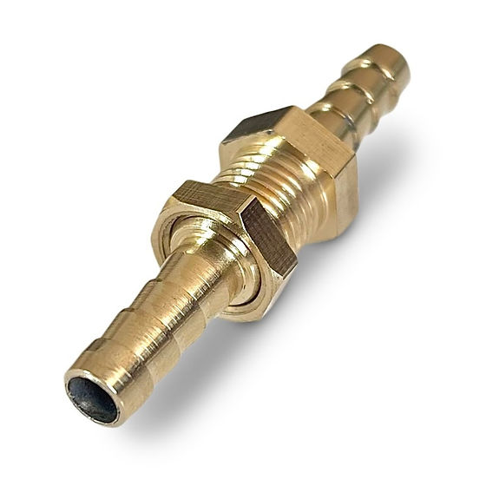
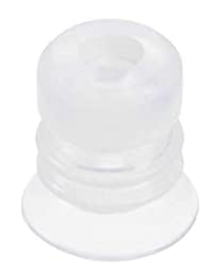
Vacuum pump
4mm Brass Barbed Hose Connector
M5 Joint Silicone Vacuum Pneumatic Suction Cup

Slide 13
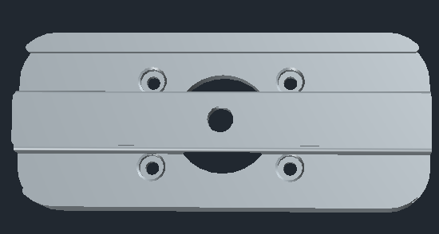
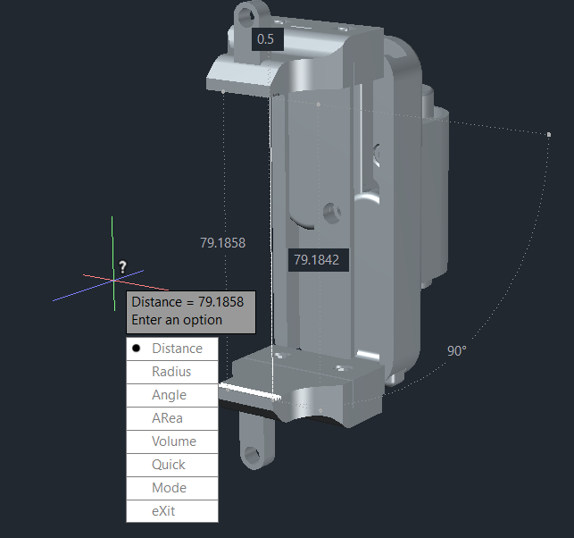
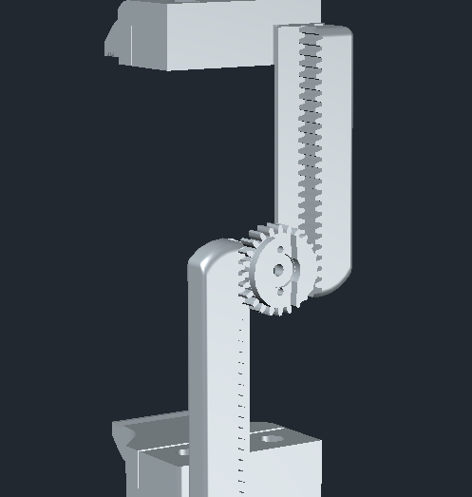
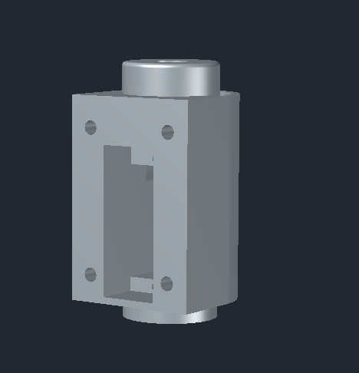

Slide 14
MEMBER 4: Ahmed Alshehhi
ACCOMPLISHED (SINCE LAST REPORT)
IN PROGRESS
Researched manual control methods for the robotic arm (joystick-based system and Robot
Shaped miniature control arm).
• Refining component selection based on cost and availability. • Studying how to connect joystick with Arduino for manual control.
•
Identified and listed required components for the control system (Arduino, joystick, wires, potentiometer, etc.)
• Collected approximate prices for all components and compared options.
• Watched and analyzed reference videos to understand implementation.
•
NEXT WEEK PLAN
HELP NEEDED / QUESTIONS
Finalize component list and confirm availability.
•
•
Start basic wiring and testing of joystick control system.
•

Slide 15
WRAP-UP: WHAT WE NEED FROM THE INSTRUCTOR / STAKEHOLDERS
DECISIONS REQUESTED
ACTION ITEMS FOLLOW-UP
Determine the control method – joystick/app
Pneumatic integration
Physical 3d printed prototype so testing can begin
Refining the computer vision model.
QUESTIONS / FEEDBACK
APPENDIX
https://maherrrrr99.github.io/maherrrrr99/
https://sabeehahasham.github.io/
https://basel-ghunaim.github.io/
https://ahmed1090822.github.io/Ahmed109.github.io/

