Slide 1
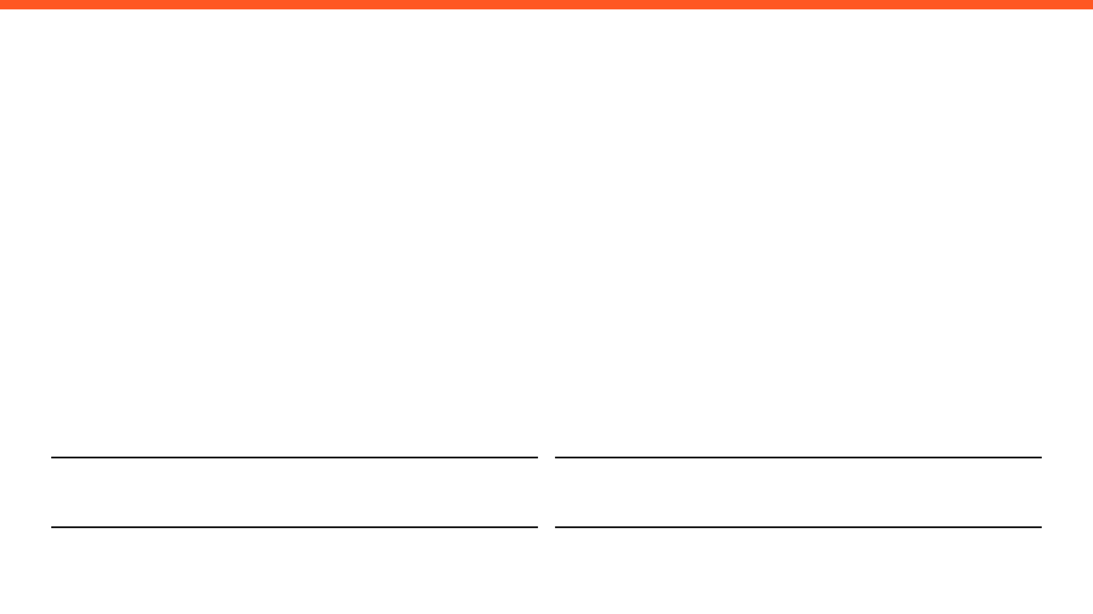
WEEKLY PROGRESS REPORT
Mechatronic System Design (MEC483) – Course Project
PROJECT / PHASE
DATE RANGE
Smart Pick and Place Robot
14/4/2026 – 21/4/2026
TEAM MEMBERS
Maher Abo Abed (1087993) , Sabeeha Zainab Hasham (1089042), Basel Feras Ghunaim (1088912), Ahmad Nasser Alshehhi (1090882)

Slide 2
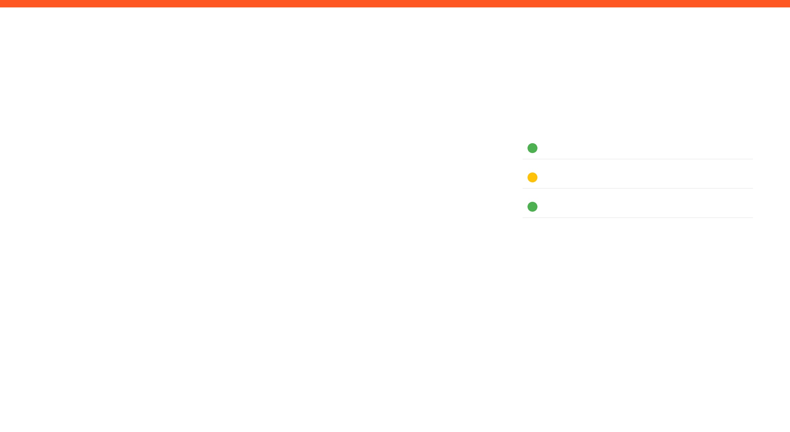
HOW ARE WE DOING THIS WEEK?
TOP WINS
KEY BLOCKERS / RISKS
PROJECT HEALTH
Successfully built and tested and IK model using moveit and Rviz for visualizing
Built, tested and successfully controlled a pneumatic suction system that is capable of relatively high pay loads
Set up the Raspberry pi with the current yolov8 model, connected and set up the camera – the full system is almost in place
Blocker: Continued printing issues – prototype and assembly can’t be made yet, causing significant delays
Scope
Under Execution
Schedule
Potential Delays
Fabrication & Prototyping
Under Execution
OPEN ISSUES
3 Active

Slide 3

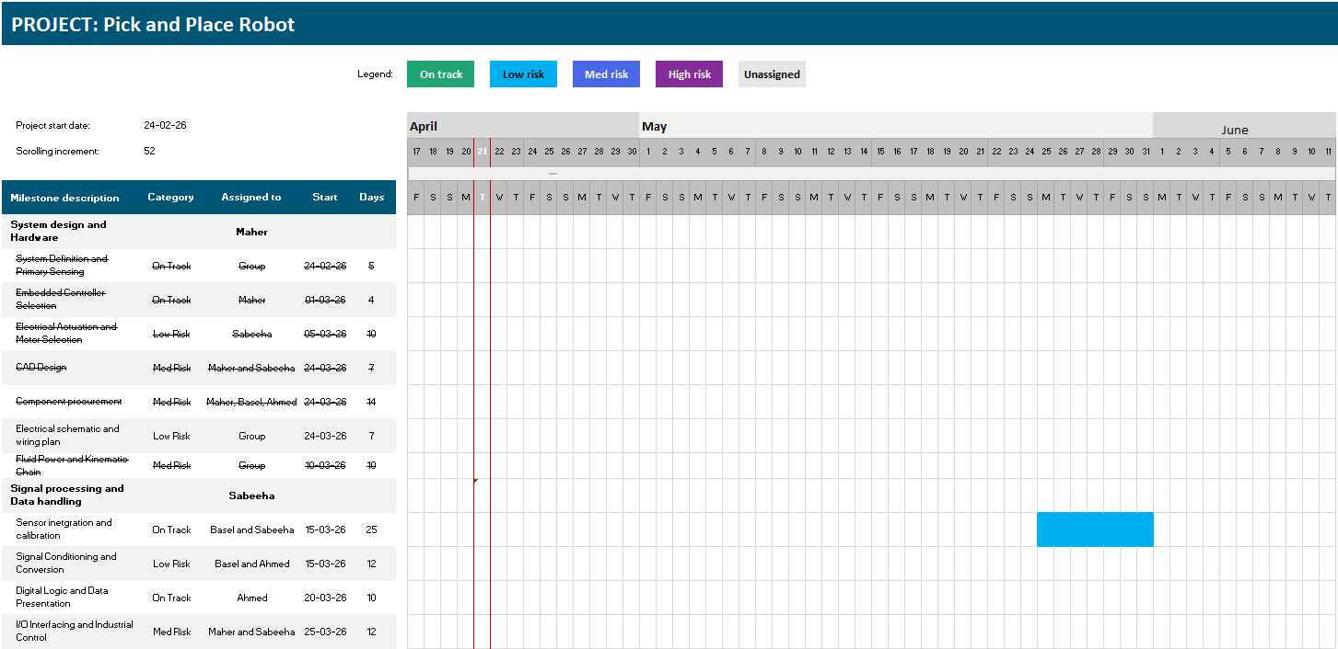
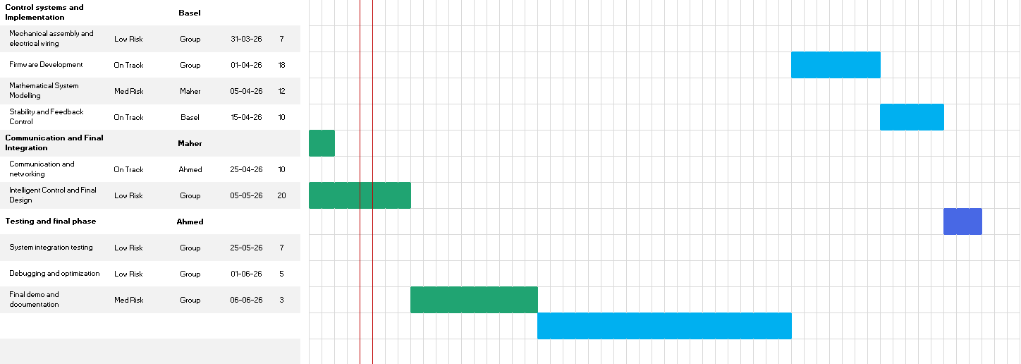
Project Schedule (Gantt)
Agile Gantt chart1.xlsx​

Slide 4
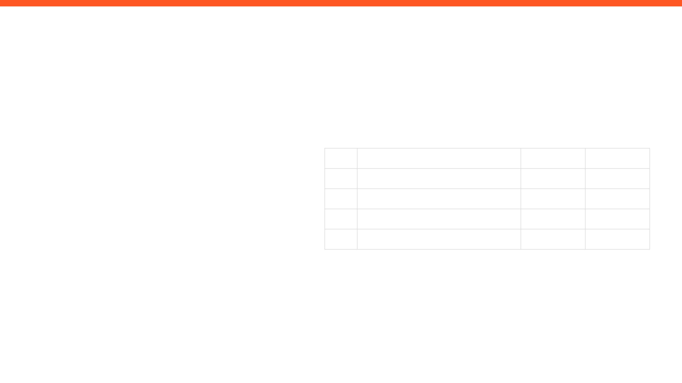
ISSUES, RISKS, AND ACTION ITEMS
TOP ISSUES (BLOCKING PROGRESS)
ACTION ITEMS (NEXT 7 DAYS)
Fabrication delays
No access to university is slowing down work efforts, and overall progress.
ID
ACTION ITEM DESCRIPTION
MEMBER
WEEK DUE
A1
Finalize and deploy the computer vision model
Sabeeha
Week 8
A2
Finish the IK kinematics
Maher
Week 7
MITIGATIONS / DECISIONS NEEDED
A3
Procure, assemble, and experiment on gripper.
Basel
Week 7
A4
Finalize a manual override system
Ahmad
Week 7
Conduct virtual meetings often.
Constant communication and updates.
Each member should take their own initiatives.
Aim to make any sort of progress, regardless of how small or big.

Slide 5

INDIVIDUAL UPDATES
WEEKLY PROGRESS & NEXT STEPS
MEMBER 1
MEMBER 2
Maher Abo Abed
Sabeeha Zainab Hasham
MEMBER 3
MEMBER 4
Basel Feras Ghunaim
Ahmad Nasser Alshehhi

Slide 6
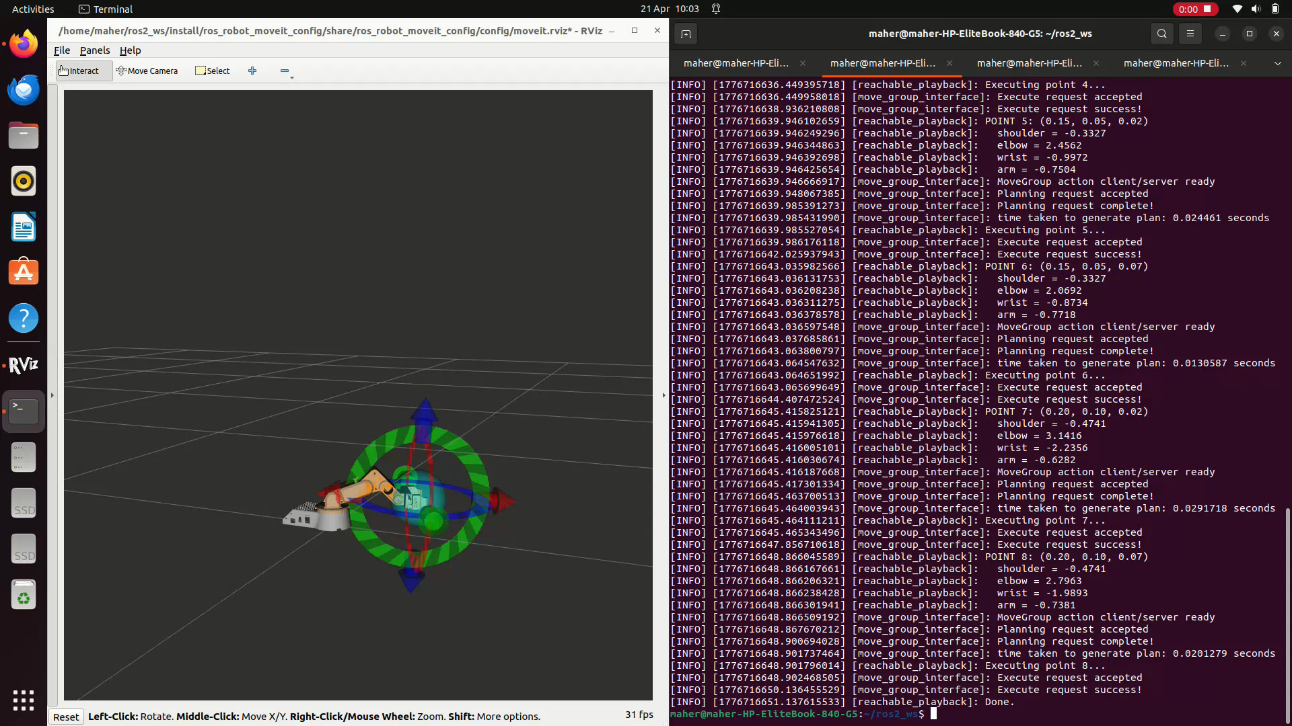
MEMBER 1: Maher Abo Abed
ACCOMPLISHED (SINCE LAST REPORT)
EVIDENCE
Finished IK (ROS Based)
IKFast – Not successful (older solution, requires almost perfect urdf, visualizing is difficult)
Hand calculations – attempted but preferred other solutions
Moveit – working, trial and tested, can be visualized
Analyzed the reachable workspace using this newly made model
Attempted random poses, and verified solution
Started with object tracking/following
Made a successful code, but suffered with hardware issues
IN PROGRESS
Inverse kinematic for the suction
Object tracking and following
Awaiting printed parts
NEXT WEEK PLAN
Mechanical assembly
Finish the IK
Finish the object tracking/following.

Slide 7
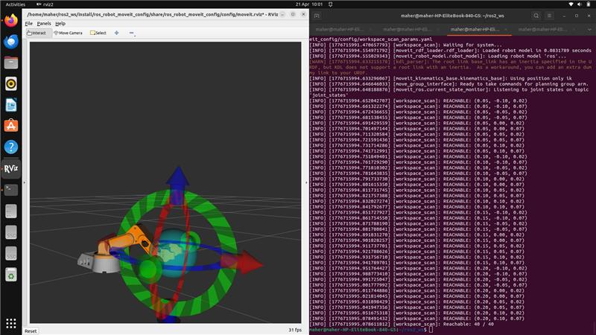
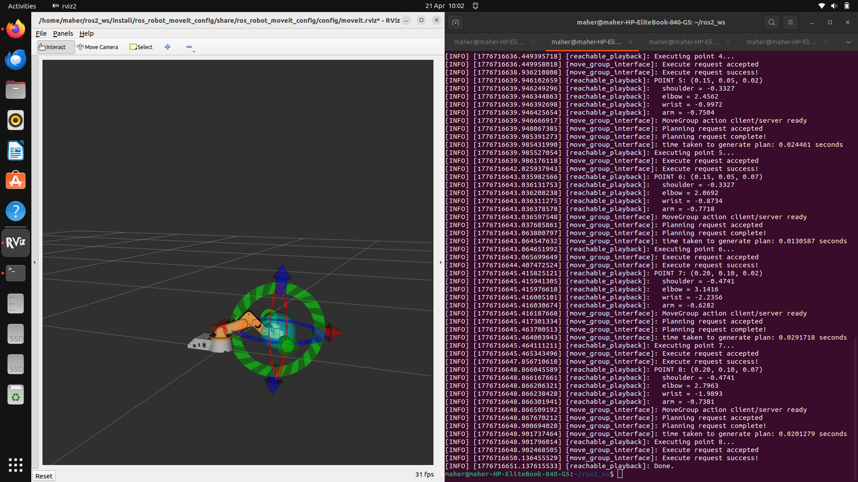

Slide 8
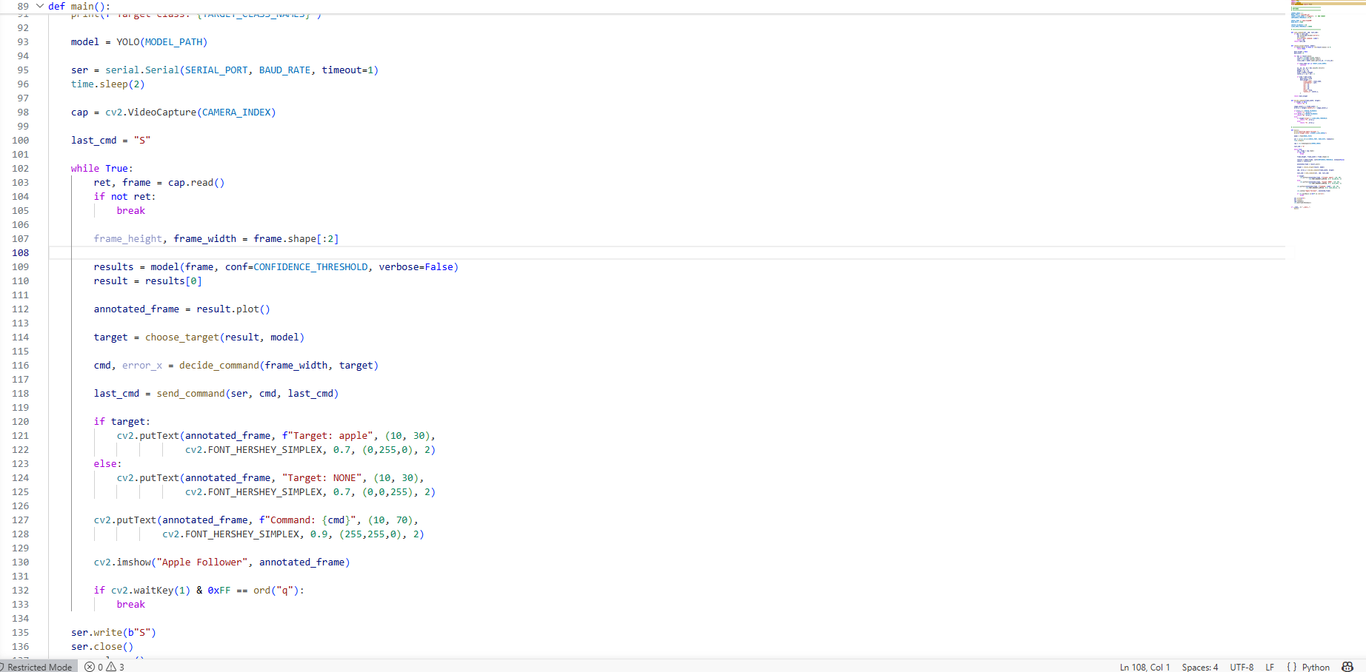
The program uses a camera to detect objects in real time using a YOLOv8 model.
It is specifically configured to detect only apples.For every video frame, the model finds objects and filters out everything except apples with sufficient confidence.If multiple apples are detected, the program selects the largest one (closest to the camera)
It calculates the horizontal position (center) and size (area) of the selected apple.
The program compares the apple’s position to the center of the screen.
If the apple is to the left, it sends a "L" command (turn left).If the apple is to the right, it sends a "R" command (turn right).
If the apple is centered:It sends "F" (move forward) if the apple is far away.It sends "S" (stop) if the apple is close enough.
Commands are sent through a serial connection to a device like an Arduino.The program avoids sending the same command repeatedly unless it changes.
It displays the video feed with detection boxes and shows the current target and command on screen.
The loop runs continuously until the user presses "q" to quit.
When exiting, it sends a stop command, closes the serial connection, and releases the camera

Slide 9
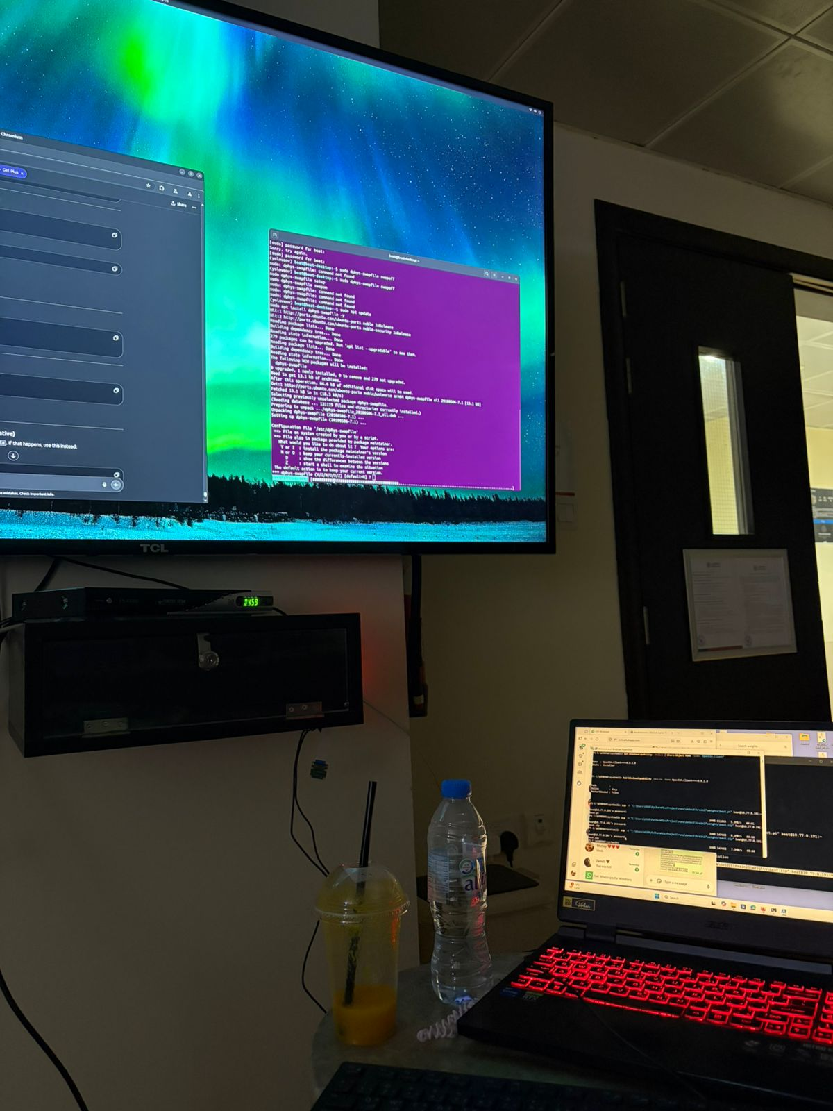

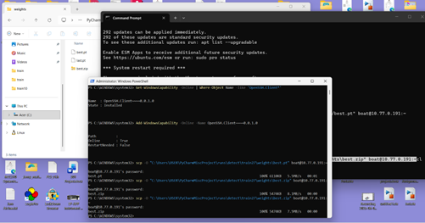
MEMBER 2: Sabeeha Hasham
EVIDENCE (SHOW, DON'T TELL)
ACCOMPLISHED (SINCE LAST REPORT)
•
Installed or worked on camera-related tools (like v4l-utils) for camera support
Connected the Raspberry Pi Camera Module 2 to the Pi
Used Windows PowerShell with the scp command to directly transfer best.zip from my PC to the Raspberry Pi over the network, instead of using file-sharing apps like WhatsApp or Google Drive – they didn’t work
Attempted to run your object detection system using YOLOv8
Encountered an error: “Illegal instruction (core dumped)” the model or environment isn't compatible with the Pi setup
Worked inside a Python virtual environment (yolovenv))
Adjusted system settings (like memory/swap limits) to improve performance
•
•
•
IN PROGRESS
•
Camera is physically connected but the detection code crashes due to compatibility/performance issues
NEXT WEEK PLAN
•
HELP NEEDED / QUESTIONS

Slide 10
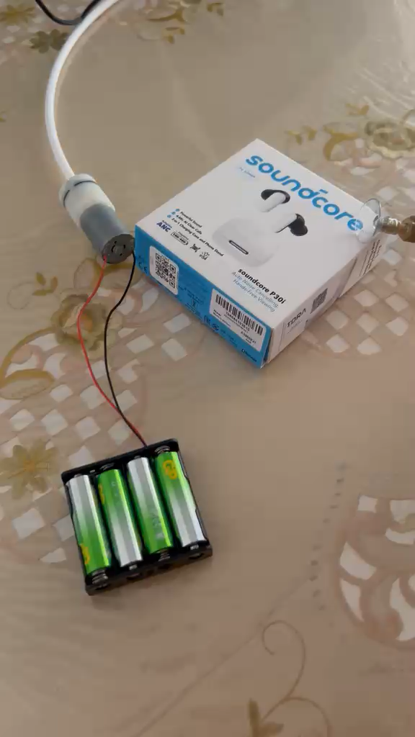
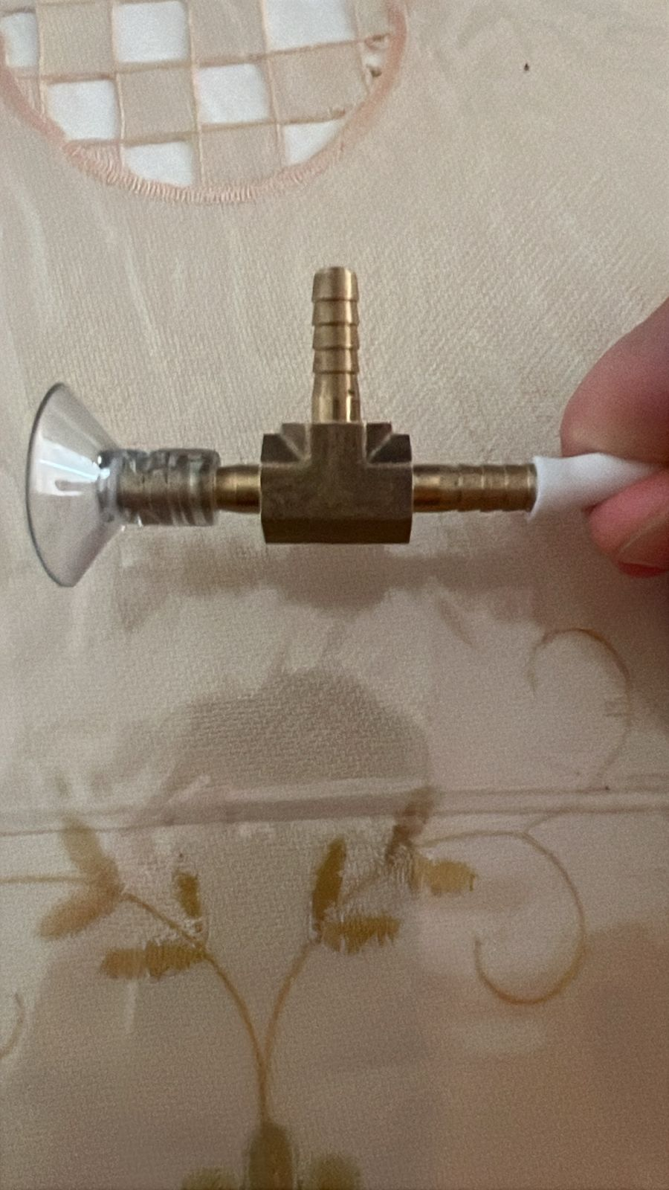
MEMBER 3: Basel Feras Ghunaim
ACCOMPLISHED (SINCE LAST REPORT)
IN PROGRESS
Completed component selection and purchasing process for the suction system Acquired:
Vacuum pump
Suction cup
Tubing and connectors
Successfully assembled and tested the suction system
Achieved lifting capability of up to 200 g, exceeding initial requirements
Validated that the suction system is functional and reliable for target objects
Evaluating overall system integration (gripper + suction)
Observing performance and identifying any improvements in stability or sealing
Discussing control methods for remote operation as a team
NEXT WEEK PLAN
Explore and implement remote control of the robotic arm/gripper.
Investigate possible control methods:
Wireless control (Bluetooth / Wi-Fi)
Remote interface via Raspberry Pi or Arduino
Select the most suitable approach and begin initial implementation and testing

Slide 11
MEMBER 4: Ahmed Alshehhi
ACCOMPLISHED (SINCE LAST REPORT)
IN PROGRESS
Looked into basic Arduino connections for joystick control
Reviewed simple circuit examples to understand wiring layout.
Preparing the wiring setup for the joystick and Arduino
Understanding signal mapping between joystick input and motor movement
NEXT WEEK PLAN
HELP NEEDED / QUESTIONS
Begin assembling the control components.
Start initial testing of joystick input with Arduino.
•

Slide 12
WRAP-UP: WHAT WE NEED FROM THE INSTRUCTOR / STAKEHOLDERS
DECISIONS REQUESTED
ACTION ITEMS FOLLOW-UP
Determine the control method – joystick/app
Pneumatic integration
Physical 3d printed prototype so testing can begin
Refining the computer vision model.
QUESTIONS / FEEDBACK
APPENDIX
https://maherrrrr99.github.io/maherrrrr99/
https://sabeehahasham.github.io/
https://basel-ghunaim.github.io/
https://ahmed1090822.github.io/Ahmed109.github.io/

