Slide 1
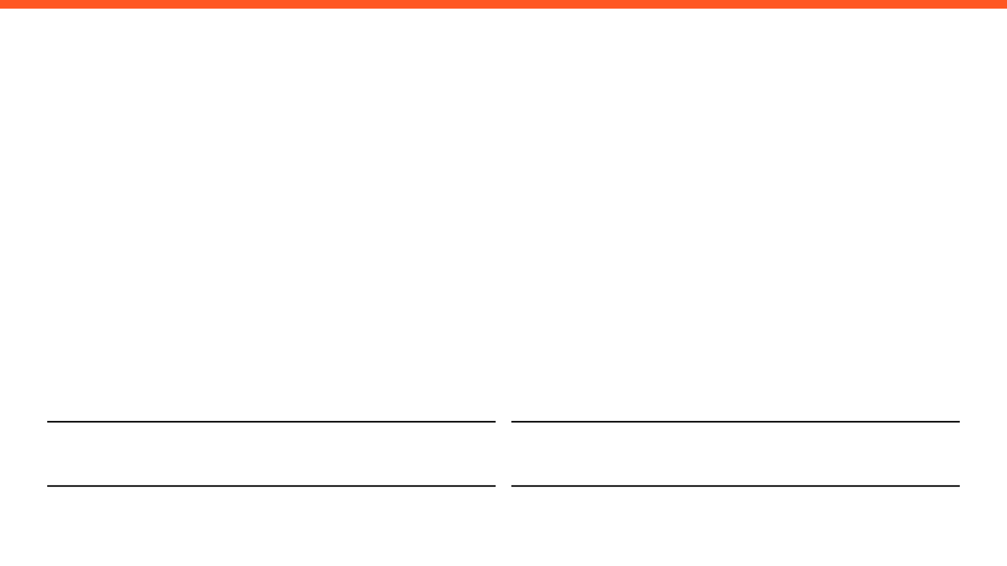
WEEKLY PROGRESS REPORT
Mechatronic System Design (MEC483) – Course Project
PROJECT / PHASE
DATE RANGE
Smart Pick and Place Robot
21/4/2026 – 28/4/2026
TEAM MEMBERS
Maher Abo Abed (1087993) , Sabeeha Zainab Hasham (1089042), Basel Feras Ghunaim (1088912), Ahmad Nasser Alshehhi (1090882)

Slide 2
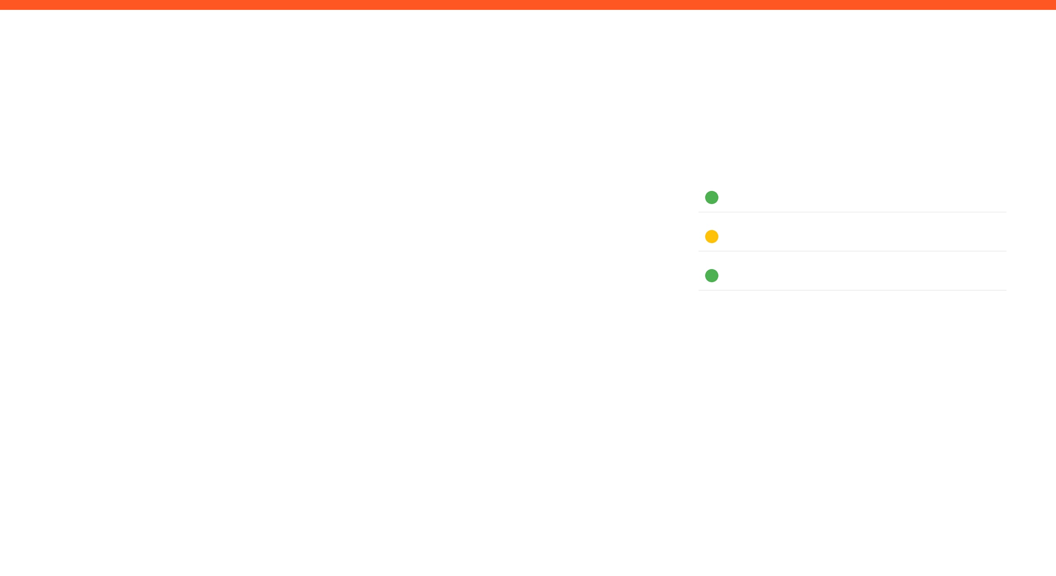
HOW ARE WE DOING THIS WEEK?
TOP WINS
KEY BLOCKERS / RISKS
PROJECT HEALTH
Successfully built and tested and IK model using moveit and Rviz for visualizing
Built, tested and successfully controlled a pneumatic suction system that is capable of relatively high pay loads
Set up the Raspberry pi with the current yolov8 model, connected and set up the camera – the full system is almost in place
Blocker: Continued printing issues – prototype and assembly can’t be made yet, causing significant delays
Scope
Under Execution
Schedule
Potential Delays
Fabrication & Prototyping
Under Execution
OPEN ISSUES
3 Active

Slide 3

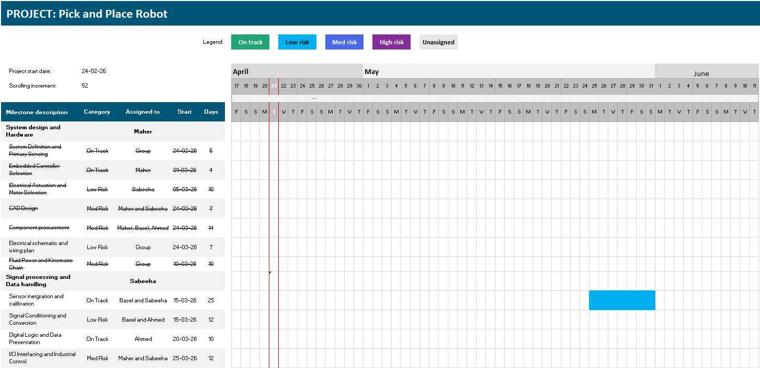
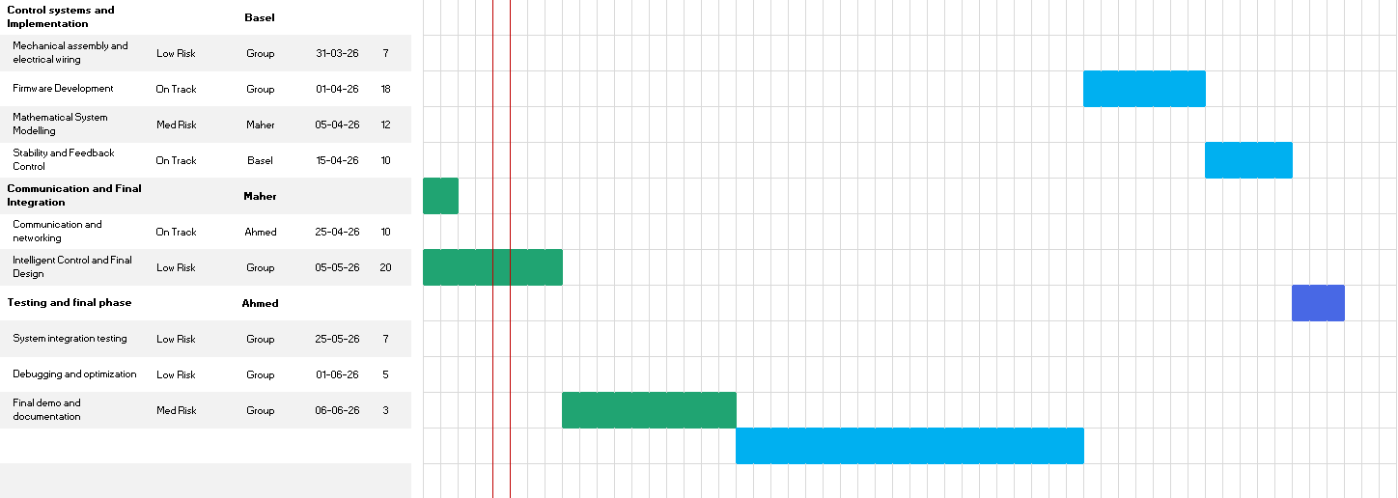
Project Schedule (Gantt)
Agile Gantt chart1.xlsx​

Slide 4
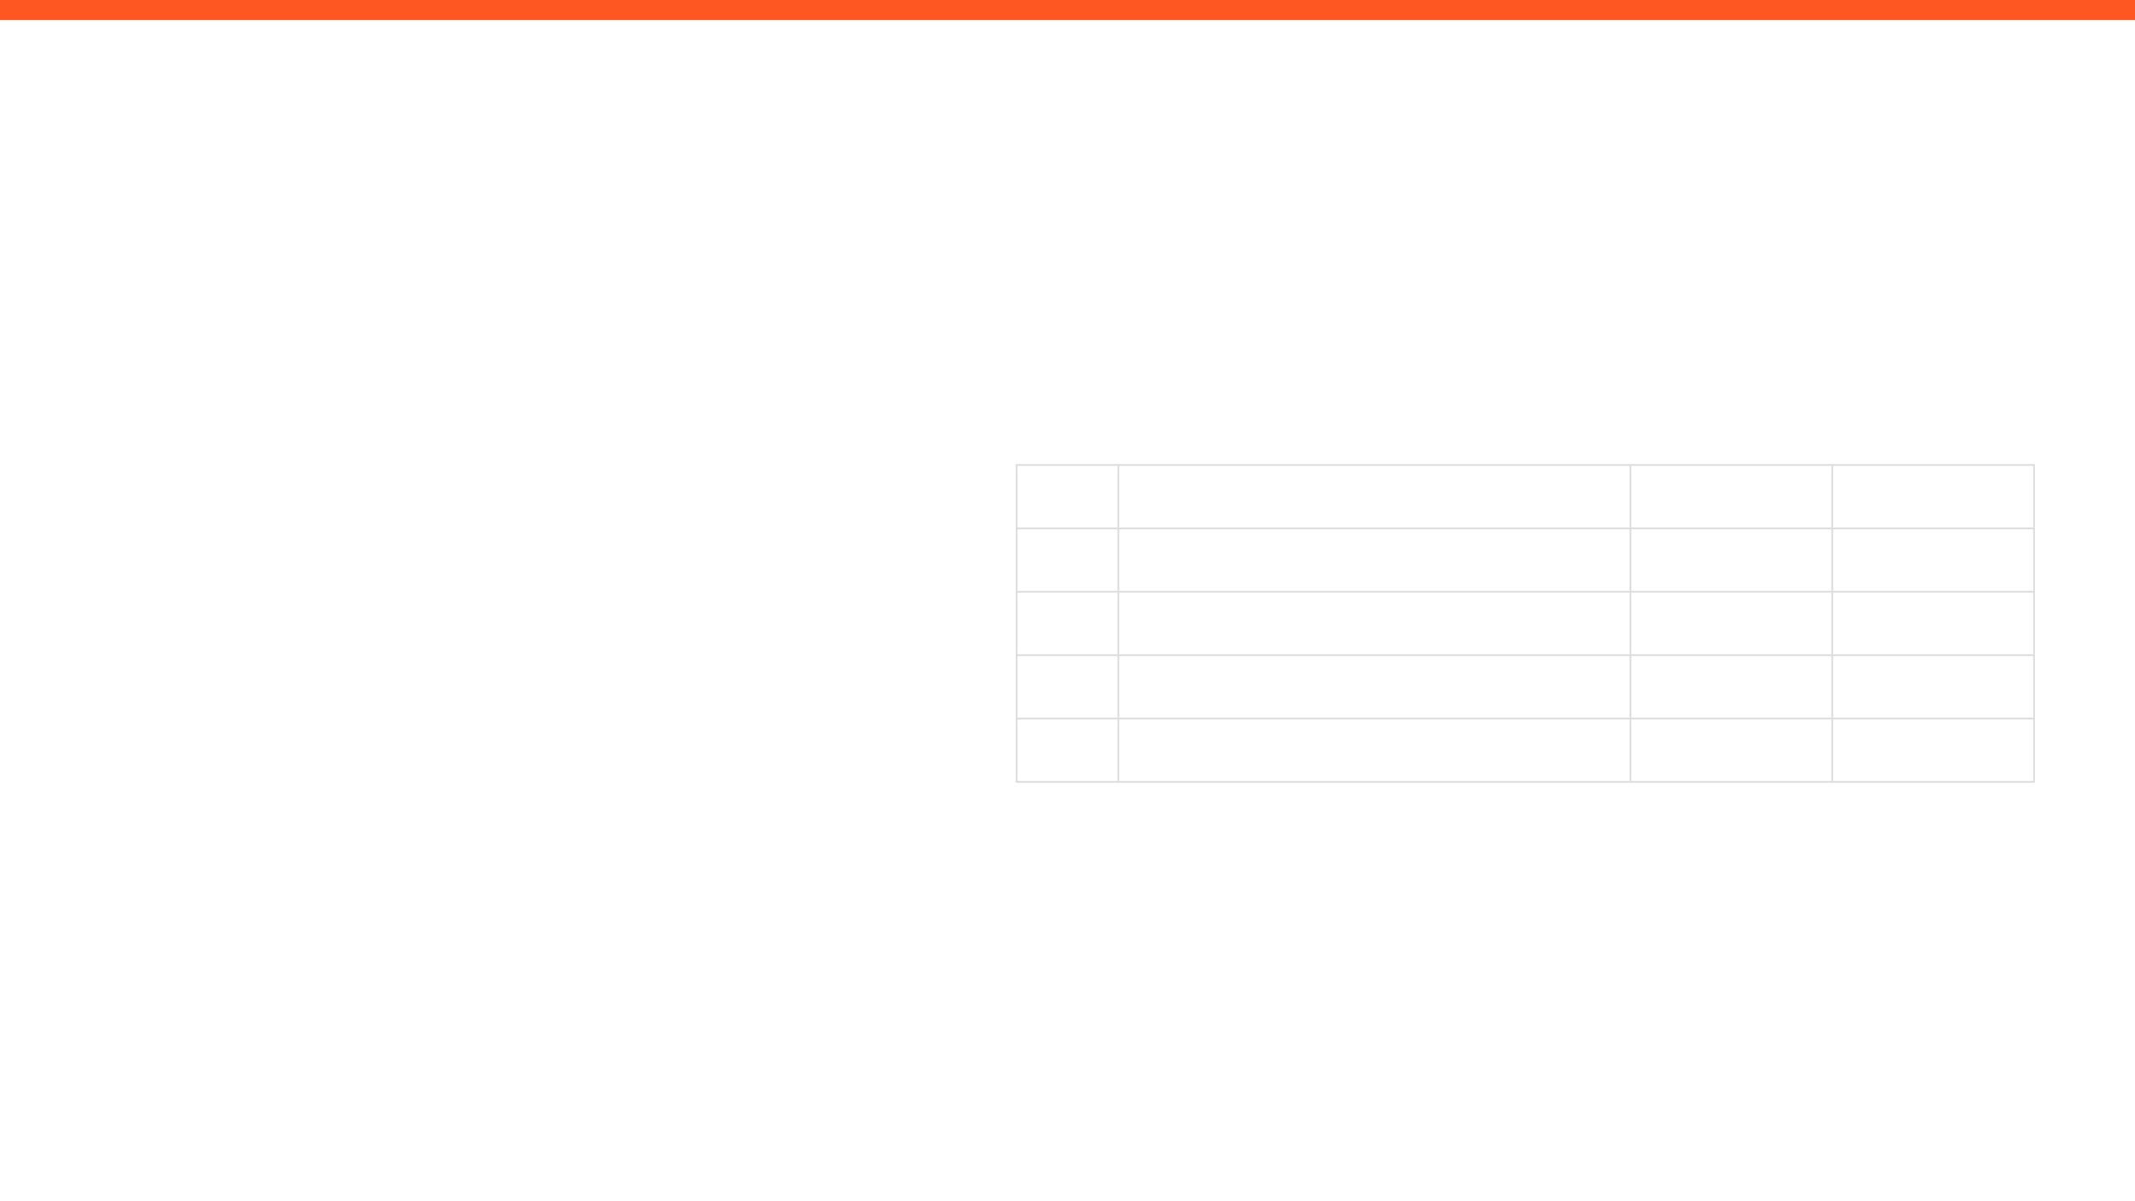
ISSUES, RISKS, AND ACTION ITEMS
TOP ISSUES (BLOCKING PROGRESS)
ACTION ITEMS (NEXT 7 DAYS)
Fabrication delays
Assembly and physical testing can be started
ID
ACTION ITEM DESCRIPTION
MEMBER
WEEK DUE
A1
TBD
Sabeeha
Week 8
A2
TBD
Maher
Week 8
MITIGATIONS / DECISIONS NEEDED
A3
TBD
Basel
Week 8
A4
TBD
Ahmad
Week 8
Printing supervision- problem is we were informed printers are not working in AD

Slide 5

GROUP UPDATE
WEEKLY PROGRESS & NEXT STEPS
MEMBER 1
MEMBER 2
Maher Abo Abed
Sabeeha Zainab Hasham
MEMBER 3
MEMBER 4
Basel Feras Ghunaim
Ahmad Nasser Alshehhi

Slide 6
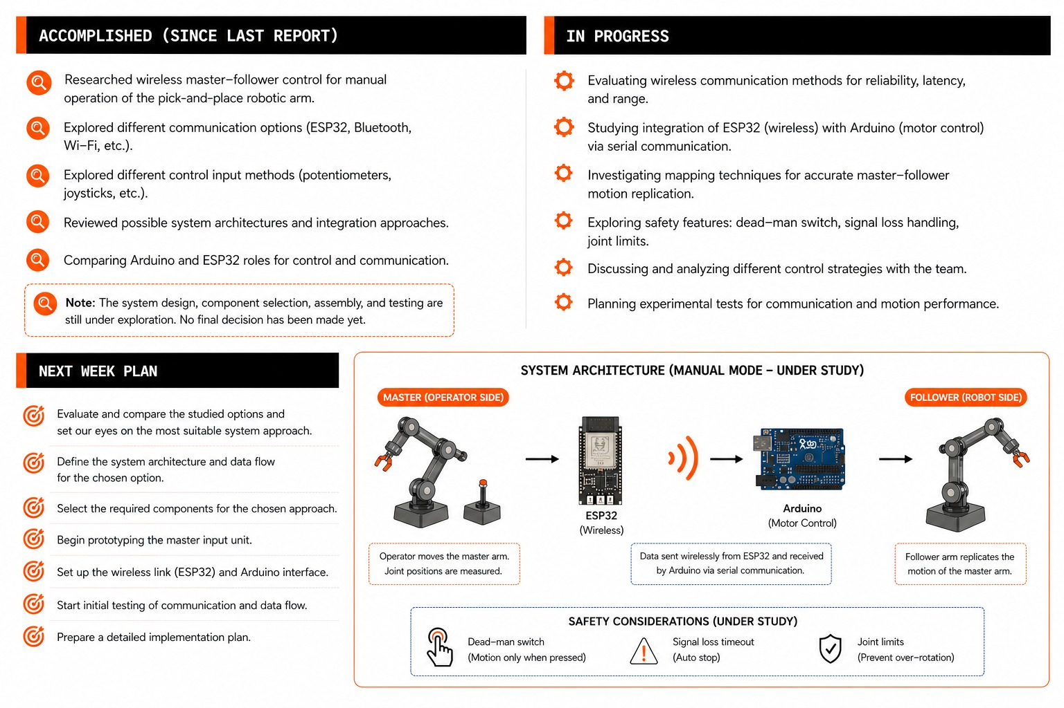

Slide 7
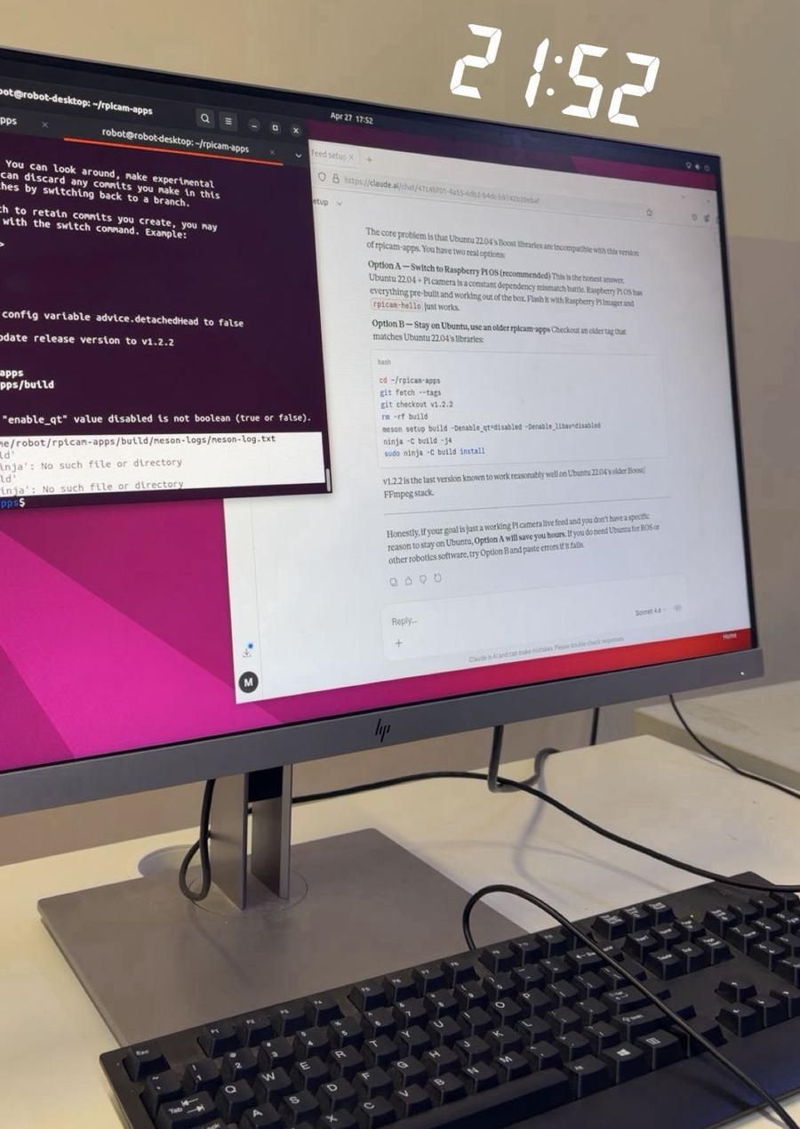
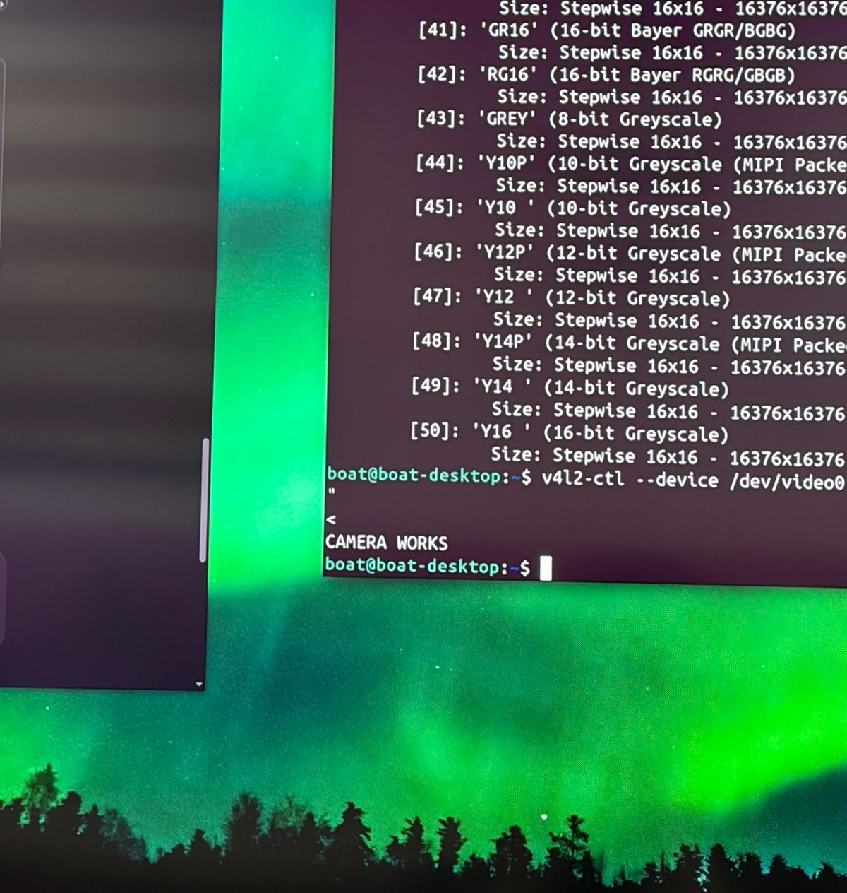
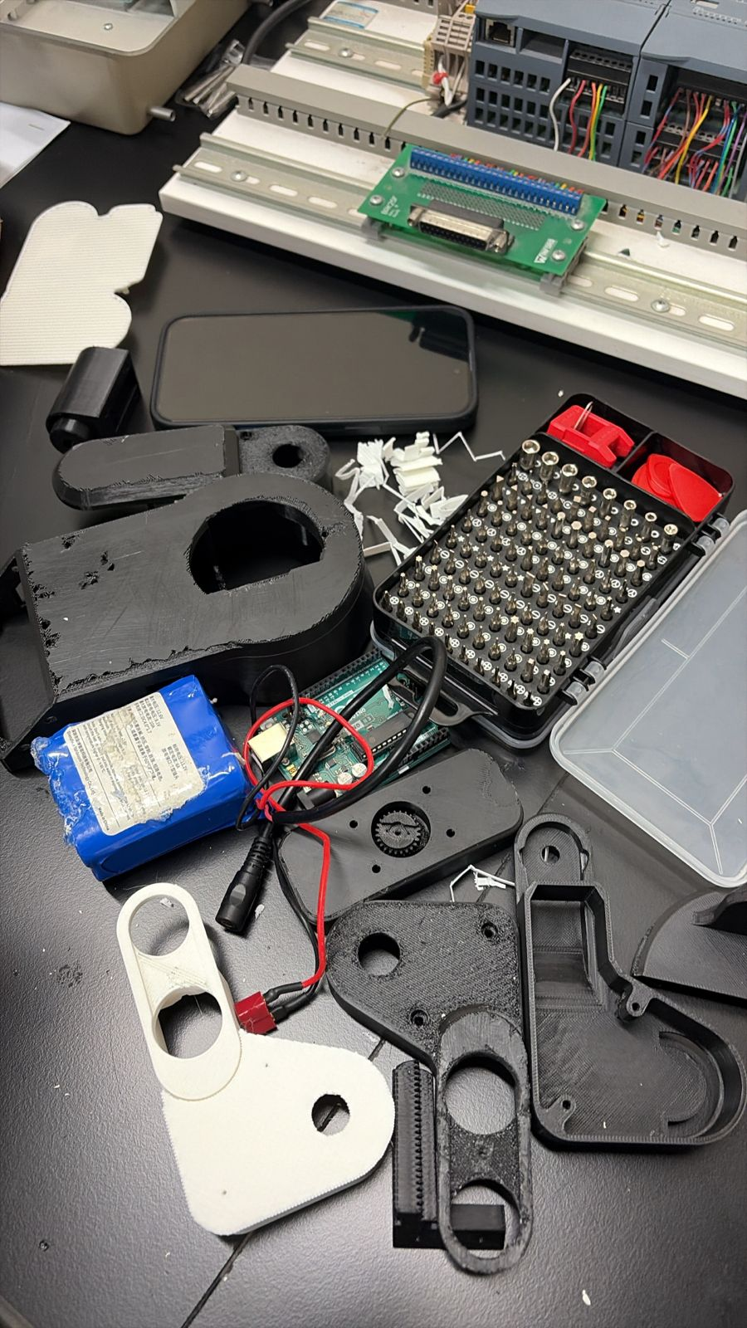
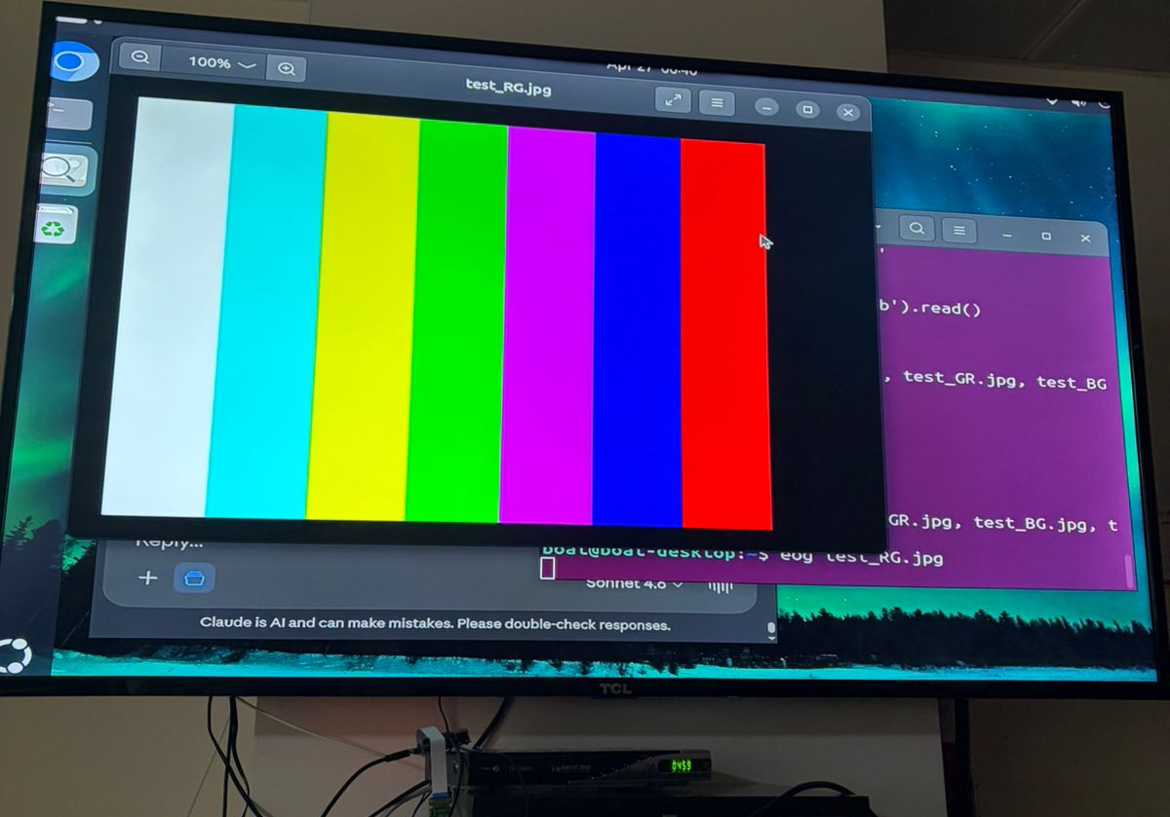

Slide 8
WRAP-UP: WHAT WE NEED FROM THE INSTRUCTOR / STAKEHOLDERS
DECISIONS REQUESTED
ACTION ITEMS FOLLOW-UP
Mechanical and electrical assembly
Sub-systems integration (vision/following/kinematics)
Platform design
More simulations, tests and runs
QUESTIONS / FEEDBACK
APPENDIX
https://maherrrrr99.github.io/maherrrrr99/
https://sabeehahasham.github.io/
https://basel-ghunaim.github.io/
https://ahmed1090822.github.io/Ahmed109.github.io/

