Slide 1
agenda
Encryption-Decryption: CAST128 with CBC mode.
Secret key delivery: RSA.
Signature: El-Gamal
Possible attack.
Conversation example

Slide 2
The CAST-128 Introduction
CAST-128 is a highly secure symmetric key block cipher algorithm that follows the Feistel network structure, consisting of either 12 or 16 rounds. It was developed in 1996 by Carlisle Adams and Stafford Tavares.
CAST-128 operates on 64-bit block sizes and supports key lengths of up to 128 bits.

Slide 3
Variable Keysize
The CAST-128 encryption algorithm has been designed to allow a key size that can vary from 40 bits to 128 bits, in 8-bit increments (that is, the allowable key sizes are 40, 48, 56, 64, ..., 112, 120, and 128 bits.
For key sizes up to and including 80 bits, the algorithm uses 12 rounds instead of 16
For key sizes greater than 80 bits, the algorithm uses the full 16 rounds;
For key sizes less than 128 bits, the key is padded with zero.

Slide 4
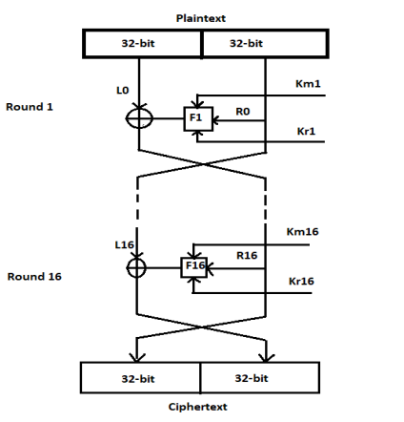
CAST128 : Encryption
Compute 16 pairs of subkeys {Kmi, Kri} from K (Explained later).
(L0,R0) = (m1...m32, m33...m64).(Split the plaintext into left and right 32-bit halves L0 = m1...m32 and R0 = m33...m64.)
(16,12 rounds) for i from 1 to (16,12), compute Li and Ri as follows:
Li = Ri-1;
Ri = Li-1 ^ f(Ri-1, Kmi,Kri)
*( F Explained later)
4. c1...c64 = (R16,L16). (Exchange final blocks L16, R16, and concatenate to form the ciphertext.)

Slide 5
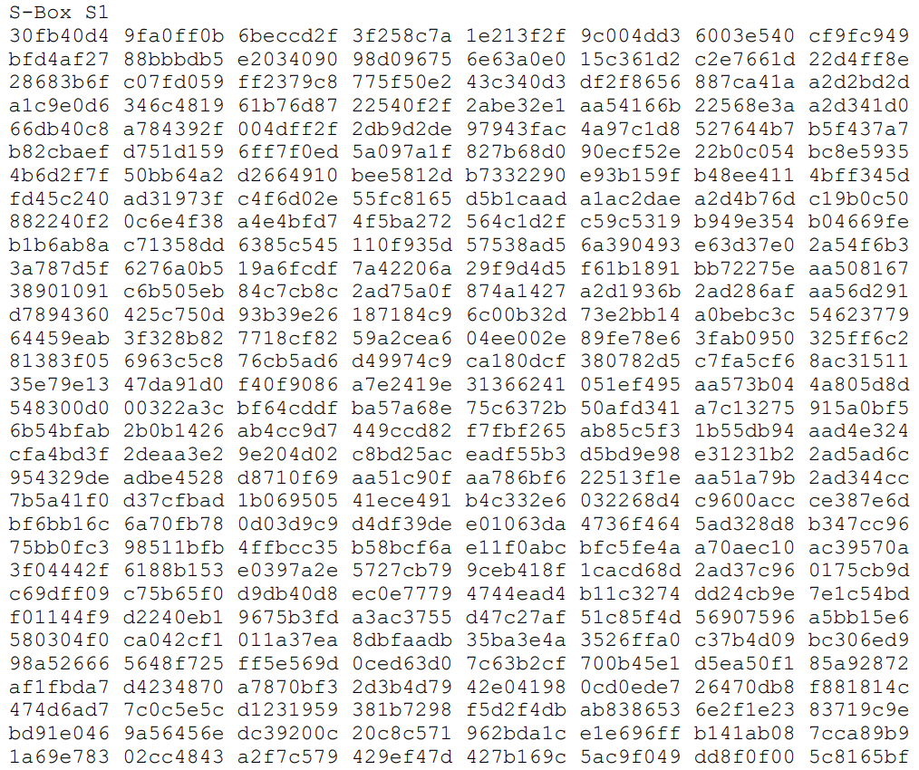
Substitution Boxes
CAST-128 uses eight substitution boxes.
S-boxes S1, S2, S3, and S4 are round function s-boxes.
S-boxes S5, S6, S7, and S8 are key schedule s- boxes.
8 s-boxes require a total of 8 KBytes of storage.

Slide 6
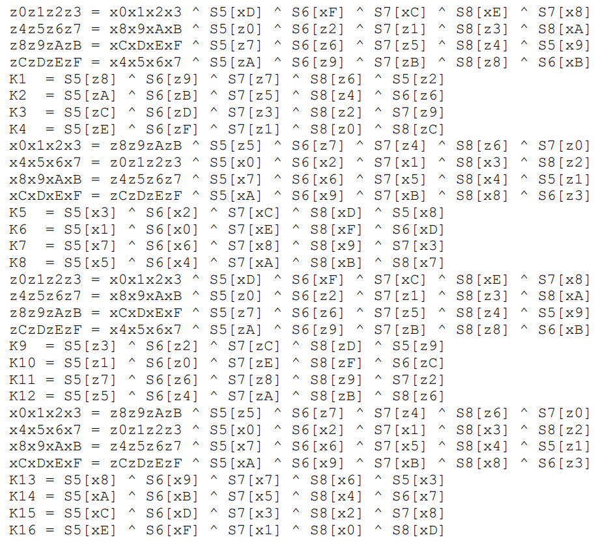
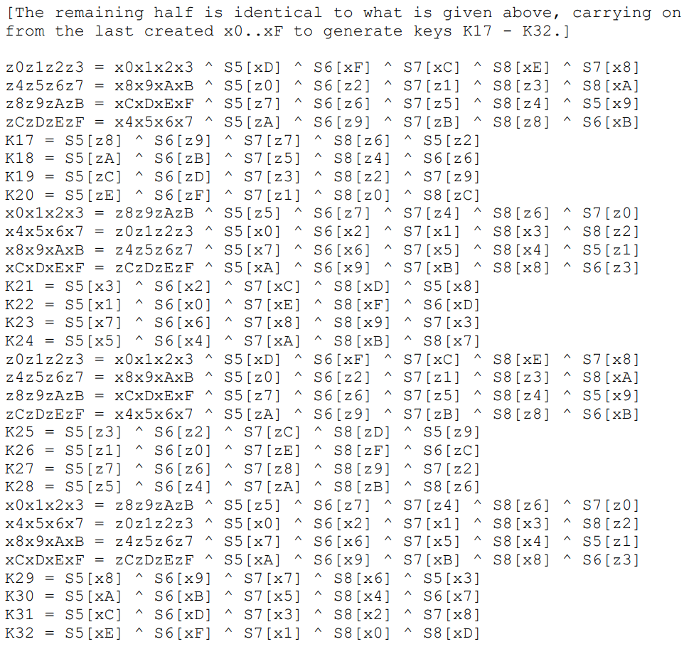

key schedule
CAST-128 uses a 32-bit Km as a "masking" key and a 5-bit quantity Kr is used as a "rotation" key.
Let the 128-bit key be x0x1x2x3x4x5x6x7x8x9xAxBxCxDxExF,. Let z0..zF be intermediate (temporary) bytes. Let Si[] represent s-box i.
Using specific formulas, we calculate 32 keys (k1 to k32).
For each round "i" we take :
$k_{m_{i}}$ = $k_{i}$ | $k_{r_{i}}$ = $k_{16+i}$

Slide 7
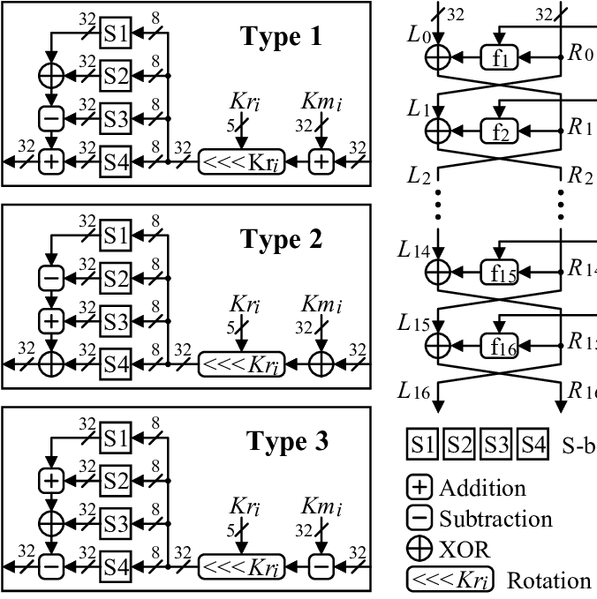
Function f
Three different round functions are used in CAST-128. The rounds are as follows (where "D" is the data input to the f function and "Ia“,” lb”,” lc”, and "Id" are the most significant byte through the least significant byte of I, respectively). Note that "+" and "-" are addition and subtraction modulo 2**32, "^" is bitwise XOR, and "<<<" is the circular left-shift operation.
Rounds 1, 4, 7, 10, 13, and 16 use f function Type 1.
Rounds 2, 5, 8, 11, and 14 use f function Type 2.
Rounds 3, 6, 9, 12, and 15 use f function Type 3.
Type 1: I = ((Kmi + D) <<< Kri)
f = ((S1[Ia] ^ S2[Ib]) - S3[Ic]) + S4[Id]
Type 2: I = ((Kmi ^ D) <<< Kri)
f = ((S1[Ia] - S2[Ib]) + S3[Ic]) ^ S4[Id]
Type 3: I = ((Kmi - D) <<< Kri)
f = ((S1[Ia] + S2[Ib]) ^ S3[Ic]) - S4[Id]

Slide 8
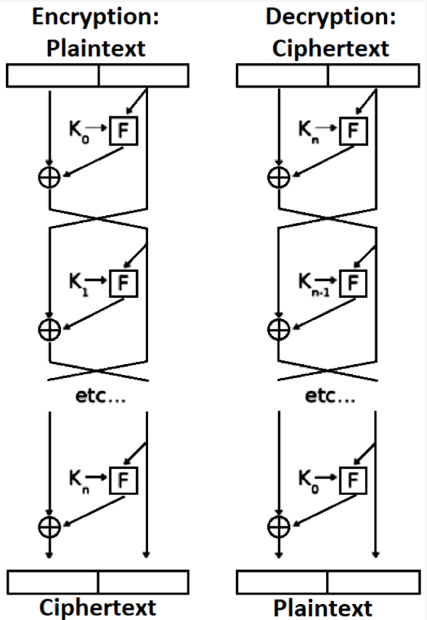
Decryption USING CAST128
Decryption is identical to the encryption algorithm given above, except that the rounds (and therefore the subkey pairs) are used in reverse order to compute (L0,R0) from (R16,L16).

Slide 9
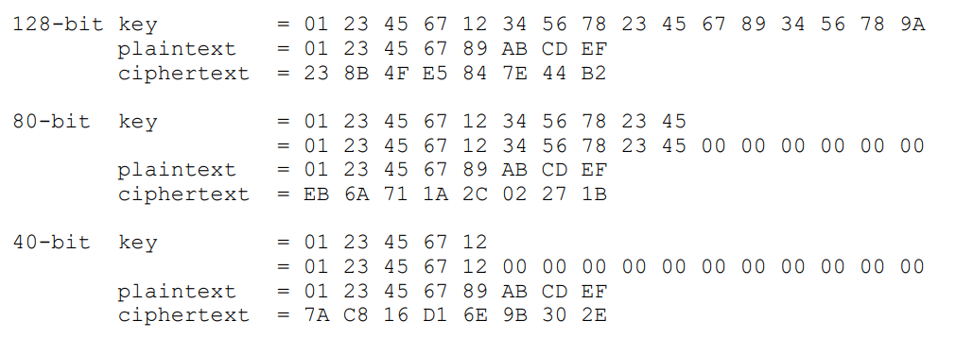
Cast 128 example

Slide 10


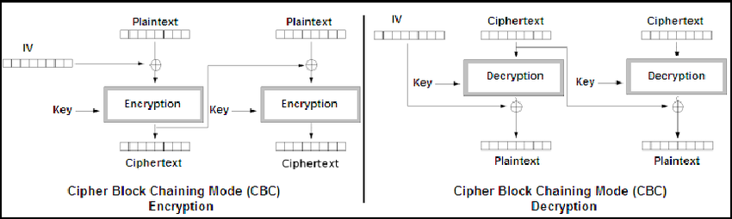
Cipher-block chaining (CBC)
Encryption:
To encrypt multiple 64 blocks.
The key-expansion phase calculate just once for all blocks encryption.
Both sides get the same key and a random number with 64 bit called IV.
Each side expand the key, and than start
to XOR the first input block with IV and encrypt it,
then each next block will be XORed with the
previous encrypted before it will be encrypted.
Decryption is the similar process but,
doing the XORs after the decipher
with previous encrypted block.

Slide 11
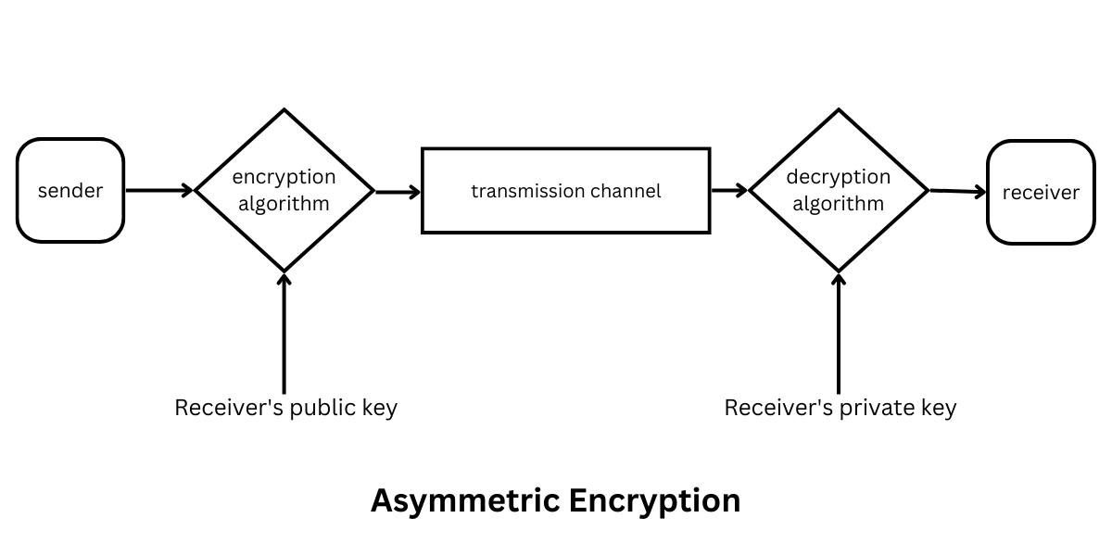
INTRODUCTION TO RSA
Asymmetric cryptography algorithm, works using two different keys public key and private key.
The public key is given to everyone, and the private key is kept private.
The security of RSA relies on the practical difficulty of factoring the product of two large prime numbers.

Slide 12
INTRODUCTION TO RSA
Key Generation: a user generates a public-private key pair. The public key is made freely available to anyone who wants to send a message to the user, while the private key is kept secret by the user.
Encryption: the sender uses the recipient’s public key to encrypt the message. This ensures that only the recipient, who has the corresponding private key, can decrypt and read the message.
Decryption: the recipient uses their private key to decrypt the message, which was encrypted using their public key. This ensures that only the recipient can read the original message.

Slide 13
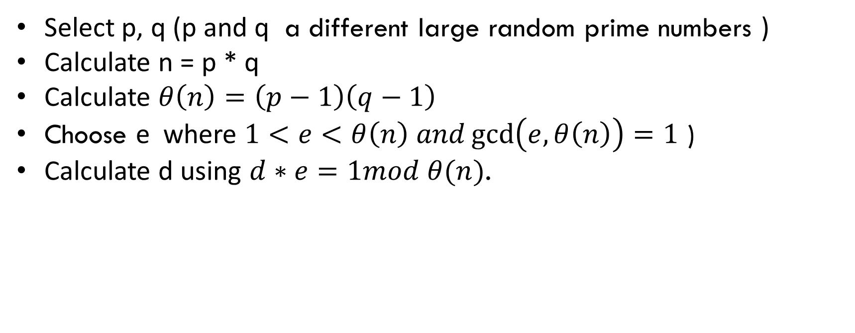
RSA – Initialization
Select p, q (p and q a different large random prime numbers )
Calculate n = p * q
Calculate $θ\left(n\right)=\left(p−1\right)\left(q−1\right)$
Choose e where $1<e<θ\left(n\right) and\gcd\left(e,θ\left(n\right)\right)=1$ )
Calculate d using $d∗e=1mod θ(n)$.
Public Key : {e, n}
Private Key: {d, p, q}

Slide 14

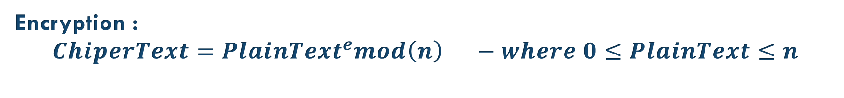
Encryption / Decryption Using RSA
Public Key : {e, n}
Private Key: {d, p, q}
Encryption :
$$ChiperText={PlainText}^{e}mod\left(n\right) −where 0≤PlainText≤n$$
Decryption :
$$PlainText={ChiperText}^{d}mod\left(n\right)$$

Slide 15
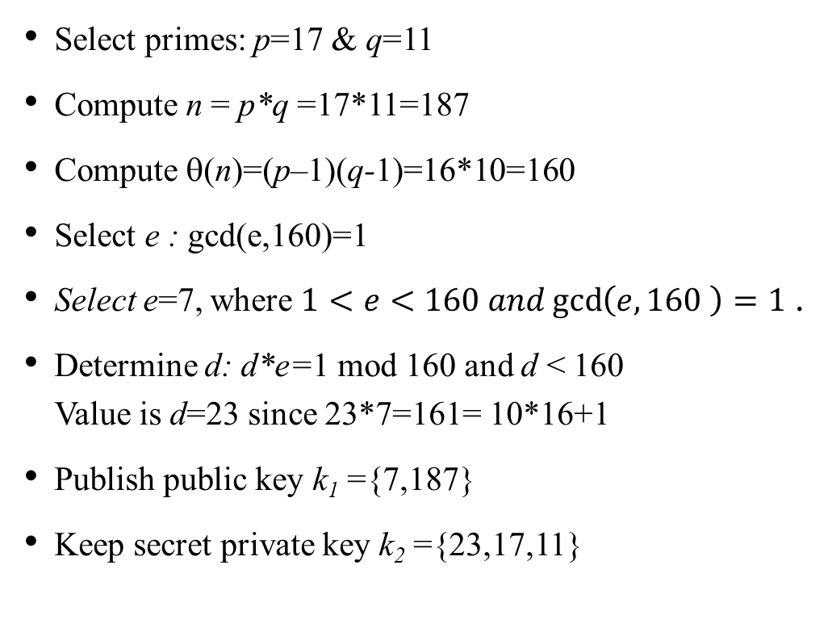
RSA Example
Select primes: p=17 & q=11
Compute n = p*q =17*11=187
Compute θ(n)=(p–1)(q-1)=16*10=160
Select e : gcd(e,160)=1
Select e=7, where $1<e<160 and\gcd\left(e,160 \right)=1$ .
Determine d: d*e=1 mod 160 and d < 160 Value is d=23 since 23*7=161= 10*16+1
Publish public key k₁ ={7,187}
Keep secret private key k₂ ={23,17,11}
encryption/decryption is:
given message M = 88 (88<187)
encryption: C = 88⁷ mod 187 = 11
decryption: M = 11²³ mod 187 = 88

Slide 16
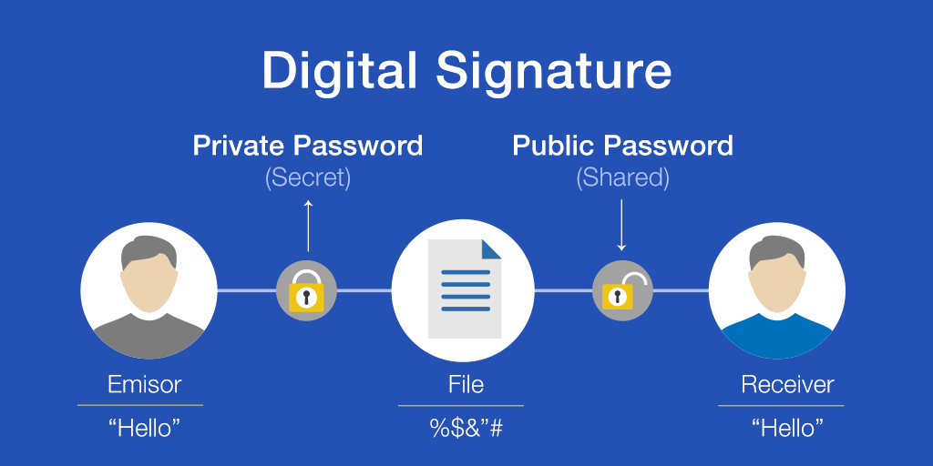
Digital Signature
What is digital signature - Digital signatures are used to verify the authenticity and integrity of electronic documents and messages.
How digital signatures work - They work by attaching a unique, unchangeable code to the document using a combination of the sender's private key and complex mathematical algorithms.
How is a digital signature verified? - The signature can be verified using the sender's public key.
What are the uses of digital signatures? - Digital signatures are very secure and are used in a variety of applications.

Slide 17
El-Gamal introduction
The ElGamal signature scheme is a digital signature scheme based on the algebraic properties of modular exponentiation, together with the discrete logarithm problem.
The algorithm uses a key pair consisting of a public key and a private key. The private key is used to generate a digital signature for a message.
the signature can be verified by using the signer's corresponding public key.

Slide 18
ElGamal Digital Signatures
signature variant of ElGamal, so uses exponentiation in a finite (Galois) with security based difficulty of computing discrete logarithms.
use private key for encryption (signing)
uses public key for decryption (verification)
each user generates their key
chooses a secret key (number): 1 < x_{A} < q-1
compute their public key: y_{A} = a^{xA} mod q
Notes:
18

Slide 19
ElGamal Digital Signature
Alice signs a message M to Bob by computing
the hash m = H(M), 0 <= m <= (q-1)
chose random integer K with 1 <= K <= (q-1) and gcd(K,q-1)=1
compute temporary key: S₁ = a^{k} mod q
compute K⁻¹ the inverse of K mod (q-1)
compute the value: S₂ = K⁻¹(m-x_{A}S₁) mod (q-1)
signature is: DS=(S₁, S₂)
any user B can verify the signature by computing
V₁ = a^{m} mod q
V₂ = y_{A}^{S1} S₁^{S2} mod q
signature is valid if V₁ = V₂
Notes:
19

Slide 20
ElGamal Signature Example
use field GF(19) q=19 and a=10
Alice computes her key:
A chooses a private key x_{A}=16
computes the public y_{A}=10¹⁶ mod 19 = 4
Alice signs message with hash m = 14 as DS = (3,4):
choosing random K=5 which has gcd(18,5)=1
computing S₁ = 10⁵ mod 19 = 3
finding K⁻¹ mod (q-1) = 5⁻¹ mod 18 = 11
computing S₂ = 11*(14-16*3) mod 18 = 4
any user B can verify the signature by computing
V₁ = a^{m} mod q = 10¹⁴ mod 19 = 16
V₂ = y_{A}^{S1} S₁^{S2} mod q = 4³*3⁴ = 5184 = 16 mod 19
since V₁ = V₂ signature is valid
Notes:
20

Slide 21

Advantages
CAST128 with CBC Mode:
Strong encryption with a 128-bit key size.
Identical blocks do not share the same cipher.
RSA for Secret Key Delivery:
Asymmetric key exchange for secure communication.
Speed–suitable for use in real-time applications.
El-Gamal for Signature Generation:
Digital signatures for data integrity and non-repudiation.
secure-ElGamal is based on the discrete logarithm problem.

Slide 22

Disadvantages
CAST128 with CBC Mode:
Parallel CBC encryption is not possible.
Not tolerant of block losses.
RSA for Secret Key Delivery:
Requires large prime numbers as part of the encryption process.
Vulnerable to attacks by quantum computers.
El-Gamal for Signature Generation:
Complexity in signature generation and verification processes.
Slower compared to other encryption algorithms.

Slide 23
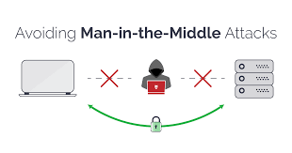
Possible Attacks
Man In The Middle: An attack where someone listens and interrupts conversations between two computers or entities in the net.
Solution: When transferring digital signature public key and RSA public key, we must deliver them in a secure channel, in order to make sure both sides can know for certain that the keys are safe.

Slide 24
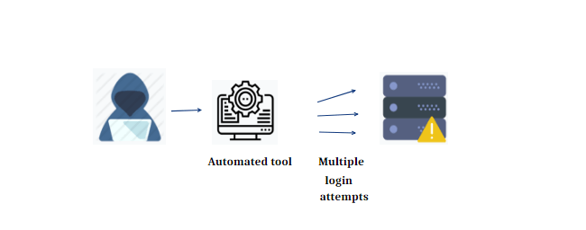
Brute force: An attack where all possible KEYS combinations are tested in order to decrypt the data.
Solution: we can calculate the total number of possible combinations :
Let's assume a hypothetical scenario where the attacker can test one billion (10^9) combinations per second:
For a 40-bit key: Number of combinations: 2^40 ,Time required: 2^40 / 10^9 seconds = 1,099 seconds or approximately 18 minutes.
For a 128-bit key: Number of combinations: 2^128 ,Time required: : 2^128 / 10^9 seconds = 340,282,366,920,938,463,463,374,607,431,768,211 seconds or approximately 10^26 years.

Slide 25


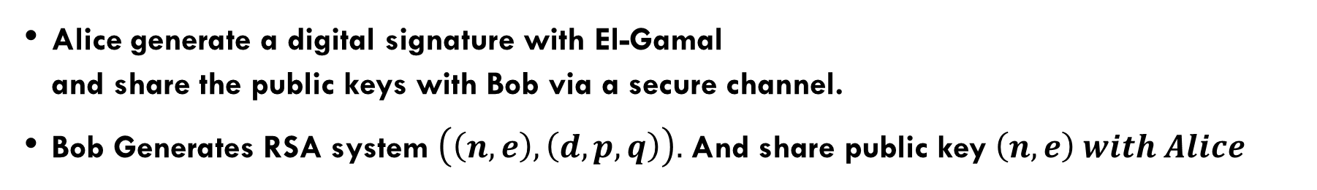
Mail Exchange -Preparations
Alice generate a digital signature with El-Gamal and share the public keys with Bob via a secure channel.
Bob Generates RSA system $\left(\left(n,e\right),\left(d,p,q\right)\right).$ And share public key $\left(n,e\right) with Alice$

Slide 26
Mail Exchange-preparations
Bob verifies Alice’s key using Elgamal, then decrypts the CAST128 key with RSA’s private key.
Alice uses RSA and (n,e) to encrypt the Key of CAST128, Finally, she signs the key using Elgamal.

Slide 27
Mail Exchange-In Action
Bob Decrypts the message with CAST128 CBC and the decrypted key, and gets the mail!
Alice writes an email to Bob and encrypts it using her key and cast128 CBC mode.

Slide 28
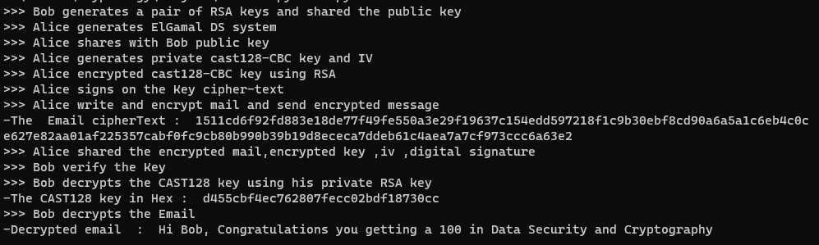
Output

Slide 29
References
CAST128 :
rfc2144.txt.pdf (rfc-editor.org)
RSA :
RSA Algorithm: Theory and Implementation in Python – AskPython
GitHub - awnonbhowmik/RSA-Python: The RSA algorithm coded in Python
ElGamal :
PowerPoint-esitys (hut.fi)
GitHub - amritesh-dasari/ElGamal-signature-scheme: Verification of the ElGamal Signature Scheme Cryptography

