Slide 1

Inverse matrix, Determinant, and Rank
By :
Maher Salman

Slide 2


Purpose of the algorithm
Input: The algorithm takes as input a quadratic matrix A of size (NxN).
Output : the inverse matrix $A^{−1}$, the determinant det(A) and the degree of the matrix rank(A).

Slide 3



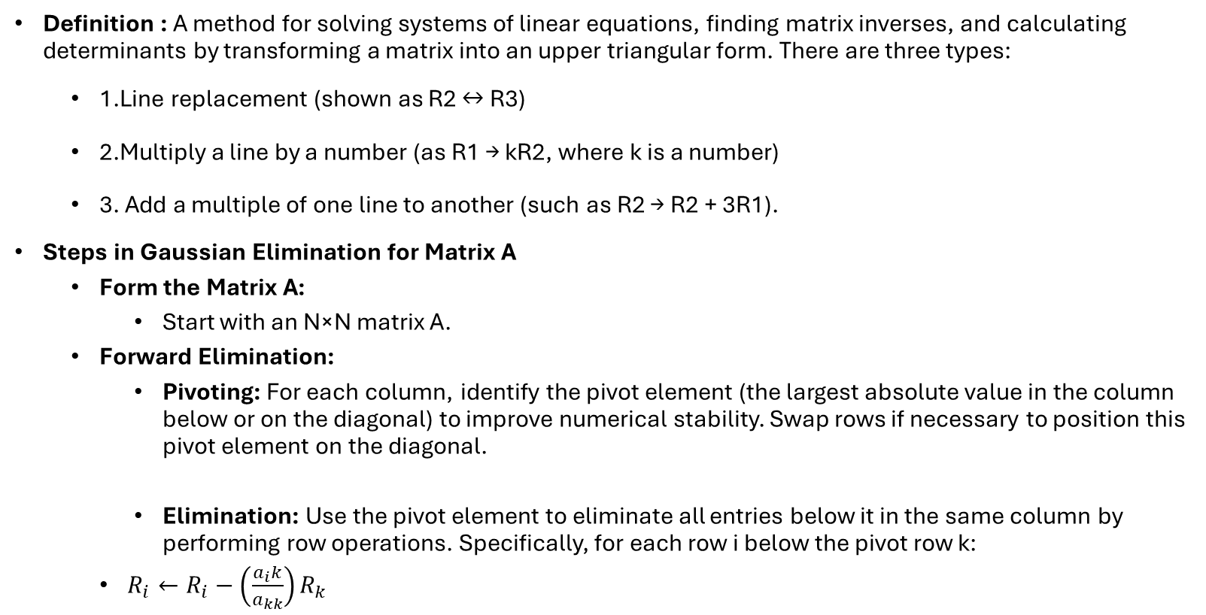
Gaussian Elimination Algorithm
Definition : A method for solving systems of linear equations, finding matrix inverses, and calculating determinants by transforming a matrix into an upper triangular form. There are three types:
1.Line replacement (shown as R2 ↔ R3) 2.Multiply a line by a number (as R1 → kR2, where k is a number) 3. Add a multiple of one line to another (such as R2 → R2 + 3R1).
Steps in Gaussian Elimination for Matrix A
Form the Matrix A:
Start with an N×N matrix A.
Forward Elimination:
Pivoting: For each column, identify the pivot element (the largest absolute value in the column below or on the diagonal) to improve numerical stability. Swap rows if necessary to position this pivot element on the diagonal.
Elimination: Use the pivot element to eliminate all entries below it in the same column by performing row operations. Specifically, for each row i below the pivot row k:
$R_{i}←R_{i}−\left(\frac{a_{i}k}{a_{kk}}\right)R_{k}$

Slide 4

Determinant
Definition: The determinant is a scalar value that can be computed from the elements of a square matrix. It provides important properties of the matrix, such as whether the matrix is invertible.
Calculating Determinants Using Gaussian Elimination
Apply row operations to transform A into an upper triangular matrix (all elements below the diagonal are zero).
Once in upper triangular form, the determinant is the product of the diagonal elements:
$$\det\left(A\right)=a_{1,1}∗a_{2,2}∗a_{3,3}∗∗∗a_{n,n}$$
If any row swaps were performed, adjust the determinant by multiplying by −1 for each swap.

Slide 5
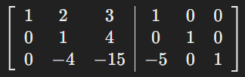
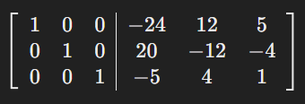
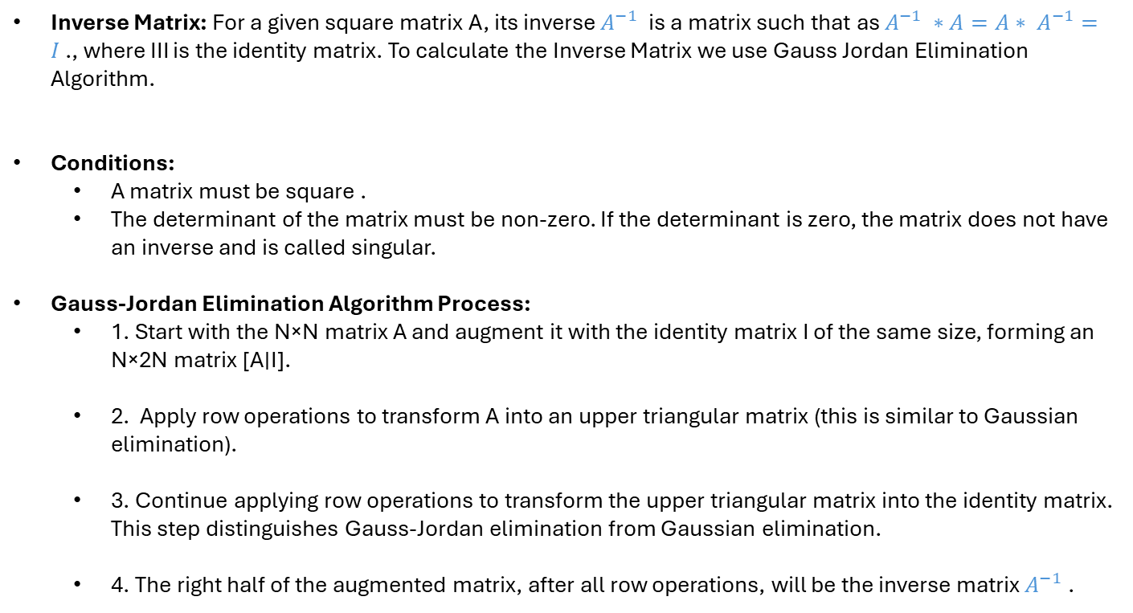
Inverse Matrix
Inverse Matrix: For a given square matrix A, its inverse $A^{−1}$ is a matrix such that as $A^{−1} ∗A=A∗ A^{−1}=I$., where III is the identity matrix. To calculate the Inverse Matrix we use Gauss Jordan Elimination Algorithm.
Conditions:
A matrix must be square .
The determinant of the matrix must be non-zero. If the determinant is zero, the matrix does not have an inverse and is called singular.
Gauss-Jordan Elimination Algorithm Process:
1. Start with the N×N matrix A and augment it with the identity matrix I of the same size, forming an N×2N matrix [A∣I].
2. Apply row operations to transform A into an upper triangular matrix (this is similar to Gaussian elimination).
3. Continue applying row operations to transform the upper triangular matrix into the identity matrix. This step distinguishes Gauss-Jordan elimination from Gaussian elimination.
4. The right half of the augmented matrix, after all row operations, will be the inverse matrix $A^{−1}$.

Slide 6
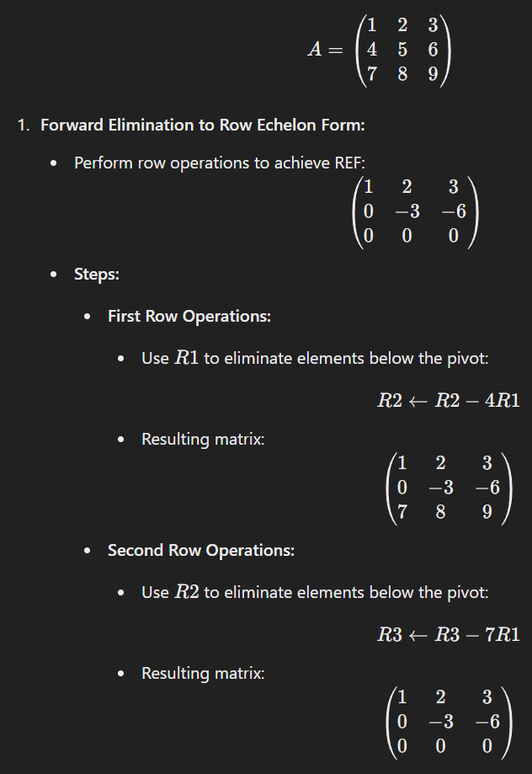
Rank
Definition: The rank of a matrix is the maximum number of linearly independent row or column vectors in the matrix. It represents the dimension of the vector space spanned by its rows or columns. The rank of a matrix is always less than or equal to the smaller of the number of rows and columns.
Determining Rank Using Gaussian Elimination :
Apply row operations to transform A.
Count Non-Zero Rows.

Slide 7

Complexity Analysis for Matrix Operations
1. Gaussian Elimination (for Determinant and Rank Calculation)
Time Complexity: $O(n^{3})$
Space Complexity: $O(n^{2})$
2.Gauss-Jordan Elimination (for Inverse Calculation)
Time Complexity: $O(n^{3})$
Space Complexity: $O(n^{2})$

Slide 8
Results

Slide 9
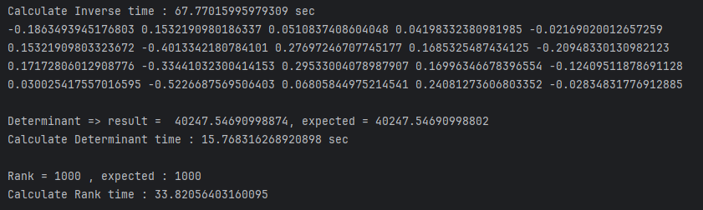
Python :
* For Inverse Matrix Printed First 5 elements from first and last two rows.

Slide 10


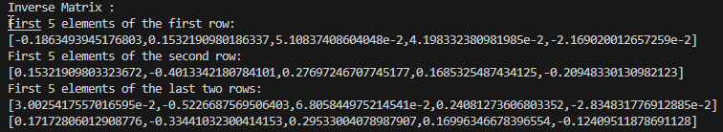
Haskell
* For Inverse Matrix Printed First 5 elements from first and last two rows.

