Slide 1
PREDICTING LIFE EXPECTANCY BASED ON INDIVIDUAL LIFESTYLE INDICATORS USING MACHINE LEARNING AND NEURAL NETWORK MODELS
By:
Maher Salman
Adan Butto
Advisors :
Dr. Naomi Unkelos-Shpigel
Dr. Samah Idrees Ghazawi

Slide 2
INTRODUCTION
Life Expectancy (LE).
Significance of Life Expectancy.
Why It Matters?

Slide 3
CHALLENGES AND THE ROLE OF MACHINE LEARNING
Challenges in Predicting LE:
Influenced by personal attributes and systemic factors.
Complex and non-linear relationships make prediction difficult.
Why Machine Learning?
Allows analysis of multiple factors simultaneously.
Outperforms traditional statistical methods in prediction accuracy.
Project Focus:
Integrating diverse real-world data.
Testing and optimizing ML and DL models for accurate, generalizable LE predictions.

Slide 4
INDICATORS FOR LIFE EXPECTANCY
Country.
Body Mass Index (BMI).
Physical Activity.
Smoking.
Alcohol Consumption
Dietary Habits.
Sleep Patterns.

Slide 5
RESEARCH PROCESS
Step 1: Exploring Life Expectancy and Indicators
Step 2: Dataset Exploration
Step 3: Synthetic Dataset Creation
Step 4: Selecting Models for Analysis
XGBoost
SAINT

Slide 6
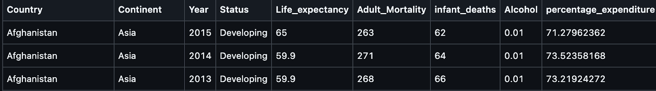
DATA SOURCE FOR LIFE EXPECTANCY PREDICTION
Dataset obtained from World Health Organization (WHO)..
Contains 15 years of data on 193 countries with health, demographic, and economic indicators.
Contain average data based on different indicators.
Key Features of the Dataset:
1. Comprehensive Indicators.
2. Rich for ML and Data Visualization.
3. Significance.

Slide 7
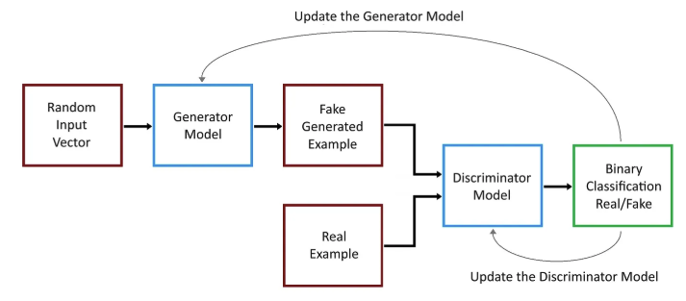
CREATING SYNTHETIC DATA USING GANS
Why Synthetic Data?
What are GANs?
1. Generator.
2. Discriminator.
Process:
Input: Random noise and averaged data.
Generator produces data resembling real-world patterns.
Discriminator evaluates if the data is real or synthetic, providing feedback for improvement.
Notes:
Visual: Use Fig. 2a to illustrate the GAN workflow, highlighting the iterative feedback loop between the generator and discriminator.

Slide 8
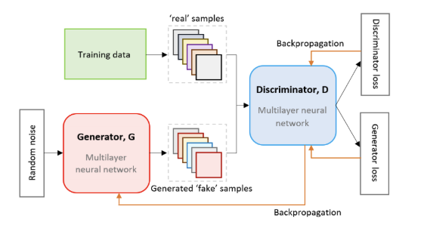
TRAINING THE GAN MODEL
Training Process:
1. Discriminator Training.
2. Generator Training.
3. Iterative Improvement.
Enhancements for Tabular Data:
Wasserstein GAN with Gradient Penalty (WGAN-GP).
Generator conditioned on specific features (e.g., region, year) to align with real-world distributions.
Notes:
Visual: Use Fig. 2b to explain the GAN architecture with detailed labels (Generator, Discriminator, Real/Fake Classification).

Slide 9
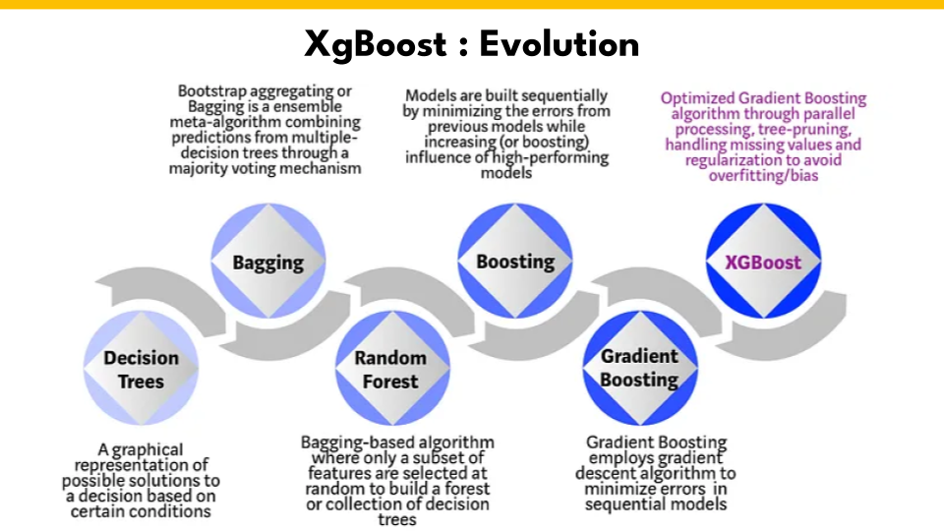
XGBOOST: AN EFFICIENT GRADIENT BOOSTING MODEL
What is XGBoost?
Why XGBoost?

Slide 10
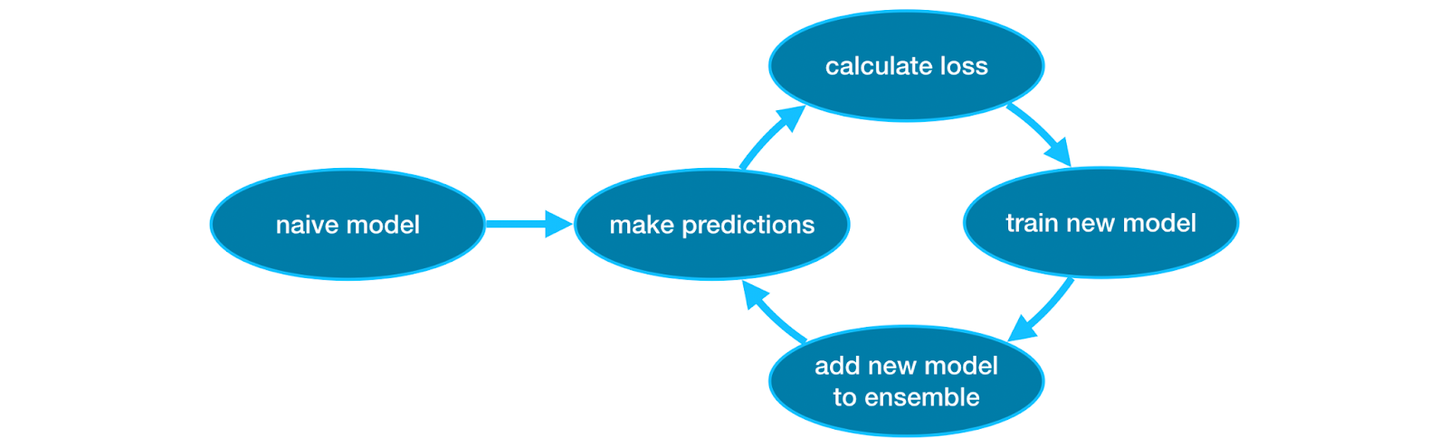
WORKFLOW OF XGBOOST
Define Objective Function.
Calculate Residuals .
Fit Decision Trees to residuals.
update predictions.
Iterate Through Multiple Trees.
Final Prediction.

Slide 11
SAINT: SELF-ATTENTION AND INTERSAMPLE ATTENTION TRANSFORMER
What is SAINT?
Challenges Solved by SAINT.

Slide 12
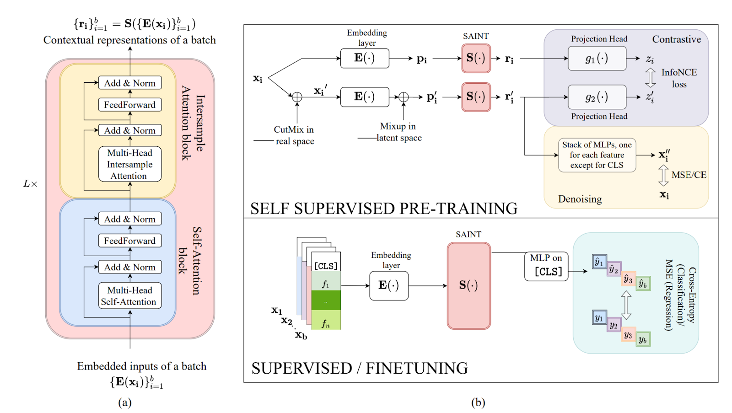
SAINT’S ARCHITECTURE
Embedding Layer.
Self-Attention Blocks.
Intersample Attention Blocks.

Slide 13
SAINT TRAINING: PRE-TRAINING AND FINE-TUNING
Pre-Training Phase.
Fine-Tuning Phase.
Key Benefits.

Slide 14
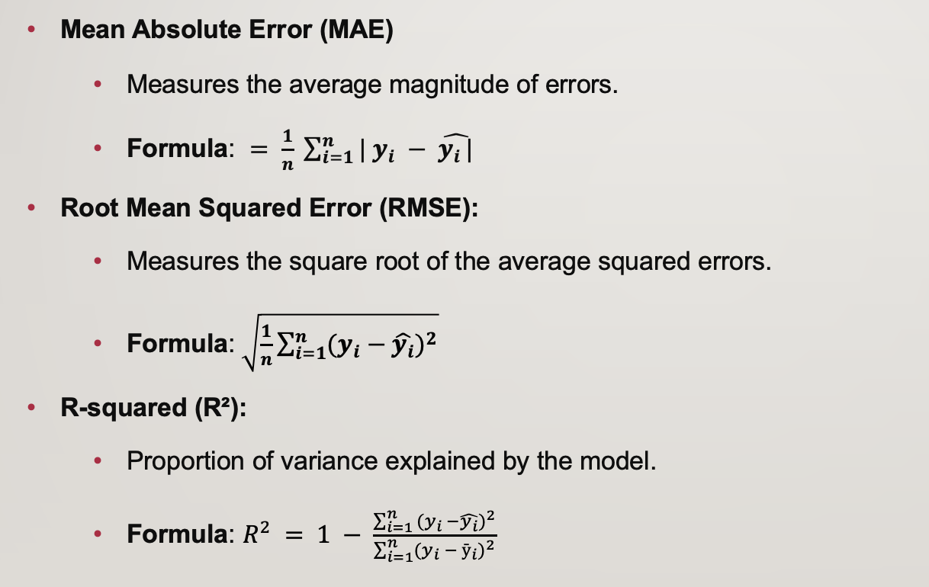
METRICS FOR MODEL EVALUATION

Slide 15
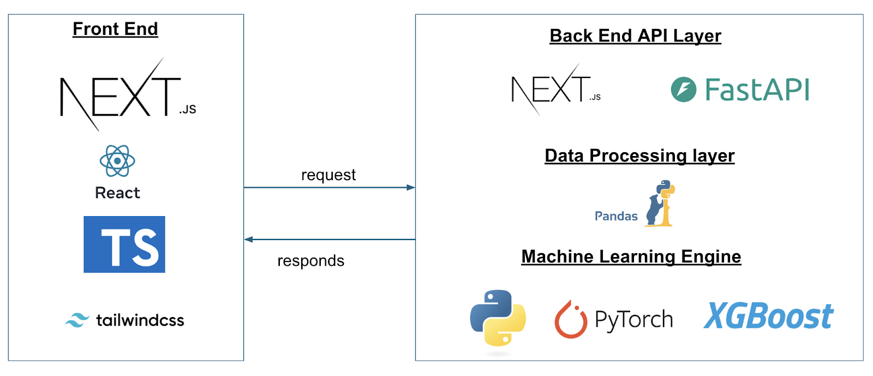
PROJECT ARCHITECTURE AND DEPLOYMENT

Slide 16
EXPECTED RESULTS
Synthetic Data Generation.
Model Evaluation.
Accuracy Improvement.

Slide 17

Thank you for your attention.

