Slide 1
PREDICTING LIFE EXPECTANCY BASED ON INDIVIDUAL LIFESTYLE INDICATORS USING MACHINE LEARNING AND NEURAL NETWORK MODELS
By:
Maher Salman
Adan Butto
Advisors :
Dr. Naomi Unkelos-Shpigel
Dr. Samah Idrees Ghazawi

Slide 2
INTRODUCTION
Life Expectancy (LE):
The average number of years a person is expected to live.
Significance of Life Expectancy.
Reflects the overall health of a population.
Indicates the effectiveness of healthcare systems.
Why It Matters:
Helps in making better public health decisions.
Guides individuals to adopt healthier lifestyles.

Slide 3
Challenges in Predicting LE
Influenced by personal attributes and systemic factors.
Complex and non-linear relationships make prediction difficult.
No individual dataset for life expectancy due to privacy concerns.

Slide 4
INDICATORS FOR LIFE EXPECTANCY
 | Indicator | Explanation | REF
1 | Country | Life expectancy differs due to healthcare, economy, and environment. Understanding these variations helps improve healthcare policies and public health.
2 | Body Mass Index (BMI) | A healthy BMI (20.0–25.0) lowers mortality risk, while being underweight or obese increases it. Maintaining a balanced BMI improves longevity. | [1]
3 | Physical Activity | Even light exercise reduces mortality risk and boosts health. Promoting regular activity supports long-term well-being and life expectancy. | [2]
4 | Smoking | Smoking shortens life expectancy by up to 2- 4 years. Reducing smoking rates improves public health and longevity. | [3]
5 | Alcohol Consumption | Heavy drinking cuts lifespan by 4–5 years. Moderation in alcohol consumption helps prevent chronic diseases and supports a healthier life. | [4]
6 | Dietary Habits | A balanced diet lowers disease risk and improves lifespan. Proper nutrition is key to better health and longevity. | [5]
7 | Sleep Patterns | Poor sleep increases health risks and shortens lifespan. Healthy sleep habits enhance overall well-being and longevity. | [5]

Slide 5
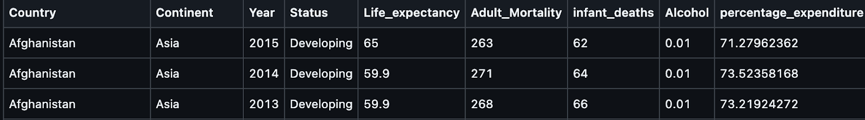
DATA SOURCE FOR LIFE EXPECTANCY PREDICTION
Dataset obtained from World Health Organization (WHO)..
Contains 15 years of data on 193 countries with health, demographic, and economic indicators.
Contain average data based on different indicators.

Slide 6
RESEARCH PROCESS
Step 1: Exploring Life Expectancy and Indicators
Step 2: Dataset Exploration
Step 3: Synthetic Dataset Creation
Step 4: Selecting Models for Analysis
XGBoost
SAINT

Slide 7
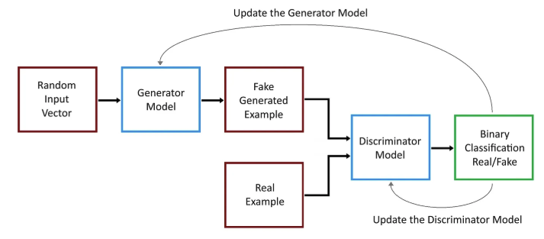
Generative Adversarial Networks
Why Synthetic Data?
What are GANs?
1. Generator.
2. Discriminator.
Process:
Input: Random noise and averaged data.
Generator produces data resembling real-world patterns.
Discriminator evaluates if the data is real or synthetic, providing feedback for improvement.

Slide 8
XGBOOST: AN EFFICIENT GRADIENT BOOSTING MODEL
What is XGBoost?
Published in 2014, XGBoost is a machine learning algorithm designed for gradient boosting optimization and is a type of ensemble learning method.
It iteratively refines predictions using decision trees, making it robust and scalable.
Widely used in industry and competitions due to its high efficiency and performance.
Why XGBoost?
Excels in tabular data, handling large datasets with missing values.
Used in previous medical research and achieved high performance in predictive modeling.
Supports L1 (Lasso) and L2 (Ridge) regularization, preventing overfitting.

Slide 9
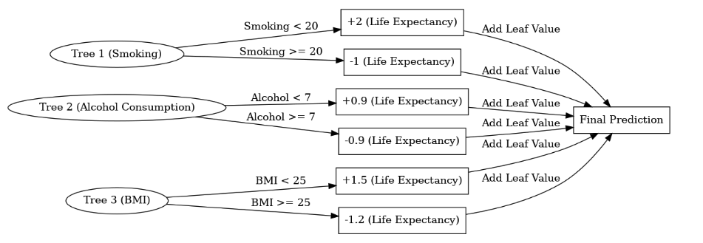
WORKFLOW OF XGBOOST
Define Objective Function.
Calculate Residuals .
Fit Decision Trees to residuals.
Update predictions.
Iterate Through Multiple Trees.
Final Prediction.
Example : Predict LE based on smoking, alcohol and BMI
Notes:
1. Define Objective Function → Start with defining the loss function to optimize.
2. Calculate Residuals → Compute the difference between actual and predicted values.
3. Fit Decision Trees to Residuals → Train weak learners (decision trees) on residual errors.
4. Update Predictions → Adjust predictions using newly trained trees.
5. Iterate Through Multiple Trees → Repeat steps 2-4 for multiple boosting rounds.
6. Final Prediction → Combine the predictions from all trees to make the final output.

Slide 10
SAINT: SELF-ATTENTION AND INTERSAMPLE ATTENTION TRANSFORMER
What is SAINT ?
SAINT, introduced in 2021, is a deep learning model for tabular data, achieving state-of-the-art performance in classification and regression tasks.
It combines self-attention and intersample attention to better capture data relationships.
SAINT handles mixed data types (numerical & categorical), requires minimal preprocessing, and outperforms traditional models like XGBoost .
Challenges Solved by SAINT:
Traditional deep learning models struggle with tabular data due to difficulty in capturing relationships.
SAINT overcomes this with attention mechanisms, modeling complex patterns effectively.

Slide 11
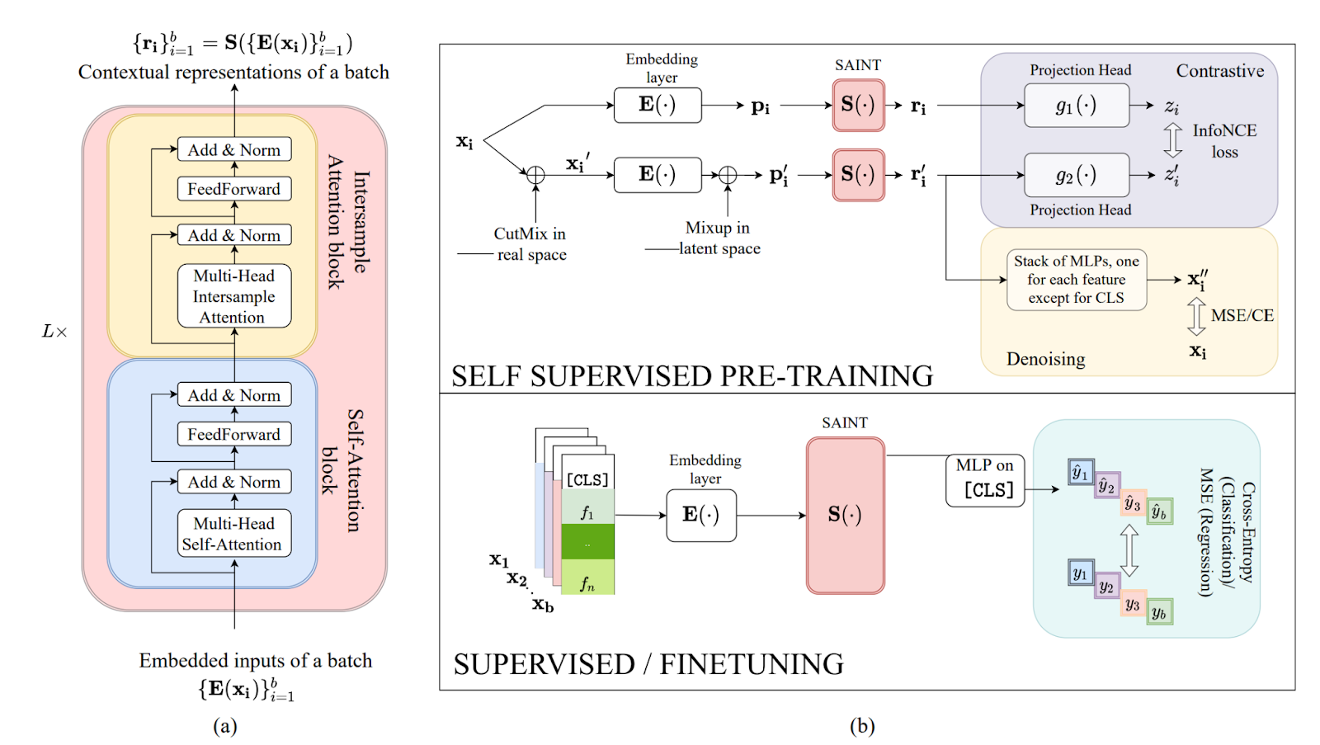
SAINT’S ARCHITECTURE
Embedding Layer.
Self-Attention Blocks.
Intersample Attention Blocks.

Slide 12
SAINT TRAINING: PRE-TRAINING AND FINE-TUNING
Pre-Training Phase.
Fine-Tuning Phase.
Notes:
Simple Explanation:
1. Contrastive Learning (Purple Box) – Making Similar Things Closer
• The model is given two slightly different versions of the same data.
• It learns to pull them closer together in its memory so that they are recognized as the same thing.
• Think of it like recognizing a friend even if they wear different clothes.
• This is done using InfoNCE loss, which helps the model focus on similarities.
2. Denoising (Yellow Box) – Fixing Missing or Noisy Data
• The model is trained to fill in the blanks when some parts of the data are missing or messed up.
• It learns by trying to predict the correct values from the rest of the information.
• Think of it like fixing a blurry image by guessing what the missing details should be.
• The model is trained using Mean Squared Error (MSE) (for numbers) or Cross-Entropy (CE) (for categories).

Slide 13
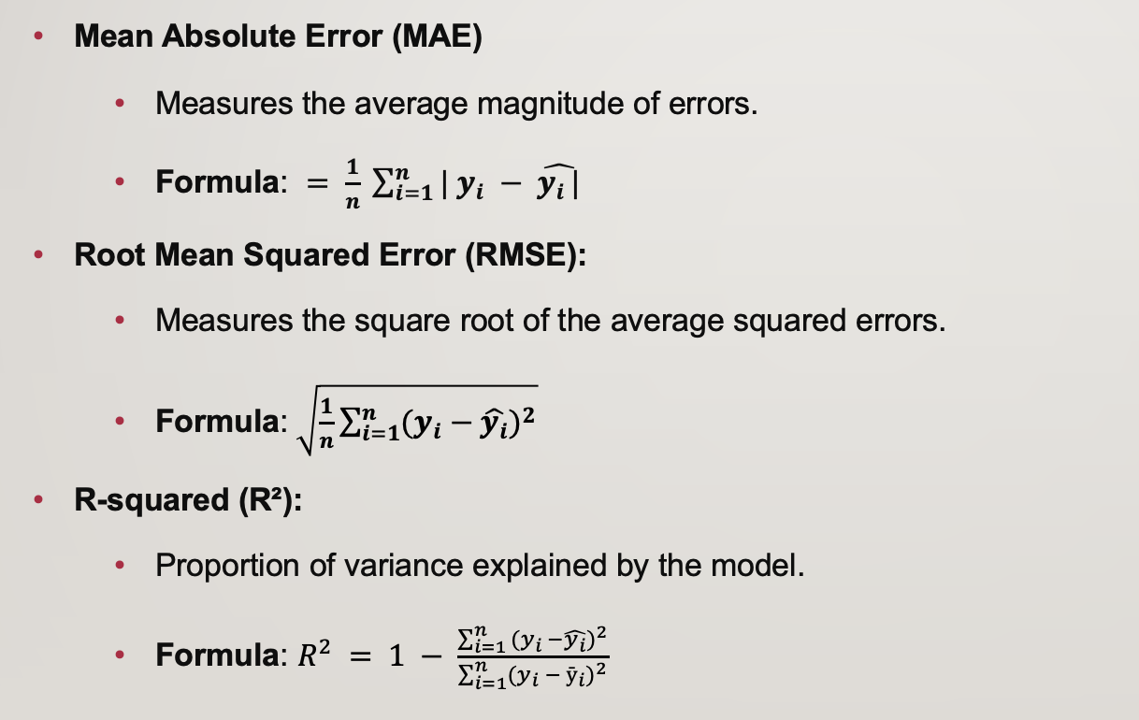
METRICS FOR MODEL EVALUATION

Slide 14
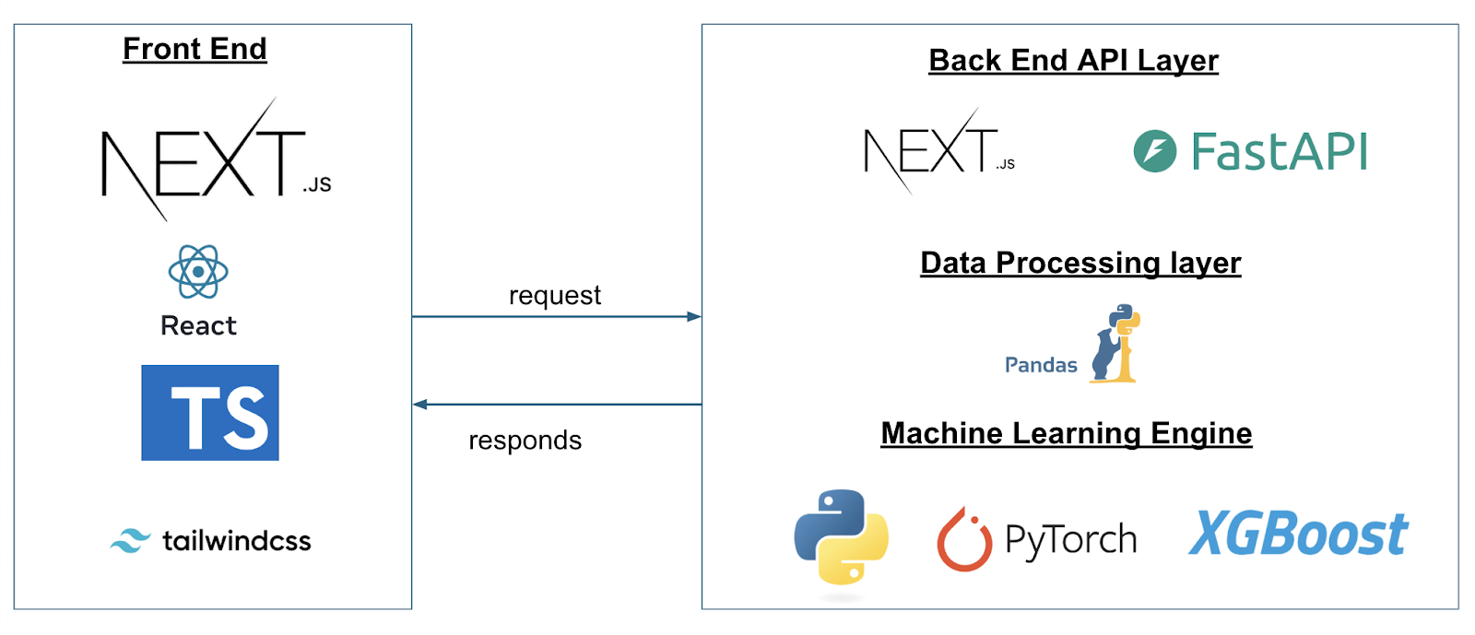
PROJECT ARCHITECTURE AND DEPLOYMENT

Slide 15
EXPECTED RESULTS
Synthetic Data Generation.
Use GANs to create realistic datasets.
This dataset can address gaps and support further studies.
Model Evaluation.
Evaluate XGBoost and SAINT for life expectancy prediction.
Use metrics like RMSE, MAE, and R² for accuracy.
Accuracy Improvement.
Aim to surpass 89% accuracy from previous studies.

Slide 16
References
[1] Wang, H., Naghavi, M., Allen, C., Barber, R. M., Bhutta, Z. A., Carter, A., … & Murray, C. J. L. (2016). Global, regional, and national life expectancy, all-cause mortality, and cause-specific mortality for 249 causes of death, 1980–2015: A systematic analysis for the Global Burden of Disease Study 2015. The Lancet, 388(10053), 1459–1544. https://doi.org/10.1016/S0140-6736(16)30175-1
[2] O’Donovan, G., Petermann-Rocha, F., Ferrari, G., Lee, I.-M., Hamer, M., Stamatakis, E., Sarmiento, O. L., Ibáñez, A., & Lopez-Jaramillo, P. (2024). Associations of the ‘weekend warrior’ physical activity pattern with all-cause, cardiovascular disease and cancer mortality: The Mexico City Prospective Study. British Journal of Sports Medicine, 58(7), 359–367. https://bjsm.bmj.com/content/58/7/359
[3] Rentería, E., Jha, P., Forman, D., & Soerjomataram, I. (2016). The impact of cigarette smoking on life expectancy between 1980 and 2010: A global perspective. Tobacco Control, 25(5), 551–557. https://doi.org/10.1136/tobaccocontrol-2015-052265
[4] Wood, A. M., Kaptoge, S., Butterworth, A. S., Willeit, P., Warnakula, S., Bolton, T., … & Danesh, J. (2018). Risk thresholds for alcohol consumption: Combined analysis of individual-participant data for 599,912 current drinkers in 83 prospective studies. The Lancet, 391(10129), 1513–1523. https://doi.org/10.1016/S0140-6736(18)30134-X
[5] Don’t die wondering: apps may soon be able to predict your life expectancy, but do you want to know?

Slide 17

Thank you for your attention.

