Slide 1

INTEGRITY tree project
Presenters: Adham Khalil, Maher Sanalla
Instructor: Meni Orenbach

Slide 2
AGENDA
Background
Motivation behind this project
Problem definition
Components & Design
Optimizations
Testing & Evaluation
Results
Conclusion

Slide 3
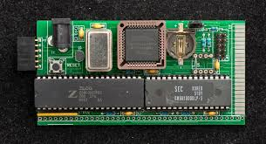
Non-volatile ram
Non-volatile RAM (NVRAM) is a random-access memory that can be read or changed in any order and retains the stored data even if the power supply was switched off.
It is less expensive than volatile RAM.
Future machines will likely utilize it.

Slide 4
INTEL-SGX
SGX provides enclaves (secure execution environment)
SGX root-of-trust is the CPU
Main memory is not trusted.
SGX CPU encrypts and validates volatile main memory content.

Slide 5

MOTIVATION
NVRAM boots up with previously stored data.
SGX Threat Model: Attacker can read/write main memory
With NVRAM attacker can read/write when machine is powered-off
For example: plugging the NVRAM to different insecure machine to manipulate its content maliciously
SGX protection is limited for NVRAM.
The encryption key is volatile
Memory content signature is volatile
Is not resistant to crashes
How can we secure our confidential data, and ensure its integrity in NVRAM?

Slide 6
approach
Integrity-Tree
Symmetric cryptography
Non-Volatile Trusted storage
Transactional writes

Slide 7
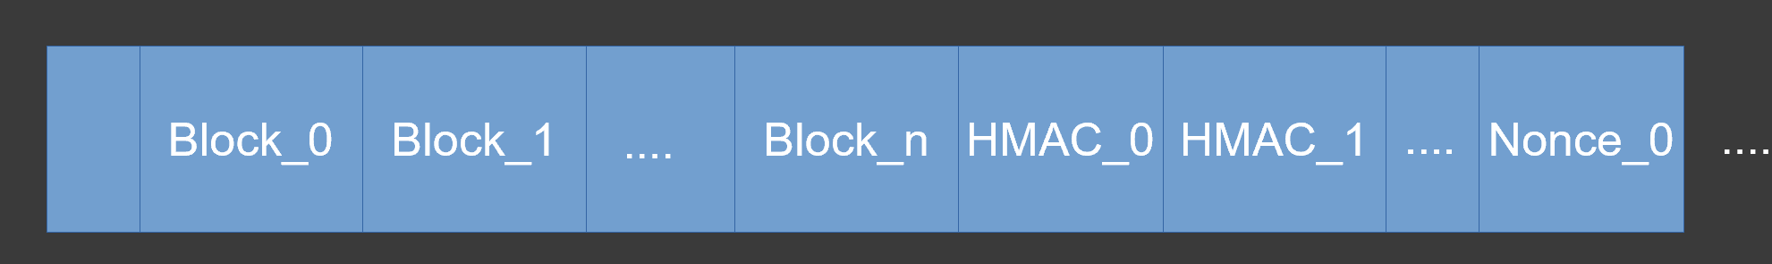
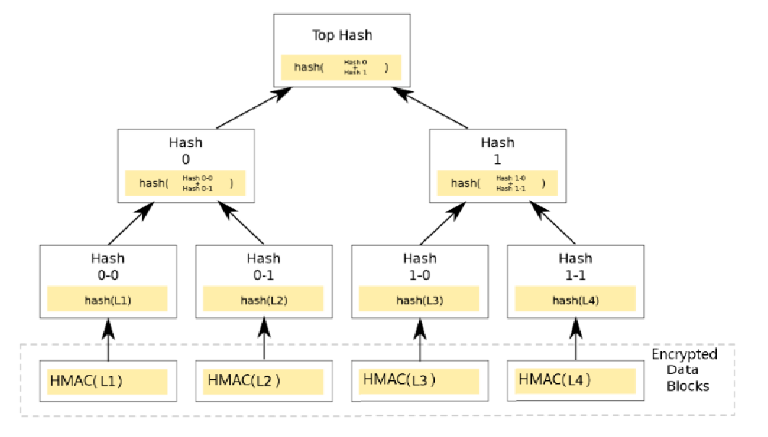
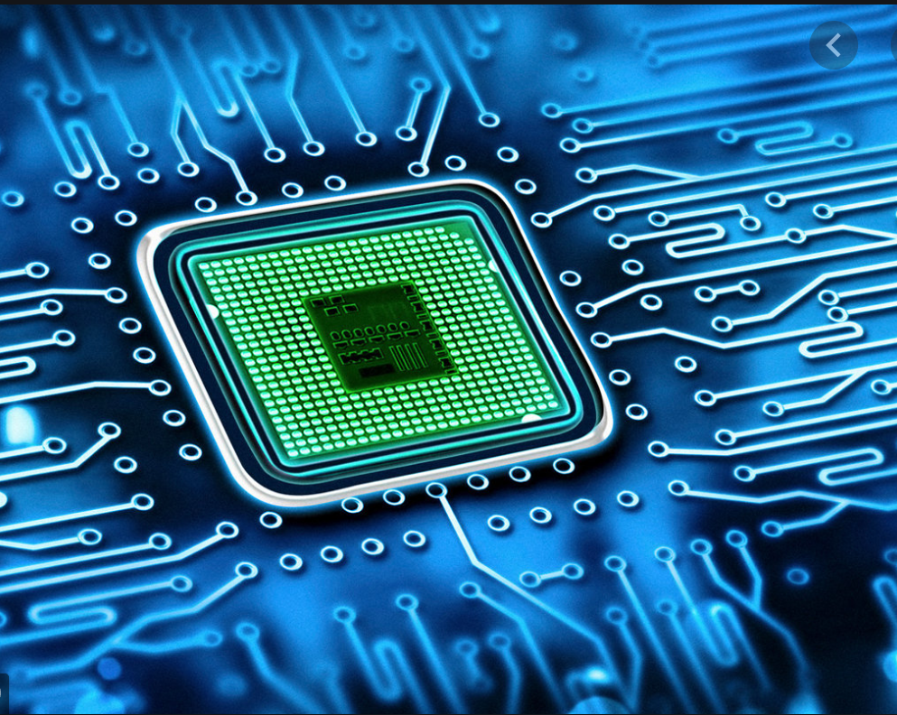
DESIGN OVERVIEW
NV-RAM
Merkle Tree
Trusted Memory region on processor
Notes:
Add previous bullets

Slide 8
MERKLE-tree BASED Integrity system
Divide the NVRAM into different regions (Data blocks, HMAC’s, Nonces)
Encrypt all the data blocks using AES-GCM
The HMAC’s are our Merkle-tree leaves.
We calculate the root of that tree
The root is an indication of the state of the memory (Valid/Corrupt)
Notes:
Reduce words

Slide 9
Planned design
API:
Read/Write
Persistent
Storage
(NVM)
Memory Integrity
System
Read/
Write
Application
(Benchmark app)
Virtual address space
Block_0
Block_1
Block_n
HMAC_0
HMAC_1
Nonce_0
....
....
....
....
0

Slide 10
BLOCK Encryption process
Data Block
Key
Nonce
AES-GCM
Encrypted Block
(Ciphertext)
HMAC
Notes:
Explain the process…

Slide 11
NVRAM partition
We partition NV-RAM to three different regions [ Data blocks – HMAC’s – Nonces ]
We chose this representation method of the memory, because lookup of a certain block is done in O(1).
Virtual address space
Encrypted
Block_0
Encrypted
Block_1
Encrypted
Block_n
HMAC_0
HMAC_1
Nonce_0
....
....
....
....
0

Slide 12

TRUSTED MEMORY AREA
A Non-Volatile memory area on the microprocessor chip
Not reachable by attackers/users
We use it to store the root of the tree
We store the encryption key
....

Slide 13
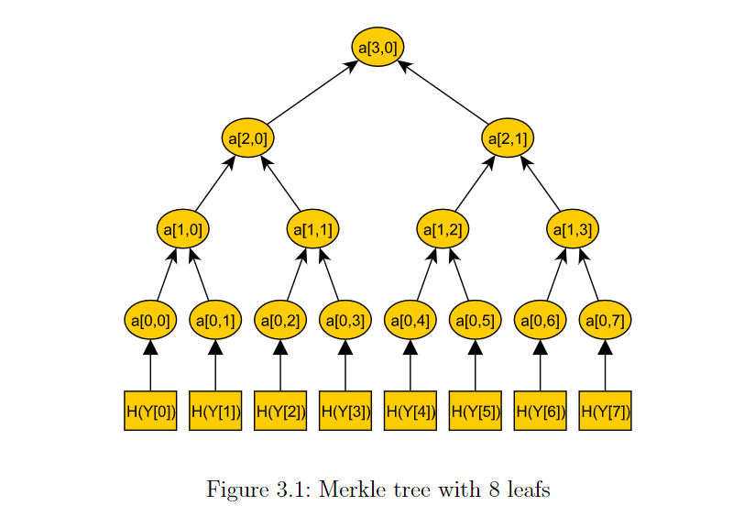
Merkle TREE
A cryptographic hash tree where every leaf node is the cryptographic hash of the data block content.
Every non-leaf node simply the cryptographic hash of the content of its child nodes
Used in peer-to-peer networks
Used in Bitcoin
Used to verify the integrity of the data blocks/leaves.

Slide 14

problems
What happens if a power shutdown occurred in the middle of an ongoing write operation?
If Our current system finished the Writing but was cut-off before updating the new root.
In that case, after the restart The system will categorize this partial-write as an attack – thus making the memory unusable.

Slide 15

HANDLING crashes
Log: a non-volatile record of operations that are performed on our NVM. It stores the most recent non-complete write operation on our system
Our
System
Write Request
processing request
Power Crash
STORE
Log
Notes:
Meni: What should we write instead of “Our System”
Note: Explain how does Log solve the power-shutdown issue (Recovery Process)

Slide 16

Cache
Stored on trusted area that we discussed earlier. (Thus, every block stored in cache is considered trusted)
We used LRU cache
Notes:
Why do we need Cache? Improve performance

Slide 17
Initialization – INIT()
When Initializing the memory-system we will build our own version of Merkle-tree
The HMAC(tags) will be the leaves of the tree. we use them to build the tree upwards till reaching the root
For every two adjacent nodes we calculate their parent as a hash of their values (SHA-256)
We keep traversing upwards till calculating the root value
Eventually, The root is stored in the trusted area alongside the keys
Tree
Notes:
Before beginning to talk here, note that we begin the init() only after partitioning is done

Slide 18
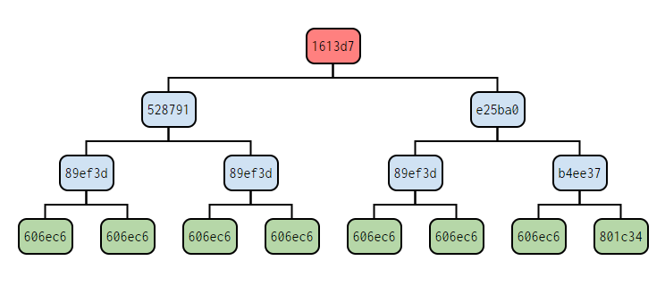
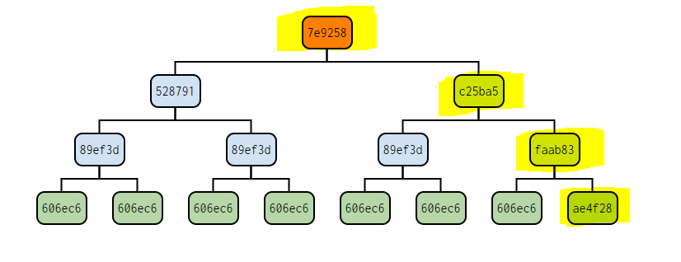
VERIFy_BLOCK_Integrity()
it builds the NV-RAM-“current-state” Merkle-tree
Then it compares the “current-state” root with the trusted areas’ root
If they’re equal: No change in NV-RAM content was detected, the memory state is valid!
Else, memory change is detected, the current-state of memory is corrupt!
This happens if the attacker has changed any memory block without authorization, which leads to a different root than the trusted-area’s root
In this case, all Read/Write operations are aborted due to attack-detection
Notes:
* Note: Explain “CURRENT_STATE”

Slide 19

VERIFy_BLOCK_Integrity()
Trusted Area
Trusted Root = c4d69c
c4d69c
859572
51c4bf
6dcd4c
ae4f28
32096c
50c9e8
HMACs
Notes:
Note: Explain that the tree is virtual in both cases…
Change in block leads to change in root
Pre state on the left
Post state on the right

Slide 20


ATTACK Detection
Trusted Area
Trusted Root = c4d69c
a4a618
c4d69c
fa9dce
859572
51c4bf
Attacker
50c9e8
6dcd4c
ae4f28
32096c
909f99
HMACs
Notes:
Note: Explain that the tree is virtual in both cases…
Change in block leads to change in root
Pre state on the left
Post state on the right

Slide 21
READ_BLOCK()
When the client wants to read block “y”, we perform the following:
Call Verify_Block_Integrity(y)
If the content-integrity is not assured, then abort the read operation and notify the client
Otherwise,
Read the ciphertext and Nonce from NV-RAM.
Grab the encryption key from the trusted-area
Decrypt the block content
Return the plaintext to the client.
Notes:
* Note: Explain “CURRENT_STATE”

Slide 22
WRITE_BLOCK()
When the client wants to write new data to block “x”, we perform the following:
Call Verify_Block_Integrity(x)
If the content-integrity is not assured, then abort the operation and notify the client
Otherwise,
Generate new nonce for the new data block.
Encrypt the new plaintext.
Store the resulting ciphertext, HMAC in the NV-RAM (Overwrite)
Update the trusted-area with the new-key
Re-generate the Merkle tree which is based on new-HMAC’s
Store the new root in the trusted-area
Return true.
Notes:
* Note: Explain “CURRENT_STATE”

Slide 23
WRITE_BLOCK()
Write Request to Block #2
Verify Integrity
In case of failure: Abort
Encrypt the Data using new Nonce
Generate new Nonce
Overwrite current ciphertext, HMAC, Nonce with new values
Calculate the new Root
Update Trusted area
Trusted root = new root
Notes:
Note: Step # “Calculate New Root” --- Mention that cache is updated as well.

Slide 24
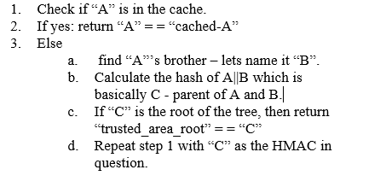
VERIFy_BLOCK_Integrity() (OPTIMIZED)
The previous verify integrity function used to calculate the whole Merkle tree to get to the root
But now, Instead of building the whole tree, we will only work on the path from the block -in-question to the root of the Merkle tree.
For example, let “A” be the HMAC of the block who we are verifying its integrity. The new verify algorithm is as follows:
The previous-overhead of calculating the whole integrity tree is now reduced substantially.
Notes:
With Cache

Slide 25


WORKING ENVIRONMENT
C++ programming language
JetBrains Clion IDE
Linux
Python scripts to for testing
OpenSSL (SHA256/AES-GCM)
....

Slide 26
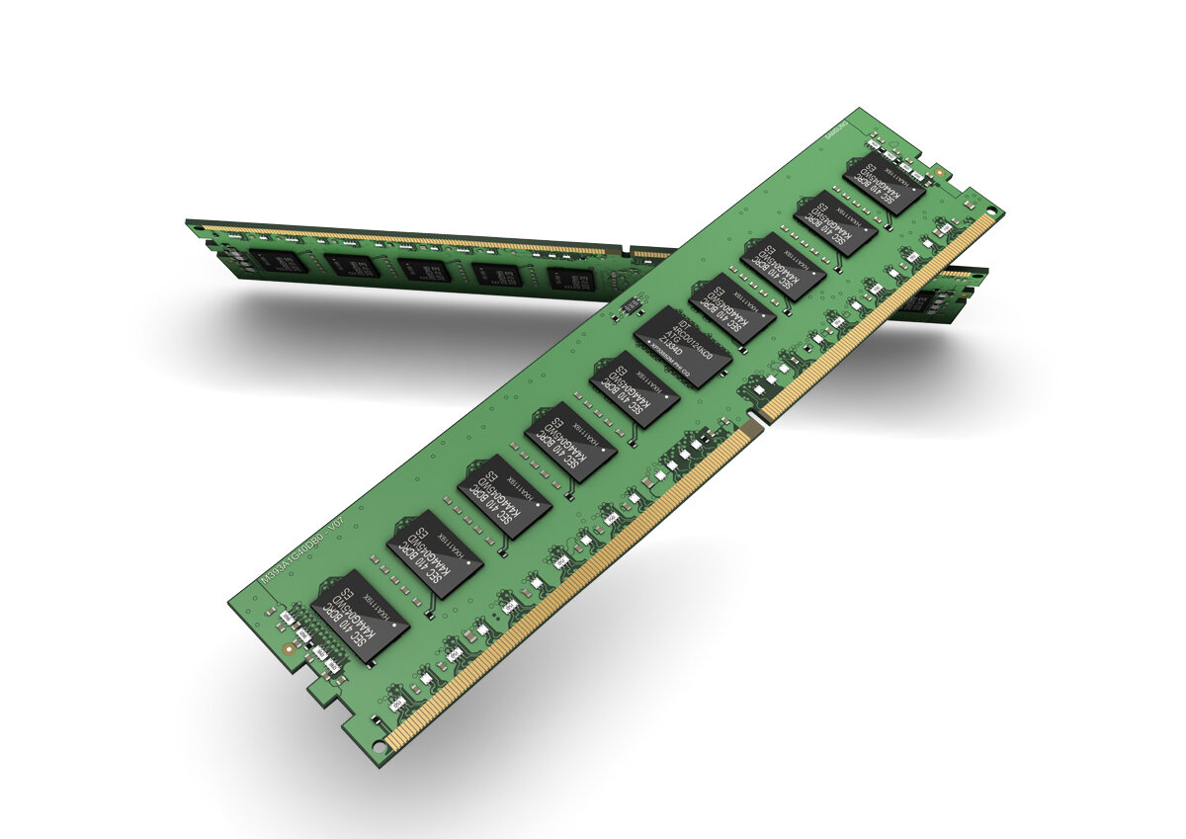
EVALUATION
To test our implementation, we wrote benchmark tests that simulate random access read/write operations on NVRAM
We used 128MB DRAM, 6400B LRU cache and 64B/4KB data blocks.
We tested the performance of read and write operations with/without integrity-check, with/without cache, for each data block size partition.
Theoretically, the tests simulate 10GB- 20GB of memory with cache size of 1MB

Slide 27
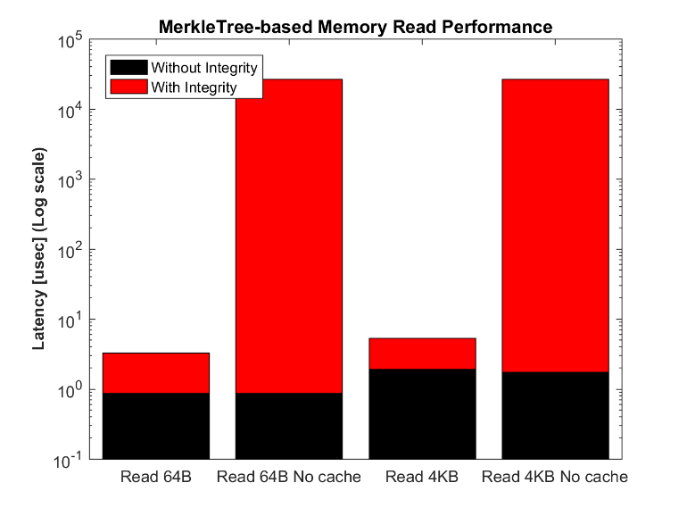
RESULTS
Notes:
With Verfiy Integrity takes more time than without
Cache effectiveness comes handy when integrity is verified. (as can be seen in decrease in red graphs)
Read of 4KB is slower than read of 64B (Logic :)

Slide 28
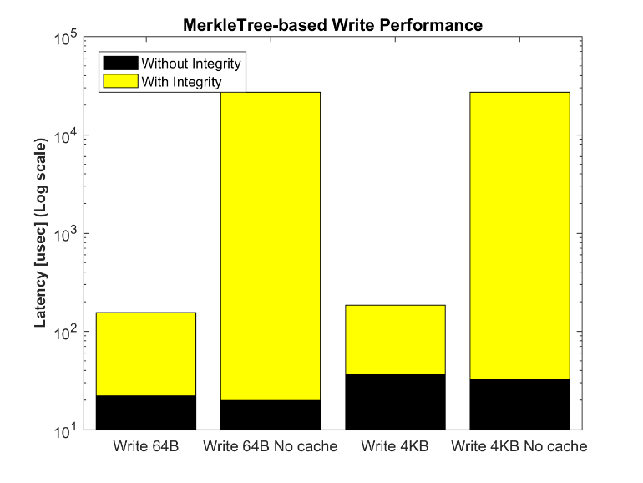
RESULTS
Notes:
* Based on our results, it can be seen that the constant-integrity check has a significant impact on memory performance.
It's noted that write is 1,096x faster without integrity check, and read is 22,920x faster under the same conditions.
However, we were able to cut down the integrity-check overhead significantly when using cache.
Since, with cache, write slowdown is 5x when checking integrity, and read slowdown is 2.29x under the same circumstances.
It is also noted that reading 4KB block is 2.2x slower than reading a 64B block.
And write of 4KB is 0.625x slower than writing 64B.
It can be noted that integrity comes with a heavy price to pay, since the performance of read/write is seriously affected when using integrity checks. The important role of Cache in Merkle-tree based integrity system is portrayed in our results as well. We leave it to future work to further optimize memory access latency.

Slide 29

CONCLUSION & FUTURE WORK
We presented a solution to hardware-memory Integrity check.
We tested our implementation by simulating NV-RAM and measuring the performance of read/write operations
We showed how can Merkle-Tree integrity system protect against attacks
We analyzed the overhead that we must pay to ensure integrity
Future work:
Evaluate different cache configurations
Evaluate different Integrity trees

