Slide 1
ilinkERP-Fabric
Accelerator
Connect any ERP to Microsoft Fabric in minutes — not months
5-step guided wizard · 8 ERP platforms · Microsoft Fabric OneLake · Free AI
ilinkERP Team · 2025

Slide 2
App Navigation — What's Inside
Four key sections covering the entire ERP-to-Fabric journey
⊕
1
⚙
2
⇄
3
☰
4
Dashboard
ERP Source Wizard
ERP Comparison
Settings
KPIs, pipeline status
& ingestion summary
5-step wizard to connect
& deploy any ERP
Compare table & field
schemas across platforms
Fabric connections &
user management
Live metrics
5-step guided wizard
Table + Field views
2 tabs

Slide 3
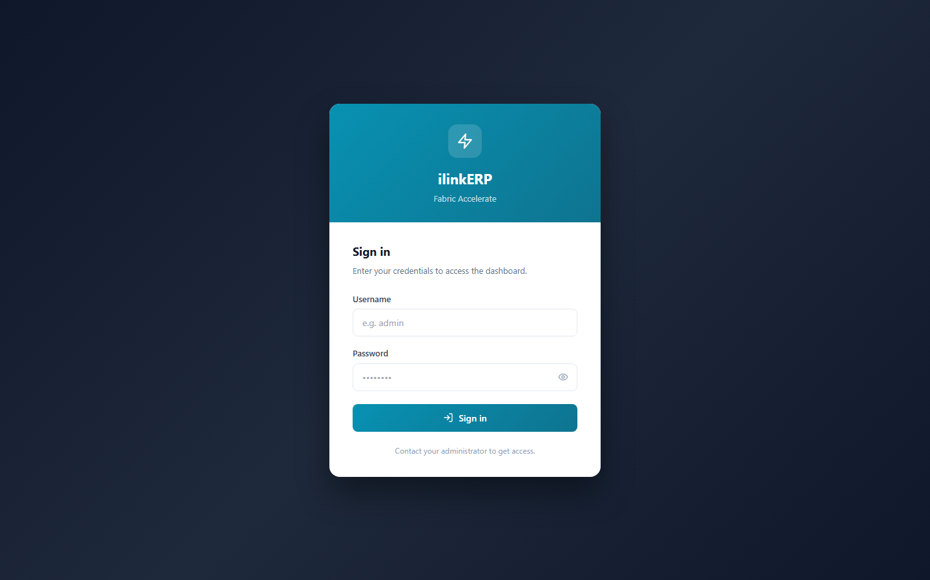
Getting Started — Secure Login
JWT-based authentication protects your ERP data
Role-based Access
Admin and Viewer roles with separate permissions
JWT Security
Tokens expire automatically — no session left open
Local Auth
No external identity provider needed; bcrypt password hashing

Slide 4
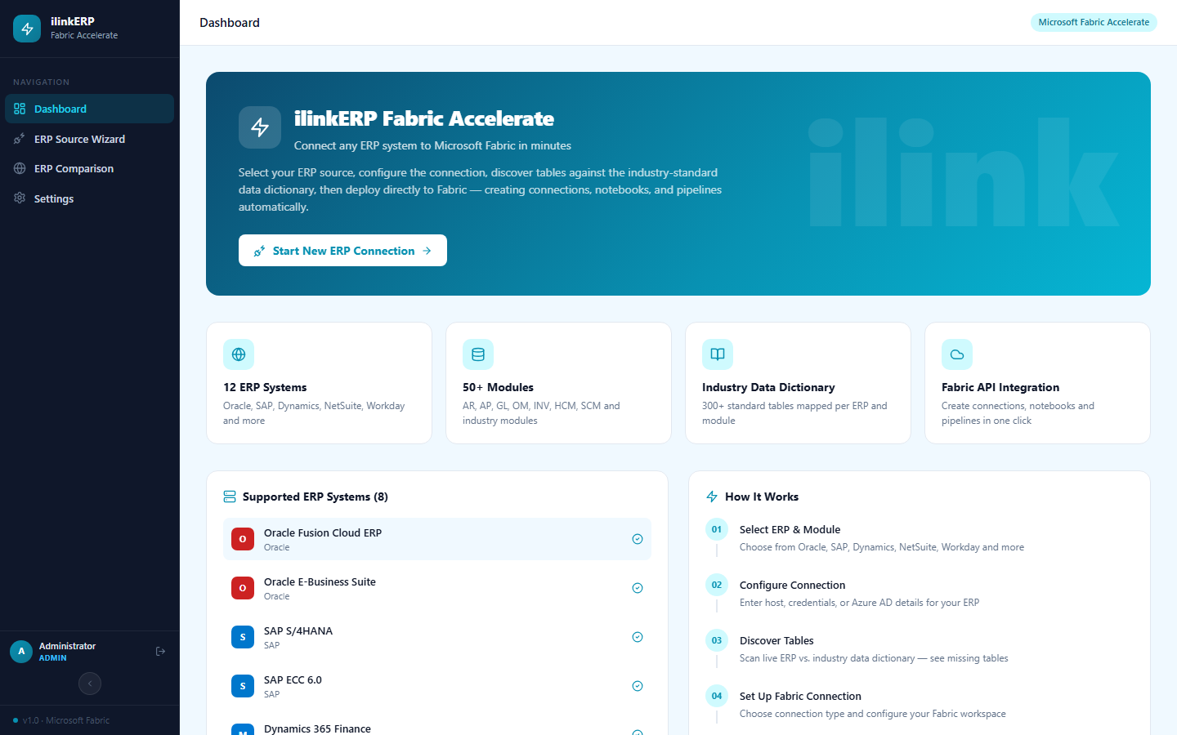
Dashboard — Your Starting Point
First page after login — shows ERP status, supported systems, and quick-start guide
After login you land here → KPI cards · Supported ERP list · How It Works guide · Start New ERP Connection button

Slide 5
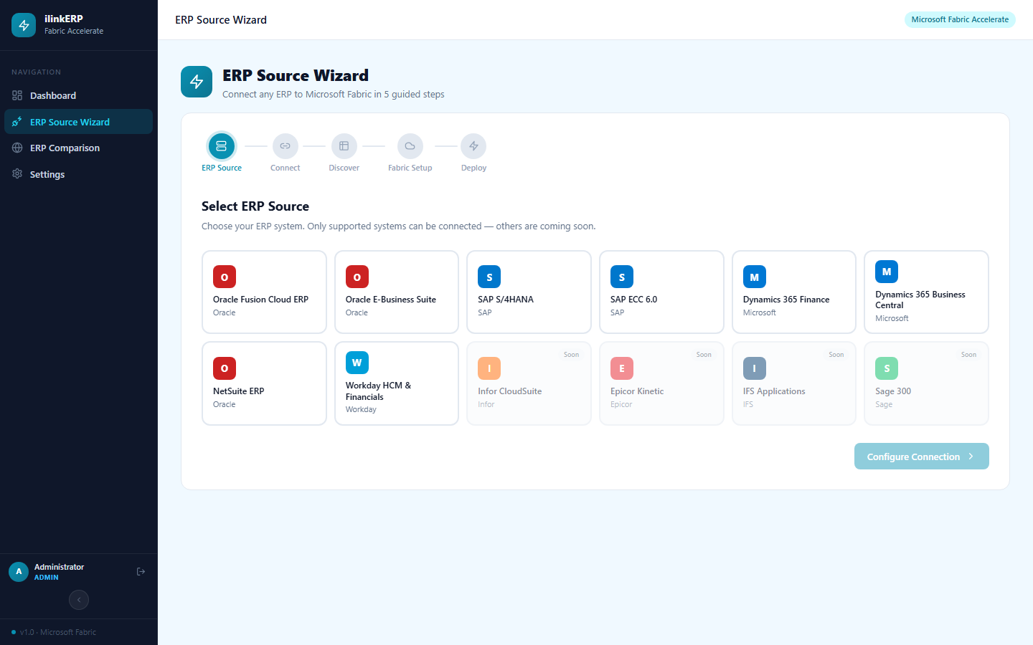
ERP Source Wizard — Step 1: Select ERP
Choose your ERP platform and modules to begin the 5-step guided setup
1
Select ERP
2
Connect
3
Discover Tables
4
Fabric Setup
5
Deploy
Select ERP → select modules → click Configure Connection →

Slide 6
Wizard — Step 2: Configure Connection
Enter your ERP credentials — or skip to use pre-built industry table schemas
Step 2 of 5 — Configure Connection
What to enter
Your ERP's database host, port, schema name, and credentials. These are used to scan the live ERP schema in Step 3.
Host / URL
e.g. erp.company.com
Port
1521
Don't have credentials?
Database / SID
No problem. Use the Skip button to bypass connection setup and proceed with pre-built industry-standard table schemas for your ERP.
PROD
Username
erp_user
Password
NEW — Skip Option
••••••••
Click "Skip — use standard tables" to proceed without ERP credentials. The app uses the industry data dictionary for your chosen ERP and module.
← Back
Skip — use standard tables
Discover Tables →

Slide 7
Wizard — Steps 3 to 5: Discover, Setup & Deploy
From schema scan to live Delta tables in Microsoft Fabric
3
Discover Tables
4
Fabric Setup
5
Deploy Pipeline
Scans live ERP schema via JDBC
Matches against industry data dictionary
Flags missing / extra tables
You select which tables to ingest
Enter OneLake storage account
Set container & schema prefix
Map ERP tables → Delta table names
Configure write mode (overwrite/append)
Creates Fabric notebooks (PySpark)
Builds Synapse pipeline trigger
Runs initial full data load
Schedules recurring sync jobs
›
›

Slide 8
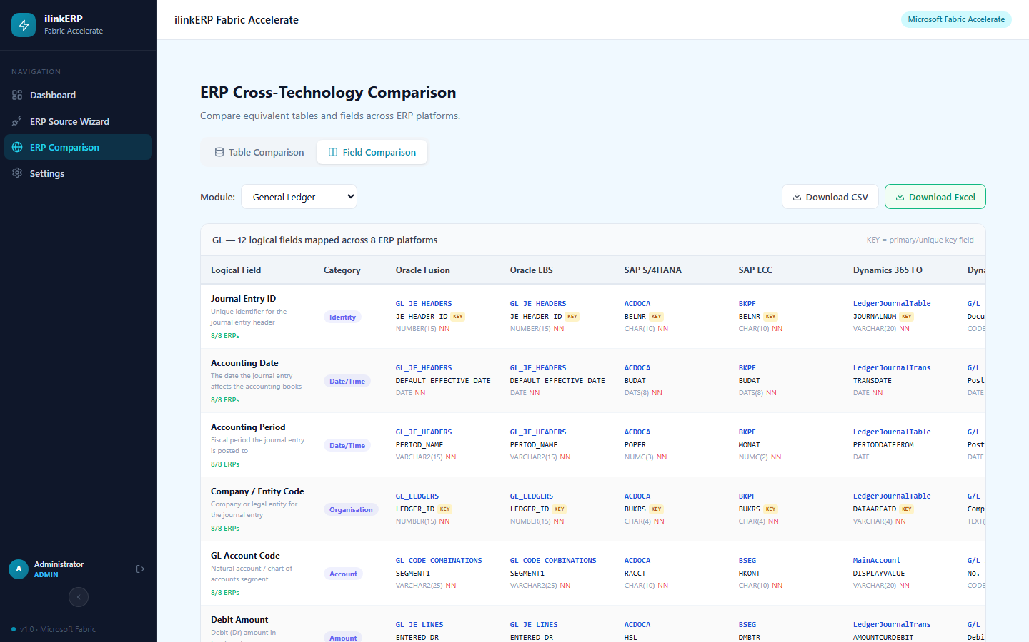
ERP Comparison — Field-Level Schema Mapping
Compare exact field names, table names, and data types across all 8 ERP platforms
Table Comparison · Filter by module (GL, AP, AR, INV…) Field Comparison · See exact column names per ERP (shown above) Download CSV / Excel

Slide 9
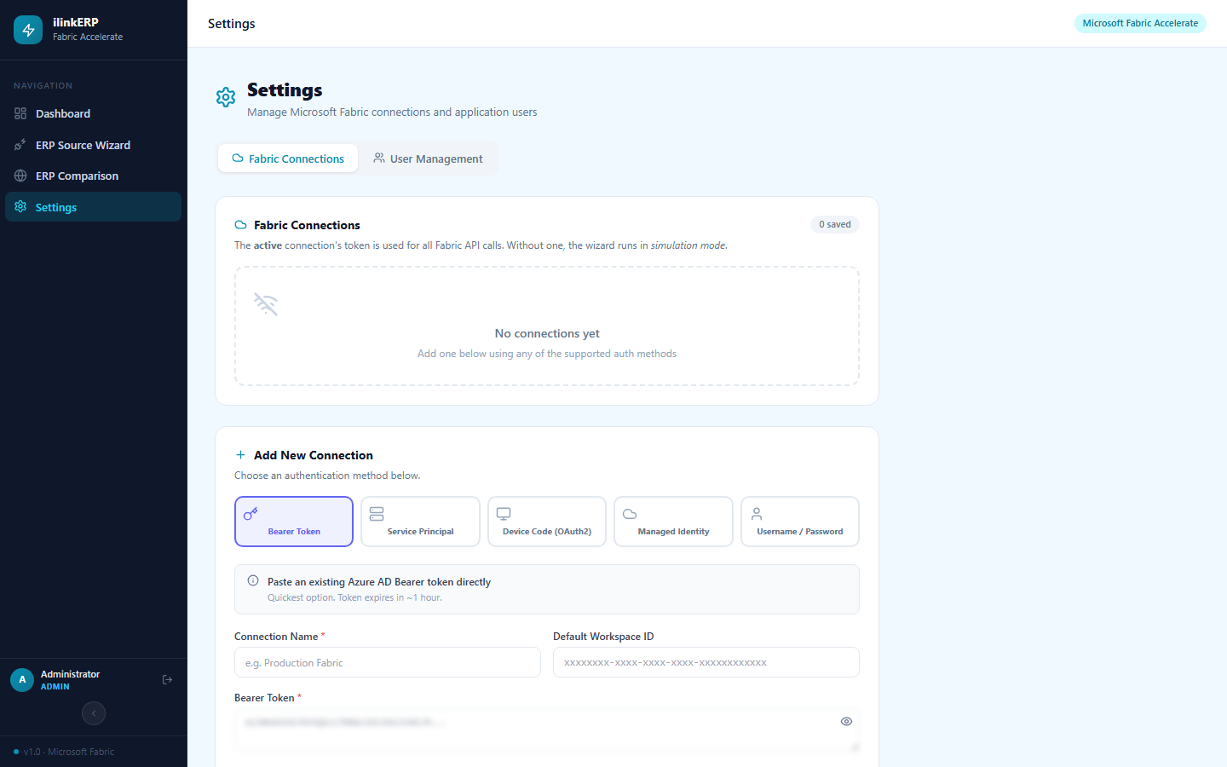
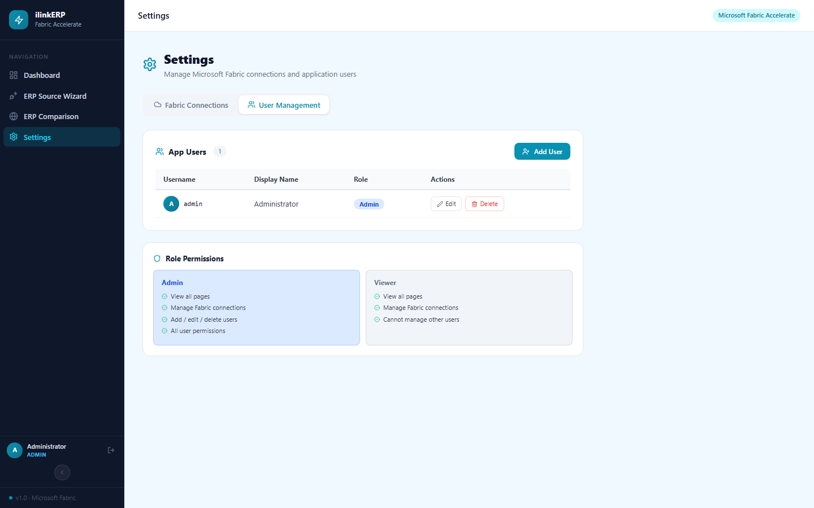
Settings — Fabric Connections & User Management
Configure where data lands in Microsoft Fabric and who has access to the app
Fabric Connections — Bearer Token, Service Principal, OAuth2, Managed Identity
User Management — Admin & Viewer roles, add/edit/delete users

Slide 10
Complete ERP → Fabric Journey in One App
1
Login with role-based JWT auth (Admin / Viewer)
2
Dashboard — live pipeline status and supported ERP list
3
5-step wizard — select ERP, connect (or skip), discover, configure Fabric, deploy
4
ERP Comparison — table & field mapping across 8 platforms, export to Excel
5
Settings — Fabric auth methods + user management
ilinkERP-Fabric Accelerator · Powered by Microsoft Fabric · Questions?

