Slide 1
Microservices Architecture – Digital Platform
May 09, 2017 – Version 1.8
Draft

Slide 2
Drivers
Address Key pain points :- Provide Guidelines and Design Patterns to address some of the key pain points raised by development team
Reduce Cost : - Reduce overall cost of designing, implementing, and maintaining IT services
Time to Market : - Increase the speed at which development team can get from idea to deployment of services
Improve Resilience :- Improve the resilience of our service/application
Enable Visibility :- Better visibility to see what is going on in the service network
Return on investment (ROI) :- is driven by accelerated realization of benefits rather than overall business transformation.

Slide 3
Microservices Architecture Key Design Principles
Small and focused - Services must align clearly to a business capabilities and should not try to do something outside of the business domain boundary.
Loosely coupled - Design should provide flexibility to deploy services on its own without any dependencies on other Microservices
Failure isolation - Any malfunctioning service, will only affect that service while other services continue to handle requests
Single responsibility - Microservice must be responsible only for a specific feature . It could be either business/Infrastructure functionality or aggregation of cohesive functionality
Decentralized - Ideally, every Microservice to manage its own database. This enables polyglot Persistence. However, we might need to have more than one Microservice use the same database for one of many reasons, for example, to preserve the ACID nature of a Transaction (Atomicity, Consistency, Isolation, Durability). In general, the level of sharing between Microservices should be limited as much as possible to make the Microservices as loosely coupled as possible.
Continuous integration using DevOps- DevOps is critical to successful Microservice deployment. Microservices cause an explosion of moving parts. It is not a good idea to attempt to implement Microservices without serious deployment and monitoring automation
Language-neutral - Building Microservice with Language neutral makes it easier to use existing skills or the most optimal language

Slide 4
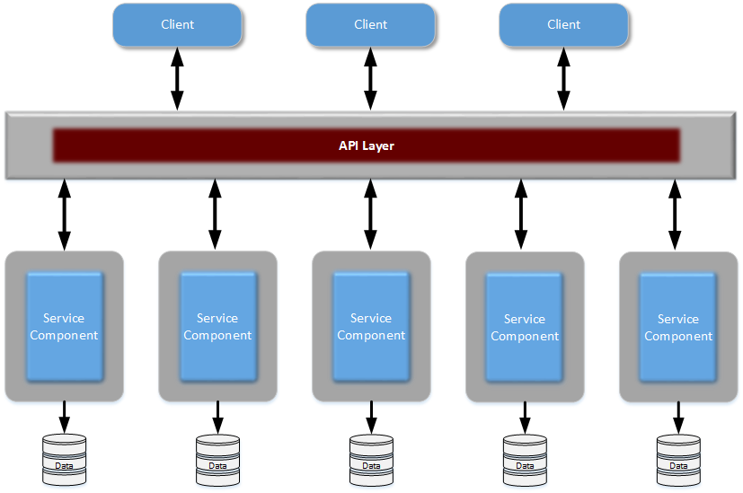
Microservices Architecture Topology and Concepts
Distributed
Protocol aware heterogeneous interoperability
Separately deployed
Each service component is a separately deployed application. Need to make sure the DevOps tools implemented to automate the deployment
Service Component
Service component consists of multiple class and module to perform a business function. Service component types are
Infrastructures Services (security, log, monitoring)
Functional services
Bounded Context
Functionality of the service is bound with its data. Comes from Domain Driven Design. Service component should be bounded by context
Share nothing
This is about dependency for the service.
Having too many dependencies may lead into an Anti pattern design
API Layer
Is a simple proxy layer which can hides the actual endpoint It provides an abstraction layer for end points which will help to implement the changes without any impact to the clients
This API layer can be optional

Slide 5
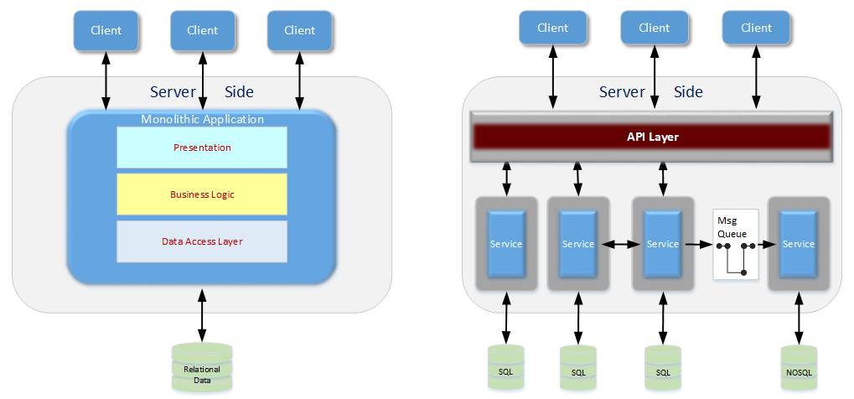
Monolithic Vs Microservice Architecture
Monolithic architecture
Built as a single logical executable
Changes to the system involve building and deploying a new version of the entire application
Entire application scaled when only one part is the bottleneck
Single code base and single Relational DB for entire application and
Require maintenance windows and scheduled downtimes
Microservice architecture
Built as a suite of small services
Changes can be applied to each service Independently
Each service scaled independently when needed
Each service can be developed in a different programming language with its own database
Simple deployment as each service can be deployed individually, with minimal if not zero downtime

Slide 6
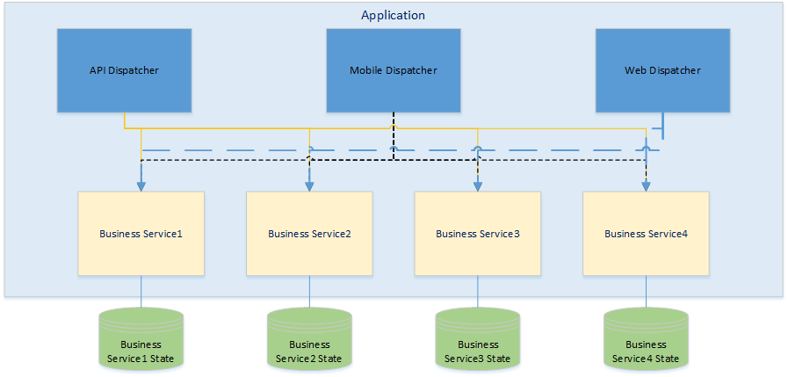
Microservices Component Architecture
Vertical columns, not horizontal layers

Slide 7
Microservice Design and Integration Patterns
Integration Patterns
Aggregator Microservice Design Pattern
Proxy Microservice Design Pattern
Chained Microservice Design Pattern
Branch Microservice Design Pattern
Shared Data Microservice Design Pattern
Asynchronous Messaging Microservice Design Pattern
Design For Failure Patterns
7. Circuit breaker Design Pattern
8. Bulk Head Design Pattern
Note: Soliciting inputs for the above patterns

Slide 8
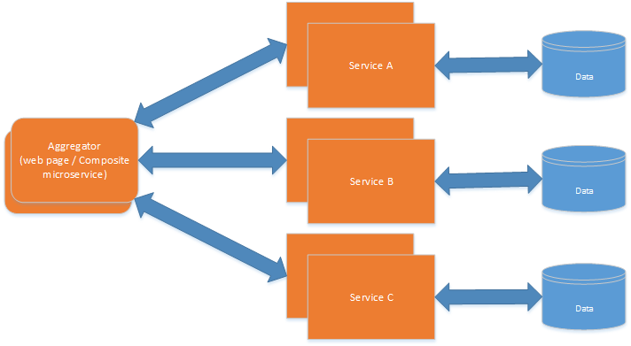
1. Aggregator Microservice Design Pattern
Aggregator would be a simple web page or a composite micro service that invokes multiple services to achieve a business functionality
An advantage of abstracting at this level is that the individual services, i.e. Service A, B, and C, and can evolve independently and the business need is still provided by the composite Microservice.
Note that each individual Microservice has its own (optional) caching and database
OLB Multibillpay UI application implementation is using Aggregator Microservice Pattern

Slide 9
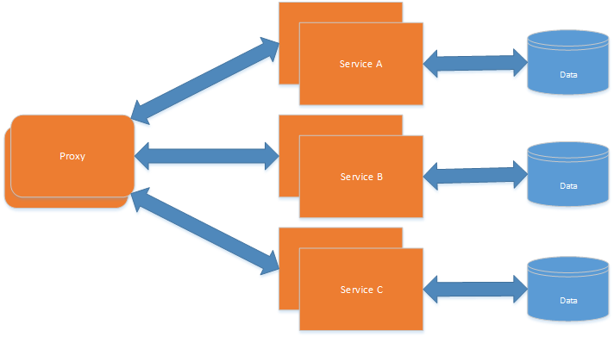
2. Proxy Microservice Design Pattern
Proxy Microservice design pattern is a variation of Aggregator.
In this case, no aggregation needs to happen on the client but a different Microservice may be invoked based upon the business need.
Central place to implement all non-functional capabilities
Alternatively, proxy layer may be an API Gateway if we need to do orchestration and additional security capabilities
A&PD (GIC renewals), bluemix service acting as a proxy service to PEGA

Slide 10
3. Chained Microservice Design Pattern
Chained Microservice design pattern produce a single consolidated response to the request
The key part to remember is that the client is blocked until the complete chain of request/response, i.e. Service A <-> Service B and Service B <-> Service C, is completed.
Another important aspect to understand here is to not make the chain too long. It may appear as long wait at the client side.

Slide 11
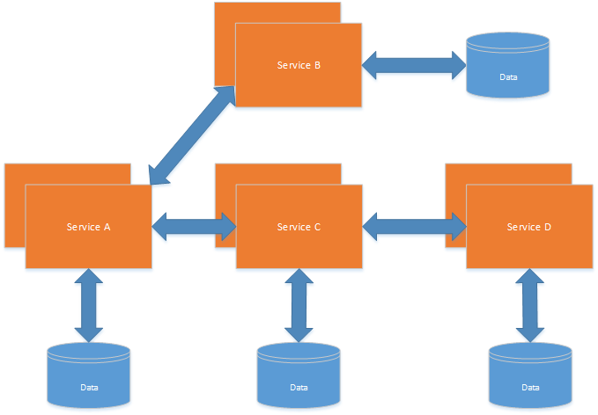
4. Branch Microservice Design Pattern
Branch Microservice design pattern extends Aggregator design pattern and allows simultaneous response processing from two, likely mutually exclusive, chains of Microservices
Based on the request from client, it can invoke different chains concurrently (similar to Aggregation pattern) or it can invoke only one chain.
Multibill pay interaction service makes simultaneous calls to other dependent services (Example client and payee services) which in turn make a sequential calls to other chain of microservice (example clientservice)

Slide 12
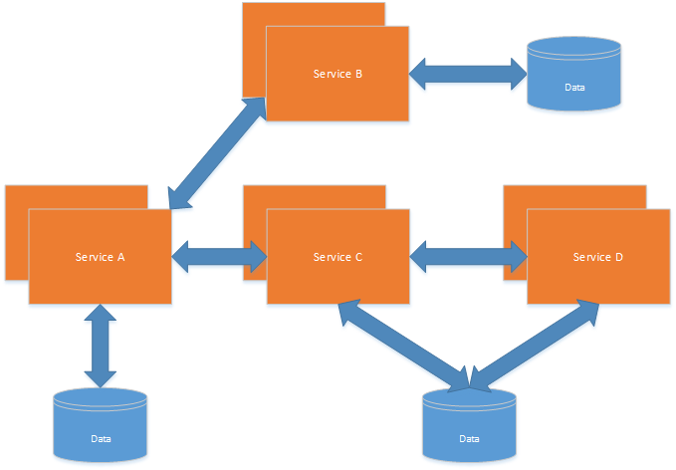
5. Shared Data Microservice Design Pattern
One of the design principles of Microservice is decentralized. This allows the service to be polyglot, and use the right tool for the right job.
However there may be a business functional requirement where data need to be shared across services. This pattern is to address this requirement.
Especially when refactoring from an existing monolithic application, denormalizing the database would lead to duplication of data, and possibly inconsistency. In a transition phase, some applications may benefit from a shared data Microservice design pattern. “Data driven migration” anti-pattern provides more details about this
This would certainly be an anti-pattern for greenfield applications Microservices
OLB Microservices are using existing OLB centralized DB

Slide 13
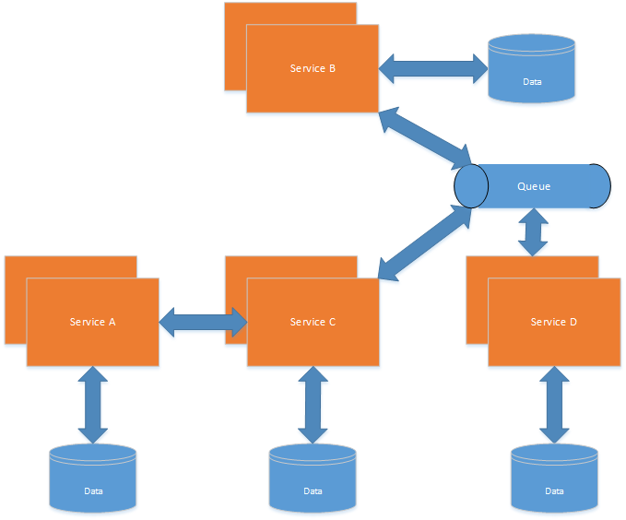
6. Asynchronous Messaging Microservice Design Pattern
Using RESTful calls has the limitation of being synchronous, and thus blocking. Asynchronous can be achieved but that is done in an application specific way. Some Microservice architectures may elect to use message queues instead of REST request/response because of that.
In this design pattern, Service A (web page) may call Service C synchronously which is then communicating with Service B and D asynchronously using a shared message queue.
If require Service A (web page) -> Service C communication may be asynchronous, possibly using WebSockets, to achieve the desired scalability.
A combination of REST request/response and pub/sub messaging may be used to accomplish the business need.
Multibillpay Interaction services are using Async integration

Slide 14
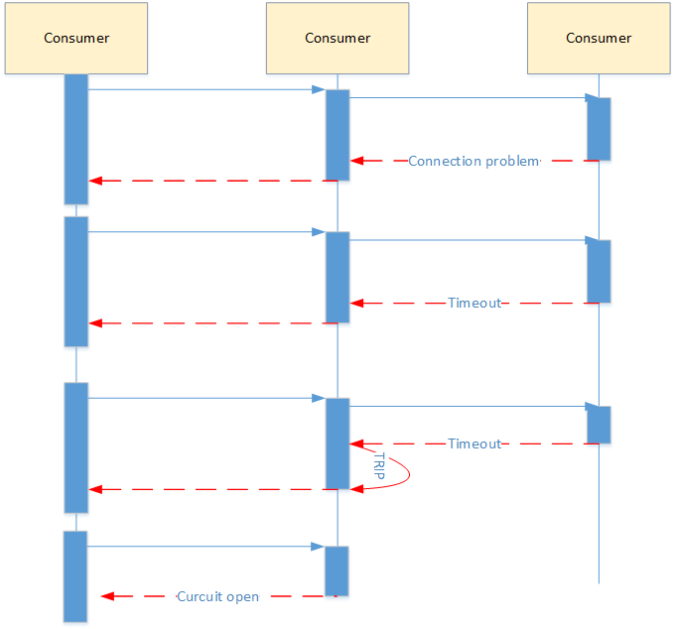
7. Circuit Breaker Design Pattern
This pattern is to address - Design for Failure model
The circuit breaker pattern is commonly used to ensure that when there is failure that the failed service does not adversely affect the entire system
This would happen if the volume of calls to the failed service was high, and for each call we’d have to wait for a timeout to occur before moving on
The circuit breaker pattern behaves just like a circuit breaker in your home electrical system. It trips to protect you
This pattern is incorporated in majority of the service implementation in online banking application

Slide 15
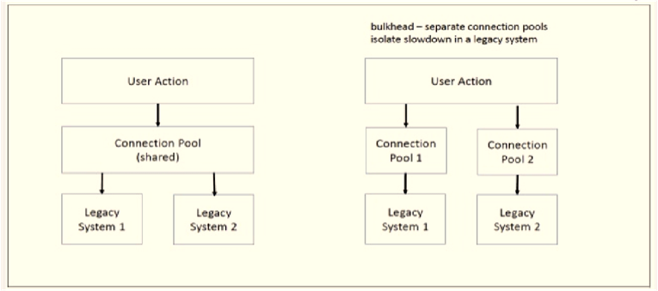
8. Bulkhead Design Pattern
Bulkhead pattern is about isolating different parts of your application so that a failure of a service in such part of the application does not affect any of the other services
Partitions can be
hardware redundancy
binding certain processes to certain CPUs
segmenting different areas of business functionality to different server farms, or partitioning threads into different thread groups for different functionality.

Slide 16
Anti-patterns for Microservices design
Data-Driven Migration anti-pattern
Hop on the bus anti-pattern
Layered Services Architecture anti-pattern

Slide 17
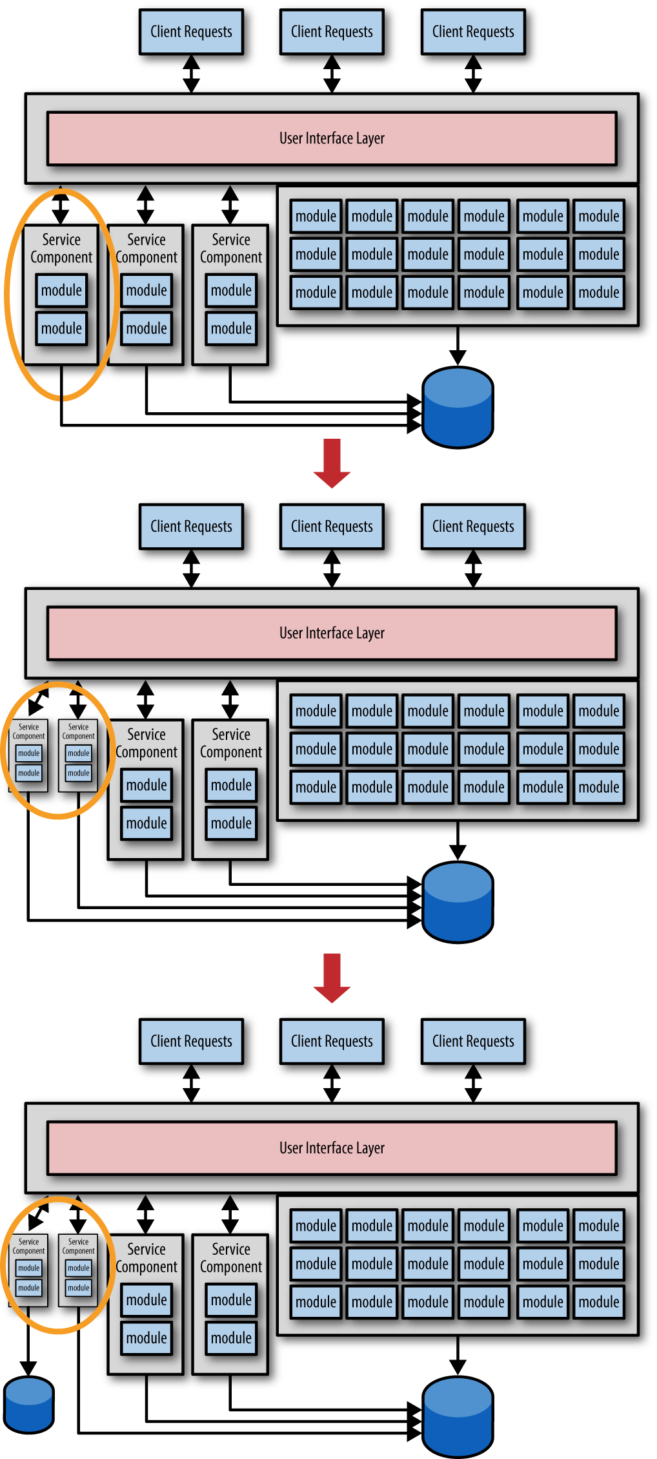
Data-Driven Migration anti-pattern
The data-driven migration antipattern occurs mostly when you are migrating from a monolithic application to a Microservices architecture.
The reason this is an antipattern is that it seems like a good idea at the start to migrate both the service functionality and the corresponding data together when creating Microservices, but this will lead you down a bad path that can result in high risk, excess cost, and additional migration effort.
Data migrations are complex and error-prone—much more so than source code migrations. Optimally you want to migrate the data for each service only once. Understanding the risks involved with data migration and the importance of “data over functionality” is the first step in avoiding this antipattern.
The primary avoidance technique for this antipattern is to migrate the functionality of the service first, and worry about the bounded context between the service and the data later.
Once you learn more about the service you will likely find the need to adjust the level of granularity through service consolidation or service splitting. After you are satisfied that you have the level of granularity correct, then migrate the data, thereby creating the much-needed bounded context between the service and the data
For OLB applicaton, only functionalities are migrated from the monolithic environment to microservices. These services share the data from the existing database.

Slide 18
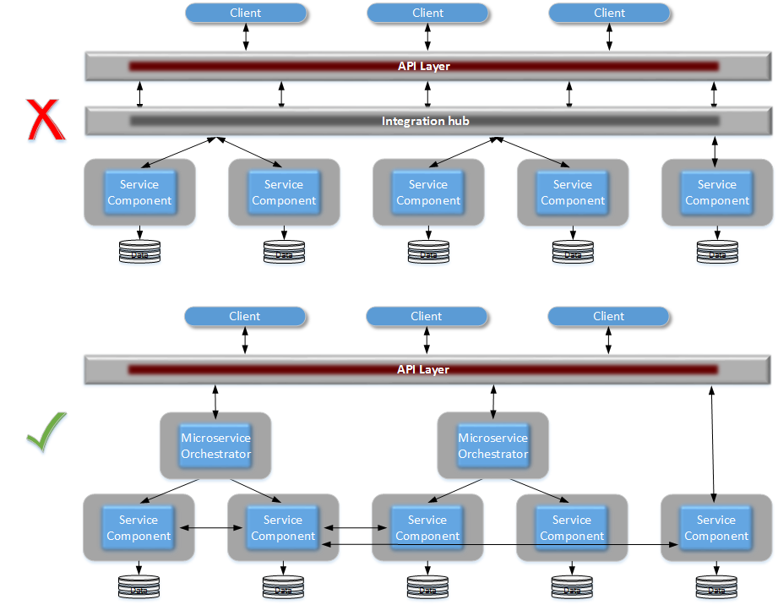
Hop on the bus anti-pattern
Hop on the bus anti-pattern is about adding an integration hub layer within a Microservices architecture between the client request and the microservices. Adding integration hub will have impact to the end to end performance because it is adding an other level of interaction, increasing the complexity further, integration hub would require significance level of governance, deployment pipeline will have impact due to integration hub and impacts the development and testing.
General reasons for integration hub is to perform
contract transformation,
service orchestration and
heterogeneous interoperability (integration with third party) integration.
In Microservice architecture,
For contract transformation we can either use a microservice for transformation which is dedicated to a specific service .
For service orchestration, we can try to have service choreography which means communication between services. If we still require orchestraction, we can still create microservice orchestration which is specific to a request.
For third party integration, we can use a microservice gateway specific to a third party system. All these alternative options above are to avoid adding an integration hub layer in the microservice architecture.

Slide 19
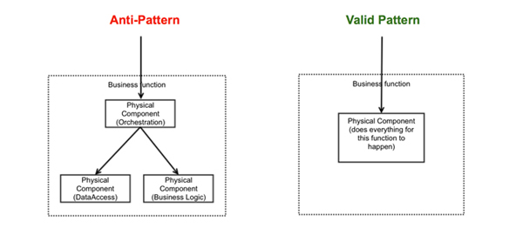
Layered Services Architecture anti-pattern
One common mistake people made with Microservices were misunderstanding how to achieve the re-usability of services. Teams mostly focused on technical cohesion rather than functional regarding reusability. For example, several services functioned as a data access layer (ORM) to expose tables as services; they thought it would be highly reusable. This created an artificial physical layer managed by a horizontal team, which caused delivery dependency. Any service created should be highly autonomous – meaning independent of each other.
Creating multiple, technical, physical layers of services would only cause delivery complexity and runtime inefficiency. We ended up in having wrapper services, orchestration services, business services and data services. These service models served technical concerns. Individual teams formed to manage these layers and ended up having business logic sprawl, no single owner for a capability, lost the efficiency and there was always a blaming game.
Logical separation of layers within a service is fine, however, there should not be any out of process calls. Try to look at a service as one atomic business entity, which must implement everything to achieve the desired business functionality. The self-contained services are more autonomous and scalable than the layered services. It's perfect to re-write some common code across multiple services, that's fine and it's a good trade-off to keep the autonomy level. The bottom line is that don't have services separated by technical concerns instead they must be separated based on the business capability. The concept of containerization is thriving because of this character.
Client interface from HTML to Data, currently it goes through 8 hops and 7 teams

Slide 20
Appendix A - References
O’REILLY – Micro Service Architecture- Aligning Principles, PRACTICES, AND CULTURE
O’REILLY – Microservices Antipattern and Pitfalls
IBM Redbook - Microservices from Theory to Practice Creating Applications in IBM Bluemix Using the Microservices Approach
IBM InterConnect 2017 – Microservices: How they relate to ESB, APIs and messaging
IBM InterConnect 2017 – Session 1375 Microservices-based Application Development Mini-Bootcamp
InfoQ - Seven Microservices Anti-patterns
https://www.infoq.com/articles/seven-uservices-antipatterns
Microservice Design Patterns - Miles to go 3.0 –
http://blog.arungupta.me/microservice-design-patterns/
http://www.ness.com/microservices-architecture-and-design-principles-2/

