Slide 1



Garbage Classification using EfficientNetV2B2
Name: Kumar Mahesh Koruprolu
Student Id: STU679c7437c55951738306615

Slide 2

Learning Objectives
Understand how to prepare and preprocess image datasets.
Learn how to apply transfer learning using EfficientNetV2B2
Implement data augmentation techniques
Train a deep learning model
Evaluate model performance using accuracy, confusion matrix and classification report
Deploy models using Gradio for real-time predictions
GOAL
Source :
www.freepik.com/

Slide 3
Tools and Technology used
Python
TensorFlow & Keras
EfficientNetV2B2 (Transfer Learning)
Google Colab
Matplotlib, Seaborn
Scikit-learn
Gradio

Slide 4
Methodology
Dataset preparation and preprocessing
Built baseline model with EffiecientNetV2B2
Split the data into training, validation and test sets
Applied data augmentation
Fine-tuned top layers of the model for better performance
Evaluated using confusion matrix and classification report
Visualized training and prediction results
Deployed the model using Gradio

Slide 5
Problem Statement:
Improper classification of waste is a major challenge in modern waste management systems. Manual sorting methods are slow, inconsistent and prone to human error, leading to inefficient recycling processes and increased environmental pollution. Many developing regions lack automated tools for categorizing different types of garbage such as plastic, metal, glass, paper, cardboard and trash. This gap calls for a reliable and intelligent system that can automatically classify waste to streamline recycling operations and reduce the environmental impact of improper disposal.

Slide 6
Solution:
Developed an automated garbage classification system using deep learning
Utilized EfficientNetV2B2 with transfer learning
Preprocessed and augmented the dataset for better generalization
Trained and fine-tuned the model on six waste categories
Evaluated performance using accuracy, confusion matrix and classification report
Achieved 91% accuracy on the test dataset
Deployed the model using Gradio for real-time image predictions
Provided an easy-to-use web interface for garbage image classification
Reduced the need for manual sorting and human error

Slide 7
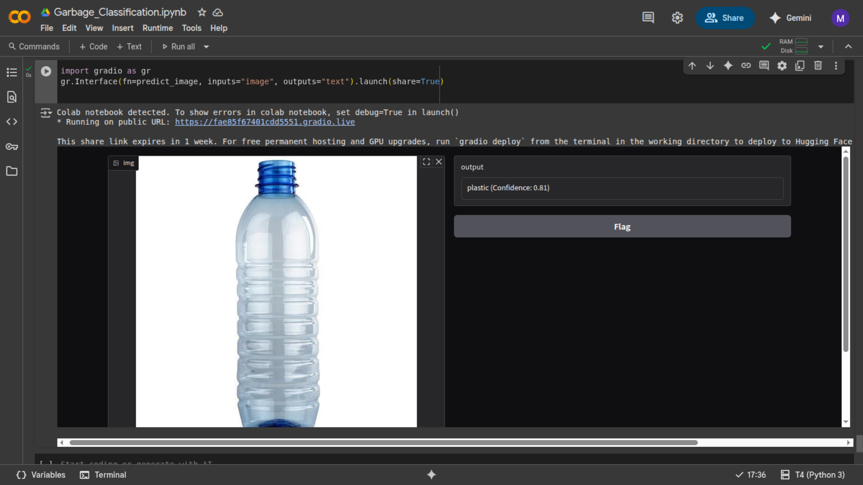
Screenshot of Output:

Slide 8
Conclusion:
The project successfully demonstrated how deep learning and transfer learning can be applied to automate the task of garbage classification. By leveraging EfficientNetV2B2, we developed a robust model capable of accurately identifying different types of waste such as plastic, metal, glass, paper, cardboard and trash. With an overall accuracy of 91%, the model showed strong performance across most classes. Through effective data preprocessing, augmentation, and fine-tuning, the model was optimized for real-world use. Furthermore, deploying the model using Gradio allowed for real-time, user-friendly predictions via a web interface. This solution not only reduces the dependency on manual waste sorting but also contributes to a more efficient and sustainable waste management process, showcasing the impactful role of AI in addressing environmental challenges.

