Slide 1

Humor Detection in Romanized
Telugu–English Code-Mixed Text
Using a Custom Synthetic Tenglish Dataset
Using MuRIL Transformer and Heuristic Augmentation
Capstone Evaluation Presentation
Department of Computer Science & Engineering
2025–2026

Slide 2











Presentation Outline
03
Introduction & Motivation
11
System Architecture
04
Problem Statement
12
Models Evaluated
05
Related Work
13
Performance Results-1
06
Dataset Description
14
Performance Results-2
07
Methodology and Architecture
15
Observations & Limitations
08
The Transformer Model
16
Future Works & Conclusion
09
Heuristic Engine
17
Thank You Note
10
Hybrid Fusion Model

Slide 3
Introduction & Motivation
Introduction
Motivation
Social media communication in India is increasingly code-mixed (Tenglish)
Tenglish text is highly unstructured, informal, and inconsistent
Traditional NLP models trained on formal monolingual text fail on such data
Humor detection depends on context, sarcasm, and implicit meaning
Code-mixed humor makes the problem more complex and real-world relevant
Most online content (memes, chats, comments) uses informal Tenglish with humor
Existing models struggle with transliteration and mixed-language patterns
Emojis, slang, and stylistic variations are key humor signals but often ignored
There is a lack of large, well-structured datasets for Tenglish humor detection
A hybrid approach is needed to combine contextual understanding and heuristic cues

Slide 4
Problem Statement
How can we accurately detect humor in Romanized Telugu–English (Tenglish)
code-mixed social media text?
Linguistic Variation
Non-Linguistic Cues
Low-Resource Setting
Tenglish has no standard grammar, spelling, or sentence structure
The same word appears in multiple transliterated forms (e.g., variations in typing)
Frequent language switching within a single sentence confuses models
Traditional NLP fails to capture meaning due to inconsistent linguistic patterns
Humor is often expressed through emojis, slang, and exaggerated text styles
Sarcasm and irony rely on context beyond literal word meanings
Repeated characters and informal expressions carry hidden humor signals
Pure text-based models ignore these cues, reducing detection accuracy
Very limited labeled datasets exist for Tenglish humor detection
Models trained on English data do not generalize well to code-mixed text
High variation in real-world data requires strong generalization ability
Lack of resources makes building robust and scalable models difficult

Slide 5
Related Work
Traditional
ML
SVM, Naïve Bayes, Logistic Regression
Relies on handcrafted features like n-grams, sentiment, and lexical patterns
Simple and interpretable but lacks deep contextual understanding
Performs poorly on sarcasm, ambiguity, and informal code-mixed text
Neural
Networks
CNN, RNN, LSTM
Automatically learns features from data without manual engineering
Captures sequential patterns better than traditional methods
Struggles with long-range dependencies and complex humor cues like sarcasm
Transformer
Era
BERT, XLM-RoBERTa, mBERT
Uses self-attention to capture deep contextual relationships in text
Strong performance in multilingual and complex NLP tasks
Limited effectiveness on informal, code-mixed text and non-linguistic signals
Indian
Languages
MuRIL, IndicBERT, Telugu-BERT
Trained specifically on Indian languages and transliterated text
Better handling of code-mixed inputs like Tenglish
Still require additional techniques to capture emojis, slang, and stylistic humor cues

Slide 6
Dataset Description
10,000
5,000
5,000
80/10/10
Total Samples
Humorous
Non-Humorous
Train/Val/Test Split
⚠ Custom Synthetic Dataset: No publicly available dataset exists for Tenglish humor detection — this dataset was created from scratch.
Dataset Characteristics
Fully synthetic dataset generated programmatically
Simulates Tenglish (Telugu + English) code-mixed text
Includes slang, emojis, and transliteration variations
Balanced data with equal humorous and non-humorous samples

Slide 7
Methodology & System Architecture
INPUT
Tenglish Text
PREPROCESSING
Clean & Normalize
TRANSFORMER
Contextual Embedding
HEURISTIC
Engine Layer
FUSION
Hybrid Score
OUTPUT
Humor / Non-Humor
Transformer Encoder
Heuristic Engine
Hybrid Fusion
Uses pre-trained models (MuRIL, BERT variants) for contextual understanding
Captures semantic relationships using self-attention mechanism
Handles code-mixed and transliterated text effectively
Outputs probability score for humor classification
Detects emojis and emotion-based patterns
Identifies slang, informal words, and exaggerations
Captures sarcasm and stylistic cues (repetition, elongation)
Generates rule-based humor score
Combines transformer output with heuristic score
Uses weighted/threshold-based decision mechanism
Enhances detection of non-linguistic humor signals
Produces final classification (humor / non-humor)

Slide 8
MuRIL — The Core Transformer Model
What is MuRIL?
Why MuRIL for Tenglish?
MuRIL = Multilingual Representations for Indian Languages
Developed by Google Research India
Pre-trained on 17 Indian languages + English
Uniquely trained on transliterated text (Roman script Indian languages)
Based on BERT architecture with multilingual cross-attention
Outperforms mBERT on all Indian language benchmarks
Natively handles Romanized Telugu text (transliteration-aware)
Understands language-switching patterns in code-mixed sentences
Captures phonetic and morphological variation in informal text
Fine-Tuning Configuration
Max sequence length: 128 tokens
Learning rate: 2×10⁻⁵ | Batch size: 16
Trained for 3–5 epochs using Adam optimizer

Slide 9
Heuristic Engine — Processing Pipeline
Step-by-step flow of the rule-based heuristic component.
01
Input Handling
02
Pattern Detection
03
Language Cues
Accept Tenglish text input
Preserve emojis and informal writing styles
Prepare text for rule-based analysis
Identify emojis and emoticons
Detect slang and informal expressions
Capture repeated letters and exaggeration
Recognize sarcasm and ironic phrases
Detect contrast words indicating humor
Identify exaggerated or playful wording
04
Feature Understanding
05
Decision Logic
06
Heuristic Output
Group detected patterns into meaningful signals
Focus on humor-related cues in text
Ignore irrelevant or weak patterns
Evaluate strength of detected humor signals
Give importance to strong indicators like sarcasm and emojis
Resolve conflicts between multiple signals
Generate final rule-based decision
Indicates whether text is humorous or not
Passed to hybrid model for final prediction

Slide 10
Hybrid Fusion Model
⭐ Hybrid approach combines deep understanding with human-like pattern recognition for accurate humor detection.
⭐ Smart Fusion Decision
Model Understanding
Rule-Based Signals
Analyzes both contextual and rule-based signals
Gives priority to strong humor indicators
Balances both inputs for better judgment
Resolves conflicts between signals
Captures contextual meaning from text
Understands language structure and semantics
Provides initial prediction
Detects emojis, slang, and informal patterns
Identifies sarcasm and exaggeration
Captures non-linguistic humor cues
→
→
↓
Final Output
Produces final classification
Humor or Non-Humor
More accurate than single-model prediction

Slide 11
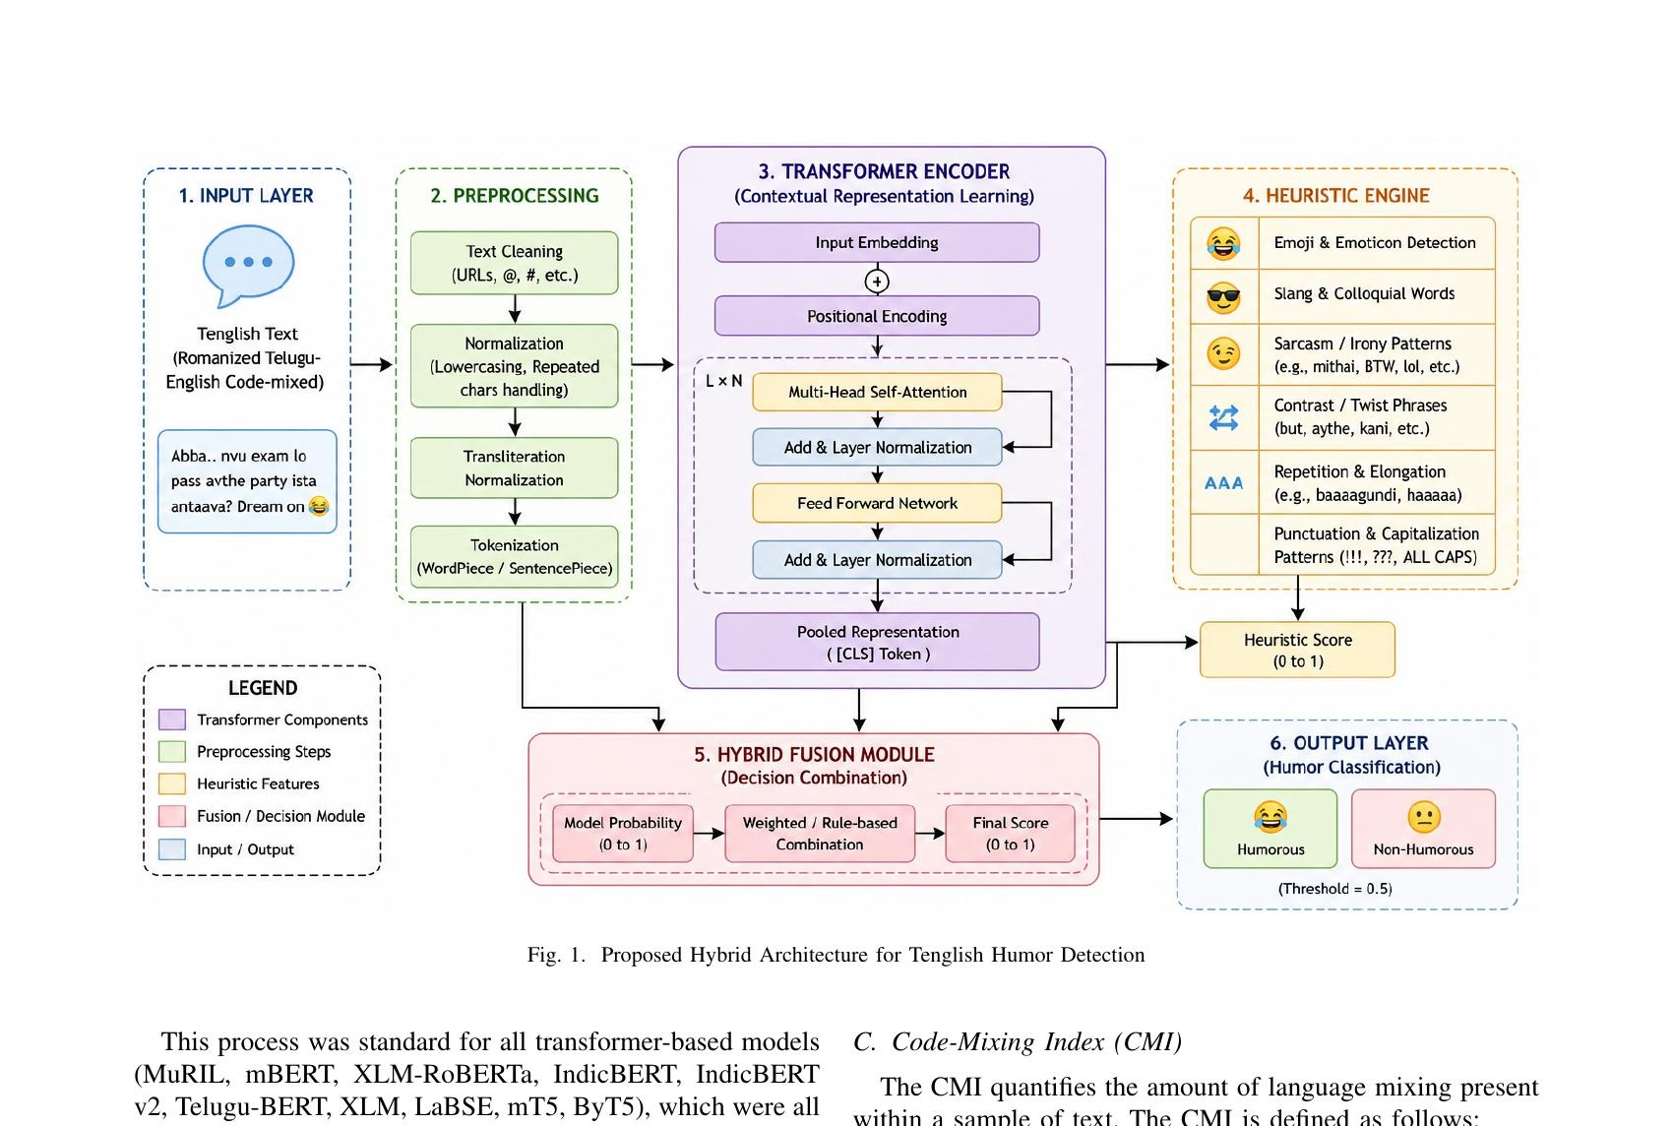
System Architecture — Proposed Hybrid Model
Full pipeline: Tenglish input → Transformer + Heuristic layers → Hybrid Fusion → Final Classification (Fig. 1 from paper)

Slide 12
Models Evaluated for Comparison
⭐ Proposed Model: MuRIL + Heuristic (Hybrid)
Accuracy: 92.4%
Best performing model — combines contextual understanding with rule-based humor signals
MuRIL (Base)
90.1%
XLM-RoBERTa
88.5%
Lacks heuristic signals like emojis and sarcasm cues
Not trained on transliterated Indian code-mixed text
IndicBERT v2
87.9%
IndicBERT
87.2%
Limited contextual understanding for informal humor patterns
Struggles with slang, sarcasm, and stylistic variations
mBERT
85.8%
Telugu-BERT
84.6%
Weak handling of code-mixed and transliterated inputs
Focused on native Telugu, not Romanized Tenglish
XLM & LaBSE
83.2% / 82.4%
mT5 & ByT5
81.6% / 80.9%
Designed for general multilingual tasks, not humor detection
Better for generation tasks, not classification problems
⚠ Other models underperformed because they lack training on transliterated Indian text and cannot capture informal humor signals like emojis and slang.

Slide 13
Model Performance Results (1/2)
Accuracy | Precision | Recall | F1 Score (bars scaled 78%–95%)
★ MuRIL + Heuristic
MuRIL (Base)
XLM-RoBERTa
Proposed Model
Acc ███████░░░ 90.1%
Acc ██████░░░░ 88.5%
Acc ████████░░ 92.4%
Pre ████████░░ 91.2%
Pre ███████░░░ 89.5%
Pre ██████░░░░ 87.4%
Rec ████████░░ 92.5%
Rec ███████░░░ 90.2%
Rec ██████░░░░ 88.8%
F1 ████████░░ 91.8%
F1 ███████░░░ 89.8%
F1 ██████░░░░ 88.1%
IndicBERT v2
IndicBERT
Acc ██████░░░░ 87.9%
Acc █████░░░░░ 87.2%
Pre █████░░░░░ 86.8%
Pre █████░░░░░ 86.5%
Rec ██████░░░░ 87.6%
Rec █████░░░░░ 87.1%
F1 █████░░░░░ 87.2%
F1 █████░░░░░ 86.8%

Slide 14
Model Performance Results (2/2)
Accuracy | Precision | Recall | F1 Score (bars scaled 78%–95%)
mBERT
Telugu-BERT
XLM
Acc █████░░░░░ 85.8%
Acc ████░░░░░░ 84.6%
Acc ███░░░░░░░ 83.2%
Pre ████░░░░░░ 84.2%
Pre ███░░░░░░░ 83.1%
Pre ███░░░░░░░ 82.0%
Rec ████░░░░░░ 86.0%
Rec ████░░░░░░ 84.5%
Rec ███░░░░░░░ 83.2%
F1 ████░░░░░░ 85.1%
F1 ███░░░░░░░ 83.8%
F1 ███░░░░░░░ 82.6%
LaBSE
mT5 / ByT5
Confusion Matrix
Acc ███░░░░░░░ 82.4%
Acc ██░░░░░░░░ 81.6%
MuRIL + Heuristic (Best Model)
Pred: Humor Pred: Non-Humor
Pre ██░░░░░░░░ 81.2%
Pre ██░░░░░░░░ 80.2%
Act: Humor 462 TP 38 FN
Act: Non-Hum 42 FP 458 TN
Rec ██░░░░░░░░ 82.5%
Rec ██░░░░░░░░ 81.4%
Acc ████████░░ 92.4%
F1 ██░░░░░░░░ 81.8%
F1 ██░░░░░░░░ 80.8%

Slide 15
Key Observations & Limitations
Key Observations
Limitations
Introduction: Detecting humor in Telugu-English mixed text is difficult due to slang, sarcasm, and mixed language usage.
Dataset: A balanced dataset of 10,000 samples (humor vs non-humor) was created for training and evaluation.
Transformer Model: Transformer models learn context and meaning from text for humor detection.
Heuristic Model: Rule-based methods help detect emojis, slang, and hidden humor patterns.
Hybrid Fusion: Combining transformer + heuristic improves overall prediction accuracy.
Results: The hybrid MuRIL-based model achieved the best performance (~92% accuracy).
Dataset is somewhat synthetic — real social media text may have more variability
Some cultural nuances and regional humor may be under-represented
Heuristic rules are manually constructed and require frequent updates as slang evolves
Model is text-only — ignores multimodal cues (images, audio, video) present in social media
Limited to Tenglish — does not cover other Indian code-mixed languages like Hinglish
No fine-grained humor type classification (sarcasm vs. irony vs. satire)

Slide 16
Future Work & Conclusion
Future Work
Final Results
Use real social media datasets (Twitter, Instagram, YouTube) for richer training
Integrate multimodal learning — combine text with images & audio for meme humor detection
Apply reinforcement or adaptive rule learning to make heuristics dynamic
Extend to Hinglish, Thanglish and other Indian code-mixed languages
Add fine-grained humor classification (sarcasm, irony, satire)
92.4%
Accuracy
0.918
F1 Score
10K
Samples
10
Models Tested
Conclusion
The proposed MuRIL + Heuristic hybrid model achieves 92.4% accuracy on Tenglish humor detection — outperforming all 10 standalone transformers. Combining deep learning with rule-based linguistic expertise proves highly effective for informal, low-resource, code-mixed language processing.

Slide 17
Thank You!
Project Team
Aarsha Sri Chandra
AP22110010413
★ ★ ★
We sincerely appreciate your time and attention throughout this presentation.
We hope our work on Tenglish humor detection inspires further research in code-mixed NLP.
We welcome your questions and feedback!
Gona Rishitha Naga Durga
AP22110010433
Bellamkonda Mahesh
AP22110010888
Surya Teja Bonthu
AP22110010912

