Slide 1
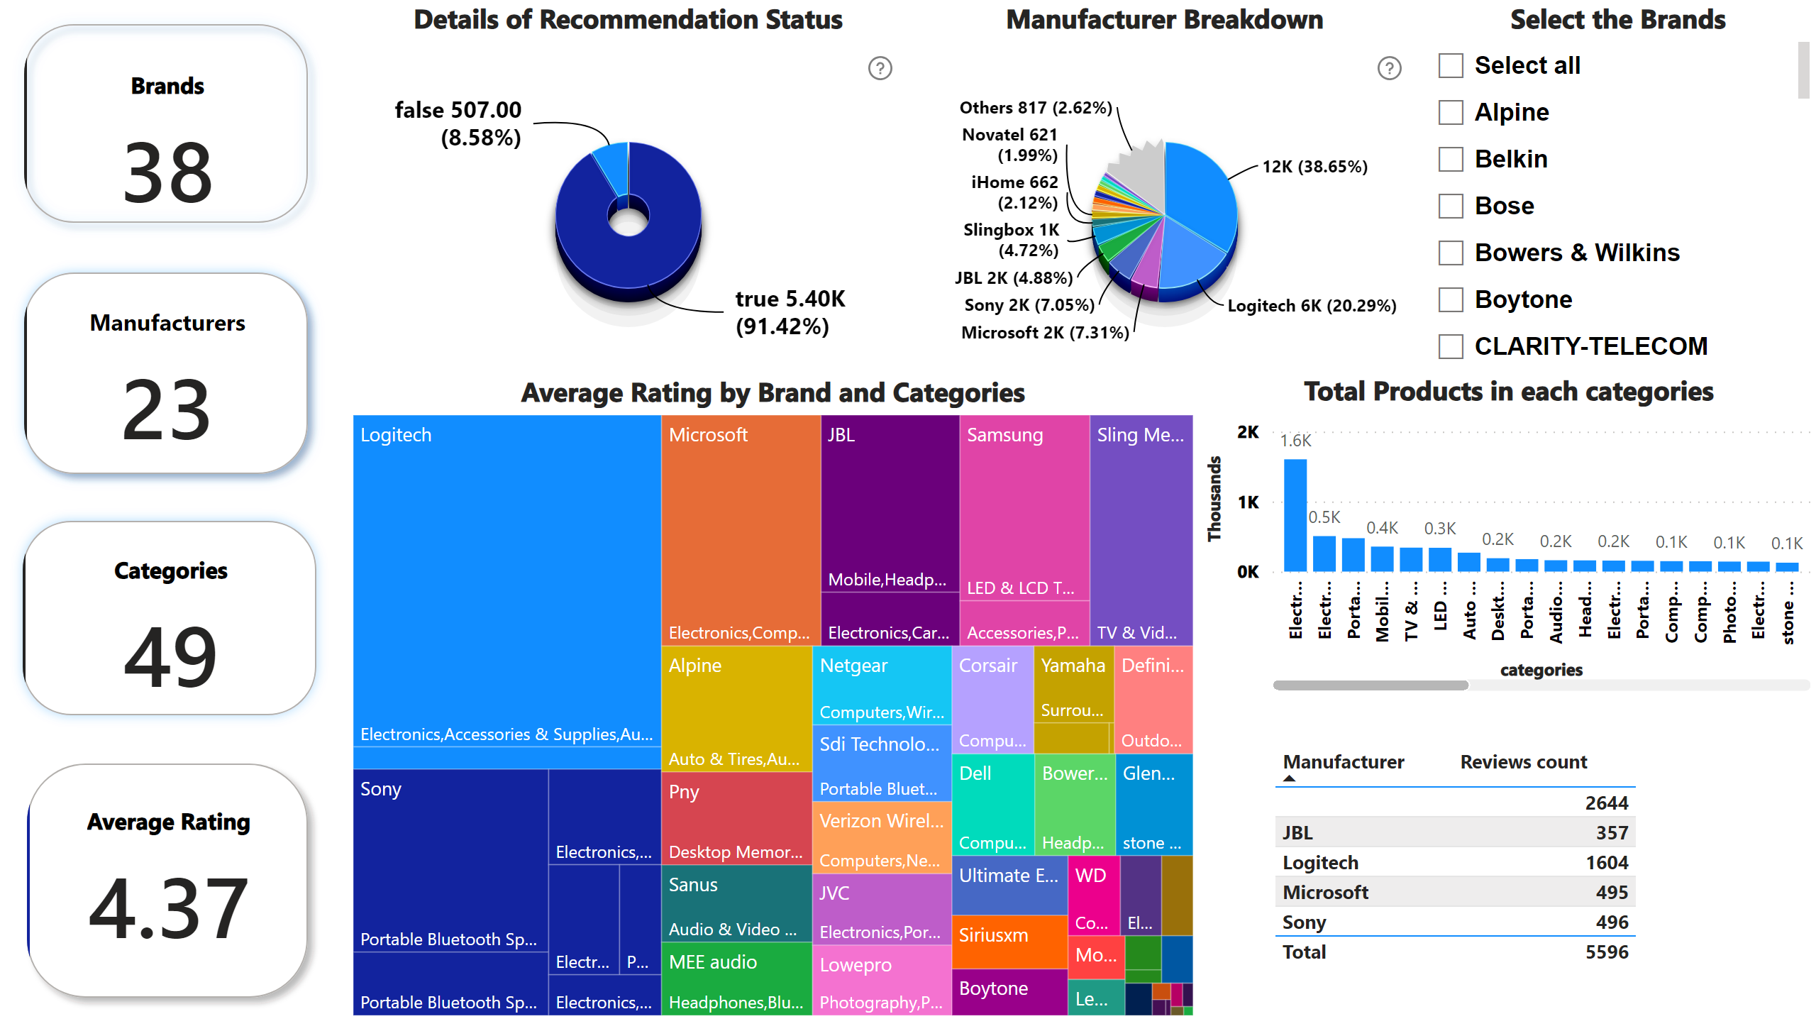
Page 1
Notes:
Select the Brands
No alt text provided
cardVisual
No alt text provided
Details of Recommendation Status
No alt text provided
cardVisual
No alt text provided
cardVisual
No alt text provided
Average Rating by Brand and Categories
No alt text provided
Manufacturer Breakdown
No alt text provided
cardVisual
No alt text provided
Total Products in each categories
No alt text provided
tableEx
No alt text provided

