Slide 1



2024_Mar
View in Power BI
Last data refresh:
02/04/2024 16:40:15 UTC
Downloaded at:
02/04/2024 16:41:10 UTC

Slide 2
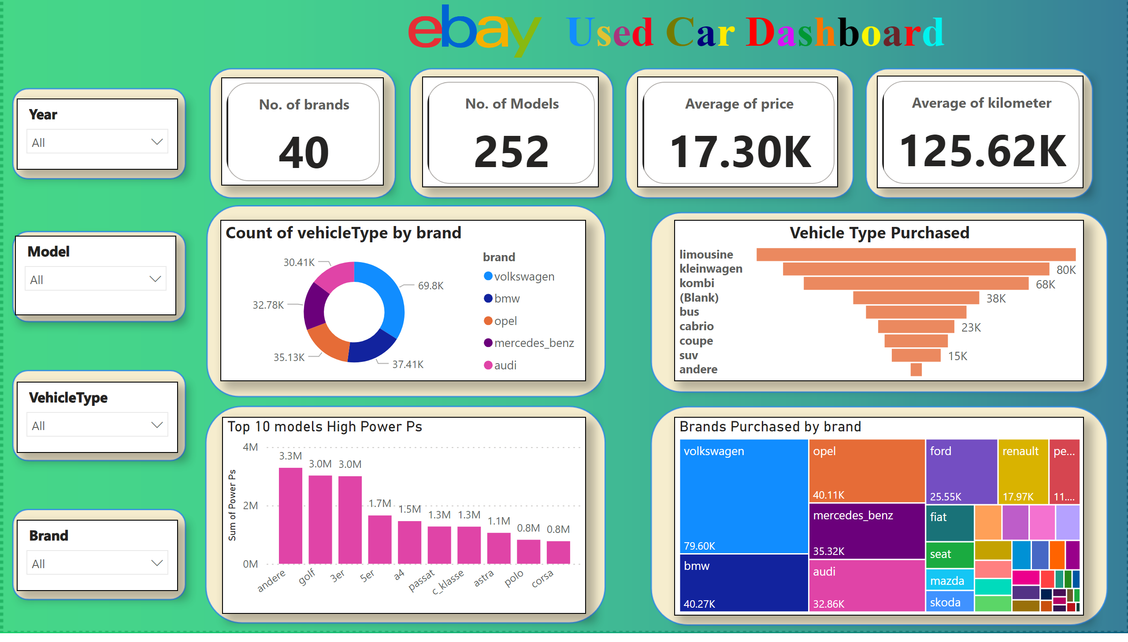
Page 1
Notes:
image
No alt text provided
textbox
No alt text provided
cardVisual
No alt text provided
cardVisual
No alt text provided
cardVisual
No alt text provided
cardVisual
No alt text provided
slicer
No alt text provided
slicer
No alt text provided
slicer
No alt text provided
slicer
No alt text provided
donutChart
No alt text provided
Vehicle Type Purchased
No alt text provided
treemap
No alt text provided
Top 10 models High Power Ps
No alt text provided
image
No alt text provided

