Slide 1
From Autoencoder to Variational Autoencoder: An intuitive journey
Mahesh Godavarti

Slide 2
What is VAE – Variational Autoencoder
A Variational Autoencoder (VAE) is one of the early breakthroughs in generative AI
It works by learning to compress data into a compact representation (latent space) and then using it to both recreate existing data and generate new, similar examples.

Slide 3
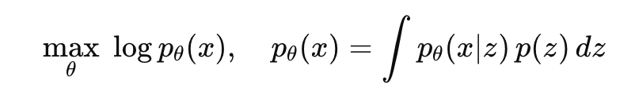
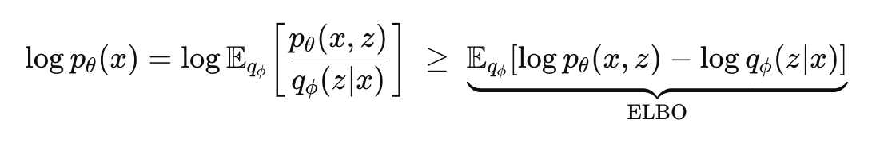
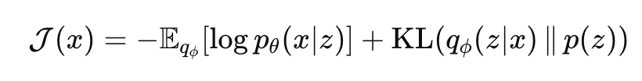
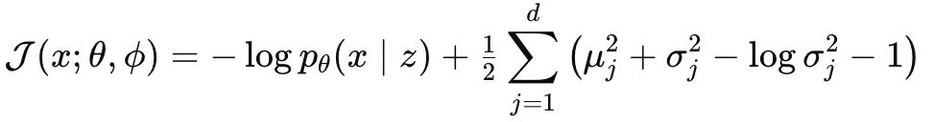
Typical Introduction to VAE – probability heavy
Goal: Maximize likelihood of data under a latent variable model
ELBO – Evidence lower bound
Loss Function

Slide 4
Toy example on MNIST
MNIST - a classic dataset of 70,000 handwritten digits (0–9) in grayscale - http://yann.lecun.com/exdb/mnist/
Toy model checked in at - https://sqbu-github.cisco.com/godavarm/mnist_toy_vae

Slide 5

Autoencoder Block Diagram
Input
Output
Image Space
Encoder
Latent Space
Decoder
Image Space

Slide 6
Autoencoder
Loss function: Reconstruction loss between Input and Output (MSE)
Similar shapes are clustered together in the latent space

Slide 7
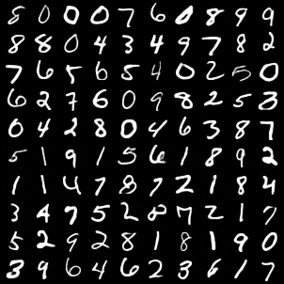
MNIST Autoencoder Output

Slide 8
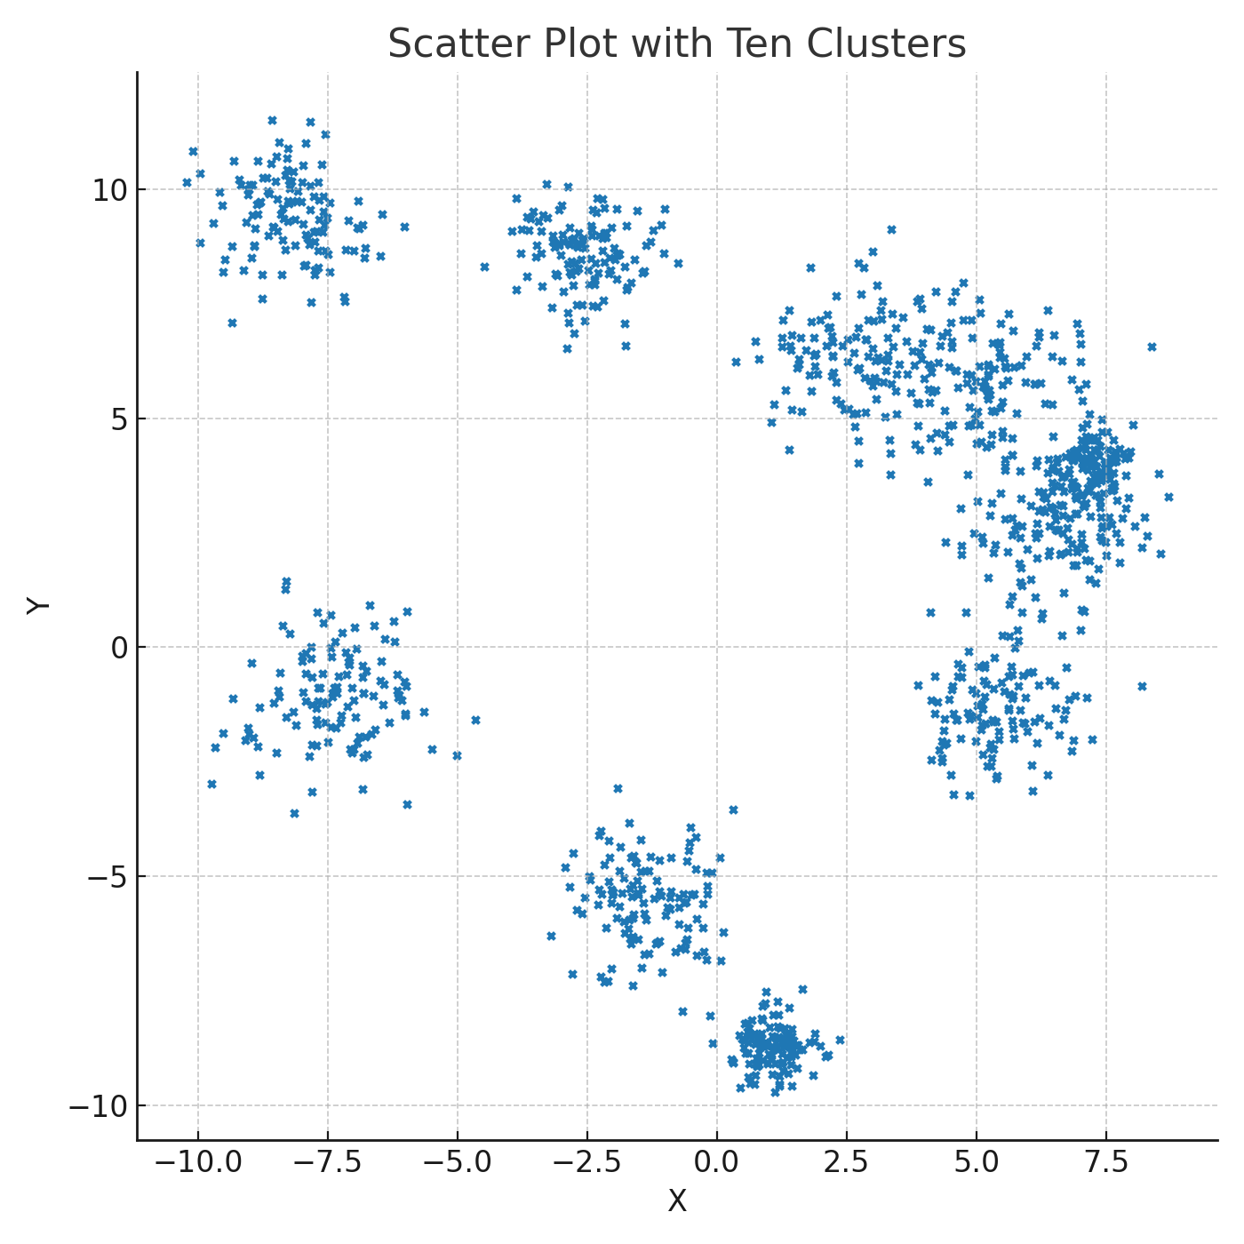
Autoencoder Latent Space (Not real – just for illustration)

Slide 9
Goal – Generate New Digits
Approach: Use the Autoencoder - pick a random point in a region in the latent space and decode it

Slide 10
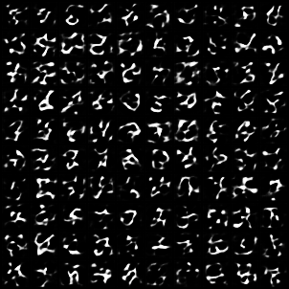
MNIST Samples from Autoencoder

Slide 11
VAE Version 1 – Impose Constraints on Latent Space
Loss Function = Reconstruction Loss + Energy of Latent Space Vectors

Slide 12
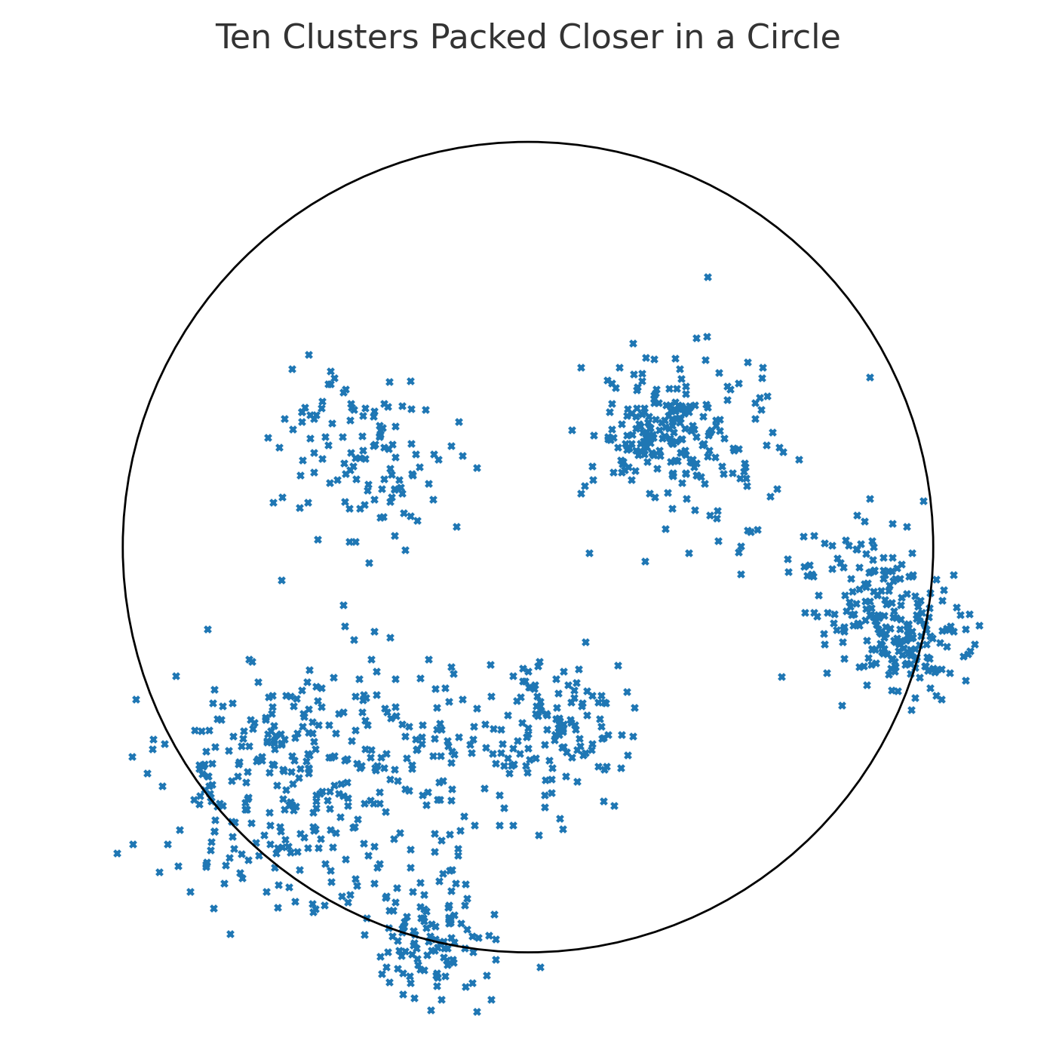
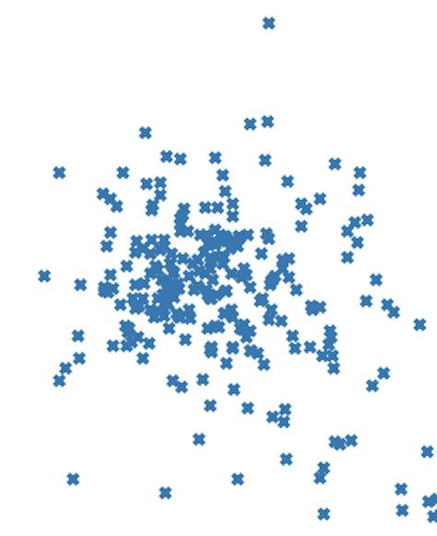
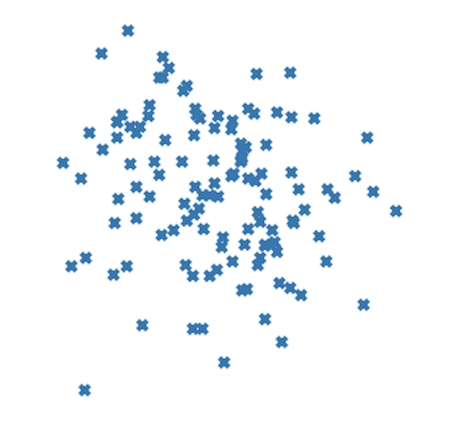
VAE 1 – Latent Space (not real – just for illustration)

Slide 13
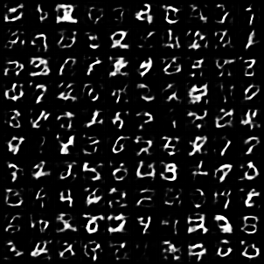
MNIST Samples from VAE1

Slide 14
VAE Version 2 – Map neighboring points to the same output
Loss Function = Reconstruction Loss from neighborhood + Energy of Latent Space Vectors

Slide 15
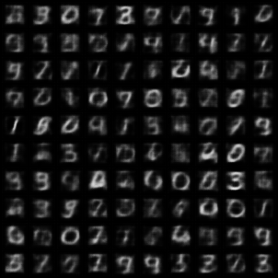
MNIST Samples from VAE2

Slide 16
VAE Version 3 – Map neighboring points to the same output (but also learn neighborhood size and shape)
Loss Function = Reconstruction Loss from neighborhood + Energy of Latent Space Vectors + Neighborhood size

Slide 17
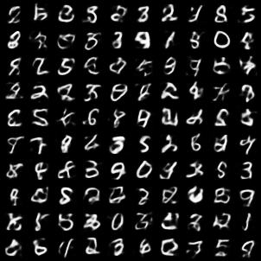
MNIST Samples from VAE3

Slide 18
VAE – Personalize Neighborhood Size and Shape
Loss Function = Reconstruction Loss from neighborhood + Energy of Latent Space Vectors + Per Sample Neighborhood size

Slide 19
Proper Introduction to VAEs (Deepia – youtube channel)
Denoising Autoencoders - https://youtu.be/0V96wE7lY4w?si=eEKcJk60gix7BZm3
Variational Autoencoders – https://youtu.be/0V96wE7lY4w?si=eEKcJk60gix7BZm3
Autoencoders - https://youtu.be/hZ4a4NgM3u0?si=u4bkunRcjp0U7HUK
Latent Space Visualization - https://youtu.be/o_cAOa5fMhE?si=5X7lACZ12RJjiK8v

