Slide 1


CREATIVE
PERIPHERALS & DISTRIBUTIONS PVT. LTD.

Slide 2
OUR MOTO:
VISION:
TO BE INDIA’S NO 1 VALUE ADDED RETAIL DISTRIBUTOR AND TO BUILD AN ORGANISATION MOST PREFERED BY VENDORS AND CUSTOMERS
THINK CREATIVE, THINK VALUE.
IF U CAN U CAN

Slide 3
ABOUT US:
Creative Peripherals & Distributions Pvt. Ltd. a company incorporated in
1992 with just three people is a Rs. 540 Millions organization today ,
employing over 80 people and having total of 3 group companies.
We are a leading Hardware and Service vendor in the city having
offices at Lamington Road in South Mumbai and branch offices at
Borivali, Pune, Ahmedabad and Valsad (Gujarat) & Vasai. Also having
Billing Locations at Delhi, Bangalore, Kolkatta, Chennai, Noida,
Gurgoan, Hyderabad and Goa.
For a focused business approach and to serve our customers better,
we have divided our activities between 3 companies.

Slide 4
I. CREATIVE PERIPHERALS & DISTRIBUTIONS PVT. LTD.
Creative Peripherals & Distributions Pvt. Ltd. is the flagship company of the group headed by Mr. Ketan Patel who is a qualified engineer having over 14 years of experience in the IT industry.
We mainly cater to the needs of Distributions, Large Format Retail, OEM and Corporate market segments with value added services.

Slide 5
II. BIT-TECH SERVICES
Bit-Tech service is the repairs and service arm of the group and is headed by Mr. Mahesh Advani who is an engineer by qualification, having experience of over 9 years of chip level repairing.
It is an authorized nationwide service centre for Microsoft Hardware as well as for Epson printers in the Mumbai region.
Bit-tech is well equipped with latest state-of-the-art equipments and has a fleet of well-trained and efficient engineers.
Bit-Tech services is presently providing services for SMPS, Stabilizers, Mother Boards, Add on cards, FDD’s, HDD’s Memory modules, Modems, Note Book PCs, Printers, Desktops & also take up AMC for machines.

Slide 6
III. K.P.ENTERPRISES
K.P.Enterprises is an on-site support and maintenance arm of the group which is again controlled and administered by Mr. Mahesh Advani with over 9 years of experience in PC support and maintenance.
We have well trained team of engineers to provide on-site support for Computers & Peripherals to end customers. The company mainly caters to SOHO and SME segment

Slide 7
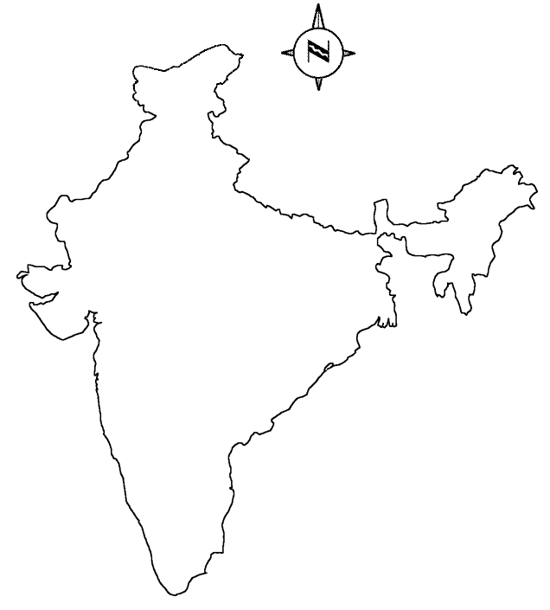
Extensive Marketing & Distribution Network
INDIA
AHMEDABAD
VALSAD
BORIVALI
LAMINGTON ROAD
PUNE
Sales Offices

Slide 8
STRENGTHS:
Our valuable services has helped us to gain over 500 SOHO, SME and corporate customers who have complete faith in our capabilities. Our list of corporate clients speaks for itself.
Our 1500 retail clients always rely on us for repair and support work. Also we provide specialized service for urgent & emergency work.
A well equipped service centre spread over 600 sq.feet at Lamington Road, in the heart of Mumbai, with well trained and experienced chip level repair engineers. The similar facilities are also available at Borivali, the other end off Mumbai, so as to cover all off Mumbai. Also have the offices in Ahmedabad and Valsad and also the Virtual Offices at Delhi, Gurgoan, Noida, Kolkatta, Hyderabad, Chennai, Bangalore & Goa.
Financially sound promoters.
Sound knowledge & channel Network for pushing relatively new brands.
Dedicated and efficient Technicians and Service coordinators.
Systems designed and implemented by qualified ISO 9000 consultants.

Slide 9
ACHIEVEMENTS:
We are Microsoft aggregators and are the highest sellers of their hardware all India and the largest seller in Asia. We were awarded the reseller of the year award for the years 2002 to 2006.
We have been the highest seller and star performer for Epson on an all India basis throughout the years 2001 to 2006.
We are AOC Monitors Regional Distributors and have received Highest Sales Award for the year 2006.
We received an award for highest sales achievement in scanners on all India basis from Canon.

Slide 10
A FEW OF OUR ESTEEMED CLIENTS
Reliance Infocom Ltd.
Reliance Ind. Ltd.
Indian Petro Chemicals Ltd.
Bayer Corp Science
IL&FS Educational Services Ltd.
UPS Freight Services Ltd.
Mitsui OSK Lines Ltd.
Intelenet Global Services Ltd.
Woolworths Wholesale (I) Pvt. Ltd.
Reliance Retail Limited
RPG Cellucom
Aditya Birla Retail
Fu-com Retail Ltd.
Hypercity Retail Ltd
& many more

Slide 11

PRODUCTS WE DISTRIBUTE

Slide 12




PRODUCTS
We are the Regional Distributors in Western India for Microsoft Hardware and Microsoft Software (FPP).
We are the Regional Distributors in Western India for AOC, world’s largest display manufacturer company.
Products : CRT, TFT & Plasma
We are the Regional Distributors for Western India for Computer Associates which is the 3rd largest software company in the world after Microsoft and Oracle Corporation.
Products : eTrust Antivirus & Internet Security Suite.
We are the Distributors in Mumbai for Epson printers, the World leaders in impact printing.
Products : Inkjet, Dot Matrix Printers, POS, Laser Printer & Consumables.

Slide 13



BenQ – Bringing Entertainment N Quality to life as the name suggests this a trendy brand for which we have the distribution rights.
Products : TFT Monitors, CD-RW & Projectors.
We are Distributors in Northern and Eastern Mumbai (Andheri (E) till Virar) for India’s No.1 & most preferred Internet Service Provider.
Products : Dialup & Broadband Service.
We are Distributors in Western and Southern Mumbai for India’s No.1 CDMA Tele solution provider & also the Preferred Internet Service Provider.
Products : PCMCAI Datacard & USB Datacard.

Slide 14


Zyxel Networking Products – Sole Distributor in Mumbai
We are Distributors for Transcend External Storage.
Products : USB pen drives, Flash memory cards, etc.
DOLLAR ($) BILLING CAN BE FURNISHED TO OUR VALUED CUSTOMER ON DEMAND

Slide 15
Creative Peripherals & Distributions Pvt. Ltd.
Location of Offices
Main Branch : 375/377, Babu Bldg., Office. No. 20, 2nd Floor, Lamington Road, Mumbai - 400 007.
Tel.: 91-22-23822222 Fax: 91-22-23804045.
E-mail : sales@ecreativeindia.com
Borivali Branch : B-104, Mandpeshwar Indl. Estate, Off. S.V.P. Road, Opp. M.C.F. Club,
Borivali (W), Mumbai - 400 092.
Tel.: 91-22-28635556 Fax: 91-22-28635558.
E-mail : corporate@ecreativeindia.com
Pune Branch : 1549, Tilak Road, Office No. 301, Indira Chambers, 3rd Floor, Pune – 411004.
Tel.: 91-20-32514015
E-mail : pune@ecreativeindia.com
Gujarat Branch : 3, Aakar Complex, Telephone Exchange Road, Opp. Government Tube Well, Bopal,
Ahmedabad – 380058.
Tel.: 09328171204
E-mail : gujarat@ecreativeindia.com

Slide 16
THANK YOU !!!
“IF U CAN WE CAN”

