Slide 1
Stastistics-Chapter 8

Slide 2
Population and Sample, Parameters and Statistics

Slide 3
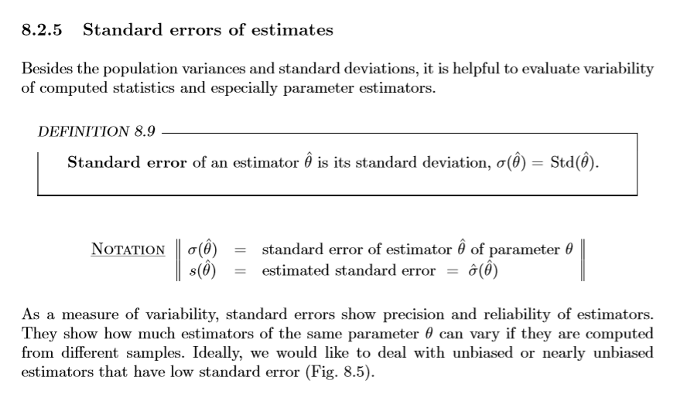
Standard Error

Slide 4
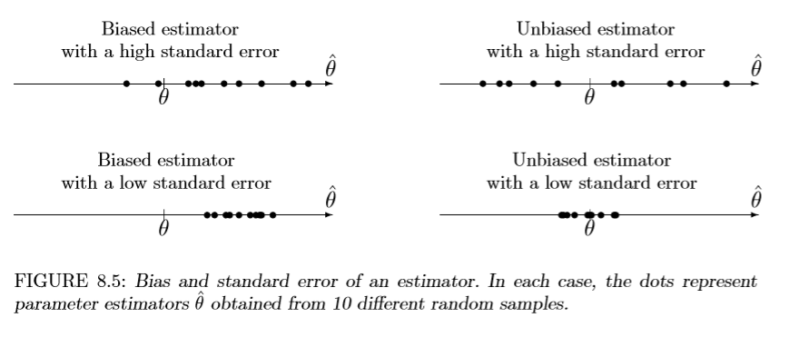
Standard Error

Slide 5
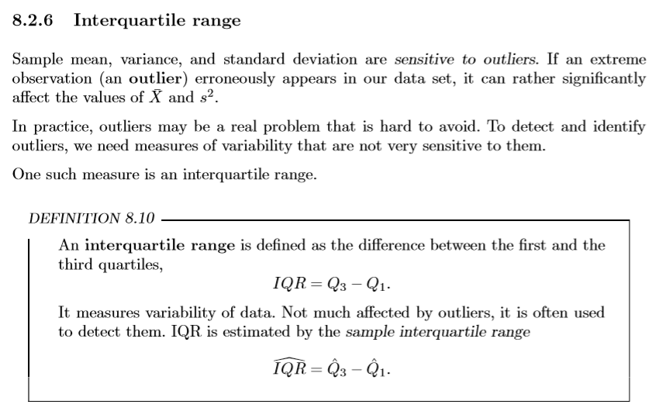
Outliers

Slide 6
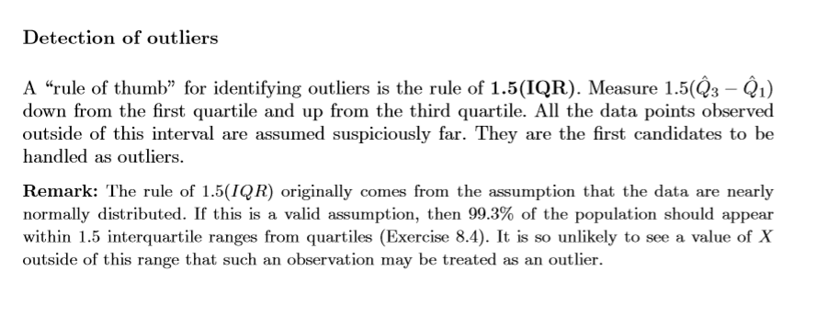
Detection of Outliers

Slide 7
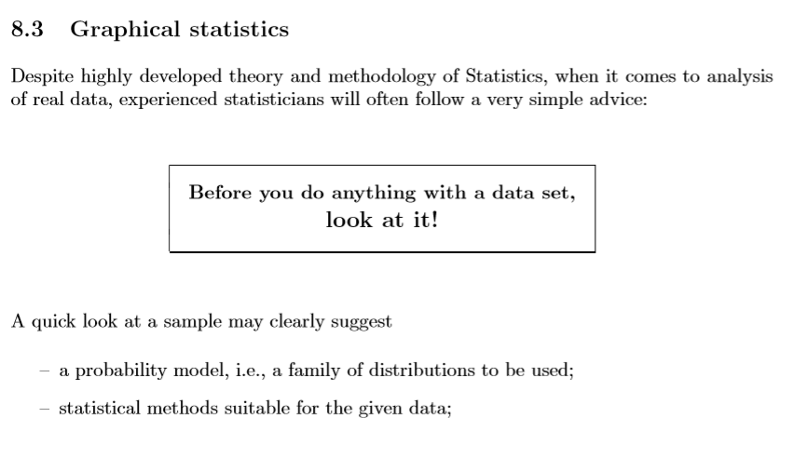
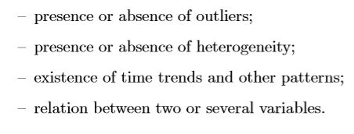
Graphical Stastistics

Slide 8
Graphical Statistics
Histograms
Stem-and-leaf plots
box plots
Time plots
Scatter plots

Slide 9


Histograms

Slide 10
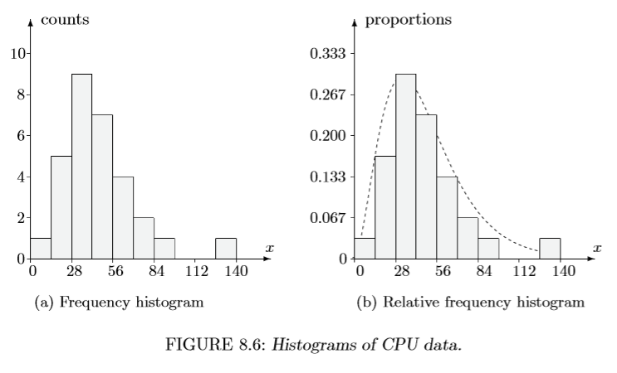
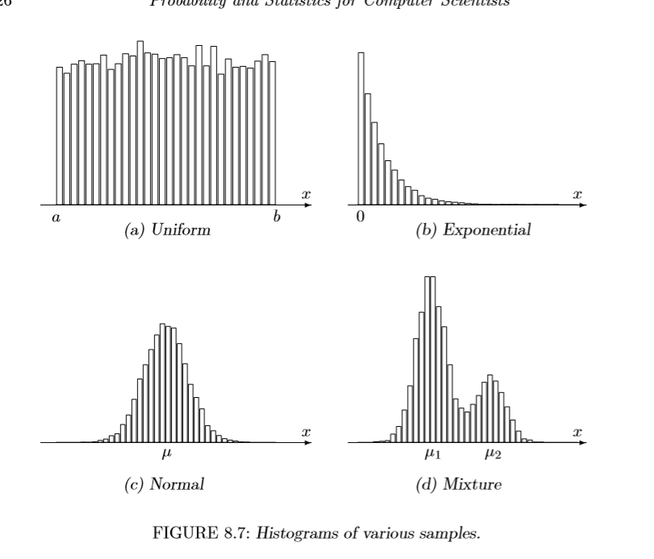
Histograms

Slide 11

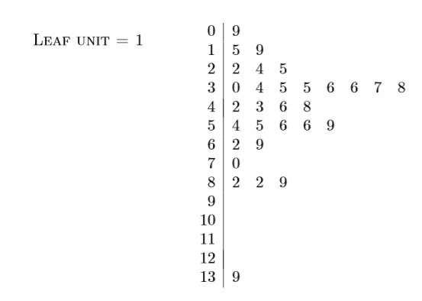
Stem-and-leaf plots

Slide 12


Box Plot

Slide 13
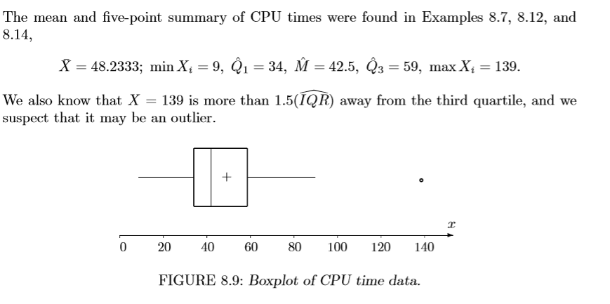
Box Plot

Slide 14
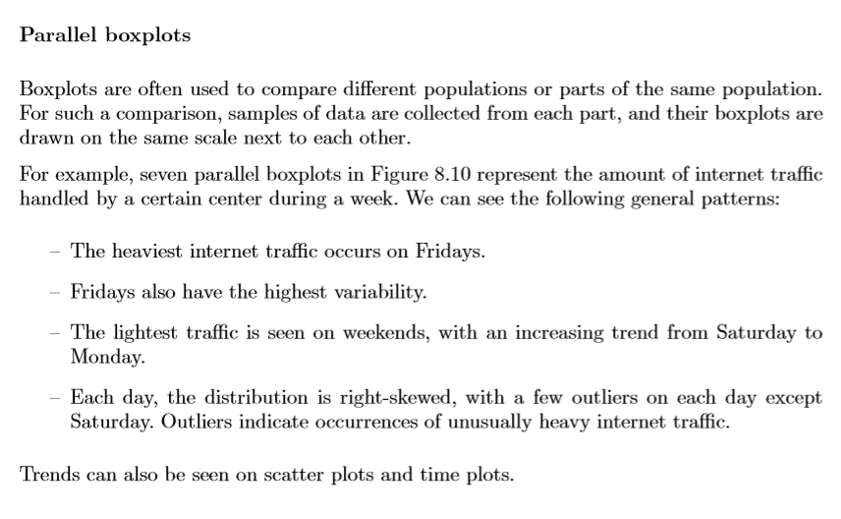
Parallel Box Plots

Slide 15
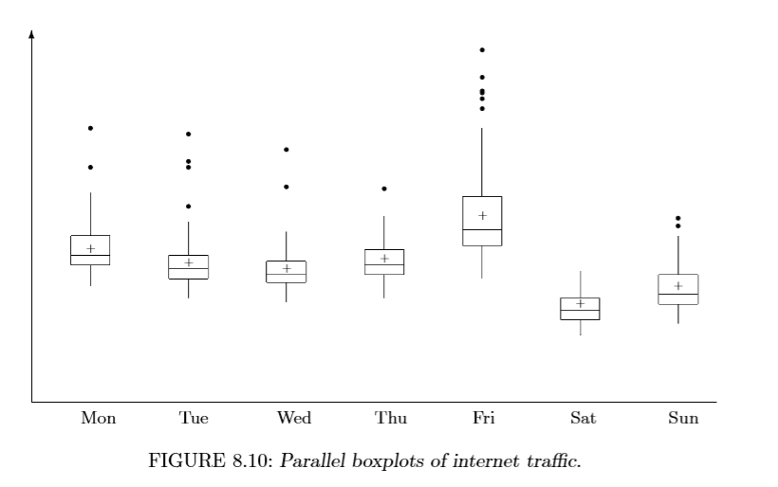
Parallel Box Plots

Slide 16
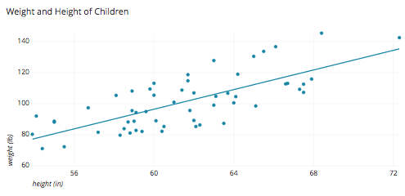
Scatter plots

Slide 17
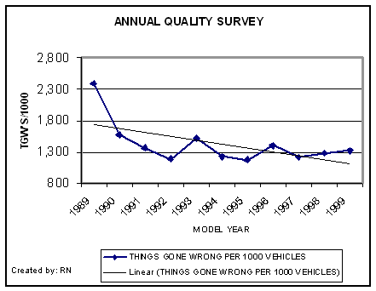
line (trend) plots

