Slide 1
Chapter 7
Functions of Random Variables (Optional)

Slide 2
Section 7.1
Introduction

Slide 3
Section 7.3
Moments and Moment-Generating Functions

Slide 4
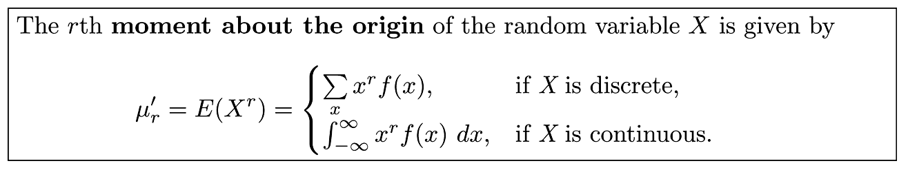
Definition 7.1
Copyright © 2010 Pearson Addison-Wesley. All rights reserved.
7 - <number>

Slide 5
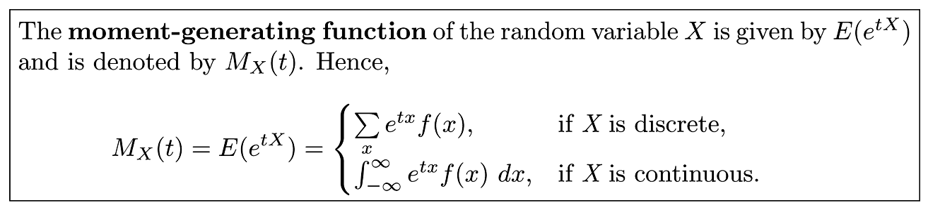
Definition 7.2
Copyright © 2010 Pearson Addison-Wesley. All rights reserved.
7 - <number>

Slide 6
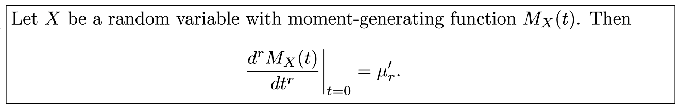
Theorem 7.6
Copyright © 2010 Pearson Addison-Wesley. All rights reserved.
7 - <number>

Slide 7
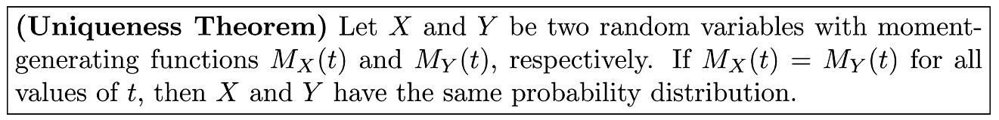
Theorem 7.7
Copyright © 2010 Pearson Addison-Wesley. All rights reserved.
7 - <number>

Slide 8
Theorem 7.8
Copyright © 2010 Pearson Addison-Wesley. All rights reserved.
7 - <number>

Slide 9
Theorem 7.9
Copyright © 2010 Pearson Addison-Wesley. All rights reserved.
7 - <number>

Slide 10
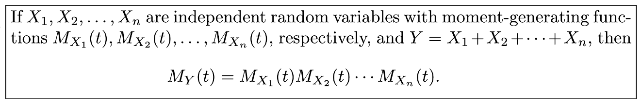
Theorem 7.10
Copyright © 2010 Pearson Addison-Wesley. All rights reserved.
7 - <number>

Slide 11
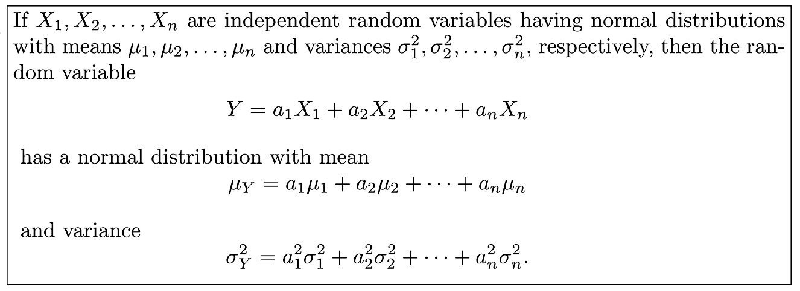
Theorem 7.11
Copyright © 2010 Pearson Addison-Wesley. All rights reserved.
7 - <number>

Slide 12
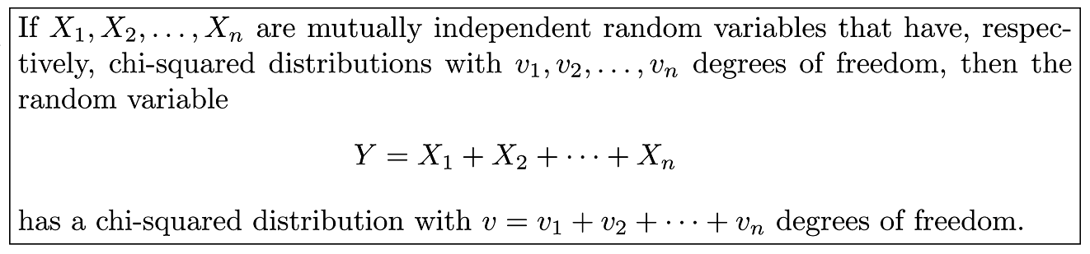
Theorem 7.12
Copyright © 2010 Pearson Addison-Wesley. All rights reserved.
7 - <number>

Slide 13
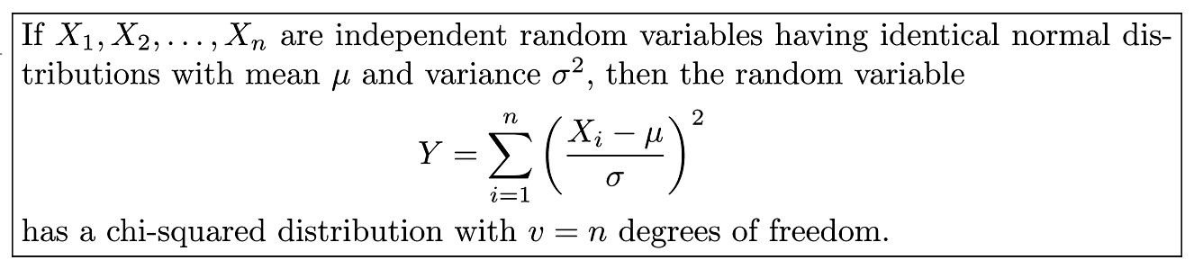
Corollary 7.1
Copyright © 2010 Pearson Addison-Wesley. All rights reserved.
7 - <number>

Slide 14
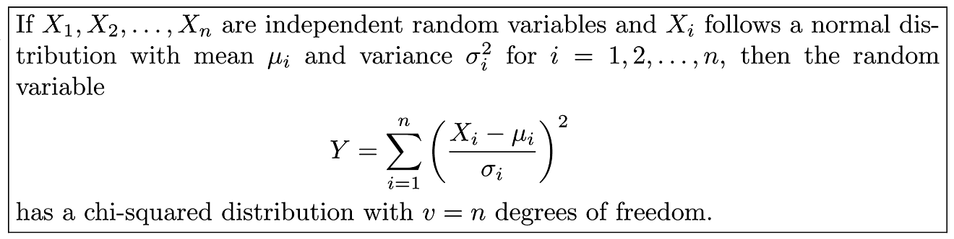
Corollary 7.2
Copyright © 2010 Pearson Addison-Wesley. All rights reserved.
7 - <number>

