Slide 1
Chapter 8
Fundamental Sampling Distributions and Data Descriptions

Slide 2
Fundamental Sampling Distributions
Linear Combinations of R.V.’s
Sampling
Estimators
  Central tendency
  Variability or dispersion
Sampling Distributions
  Sample mean and sample variance
  Student’s t-distribution
  F-distribution

Slide 3
Section 8.1
Random Sampling

Slide 4
Definition 8.1
Copyright © 2010 Pearson Addison-Wesley. All rights reserved.
8 - <number>

Slide 5
Definition 8.2
Copyright © 2010 Pearson Addison-Wesley. All rights reserved.
8 - <number>

Slide 6
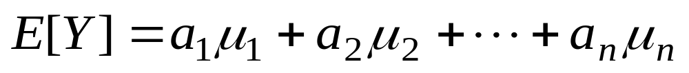
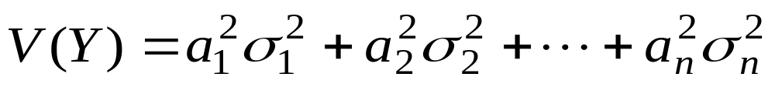
Linear Combinations of R.V.’s
X₁, X₂, … , X_{n} are independent and normally distributed r.v.’s with means μ₁, μ₂, … , μ_{n} and standard deviations σ₁, σ₂, … , σ_{n} , respectively
Let Y = a₁X₁ + a₂X₂ + … + a_{n}X_{n}
  Y is normally distributed

Slide 7
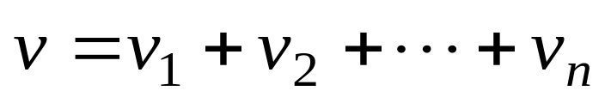
Linear Combinations of R.V.’s
X₁, X₂, … , X_{n} are mutually independent r.v.’s distributed chi-squared with v₁, v₂, … , v_{n} degrees of freedom , respectively
Let Y = X₁ + X₂ + … + X_{n}
  Y is distributed chi-squared with degrees of freedom
  Denoted as χ ²(v)

Slide 8
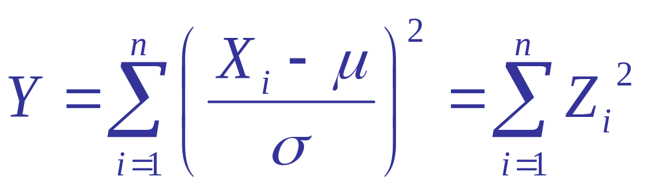
Linear Combinations of R.V.’s
X₁, X₂, … , X_{n} are identically distributed normal r.v.’s with mean μ and variance σ ²
Let
  Y is distributed chi-squared with n degrees of freedom, denoted as χ ²(n)

Slide 9
Sampling
Parameter
  A property of an probability distribution.
  In real life, these are typically unknown.
Population
  The totality of the observations of interest.
  Typically, it is not practical to see all observations in a population.
Sample
  A subset of observations from a population.
  These should be representative of the population.

Slide 10
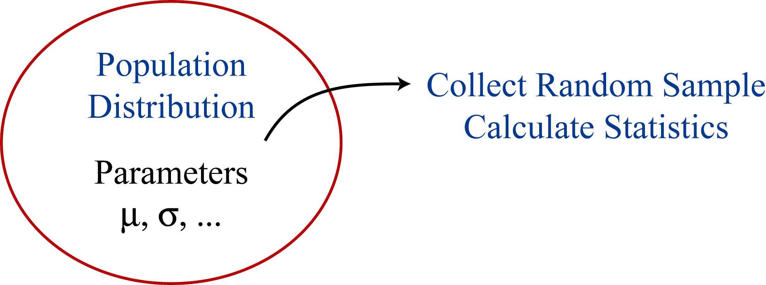
Sampling
Random Sample
  Before data: X₁, X₂, … , X_{n} are independent and identically distributed (i.i.d.) r.v.’s
  After data: Denote observed values by x₁, x₂, …, x_{n}

Slide 11
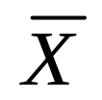
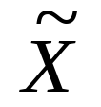



Estimators
A statistic is a function u(X₁, X₂, … , X_{n})
An estimator is a statistic designed to estimate an unknown parameter
  is an estimator for the population mean μ
  is an estimator for the population median
  S² is an estimator for the population variance σ ²
Statistics and estimators are r.v.’s
An estimate is a calculated value (not random) of an estimator
  e.g., , , s²

Slide 12


Sampling Distributions
Before we collect data, the value of a statistic u(X₁, X₂, … , X_{n}) is random
If we collect multiple random samples:
  Sample 1 →
  Sample 2 →
  etc.
This variability is called sampling error
A sampling distribution is the distribution for a statistic

Slide 13
Sampling Distributions - Setup
Let X denote an observation to be sampled
  X follows the population distribution
If we collect a sample of n observations
  X₁, X₂, … , X_{n} are i.i.d. population distribution
  E[X_{i}] = μ = the population mean
  V(X_{i}) = σ ² = the population variance
Example: Suppose we are studying the lifetime of lightbulbs, and we collect n = 100
  Assume the population distribution is Exp(β)
  X₁, X₂, … , X₁₀₀ are i.i.d. Exp(β)

Slide 14
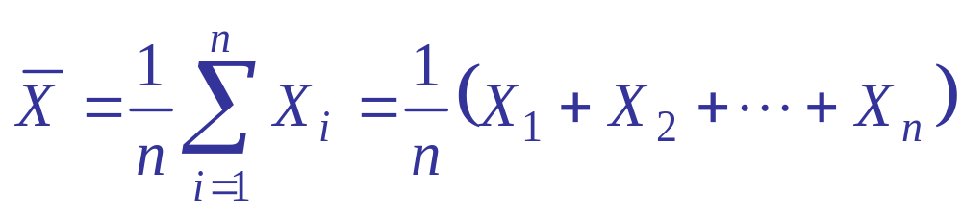

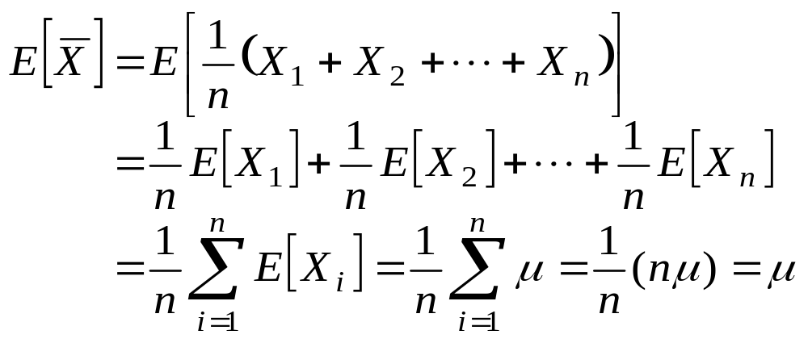
Sampling Distributions - Mean
Sample Mean (before data)
Expected value of

Slide 15
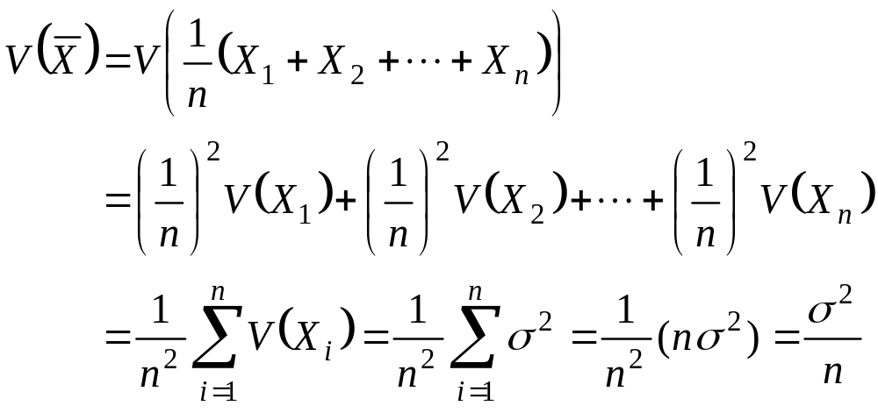
Sampling Distributions - Mean
Variance of
  Note: X₁, X₂, … , X_{n} are independent r.v.’s

Slide 16
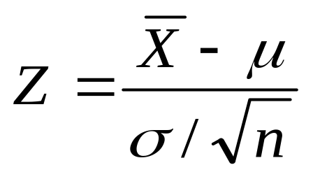
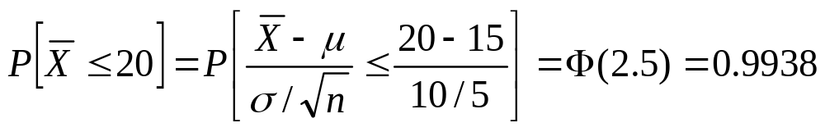
Sampling Distributions - Mean
If the population distribution is N(μ , σ ²)
  X₁, X₂, … , X_{n} are i.i.d. N(μ , σ ²)
  is distributed N(μ , σ ²/n)
  is distributed N(0 , 1)
Example: X₁, …, X₂₅ i.i.d. N(μ = 15 , σ ² = 100)

Slide 17
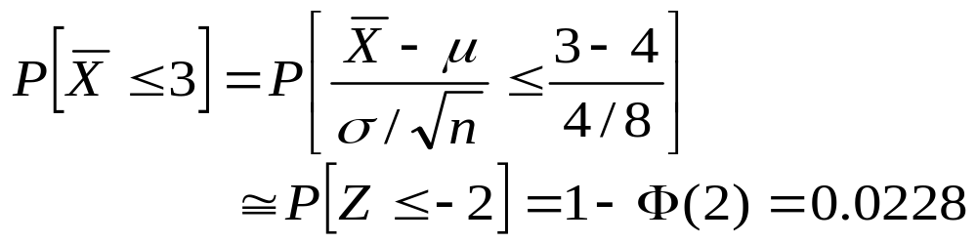
Central Limit Theorem (CLT)
X₁, …, X_{n} i.i.d some population distribution with mean μ and variance σ ²
For large n
  is approximately distributed N(μ , σ ²/n)
Example: X₁, …, X₆₄ i.i.d. Exp(β = 4)
  μ = E[X_{i}] = β = 4 , σ ² = V(X_{i}) = β ² = 16

Slide 18
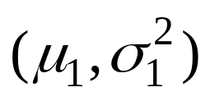
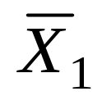
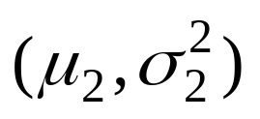
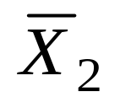
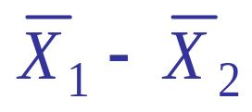
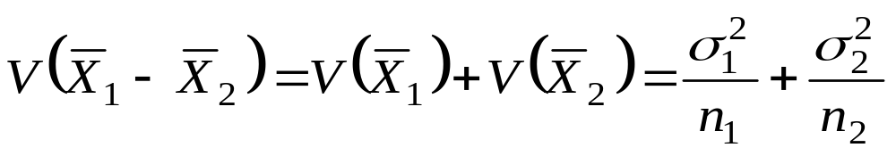
Sampling Distributions - Means
Two Independent Populations (any distributions)
  Pop. 1 → Sample 1 with n₁ obsns →
  Pop. 2 → Sample 2 with n₂ obsns →
Expected value of
Variance of
  Note: and are independent r.v.’s

Slide 19
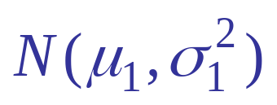
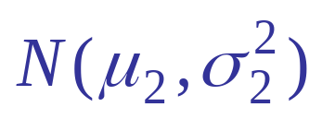
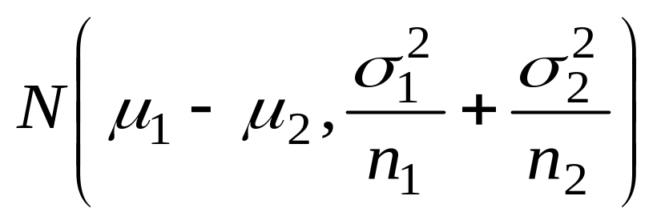
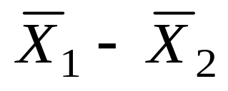
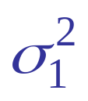
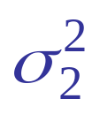
Sampling Distributions - Means
If Pop. 1 is and Pop. 2 is
  is distributed
CLT: For large n₁ and n₂ and for any distns, if Pop. 1 has mean μ₁ and variance , and Pop. 2 has mean μ₂ and variance
  is approximately distributed

Slide 20
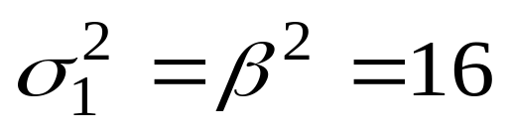
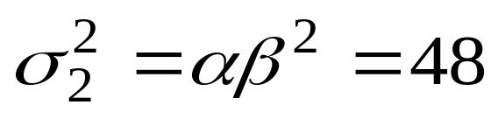
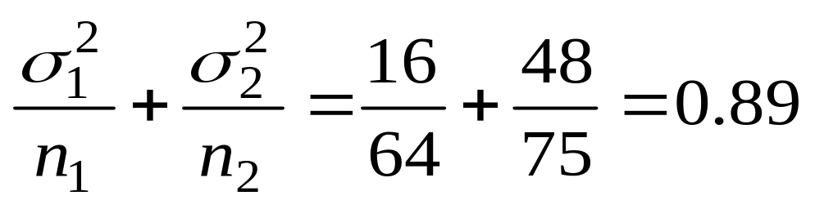
Sampling Distributions - Means
Example: Pop. 1 is distributed Exp(β = 4) and Pop. 2 is distributed Gamma(α = 3, β = 4)
  μ₁ = β = 4 ,
  μ₂ = αβ = 12 ,
Sample 64 obsns from Pop.1 and 75 obsns from Pop.2
  μ₁ − μ₂ = −8

Slide 21
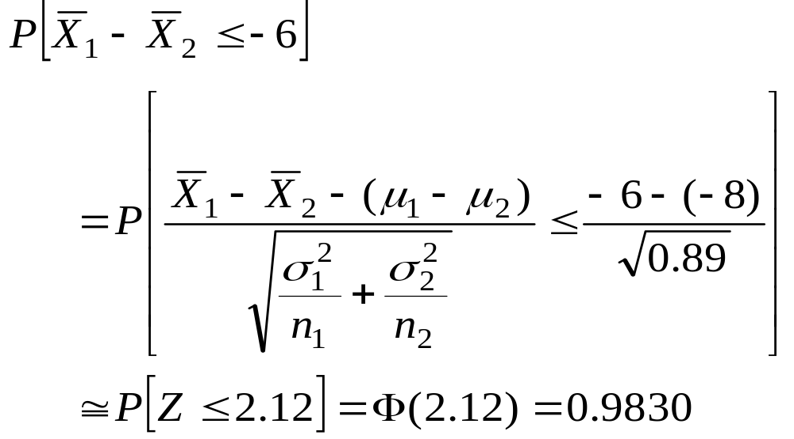
Sampling Distributions - Means

Slide 22
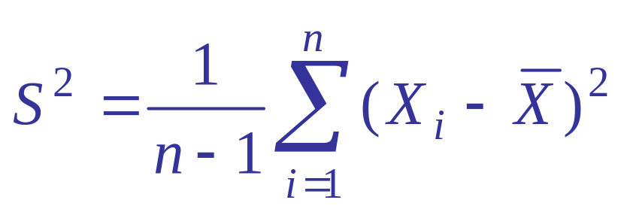
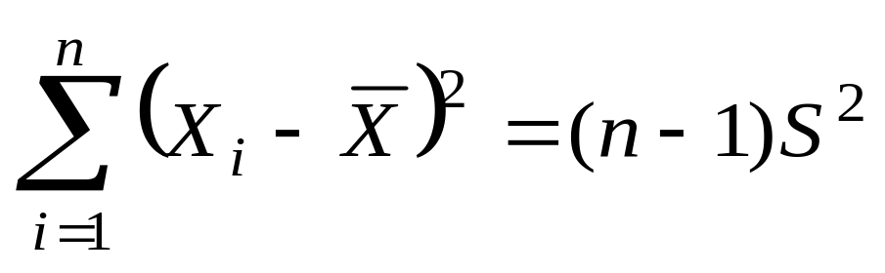
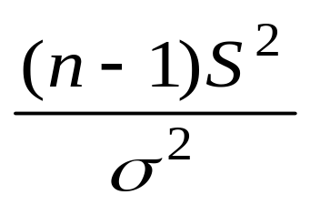
Sampling Distributions - Variance
Sample Variance (before data)
  Note:
Assume X₁, X₂, … , X_{n} are i.i.d. N(μ , σ ²)
  Then is distributed χ ²(n − 1)

Slide 23
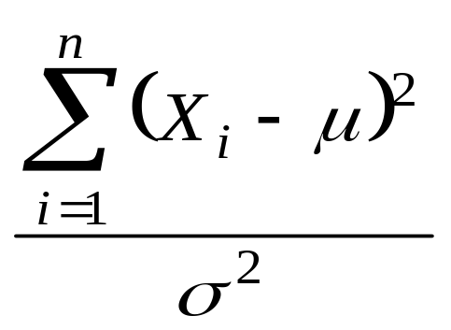
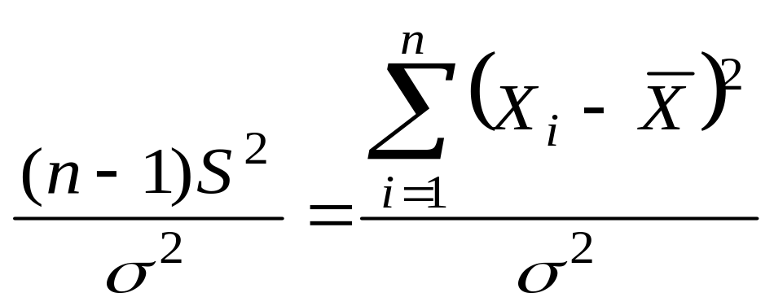
Sampling Distributions - Variance
Recall is distributed χ ²(n)
Now loses one
d.f. because μ is estimated by
Note: d.f. = degrees of freedom

Slide 24
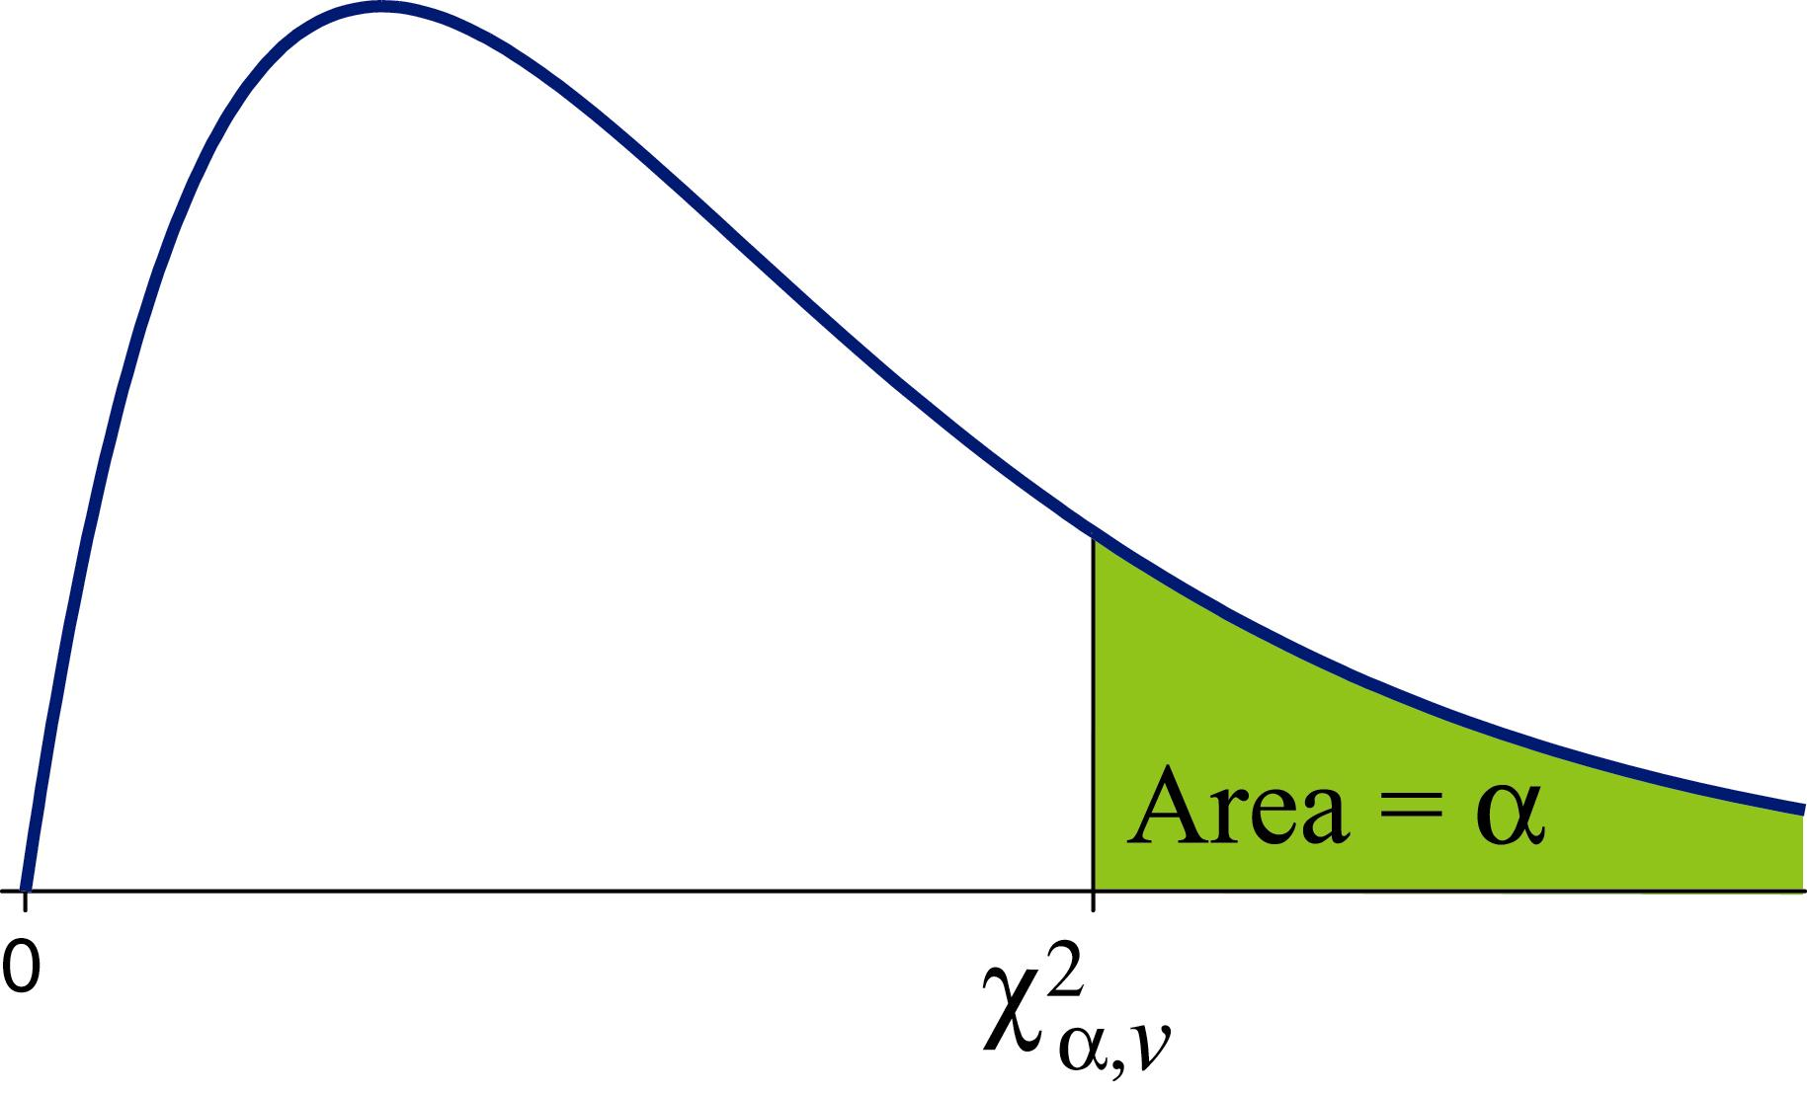
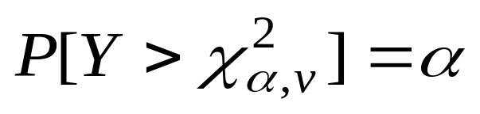
Sampling Distributions - Variance
Upper tail percentiles of the χ ²(v) distribution
  Table A.5
Y is distributed χ ²(v)

Slide 25
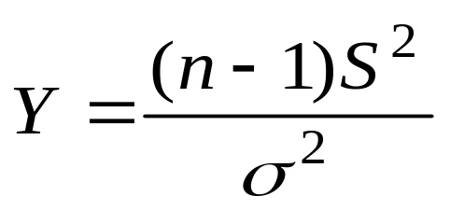
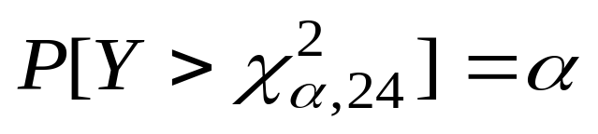
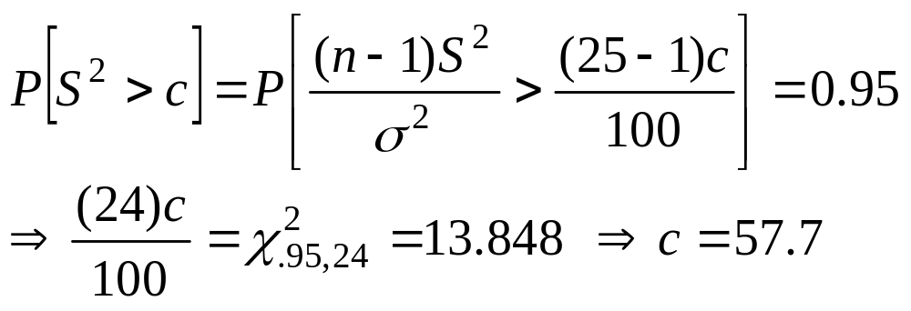
Sampling Distributions - Variance
Example: X₁, …, X₂₅ i.i.d. N(μ = 15 , σ ² = 100)
  Then is distributed χ ²(v = 24)
Find c such that P[S² > c] = 0.95

Slide 26
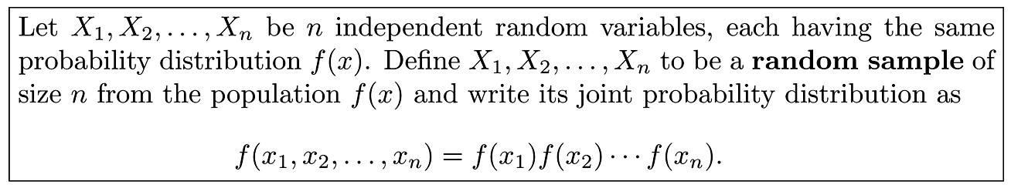
Definition 8.3
Copyright © 2010 Pearson Addison-Wesley. All rights reserved.
8 - <number>

Slide 27
Section 8.2
Some Important Statistics

Slide 28
Section 8.3
Sampling Distributions

Slide 29
Definition 8.5
Copyright © 2010 Pearson Addison-Wesley. All rights reserved.
8 - <number>

Slide 30
Section 8.4
Sampling Distribution of Means and the Central Limit Theorem

Slide 31
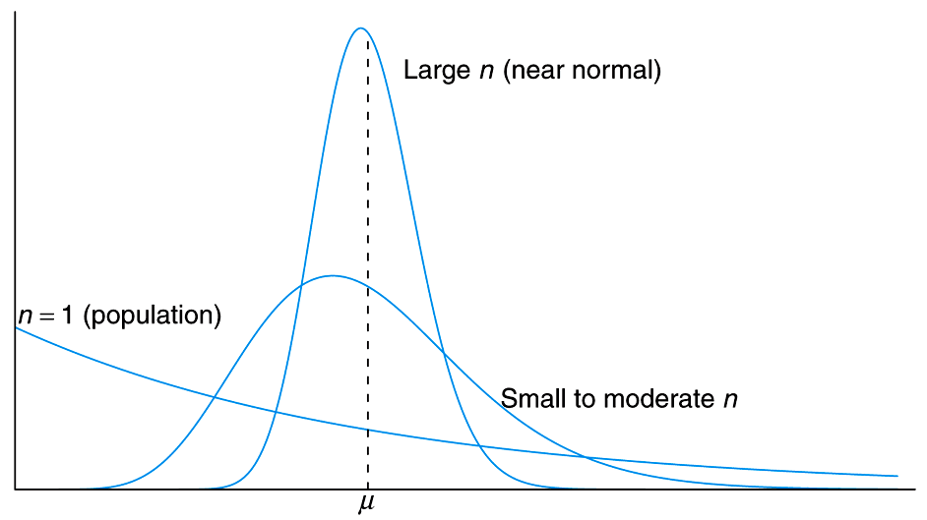
Figure 8.1 Illustration of the Central Limit Theorem (distribution of X for n = 1, moderate n, and large n)
_
Copyright © 2010 Pearson Addison-Wesley. All rights reserved.
8 - <number>

Slide 32
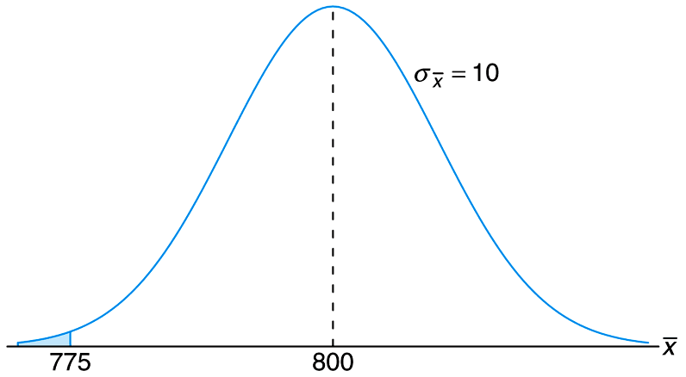
Figure 8.2 Area for Example 8.4
Copyright © 2010 Pearson Addison-Wesley. All rights reserved.
8 - <number>

Slide 33
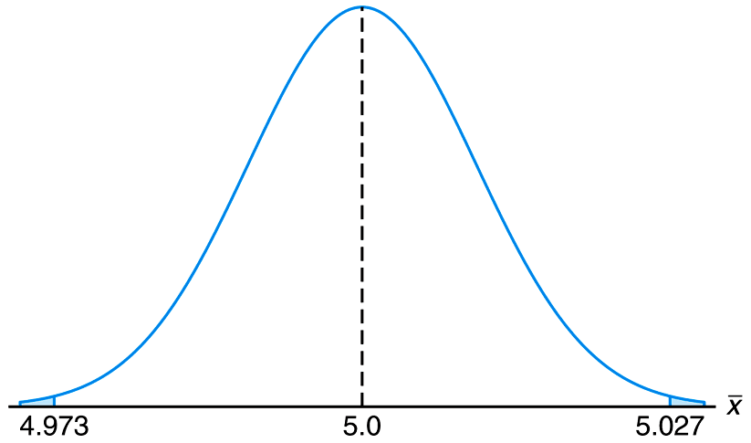
Figure 8.3 Area for Case Study 8.1
Copyright © 2010 Pearson Addison-Wesley. All rights reserved.
8 - <number>

Slide 34
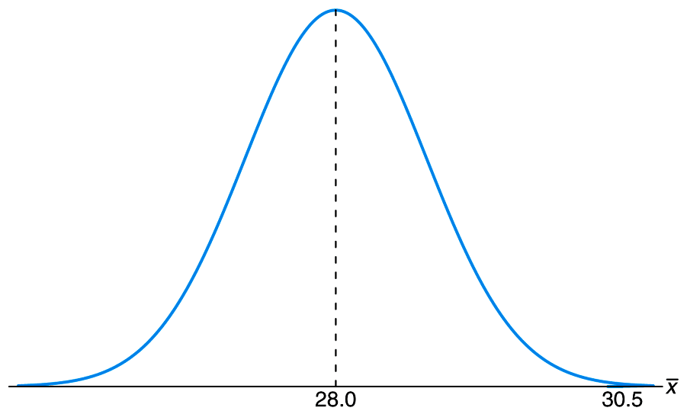
Figure 8.4 Area for Example 8.5
Copyright © 2010 Pearson Addison-Wesley. All rights reserved.
8 - <number>

Slide 35
Example 8.8
Two independent experiments are being run in which two different types of paints are compared. Eighteen specimen are painted using type A and drying time, in hours, is recorded on each. The same is done with type B. The population standard deviations are both known to be 1.0
Assuming that mean drying time is equal for the two types of paint, find P(X_{a}-X_{b}>1.0), where Xa and Xb are average drying times for sample of size n_{a}=n_{b}=18)
Copyright © 2010 Pearson Addison-Wesley. All rights reserved.
8 - <number>

Slide 36
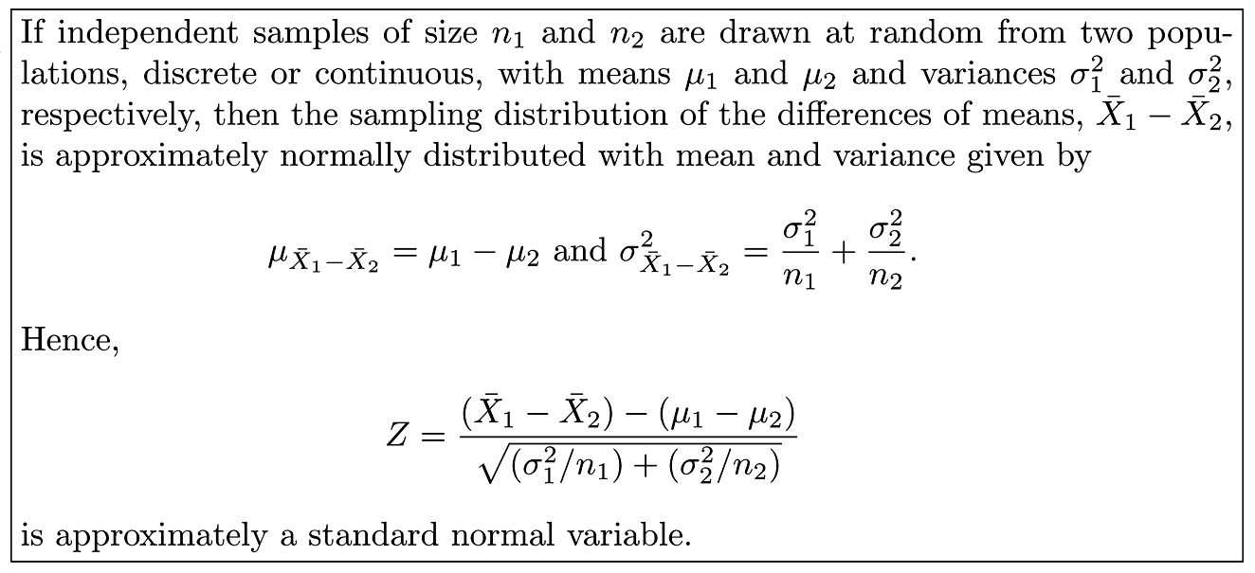
Theorem 8.3
Copyright © 2010 Pearson Addison-Wesley. All rights reserved.
8 - <number>

Slide 37
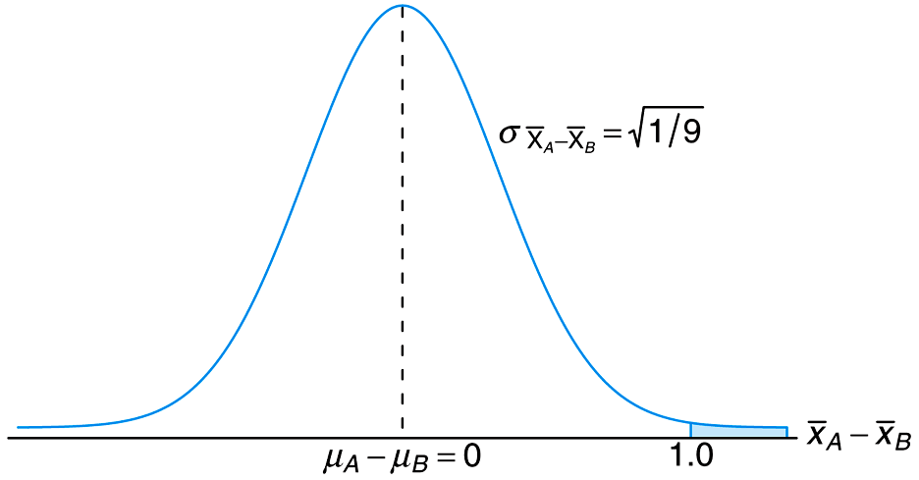
Figure 8.10 Area for Case Study 8.8
Copyright © 2010 Pearson Addison-Wesley. All rights reserved.
8 - <number>

Slide 38
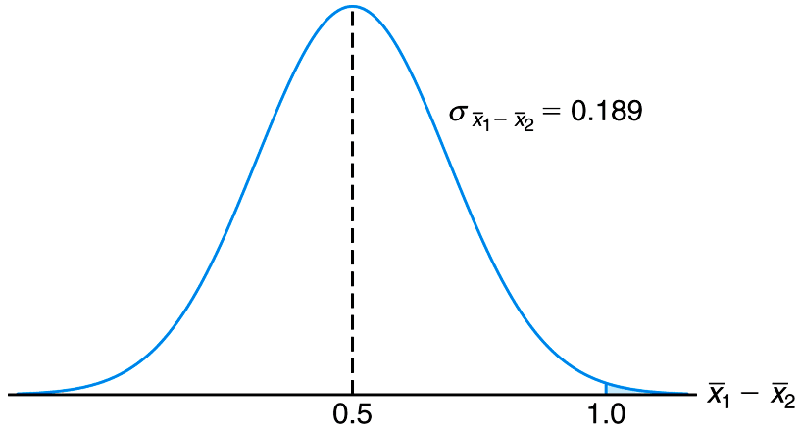
Figure 8.6 Area for Example 8.6
Copyright © 2010 Pearson Addison-Wesley. All rights reserved.
8 - <number>

Slide 39
Section 8.5
Sampling Distribution of S²

Slide 40
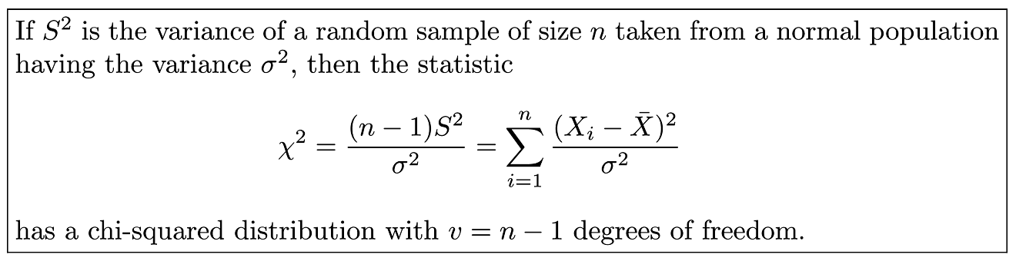
Theorem 8.4
Copyright © 2010 Pearson Addison-Wesley. All rights reserved.
8 - <number>

Slide 41
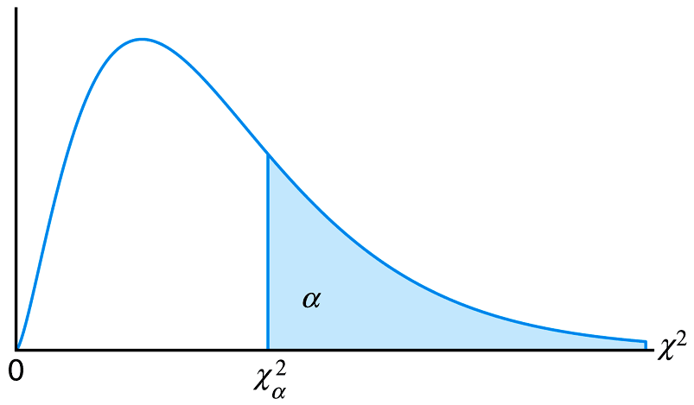
Figure 8.7 The chi-squared distribution
Copyright © 2010 Pearson Addison-Wesley. All rights reserved.
8 - <number>

Slide 42
Section 8.6
t-Distribution

Slide 43
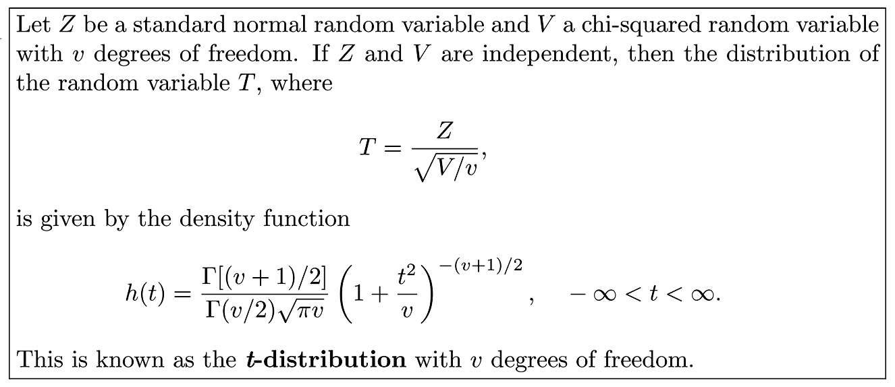
Theorem 8.5
Copyright © 2010 Pearson Addison-Wesley. All rights reserved.
8 - <number>

Slide 44

Corollary 8.1
Copyright © 2010 Pearson Addison-Wesley. All rights reserved.
8 - <number>

Slide 45


Student’s t-Distribution
Let Z be N(0, 1) and Y be χ ²(v)
Define
  T has a t-distribution with v d.f., denoted as t (v)
  Symmetric about E[T] = 0
  Longer tails than the normal distribution
Upper tail percentiles of the t (v) distribution
  Table A.4

Slide 46

Student’s t-Distribution
Assume X₁, X₂, … , X_{n} are i.i.d. N(μ , σ ²)
  is N(0 , 1); is χ ²(n − 1)
Then
is distributed t (n − 1)

Slide 47



Student’s t-Distribution
Example: X₁, …, X₂₅ i.i.d. N(μ = 15 , σ ² = 100)
  Then is distributed t (v = 24)
Find c such that P[T < c] = 0.05

Slide 48


Figure 8.8 The t-distribution curves for v = 2, 5, and
Copyright © 2010 Pearson Addison-Wesley. All rights reserved.
8 - <number>

Slide 49

Figure 8.9 Symmetry property (about 0) of the t-distribution
Copyright © 2010 Pearson Addison-Wesley. All rights reserved.
8 - <number>

Slide 50

Figure 8.10 The t-values for Example 8.10
Copyright © 2010 Pearson Addison-Wesley. All rights reserved.
8 - <number>

Slide 51
Section 8.7
F-Distribution

Slide 52
F-Distribution
F-Distribution is related to Chi-Squared distribution
Applications are in comparing sample variances
Also called as Variance ratio Distribution
Applications of F-Distribution are found in problems involving two or more samples
Copyright © 2010 Pearson Addison-Wesley. All rights reserved.
8 - <number>

Slide 53

Theorem 8.6
Copyright © 2010 Pearson Addison-Wesley. All rights reserved.
8 - <number>

Slide 54



F-Distribution
Two Independent Populations
  Pop. 1 → Sample 1 with n₁ obsns →
  Pop. 2 → Sample 2 with n₂ obsns →
If Pop. 1 is and Pop. 2 is
Then
is distributed F (n₁ − 1, n₂ − 1)

Slide 55



F-Distribution
Let Y₁ be χ ²(v₁) and Y₂ be χ ²(v₂)
Define (Note: F > 0)
  F has an F-distribution with v₁ d.f. in the numerator and v₂ d.f. in the denominator, denoted as F (v₁, v₂)
Upper tail percentiles of F (v₁, v₂) distribution
  Table A.6:

Slide 56





F-Distribution
Example: Pop. 1 is
and Pop. 2 is
Sample n₁ = 15 and n₂ = 10 obsns
  Then is distributed F (14, 9)
Find c such that

Slide 57


F-Distribution

Slide 58

Figure 8.11 Typical F-distributions
Copyright © 2010 Pearson Addison-Wesley. All rights reserved.
8 - <number>

Slide 59

Figure 8.12 Illustration of the f_{α} for the F-distribution
Copyright © 2010 Pearson Addison-Wesley. All rights reserved.
8 - <number>

Slide 60

Theorem 8.7
Copyright © 2010 Pearson Addison-Wesley. All rights reserved.
8 - <number>

Slide 61

Theorem 8.8
Copyright © 2010 Pearson Addison-Wesley. All rights reserved.
8 - <number>

Slide 62

Figure 8.13 Data from three distinct samples
Copyright © 2010 Pearson Addison-Wesley. All rights reserved.
8 - <number>

Slide 63
Figure 8.14 Data that easily could have come from the same population
Copyright © 2010 Pearson Addison-Wesley. All rights reserved.
8 - <number>

Slide 64
Section 8.8
Quantile and Probability Plots

Slide 65
Definition 8.6
Copyright © 2010 Pearson Addison-Wesley. All rights reserved.
8 - <number>

Slide 66
Upper Tail Probabilities in Excel
χ²-distribution: CHIDIST(x, v)
  X ~ χ²(7) → CHIDIST(2, 7) = P[X > 2] = 0.9598
Student’s t-distribution: TDIST(x, v, 1)
  X ~ t(7) → TDIST(2, 7, 1) = P[X > 2] = 0.0428
Student’s t-distribution: TDIST(x, v, 2)
  X ~ t(7) → TDIST(2, 7, 2) = P[|X| > 2] = 0.0856
F-distribution: FINV(1−α, v₁, v₂)
  X ~ F(7, 9) → FDIST(2, 7, 9) = P[X > 2] = 0.1643

Slide 67




Upper Tail Percentiles in Excel
Standard Normal: NORMSINV(1−α)
  NORMSINV(.99) =
χ²-distribution: CHIINV(1−α, v)
  → CHIINV(.95, 24) =
Student’s t-distribution: TINV(2α, v)
  TINV(.1, 24) =
F-distribution: FINV(1−α, v₁, v₂)
  FINV(.05, 9, 14) =
  FINV(.95, 14, 9) =

Slide 68
Section 8.9
Potential Misconceptions and Hazards; Relationship to Material in Other Chapters

